Slide 1

Process Flow Analysis
One Example on the Little’s Law
Eyes must be washed; to see things differently.
Sohrab Sepehri, Persian Poet, 1928 – 1980.
Parts of the slides of this lecture that were prepared over my teaching lifetime based on the material that I have learned & benefited from this book ends here.

Slide 2
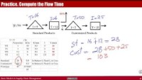
Practice. Compute the Flow Time (8 mins)
https://youtu.be/6RRp73I7L7c

Slide 3
Practice. Compute the Flow Time
80%
I = 8
T = 12
I = 5
30 /hr
T = 25
Standard Products
Customized Products

Slide 4
Practice. Compute the Flow Time
80%
I = 8
T = 12
I = 5
30 /hr
T = 25
Standard Products
Customized Products

