Slide 1
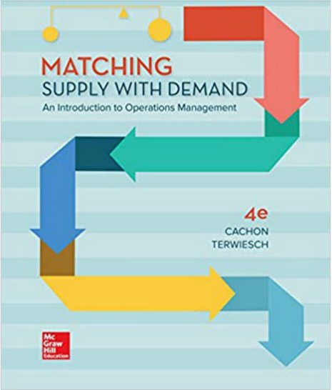
Process Flow Analysis
Another Examples on the Little’s Law
Eyes must be washed; to see things differently.
Sohrab Sepehri, Persian Poet, 1928 – 1980.
Parts of the slides of this lecture that were prepared over my teaching lifetime based on the material that I have learned & benefited from this book ends here.

Slide 2
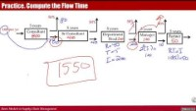
Practice. Compute the Flow Time (5 mins) https://youtu.be/ccZudq3ebgo

Slide 3
Practice. Compute the Flow Time
50%
50%
50%
5 years
50%
160 per yr
5 years
5 years
5 years
Consultant
5 years
Sr Consultant
Department
Head
Manager
Partner
Each phase takes 5 years
How many employees this firm has?
What is average life-time of an employee in this firm
# of Consultant = 160(5)=800
Senior Consultant Rate =50%(160)= 80/year
# Senior Consultant = 80*5= 400
Department Head Rate = 50%(80)=40
# of Department Heads = 40(5) =200
Manager Rate = 50%(40)=20
# of Managers = 20(5) =100
Partner = 50%(20)=10
# of Partners = 10(5) =50
Total # of Employees?
# of employees 1550
Average Years in the firm?
T=1550/160= 9.875

