Slide 1
K1 . The Coffee Shop
Chapter 1
Process Flow Analysis
The Little’s Law
The Core Concept in Business Processes Engineering
Eyes must be washed; to see things differently.
Sohrab Sepehri, Persian Poet, 1928 – 1980.
Please start reading these slides before coming to class. I assume you have already carefully have gone through Problem K1 (pages 1 to 15) before coming to class. Please then go through the following problems — Problem K1b which is on pages 16-21 and is very similar to K1. For a better preparation you may go through the following problems. Problem K2 is on pages 22 to 24. The recorded lecture on this problem is posted on page 22. Problem K3 is on pages 32 to 36. The recorded lecture on this problem is on page 32.

Slide 2
Hour Zero
1
20
1
10
100
10
9
9
9

Slide 3
K1 . The Coffee Shop
A manager of a local coffee shop near the Reseda and Plummer intersection realized that during busy hours, the entrance door opens, on average, once per minute, and a customer enters.
In a stable system, if one customer enters per minute, one customer should leave per minute. In the short run, we may have variations, but over a long period, output cannot be less than input. Output should be equal to input.
It is possible that in 5 minutes, 4 customers come in, and 7 customers go out. However, over a long period (even a day), the output cannot exceed input, because how can that difference be generated?
On average, in 5 minutes, 5 customers enter and 5 customers leave.

Slide 4
K1 . The Coffee Shop
Similarly, the output cannot be less than input, because, over a long period, there will be no room in the coffee shop (or even in a large stadium).
It is possible that in 5 minutes, 9 customers come in and 6 customers go out. However, over a full day, input cannot exceed output. Input should be equal to output.
In stable systems, flow units come in as input, leave the system as output, and input per unit of time is equal to output per unit of time. If, on average, one customer comes in per minute, then on average, one customer should leave per minute.

Slide 5
K1 . The Coffee Shop
a) What is the throughput (R) of the coffee shop?
Every minute, 1 customer enters and 1 customer leaves.
R= 1 per minute.
Throughput is the average flow rate in a stable system (where the average input is equal to average output over an extended period). Throughput is expressed as a number with a time unit attached to it (e.g. per minute, per hour, per day, per month, etc.).
Inventory (I) is the number of flow units in the system (e.g. customers in a coffee shop, headcount of students at CSUN, cars in a dealership, etc.). Inventory is a number with no time unit attached to it.

Slide 6
K1 . The Coffee Shop
On average, there are 5 customers in the store (system), 4 are waiting in line (buffer) to order, and one is with the server.
b) What is the inventory (I) in the coffee shop?
On average, there are 5 customers in the coffee shop.
Inventory is 5.
I = 5 flow units.
R = 1 flow unit per minute

Slide 7
K1 . The Coffee Shop
c) How long, on average, is a customer in your coffee shop?
It is indeed inventory expressed in units of time.
Flow Time (T) is the time it takes an input to become an output. It is the time a flow unit spends within a system.
Before a customer steps into the system, there are 5 other customers in the system.
At the instant she steps into the line for service, one fully served customer leaves the system. That is, there are always 5 people in the system.
Our incoming customer at the beginning has 4 people in front of them, then 3 in front and 1 behind, then 2 in front and 2 behind, then 1 in front and 3 behind, then no one in front and 4 behind her.

Slide 8
K1 . The Coffee Shop
At the instance when she steps out of the system, just in the fraction of second stepping out, she looks over her shoulder.
How many people are behind her?
5 people.
At what rate did they come in?
1 per minute.
How long does it take 5 people to come in if they arrive at the rate of 1 per minute?
1 minute 1 customer
How many minutes (T) 5 customers
T = (1×5)/1
T = 5 minutes.

Slide 9
K1 . The Coffee Shop
We could have also said:
How many customers are in the system?
5 customers.
At what rate are they served?
1 per minute.
How long does it take to serve 5 people at the rate of 1 per minute?
T= 5/1 = 5 minutes.

Slide 10
K1 . The Coffee Shop
On average, a customer spends 5 minutes in the coffee shop; flow time (T) is 5 minutes.
Each customer enters the coffee shop, spends 5 minutes on average and then leaves.
In the above computation, the flow time (T) is defined in minutes, because R was in minutes.
R carries a time unit with it, i.e., 1/minute., 1(60) = 60/hour, and, if a day is 8 hours, it can also be expressed as (60) (8) = 480/day.
However, remember: inventory (I), does not carry a time unit, it is always a number.

Slide 11
K1 . The Coffee Shop
Now, let us generalize:
1 time unit R flow units
How many time units (T) I flow units
T= I*1/R ➔ T = I/R
RT= I.
The Little’s Law is expressed as Throughput x Flow Time = Inventory.
R×T = I or T = I/R or R = I/T

Slide 12
K1 . The Coffee Shop
A Fundamental Insight. Note, that the Little’s Law, T=I/R, is nothing more than a unit conversion, converting numbers into time. It turned 5 units of inventory into 5 minutes of inventory.
Suppose we have 100 units of item A, and 1,000 units of item B. What item do we have more of? In the count dimension, item B has a higher inventory. Suppose we use 4 units of item A per day (RA= 4/day), and 200 units of item B per day (RB=200/day). In the time dimension, we have (T=100/4), 25 days inventory of item A, and (T=1,000/200) 5 days inventory of item B.
On the time dimension, the inventory of item A is larger than the inventory of item B. It takes more time to consume the inventory of item A, compared to that of consuming item B.

Slide 13
K1 . The Coffee Shop
In addition to measuring inventory in count and time dimensions, we can measure it on the third dimension of value. How much money is invested in the inventory of each item? This is useful in financial planning, cost analysis, and warehouse operations.
There is even a fourth dimension. How much space (in a warehouse)? For items taking a large portion of a warehouse, we may conduct a more careful warehouse design. For a large number of items which may take a small portion of warehouse, we may have a rough design.
Units
Value
Inventory
Space
Time

Slide 14
K1 . The Coffee Shop
Now suppose there are two waiting lines. Suppose R is still 1 per minute and still on average there are 5 customers in the first line to pay for their order and get their non-exotic orders. In addition, suppose there are 4 customers in the exotic order (latte, cappuccino, etc.) waiting line. 40% of the customers place exotic orders. What is the flow time of a person who orders latte, cappuccino, etc.
40%
1/min

Slide 15
K1 . The Coffee Shop
Such a customer spends 5 minutes in the first line. Throughput of the second line is R= 0.4(1) = 0.4 customers per minute.
Inventory of the second line is 4.
RT=I ➔ 0.4T=4 ➔ T=10
Simple order T =5, Exotic order T= 5+10 = 15
What is the flow time of a customer? S/he is neither a customer who puts in a simple order nor one with exotic order, but s/he is both.
Procedure 1- Not good.
60% simple order: T = 5, 40% exotic order: T=5+10= 15

Slide 16
K1 . The Coffee Shop
A customer: T= 0.6(5) + 0.4(15) = 9 minutes
Procedure 2- Not bad.
Everyone goes through the first process and spends 5 minutes. 60% spend no additional time, 40% spend 10 additional minutes. 0.6(0) + 0.4(10) = 4 ➔ 4+5 =9.
Procedure 3- Good.
Throughput of the system is 1 per minute. There are 9 people in the system (5 at the register and 4 in the second line).
RT= I ➔ 1T=9 ➔ T=9
Throughput in this system was 1 per minute or 60 per hour or 720 per day (assuming 12 hours per day). But inventory in the system is always 9.

Slide 17
K1b . The Coffee Shop
You enter a Starbucks coffee shop. The door opens every 20 seconds. Once for a customer to come in, once for a customer to leave. On average there are 6 customers in the line. What is the throughput of this system.
Every 40 seconds, one customer enters and one customer leaves.
Customer Time (s)
1 40
x 1
X = (1×1)/40 ➔ 1/40 per second

Slide 18
K1b. The Coffee Shop
R= 1/40 per second.
R= How many per minute?
R= (1/40)60 = 1.5 per minute.
R= How many per hour?
R= (1.5)60 = 90 per hour.
If there are 4 busy-hours of this type,
R= How many per 4-busy-hour-day?
R= 90(4) = 360
If a month is twenty 4-hour-busy days,
R= How many per month?
R = 20(360) = 7,200 per month
In all these situations there are always, on average, 6 customers in the waiting line.

Slide 19
K1b. The Coffee Shop
R = 1.5 per minute.
There are 6 customers in the line, how long does it take you to get your coffee and leave.
1.5/min
1.5/min
I = 6
RT=I
1.5T=6
T= 4 minutes

Slide 20
K1b. The Coffee Shop
Now suppose there are two waiting lines. R is still 1.5 per minute, and still, on average, there are 6 customers in the first line to pay for their order and get their non-exotic orders. In addition, there are 3 customers in the exotic order (latte, cappuccino, etc.) waiting line.
1/3 = 33.33333333333333333333333333333333333333% of the customers place exotic orders. What is the flow time of a person who orders latte, cappuccino, etc.?
1/3
1.5/min
1.5/min
2/3

Slide 21
K1b. The Coffee Shop
Such a customer spends 4 minutes in the first line.
I= 6, R=1.5/min ➔ T=6/1.5= 4 ?
4 minutes since R is in minutes.
Throughput of the second line is R= (1/3)(1.5) = 0.5 customers per minute. Inventory of the second line is 3.
RT=I ➔ 0.5T=3 ➔ T=6
Simple order T =4. Exotic order T= 4+6 = 10
What is the flow time of a customer? S/he is neither a customer who puts a simple order nor one with exotic order, but s/he is both.
Procedure 1- Not good.
2/3 simple order: T = 4
1/3 exotic order: T=10

Slide 22
K1b. The Coffee Shop
A customer: T= (2/3)4 + (1/3)10 = 6 minutes
Procedure 2- Not bad.
Everyone goes through the first process and spends 4 minutes. 2/3 spend no additional time, 1/3 spend 6 additional minutes. 0(2/3) + 6(1/3) = 2
4+2 = 6
Procedure 3- Good.
Throughput of the system is 1.5 per minute. There are 9 people in the system (6 at the register and 3 in the second line).
RT= I ➔ 1.5T=9 ➔ T=6

Slide 23

K2. The Insurance Company
Time Travelers Insurance Company (TTIS) processes 12,000 claims per year. The average processing time is 3 weeks. Assume 50 weeks per year.
The solution to this problem is recorded at the first part of
https://youtu.be/gFNYXGye4Jo
a) What is the average number of claims that are in process?
R per week = 12,000/50 = 240 claims/week
RT = I
I = 240(3) = 720 claims waiting

Slide 24
K2. The Insurance Company
b) 50% of all the claims that TTIS receives are car insurance claims, 10% motorcycle, 10% boat, and the remaining are house insurance claims. On average, there are 300 car, 114 motorcycle, and 90 boat claims in process. How long, on average, does it take to process a car insurance claim?
car
300
0.5
120
240
0.1
114
I = 300 cars
R = 0.5(240) =120 claims/wk
TR = I ➔ T(120) = 300
T = 300/120= 2.5 weeks
24
motorcycle
24
0.1
90
72
boat
0.3
house
?

Slide 25
K2. The Insurance Company
c) How long, on average, does it take to process a house insurance claim?
car
300
0.5
120
240
0.1
114
24
motorcycle
24
0.1
90
Average # of claims in process = 720
720–300 car–114 motorcycle–90 boat = 216
Average # of claims for house: I = 216
House claims are 1- 0.5-0.1-0.1 = 0.3 of all claims
R = 0.3(240) = 72
TR = I ➔ T = I/R ➔ T = 216/72= 3 weeks
72
boat
0.3
house
?

Slide 26
K2b. Flow Time at a B-School
Over the past 10 years, on average, there were 1,600 incoming students per year at a B-School. On average, the headcount of students enrolled over the same period was 7,200.
a) On average, how long does a student spend in this school?
RT=I ➔ 1,600T = 7,200 ➔ T = 4.5 years.
Out of the 1,600 incoming students per year, on average, 25% are accounting majors, 20% are marketing, 20% are management, 15% are finance, and the rest are other majors.
The School has 2,200 accounting students, 1,200 marketing students, 1,200 management students, and 1,400 students in all other majors except finance. The rest are in the finance department.
b) Compute the flow time at each department.

Slide 27
K2b. DNCBE- Time to Graduation
0.25
ACC
2200
0.20
MKT
1200
1600
0.20
MGT
1200
1600
0.15
FIN
1200
0.20
OTH
1400

Slide 28
K2b. The Flow Time at the B-School
400
ACC
2200
320
MKT
1200
1600
320
MGT
1200
1600
240
FIN
1200
320
OTH
1400

Slide 29
K2b. DNCBE- Time to Graduation
Using part (a), prove that your computations in part (b) are correct.
We have time-to-graduation for all five of the groups and their relative weights.
SUMPRODUCT 0.25(5.5) + 0.2(3.75), 0.2(3.75), 0.15 (5), 0.2(4.375) = 4.5.
On average, 50% of the incoming students of this B-School are freshmen, and the rest are transfer students. Time-to-Degree (TTD) for FTF is twice of FTT.
c) How long does it take FTF students to graduate?
T = Time to graduation for FTTs (50% of all students).
2T = Time to graduation for FTFs (50% of all students).
Average time-to-graduation for all students = 4.5 years.
0.5T+0.5(2T) = 4.5 years

Slide 30
K2b. DNCBE- Time to Graduation
0.5T +T = 4.5
1.5T = 4.5 years ➔ T = 3 years
Time to graduation for a transfer student = 3 years.
Time to graduation of for a freshman student =
3(2) = 6 years.
d) Sadly, we have the additional information that there are 30% dropouts, where 15% are freshmen and 15% transfers. The average time that freshman dropouts spend in the B-School is 2 years. This time for transfer dropouts is 1 year. Given this new information, how long does it take FTFs to graduate? Time to graduation of FTF (first-time-freshman) is still twice of FTT (first-time-transfer).

Slide 31
K2b. The B-School- Time to Graduation
T: time to graduation for FTTs @50%-15% = 35%.
2T: time to graduation for FTFs @50%-15% = 35%.
2 years: Time to drop-out for a freshman@15%
1 year: Time to drop-out for a transfer@15%
0.15(1)+0.15(2)+0.35T+0.35(2T)=4.5
0.15+0.3+0.35T+0.70T=4.5
1.05T=4.5-0.45 =4.05
T=3.857
Time to graduation for freshman student = 2(3.857)
Time to graduation for freshman student ≈ 7.7 years

Slide 32
K3. Cold Beverage
A recent CSUN graduate has opened up a cold beverage stand “CSUN-Stop” in Venice Beach. She takes life easy, and does a lot of surfing. It sounds crazy, but she only opens her store for 4 hours a day. She observes that, on average, there are 120 customers visiting the stand every day. She also observes that on average a customer stays about 6 minutes at the stand.
The solution to this problem is recorded at
https://youtu.be/QjS_K1zcmw0
a) How many customers on average are waiting at “CSUN-Stop”?
R = 120 in 4 hours ➔ R = 120/4 = 30 per hour
R = 30/60 = 0.5 per minute
T = 6 minutes
RT = I ➔ I = 0.5(6) = 3 customers are waiting

Slide 33
K3. Cold Beverage
She is thinking about running a marketing campaign to boost the number of customers per day. She expects that the number of customers will increase to 240 per day after the campaign. She wants to keep the line short at the stand and hopes to have only 2 people waiting on the average. Thus, she decides to hire an assistant.
b) What is the average time a customer will wait in the system after all these changes?
R = 240/(4hrs*60min) = 1 person/minute
I = 2
Average time a customer will wait:
T = I/R = 2/1 = 2 minutes

Slide 34
K3. Cold Beverage
The business got a lot better after the marketing campaign and she ended up having about 360 customers visiting the stand every day. So, she decided to change the processes. She is now taking the orders and her assistant is filling the orders. They observe that there are about 2 people at the ordering station of the stand and 1 person at the filling station.
c) How long does a customer stay at the stand?
R = 360/4 hours = 1.5 people/minute
I = 2 (ordering station) and 1 (filling station) = 3
RT = I ➔ 1.5T = 3 ➔ T = 2 minutes
360/4hrs
2
1

Slide 35
K3. Cold Beverage
A recent UCLA graduate has opened up a competing cold beverage stand “UCLA-Slurps.” The UCLA grad is not as efficient as the CSUN grad, so customers must stay an average of 15 minutes at “UCLA-Slurps,” as opposed to 6 minutes at the “CSUN-Stop.” Suppose there is an average of 3 customers at “UCLA-Slurps.” The total number of customers remains at 120, as it was before the marketing campaign. But now the 120 is divided between the “CSUN-Stop” and “UCLA-Slurps.”
d) By how much has business at the “CSUN-Stop” decreased?
First, find how many customers “CSUN-Stop” is losing to “UCLA-Slurps.”

Slide 36
K3. Cold Beverage
At “UCLA-Slurps” we have
I = 3 people and T = 15 minutes
TR = I ➔ 15R = 3 ➔ R= 1/5 per minute R = 60(1/5) = 12 customers per hour or = 48 customers/day
Business at “CSUN-Stop” has decreased by 48 customers/day
The new (lower) arrival rate to the “CSUN-Stop”?
120-48 = 72 customers/day
e) Now, what is the average number of customers waiting at the “CSUN-Stop,” if the flow time at CSUN-Stop remains 6 mins?
R = 72/day = 72/(60min×4hrs) = 0.3/minute
T = 6 minutes
RT = I ➔ I = 0.3(6) = 1.8 customers

Slide 37
K4. Auto-Moto Financial Services- The Old Process
Auto-Moto receives 1,000 applications per month. In the old process, each application is handled in a single activity, with 20% of applications being approved. 500 were in the process at any time. Average flow time T = ?
200/month
1000/month
Process
I_{p}=500
RT = I
T = I/R = 500/1,000 months = 0.5 month or 15 days.
800/month
The firm recently implemented a new loan application process. In the new process, applicants go through an initial review and are divided into three categories.
Discussion: How operational power destroys the walls of poverty.
The first part is available at: https://www.youtube.com/watch?v=TauGBb5xbVs&t=10s
Notes:
Throughput R = 1,000 applications/month, Average Inventory I = 500 applications; T=15 days means that each application spent 15 days (on average) before receiving accept/reject decision.

Slide 38
K4. New Process: The Same R, But smaller I
Subprocess A
Review
70%
200/month
Accepted
I_{A} = 25
30%
25%
10%
1000/month
Initial
Review
Subprocess B
Review
25%
I_{R} = 200
I_{B} = 150
90%
50%
800/month
R = 1000
I = I_{IR} + I_{A} + I_{B} = 200 + 25 + 150 = 375
Inventory reduced to 375 from 500 in the old process.
Since R is constant, therefore T has reduced.
T = I/R = 375/1000 = 0.375 month or 0.375(30) = 11.25 days
The new process has decreased the processing time from 15 days to 11.25 days.
Rejected
Notes:
New process for loan application review:
Each application is preprocessed and divided into three categories based on mechanical criteria. The company found the following data upon analyzing the new system:
On average, 200 applications are with the Initial ‘Review Team at any time.
Of those reviewed, 25% are categorized as “Excellent”, 25% as “Needs Further review”, and 50% are “Rejected”.
70% of the “Excellent” applications are eventually approved.
10% of the “Needs Further Review” applications are approved.

Slide 39
K4. Questions
Compute average flow time.
Compute average flow time at Initial Review Process.
Compute average flow time at Subprocess A.
Compute average flow time at Subprocess B.
Compute average flow time of an Accepted application.
Compute average flow time of a Rejected application.
The first part of the lecture on this problem is available at
https://www.youtube.com/watch?v=TauGBb5xbVs&t=10s
The second part of the lecture on this problem is available at
https://youtu.be/pyFq8JDHljM

Slide 40
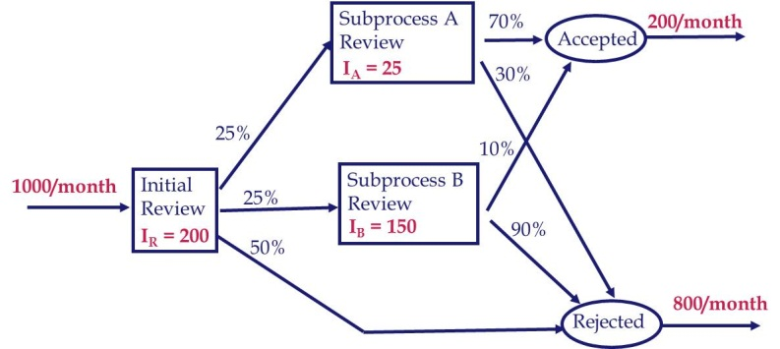
K4. Flow Time at Each Sub-process (or activity)
Average Flow Time for sub-process IR.
Throughput R_{IR} = 1,000 applications/month
Average Inventory I_{IR} = 200 applications
T_{IR} = 200/1,000 = 0.2 months = 6 days in the IR sub-process
Average Flow Time for sub-process A.
Throughput R_{A} = 250 applications/month
Average Inventory I_{A} = 25 applications
T_{A} = 25/250 months = 0.1 months = 3 days in sub-process A.
Average Flow Time for sub-process B.
Throughput R_{B} = 250 applications/month
Average Inventory I_{B} = 150 applications
T_{B} = 150/250 months = 0.6 months = 18 days in sub-process B

Slide 41
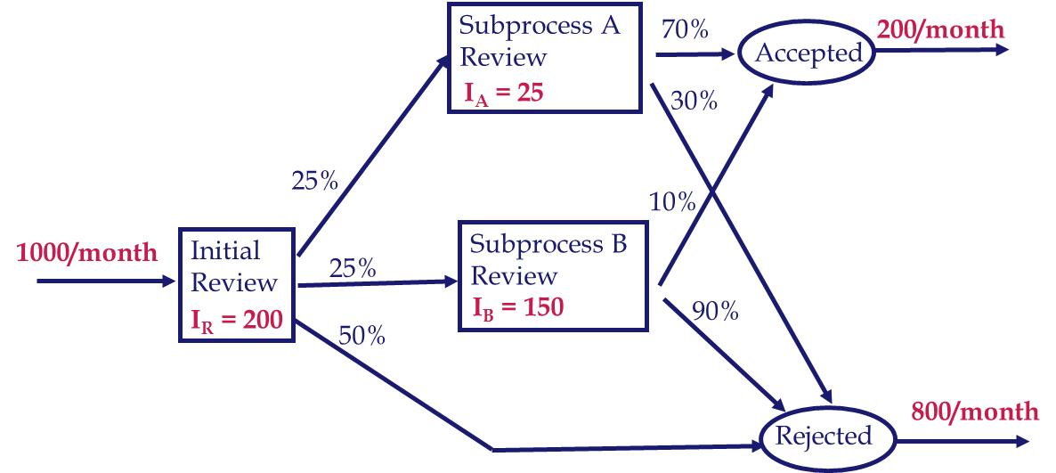
K4. Routing, Flow Time, and Percentage of Each Flow units
One flow unit at very macro level: Application
1000 flow units/month at very micro level: Each specific application
Two flow units: Accepted and rejected
Five flow units: Accepted-A, Accepted-B
Rejected-IR, Rejected-A, Rejected-B
Accepted-A: IR, A
Accepted-B: IR, B
Rejected-IR: IR
Rejected-A: IR, A
Rejected-B: IR, B
T_{IR} = 6 days
T_{A} = 3 days
T_{B} = 18 days
We also need percentages of each of the five flow units
Notes:
New process for loan application review:
Each application is preprocessed and divided into three categories based on mechanical criteria. The company found the following data upon analyzing the new system:
On average, 200 applications are with the Initial ‘Review Team at any time.
Of those reviewed, 25% are categorized as “Excellent”, 25% as “Needs Further review”, and 50% are “Rejected”.
70% of the “Excellent” applications are eventually approved.
10% of the “Needs Further Review” applications are approved.

Slide 42
K4. New Process: Intermediate Probabilities
Subprocess A
Review
T = 3
70%
20%
Accepted
30%
25%
10%
100%
Initial
Review
T = 6
Subprocess B
Review
T = 18
25%
90%
50%
80%
Rejected
Notes:
New process for loan application review:
Each application is preprocessed and divided into three categories based on mechanical criteria. The company found the following data upon analyzing the new system:
On average, 200 applications are with the Initial ‘Review Team at any time.
Of those reviewed, 25% are categorized as “Excellent”, 25% as “Needs Further review”, and 50% are “Rejected”.
70% of the “Excellent” applications are eventually approved.
10% of the “Needs Further Review” applications are approved.

Slide 43
K4. New Process: Intermediate Probabilities
Subprocess A
Review
T = 3
17.5%
20%
Accepted
7.5%
25%
2.5%
100%
Initial
Review
T = 6
Subprocess B
Review
T = 18
25%
22.5%
50%
50%
80%
Rejected
Notes:
New process for loan application review:
Each application is preprocessed and divided into three categories based on mechanical criteria. The company found the following data upon analyzing the new system:
On average, 200 applications are with the Initial ‘Review Team at any time.
Of those reviewed, 25% are categorized as “Excellent”, 25% as “Needs Further review”, and 50% are “Rejected”.
70% of the “Excellent” applications are eventually approved.
10% of the “Needs Further Review” applications are approved.

Slide 44
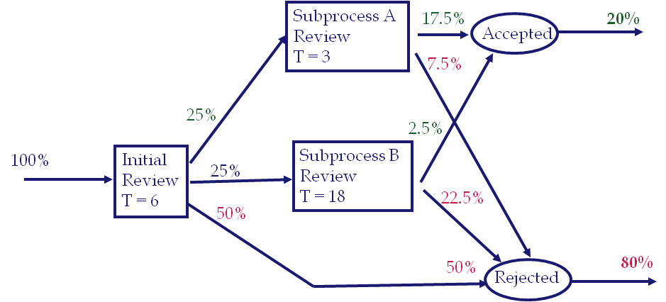
K4. Flow Time of the Accepted Applications
Under the Original Process – the average time spent by an application in the process is 15 days (approved or rejected).
In the new process: 15 days reduced to 11.25 days.
On average, how long does it take to approve an applicant?
On average, how long does it take to reject an applicant?
Accepted-A: IR, A ➔ Accepted-A(T) = 6 + 3 = 9 ➔ Accepted-A = 17.5 %
Accepted-B: IR, B ➔ Accepted-B(T) = 6 + 18 = 24 ➔ Accepted-B = 2.5 %
Average Flow time of an accepted application =
[0.175(9)+0.025(24)]
/
(0.175+.025)
= 10.875
The average flow time has reduced from 15 to 11.25. In addition, the flow time of accepted applications has reduced to 10.875. That is what the firm really cares about, the flow time of the accepted applications.
Notes:
New process for loan application review:
Each application is preprocessed and divided into three categories based on mechanical criteria. The company found the following data upon analyzing the new system:
On average, 200 applications are with the Initial ‘Review Team at any time.
Of those reviewed, 25% are categorized as “Excellent”, 25% as “Needs Further review”, and 50% are “Rejected”.
70% of the “Excellent” applications are eventually approved.
10% of the “Needs Further Review” applications are approved.

Slide 45
K4. Flow Time of Rejected Applications
Rejected-IR: IR ➔ Rejected-IR(T) = 6 ➔ Rejected-IR(%) = 50%
Rejected-A: IR, A ➔ Rejected-A(T) = 6+3 = 9 ➔ Rejected-A(%) = 7.5%
Rejected-B: IR, B ➔ Rejected-B(T) = 6+18 = 24 ➔ Rejected-B(%) = 22.5%
Average Flow time of a rejected application =
= 11.343
Check our computations:
Average flow time of an application
0.8(11.343)+0.2(10.875) = 11.25
Did I need to solve for the Rejected Applications?
Notes:
New process for loan application review:
Each application is preprocessed and divided into three categories based on mechanical criteria. The company found the following data upon analyzing the new system:
On average, 200 applications are with the Initial ‘Review Team at any time.
Of those reviewed, 25% are categorized as “Excellent”, 25% as “Needs Further review”, and 50% are “Rejected”.
70% of the “Excellent” applications are eventually approved.
10% of the “Needs Further Review” applications are approved.

Slide 46
K5. LFT-Game1-Example 1 (50 days)
http://www.csun.edu/~aa2035/CourseBase/Games/1.Flow-Time-Game-Inclass.xlsx
Notes:
New process for loan application review:
Each application is preprocessed and divided into three categories based on mechanical criteria. The company found the following data upon analyzing the new system:
On average, 200 applications are with the Initial ‘Review Team at any time.
Of those reviewed, 25% are categorized as “Excellent”, 25% as “Needs Further review”, and 50% are “Rejected”.
70% of the “Excellent” applications are eventually approved.
10% of the “Needs Further Review” applications are approved.

Slide 47
K5. LFT-Game1-Example 2 (50 days)
http://www.csun.edu/~aa2035/CourseBase/Games/Game1-Book-FlowTime42.xlsx#page1
Notes:
New process for loan application review:
Each application is preprocessed and divided into three categories based on mechanical criteria. The company found the following data upon analyzing the new system:
On average, 200 applications are with the Initial ‘Review Team at any time.
Of those reviewed, 25% are categorized as “Excellent”, 25% as “Needs Further review”, and 50% are “Rejected”.
70% of the “Excellent” applications are eventually approved.
10% of the “Needs Further Review” applications are approved.

Slide 48
Little’s Law - Finance
Talking about Throughput and Inventory in terms of $$
In this course we assume Units Sold = Units Produced
Rev= Gross Sales
Throughput is computed in terms of $$ Cost of Goods Sold not in terms of $$ Sales.
R = Cost of Goods Sold (CGS)
I = Cost of Average Inventory
Gross Margin = (Rev-CGS)/Rev
Inventory Turn = Production divided by inventory.
Inventory Turn = R/I
Since R in $ is measured as CGS
Inventory Turn = CGS/I
Notes:
New process for loan application review:
Each application is preprocessed and divided into three categories based on mechanical criteria. The company found the following data upon analyzing the new system:
On average, 200 applications are with the Initial ‘Review Team at any time.
Of those reviewed, 25% are categorized as “Excellent”, 25% as “Needs Further review”, and 50% are “Rejected”.
70% of the “Excellent” applications are eventually approved.
10% of the “Needs Further Review” applications are approved.

Slide 49
Little’s Law - Finance
Total Sales is 20M per year. Gross Margin in 25%. Inventory turn is 7.5 times. Compute the average inventory.
Gross Margin = (Rev-CGS)/Rev =1-CGS/Rev
0.25 =1-CGS)/20 ➔ CGS/20=0.75
-0.75=-CGS/20 ➔CGS= 15 Million
InvTurns = CGS/I
7.5=15/I ➔ 7.5I=15
I = 15/7.5=2 Millions
For how long a unit of inventory stays in this system. Assume a month is 30 days.
Using InvTurns
InvTurns = R/I ⬅➔ T= I/R
T = 1/InvTurns
Notes:
New process for loan application review:
Each application is preprocessed and divided into three categories based on mechanical criteria. The company found the following data upon analyzing the new system:
On average, 200 applications are with the Initial ‘Review Team at any time.
Of those reviewed, 25% are categorized as “Excellent”, 25% as “Needs Further review”, and 50% are “Rejected”.
70% of the “Excellent” applications are eventually approved.
10% of the “Needs Further Review” applications are approved.

Slide 50
Little’s Law - Finance
Therefore one unit of inventory stays for 1/7.5 = Year
Inventory stays for 12(1/7.5) Months
Inventory stays for 1.6 Months
Using the Little’s Law ➔ RT=I ➔ T=I/R
T=I/CGS
T= 2/15 = 0.1333333 what?
0.1333333 year because R is in terms of year.
T= 0.1333333(12) = 1.6 mounts or 48 days
Suppose each product costs $100.
How many products have we produced?
Throughput in units = 120000000/100= 120000 units
Flow time may also be referred to as days of supply.
Notes:
New process for loan application review:
Each application is preprocessed and divided into three categories based on mechanical criteria. The company found the following data upon analyzing the new system:
On average, 200 applications are with the Initial ‘Review Team at any time.
Of those reviewed, 25% are categorized as “Excellent”, 25% as “Needs Further review”, and 50% are “Rejected”.
70% of the “Excellent” applications are eventually approved.
10% of the “Needs Further Review” applications are approved.

Slide 51
Little’s Law - Finance
Gross Margin = (Rev-CGS)/Rev
Suppose inventory carrying cost of a unit of product per year is 20% of its cost. That means if we keep one unit product for one full year it has a cost of H= 0.20(100) = $20.
Compute total inventory carrying cost per year.
We already know that I=2M
Therefore carrying cost is 0.2(2) = 0.4M per year.
Compute the inventory carrying cost of each unit produced.
If a unit produced was in inventory for one year, its cost was $20.
But each unit produced stays in inventory only for 0.1333333 year.
Inventory carrying cost of each unit produced =
0.1333333(20) = 2.666667
Notes:
New process for loan application review:
Each application is preprocessed and divided into three categories based on mechanical criteria. The company found the following data upon analyzing the new system:
On average, 200 applications are with the Initial ‘Review Team at any time.
Of those reviewed, 25% are categorized as “Excellent”, 25% as “Needs Further review”, and 50% are “Rejected”.
70% of the “Excellent” applications are eventually approved.
10% of the “Needs Further Review” applications are approved.

Slide 52
Do You Remember This?
Suppose in a busy day, 20,000 visitors attend Universal Studio. 90% of visitors take a Transformers 3D rides. On average there are 8 visitor in each car (room). The ride takes 4 minutes. On average how many cars are needed. Assume 10 hours daily work.
R = 0.9 (20,000) = 18,000 per day
R= 18,000/10 = 1800 per hour
R= 1800/60= 30 per minute.
RT=I
30(4) = I
I = 120
On average 120 visitors are on the rides (rooms)
120/8 = 15 cars (rooms)
Notes:
New process for loan application review:
Each application is preprocessed and divided into three categories based on mechanical criteria. The company found the following data upon analyzing the new system:
On average, 200 applications are with the Initial ‘Review Team at any time.
Of those reviewed, 25% are categorized as “Excellent”, 25% as “Needs Further review”, and 50% are “Rejected”.
70% of the “Excellent” applications are eventually approved.
10% of the “Needs Further Review” applications are approved.

