Slide 1
Interfaces between SOM306 and FIN303.
One other Example
R and I in terms of $ not counts

Slide 2
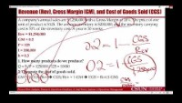
Recorded Lecture

Slide 3
Little’s Law – Finance & Operations
We have discussed R and I in terms of numbers and counts. We now discuss them in terms of dollar values.
We assume Units Sold = Units Produced
Rev = $Sales
Gross Margin = (Rev-CGS)/Rev =1-CGS/Rev
Throughput is computed in terms of $$ Cost of Goods Sold, not in terms of $$ Sales.
R = Cost of Goods Sold (CGS)
I = Cost of Average Inventory
Inventory Turn = Throughput divided by average inventory.
Flow time may also be referred to as the number of days of supply.
Inventory Turn = R/I
Since R in $ is measured as CGS
Inventory Turn = CGS/I
Notes:
New process for loan application review:
Each application is preprocessed and divided into three categories based on mechanical criteria. The company found the following data upon analyzing the new system:
On average, 200 applications are with the Initial ‘Review Team at any time.
Of those reviewed, 25% are categorized as “Excellent”, 25% as “Needs Further review”, and 50% are “Rejected”.
70% of the “Excellent” applications are eventually approved.
10% of the “Needs Further Review” applications are approved.

Slide 4
Revenue (Rev), Gross Margin (GM), and Cost of Goods Sold (CGS)
A company's annual sales are $1,250,000 with a Gross Margin of 20%. The price of one unit of product is $125. The average inventory is $200,000, and the inventory carrying cost is 30% of the inventory cost. A year is 50 weeks.
Rev = $1,250,000
GM = 0.2
P = 125
I = 200,000
h = 0.3
1. How many products do we produce?
Q = S/P = 1250000/125 = 10000
2. Compute the cost of goods sold.
GM = 1-CGS/Rev ➔ CGS/Rev = 1-GM ➔ CGS = Rev(1-GM)
CGS = Rev(1-GM) = 1250000(1-0.25) = 1000,000
Notes:
New process for loan application review:
Each application is preprocessed and divided into three categories based on mechanical criteria. The company found the following data upon analyzing the new system:
On average, 200 applications are with the Initial ‘Review Team at any time.
Of those reviewed, 25% are categorized as “Excellent”, 25% as “Needs Further review”, and 50% are “Rejected”.
70% of the “Excellent” applications are eventually approved.
10% of the “Needs Further Review” applications are approved.

Slide 5
Flow Time, Inventory Turns, Carrying Cost Per Unit of Product
3. How long does a $ stays in inventory?
RT = I
R = CGS
CGS*T=I
1000000T=200000
T = 0.2 year or 10 weeks.
4. Compute Inventory Turns.
InvTurns = R/I = CGS/I = 1000,000/200,000 = 5
5. Compute annual Inventory Carrying Costs.
CC= hI = 0.3(200,000) = 60,000
6. How much is the carrying cost associated with each unit of product?
CC per unit of product = CC/Q = 60,000/10,000 = $6.
Notes:
New process for loan application review:
Each application is preprocessed and divided into three categories based on mechanical criteria. The company found the following data upon analyzing the new system:
On average, 200 applications are with the Initial ‘Review Team at any time.
Of those reviewed, 25% are categorized as “Excellent”, 25% as “Needs Further review”, and 50% are “Rejected”.
70% of the “Excellent” applications are eventually approved.
10% of the “Needs Further Review” applications are approved.

Slide 6
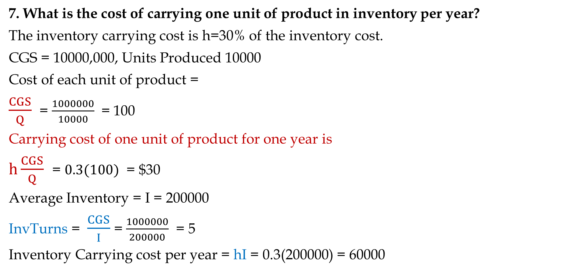
Carrying Cost per Unit of Product per Year
7. What is the cost of carrying one unit of product in inventory per year?
The inventory carrying cost is h=30% of the inventory cost.
CGS = 10000,000, Units Produced 10000
Cost of each unit of product =
$\frac{CGS}{Q}$ = $\frac{1000000}{10000}$ = 100
Carrying cost of one unit of product for one year is
$h\frac{CGS}{Q}$ = $0.3(100)$ = $30
Average Inventory = I = 200000
InvTurns = $\frac{CGS}{I}$ = $\frac{1000000}{200000}$ = 5
Inventory Carrying cost per year = hI = 0.3(200000) = 60000
Notes:
New process for loan application review:
Each application is preprocessed and divided into three categories based on mechanical criteria. The company found the following data upon analyzing the new system:
On average, 200 applications are with the Initial ‘Review Team at any time.
Of those reviewed, 25% are categorized as “Excellent”, 25% as “Needs Further review”, and 50% are “Rejected”.
70% of the “Excellent” applications are eventually approved.
10% of the “Needs Further Review” applications are approved.

Slide 7
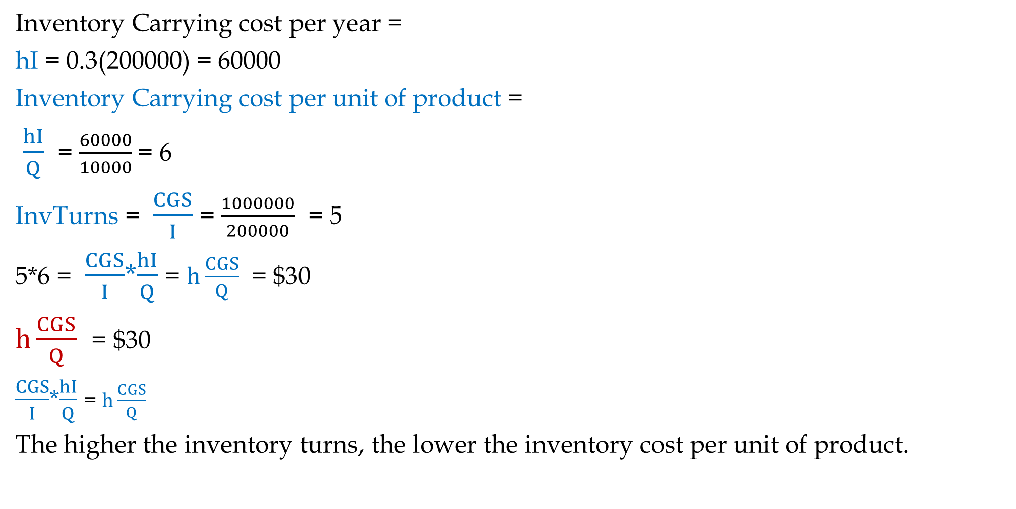
Carrying Cost per Unit of Product per Year
Inventory Carrying cost per year =
hI = 0.3(200000) = 60000
Inventory Carrying cost per unit of product =
$\frac{hI}{Q}$ = $\frac{60000}{10000}$= 6
InvTurns = $\frac{CGS}{I}$ = $\frac{1000000}{200000}$ = 5
5*6 = $\frac{CGS}{I}$*$\frac{hI}{Q}$ = $h\frac{CGS}{Q}$ = $30
$h\frac{CGS}{Q}$ = $30
$\frac{CGS}{I}$*$\frac{hI}{Q}$ = $h\frac{CGS}{Q}$
The higher the inventory turns, the lower the inventory cost per unit of product.
Notes:
New process for loan application review:
Each application is preprocessed and divided into three categories based on mechanical criteria. The company found the following data upon analyzing the new system:
On average, 200 applications are with the Initial ‘Review Team at any time.
Of those reviewed, 25% are categorized as “Excellent”, 25% as “Needs Further review”, and 50% are “Rejected”.
70% of the “Excellent” applications are eventually approved.
10% of the “Needs Further Review” applications are approved.

Slide 8
Relationship Between Carrying Cost Per Unit and Inventory Turn
I have set h, and I equal to two random numbers in the following table. Right-click on the file, open the file, go to an empty cell, and click delete several times. As you can see, RED and GREEN always have the same results. That means if inventory goes up or down, the carrying cost of one unit of inventory goes up or down. At the same time, since inventory goes up or down, inventory turns will go down or up. Therefore, they compensate for each other, and H is independent of I.
Notes:
New process for loan application review:
Each application is preprocessed and divided into three categories based on mechanical criteria. The company found the following data upon analyzing the new system:
On average, 200 applications are with the Initial ‘Review Team at any time.
Of those reviewed, 25% are categorized as “Excellent”, 25% as “Needs Further review”, and 50% are “Rejected”.
70% of the “Excellent” applications are eventually approved.
10% of the “Needs Further Review” applications are approved.

