Slide 1
K1 . The Coffee Shop
Chapter 1
Process Flow Analysis
The Little’s Law
The Core Concept in Business Processes Engineering
Eyes must be washed; to see things differently.
Sohrab Sepehri, Persian Poet, 1928 – 1980.

Slide 2
K4. Auto-Moto Financial Services- The Old Process
Auto-Moto receives 1,000 applications per month. In the old process, each application is handled in a single activity, with 20% of applications being approved. 500 were in the process at any time. Average flow time T = ?
200/month
1000/month
Process
I_{p}=500
RT = I
T = I/R = 500/1,000 months = 0.5 month or 15 days.
800/month
The firm recently implemented a new loan application process. In the new process, applicants go through an initial review and are divided into three categories.
Discussion: How operational power destroys the walls of poverty.
Notes:
Throughput R = 1,000 applications/month, Average Inventory I = 500 applications; T=15 days means that each application spent 15 days (on average) before receiving accept/reject decision.

Slide 3
K4. New Process: The Same R, But smaller I
Subprocess A
Review
70%
200/month
Accepted
I_{A} = 25
30%
25%
10%
1000/month
Initial
Review
Subprocess B
Review
25%
I_{R} = 200
I_{B} = 150
90%
50%
800/month
R = 1000
I = I_{IR} + I_{A} + I_{B} = 200 + 25 + 150 = 375
Inventory reduced to 375 from 500 in the old process.
Since R is constant, therefore T has reduced.
T = I/R = 375/1000 = 0.375 month or 0.375(30) = 11.25 days
The new process has decreased the processing time from 15 days to 11.25 days.
Rejected
Notes:
New process for loan application review:
Each application is preprocessed and divided into three categories based on mechanical criteria. The company found the following data upon analyzing the new system:
On average, 200 applications are with the Initial ‘Review Team at any time.
Of those reviewed, 25% are categorized as “Excellent”, 25% as “Needs Further review”, and 50% are “Rejected”.
70% of the “Excellent” applications are eventually approved.
10% of the “Needs Further Review” applications are approved.

Slide 4

K4. Questions
Compute average flow time.
Compute average flow time at Initial Review Process.
Compute average flow time at Subprocess A.
Compute average flow time at Subprocess B.
Compute average flow time of an Accepted application.
Compute average flow time of a Rejected application.
The first part of the lecture on this problem is available at
https://www.youtube.com/watch?v=TauGBb5xbVs&t=10s
The second part of the lecture on this problem is available at
https://youtu.be/pyFq8JDHljM

Slide 5
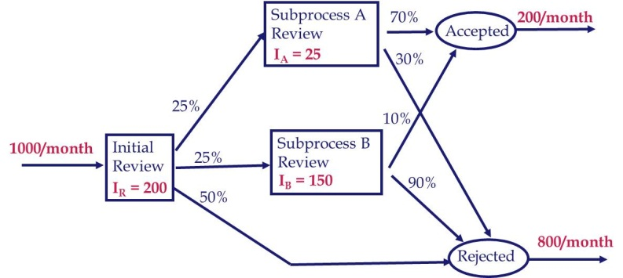
K4. Flow Time at Each Sub-process (or activity)
Average Flow Time for sub-process IR.
Throughput R_{IR} = 1,000 applications/month
Average Inventory I_{IR} = 200 applications
T_{IR} = 200/1,000 = 0.2 months = 6 days in the IR sub-process
Average Flow Time for sub-process A.
Throughput R_{A} = 250 applications/month
Average Inventory I_{A} = 25 applications
T_{A} = 25/250 months = 0.1 months = 3 days in sub-process A.
Average Flow Time for sub-process B.
Throughput R_{B} = 250 applications/month
Average Inventory I_{B} = 150 applications
T_{B} = 150/250 months = 0.6 months = 18 days in sub-process B

Slide 6
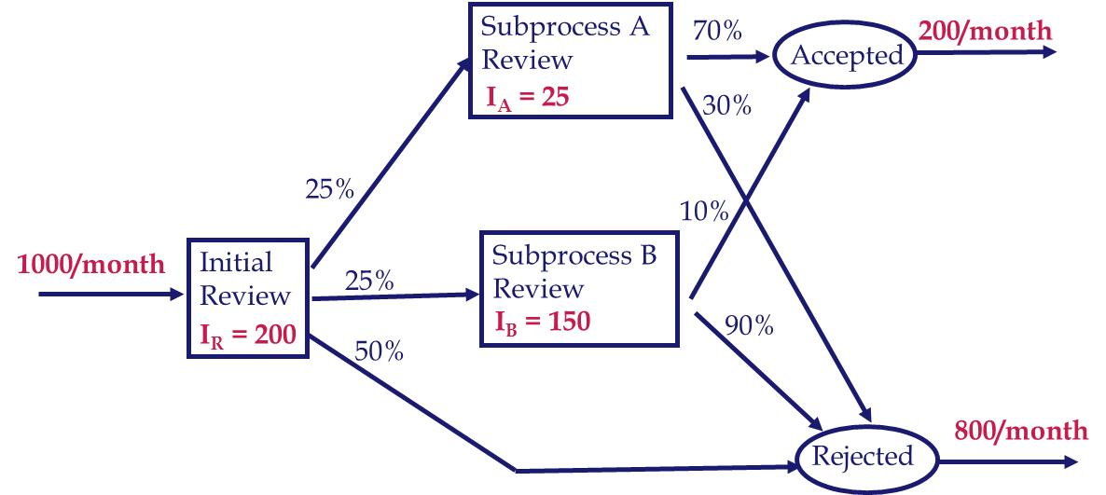
K4. Routing, Flow Time, and Percentage of Each Flow units
One flow unit at very macro level: Application
1000 flow units/month at very micro level: Each specific application
Two flow units: Accepted and rejected
Five flow units: Accepted-A, Accepted-B
Rejected-IR, Rejected-A, Rejected-B
Accepted-A: IR, A
Accepted-B: IR, B
Rejected-IR: IR
Rejected-A: IR, A
Rejected-B: IR, B
T_{IR} = 6 days
T_{A} = 3 days
T_{B} = 18 days
We also need percentages of each of the five flow units
Notes:
New process for loan application review:
Each application is preprocessed and divided into three categories based on mechanical criteria. The company found the following data upon analyzing the new system:
On average, 200 applications are with the Initial ‘Review Team at any time.
Of those reviewed, 25% are categorized as “Excellent”, 25% as “Needs Further review”, and 50% are “Rejected”.
70% of the “Excellent” applications are eventually approved.
10% of the “Needs Further Review” applications are approved.

Slide 7
K4. New Process: Intermediate Probabilities
Subprocess A
Review
T = 3
70%
20%
Accepted
30%
25%
10%
100%
Initial
Review
T = 6
Subprocess B
Review
T = 18
25%
90%
50%
80%
Rejected
Notes:
New process for loan application review:
Each application is preprocessed and divided into three categories based on mechanical criteria. The company found the following data upon analyzing the new system:
On average, 200 applications are with the Initial ‘Review Team at any time.
Of those reviewed, 25% are categorized as “Excellent”, 25% as “Needs Further review”, and 50% are “Rejected”.
70% of the “Excellent” applications are eventually approved.
10% of the “Needs Further Review” applications are approved.

Slide 8
K4. New Process: Intermediate Probabilities
Subprocess A
Review
T = 3
17.5%
20%
Accepted
7.5%
25%
2.5%
100%
Initial
Review
T = 6
Subprocess B
Review
T = 18
25%
22.5%
50%
50%
80%
Rejected
Notes:
New process for loan application review:
Each application is preprocessed and divided into three categories based on mechanical criteria. The company found the following data upon analyzing the new system:
On average, 200 applications are with the Initial ‘Review Team at any time.
Of those reviewed, 25% are categorized as “Excellent”, 25% as “Needs Further review”, and 50% are “Rejected”.
70% of the “Excellent” applications are eventually approved.
10% of the “Needs Further Review” applications are approved.

Slide 9
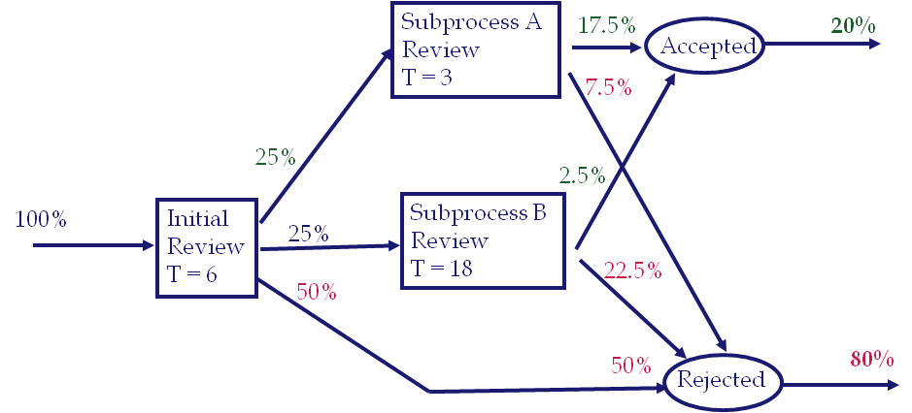
K4. Flow Time of the Accepted Applications
Under the Original Process – the average time spent by an application in the process is 15 days (approved or rejected).
In the new process: 15 days reduced to 11.25 days.
On average, how long does it take to approve an applicant?
On average, how long does it take to reject an applicant?
Accepted-A: IR, A ➔ Accepted-A(T) = 6 + 3 = 9 ➔ Accepted-A = 17.5 %
Accepted-B: IR, B ➔ Accepted-B(T) = 6 + 18 = 24 ➔ Accepted-B = 2.5 %
Average Flow time of an accepted application =
[0.175(9)+0.025(24)]
/
(0.175+.025)
= 10.875
The average flow time has reduced from 15 to 11.25. In addition, the flow time of accepted applications has reduced to 10.875. That is what the firm really cares about, the flow time of the accepted applications.
Notes:
New process for loan application review:
Each application is preprocessed and divided into three categories based on mechanical criteria. The company found the following data upon analyzing the new system:
On average, 200 applications are with the Initial ‘Review Team at any time.
Of those reviewed, 25% are categorized as “Excellent”, 25% as “Needs Further review”, and 50% are “Rejected”.
70% of the “Excellent” applications are eventually approved.
10% of the “Needs Further Review” applications are approved.

Slide 10
K4. Flow Time of Rejected Applications
Rejected-IR: IR ➔ Rejected-IR(T) = 6 ➔ Rejected-IR(%) = 50%
Rejected-A: IR, A ➔ Rejected-A(T) = 6+3 = 9 ➔ Rejected-A(%) = 7.5%
Rejected-B: IR, B ➔ Rejected-B(T) = 6+18 = 24 ➔ Rejected-B(%) = 22.5%
Average Flow time of a rejected application =
= 11.343
Check our computations:
Average flow time of an application
0.8(11.343)+0.2(10.875) = 11.25
Did I need to solve for the Rejected Applications?
Notes:
New process for loan application review:
Each application is preprocessed and divided into three categories based on mechanical criteria. The company found the following data upon analyzing the new system:
On average, 200 applications are with the Initial ‘Review Team at any time.
Of those reviewed, 25% are categorized as “Excellent”, 25% as “Needs Further review”, and 50% are “Rejected”.
70% of the “Excellent” applications are eventually approved.
10% of the “Needs Further Review” applications are approved.

Slide 11

Practice. Compute the Flow Time
B
T = 15
30%
D
I = 18
70%
40%
10%
100%
A
T = 10
F
T = 10
100%
40%
60%
E
T = 16
30%
C
I = 12
20%
Notes:
New process for loan application review:
Each application is preprocessed and divided into three categories based on mechanical criteria. The company found the following data upon analyzing the new system:
On average, 200 applications are with the Initial ‘Review Team at any time.
Of those reviewed, 25% are categorized as “Excellent”, 25% as “Needs Further review”, and 50% are “Rejected”.
70% of the “Excellent” applications are eventually approved.
10% of the “Needs Further Review” applications are approved.

