Slide 1
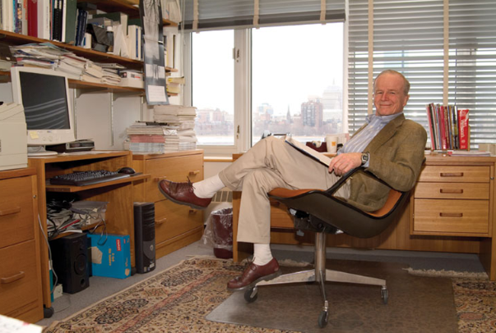
The Little’s Law
The Core Concept in Business Processes Engineering
Eyes must be washed; to see things differently. Sohrab Sepehri, Persian Poet, 1928 – 1980.

Slide 2
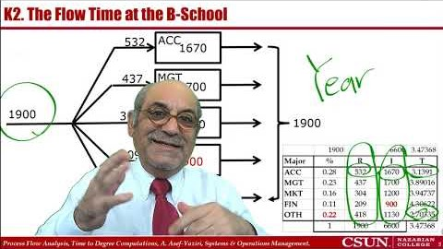
Recorded Lecture https://youtu.be/con6BNHeKZs
Recorded Lecture https://youtu.be/con6BNHeKZs

Slide 3
K2. Flow Time (Time-to-Degree) at a B-School
Over the past 7 years, on average, there were 1,900 incoming students per year at DNCBE-School. On average, the headcount of students enrolled over the same period was 6,600.
a) On average, how long does a student spend in this school?
RT=I ➔ 1,900T = 6,600 ➔ T = 3.47 years.
Out of the 1,900 incoming students per year, on average, 28% are accounting majors, 23% are management 16% are marketing, 11% are finance, and the rest are other majors.
The School has 1,670 accounting students, 1,700 Management students, 1,200 Marketing students, and 1,130 students in all other majors except finance. The rest are in the finance department.
b) Compute the flow time at each department.

Slide 4
K2. DNCBE- Time to Graduation
0.28
ACC
1670
0.23
MGT
1700
1900
0.16
MKT
1200
1900
0.11
FIN
900
0.22
OTH
1130
1-(0.28+0.23+0.16+0.11) = 0.22
6600-(1670+1700+1200+1130)= 900

Slide 5
K2. The Flow Time at the B-School
532
ACC
1670
437
MGT
1700
1900
304
MKT
1200
1900
209
FIN
900
418
OTH
1130

Slide 6
K2. DNCBE- Time to Graduation
Using part (a), prove that your computations in part (b) are correct.
We have time-to-graduation for all five of the groups and their relative weights.
SUMPRODUCT (%,TtD) =0.28(3.14) + 0.23(3.89), 0.16(2.95), 0.11 (4.31), 0.22(2.7) = 3.47.
On average, 36% of the incoming students of this B-School are freshmen (FTF) , and the rest are transfer (FTT) students.
Time-to-Degree (TTD) for FTF is estimated to be twice of FTT.
c) How long does it take FTF students to graduate?
T = TTD for FTTs (64% of all students).
2T = TTD for FTFs (36% of all students).
Average time-to-graduation for all students = 3.47 years.
0.64T+0.36 (2T) = 3.47 years
1.36T=3.47
T=2.55 ➔ TTD-FTT = 2.55, TTD-FTF = 5.1

Slide 7
K2. DNCBE- Time to Graduation
d) Sadly, we have the additional information that 35% of FTF and 25% of FTT dropouts drop out. Out of 100% incoming students, what % are FTF graduate, FTT graduate, FTF dropout, and FTT dropout.
FTF-D=0.35(0.36) = 0.126 ➔ 12.6%
FTF-G= 0.36-0.126= 0.234 ➔23.4%
FTT-D=0.25(0.64) = 0.16 ➔ 16%
FTT-G= 0.64-0.16= 0.48 ➔ 48%
The average time that freshman dropouts spend in the School is 1.5 years. This time for transfer dropouts is 0.75 year. Given this new information, how long does it take FTFs to graduate? Time to graduation of first-time-freshman is still twice of first-time-transfer.
0.126(1.5) + 0.234(2T) + 0.16(0.75) + 0.48(T) = 3.47
0.948T=3.16
T=3.33 ➔ TTD-FTT = 3.33, TTD-FTF = 6.66

Slide 8
Practice
Given the following data
How many students this college has?
How many new students are there?

Slide 9

Incoming Students and Headcount in the Past 7 Years
SOM & MGT data are mixed up in 2018 & 2019

Slide 10
Incoming Students and Headcount in the Past 7 Years
MKT 12 29
FIN 16 25
SOM 6 9 200

