Slide 1

Test of Hypothesis Part A
By Using Confidence Interval for $\overline{X}$
Don't wait for the last judgment - it takes place every day.
Albert Camus

Slide 2
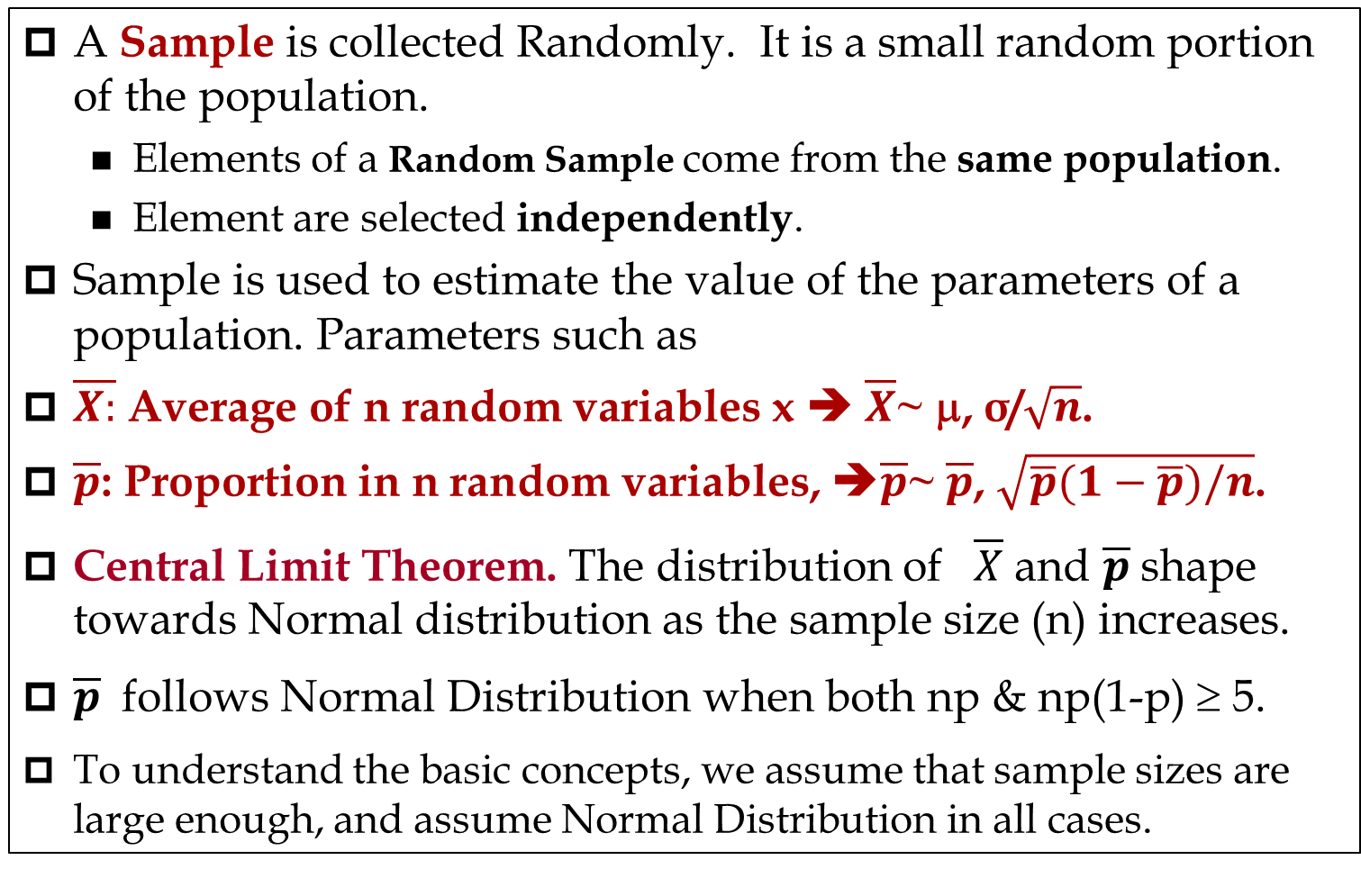
Sampling
A Sample is collected Randomly. It is a small random portion of the population.
  Elements of a Random Sample come from the same population.
  Element are selected independently.
Sample is used to estimate the value of the parameters of a population. Parameters such as
$\overline{X:}$ Average of n random variables x ➔ $\overline{X}$~ μ, σ/$\sqrt{n}$.
$\overline{p}$: Proportion in n random variables, ➔$\overline{p}$~ $\overline{p}$, $\sqrt{\overline{p}(1−\overline{p})/n}$.
Central Limit Theorem. The distribution of $\overline{X}$ and $\overline{p}$shape towards Normal distribution as the sample size (n) increases.
$\overline{p}$ follows Normal Distribution when both np & np(1-p) ≥ 5.
To understand the basic concepts, we assume that sample sizes are large enough, and assume Normal Distribution in all cases.

Slide 3
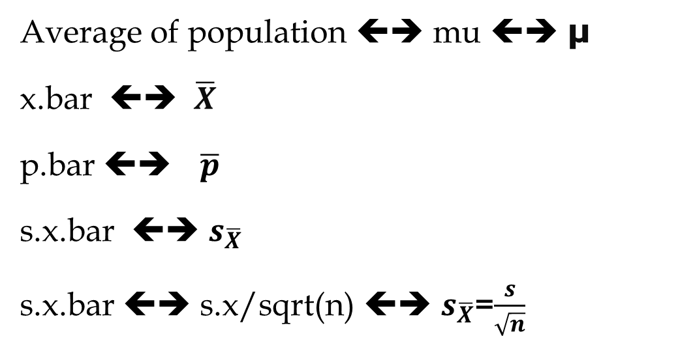
Te following notations are interchangeable. We may use each of them in the lectures, quizzes, and exams, terms such as the following notations, especially in the exams and quizzes
Average of population ⬅➔ mu ⬅➔ μ
x.bar ⬅➔ $\overline{X}$
p.bar ⬅➔ $\overline{p}$
s.x.bar ⬅➔ $s_{\overline{X}}$
s.x.bar ⬅➔ s.x/sqrt(n) ⬅➔ $s_{\overline{X}}$=$\frac{s}{\sqrt{n}}$

Slide 4
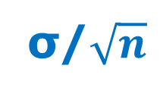

Case 1. Two Tail Test- H0: μ = K
σ/$\sqrt{n}$
α/2
1-α
α/2
$$\overline{X}$$

Slide 5
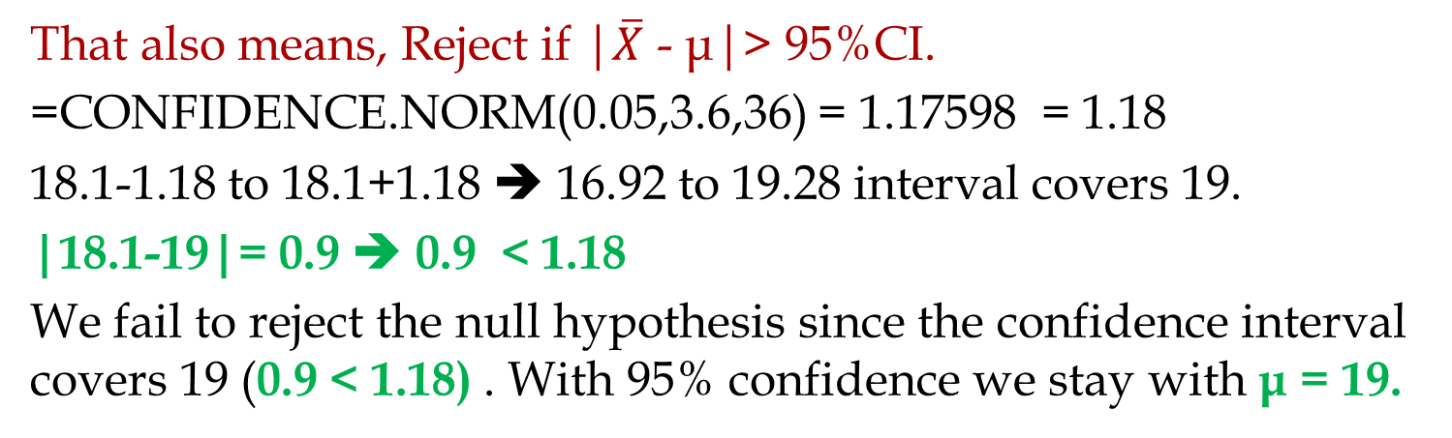
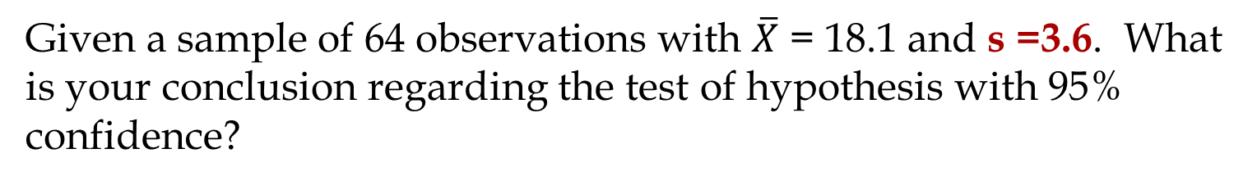
Two Tail Test – Using Confidences Interval.
Given a sample of 64 observations with $\overline{X}$ = 18.1 and s =3.6. What is your conclusion regarding the test of hypothesis with 95% confidence?
H0 : μ = 19
Ha: μ ≠ 19
Compute 95% confidence interval.
Reject, if the interval does not cover 19.
That also means, Reject if |$\overline{X}$ - μ|> 95%CI.
=CONFIDENCE.NORM(0.05,3.6,36) = 1.17598 = 1.18
18.1-1.18 to 18.1+1.18 ➔ 16.92 to 19.28 interval covers 19.
|18.1-19|= 0.9 ➔ 0.9 < 1.18
We fail to reject the null hypothesis since the confidence interval covers 19 (0.9 < 1.18) . With 95% confidence we stay with μ = 19.

Slide 6
Case 2. One Tail Test- H0: μ ≤ K
σ/$\sqrt{n}$
1-α
α
$$\overline{X}$$

Slide 7
Case 2b. One Tail Test- H0: μ ≥ K
σ/$\sqrt{n}$
α
1-α
$$\overline{X}$$

Slide 8
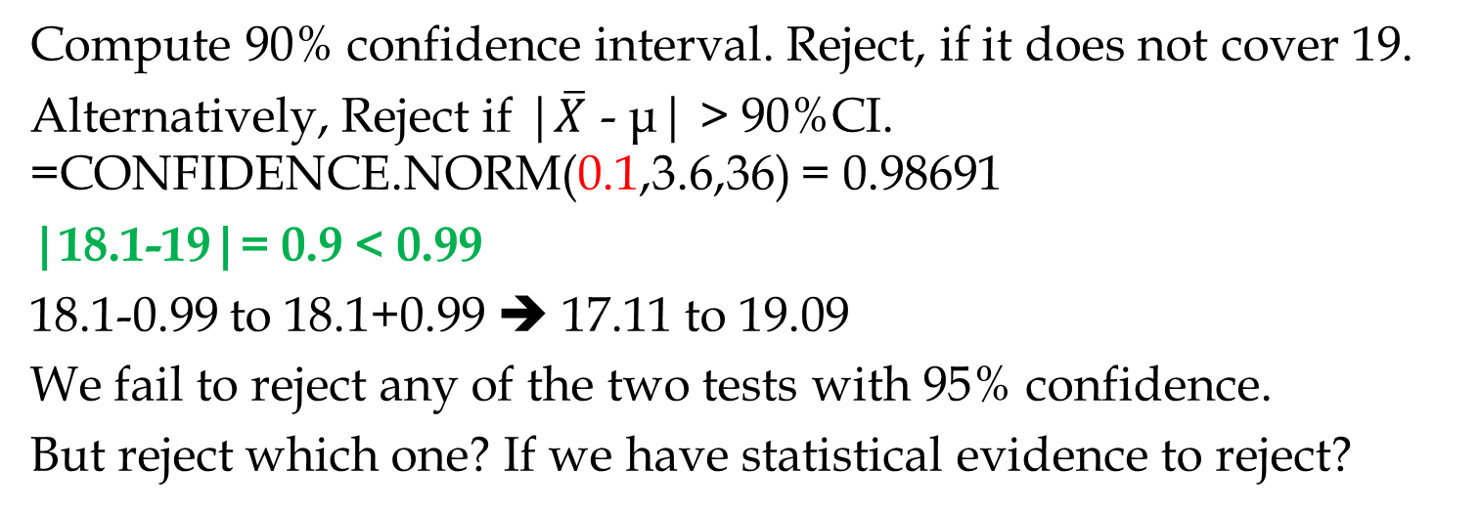
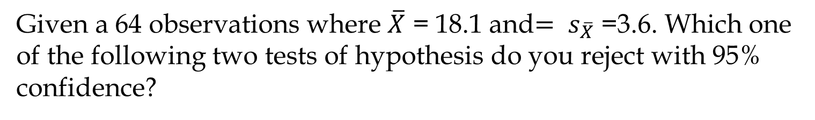
Case 2- One Tail Test
Given a 64 observations where $\overline{X}$ = 18.1 and${= s}_{\overline{X}}$ =3.6. Which one of the following two tests of hypothesis do you reject with 95% confidence?
(a)
H0 : μ ≤ 19
H1: μ >19
(b)
H0 : μ ≥ 19
H1: μ <19
Compute 90% confidence interval. Reject, if it does not cover 19.
Alternatively, Reject if |$\overline{X}$ - μ| > 90%CI. =CONFIDENCE.NORM(0.1,3.6,36) = 0.98691
|18.1-19|= 0.9 < 0.99
18.1-0.99 to 18.1+0.99 ➔ 17.11 to 19.09
We fail to reject any of the two tests with 95% confidence.
But reject which one? If we have statistical evidence to reject?

Slide 9
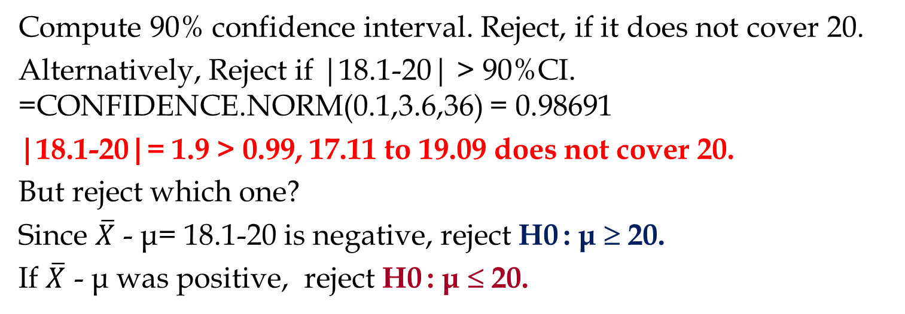
Case 2- One Tail Test
Given a 64 observations where $\overline{X}$ = 18.1 and${= s}_{\overline{X}}$ =3.6. Which one of the following two tests of hypothesis do you reject with 95% confidence?
(a)
H0 : μ ≤ 20
H1: μ >20
(b)
H0 : μ ≥ 20
H1: μ <20
Compute 90% confidence interval. Reject, if it does not cover 20.
Alternatively, Reject if |18.1-20| > 90%CI. =CONFIDENCE.NORM(0.1,3.6,36) = 0.98691
|18.1-20|= 1.9 > 0.99, 17.11 to 19.09 does not cover 20.
But reject which one?
Since $\overline{X}$ - μ= 18.1-20 is negative, reject H0 : μ ≥ 20.
If $\overline{X}$ - μ was positive, reject H0 : μ ≤ 20.

Slide 10
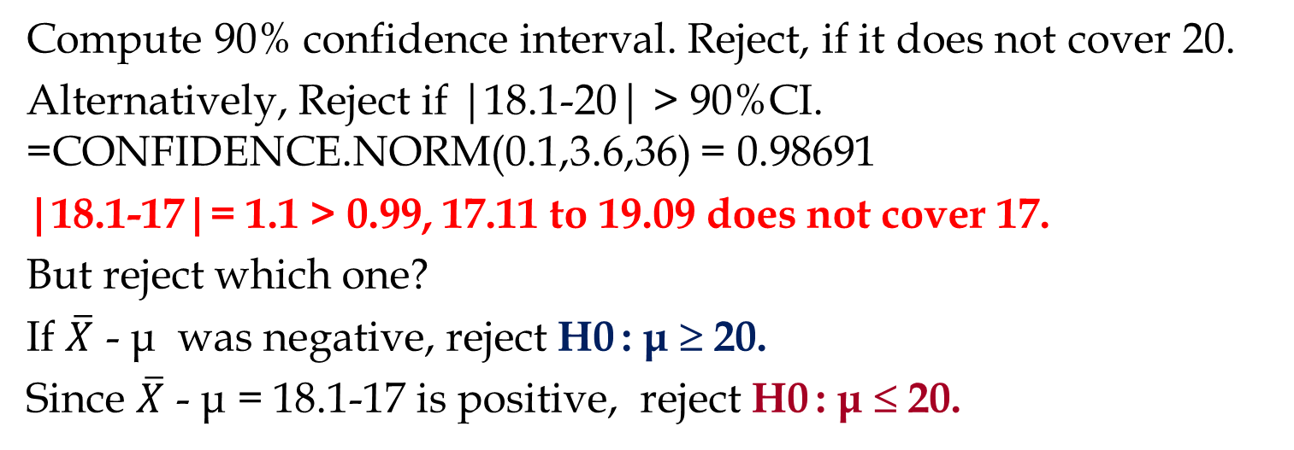
Case 2- One Tail Test
Given a 64 observations where $\overline{X}$ = 18.1 and${= s}_{\overline{X}}$ =3.6. Which one of the following two tests of hypothesis do you reject with 95% confidence?
(a)
H0 : μ ≤ 17
H1: μ >17
(b)
H0 : μ ≥ 17
H1: μ <17
Compute 90% confidence interval. Reject, if it does not cover 20.
Alternatively, Reject if |18.1-20| > 90%CI. =CONFIDENCE.NORM(0.1,3.6,36) = 0.98691
|18.1-17|= 1.1 > 0.99, 17.11 to 19.09 does not cover 17.
But reject which one?
If $\overline{X}$ - μ was negative, reject H0 : μ ≥ 20.
Since $\overline{X}$ - μ = 18.1-17 is positive, reject H0 : μ ≤ 20.

Slide 11
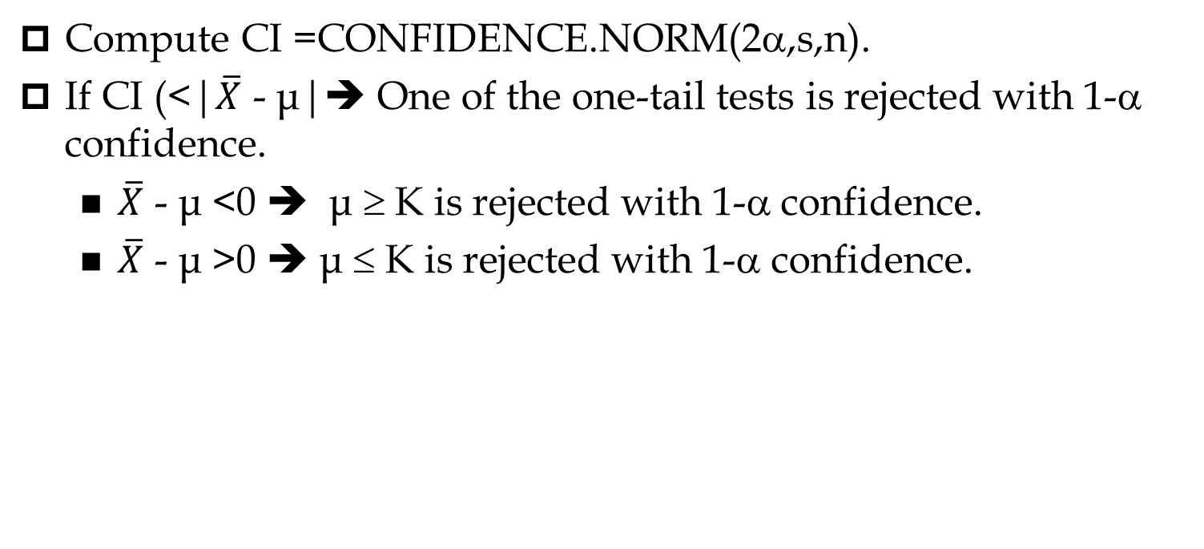
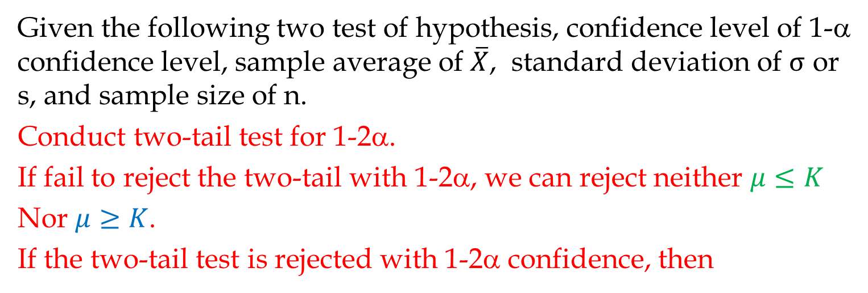
Case 2
Given the following two test of hypothesis, confidence level of 1-α confidence level, sample average of $\overline{X}$, standard deviation of $σ$ or s, and sample size of n.
Conduct two-tail test for 1-2α.
If fail to reject the two-tail with 1-2α, we can reject neither $μ≤K$
Nor $μ≥K$.
If the two-tail test is rejected with 1-2α confidence, then
H0 : μ ≤ K
H1: μ >K
H0 : μ ≥ K
H1: μ <K
Compute CI =CONFIDENCE.NORM(2α,s,n).
If CI (<|$\overline{X}$ - μ|➔ One of the one-tail tests is rejected with 1-α confidence.
  $\overline{X}$ - μ <0 ➔ μ ≥ K is rejected with 1-α confidence.
  $\overline{X}$ - μ >0 ➔ μ ≤ K is rejected with 1-α confidence.

Slide 12
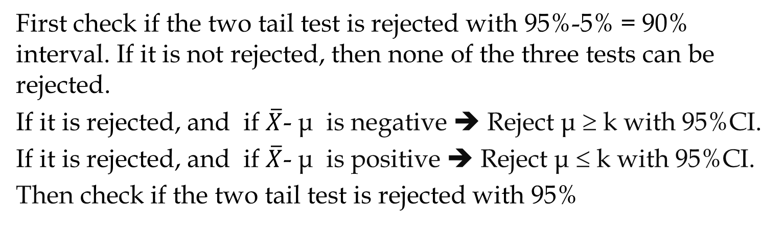
Practice
Given the following data, which test of hypothesis is rejected?
H0 : μ = k
Ha: μ ≠ k
H0 : μ ≤ k
Ha: μ > k
H0 : μ ≥ k
Ha: μ < k
Given the following data, which test of hypothesis is rejected?
$\overline{X}=19.1 ,$s= 4.25 , n = 49, and 95% confidence?
First check if the two tail test is rejected with 95%-5% = 90% interval. If it is not rejected, then none of the three tests can be rejected.
If it is rejected, and if $\overline{X}$- μ is negative ➔ Reject μ ≥ k with 95%CI.
If it is rejected, and if $\overline{X}$- μ is positive ➔ Reject μ ≤ k with 95%CI.
Then check if the two tail test is rejected with 95%

Slide 13
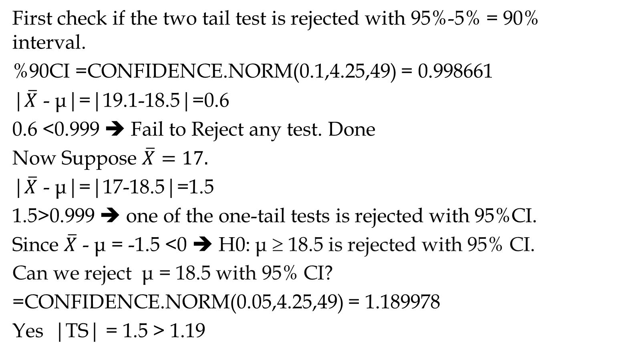
Practice
$\overline{X}=19.1 ,$s= 4.25 , n = 49, μ= 18.5, and 95% confidence?
First check if the two tail test is rejected with 95%-5% = 90% interval.
%90CI =CONFIDENCE.NORM(0.1,4.25,49) = 0.998661
|$\overline{X}$ - μ|=|19.1-18.5|=0.6
0.6 <0.999 ➔ Fail to Reject any test. Done
Now Suppose $\overline{X}=17.$
|$\overline{X}$ - μ|=|17-18.5|=1.5
1.5>0.999 ➔ one of the one-tail tests is rejected with 95%CI.
Since $\overline{X}$ - μ = -1.5 <0 ➔ H0: μ ≥ 18.5 is rejected with 95% CI.
Can we reject μ = 18.5 with 95% CI?
=CONFIDENCE.NORM(0.05,4.25,49) = 1.189978
Yes |TS| = 1.5 > 1.19

Slide 14
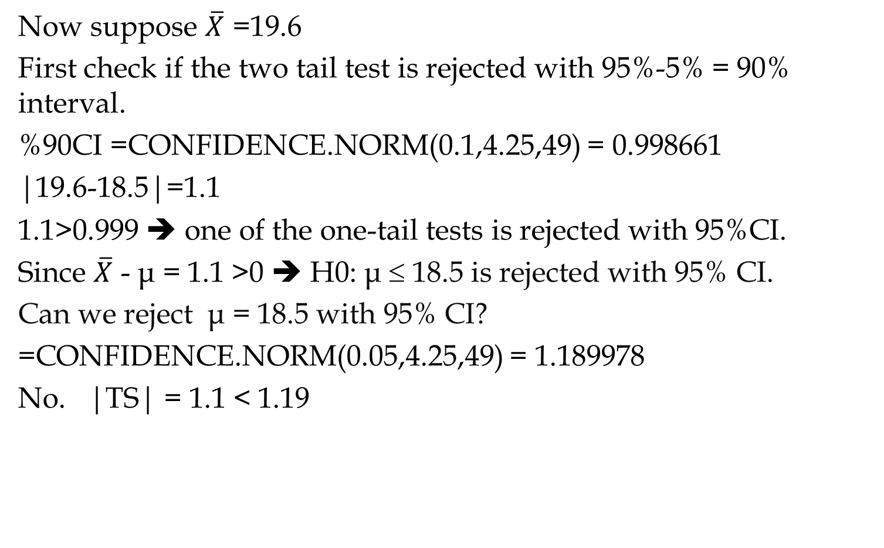
Practice
Now suppose $\overline{X}$ =19.6
First check if the two tail test is rejected with 95%-5% = 90% interval.
%90CI =CONFIDENCE.NORM(0.1,4.25,49) = 0.998661
|19.6-18.5|=1.1
1.1>0.999 ➔ one of the one-tail tests is rejected with 95%CI.
Since $\overline{X}$ - μ = 1.1 >0 ➔ H0: μ ≤ 18.5 is rejected with 95% CI.
Can we reject μ = 18.5 with 95% CI?
=CONFIDENCE.NORM(0.05,4.25,49) = 1.189978
No. |TS| = 1.1 < 1.19

Slide 15

Test of Hypothesis Part B
By Using Test Statistics and p-value for $\overline{X}$
Don't wait for the last judgment - it takes place every day.
Albert Camus

Slide 16
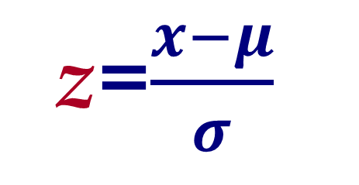
Normal & Standard Normal Distribution
x
σ
z=$\frac{x−μ}{σ}$
μ
z
1
0

Slide 17
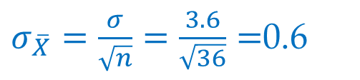
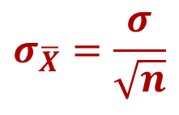


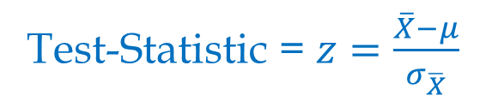
Two Tail Test- Test Statistic & Critical Value
Critical Value = NORM.S.INV(1-α/2)
$$σ_{\overline{X}}=\frac{σ}{\sqrt{n}}$$
Test-Statistic = $z=\frac{\overline{X}−μ}{σ_{\overline{X}}}$
Reject if |Test-Statistic|> Critical Value
Given n=64, $\overline{X}$ = 18.1, $σ$ =3.6, 95% confidence, and H0: $μ$=19.
Critical Value = NORM.S.INV(1-0.05/2)
Critical Value = NORM.S.INV(0.975)= 1.96996
$σ_{\overline{X}}=\frac{σ}{\sqrt{n}}=\frac{3.6}{\sqrt{36}}=$0.6
1
Test-Statistic $\text{= }z=\frac{\overline{X}−μ}{σ_{\overline{X}}}$
α/2
α/2
Test-Statistic $\text{= }z=\frac{18.1−19}{0.6}=1.5$
0
|Test-Statistic|= |1.5|= 1.5 < 1.96996
We fail to reject H0 : μ = 10.

Slide 18

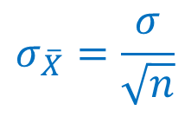

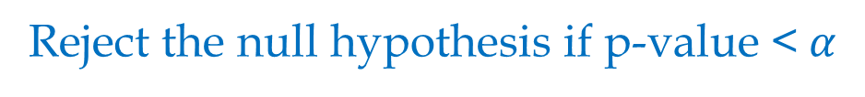
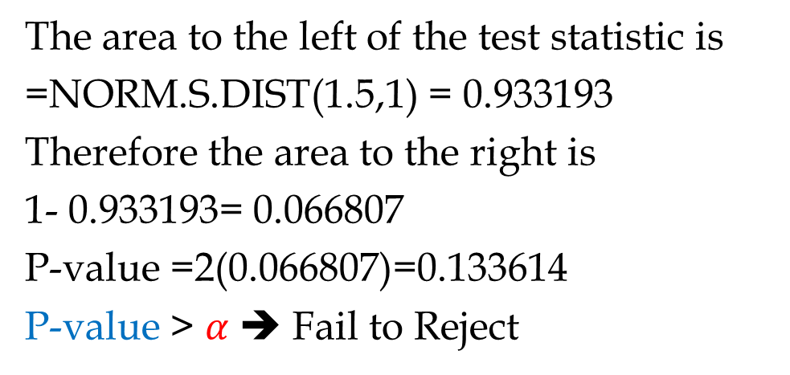
Two Tail Test- P-value & α
Given a 1- α confidence level
$$σ_{\overline{X}}=\frac{σ}{\sqrt{n}}$$
Test-Statistic = $z=\frac{\overline{X}−μ}{σ_{\overline{X}}}$
p-value is twice of the area to the right of |$z=\frac{\overline{X}−μ}{σ_{\overline{X}}}|$
Reject the null hypothesis if p-value <$α$
Given $z=\frac{18.1−19}{0.6}=1.5$ in the previous example
The area to the left of the test statistic is
=NORM.S.DIST(1.5,1) = 0.933193
Therefore the area to the right is
1- 0.933193= 0.066807
P-value =2(0.066807)=0.133614
P-value > $α$ ➔ Fail to Reject
1
α/2
α/2
0

Slide 19
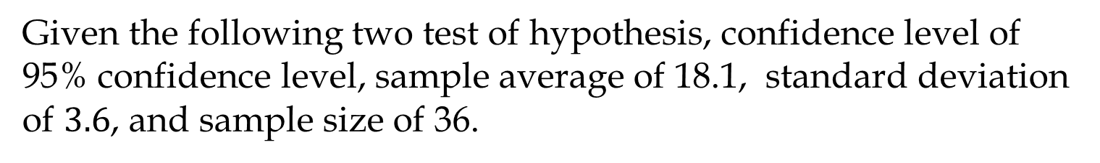

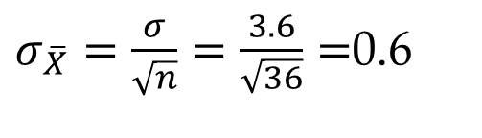
Case 2- One Tail Test
Given the following two test of hypothesis, confidence level of 95% confidence level, sample average of 18.1, standard deviation of $3.6$, and sample size of 36.
H0 : μ ≤ 20
H1: μ >20
H0 : μ ≥ 20
H1: μ <20
$σ_{\overline{X}}=\frac{σ}{\sqrt{n}}=\frac{3.6}{\sqrt{36}}=$0.6
Test-Statistic $\text{= }z=\frac{\overline{X}−μ}{σ_{\overline{X}}}=\frac{18.1−20}{0.6}=$-3.16667
Conduct a two tail test with 90% confidence (α=10%)
Critical Value = NORM.S.INV(1-0.1/2)
Critical Value = NORM.S.INV(0.95) = 1.64485
| 3.16667 | > 1.64485 ➔ Reject the Null Hypothesis.
Which Null Hypothesis?
Since -3.16667 is negative, Reject μ ≥ 20.
Can we also say something about μ ≤ 20? Yes we fail to reject it.

Slide 20

Test of Hypothesis Part C t-Distribution for $\overline{X}$
Don't wait for the last judgment - it takes place every day.
Albert Camus

Slide 21
When σ is Not Known and We Estimate it by s
In the previous analysis we used normal distribution in all cases. That was for the purpose of simplicity in getting the basic concepts.
In reality, when we do not know the standard deviation of the population (σ) , and when we estimate it by the standard deviation of the sample (s) and the sample size is less than 30, instead of Normal distribution, we need to use t-distribution.
All the steps will remain exactly as we explained earlier but
  Instead of NORM.S.DIST(z,1) ➔ T.DIST(t,d.f.,1)
  Instead of NORM.S.INV(probability) ➔ T.INV(probability, d.f.)
  d.f. = Degrees of Freedom = n-1.
Nevertheless, in the quizzes and exams, you always use Normal Distribution unless stated otherwise.
We explain two-tail tests, the logic remains the same for one-tail

Slide 22
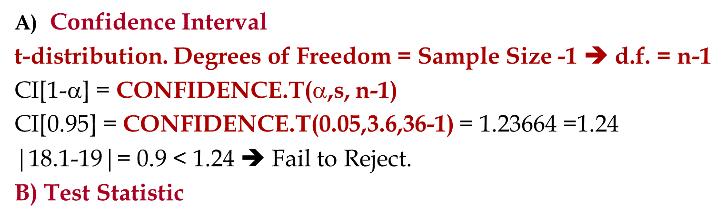

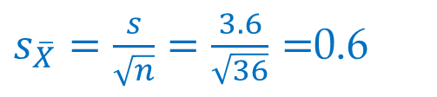

When σ is Not Known and We Estimate it by s
Given a sample of 64 observations, we have can use functions =AVERAGE() and =STDEV.S() to compute $\overline{X}$ and s.
For the purpose of comparisons, suppose $\overline{X}$ = 18.1 and $s$ =3.6.
Compute 95% confidence interval, Test Statistic, and p-value for the same problem (H0 : μ = 19, Ha: μ ≠ 19)
Confidence Interval
t-distribution. Degrees of Freedom = Sample Size -1  d.f. = n-1
CI[1-α] = CONFIDENCE.T($$,s, n-1)
CI[0.95] = CONFIDENCE.T(0.05,3.6,36-1) = 1.23664 =1.24
|18.1-19|= 0.9 < 1.24  Fail to Reject.
B) Test Statistic
$s_{\overline{X}}=\frac{s}{\sqrt{n}}=\frac{3.6}{\sqrt{36}}=$0.6
Test-Statistic = t$=\frac{\overline{X}−μ}{s_{\overline{X}}}=\frac{18.1−19}{0.6}$=1.5

Slide 23
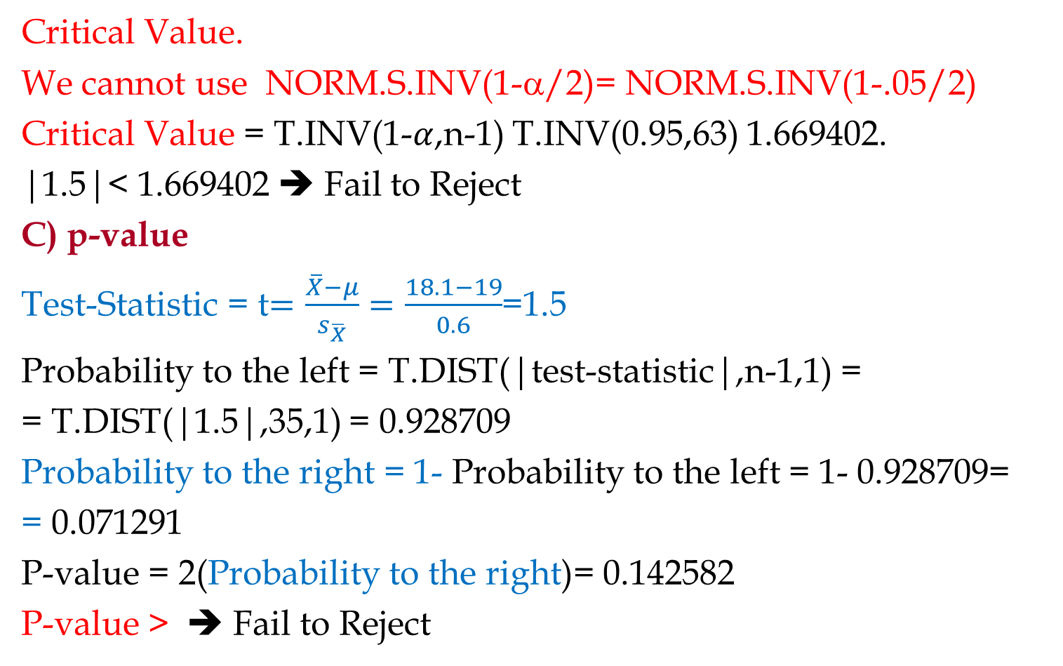
When σ is Not Known and We Estimate it by s
Critical Value.
We cannot use NORM.S.INV(1-α/2)= NORM.S.INV(1-.05/2)
Critical Value = T.INV(1-$α$,n-1) T.INV(0.95,63) 1.669402.
|1.5|< 1.669402 ➔ Fail to Reject
C) p-value
Test-Statistic = t$=\frac{\overline{X}−μ}{s_{\overline{X}}}=\frac{18.1−19}{0.6}$=1.5
Probability to the left = T.DIST(|test-statistic|,n-1,1) =
= T.DIST(|1.5|,35,1) = 0.928709
Probability to the right = 1- Probability to the left = 1- 0.928709=
= 0.071291
P-value = 2(Probability to the right)= 0.142582
P-value > ➔ Fail to Reject

Slide 24

Test of Hypothesis
Part 3
Population Proportion $\overline{p}$
Don't wait for the last judgment - it takes place every day.
Albert Camus

Slide 25
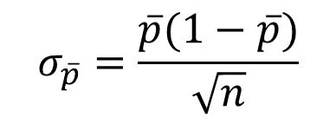

Test for Proportion
The procedure is exactly the same as what we learned about population Mean. The only difference is
$$\overline{p}=\frac{x}{n}$$
$$σ_{\overline{p}}=\frac{\overline{p}(1−\overline{p})}{\sqrt{n}}$$
=CONFIDENCE.NORM($α$, $\overline{p}(1−\overline{p}$), n)
The sampling distribution of the sample proportion can be approximated by a normal probability distribution when both np & n(1-p) ≥5.
For the sake of simplicity, in this course we assume that pbar is normally distributed in all cases.

Slide 26
Two Tail Test – Using Confidences Interval.
Given a sample of 64 observations with $\overline{X}$ = 18.1 and s =3.6. What is your conclusion regarding the test of hypothesis with 95% confidence?
H0 : μ = 19
Ha: μ ≠ 19
Compute 95% confidence interval.
Reject, if the interval does not cover 19.
That also means, Reject if |$\overline{X}$ - μ|> 95%CI.
=CONFIDENCE.NORM(0.05,3.6,36) = 1.17598 = 1.18
18.1-1.18 to 18.1+1.18 ➔ 16.92 to 19.28 interval covers 19.
|18.1-19|= 0.9 ➔ 0.9 < 1.18
We fail to reject the null hypothesis since the confidence interval covers 19 (0.9 < 1.18) . With 95% confidence we stay with μ = 19.

Slide 27

Test of Hypothesis
Part 4
Using Test Statistics and p-value for $\overline{p}$
Don't wait for the last judgment - it takes place every day.
Albert Camus

Slide 28
When σ is Unknown and Sample Size is Small
Given the following hypothesis
H0 : μ ≥ 55
H1: μ < 55
Suppose we have failed to reject the Null hypothesis. What is the conclusion?
We can stay on the hypothesis that μ is greater than or equal to 55.

Slide 29
When σ is Unknown and Sample Size is Small
Given the following hypothesis
H0 : μ ≥ 55
H1: μ < 55
Suppose we have failed to reject the Null hypothesis. What is the conclusion?
We can stay on the hypothesis that μ is greater than or equal to 55.

Slide 30
When σ is Unknown and Sample Size is Small
Given the following hypothesis
H0 : μ = 55
H1: μ ≠ 55
Suppose we have a sample of 36 observations with mean of 53 and standard deviation of 12.
Compute the test statistics.
Compute the p value.
Suppose the hypothesis is changed to
H0 : μ ≥ 55
H1: μ < 55
Compute the test statistics.
Compute the p value.

Slide 31
When σ is Unknown and Sample Size is Small
Suppose the hypothesis is changed to
H0 : μ ≤ 55
H1: μ > 55
Compute the test statistics.
Compute the p value.
With 95% confidence which one of the following hypothesis is rejected
H0 : μ = 55
H1: μ ≠ 55
H0 : μ ≥ 55
H1: μ < 55
H0 : μ ≤ 55
H1: μ > 55

Slide 32
When σ is Unknown and Sample Size is Small
Given the following hypothesis
H0 : μ ≥ 55
H1: μ < 55
Suppose we have sample of …. Observations with mean of …, standard deviation of … and α -0.25.
What is the conclusion?
A local bakery advertises to deliver made to order products in less than 4 hours. Write the appropriate test of hypothesis to examine this claim.
Out of a sample of 200 students, 90 of them where international. Compute the average and standard deviation of the same. Compute the standard error of the proportion.
A parameter – or a statistic - is a numerical measure from a population. Examples are mu, sigma, n, pbar,..

Slide 33
Relationship between μ and x
0.95
1-α

Slide 34
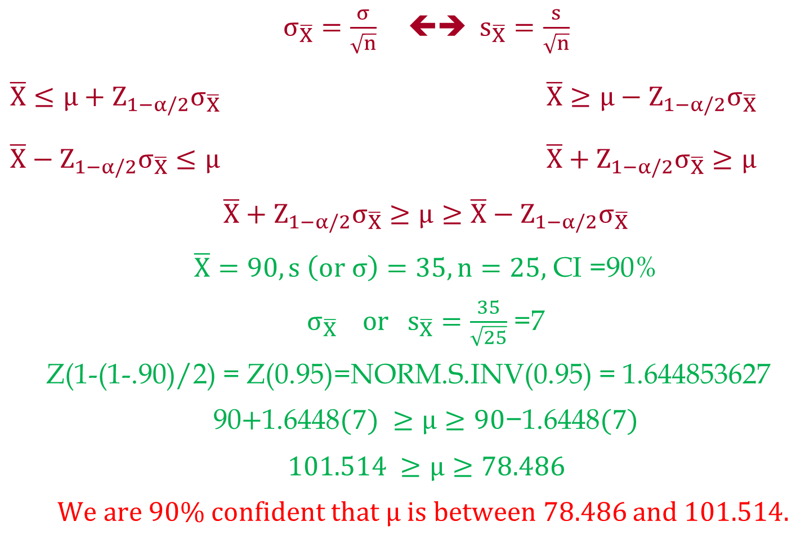
Relationship between μ and x
$σ_{\overline{X}}=\frac{σ}{\sqrt{n}}$ ⬅➔ $s_{\overline{X}}=\frac{s}{\sqrt{n}}$
$\overline{X}≤μ+Z_{1−α/2}σ_{\overline{X}}$ $\overline{X}≥μ−Z_{1−α/2}σ_{\overline{X}}$
$\overline{X}−Z_{1−α/2}σ_{\overline{X}}≤μ$ $\overline{X}+Z_{1−α/2}σ_{\overline{X}}≥μ$
$$\overline{X}+Z_{1−α/2}σ_{\overline{X}}≥μ≥\overline{X}−Z_{1−α/2}σ_{\overline{X}}$$
$\overline{X}=90, s \left(or σ\right)=35, n=25,$ CI =90%
$σ_{\overline{X}} or{ s}_{\overline{X}}=\frac{35}{\sqrt{25}}$ =7
Z(1-(1-.90)/2) = Z(0.95)=NORM.S.INV(0.95) = 1.644853627
90$+\text{1.6448}(7) ≥μ≥90\text{−}\text{1.6448}(7)$
$$101.514 ≥μ≥78.486$$
We are 90% confident that $μ is between 78.486$ and $101.514.$

Slide 35
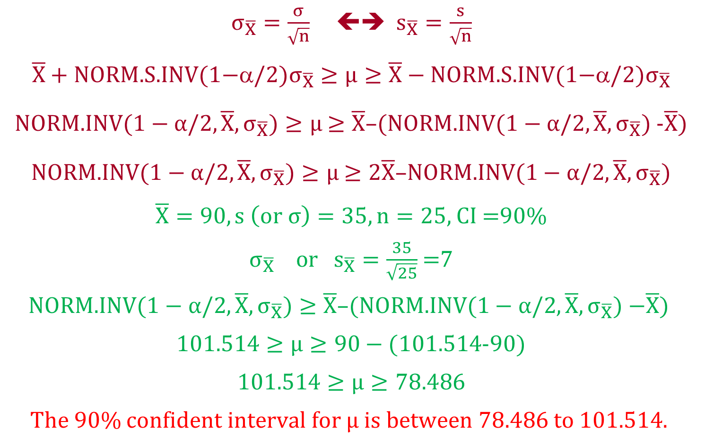
Relationship between μ and x
$σ_{\overline{X}}=\frac{σ}{\sqrt{n}}$  $s_{\overline{X}}=\frac{s}{\sqrt{n}}$
$$\overline{X}+\text{NORM}\text{.}\text{S}\text{.}\text{INV}\text{(1−}/2{)σ}_{\overline{X}}≥μ≥\overline{X}−\text{NORM}\text{.}\text{S}\text{.}\text{INV}\text{(1−}α/2\text{)}σ_{\overline{X}}$$
NORM.INV($1−α/2,\overline{X}, σ_{\overline{X}})≥μ$ $≥\overline{X}$–(NORM.INV($1−α/2,\overline{X}, σ_{\overline{X}})$-$\overline{X}$)
NORM.INV($1−α/2,\overline{X}, σ_{\overline{X}})≥μ$ $≥2\overline{X}$–NORM.INV($1−α/2,\overline{X}, σ_{\overline{X}})$
$\overline{X}=90, s \left(or σ\right)=35, n=25,$ CI =90%
$σ_{\overline{X}} or{ s}_{\overline{X}}=\frac{35}{\sqrt{25}}$ =7
$$\text{NORM}\text{.}\text{INV}\text{(}1−α/2,\overline{X}, σ_{\overline{X}})≥\overline{X}\text{–(}\text{NORM}\text{.}\text{INV}\text{(}1−α/2,\overline{X}, σ_{\overline{X}}) \text{−}\overline{X}\text{) }$$
1$01.514≥μ≥90−($1$01.514$-90)
$$101.514≥μ≥78.486$$
The 90% confident interval for $μ is between 78.486$ to $101.514.$

Slide 36
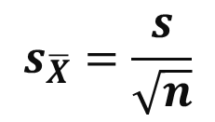
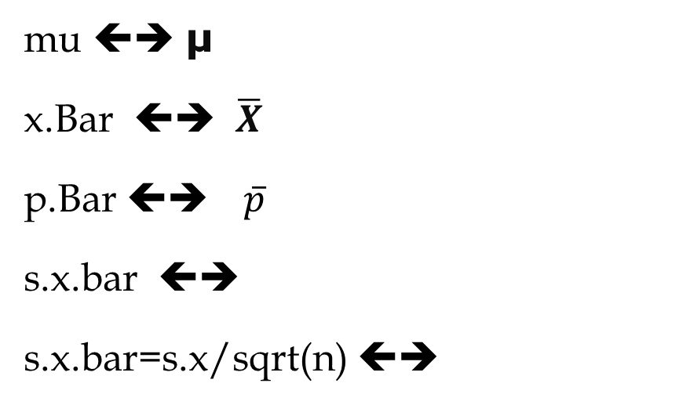

We may also use the following notations, especially in the exams and quizzes
mu ⬅➔ μ
x.Bar ⬅➔ $\overline{X}$
p.Bar ⬅➔ $\overline{p}$
s.x.bar ⬅➔
s.x.bar=s.x/sqrt(n) ⬅➔
$$s_{\overline{X}}$$
$$s_{\overline{X}}=\frac{s}{\sqrt{n}}$$

Slide 37
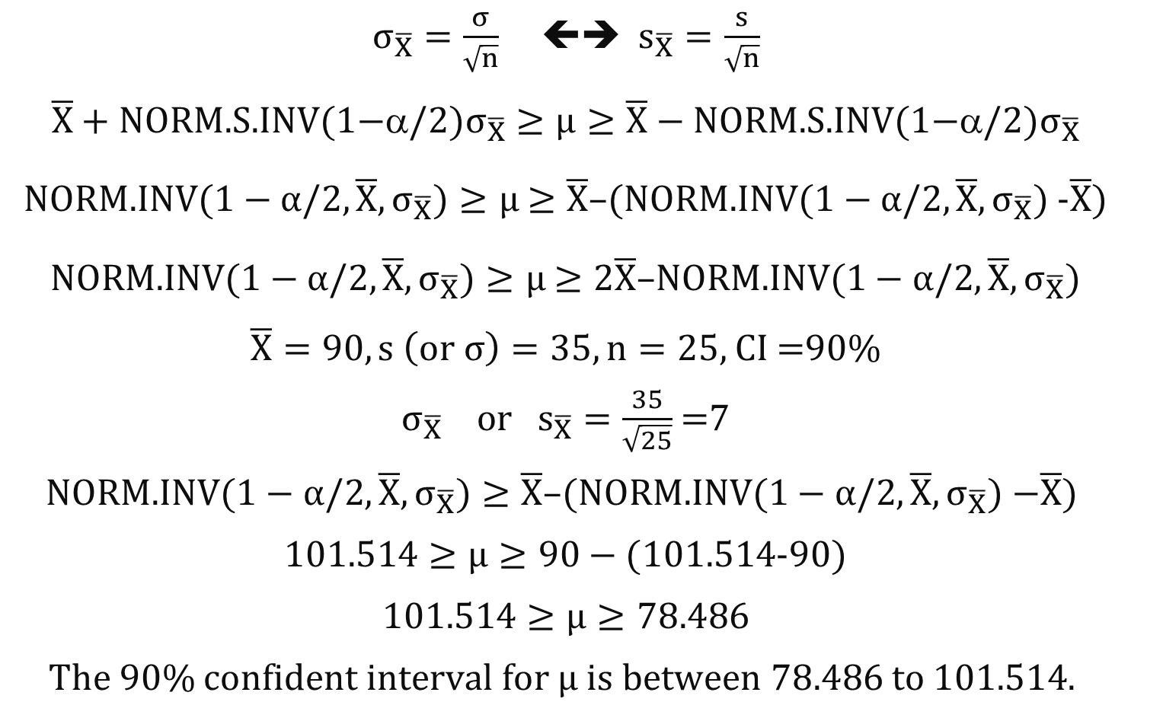
Relationship between μ and x
$σ_{\overline{X}}=\frac{σ}{\sqrt{n}}$  $s_{\overline{X}}=\frac{s}{\sqrt{n}}$
$$\overline{X}+\text{NORM}\text{.}\text{S}\text{.}\text{INV}\text{(1−}/2{)σ}_{\overline{X}}≥μ≥\overline{X}−\text{NORM}\text{.}\text{S}\text{.}\text{INV}\text{(1−}α/2\text{)}σ_{\overline{X}}$$
NORM.INV($1−α/2,\overline{X}, σ_{\overline{X}})≥μ$ $≥\overline{X}$–(NORM.INV($1−α/2,\overline{X}, σ_{\overline{X}})$-$\overline{X}$)
NORM.INV($1−α/2,\overline{X}, σ_{\overline{X}})≥μ$ $≥2\overline{X}$–NORM.INV($1−α/2,\overline{X}, σ_{\overline{X}})$
$\overline{X}=90, s \left(or σ\right)=35, n=25,$ CI =90%
$σ_{\overline{X}} or{ s}_{\overline{X}}=\frac{35}{\sqrt{25}}$ =7
$$\text{NORM}\text{.}\text{INV}\text{(}1−α/2,\overline{X}, σ_{\overline{X}})≥\overline{X}\text{–(}\text{NORM}\text{.}\text{INV}\text{(}1−α/2,\overline{X}, σ_{\overline{X}}) \text{−}\overline{X}\text{) }$$
1$01.514≥μ≥90−($1$01.514$-90)
$$101.514≥μ≥78.486$$
The 90% confident interval for $μ is between 78.486$ to $101.514.$

