Slide 1
Tests of Hypothesis
Don't wait for the last judgment - it takes place every day.
Albert Camus

Slide 2

Test of Hypothesis Part A
By Using Confidence Interval for $\overline{X}$

Slide 3
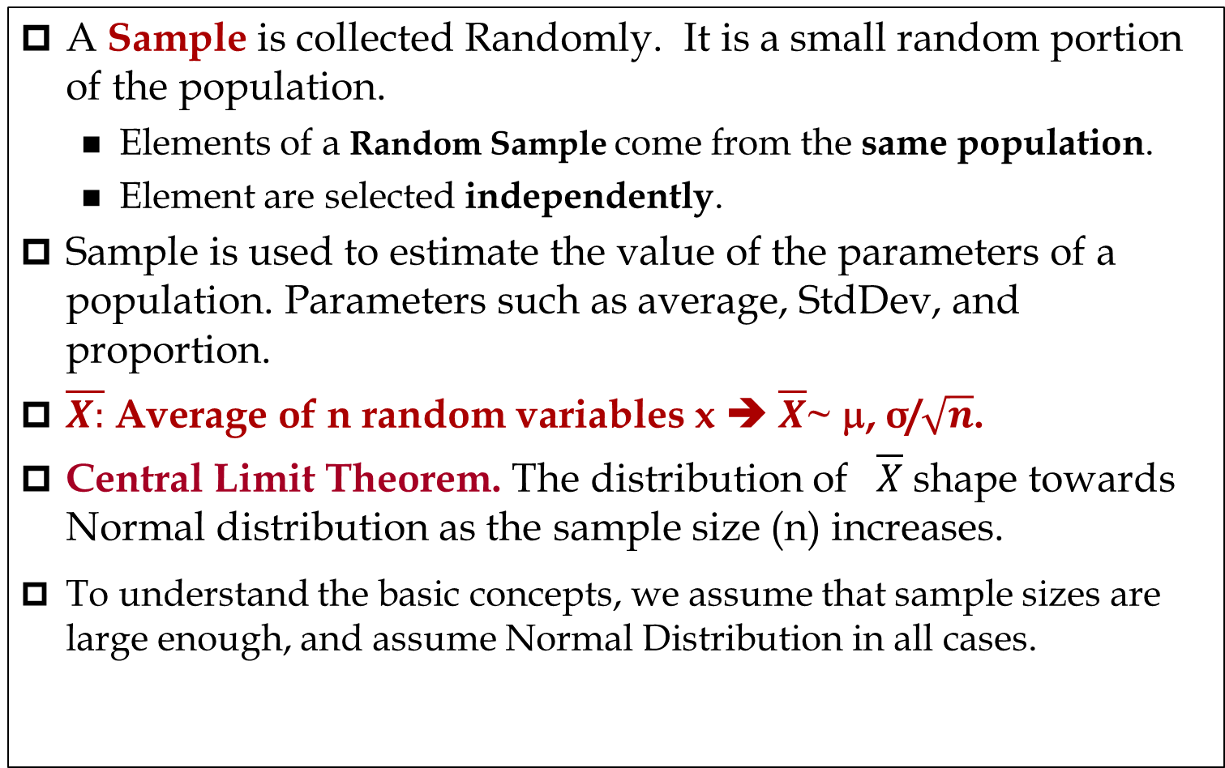
Sampling
A Sample is collected Randomly. It is a small random portion of the population.
  Elements of a Random Sample come from the same population.
  Element are selected independently.
Sample is used to estimate the value of the parameters of a population. Parameters such as average, StdDev, and proportion.
$\overline{X:}$ Average of n random variables x ➔ $\overline{X}$~ μ, σ/$\sqrt{n}$.
Central Limit Theorem. The distribution of $\overline{X}$ shape towards Normal distribution as the sample size (n) increases.
To understand the basic concepts, we assume that sample sizes are large enough, and assume Normal Distribution in all cases.

Slide 4
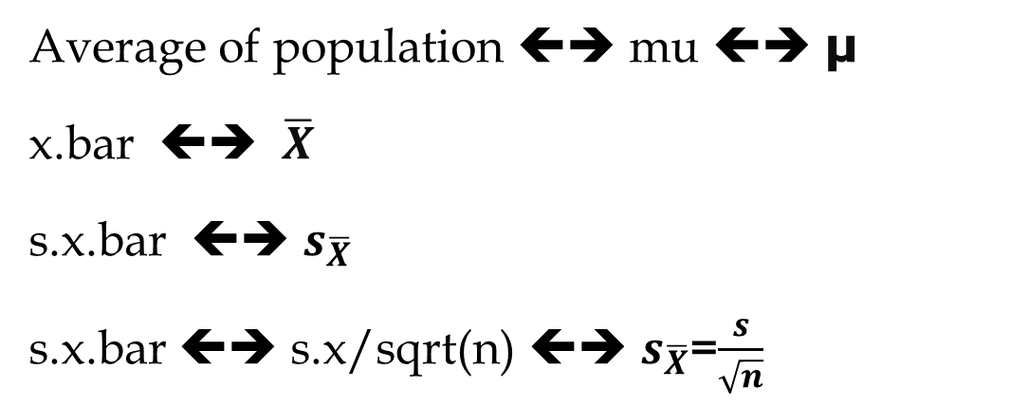
Interchangeable Notations
Te following notations are interchangeable. We may use each of them in the lectures, quizzes, and exams, terms such as the following notations, especially in the exams and quizzes
Average of population ⬅➔ mu ⬅➔ μ
x.bar ⬅➔ $\overline{X}$
s.x.bar ⬅➔ $s_{\overline{X}}$
s.x.bar ⬅➔ s.x/sqrt(n) ⬅➔ $s_{\overline{X}}$=$\frac{s}{\sqrt{n}}$

Slide 5
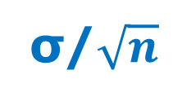

Case 1. Two Tail Test- H0: μ = K
σ/$\sqrt{n}$
α/2
1-α
α/2
$$\overline{X}$$

Slide 6
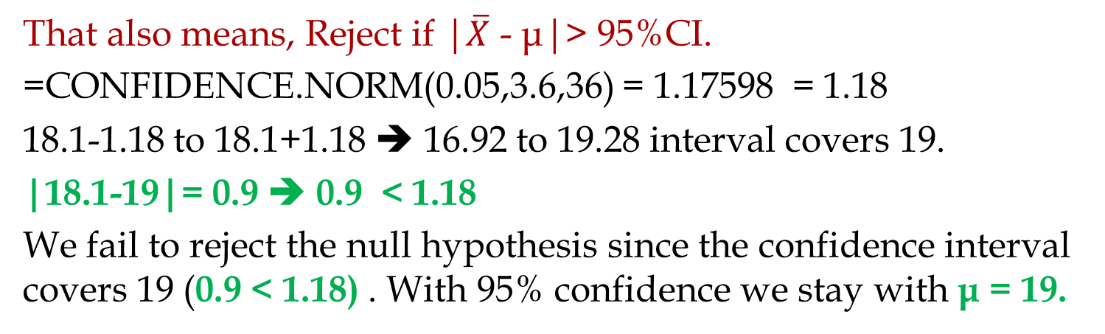
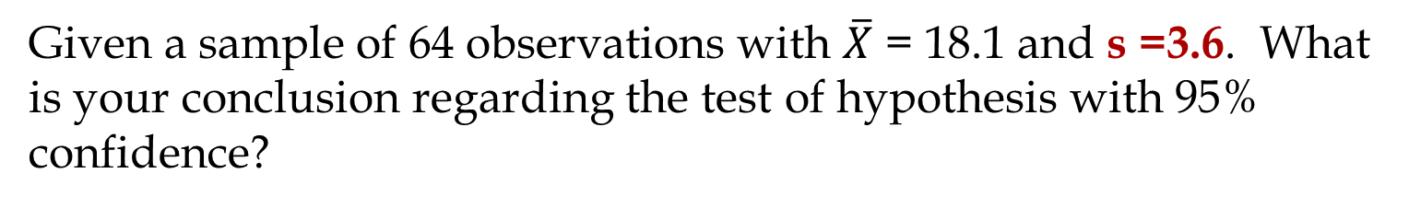
Two Tail Test – Using Confidences Interval.
Given a sample of 64 observations with $\overline{X}$ = 18.1 and s =3.6. What is your conclusion regarding the test of hypothesis with 95% confidence?
H0 : μ = 19
Ha: μ ≠ 19
Compute 95% confidence interval.
Reject, if the interval does not cover 19.
That also means, Reject if |$\overline{X}$ - μ|> 95%CI.
=CONFIDENCE.NORM(0.05,3.6,36) = 1.17598 = 1.18
18.1-1.18 to 18.1+1.18 ➔ 16.92 to 19.28 interval covers 19.
|18.1-19|= 0.9 ➔ 0.9 < 1.18
We fail to reject the null hypothesis since the confidence interval covers 19 (0.9 < 1.18) . With 95% confidence we stay with μ = 19.

Slide 7
Case 2. One Tail Test- H0: μ ≤ K
σ/$\sqrt{n}$
1-α
α
$$\overline{X}$$

Slide 8
Case 2b. One Tail Test- H0: μ ≥ K
σ/$\sqrt{n}$
α
1-α
$$\overline{X}$$

Slide 9
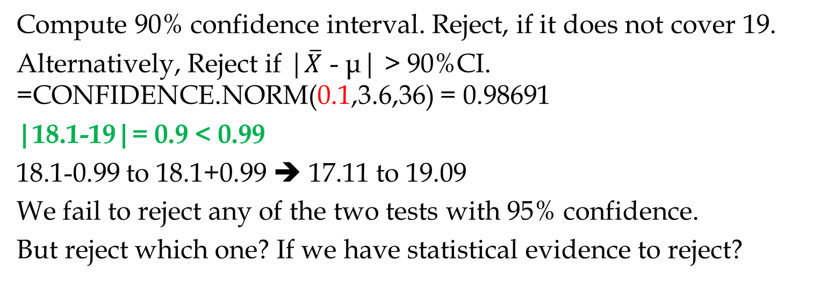
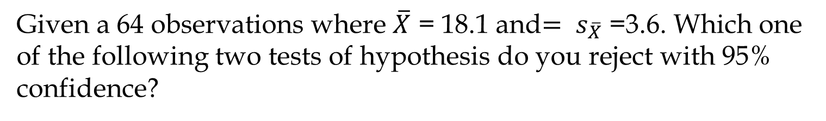
Case 2- One Tail Test
Given a 64 observations where $\overline{X}$ = 18.1 and${= s}_{\overline{X}}$ =3.6. Which one of the following two tests of hypothesis do you reject with 95% confidence?
(a)
H0 : μ ≤ 19
H1: μ >19
(b)
H0 : μ ≥ 19
H1: μ <19
Compute 90% confidence interval. Reject, if it does not cover 19.
Alternatively, Reject if |$\overline{X}$ - μ| > 90%CI. =CONFIDENCE.NORM(0.1,3.6,36) = 0.98691
|18.1-19|= 0.9 < 0.99
18.1-0.99 to 18.1+0.99 ➔ 17.11 to 19.09
We fail to reject any of the two tests with 95% confidence.
But reject which one? If we have statistical evidence to reject?

Slide 10
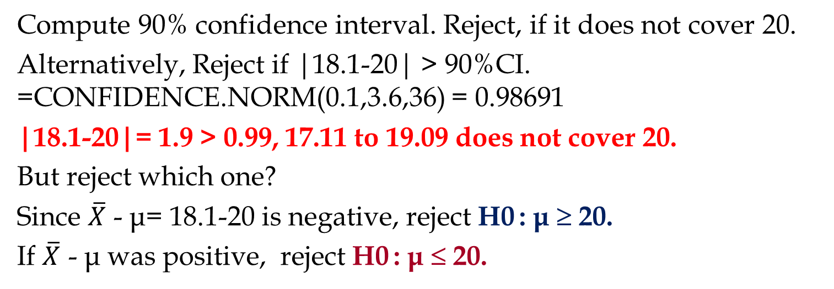
Case 2- One Tail Test
Given a 64 observations where $\overline{X}$ = 18.1 and${= s}_{\overline{X}}$ =3.6. Which one of the following two tests of hypothesis do you reject with 95% confidence?
(a)
H0 : μ ≤ 20
H1: μ >20
(b)
H0 : μ ≥ 20
H1: μ <20
Compute 90% confidence interval. Reject, if it does not cover 20.
Alternatively, Reject if |18.1-20| > 90%CI. =CONFIDENCE.NORM(0.1,3.6,36) = 0.98691
|18.1-20|= 1.9 > 0.99, 17.11 to 19.09 does not cover 20.
But reject which one?
Since $\overline{X}$ - μ= 18.1-20 is negative, reject H0 : μ ≥ 20.
If $\overline{X}$ - μ was positive, reject H0 : μ ≤ 20.

Slide 11
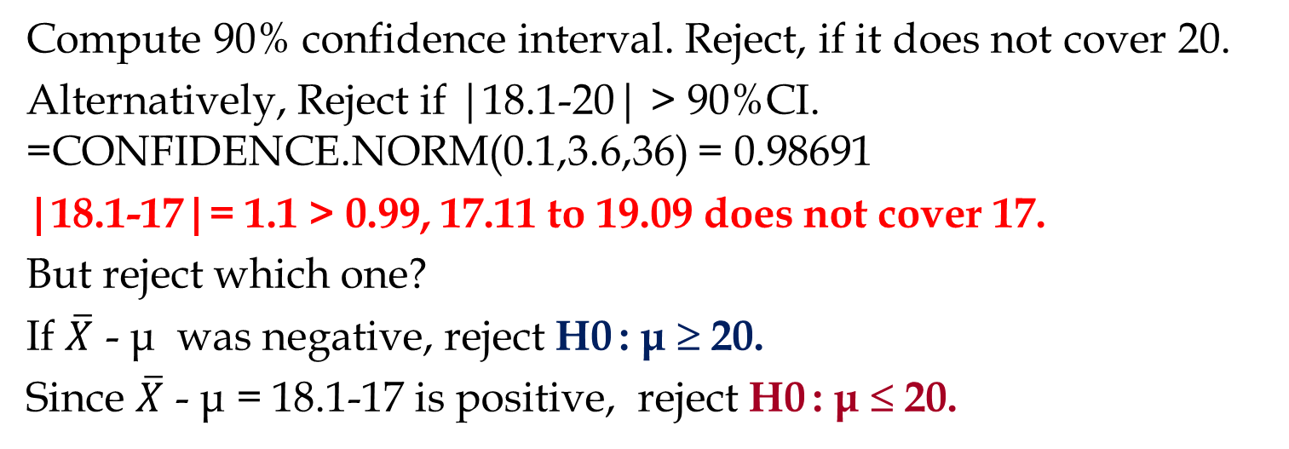
Case 2- One Tail Test
Given a 64 observations where $\overline{X}$ = 18.1 and${= s}_{\overline{X}}$ =3.6. Which one of the following two tests of hypothesis do you reject with 95% confidence?
(a)
H0 : μ ≤ 17
H1: μ >17
(b)
H0 : μ ≥ 17
H1: μ <17
Compute 90% confidence interval. Reject, if it does not cover 20.
Alternatively, Reject if |18.1-20| > 90%CI. =CONFIDENCE.NORM(0.1,3.6,36) = 0.98691
|18.1-17|= 1.1 > 0.99, 17.11 to 19.09 does not cover 17.
But reject which one?
If $\overline{X}$ - μ was negative, reject H0 : μ ≥ 20.
Since $\overline{X}$ - μ = 18.1-17 is positive, reject H0 : μ ≤ 20.

Slide 12
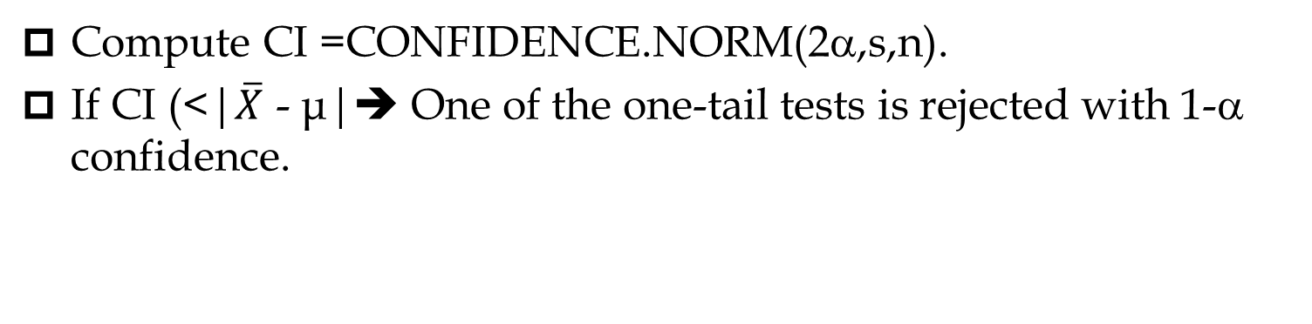
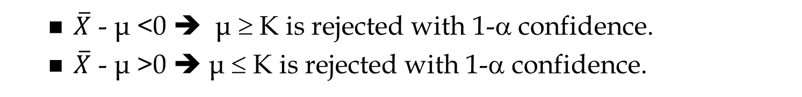
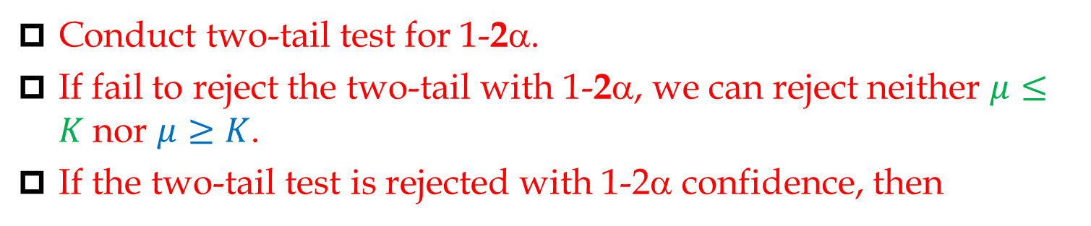
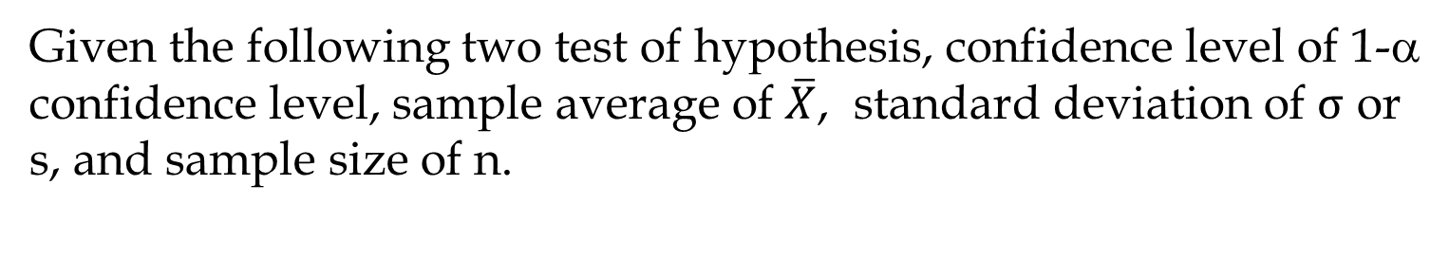
Case 2
Given the following two test of hypothesis, confidence level of 1-α confidence level, sample average of $\overline{X}$, standard deviation of $σ$ or s, and sample size of n.
H0 : μ ≤ K
H1: μ >K
H0 : μ ≥ K
H1: μ <K
Conduct two-tail test for 1-2α.
If fail to reject the two-tail with 1-2α, we can reject neither $μ≤K$nor $μ≥K$.
If the two-tail test is rejected with 1-2α confidence, then
Compute CI =CONFIDENCE.NORM(2α,s,n).
If CI (<|$\overline{X}$ - μ|➔ One of the one-tail tests is rejected with 1-α confidence.
  $\overline{X}$ - μ <0 ➔ μ ≥ K is rejected with 1-α confidence.
  $\overline{X}$ - μ >0 ➔ μ ≤ K is rejected with 1-α confidence.

Slide 13
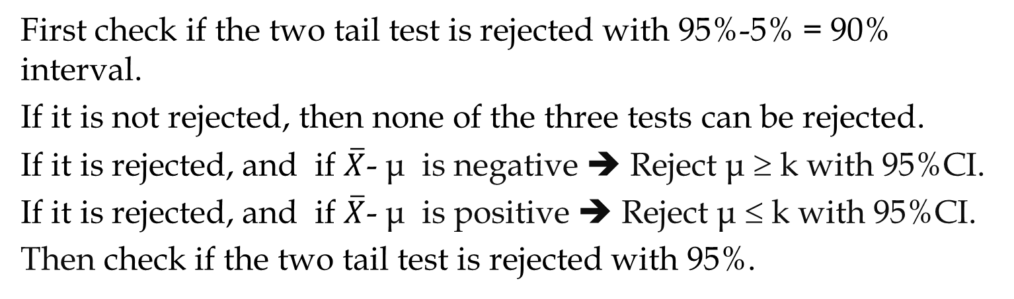
Practice
Given the following data, which test of hypothesis is rejected?
H0 : μ = k
Ha: μ ≠ k
H0 : μ ≤ k
Ha: μ > k
H0 : μ ≥ k
Ha: μ < k
Given the following data, which test of hypothesis is rejected?
$\overline{X}=19.1 ,$s= 4.25 , n = 49, and 95% confidence?
First check if the two tail test is rejected with 95%-5% = 90% interval.
If it is not rejected, then none of the three tests can be rejected.
If it is rejected, and if $\overline{X}$- μ is negative ➔ Reject μ ≥ k with 95%CI.
If it is rejected, and if $\overline{X}$- μ is positive ➔ Reject μ ≤ k with 95%CI.
Then check if the two tail test is rejected with 95%.

Slide 14
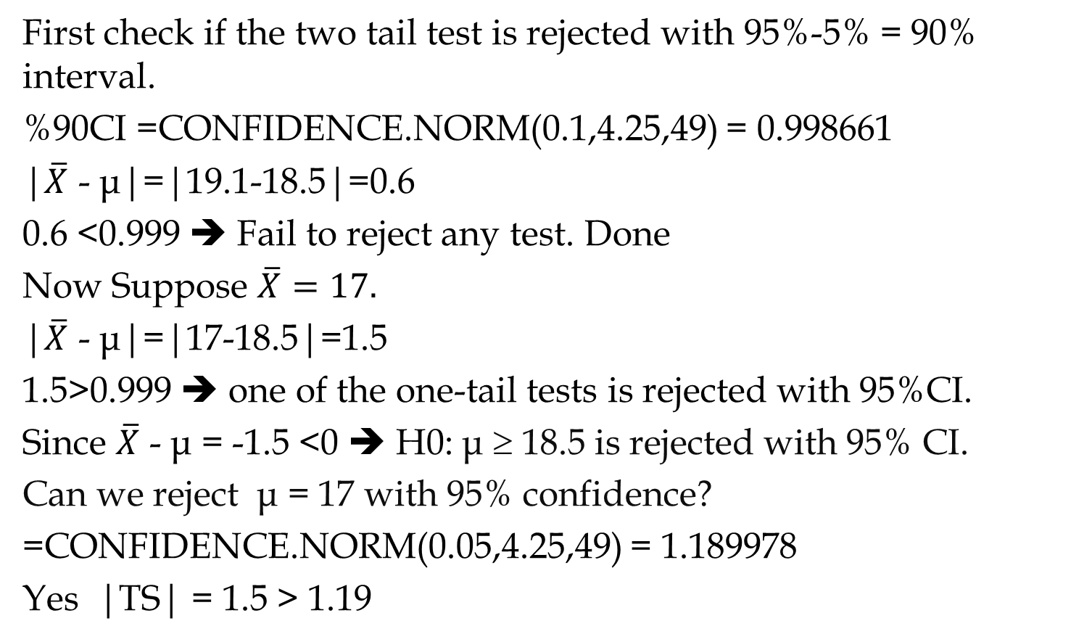
Practice
$\overline{X}=19.1 ,$s= 4.25 , n = 49, μ= 18.5, and 95% confidence?
First check if the two tail test is rejected with 95%-5% = 90% interval.
%90CI =CONFIDENCE.NORM(0.1,4.25,49) = 0.998661
|$\overline{X}$ - μ|=|19.1-18.5|=0.6
0.6 <0.999 ➔ Fail to reject any test. Done
Now Suppose $\overline{X}=17.$
|$\overline{X}$ - μ|=|17-18.5|=1.5
1.5>0.999 ➔ one of the one-tail tests is rejected with 95%CI.
Since $\overline{X}$ - μ = -1.5 <0 ➔ H0: μ ≥ 18.5 is rejected with 95% CI.
Can we reject μ = 17 with 95% confidence?
=CONFIDENCE.NORM(0.05,4.25,49) = 1.189978
Yes |TS| = 1.5 > 1.19

Slide 15
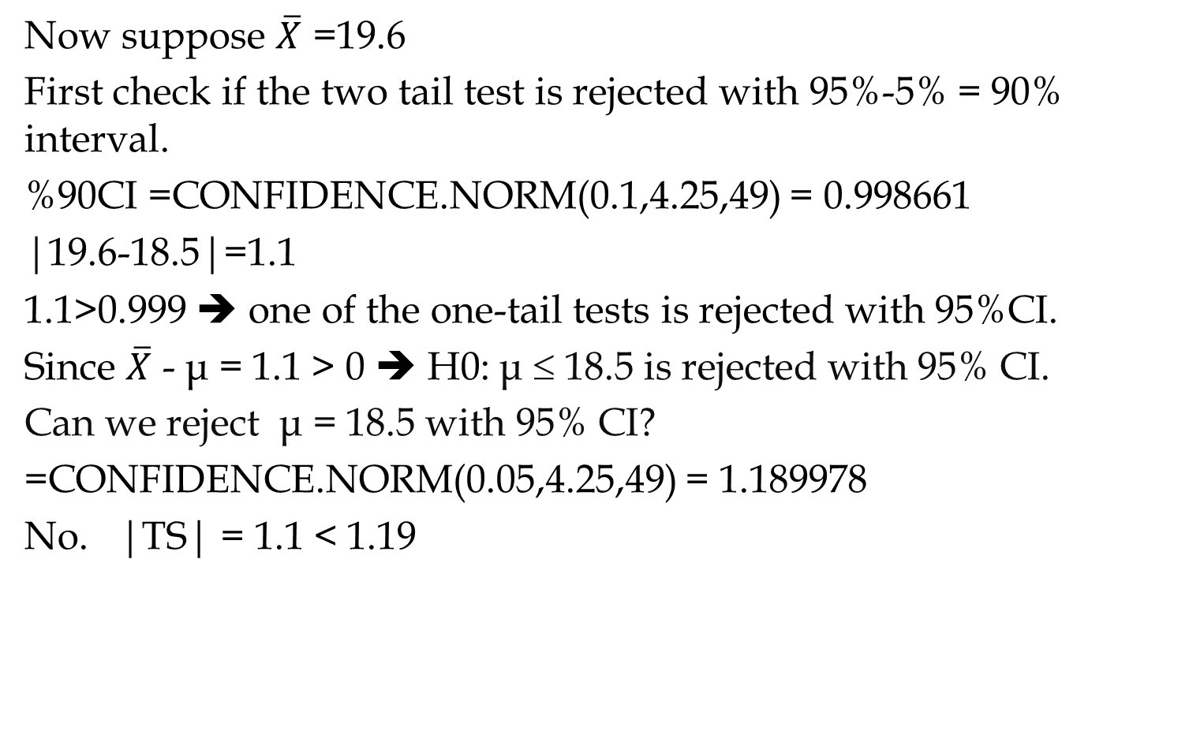
Practice
Now suppose $\overline{X}$ =19.6
First check if the two tail test is rejected with 95%-5% = 90% interval.
%90CI =CONFIDENCE.NORM(0.1,4.25,49) = 0.998661
|19.6-18.5|=1.1
1.1>0.999 ➔ one of the one-tail tests is rejected with 95%CI.
Since $\overline{X}$ - μ = 1.1 > 0 ➔ H0: μ ≤ 18.5 is rejected with 95% CI.
Can we reject μ = 18.5 with 95% CI?
=CONFIDENCE.NORM(0.05,4.25,49) = 1.189978
No. |TS| = 1.1 < 1.19

Slide 16

Test of Hypothesis Part B
Two Population $\overline{X}$ Using Confidence Interval

Slide 17


Test of Hypothesis 2- & 1-Tail Using CI

Slide 18
Test of Hypothesis 2- & 1-Tail Using CI
The following file contains 5 tabs. The lecture was recoded based on the last tab. While you do not need to go through all other four tabs. But they include useful material.

Slide 19
Test of Hypothesis 2- & 1-Tail Using CI
The following computations are on the second tab of the Excel file.

Slide 20

Test of Hypothesis Part C
By Using Test Statistics and p-value for $\overline{X}$

Slide 21
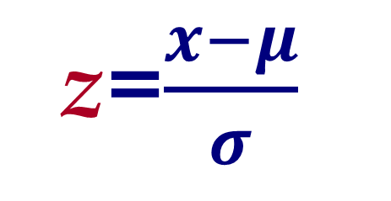
Normal & Standard Normal Distribution
x
σ
z=$\frac{x−μ}{σ}$
μ
z
1
0

Slide 22
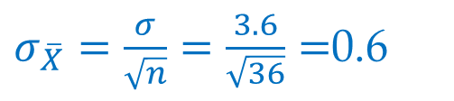
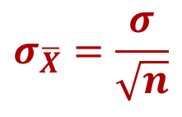


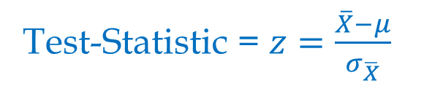
Two Tail Test- Test Statistic & Critical Value
Critical Value = NORM.S.INV(1-α/2)
$$σ_{\overline{X}}=\frac{σ}{\sqrt{n}}$$
Test-Statistic = $z=\frac{\overline{X}−μ}{σ_{\overline{X}}}$
Reject if |Test-Statistic|> Critical Value
Given n=64, $\overline{X}$ = 18.1, $σ$ =3.6, 95% confidence, and H0: $μ$=19.
Critical Value = NORM.S.INV(1-0.05/2)
Critical Value = NORM.S.INV(0.975)= 1.96996
$σ_{\overline{X}}=\frac{σ}{\sqrt{n}}=\frac{3.6}{\sqrt{36}}=$0.6
1
Test-Statistic $\text{= }z=\frac{\overline{X}−μ}{σ_{\overline{X}}}$
α/2
α/2
Test-Statistic $\text{= }z=\frac{18.1−19}{0.6}=1.5$
0
|Test-Statistic|= |1.5|= 1.5 < 1.96996
We fail to reject H0 : μ = 10.

Slide 23

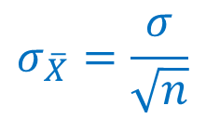


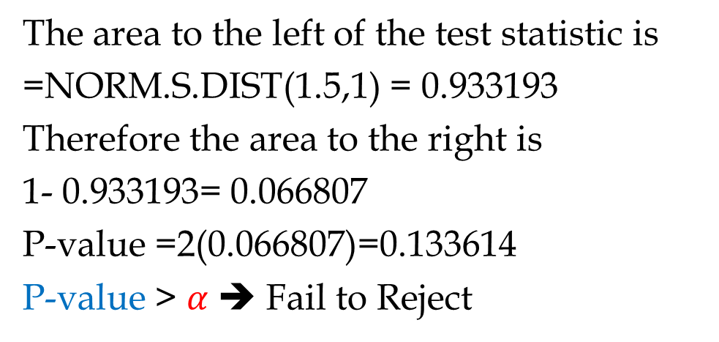
Two Tail Test- P-value & α
Given a 1- α confidence level
$$σ_{\overline{X}}=\frac{σ}{\sqrt{n}}$$
Test-Statistic = $z=\frac{\overline{X}−μ}{σ_{\overline{X}}}$
p-value is twice of the area to the right of |$z=\frac{\overline{X}−μ}{σ_{\overline{X}}}|$
Reject the null hypothesis if p-value <$α$
Given $z=\frac{18.1−19}{0.6}=1.5$ in the previous example
The area to the left of the test statistic is
=NORM.S.DIST(1.5,1) = 0.933193
Therefore the area to the right is
1- 0.933193= 0.066807
P-value =2(0.066807)=0.133614
P-value > $α$ ➔ Fail to Reject
1
α/2
α/2
0

Slide 24
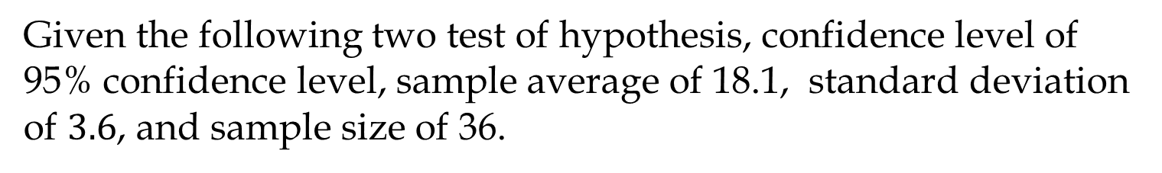

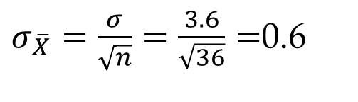
Case 2- One Tail Test
Given the following two test of hypothesis, confidence level of 95% confidence level, sample average of 18.1, standard deviation of $3.6$, and sample size of 36.
H0 : μ ≤ 20
H1: μ >20
H0 : μ ≥ 20
H1: μ <20
$σ_{\overline{X}}=\frac{σ}{\sqrt{n}}=\frac{3.6}{\sqrt{36}}=$0.6
Test-Statistic $\text{= }z=\frac{\overline{X}−μ}{σ_{\overline{X}}}=\frac{18.1−20}{0.6}=$-3.16667
Conduct a two tail test with 90% confidence (α=10%)
Critical Value = NORM.S.INV(1-0.1/2)
Critical Value = NORM.S.INV(0.95) = 1.64485
| 3.16667 | > 1.64485 ➔ Reject the Null Hypothesis.
Which Null Hypothesis?
Since -3.16667 is negative, Reject μ ≥ 20.

Slide 25
Case 2- One Tail Test
Given the following two test of hypothesis, confidence level of 95% confidence level, sample average of 18.1, standard deviation of $3.6$, and sample size of 36.
H0 : μ ≤ 20
H1: μ >20
H0 : μ ≥ 20
H1: μ <20
$σ_{\overline{X}}=\frac{σ}{\sqrt{n}}=\frac{3.6}{\sqrt{36}}=$0.6
Test-Statistic $\text{= }z=\frac{\overline{X}−μ}{σ_{\overline{X}}}=\frac{18.1−20}{0.6}=$-3.16667
Conduct a two tail test with 90% confidence (α=10%)
Critical Value = NORM.S.INV(1-0.1/2)
Critical Value = NORM.S.INV(0.95) = 1.64485
| 3.16667 | > 1.64485 ➔ Reject the Null Hypothesis.
Which Null Hypothesis?
Since -3.16667 is negative, Reject μ ≥ 20.
Can we also say something about μ ≤ 20? Yes we fail to reject it.

Slide 26

Case 2- One Tail Test
Can we also say something about μ ≤ 20?
Yes we fail to reject it.
Can we also say something about μ ≤=20?
Test-Statistic $\text{= }z=$-3.16667
Critical Value = NORM.S.INV(1-0.05/2)
Critical Value = NORM.S.INV(0.975) = 1.959964
Yes we fail to reject it.

Slide 27

Test of Hypothesis Part D t-Distribution for $\overline{X}$
Don't wait for the last judgment - it takes place every day.
Albert Camus

Slide 28
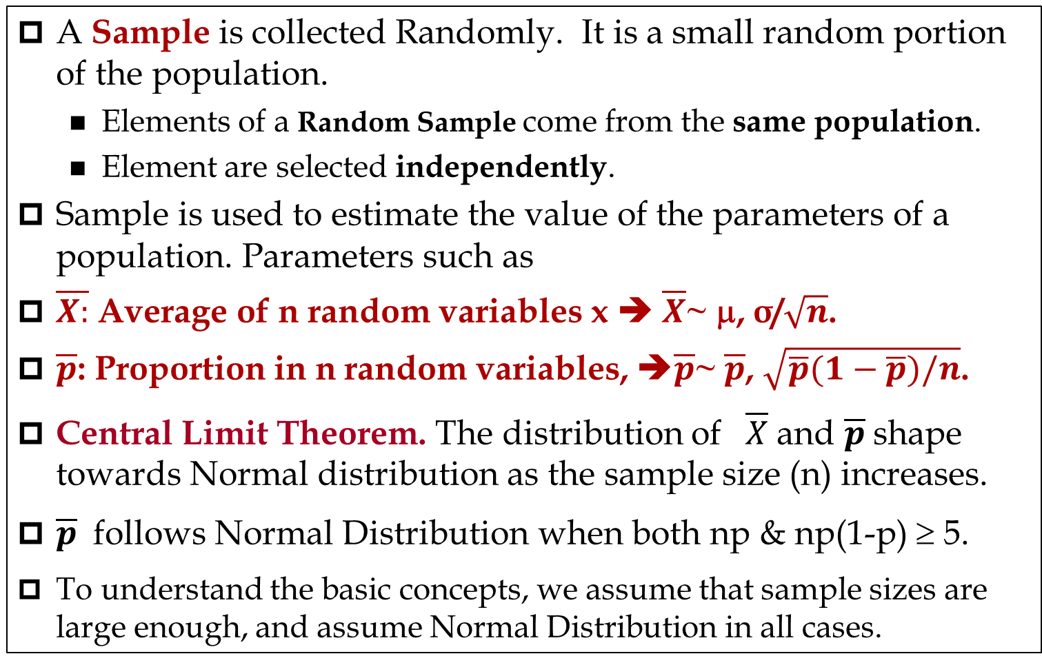
Sampling
A Sample is collected Randomly. It is a small random portion of the population.
  Elements of a Random Sample come from the same population.
  Element are selected independently.
Sample is used to estimate the value of the parameters of a population. Parameters such as
$\overline{X:}$ Average of n random variables x ➔ $\overline{X}$~ μ, σ/$\sqrt{n}$.
$\overline{p}$: Proportion in n random variables, ➔$\overline{p}$~ $\overline{p}$, $\sqrt{\overline{p}(1−\overline{p})/n}$.
Central Limit Theorem. The distribution of $\overline{X}$ and $\overline{p}$shape towards Normal distribution as the sample size (n) increases.
$\overline{p}$ follows Normal Distribution when both np & np(1-p) ≥ 5.
To understand the basic concepts, we assume that sample sizes are large enough, and assume Normal Distribution in all cases.

Slide 29
When σ is Not Known and We Estimate it by s
In the previous analysis we used normal distribution in all cases. That was for the purpose of simplicity in getting the basic concepts.
In reality, when we do not know the standard deviation of the population (σ) , and when we estimate it by the standard deviation of the sample (s) and the sample size is less than 30, instead of Normal distribution, we need to use t-distribution.
All the steps will remain exactly as we explained earlier but
  Instead of NORM.S.DIST(z,1) ➔ T.DIST(t,d.f.,1)
  Instead of NORM.S.INV(probability) ➔ T.INV(probability, d.f.)
  d.f. = Degrees of Freedom = n-1.
Nevertheless, in the quizzes and exams, you always use Normal Distribution unless stated otherwise.
We explain two-tail tests, the logic remains the same for one-tail

Slide 30
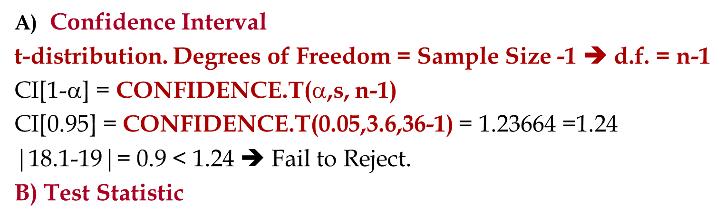

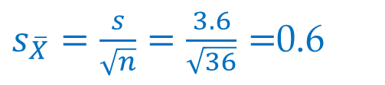

When σ is Not Known and We Estimate it by s
Given a sample of 64 observations, we have can use functions =AVERAGE() and =STDEV.S() to compute $\overline{X}$ and s.
For the purpose of comparisons, suppose $\overline{X}$ = 18.1 and $s$ =3.6.
Compute 95% confidence interval, Test Statistic, and p-value for the same problem (H0 : μ = 19, Ha: μ ≠ 19)
Confidence Interval
t-distribution. Degrees of Freedom = Sample Size -1  d.f. = n-1
CI[1-α] = CONFIDENCE.T($$,s, n-1)
CI[0.95] = CONFIDENCE.T(0.05,3.6,36-1) = 1.23664 =1.24
|18.1-19|= 0.9 < 1.24  Fail to Reject.
B) Test Statistic
$s_{\overline{X}}=\frac{s}{\sqrt{n}}=\frac{3.6}{\sqrt{36}}=$0.6
Test-Statistic = t$=\frac{\overline{X}−μ}{s_{\overline{X}}}=\frac{18.1−19}{0.6}$=1.5

Slide 31
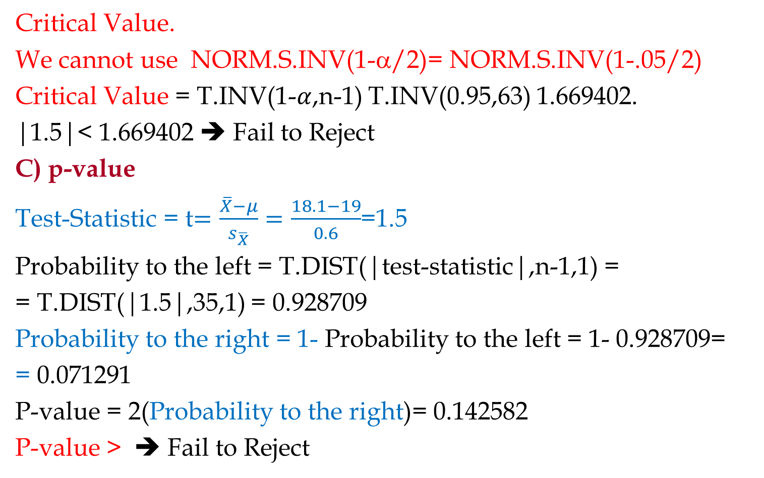
When σ is Not Known and We Estimate it by s
Critical Value.
We cannot use NORM.S.INV(1-α/2)= NORM.S.INV(1-.05/2)
Critical Value = T.INV(1-$α$,n-1) T.INV(0.95,63) 1.669402.
|1.5|< 1.669402 ➔ Fail to Reject
C) p-value
Test-Statistic = t$=\frac{\overline{X}−μ}{s_{\overline{X}}}=\frac{18.1−19}{0.6}$=1.5
Probability to the left = T.DIST(|test-statistic|,n-1,1) =
= T.DIST(|1.5|,35,1) = 0.928709
Probability to the right = 1- Probability to the left = 1- 0.928709=
= 0.071291
P-value = 2(Probability to the right)= 0.142582
P-value > ➔ Fail to Reject

Slide 32

Test of Hypothesis
Part E
Using Test Statistics and p-value for $\overline{p}$

Slide 33
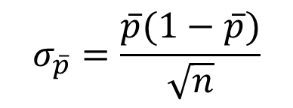
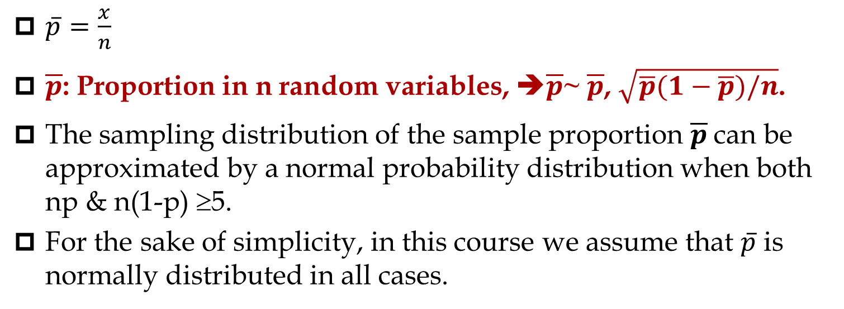

Sampling
$\overline{p}=\frac{x}{n}$
$\overline{p}$: Proportion in n random variables, ➔$\overline{p}$~ $\overline{p}$, $\sqrt{\overline{p}(1−\overline{p})/n}$.
The sampling distribution of the sample proportion $\overline{p}$can be approximated by a normal probability distribution when both np & n(1-p) ≥5.
For the sake of simplicity, in this course we assume that $\overline{p}$ is normally distributed in all cases.
$$\overline{p}=\frac{x}{n}$$
$$σ_{\overline{p}}=\frac{\overline{p}(1−\overline{p})}{\sqrt{n}}$$
=CONFIDENCE.NORM($α$, $\overline{p}(1−\overline{p}$), n)

Slide 34
p.bar – Every Thing the same as X.bar
All the procedures for p.bar stays as for X-bar. The only differences are the following substitutions (at no additional cos!)
mu ➔ p
X.bar ➔ p.bar
s.X.bar ➔ SQRT(p.bar(1-p.bar)/n) ⬅➔ note the position of n
(1-alpha)CI= (alpha, p.bar(1.p.bar),n) ,⬅➔ note the position of n is different than that of the previous one.

Slide 35
Test of Hypothesis
Part F
Additional Examples
Don't wait for the last judgment - it takes place every day.
Albert Camus

Slide 36
When σ is Unknown and Sample Size is Small
Given the following hypothesis
H0 : μ ≥ 55
H1: μ < 55
Suppose we have failed to reject the Null hypothesis. What is the conclusion?
We can stay on the hypothesis that μ is greater than or equal to 55.

Slide 37
When σ is Unknown and Sample Size is Small
Given the following hypothesis
H0 : μ = 55
H1: μ ≠ 55
Suppose we have a sample of 36 observations with mean of 53 and standard deviation of 12.
Compute the test statistics.
Compute the p value.
Suppose the hypothesis is changed to
H0 : μ ≥ 55
H1: μ < 55
Compute the test statistics.
Compute the p value.

Slide 38
When σ is Unknown and Sample Size is Small
Suppose the hypothesis is changed to
H0 : μ ≤ 55
H1: μ > 55
Compute the test statistics.
Compute the p value.
With 95% confidence which one of the following hypothesis is rejected
H0 : μ = 55
H1: μ ≠ 55
H0 : μ ≥ 55
H1: μ < 55
H0 : μ ≤ 55
H1: μ > 55

Slide 39
When σ is Unknown and Sample Size is Small
Given the following hypothesis
H0 : μ ≥ 55
H1: μ < 55
Suppose we have sample of …. Observations with mean of …, standard deviation of … and α -0.25.
What is the conclusion?
A local bakery advertises to deliver made to order products in less than 4 hours. Write the appropriate test of hypothesis to examine this claim.
Out of a sample of 200 students, 90 of them where international. Compute the average and standard deviation of the same. Compute the standard error of the proportion.
A parameter – or a statistic - is a numerical measure from a population. Examples are mu, sigma, n, pbar,..

Slide 40
Relationship between μ and x
0.95
1-α

Slide 41
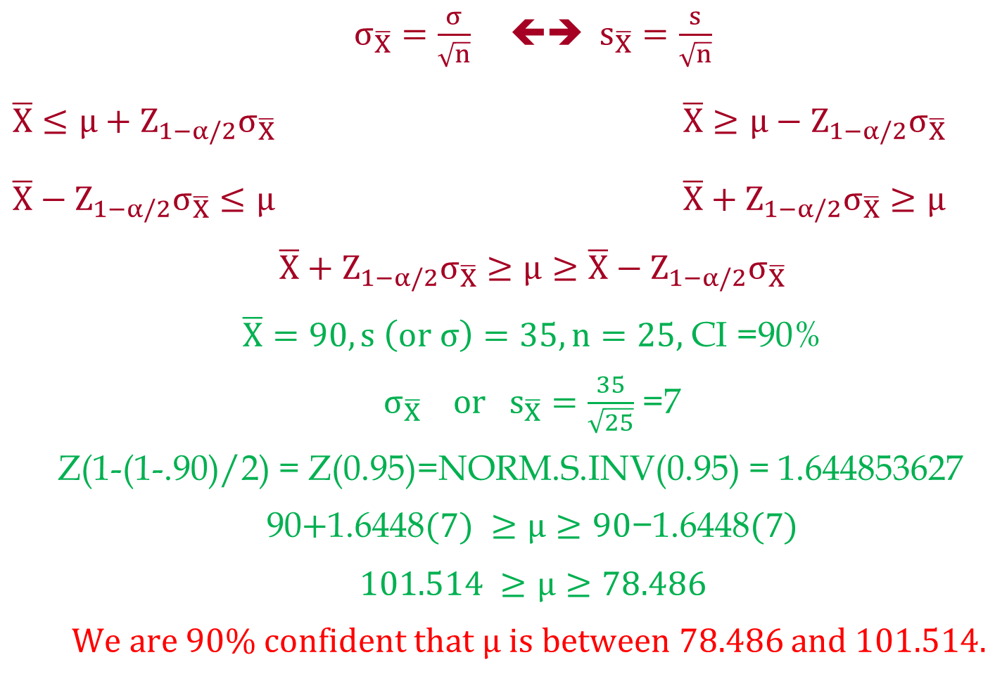
Relationship between μ and x
$σ_{\overline{X}}=\frac{σ}{\sqrt{n}}$ ⬅➔ $s_{\overline{X}}=\frac{s}{\sqrt{n}}$
$\overline{X}≤μ+Z_{1−α/2}σ_{\overline{X}}$ $\overline{X}≥μ−Z_{1−α/2}σ_{\overline{X}}$
$\overline{X}−Z_{1−α/2}σ_{\overline{X}}≤μ$ $\overline{X}+Z_{1−α/2}σ_{\overline{X}}≥μ$
$$\overline{X}+Z_{1−α/2}σ_{\overline{X}}≥μ≥\overline{X}−Z_{1−α/2}σ_{\overline{X}}$$
$\overline{X}=90, s \left(or σ\right)=35, n=25,$ CI =90%
$σ_{\overline{X}} or{ s}_{\overline{X}}=\frac{35}{\sqrt{25}}$ =7
Z(1-(1-.90)/2) = Z(0.95)=NORM.S.INV(0.95) = 1.644853627
90$+\text{1.6448}(7) ≥μ≥90\text{−}\text{1.6448}(7)$
$$101.514 ≥μ≥78.486$$
We are 90% confident that $μ is between 78.486$ and $101.514.$

Slide 42
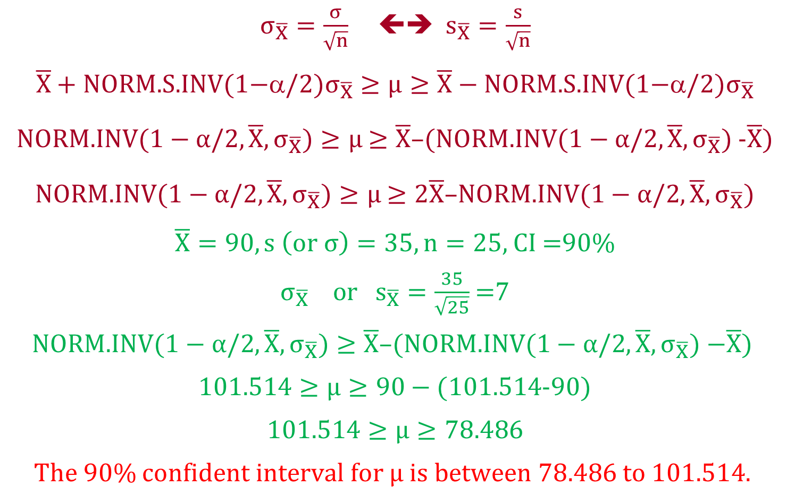
Relationship between μ and x
$σ_{\overline{X}}=\frac{σ}{\sqrt{n}}$  $s_{\overline{X}}=\frac{s}{\sqrt{n}}$
$$\overline{X}+\text{NORM}\text{.}\text{S}\text{.}\text{INV}\text{(1−}/2{)σ}_{\overline{X}}≥μ≥\overline{X}−\text{NORM}\text{.}\text{S}\text{.}\text{INV}\text{(1−}α/2\text{)}σ_{\overline{X}}$$
NORM.INV($1−α/2,\overline{X}, σ_{\overline{X}})≥μ$ $≥\overline{X}$–(NORM.INV($1−α/2,\overline{X}, σ_{\overline{X}})$-$\overline{X}$)
NORM.INV($1−α/2,\overline{X}, σ_{\overline{X}})≥μ$ $≥2\overline{X}$–NORM.INV($1−α/2,\overline{X}, σ_{\overline{X}})$
$\overline{X}=90, s \left(or σ\right)=35, n=25,$ CI =90%
$σ_{\overline{X}} or{ s}_{\overline{X}}=\frac{35}{\sqrt{25}}$ =7
$$\text{NORM}\text{.}\text{INV}\text{(}1−α/2,\overline{X}, σ_{\overline{X}})≥\overline{X}\text{–(}\text{NORM}\text{.}\text{INV}\text{(}1−α/2,\overline{X}, σ_{\overline{X}}) \text{−}\overline{X}\text{) }$$
1$01.514≥μ≥90−($1$01.514$-90)
$$101.514≥μ≥78.486$$
The 90% confident interval for $μ is between 78.486$ to $101.514.$

Slide 43
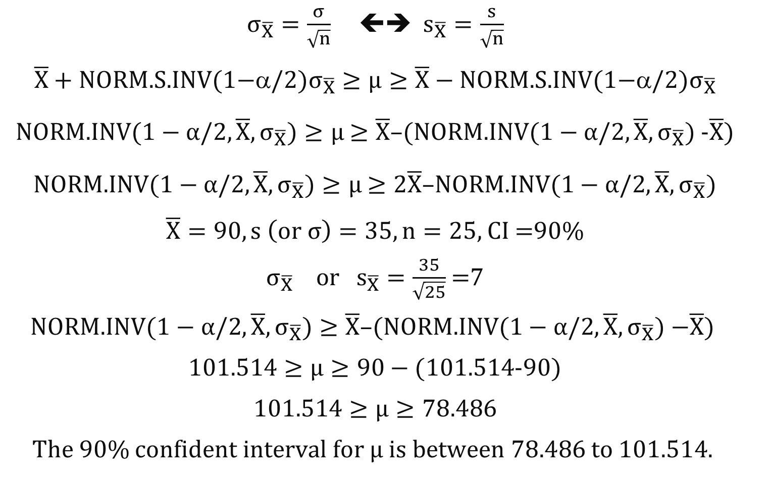
Relationship between μ and x
$σ_{\overline{X}}=\frac{σ}{\sqrt{n}}$  $s_{\overline{X}}=\frac{s}{\sqrt{n}}$
$$\overline{X}+\text{NORM}\text{.}\text{S}\text{.}\text{INV}\text{(1−}/2{)σ}_{\overline{X}}≥μ≥\overline{X}−\text{NORM}\text{.}\text{S}\text{.}\text{INV}\text{(1−}α/2\text{)}σ_{\overline{X}}$$
NORM.INV($1−α/2,\overline{X}, σ_{\overline{X}})≥μ$ $≥\overline{X}$–(NORM.INV($1−α/2,\overline{X}, σ_{\overline{X}})$-$\overline{X}$)
NORM.INV($1−α/2,\overline{X}, σ_{\overline{X}})≥μ$ $≥2\overline{X}$–NORM.INV($1−α/2,\overline{X}, σ_{\overline{X}})$
$\overline{X}=90, s \left(or σ\right)=35, n=25,$ CI =90%
$σ_{\overline{X}} or{ s}_{\overline{X}}=\frac{35}{\sqrt{25}}$ =7
$$\text{NORM}\text{.}\text{INV}\text{(}1−α/2,\overline{X}, σ_{\overline{X}})≥\overline{X}\text{–(}\text{NORM}\text{.}\text{INV}\text{(}1−α/2,\overline{X}, σ_{\overline{X}}) \text{−}\overline{X}\text{) }$$
1$01.514≥μ≥90−($1$01.514$-90)
$$101.514≥μ≥78.486$$
The 90% confident interval for $μ is between 78.486$ to $101.514.$

