Slide 1
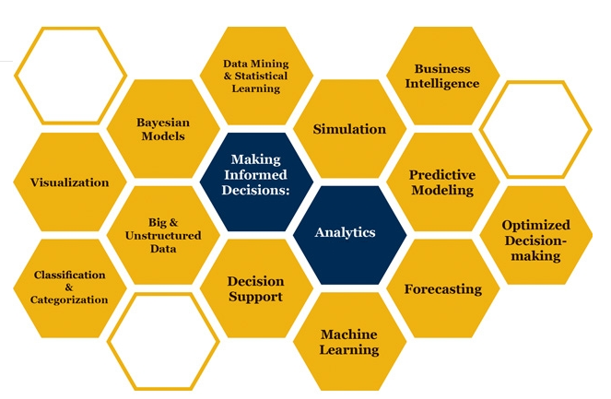

Slide 2

Sampling and Confidence Interval
How can it be that mathematics, being after all a product of human thought independent of experience, is so admirably adapted to the objects of reality
Albert Einstein
Some parts of these slides were prepared based on
Managing Business Process Flow, Anupindi et al. 2012. Pearson.
Essentials of Modern Busines Statistics, Anderson et al. 2012. Cengage.

Slide 3
Before coming to class, please watch the following 3 repository lectures on youtube
Mean and Variance of Sample Mean.youtube.repository
https://www.youtube.com/watch?v=7mYDHbrLEQo
The Sampling Distribution of the Sample Mean.youtube.repository
https://www.youtube.com/watch?v=q50GpTdFYyI
Confidence Interval.youtube.repository
https://www.youtube.com/watch?v=lwpobQmUTd8
The link to the excel file
Sampling and Confidence Interval-exl
http://www.csun.edu/~aa2035/CourseBase/S-Sampling-CI/ArdiCh78.xlsx

Slide 4
X: μ, σ, y = 2x➔ μ_{y} = 2μ, σ _{y} = 2σ
Past data on a specific stock shows that the return of this stock has a mean of 0.05 and StdDev of 0.05. Therefore, if we invest $1, our investment after one year will have an average of $0.05 and standard deviation of $0.05.
Using simulation in excel show what is the mean and standard deviation of 10,000 and 20,000 investments.
A random variable x with mean of μ , and standard deviation of σ is multiplied by 2 generates the random variable y=2x.
x: (μ , σ) ➔ y: (?,?)

Slide 5
$10,000 or $20,000 in One Stock
Probability is between 0 and 1.
rand() is between 0 and 1.
Therefore, it is valid if we assume that a rand() is a random probability. Accoordingly
=NORM.S.INV(rand())
Will provide us with a random z ➔ suppose it is z = 0.441475
x= µ + σz = x = 5%+ 0.441475(5%) ➔ x= 5%+2.21% = 7.21%
On the same line of reasoning,
=NORM.INV(probability, µ, σ)
=NORM.INV(probability, 5%, 5%)
Will directly generate a random x from N(µ, σ)

Slide 6
10,000 and 20,000 in One Stock
=10,000*NORM.INV(rand(), 5%, 5%)
=20,000*NORM.INV(rand(), 5%, 5%)

Slide 7
X: μ, σ, y = 2x➔ μ_{y} = 2μ, σ _{y} = 2σ
A random variable x (μ, σ).
A random variable y = 2x.
μ_{y} = 2 μ
σ_{y} = 2σ
A random variable x (μ, σ).
A random variable y = nx.
μ_{y} = nμ
σ_{y} = nσ

Slide 8
ROP; Variable R, Fixed L
Demand is fixed and is 50 units per day. From the time that we order until the time we receive the order is referred to as Lead Time. Suppose average lead time is 5 days and standard deviation of lead time is 1 day.
At what level of inventory should we place an order such that the service level is 90% (Probability of demand during the lead time exceeding inventory is 10%).
This point is known as Reorder point (ROP).
The difference between ROP and Average demand during lead time is referred to as Safety Stock.
What is the average demand during the lead time?
What is standard deviation of demand during lead time?

Slide 9
μ and σ of the Lead Time and Fided demand per period
x: (μ , σ) ➔ y: (nμ , nσ)

Slide 10
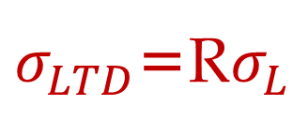
μ and σ of L and Fixed R
If Lead time is variable and Demand is fixed
L: Lead Time
L: Average Lead Time
σ_{L}: Standard deviation of Lead time
R: Demand per period
LTD: Average Demand during lead time
LTD = L × R
σ_{LTD}: Standard deviation of demand during lead time
$σ_{LTD}$=R$σ_{L}$

Slide 11
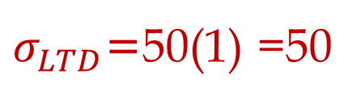
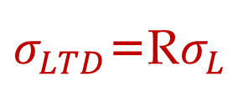
μ and σ of L and Fixed R
If Lead time is variable and Demand is fixed
L: Lead Time
L: Average Lead Time = 5 days
σ_{L}: Standard deviation of Lead time = 1 day
R: Demand per period = 50 per day
LTD: Average Demand During Lead Time
LTD = 5 × 50 = 250
σ_{LTD}: Standard deviation of demand during lead time
$σ_{LTD}$=R$σ_{L}$
$σ_{LTD}$=50(1) =50
=NORM.INV(0.9,250,50) =314.1

Slide 12
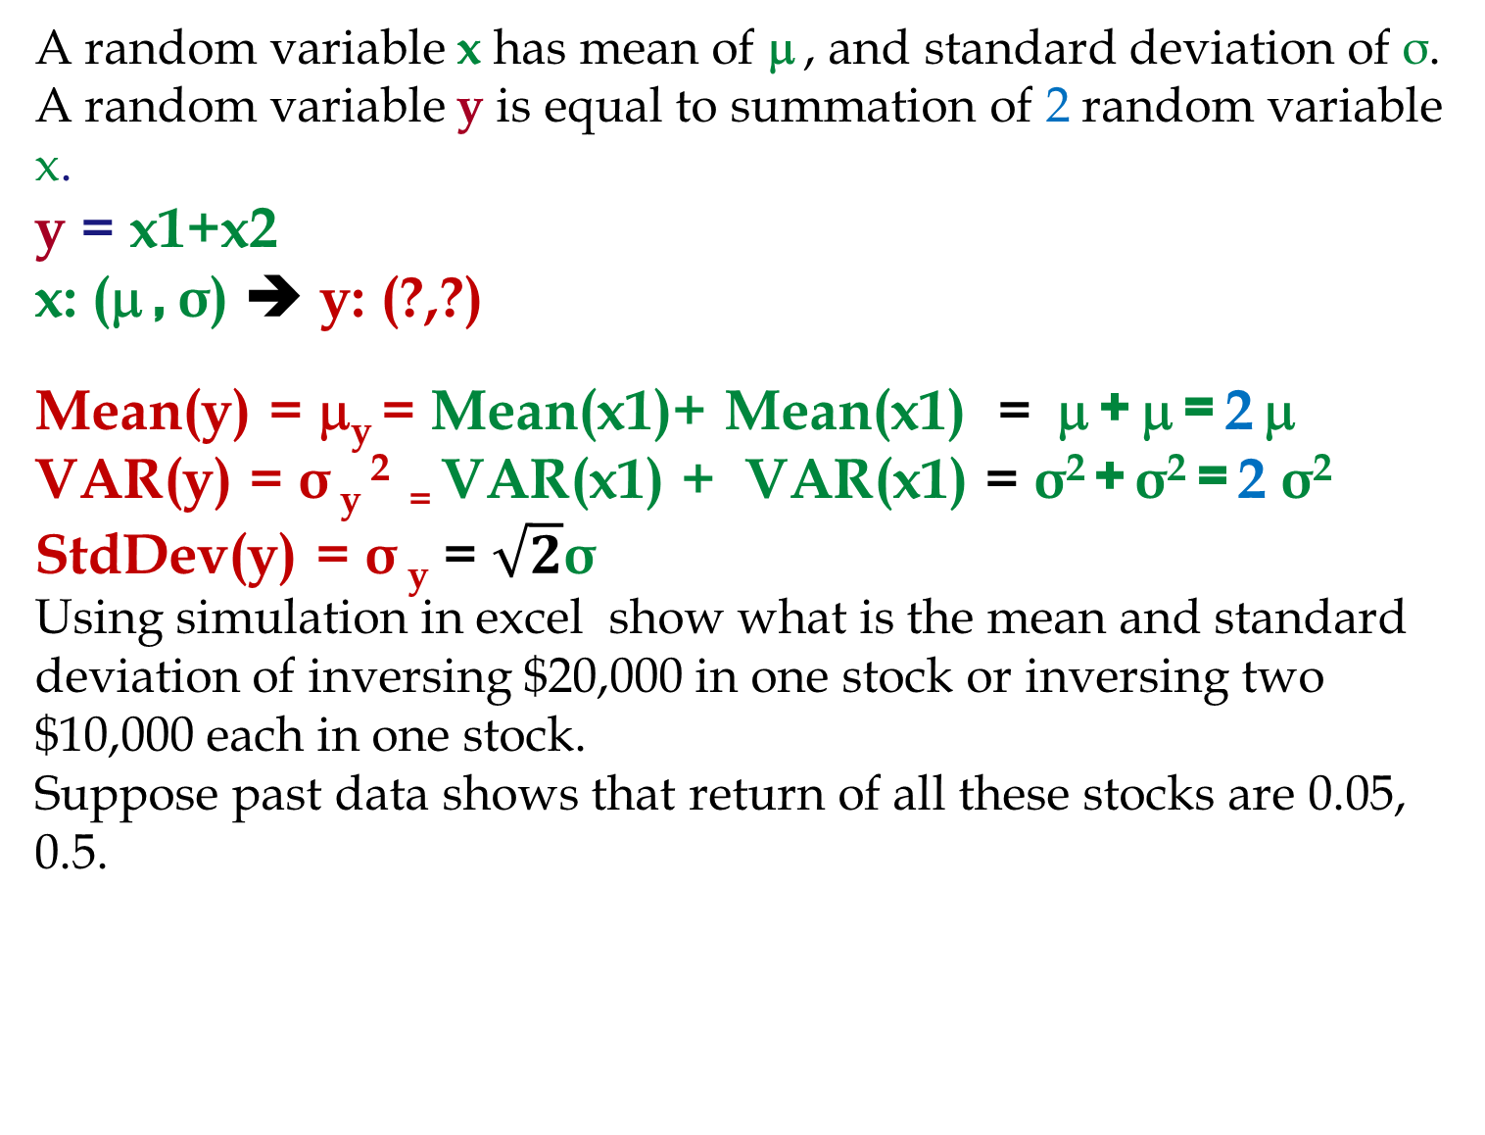
X: μ, σ, y = x1+X2, μ_{y} = 2μ, σ² _{y}= 2σ², σ _{y}= √2σ
A random variable x has mean of μ , and standard deviation of σ. A random variable y is equal to summation of 2 random variable x.
y = x1+x2
x: (μ , σ) ➔ y: (?,?)
Mean(y) = μ_{y} = Mean(x1)+ Mean(x1) = μ + μ = 2 μ
VAR(y) = σ _{y} ² ₌ VAR(x1) + VAR(x1) = σ² + σ² = 2 σ²
StdDev(y) = σ _{y} = $\sqrt{2}$σ
Using simulation in excel show what is the mean and standard deviation of inversing $20,000 in one stock or inversing two $10,000 each in one stock.
Suppose past data shows that return of all these stocks are 0.05, 0.5.

Slide 13
20,000 One Stock or 20,000 in Two Stocks

Slide 14
20,000 One Stock or 20,000 in Two Stocks

Slide 15
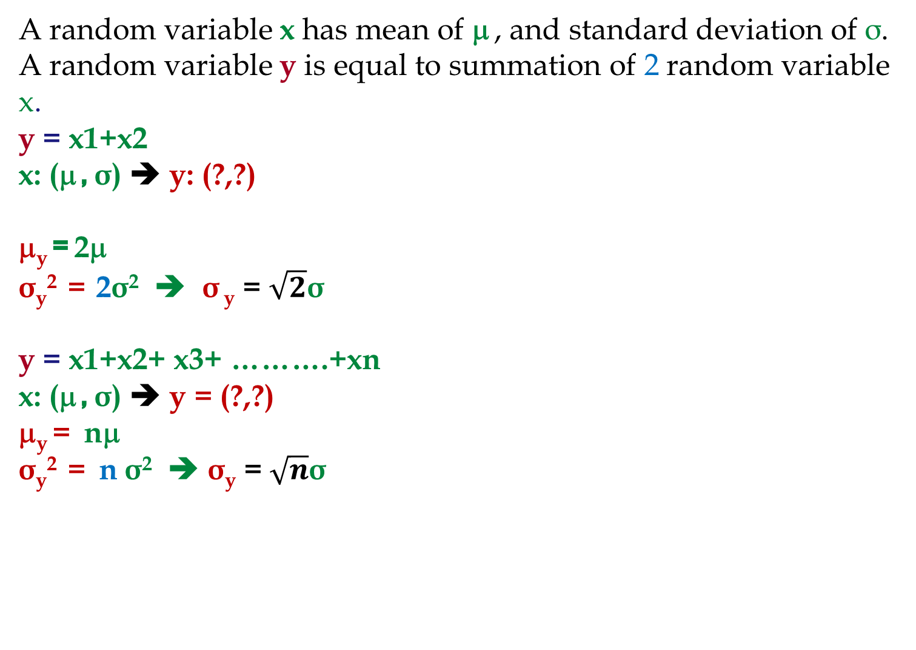
X: μ, σ, y = x1+X2, μ_{y} = 2μ, σ² _{y}= 2σ², σ _{y}= √2σ
A random variable x has mean of μ , and standard deviation of σ. A random variable y is equal to summation of 2 random variable x.
y = x1+x2
x: (μ , σ) ➔ y: (?,?)
μ_{y} = 2μ
σ_{y}² = 2σ² ➔ σ _{y} = $\sqrt{2}$σ
y = x1+x2+ x3+ ……….+xn
x: (μ , σ) ➔ y = (?,?)
μ_{y} = nμ
σ_{y}² = n σ² ➔ σ_{y} = $\sqrt{n}$σ

Slide 16
100,000 in One Stock or 10,000 in Each of 10 stocks
Suppose there are 10 stocks and with high probability they all have Normal pdf return with mean of 5% and standard deviation of 5%. These stocks are your only options and no more information is available. You have to invest $100,000. What do you do?

Slide 17
100,000 vs. 10(10,000) investment in N(5%, 5%)

Slide 18
Risk Aversion Individual

Slide 19
Problem Game- The News Vendor Problem
Daily demand for your merchandise has mean of 20 and standard deviation of 5. Sales price is $100 per unit of product.
You have decided to close this business line in 60 days. Your supplier has also decided to close this line immediately, but has agreed to provide your last order at a cost of $60 per unit. Any unsold product will be disposed at cost of $10 per unit. How many units do you order
LTD = R ×L =20 ×60 = 1200.
Should we order 1200 units or more or less?
It depends on our service level.
Underage cost = Cu = p – c = 100 – 60 = 40.
Overage cost = Co = 60-0+10 =70
SL = Cu/(Cu+Co) = 40/(40+70) = 0.3636.
Due to high overage cost, SL*< 50%.
Z(0.3636) = ？

Slide 20
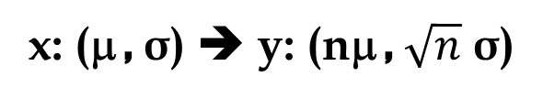
μ and σ of demand per period and fixed L
x: (μ , σ) ➔ y: (nμ , $\sqrt{n}$ σ)

Slide 21
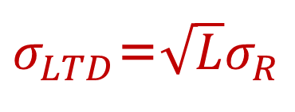
μ and σ of demand per period and fixed L
If Demand is variable and Lead time is fixed
L: Lead Time
R: Demand per period (per day, week, month)
R: Average Demand per period (day, week, month)
σ_{R}: Standard deviation of demand (per period)
LTD: Average Demand During Lead Time
LTD = L × R
σ_{LTD}: Standard deviation of demand during lead time
$σ_{LTD}$=$\sqrt{L}σ_{R}$

Slide 22
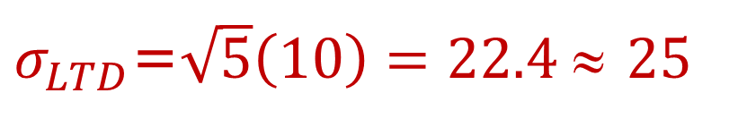
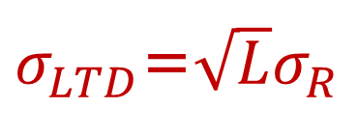
μ and σ of demand per period and fixed L
If demand is variable and Lead time is fixed
L: Lead Time = 5 days
R: Demand per day
R: Average daily demand =50
σ_{R}: Standard deviation of daily demand =10
LTD: Average Demand During Lead Time
LTD = L × R = 5 × 50 = 250
σ_{LTD}: Standard deviation of demand during lead time
$σ_{LTD}$=$\sqrt{L}σ_{R}$
$σ_{LTD}$=$\sqrt{5}\left(10\right)=22.4$≈ 25

Slide 23
Now It is Transformed
The Problem originally was: If average demand per day is 50 units and standard deviation of demand is 10 per day, and lead time is 5 days. Compute ROP at 90% service level. Compute safety stock.
We transformed it to: The average demand during the lead time is 250 and the standard deviation of demand during the lead time is 22.4. Compute ROP at 90% service level. Compute safety stock.
=NORM.INV(0.9,250,22.4)
=278.7 ≈ 279

Slide 24
Comparing the two problems

Slide 25
The News Vendor Problem- Example
Daily demand for your merchandise has mean of 20 and standard deviation of 5. Sales price is $100 per unit of product.
You have decided to close this business line in 64 days. Your supplier has also decided to close this line immediately, but has agreed to provide your last order at a cost of $60 per unit. Any unsold product will be disposed at cost of $10 per unit. How many units do you order
Underage cost = Cu = = 100 – 60 = 40.
Overage cost = Co = 60 +10 =70
SL = Cu/(Cu+Co) = 40/(40+70) = 0.3636.
Due to high overage cost, SL*< 50%.

Slide 26
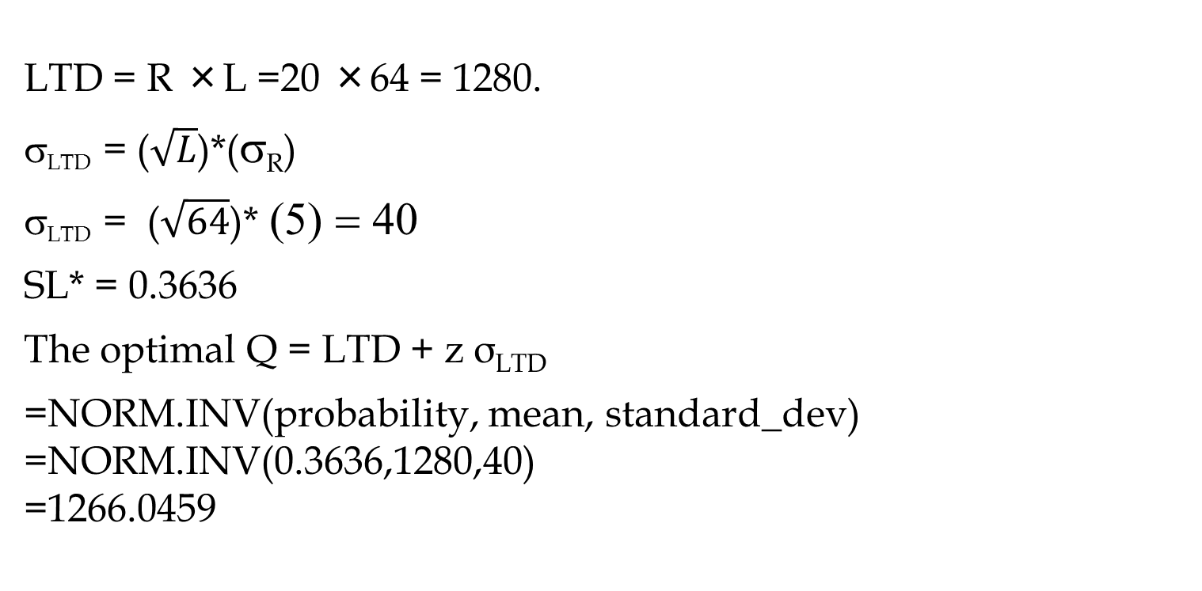
The News Vendor Problem- Extended
LTD = R ×L =20 ×64 = 1280.
σ_{LTD} = ($\sqrt{L}$)*(σ_{R})
σ_{LTD} = ($\sqrt{64}$)* (5) = 40
SL* = 0.3636
The optimal Q = LTD + z σ_{LTD}
=NORM.INV(probability, mean, standard_dev)
=NORM.INV(0.3636,1280,40)
=1266.0459

Slide 27
Sampling
Element. Any unit of data defined for processing is a data element; for example, ACCOUNT NUMBER, NAME, ADDRESS and CITY. A population is a collection of all the elements of interest.
Sample is a subset of the population. It contains only a portion of the population.
Frame. A sampling frame is the source material or device from which a sample is drawn. It is a list of all those within a population who can be sampled, and may include individuals, households or institutions is a list of objects
The sample results provide estimates of the values of the population characteristics
With proper sampling methods, the sample results can provide “good” estimates of the population characteristics.

Slide 28
Sampling from a Finite Population
St. Andrew’s College received 900 applications for admission in the upcoming year from prospective students. The applicants were numbered, from 1 to 900, as their applications arrived. The Director of Admissions would like to select a simple random sample of 30 applicants.
Generate rand() in column next to the names. Then sort the rand column. Select the top 30 names.
Sometimes we want to select a sample, but find it is not possible to obtain a list of all elements in the population.
As a result, we cannot construct a frame for the population. We cannot use the random number selection procedure.
Most often this situation occurs in infinite population
cases.

Slide 29
Sampling from an Infinite Population
Populations are often generated by an ongoing process where there is no upper limit on the number of units that can be generated. Examples of on-going processes, with infinite populations, are:
parts being manufactured on a production line
transactions occurring at a bank
telephone calls arriving at a technical help desk
customers entering a store
These are objects.
A random sample from an infinite population is a sample selected such that the following conditions are satisfied.
Each element selected comes from the population of interest.
Each element is selected independently.

Slide 30
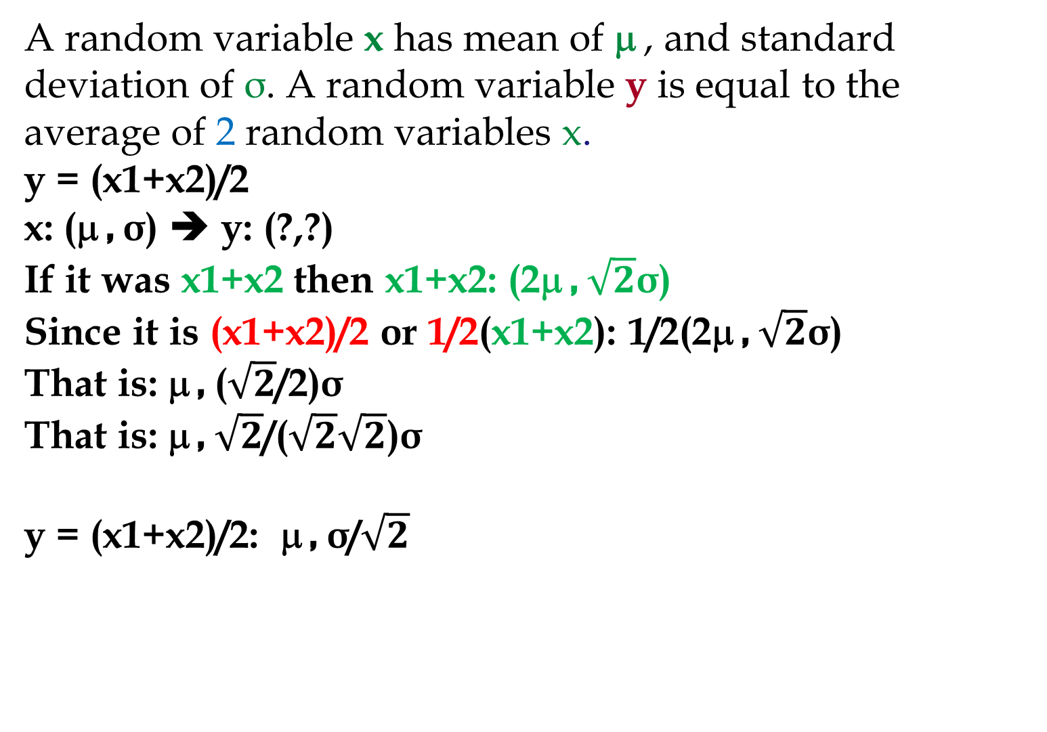
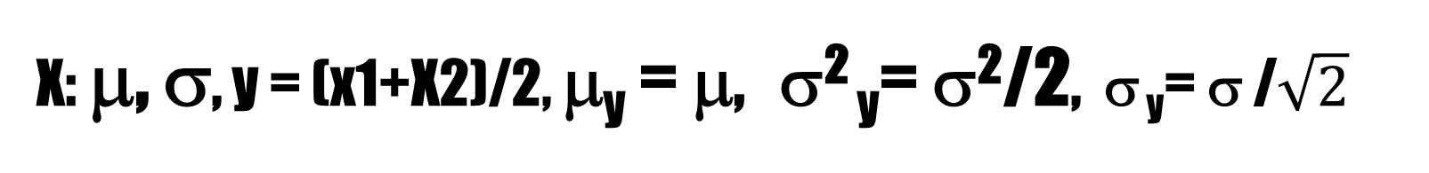
X: μ, σ, y = (x1+X2)/2, μ_{y} = μ, σ² _{y}= σ²/2, σ _{y}= σ /$\sqrt{2}$
A random variable x has mean of μ , and standard deviation of σ. A random variable y is equal to the average of 2 random variables x.
y = (x1+x2)/2
x: (μ , σ) ➔ y: (?,?)
If it was x1+x2 then x1+x2: (2μ , $\sqrt{2}$σ)
Since it is (x1+x2)/2 or 1/2(x1+x2): 1/2(2μ , $\sqrt{2}$σ)
That is: μ , ($\sqrt{2}$/2)σ
That is: μ , $\sqrt{2}$/($\sqrt{2}\sqrt{2}$)σ
y = (x1+x2)/2: μ , σ/$\sqrt{2}$

Slide 31
20 Samples of size 25

Slide 32
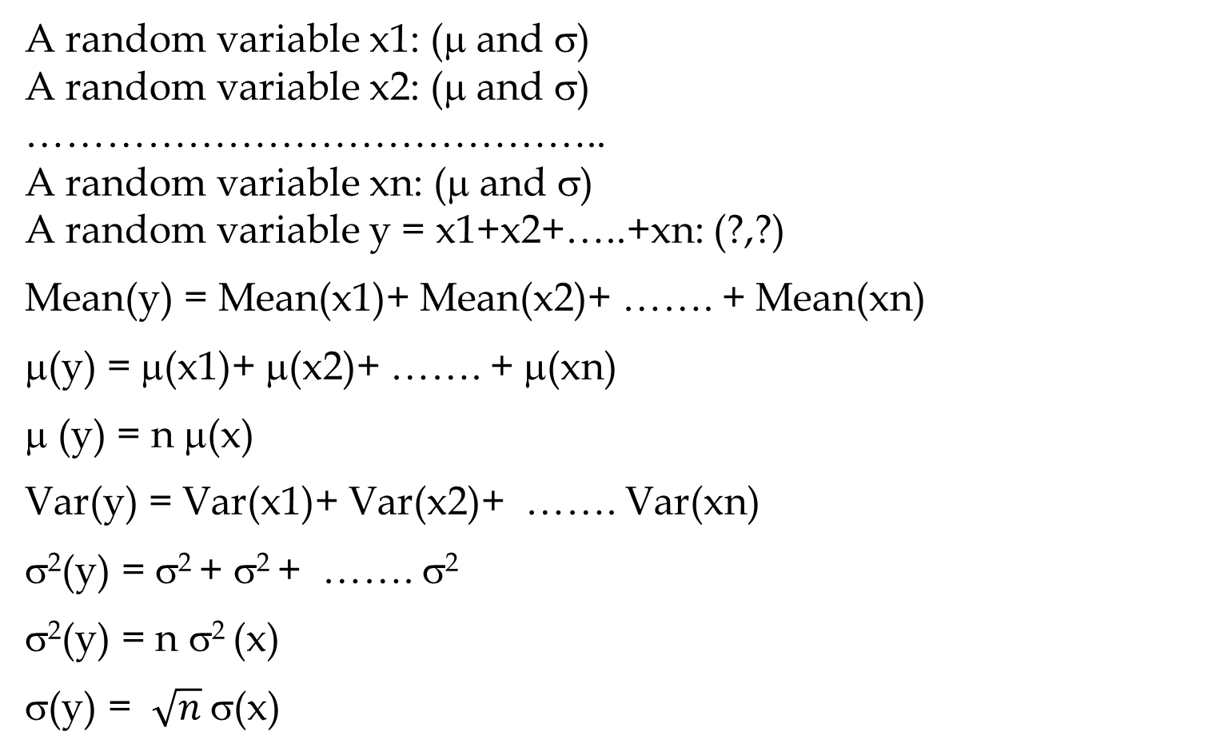
Sampling from an Infinite Population
A random variable x1: (μ and σ)
A random variable x2: (μ and σ)
……………………………………..
A random variable xn: (μ and σ)
A random variable y = x1+x2+…..+xn: (?,?)
Mean(y) = Mean(x1)+ Mean(x2)+ ……. + Mean(xn)
μ(y) = μ(x1)+ μ(x2)+ ……. + μ(xn)
μ (y) = n μ(x)
Var(y) = Var(x1)+ Var(x2)+ ……. Var(xn)
σ²(y) = σ² + σ² + ……. σ²
σ²(y) = n σ² (x)
σ(y) = $\sqrt{n}$σ(x)

Slide 33
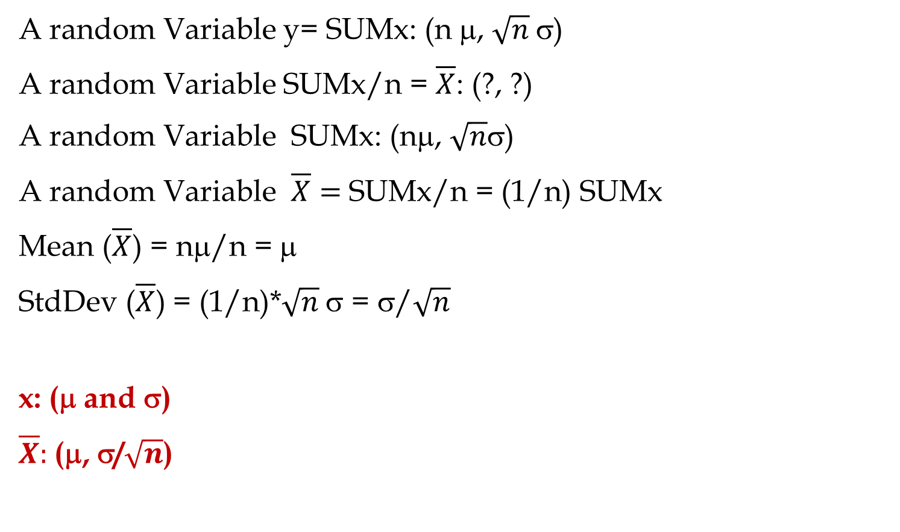
Sampling from an Infinite Population
A random Variable y= SUMx: (n μ, $\sqrt{n}$σ)
A random Variable SUMx/n = $\overline{X}$: (?, ?)
A random Variable SUMx: (nμ, $\sqrt{n}$σ)
A random Variable $\overline{X}=$SUMx/n = (1/n) SUMx
Mean ($\overline{X}$) = nμ/n = μ
StdDev ($\overline{X}$) = (1/n)*$\sqrt{n}$σ = σ/$\sqrt{n}$
x: (μ and σ)
$\overline{X}:$(μ, σ/$\sqrt{n}$)

Slide 34

Standard Deviation of $\overline{X}$ for N=25 and N=50

Slide 35

Sampling from an Infinite Population
CENTRAL LIMIT THEOREM: In selecting random samples of size n from a population, the sampling distribution of the sample mean $\overline{X}$ can be approximated by a normal distribution as the sample size becomes large.

Slide 36
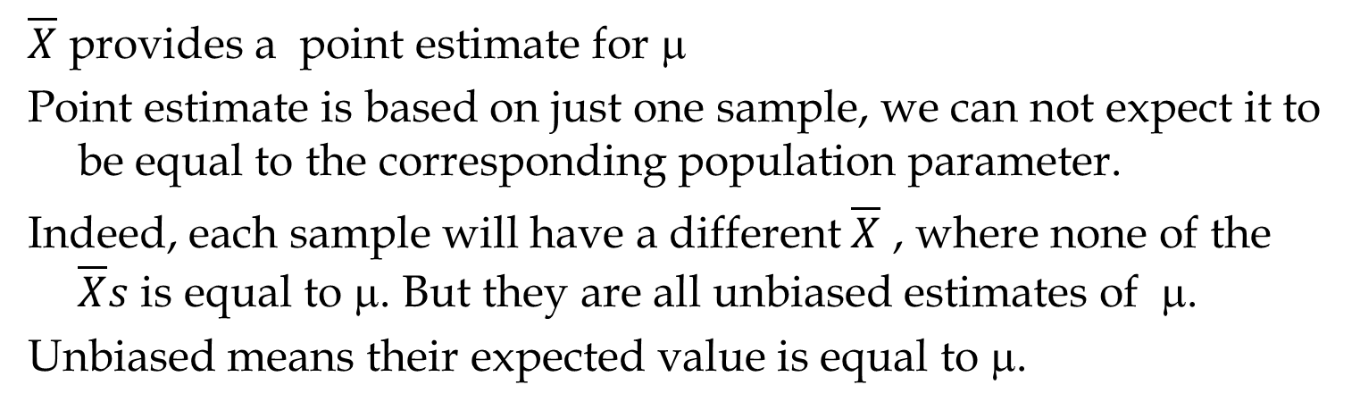
Interval Estimation vs Point Estimation
$\overline{X}$ provides a point estimate for μ
Point estimate is based on just one sample, we can not expect it to be equal to the corresponding population parameter.
Indeed, each sample will have a different $\overline{X}$ , where none of the $\overline{X}s$ is equal to μ. But they are all unbiased estimates of μ.
Unbiased means their expected value is equal to μ.
Point estimate;
Interval Estimate ; with a certain confidence (probability)

Slide 37
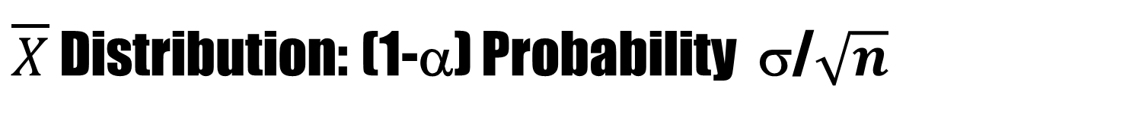
$\overline{X}$ Distribution: (1-α) Probability σ/$\sqrt{n}$
35/sqrt(25)=7

Slide 38
Relationship between μ and x
0.95
1-α

Slide 39
Relationship between μ and x

Slide 40
Relationship between μ and x

Slide 41
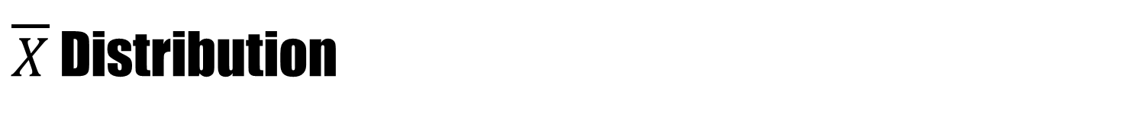
$\overline{X}$ Distribution
35/sqrt(25)=7

Slide 42
Interval Estimation of a Population Mean: σ is known

Slide 43
Example: National Discount, Inc.
National Discount has 260 retail outlets throughout the U.S. National evaluates each potential location for a new retail outlet in part on the mean annual income of the individuals in the marketing area of the new location. The purpose of this example is to show how sampling can be used to develop an interval estimate of the mean annual income for individuals in a potential marketing area for National Discount.
Based on similar annual income surveys, the standard deviation of annual incomes in the entire population is considered known with σ = $5,000. We will use a sample size of n = 64.
Question. There is a 0.95 probability that the value of a sample mean for National Discount will provide a sampling error of $????? or less.

Slide 44

Example: National Discount, Inc.
$σ_{\overline{X}}=\frac{σ}{\sqrt{n}}$ = $\frac{5000}{\sqrt{64}}$ = 626
Z0.975 = 1.959964 ➔
(Z0.975)($σ_{\overline{X}}$) = 1.96(625) = 1225
Answer. There is a 0.95 probability that the value of a sample mean for National Discount will provide a sampling error of $1,225 or less.

Slide 45
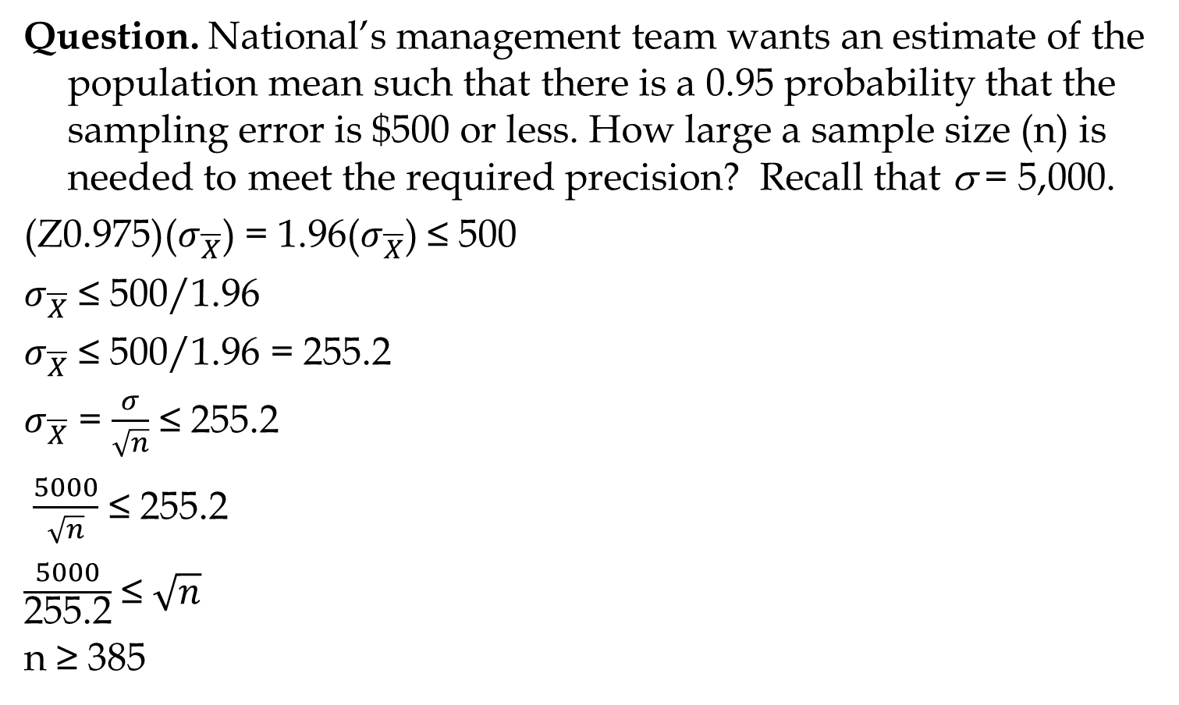
Example: National Discount, Inc.
Question. National’s management team wants an estimate of the population mean such that there is a 0.95 probability that the sampling error is $500 or less. How large a sample size (n) is needed to meet the required precision? Recall that σ = 5,000.
(Z0.975)($σ_{\overline{X}}$) = 1.96($σ_{\overline{X}}$) ≤ 500
$σ_{\overline{X}}$ ≤ 500/1.96
$σ_{\overline{X}}$ ≤ 500/1.96 = 255.2
$σ_{\overline{X}}$ = $\frac{σ}{\sqrt{n}}$ ≤ 255.2
$\frac{5000}{\sqrt{n}}$ ≤ 255.2
$\frac{5000}{\text{255.2}}$ ≤ $\sqrt{n}$
n ≥ 385

Slide 46
2-Ways to Compute CI in Excel: σ is known

Slide 47
Third Way to Compute CI in Excel: σ is known

Slide 48
Interval Estimation of a Population Mean: σ is unknown
Instead of population standard deviation σ, we have sample standard deviation of s
Instead of normal distribution, we have t distribution
The t distribution is a family of similar probability distributions.
A specific t distribution depends on a parameter known as the degrees of freedom.
As the number of degrees of freedom increases, the difference between the t distribution and the standard normal probability distribution becomes smaller and smaller.
A t distribution with more degrees of freedom has less dispersion.
The mean of the t distribution is zero

Slide 49
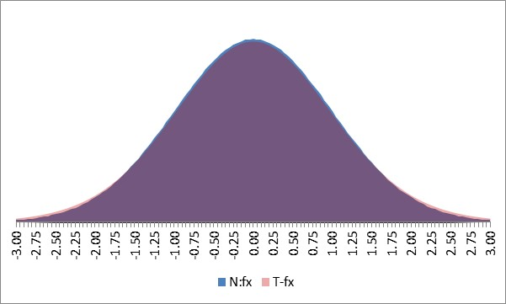
z and t: n=2, 10, 20

Slide 50
Interval Estimation of a Population Mean: σ Unknown
The interval estimate is given by:
The confidence level is 1 -α
t_{α/2} is the t value providing an area of α/2 in the upper tail of a t distribution with n - 1 degrees of freedom
s is the sample standard deviation

Slide 51
Example: Apartment Rents

Slide 52
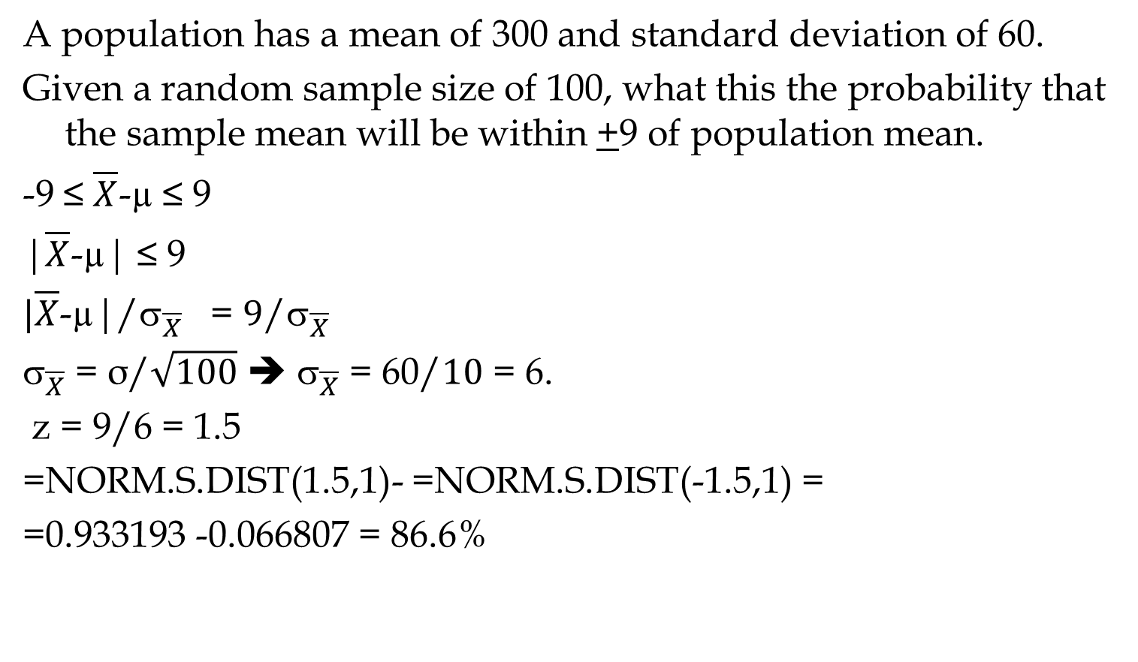
Sampling from an Infinite Population
A population has a mean of 300 and standard deviation of 60.
Given a random sample size of 100, what this the probability that the sample mean will be within +9 of population mean.
-9 ≤ $\overline{X}$-µ ≤ 9
|$\overline{X}$-µ| ≤ 9
$|\overline{X}$-µ|/${\text{}}_{\overline{X}}$ = $9$/${\text{}}_{\overline{X}}$
${\text{}}_{\overline{X}}$ = σ/$\sqrt{100}$ ➔ ${\text{}}_{\overline{X}}$ = 60/$10$ = 6.
z = 9/6 = 1.5
=NORM.S.DIST(1.5,1)- =NORM.S.DIST(-1.5,1) =
=0.933193 -0.066807 = 86.6%

Slide 53
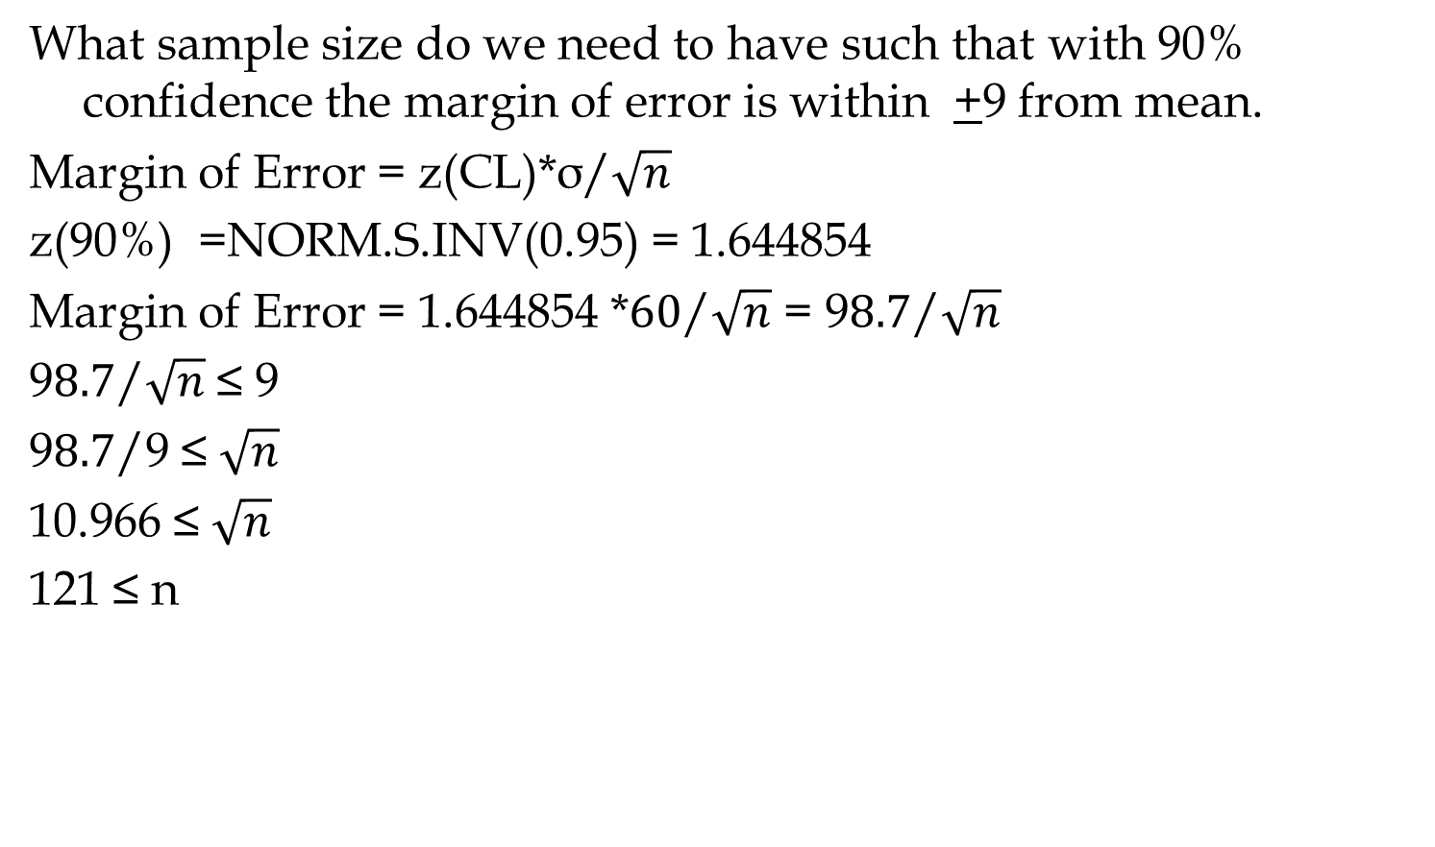
Sampling from an Infinite Population
What sample size do we need to have such that with 90% confidence the margin of error is within +9 from mean.
Margin of Error = z(CL)*$\text{σ}\text{/}\sqrt{n}$
z(90%) =NORM.S.INV(0.95) = 1.644854
Margin of Error = 1.644854 *$\text{6}\text{0}\text{/}\sqrt{n}$ = 9$8.7\text{/}\sqrt{n}$
9$8.7\text{/}\sqrt{n}$ ≤ 9
9$8.7\text{/}\text{9}$ ≤ $\sqrt{n}$
10.966 ≤ $\sqrt{n}$
121 ≤ n

