Slide 1
Statistical Inference
Chapter 6

Slide 2
Introduction
A census collects data from every element in the population of interest
Many potential difficulties associated with taking a census; it may be:
  Expensive
  Time consuming
  Misleading
  Unnecessary
  Impractical

Slide 3
Introduction
Statistical inference uses sample data to make inferences and answer research questions
Sample results provide only estimates of the values of the corresponding population characteristics
Some sampling error occurs as the sample contains only a portion of the population
The sampled population is the population from which the sample is drawn
A frame is a list of elements from which the sample will be selected

Slide 4
Selecting a Sample
Sampling from a Finite Population
Sampling from an Infinite Population

Slide 5

Selecting a Sample
Parameter: A measurable factor that defines a characteristic of a population, process, or system
Sampling from a Finite Population
  Statisticians recommend selecting a probability sample when sampling from a finite population because a probability sample allows you to make valid statistical inferences about the population

Slide 6
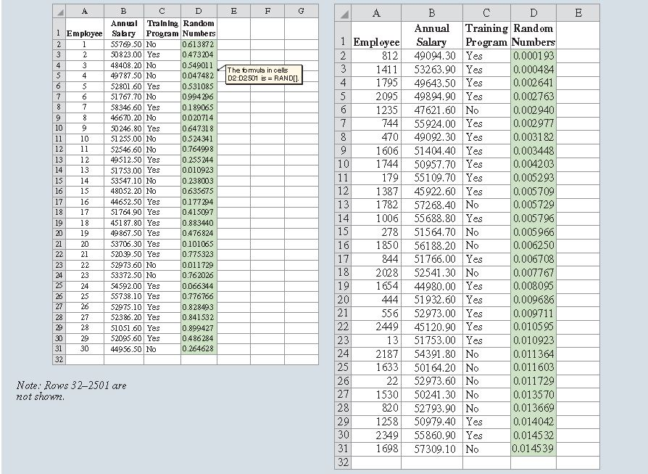
Figure 6.1:
Using Excel to Select a Simple Random Sample

Slide 7
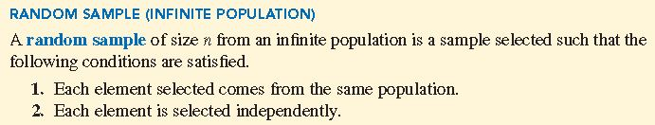
Selecting a Sample
Sampling from an Infinite Population
  With an infinite population, you cannot select a simple random sample because you cannot construct a frame consisting of all the elements
  Statisticians recommend selectin what is called a random sample

Slide 8
Selecting a Sample
Care and judgement must be implemented in the selection process for a random sample from an infinite population:
  Each element selected comes from the same population
  Each element is selected independently
Situations involving sampling from an infinite population are usually associated with a process that operates over time

Slide 9
Point Estimation
Practical Advice

Slide 10
Point Estimation
To estimate the value of a population parameter, computer a corresponding characteristic of the sample—a sample statistic
Using the data in Table 6.1:
  The sample mean is:
  The sample standard deviation is:
  The sample proportion is:

Slide 11
Point Estimation
Calculating sample mean, sample standard deviation, and sample proportion is called point estimation
  The sample mean is the point estimator of the population mean
  The sample standard deviation s is the point estimator of the population standard deviation
  The sample proportion is the point estimator of the population p
The numerical value obtained for , s, or is called the point estimate

Slide 12
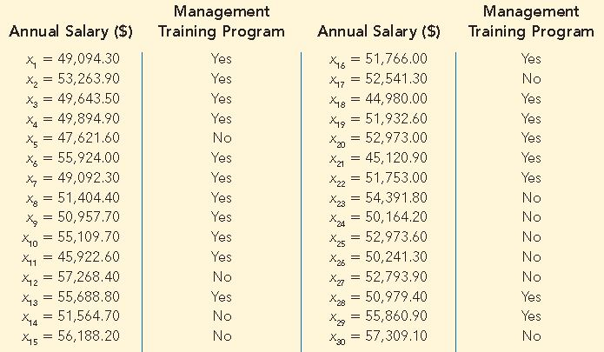
Table 6.1: Annual Salary and Training Program Status for a Simple Random Sample of 30 EAI Employees

Slide 13
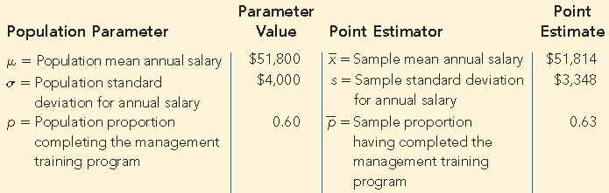
Table 6.2: Summary of Point Estimates Obtained from a Simple Random Sample of 30 EAI Employees
The point estimates differ somewhat from the values of corresponding population parameters

Slide 14
Point Estimation
Practical Advice
When making inferences, it is important to have a close correspondence between the sampled population and the target population
  Target population: Population about which we want to make inferences
  Sampled population: Population from the sample is taken
Good judgment is a necessary ingredient of sound statistical practice

Slide 15
Sampling Distributions
Sampling Distribution of
Sampling Distribution of

Slide 16
Sampling Distributions
Because the various possible values of are the result of different simple random samples, the probability distribution of is called the sampling distribution of
Knowledge of the sample distribution and its properties enables us to make probability statements about how close the sample mean is to the population mean

Slide 17
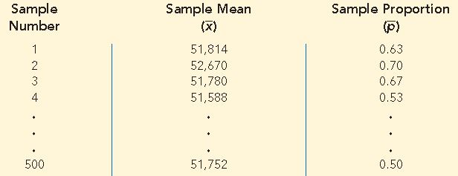
Table 6.3: Values of and from 500 Simple Random Samples of 30 EAI Employees

Slide 18
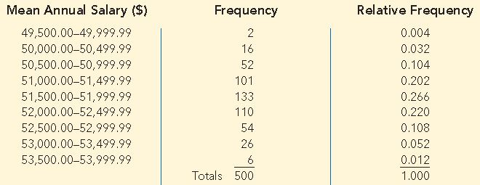
Table 6.4: Frequency and Relative Frequency Distributions of from 500 Simple Random Samples of 30 EAI Employees

Slide 19
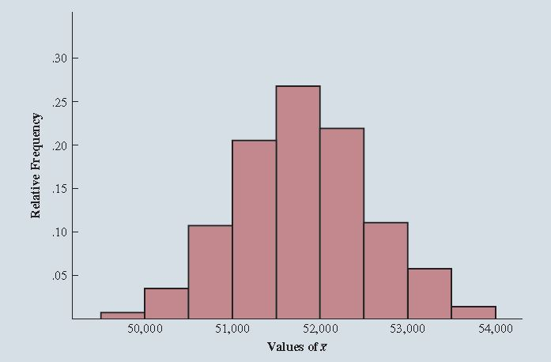
Figure 6.2: Relative Frequency Histogram of Values from 500 Simple Random Samples of Size 30 Each

Slide 20
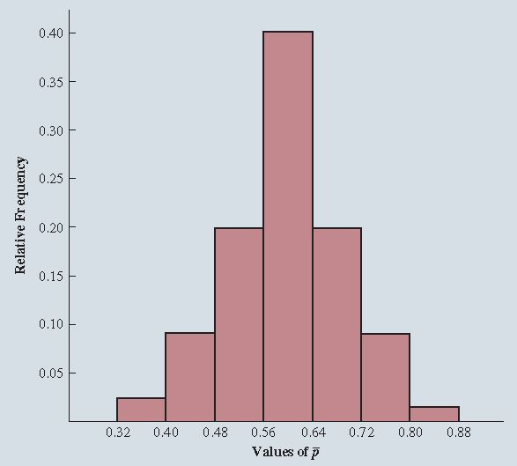
Figure 6.3: Relative Frequency Histogram of Values from 500 Simple Random Sample Sizes of 30 Each

Slide 21

Sampling Distributions
Sampling Distribution of
Sampling distribution has
  An expected value or mean
  A standard deviation
  A characteristic shape or form

Slide 22
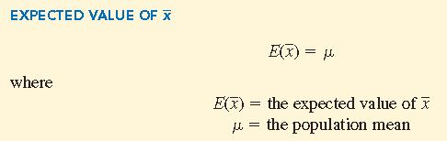
Sampling Distributions
When the expected value of a point estimator equals the population parameter, we say the point estimator is unbiased

Slide 23

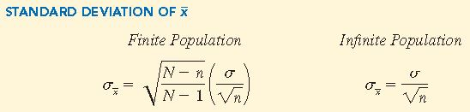
Sampling Distributions
The formula for the standard deviation of depends on whether the population is finite or infinite
Using the following notation:

Slide 24
Sampling Distributions
Finite population correction factor:
In many practical sampling situations, the finite population correction factor is close to 1—so the difference between the values of the standard deviation for the finite and infinite populations is negligible

Slide 25
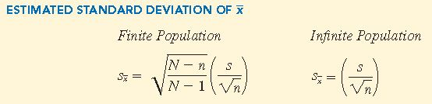


Sampling Distributions
Estimated standard error:
True standard error:
The difference between and is due to sampling error

Slide 26
Sampling Distributions
When the population has a normal distribution, the sampling distribution of is normally distributed for any sample size
When the population does not have a normal distribution, the central limit theorem is helpful in identifying the shape of the sampling distribution of
Central Limit Theorem: In selecting random samples of size n from a population, the sampling distribution of the sample mean can be approximated by a normal distribution as the sample size becomes large

Slide 27
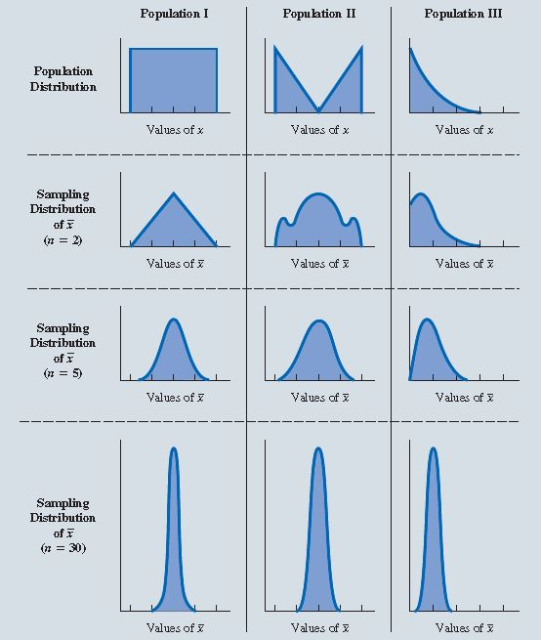
Figure 6.4: Illustration of the Central Limit Theorem for Three Populations
Top panel shows that none of the populations are normally distributed
Bottom three panels show the shape of the sampling distribution for samples n=2, n=5, and n=30
General statistical practice is to assume that, for most applications, the sampling distribution can be approximated by normal distribution whenever the sample size is 30 or more

Slide 28
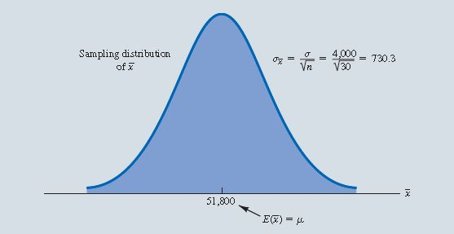
Figure 6.5: Sampling Distribution of for the Mean Annual Salary of a Simple Random Sample of 30 EAI Employees

Slide 29
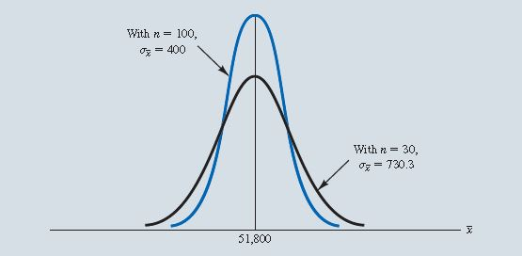
Figure 6.6: A Comparison of the Sampling Distributions of for Simple Random Samples of n=30 and n=100 EAI Employees

Slide 30
Sampling Distributions
Sampling Distribution of
The sample proportion is the point estimator of the population proportion
The formula for computing the sample proportion is:
  where
  x = the number of elements in the sample that possess the characteristic of interest
  n = sample size

Slide 31

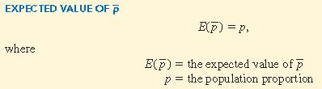
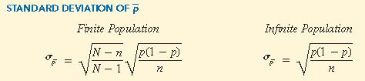
Sampling Distributions

Slide 32
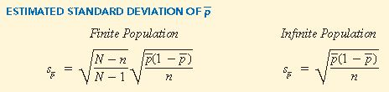
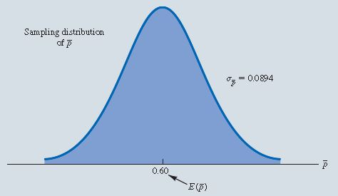
Sampling Distributions

Slide 33
Interval Estimation
Interval Estimation of the Population Mean
Interval Estimation of the Population Proportion

Slide 34
Interval Estimation
Because a point estimator cannot be expected to provide the exact value of a population parameter, interval estimation is frequently used to generate an estimate of the value of a population parameter
An interval estimate is often computer by adding and subtracting a value, called the margin of error, to the point estimate
The general form of an interval estimate is:

Slide 35
Interval Estimation
An interval estimate provides information about how close the point estimate is to the value of the population parameter
General form of an interval estimate of a population mean is:
General form of an interval estimate of a population proportion is:

Slide 36
Interval Estimation
Interval Estimation of the Population Mean
  For any normally distributed random variable:
    90% of the values lie within 1.645 standard deviations of the mean
    95% of the values lie within 1.960 standard deviations of the mean
    99% of the values lie within 2.576 standard deviations of the mean

Slide 37
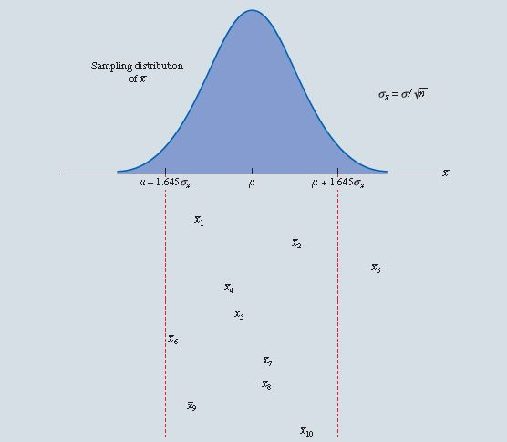
Figure 6.8: Sampling Distribution of the Sample Mean

Slide 38
Interval Estimation
If the sampling distribution follows a normal distribution, address this additional source of uncertainty by using a probability distribution known as the t distribution
  A family of similar probability distributions
  The shape of each specific depends on a parameter referred to as the degrees of freedom
  Similar in shape to the standard normal distribution, but wider
As the degrees of freedom increase, the t distribution narrow, its peak becomes higher and it becomes more similar to the standard normal distribution

Slide 39
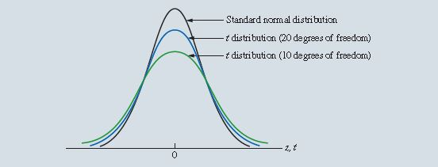
Figure 6.9: Comparison of the Standard Normal Distribution with t Distributions with 10 and 20 Degrees of Freedom

Slide 40
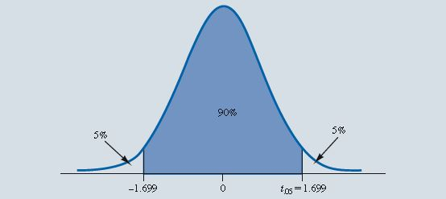
Interval Estimation
Use Excel’s T.INV.2T function to find the value from a t distribution such that a given percentage of the distribution is included in the interval for any degrees of freedom

Slide 41
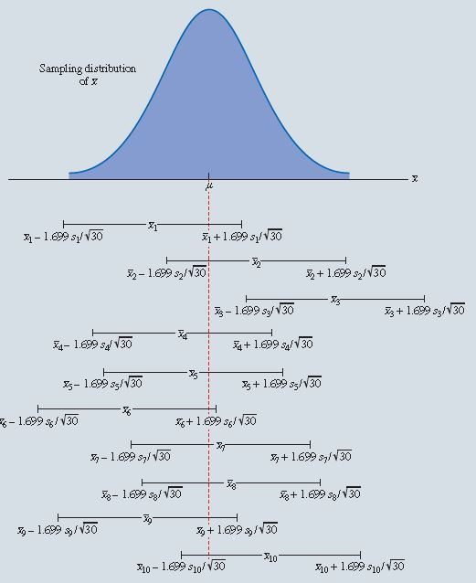
Figure 6.11: Intervals Formed Around Sample Means from 10 Independent Random Samples

Slide 42
Interval Estimation
Because approximately 90% of all the intervals constructed will contain the population mean, we say that we are approximately 90% confident that the interval will include the population mean
  Say that the interval has been established at the 90% confidence level
  The value of 0.90 is referred to as the confidence coefficient
  The interval is called the 90% confidence interval
The level of significance is the probability that the interval estimation procedure will generate an interval that does not contain the population mean

Slide 43
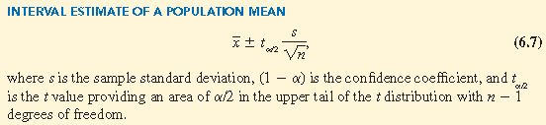
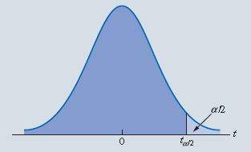
Figure 6.12: t Distribution with Area or Probability in the Upper Tail

Slide 44
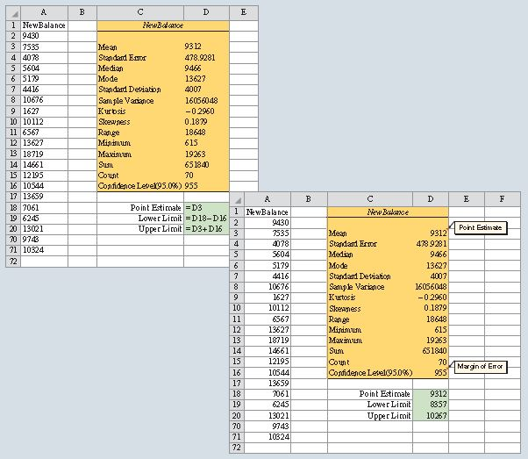
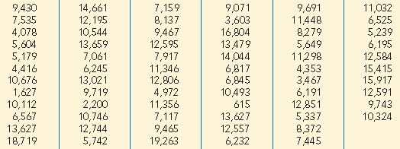
Interval Estimation
Figure 6.13: 95% Confidence Interval for Credit Card Balances
Table 6.5: Credit Card Balances for a Sample of 70 Households

Slide 45
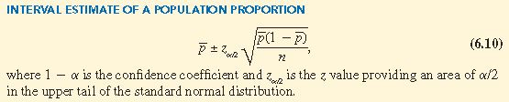
Interval Estimation
Interval Estimation of the Population Proportion
The sampling distribution of plays a key role in computing the margin of error in the interval estimate

Slide 46
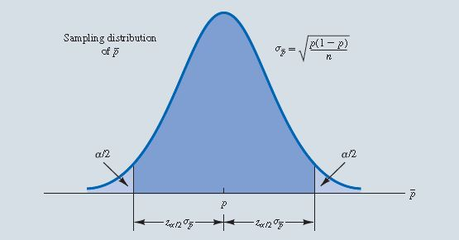
Figure 6.14: Normal Approximation of the Sampling Distribution of

Slide 47
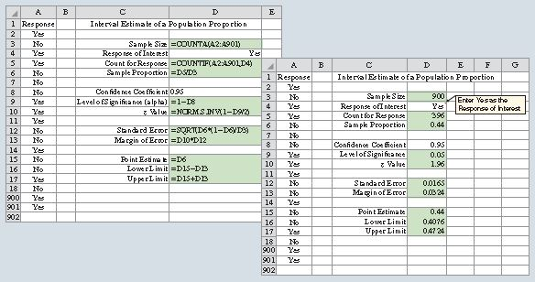
Figure 6.15: 95% Confidence Interval for Survey of Women Golfers

Slide 48
Hypothesis Tests
Developing Null and Alternative Hypothesis
Type I and Type II Errors
Hypothesis Test of the Population Mean
Hypothesis Test of the Population Proportion
Big Data, Statistical Inference, and Practical Significance

Slide 49
Hypothesis Tests
The tentative conjecture is called the null hypothesis
The opposite of what is stated in the null hypothesis is the alternative hypothesis
The hypothesis testing procedure uses data from a sample to test the validity of the two competing statements about a population

Slide 50
Hypothesis Tests
Developing Null and Alternative Hypotheses
Context of the situation is very important in determining how the hypotheses should be stated
All hypothesis testing applications involve collecting a random sample and using the sample results to provide evidence for drawing a conclusion
Ask:
  What is the purpose of collecting the sample?
  What conclusions are we hoping to make?

Slide 51
Hypothesis Tests
Many applications of hypothesis testing involve an attempt to gather evidence in support of a research hypothesis—best to begin with the alternative hypothesis and make it the conclusion that the researcher hopes to support
Not all hypothesis tests involve research hypothesis:
  Begin with a belief or a conjecture that a statement about the value of a population parameter is true
  Use a hypothesis test to challenge the conjecture and determine whether there is statistical evidence to conclude that the conjecture is incorrect
  Helpful to develop the null hypothesis first; the alternative hypothesis is that the belief or conjecture is incorrect

Slide 52

Hypothesis Tests
Depending upon the situation, hypothesis tests about a population parameter may take on of three forms:
  Two use inequalities in the null hypothesis
  One uses an equality in the null hypothesis
  First two forms are called one-tailed tests
  Third form is called a two-tailed test

Slide 53
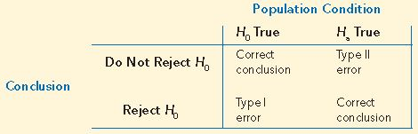
Hypothesis Tests
Type I and Type II Errors
First row shows what can happen if the conclusions is to accept H₀
  If H₀ is true, this conclusion is correct
  If H_{a} is true, we made a Type II error (accepted H₀ when it is false)
Second row shows what can happen if the conclusion is to reject H₀
  If H₀ is true, we made a Type I error (rejected H₀ when it is true)
  If H_{a} is true, rejecting H₀ is correct

Slide 54

Hypothesis Tests
The person responsible for the hypothesis test specifies the level of significance and the probability of making a Type I error
Applications of hypothesis testing that only control for the Type I error are called significance tests
Most applications of hypothesis testing control for the probability of making a Type I error; they do not always control for the probability of making a Type II error

Slide 55
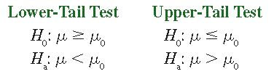
Hypothesis Tests
Hypothesis Test of the Population Mean
One tailed tests about a population mean take one of the following forms:
  Develop the null and alternative hypothesis for the test
  Specify the level of significance for the test
  Collect the sample data and computer the value of what is called a test statistic

Slide 56
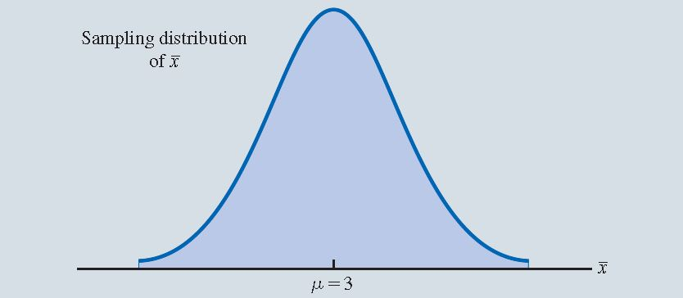
Figure 6.16: Sampling Distribution of for the Hilltop Coffee Study When the Null Hypothesis Is True as an Equality ( = 3)

Slide 57
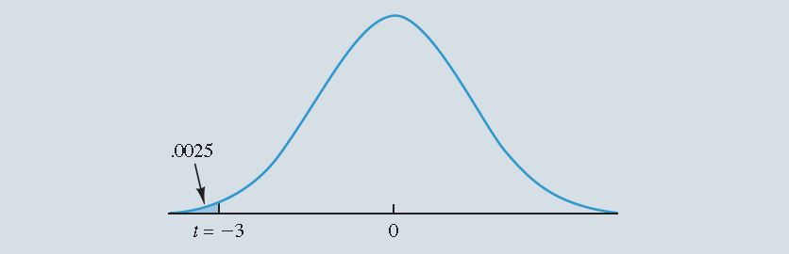
Figure 6.17: Lower-Tail Probability for t = –3 from a t Distribution with 35 Degrees of Freedom

Slide 58
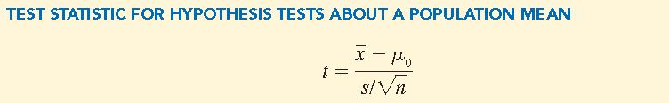

Hypothesis Tests
Use the t-distributed random variable t as a test statistic to determine whether deviates from the hypothesized value of enough to justify rejecting the null hypothesis
The key question for a lower-tail test is: How small must the test statistic t be before we choose to reject the null hypothesis?

Slide 59
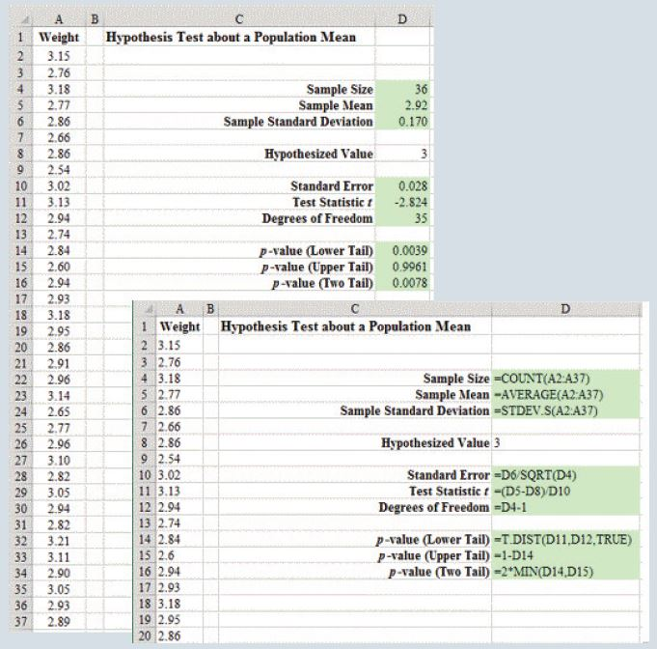
Figure 6.18: Hypothesis Test About a Population Mean

Slide 60
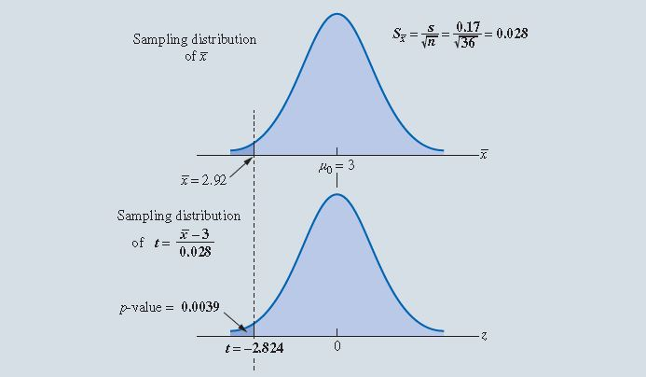
Figure 6.19: p Value for the Hilltop Coffee Study When = 2.92 and s = 0.17

Slide 61

Hypothesis Tests
The level of significance indicates the strength of evidence that is needed in the sample data before rejection of the null hypothesis
Different decision makers may express different opinions concerning the cost of making a Type I error and may choose a different level of significance
Providing the p value as part of the hypothesis testing results allows decision makers to compare the reported p value to his or her own level of significance

Slide 62
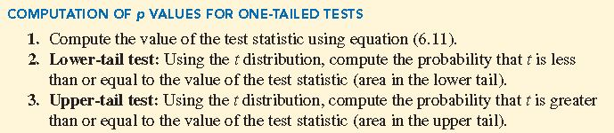
Hypothesis Tests
For an upper-tail test, the p value is the probability of obtaining a value for the test statistic as large as or larger than that provided by the sample

Slide 63
Hypothesis Tests
In hypothesis testing, the general form for a two-tailed test about population mean is:

Slide 64
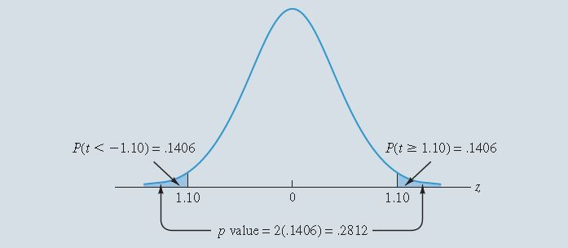
Figure 6.20: p Value for the Holiday Toys Two-Tailed Hypothesis Test

Slide 65
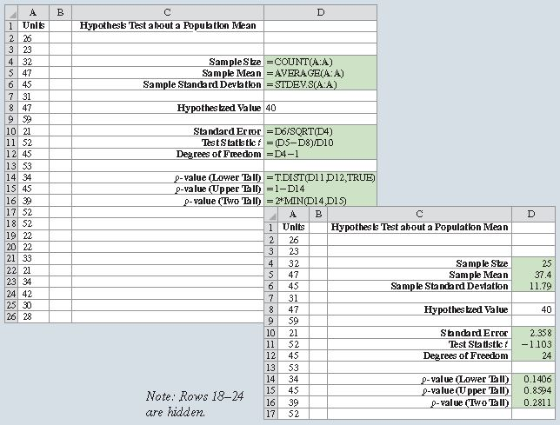
Figure 6.21: Two-Tailed Hypothesis Test for Holiday Toys

Slide 66
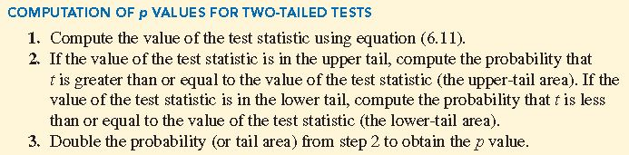
Hypothesis Tests

Slide 67
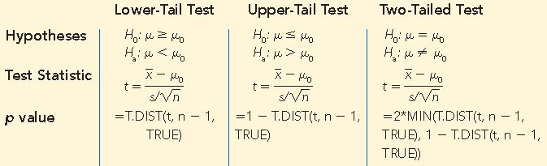
Table 6.7: Summary of Hypothesis Tests About a Population Mean

Slide 68
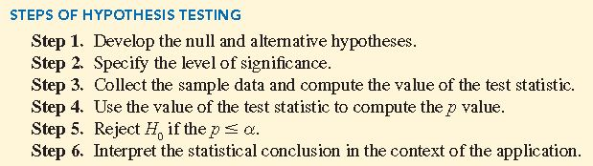
Hypothesis Tests

Slide 69
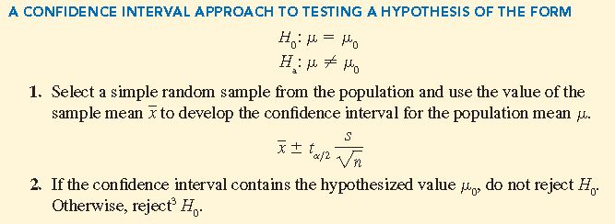
Hypothesis Tests

Slide 70

Hypothesis Tests
Hypothesis Test of the Population Proportion
The three forms for a hypothesis test about a population proportion are:
  The first form is called a lower-tail test
  The second form is called an upper-tail test
  The third form is called a two-tailed test

Slide 71
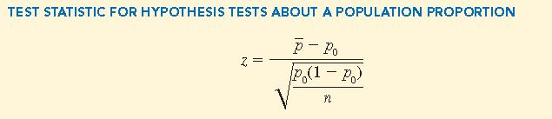
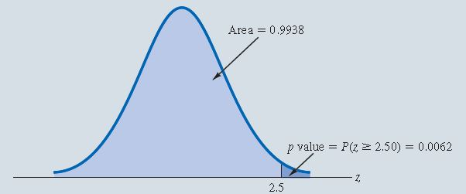
Hypothesis Test
Figure 6.22: Calculation of the p Value for the Pine Creek Hypothesis Test

Slide 72
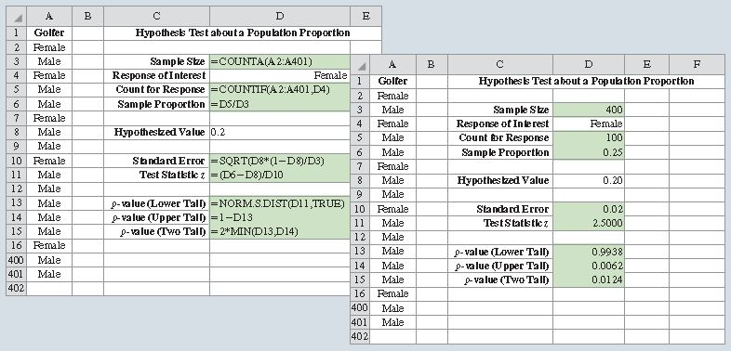
Figure 6.23: Hypothesis Test for Pine Creek Golf Course

Slide 73
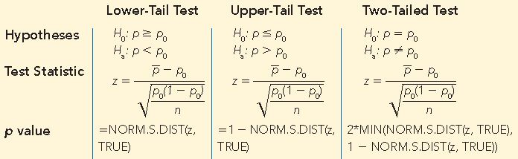
Table 6.8: Summary of Hypothesis Tests About a Population Proportion

Slide 74
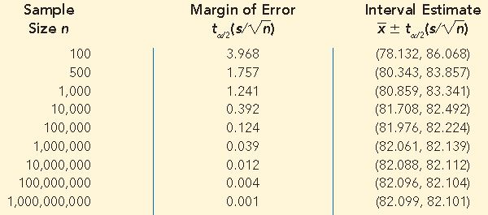
Table 6.9: Margins of Error and Interval Estimates of the Population Mean at Various Sample Sizes n

Slide 75
Hypothesis Tests
Big Data, Statistical Inference, and Practical Significance
Businesses are collecting greater volumes of greater varieties of data at a higher velocity that ever
With very large sample, it is particularly important that we consider the practical implications, or practical significance, of a statistically significant result in hypothesis testing
  No business decision should be based solely on statistical significance
  Consider the practical significance of the difference between the sample mean and the hypothesized population mean
  Consider the difference between the sample proportion and the hypothesized population proportion

