Slide 1
Sampling and Confidence Interval
The Recording is on Slides 9&13
Put slides 1-8 in slide show mode, spend 15 minutes. Read carefully.
Watch the lecture on Slide 9,
Solve the problems on 10-12 based on the ecture on slide 9
Watch the lecture on slide 13. Watch it to the end- I have made some parts easier as you move forward- Watch it to the end.
Go through the practice problems starting on page 14
Confidence comes not from always being right but from not fearing to be wrong. Peter T. McIntyre

Slide 2
Sampling
Element. Any piece of data is a data element; for example, Student ID, Name, Courses Taken, GPA.
A population is a collection of all the potential elements.
Sample is a small portion of the population.
Sample (a random sample) is used to estimate the values of the population parameters, such as average, proportion, variance.
Characteristics of a Random Sample.
  Elements come from the same population.
  Element are selected independently.

Slide 3
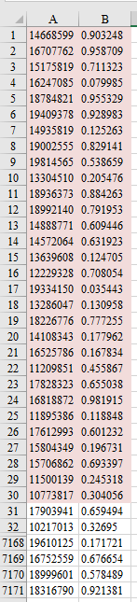
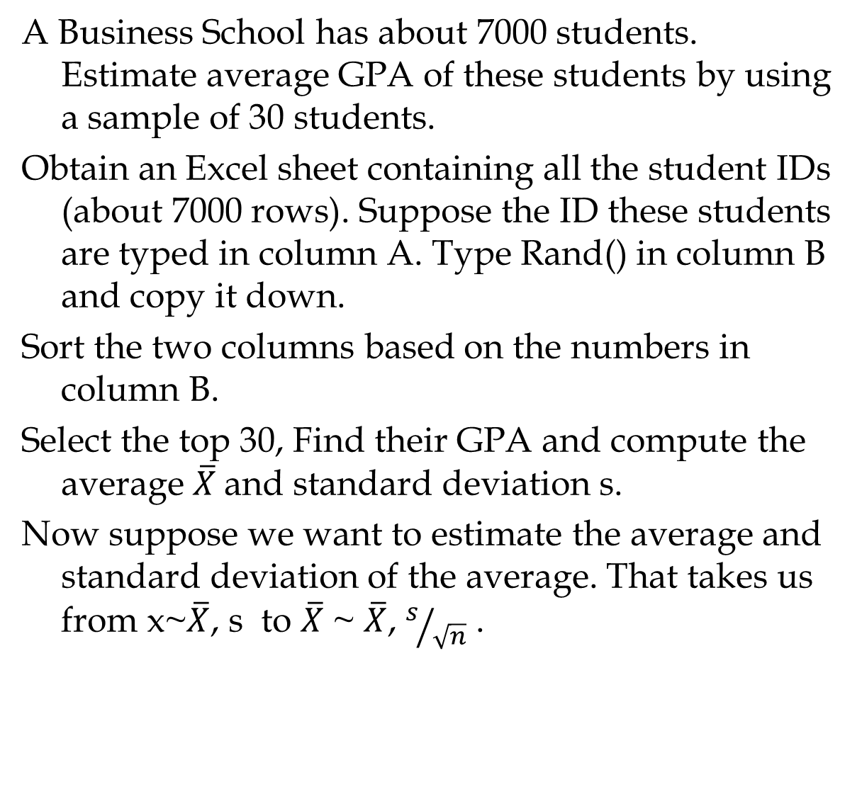
Sampling from a Finite Population
A Business School has about 7000 students. Estimate average GPA of these students by using a sample of 30 students.
Obtain an Excel sheet containing all the student IDs (about 7000 rows). Suppose the ID these students are typed in column A. Type Rand() in column B and copy it down.
Sort the two columns based on the numbers in column B.
Select the top 30, Find their GPA and compute the average $\overline{X}$and standard deviation s.
Now suppose we want to estimate the average and standard deviation of the average. That takes us from x~$\overline{X}$, s to $\overline{X}$ ~ $\overline{X}$, $s/{\sqrt{n}}$ .

Slide 4
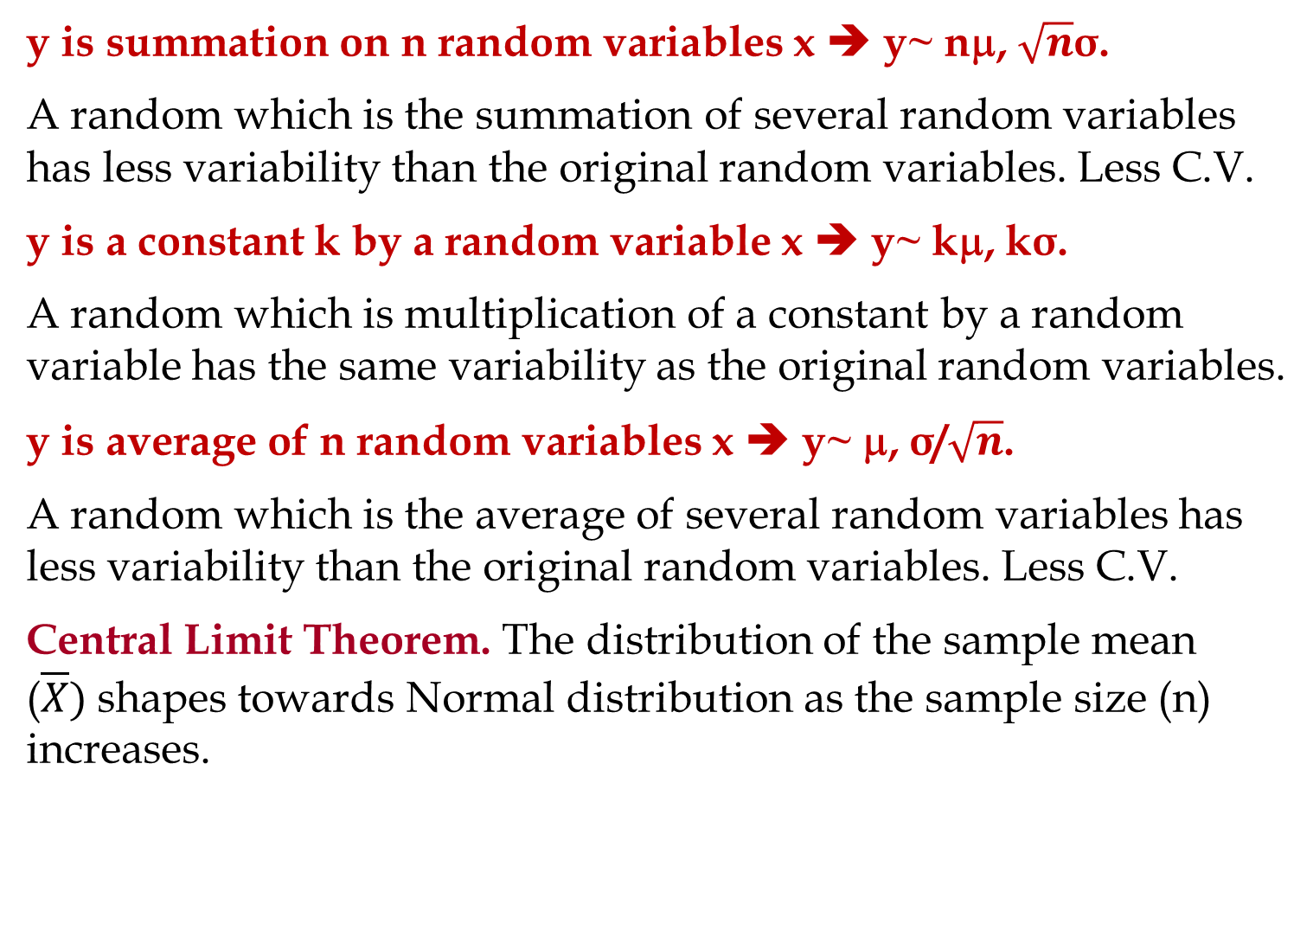
Summation, Multiplication, Average
y is summation on n random variables x ➔ y~ nμ, $\sqrt{n}$σ.
A random which is the summation of several random variables has less variability than the original random variables. Less C.V.
y is a constant k by a random variable x ➔ y~ kμ, kσ.
A random which is multiplication of a constant by a random variable has the same variability as the original random variables.
y is average of n random variables x ➔ y~ μ, σ/$\sqrt{n}$.
A random which is the average of several random variables has less variability than the original random variables. Less C.V.
Central Limit Theorem. The distribution of the sample mean ($\overline{X})$shapes towards Normal distribution as the sample size (n) increases.

Slide 5
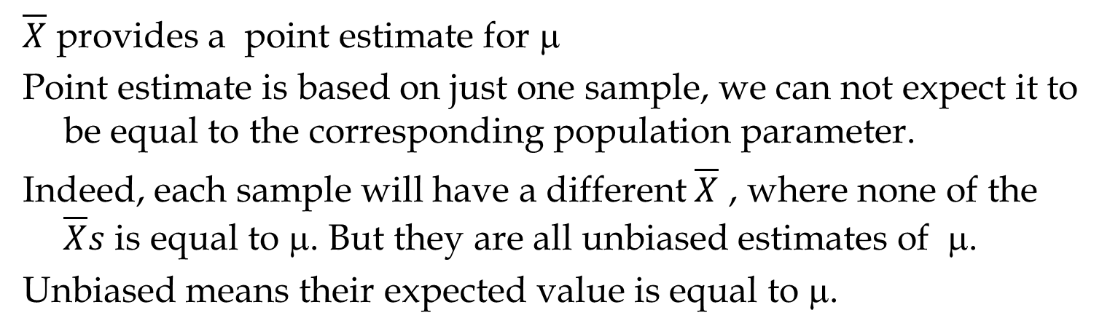
Interval Estimation vs Point Estimation
$\overline{X}$ provides a point estimate for μ
Point estimate is based on just one sample, we can not expect it to be equal to the corresponding population parameter.
Indeed, each sample will have a different $\overline{X}$ , where none of the $\overline{X}s$ is equal to μ. But they are all unbiased estimates of μ.
Unbiased means their expected value is equal to μ.
Point estimate;
Interval Estimate ; with a certain confidence (probability)

Slide 6



$\overline{X}$ Distribution: (1-α) Probability σ/$\sqrt{n}$
$$σ/\sqrt{n}$$
$$μ$$

Slide 7
Relationship between μ and x
0.95
1-α

Slide 8
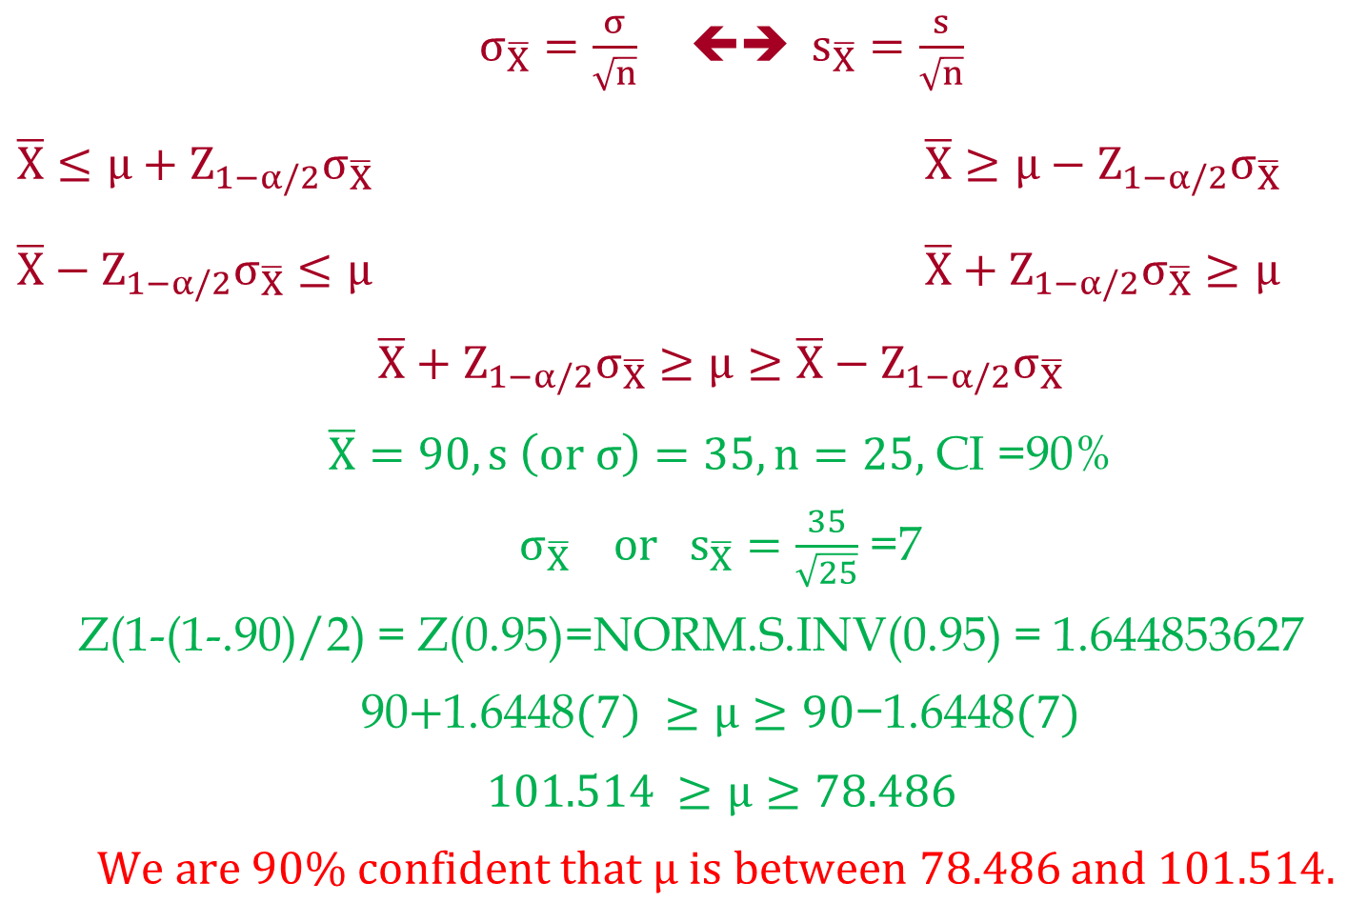
Relationship between μ and x
$σ_{\overline{X}}=\frac{σ}{\sqrt{n}}$ ⬅➔ $s_{\overline{X}}=\frac{s}{\sqrt{n}}$
$\overline{X}≤μ+Z_{1−α/2}σ_{\overline{X}}$ $\overline{X}≥μ−Z_{1−α/2}σ_{\overline{X}}$
$\overline{X}−Z_{1−α/2}σ_{\overline{X}}≤μ$ $\overline{X}+Z_{1−α/2}σ_{\overline{X}}≥μ$
$$\overline{X}+Z_{1−α/2}σ_{\overline{X}}≥μ≥\overline{X}−Z_{1−α/2}σ_{\overline{X}}$$
$\overline{X}=90, s \left(or σ\right)=35, n=25,$ CI =90%
$σ_{\overline{X}} or{ s}_{\overline{X}}=\frac{35}{\sqrt{25}}$ =7
Z(1-(1-.90)/2) = Z(0.95)=NORM.S.INV(0.95) = 1.644853627
90$+\text{1.6448}(7) ≥μ≥90\text{−}\text{1.6448}(7)$
$$101.514 ≥μ≥78.486$$
We are 90% confident that $μ is between 78.486$ and $101.514.$

Slide 9

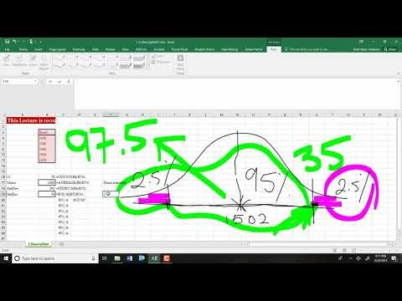
Interval Estimation vs Point Estimation
https://www.youtube.com/watch?v=Mm0PrmJSolM
Excelsheets is on the next page.

Slide 10
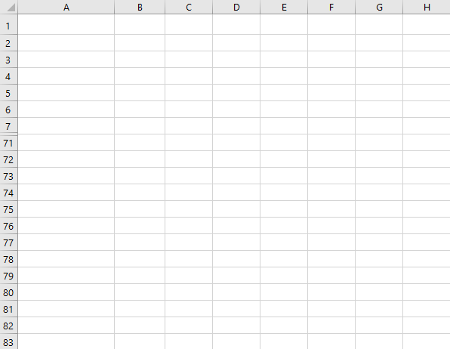
Interval Estimation vs Point Estimation

Slide 11
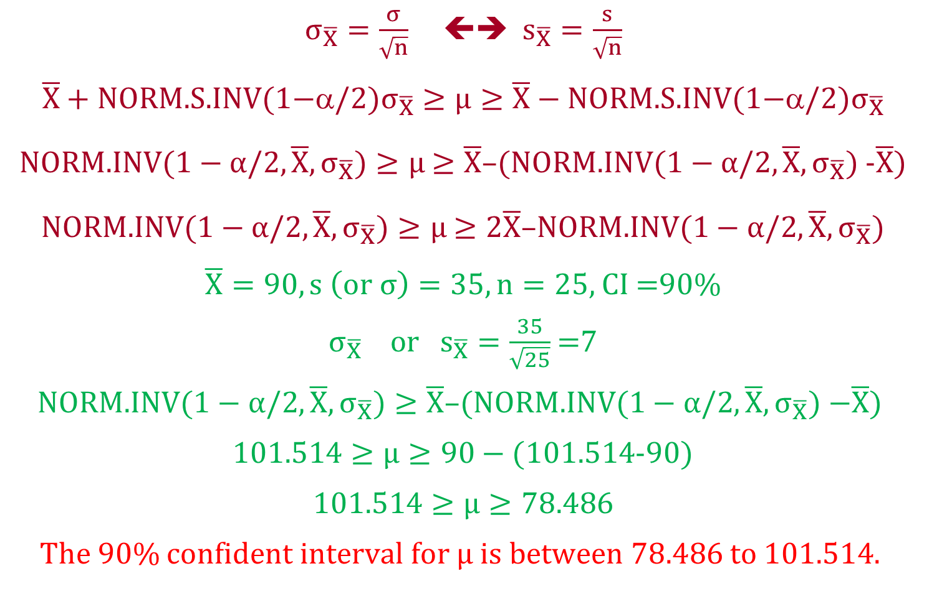
Relationship between μ and x
$σ_{\overline{X}}=\frac{σ}{\sqrt{n}}$  $s_{\overline{X}}=\frac{s}{\sqrt{n}}$
$$\overline{X}+\text{NORM}\text{.}\text{S}\text{.}\text{INV}\text{(1−}/2{)σ}_{\overline{X}}≥μ≥\overline{X}−\text{NORM}\text{.}\text{S}\text{.}\text{INV}\text{(1−}α/2\text{)}σ_{\overline{X}}$$
NORM.INV($1−α/2,\overline{X}, σ_{\overline{X}})≥μ$ $≥\overline{X}$–(NORM.INV($1−α/2,\overline{X}, σ_{\overline{X}})$-$\overline{X}$)
NORM.INV($1−α/2,\overline{X}, σ_{\overline{X}})≥μ$ $≥2\overline{X}$–NORM.INV($1−α/2,\overline{X}, σ_{\overline{X}})$
$\overline{X}=90, s \left(or σ\right)=35, n=25,$ CI =90%
$σ_{\overline{X}} or{ s}_{\overline{X}}=\frac{35}{\sqrt{25}}$ =7
$$\text{NORM}\text{.}\text{INV}\text{(}1−α/2,\overline{X}, σ_{\overline{X}})≥\overline{X}\text{–(}\text{NORM}\text{.}\text{INV}\text{(}1−α/2,\overline{X}, σ_{\overline{X}}) \text{−}\overline{X}\text{) }$$
1$01.514≥μ≥90−($1$01.514$-90)
$$101.514≥μ≥78.486$$
The 90% confident interval for $μ is between 78.486$ to $101.514.$

Slide 12
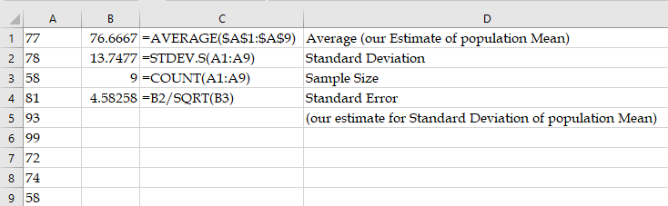
CI-IE-Problem-1
Given the following data on the number of monthly working hours of a sample of part time workers.
Estimate the standard deviation (standard Error) of the average of the population.
A. (5.78), B. (4.58), C. (6.18), D. (6.36), E. (6.2).

Slide 13
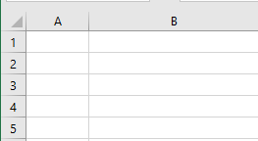

CI-IE-Problem-2
Given a sample of 16 observations on the number of monthly working hours of part time workers in a company. Suppose the average working hours per months for this sample is 86, and the standard deviation of the sample is 43 hours. Provide the upper limit for 96 % interval Estimate of the average of the population.
1-α
A. (66.12) B. (70.87) C. (108.08) D. (99.32) E. (79.63)

Slide 14
CI-IE-Problem-3
Given a sample of 16 observations on the number of monthly working hours of part time workers in a company. Suppose the average working hours per months for this sample is 86, and the standard deviation of the sample is 43 hours. Provide the lower limit for 96 % interval Estimate of the average of the population.
A. (35.88) B. (63.92) C. (38.49) D. (74.68) E. (64.37)

Slide 15
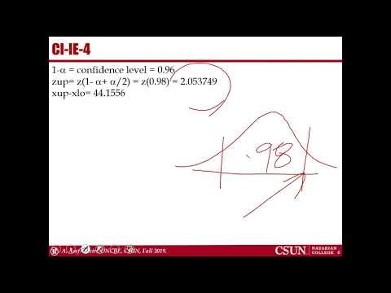
Sample Size

Slide 16
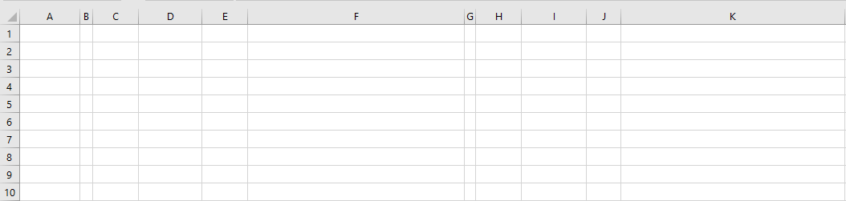
CI-IE-Problem-4
Given a sample on the number of monthly working hours of a sample of part time workers.
Suppose the average working hours per months for this sample is 86, and the standard deviation of the sample is 43 hours.
Suppose for a 96% interval Estimate, the distance between the Upper and the lower limits is 44.1556. What is the sample size?
A. (25) B. (36) C. (49) D. (16) E. (81)

Slide 17
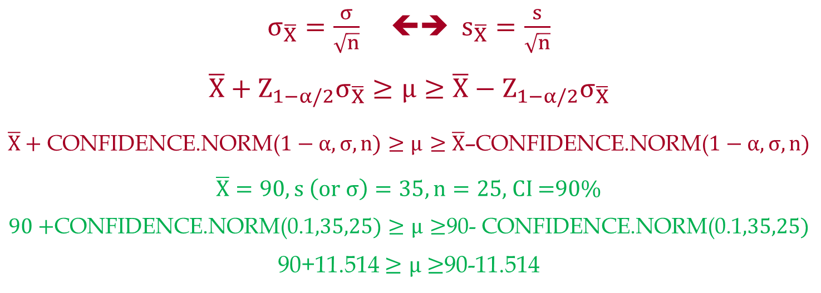
Relationship between μ and x
$σ_{\overline{X}}=\frac{σ}{\sqrt{n}}$ ⬅➔ $s_{\overline{X}}=\frac{s}{\sqrt{n}}$
$$\overline{X}+Z_{1−α/2}σ_{\overline{X}}≥μ≥\overline{X}−Z_{1−α/2}σ_{\overline{X}}$$
$\overline{X}+$CONFIDENCE.NORM($1−α,σ,n)≥μ$ $≥\overline{X}$–CONFIDENCE.NORM($1−α,σ,n)$
$\overline{X}=90, s \left(or σ\right)=35, n=25,$ CI =90%
$90+$CONFIDENCE.NORM(0.1$,35,25)≥μ$ $≥$90- CONFIDENCE.NORM(0.1$,35,25)$
90+11.514 $≥μ$ $≥$90-11.514

Slide 18
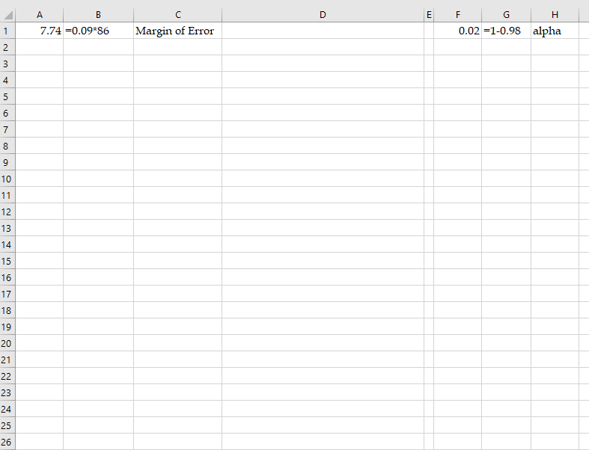
CI-IE-5
Compute the Sample Size.
The average working hours per months is 86, and the standard deviation is 43 hours. The margin of error must be within 9 % of the average for a 98 % confidence interval.

Slide 19
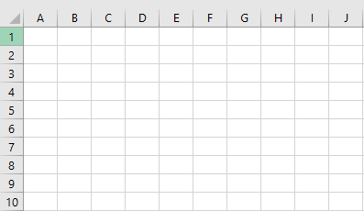
CI-IE-6. Three Procedures
Provide a 95.45% interval estimate for the Mean of the following sample.
Sample Size (n) =COUNT(A1:J10) =100
Point Estimate (Xbar) = AVERAGE(A1:J10) = 79.7
StdDev X = STDEV.S(A1:J10) = 22.45286871
StdDevXbar = N4/SQRT(100) = 2.245286871
(1-.95)/2 = 0.025
0.95+0.025=0.975
Z0.975 =NORM.S.INV(0.975) =2.00
With 95% confidence, the average is between 75.21 and 84.19
UCL = 79.7+2*2.25 = 84.19
LCL = 79.7-2*2.25 = 75.21
UCL = NORM.INV(0.975,79.7,2.25) = 84.19
LCL = 79.7- (84.19- 79.7) = 2×79.7- 84.19 = 75.21
ME = CONFIDENCE.NORM(1-0.95,22.45,100) = 4.49
UCL = 79.7+4.49 = 84.19
LCL = 79.7-4.49 = 75.21

Slide 20
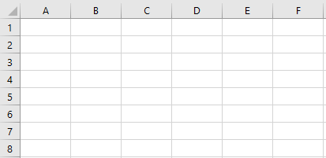
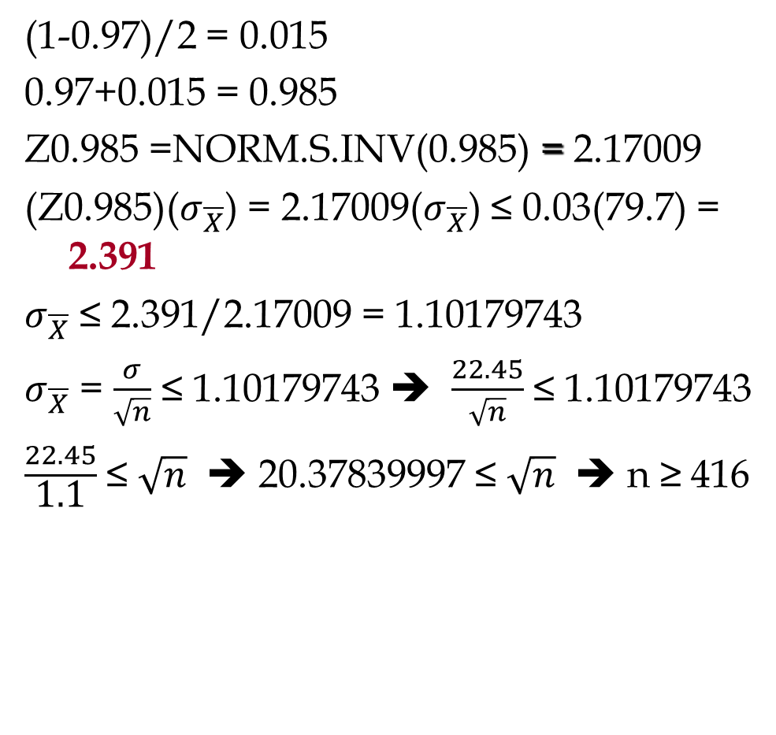
Example: National Discount, Inc.
Compute the sample size in the previous problem such that there is a 0.97 probability that the sampling error is within 3% of the Mean.
(1-0.97)/2 = 0.015
0.97+0.015 = 0.985
Z0.985 =NORM.S.INV(0.985) = 2.17009
(Z0.985)($σ_{\overline{X}}$) = 2.17009($σ_{\overline{X}}$) ≤ 0.03(79.7) = 2.391
$σ_{\overline{X}}$ ≤ 2.391/2.17009 = 1.10179743
$σ_{\overline{X}}$ = $\frac{σ}{\sqrt{n}}$ ≤ 1.10179743 ➔ $\frac{22.45}{\sqrt{n}}$ ≤ 1.10179743
$\frac{22.45}{\text{1.1}}$ ≤ $\sqrt{n}$ ➔ 20.37839997 ≤ $\sqrt{n}$ ➔ n ≥ 416

Slide 21
3-Ways to Compute CI in Excel

Slide 22
STOP HERE

Slide 23
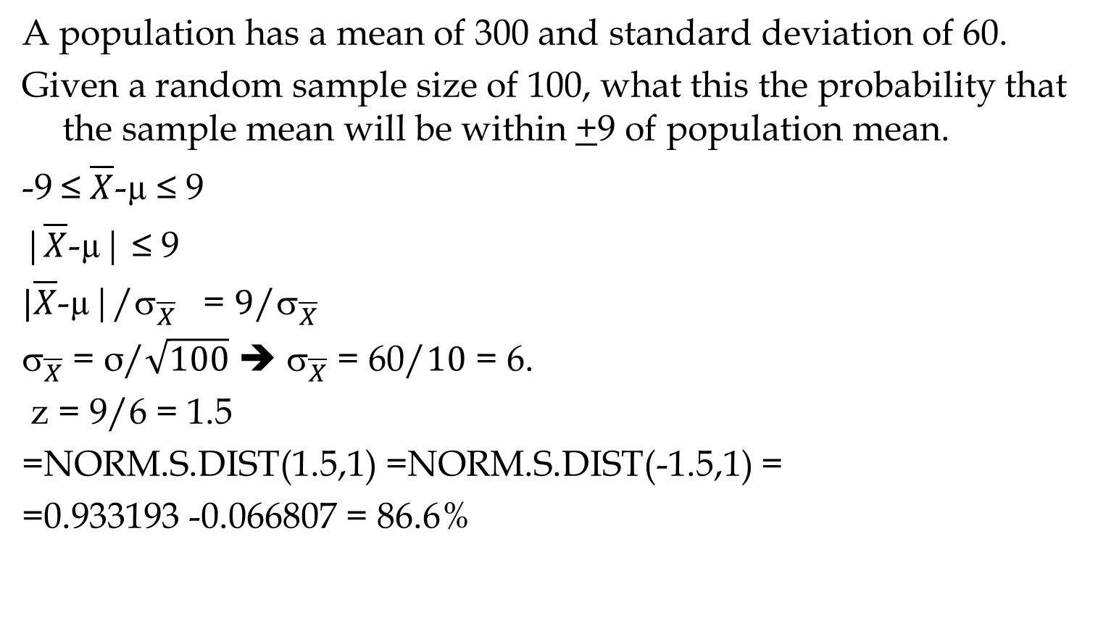
Sampling from an Infinite Population
A population has a mean of 300 and standard deviation of 60.
Given a random sample size of 100, what this the probability that the sample mean will be within +9 of population mean.
-9 ≤ $\overline{X}$-µ ≤ 9
|$\overline{X}$-µ| ≤ 9
$|\overline{X}$-µ|/${\text{}}_{\overline{X}}$ = $9$/${\text{}}_{\overline{X}}$
${\text{}}_{\overline{X}}$ = σ/$\sqrt{100}$ ➔ ${\text{}}_{\overline{X}}$ = 60/$10$ = 6.
z = 9/6 = 1.5
=NORM.S.DIST(1.5,1) =NORM.S.DIST(-1.5,1) =
=0.933193 -0.066807 = 86.6%

Slide 24
Standard Deviation Xbar & Pbar

Slide 25
When σ is Unknown and Sample Size is Small
If we do not have the population standard deviation σ, we estimate σ by s.
When we estimate σ by s, if the sample size is small (<30), we then need to use t-distribution instead of normal distribution.
t-distribution is a family of similar probability distributions.
A specific t distribution depends on a parameter known as the degrees of freedom.
As the number of degrees of freedom increases, the difference between the t distribution and the standard normal probability distribution becomes smaller and smaller.
A t distribution with more degrees of freedom has less dispersion.
The mean of the t distribution is zero
t-distribution get closer to Normal distribution as n increases.

Slide 26
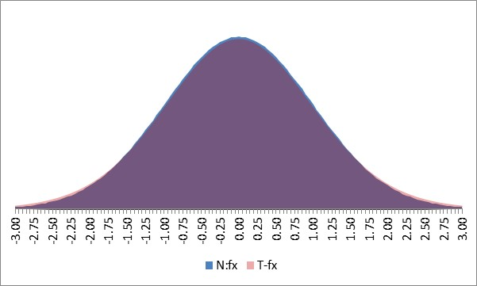
z and t: n=2, 10, 20
The interval estimate is given by:
The confidence level is 1 -α
s is the sample standard deviation
t_{α/2} is the t value providing an area of α/2 in the upper tail of a t distribution with n - 1 degrees of freedom.
To Make it easy, in this course we always use Normal Distribution)

Slide 27
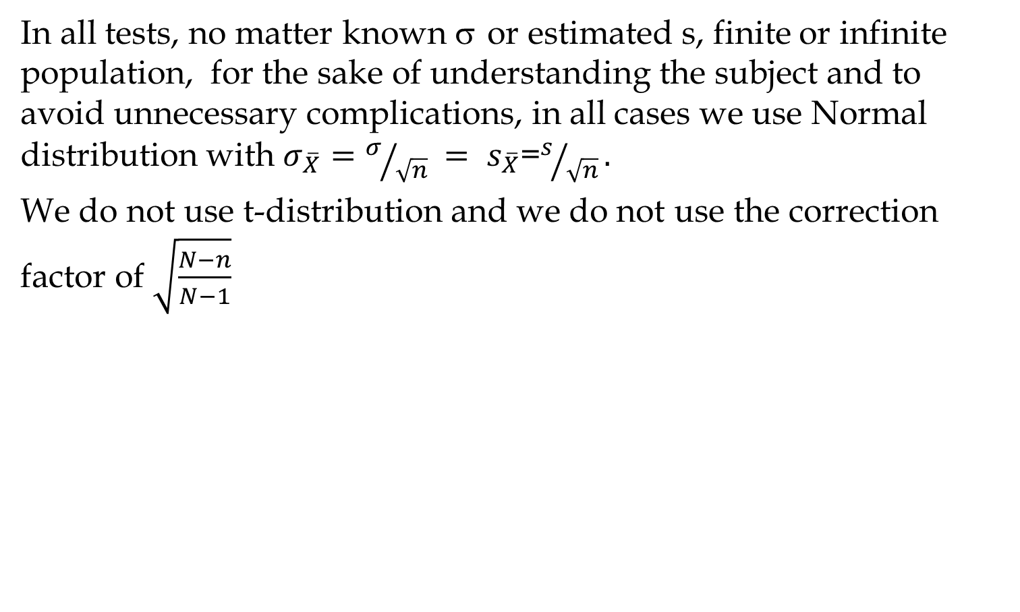
When σ is Unknown and Sample Size is Small
In all tests, no matter known σ or estimated s, finite or infinite population, for the sake of understanding the subject and to avoid unnecessary complications, in all cases we use Normal distribution with $σ_{\overline{X}}={σ/{\sqrt{n}} = s}_{\overline{X}}$=$s/{\sqrt{n}}.$
We do not use t-distribution and we do not use the correction factor of $\sqrt{\frac{N−n}{N−1}}$

Slide 28
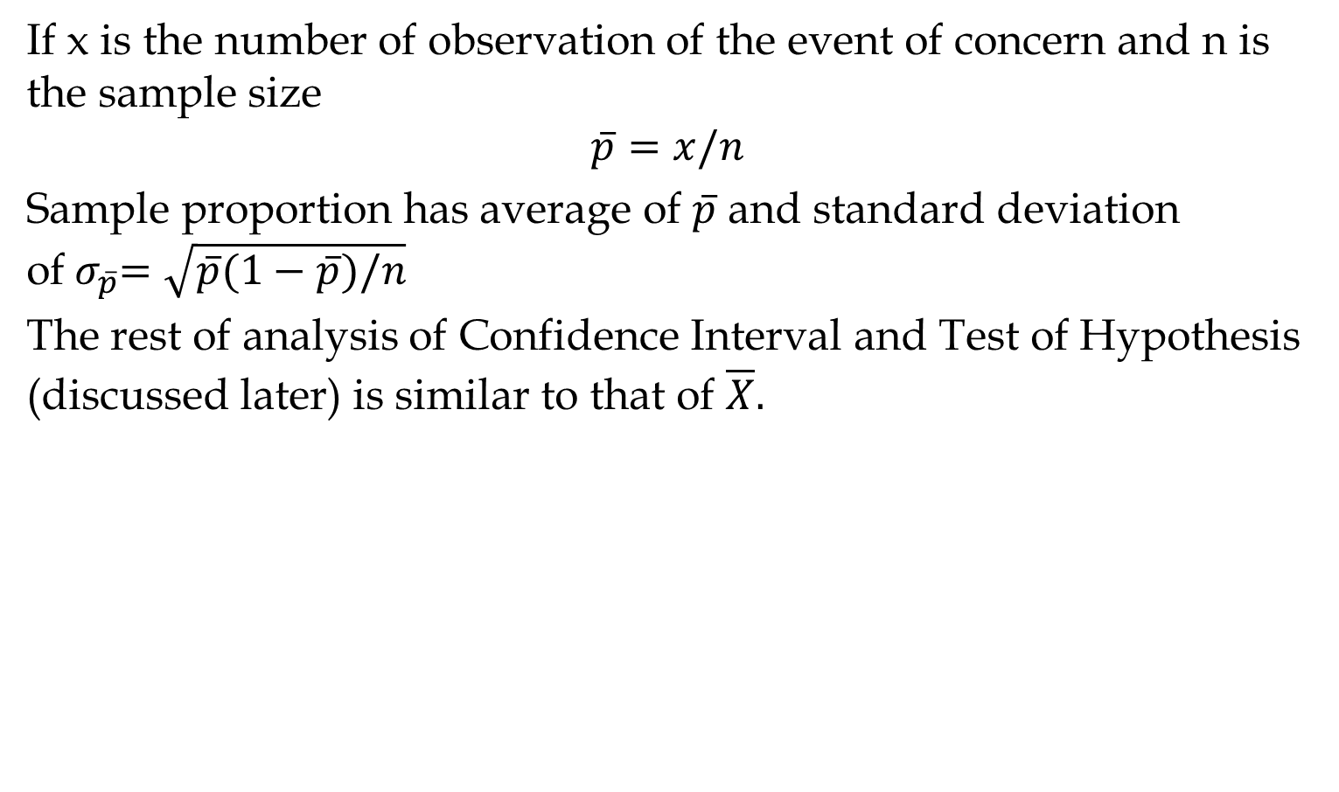
Proportion
If x is the number of observation of the event of concern and n is the sample size
$$\overline{p}=x/n$$
Sample proportion has average of $\overline{p}$ and standard deviation of${ σ}_{\overline{p}}=\sqrt{\overline{p}(1−\overline{p})/n}$
The rest of analysis of Confidence Interval and Test of Hypothesis (discussed later) is similar to that of $\overline{X}.$

