Slide 1
Random Variables Summation, Multiplication By a Constant, and Average

Slide 2
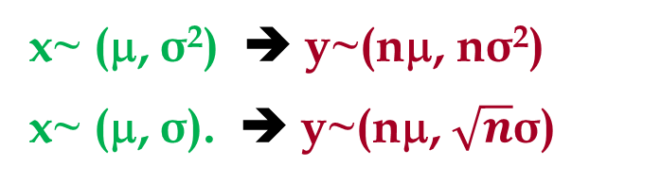
Summation of Several Random Variables
y = x1+x2+x3+……xn x~ (μ, σ): y~ (?, ?)
x~ (μ, σ²) ➔ y~(nμ, nσ²)
x~ (μ, σ). ➔ y~(nμ, $\sqrt{n}$σ)

Slide 3
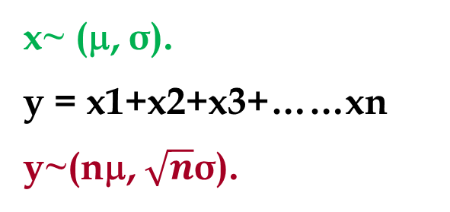
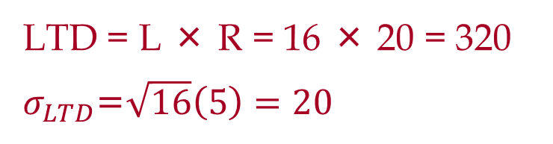
Variable Demand, Fixed Lead Time
Average demand per day is 20 units and standard deviation of demand per day is 5 units. The lead time (from the time that we place an order till we receive it) is 16 days. Compute the average and standard deviation of demand during the lead time.
x~ (μ, σ).
y = x1+x2+x3+……xn
y~(nμ, $\sqrt{n}$σ).
LTD = L × R = 16 × 20 = 320
$σ_{LTD}$=$\sqrt{16}\left(5\right)=20$

Slide 4
Multiplication of a Random Variable By a Constant
A random variable x~ μ, σ
y = kx ➔ y ~ (?, ?)
A random variable multiplied by a constant has the same variability as the original variable. The same C.V.
x ~ (μ, σ) ➔ y =kx ~ (kμ, kσ )

Slide 5
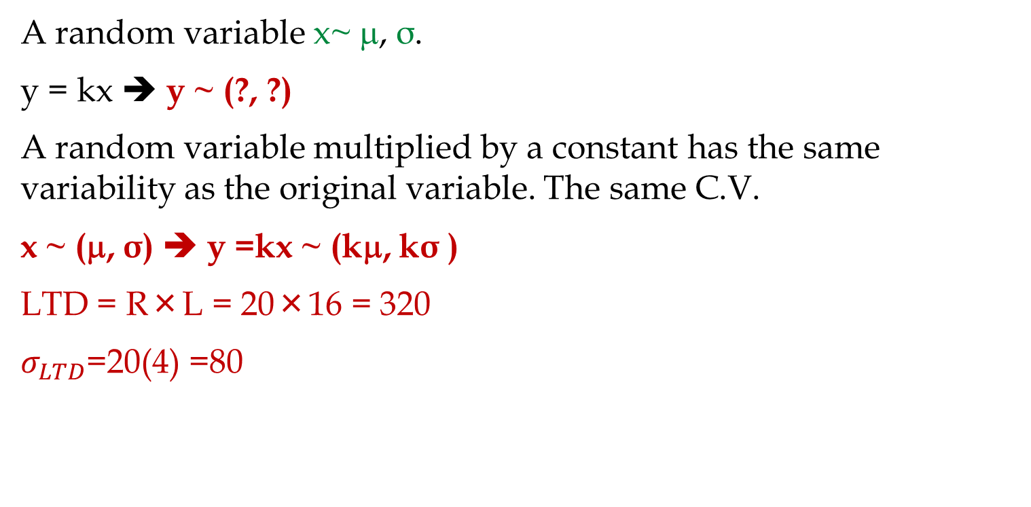
Variable Lead Time, Fixed Demand
Demand per day is 20 units. Lead time has an average duration of 16 days and standard deviation of lead time is 4 days. Compute the average and standard deviation of demand during the lead time.
A random variable x~ μ, σ.
y = kx ➔ y ~ (?, ?)
A random variable multiplied by a constant has the same variability as the original variable. The same C.V.
x ~ (μ, σ) ➔ y =kx ~ (kμ, kσ )
LTD = R×L = 20×16 = 320
$σ_{LTD}$=20(4) =80

Slide 6
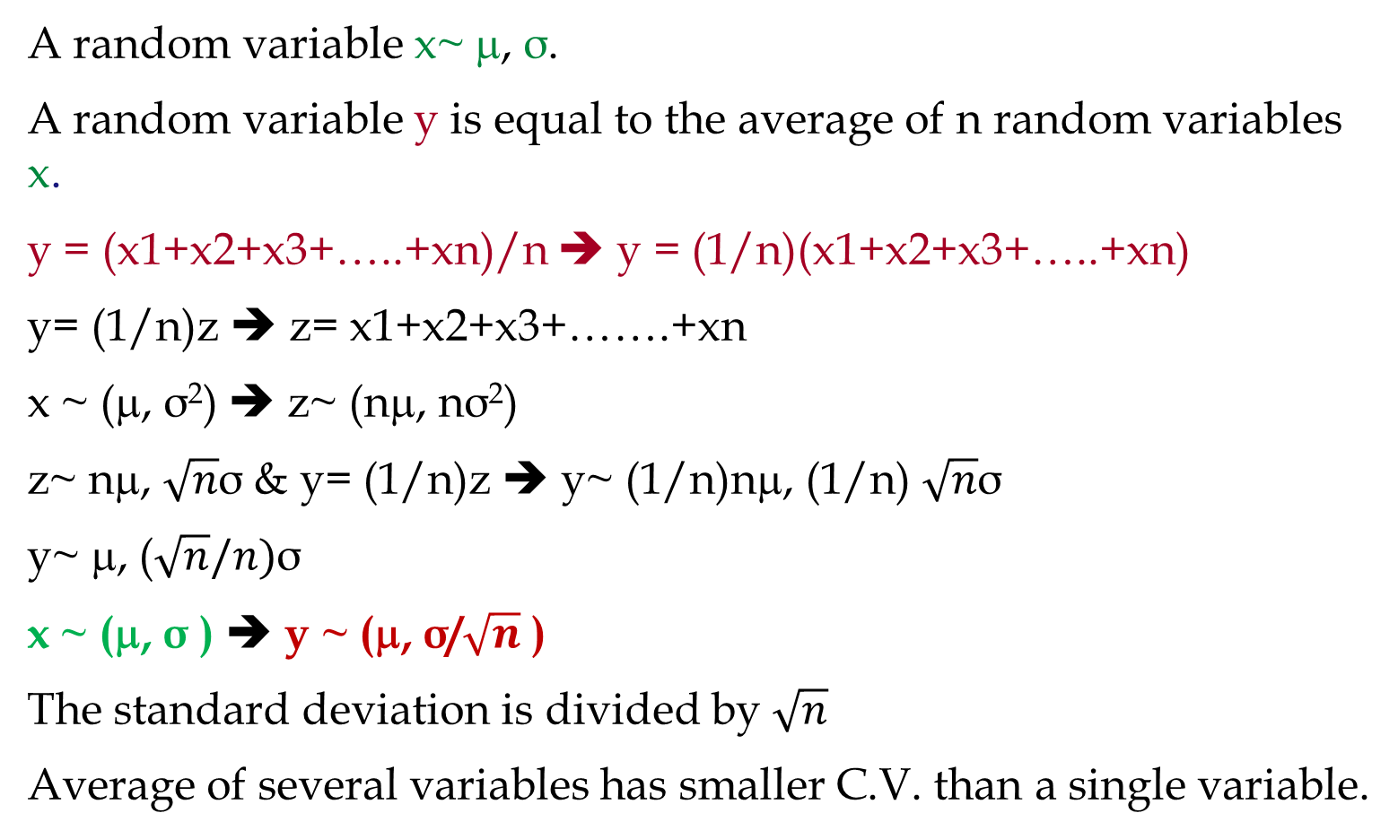
Average of Several Random Variables
A random variable x~ μ, σ.
A random variable y is equal to the average of n random variables x.
y = (x1+x2+x3+…..+xn)/n ➔ y = (1/n)(x1+x2+x3+…..+xn)
y= (1/n)z ➔ z= x1+x2+x3+…….+xn
x ~ (μ, σ²) ➔ z~ (nμ, nσ²)
z~ nμ, $\sqrt{n}$σ & y= (1/n)z ➔ y~ (1/n)nμ, (1/n) $\sqrt{n}$σ
y~ μ, ($\sqrt{n}/n)$σ
x ~ (μ, σ ) ➔ y ~ (μ, σ/$\sqrt{n}$ )
The standard deviation is divided by $\sqrt{n}$
Average of several variables has smaller C.V. than a single variable.

Slide 7
Average of 36 Randon Variables

Slide 8

Standard Deviation of $\overline{X}$ for N=25 and N=50

Slide 9
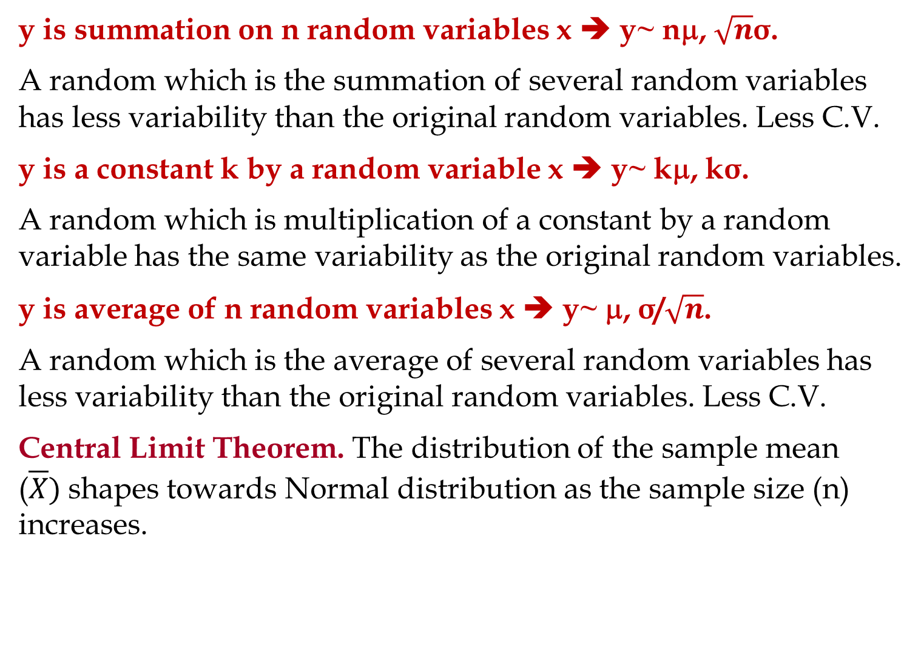
Summary
y is summation on n random variables x ➔ y~ nμ, $\sqrt{n}$σ.
A random which is the summation of several random variables has less variability than the original random variables. Less C.V.
y is a constant k by a random variable x ➔ y~ kμ, kσ.
A random which is multiplication of a constant by a random variable has the same variability as the original random variables.
y is average of n random variables x ➔ y~ μ, σ/$\sqrt{n}$.
A random which is the average of several random variables has less variability than the original random variables. Less C.V.
Central Limit Theorem. The distribution of the sample mean ($\overline{X})$shapes towards Normal distribution as the sample size (n) increases.

Slide 10
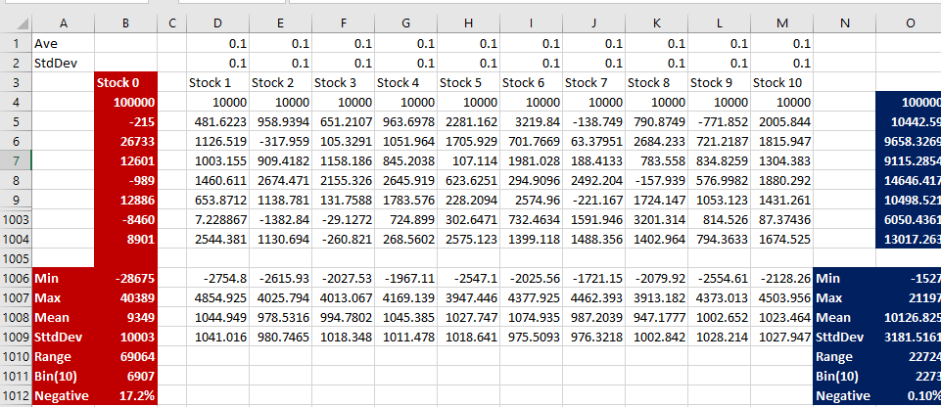
Centralization
Suppose there are 10 types of stock. The average return on each is 10% with standard deviation of 10%. Suppose one investor puts $100,000 in one of these stocks and another person puts $10,000 in each. Compute the probability of loss in these two investments by generating 1,0000 instances of each of these stocks.
Find the Excel Sheet

Slide 11
Risk Aversion with Centralization

Slide 12
Slightly Advanced Problems
Stop Here

Slide 13
Present Value Mean and Standard Deviation
We will have a cash inflow at the end of next year. This cash flow has mean of $1000 and standard deviation of 250. What is the mean and standard deviation of the present value of this cash flow. Our minimum acceptable rate of return in 12%.
We will have two cash inflows at the end of next two years. They both have mean of $1000 and standard deviation of 250. What is the mean and standard deviation of the present value of this cash flow. Our minimum acceptable rate of return in 12%.

Slide 14

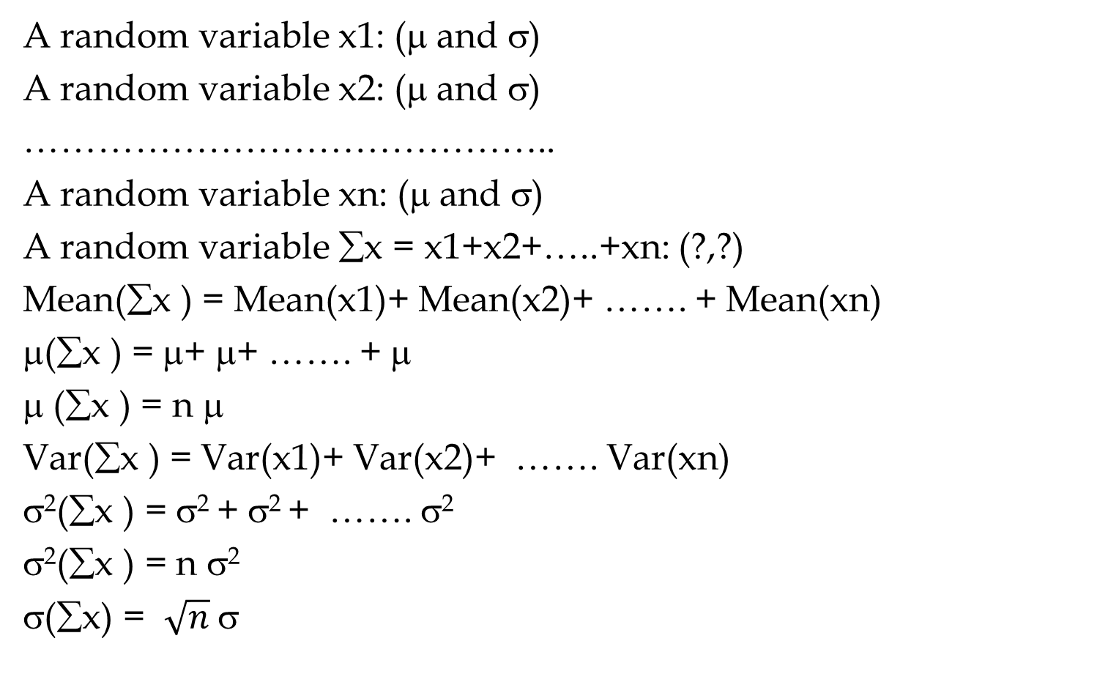
Sampling: Mean and Standard Deviation $\overline{X}$
A random variable x1: (μ and σ)
A random variable x2: (μ and σ)
……………………………………..
A random variable xn: (μ and σ)
A random variable ∑x = x1+x2+…..+xn: (?,?)
Mean(∑x ) = Mean(x1)+ Mean(x2)+ ……. + Mean(xn)
μ(∑x ) = μ+ μ+ ……. + μ
μ (∑x ) = n μ
Var(∑x ) = Var(x1)+ Var(x2)+ ……. Var(xn)
σ²(∑x ) = σ² + σ² + ……. σ²
σ²(∑x ) = n σ²
σ(∑x) = $\sqrt{n}$σ

Slide 15

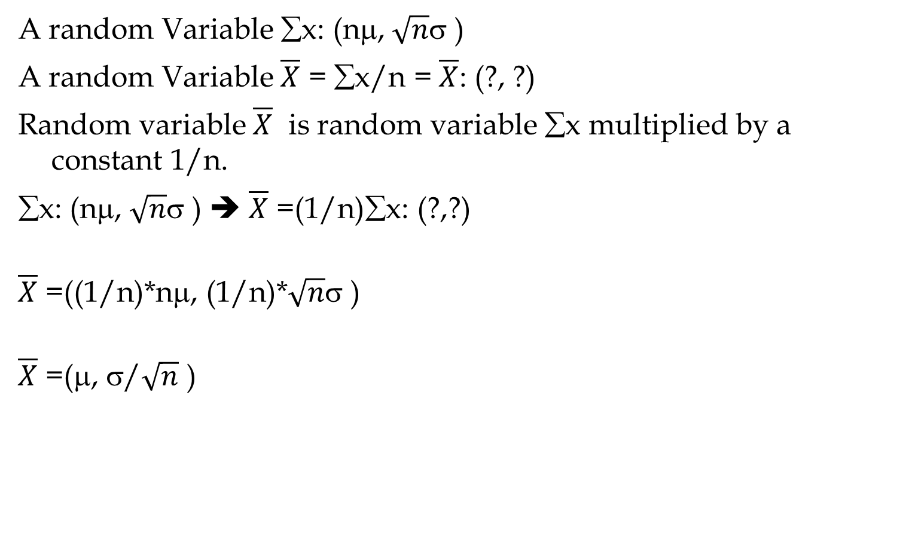
Sampling: Mean and Standard Deviation $\overline{X}$
A random Variable ∑x: (nμ, $\sqrt{n}$σ )
A random Variable $\overline{X}$ = ∑x/n = $\overline{X}$: (?, ?)
Random variable $\overline{X}$ is random variable ∑x multiplied by a constant 1/n.
∑x: (nμ, $\sqrt{n}$σ ) ➔ $\overline{X}$ =(1/n)∑x: (?,?)
$\overline{X}$ =((1/n)*nμ, (1/n)*$\sqrt{n}$σ )
$\overline{X}$ =(μ, σ/$\sqrt{n}$ )

Slide 16
Future Value (FV)
$100, put it in a bank. Interest rate = 10%. How much after 1 year. P = 100. F?
F1 = 100 +0.1(100) = 100(1+0.1)
How much after 2 years?
F2= 100(1+0.1) + 0.1(100(1+0.1)) =
F2= 100(1+0.1) (1+0.1) = 100(1.1)²
How much after 3 years?
F3 = 100(1.1)² + 0.1[100(1.1)²] =
F3 = 100(1.1)² [1+0.1] = 100(1.1)² [1.1] = 100(1.1)³
How much after N years
F = 100(1.1)^{N}

Slide 17
Future Value (FV); Present Value (PV)
P: The initial vale
MARR: Minimum Acceptable Rate of Return
F= P(1+MARR)^{N}
P = F/(1+MARR)^{N}
P = F/(1+r)^{N}
r = the minimum acceptable rate of return
=FV(r, N,PMT,PV,0→ EOY) =
=PV(r, N,PMT,FV,0 →EOY) =

Slide 18
Future Value (FV); Present Value (PV)
=FV(r, N,PMT,PV,0→ EOY) =
=PV(r, N,PMT,FV,0 →EOY) =
=FV(r,N, PMT, PV,0) =
FV(10%,3,0,100,0) =
=PV(r,N, PMT, FV,0) =
PV(10%,3,0,133.1,0) =

Slide 19
Present Value Mean and Standard Deviation
We will have a cash inflow at the end of next year. This cash flow has mean of $1000 and standard deviation of 250. What is the mean and standard deviation of the present value of this cash flow. Our minimum acceptable rate of return in 12%.
P=F/(1+r)
P= [1/(1+r)]F
P= KF
y=Kx
Mean (y) = K*Mean(x)
StdDev(y) = K*StdDev(x)
Mean (x) =1000
StdDev(x) = 300
K= (1/(1+.12) = 1/1.12 =
Mean (P) = 0.893* Mean(F)
Mean (P) = 0.893(1000)
Mean (P) = $893
StdDev(P) = 0.893*StdDev(x)
StdDev(P) = 0.893*250
StdDev(x) = 223
If P has Normal Distribution, Compute
Probability of P ≥ $1000
0.892857

Slide 20
Present Value Mean and Standard Deviation
We will have two cash inflows at the end of next two years. They both have mean of $1000 and standard deviation of 250. What is the mean and standard deviation of the present value of this cash flow. Our minimum acceptable rate of return in 12%.
P1=0.893F/(1+r)
P1= [1/(1+r)]F1
P2= [1/(1+r)²]F2
P1= [1/(1.12)]F1
P2= [1/(1.12)²]F2
P1= 0.893F1
P2= 0.797F2
Mean (P1) = 0.893(1000)
Mean (P2) = 0.797(1000)
P=P1+P2
y=x1+x2
Mean (y) = Mean (x1)+Mean(x2)
Var(y) = Var(x1)+Var(x2)
Mean (P) = Mean(P1)+Mean(P2)
Mean (P) = 893+797 = 1690
StdDev (P1) = 0.893(250) =223
StdDev (P2) = 0.797(250) = 199
Var (P) = Var(P1)+Var(P2)

Slide 21
Present Value Mean and Standard Deviation
Mean (P) = 1690
StdDev (P1) = 0.893(250) =223
StdDev (P2) = 0.797(250) = 199
Var(P1) = (223)² = 49824
Var(P2) = (199)² = 39720
Var (P) = Var(P1)+Var(P2)
Var (P) = 49824 + 39720 = 89544
StdDev (P) = SQRT(Var(P))
StdDev (P) = 299
If P has Normal Distribution, Compute
Probability of P ≥ $2000

Slide 22
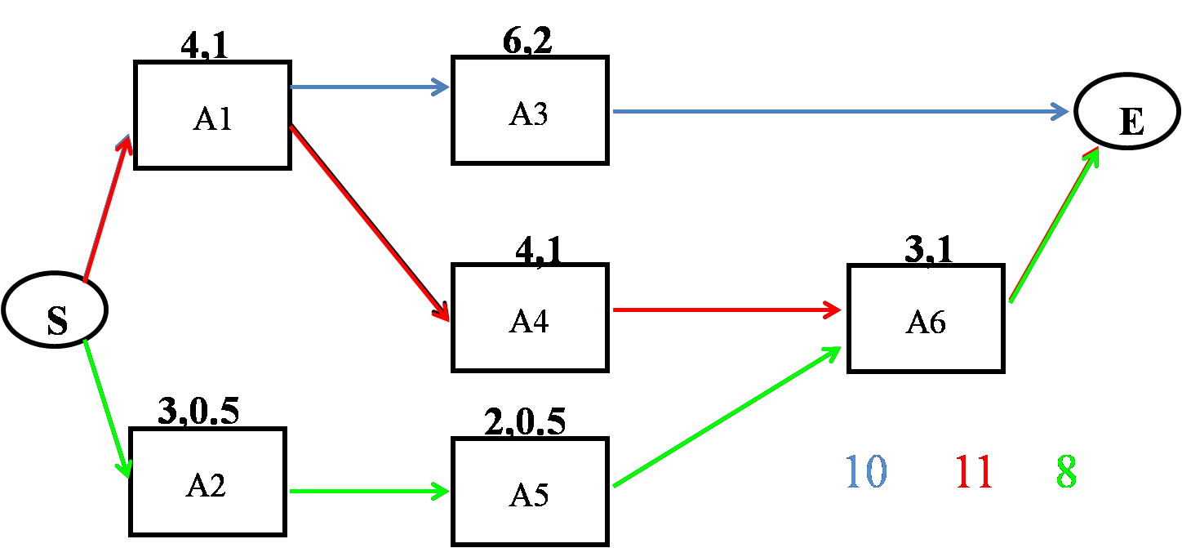
Project Scheduling
Given the following project with three paths, compute the mean and StdDev of each path. The pairs of numbers on each activity represent the mean and StdDev of each activity.

Slide 23
Project Scheduling
m_{CP}= 4+4+3 = 11
σ²_{CP} = 1²+1²+1² = 3
σ_{CP} = 1.73
=NORM.DIST(12,11,1.73,1)
= 0.7184
m_{CP}= 6+4 = 10
σ²_{CP} = 1²+2² = 5
σ_{CP} = 2.24
=NORM.DIST(12,10,2.24,1)
= 0.814
=NORM.DIST(12,8,1.22,1)
= 0.9995
m_{CP}= 3+2+3 = 8
σ²_{CP} = 0.5²+0.5²+1²
σ²_{CP} = 1.5
σ_{CP} = 1.22
The probability of competing the Project in not more than 12 days is 0.72×0.81×1 = 0.58

Slide 24
Project Scheduling
Critical Path
D_{CP} = the desired completion date of the critical path
μ_{CP}= the sum of the T_{E} for the activities on the critical path
σ²_{CP} = the sum of the variances of the activities on the critical path
Using μ_{CP} and σ_{CP} and NORM.DIST(D_{CP}, μ_{CP}, σ_{CP},1) we can find probability of completing the critical path in ≤ D_{CP} .
Project
Find all paths in the network. Compute µ and σ of each path
Compute the probability of completing each path in ≤ the given time
Calculate the probability that the entire project is completed within the specified time by multiplying these probabilities together

Slide 25
Practice
15, 3
5,1
20,4
A
D
G
E
20,2
10,2
10,2
B
S
E
H
10,3
20,5
C
F

