Slide 1
Chapter 7 Demand Forecasting in a Supply Chain
Forecasting -2.2
Regression Analysis
Ardavan Asef-Vaziri

Slide 2
Associative (Causal) Forecasting -Regression
The primary method for associative forecasting is Regression Analysis.
The relationship between a dependent variable and one or more independent variables.
The independent variables are also referred to as predictor variables.
We only discuss linear regression between two variables.
We consider the relationship between the dependent variable (demand) and the independent variable (time).

Slide 3
Regression Method
Computed relationship
Least Squares Line minimizes sum of squared deviations around the line

Slide 5
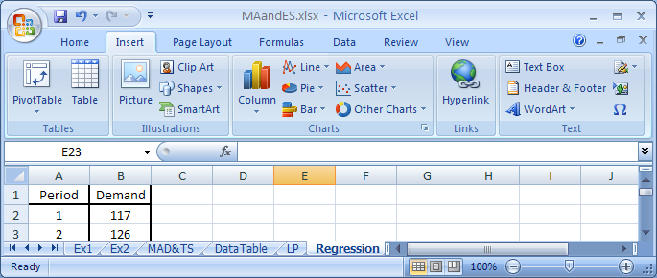
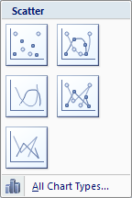
Regression: Chart the Data

Slide 6
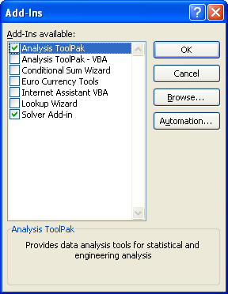
Regression: The Same as Solver but This Time Data Analysis

Slide 7
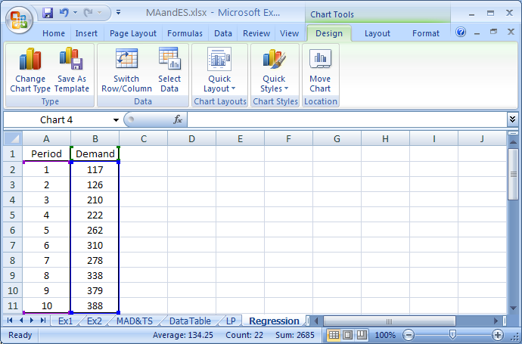
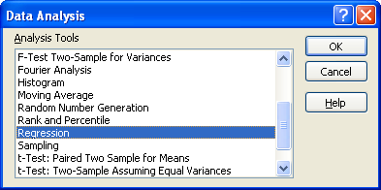
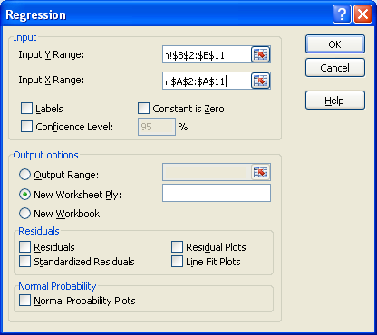
Data/Data Analysis/ Regression

Slide 8
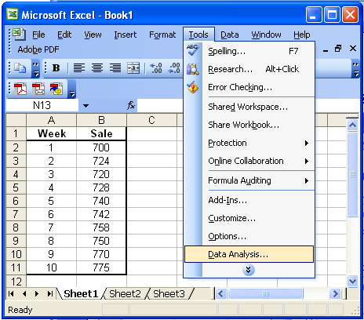
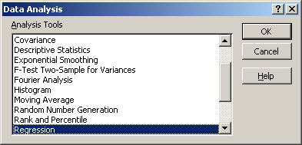
Regression: Tools / Data Analysis / Regression

Slide 9
Regression Output
Correlation Coefficient +↑. Close to + 1
Coefficient of Determination ↑ Close to 1
Standard Deviation of Forecast ↓
If the first period is 1, next period is 10+1 = 11
P-value ↓ less than 0.05

Slide 10
Regression Output
F_{t} = 94.13 +30.71t
What is your forecast for the next period.
F11 = 94.13 +30.71(11) = 431.7
Mean Forecast = 431.7, Standard Deviation of Forecast = 22.21

