Slide 1
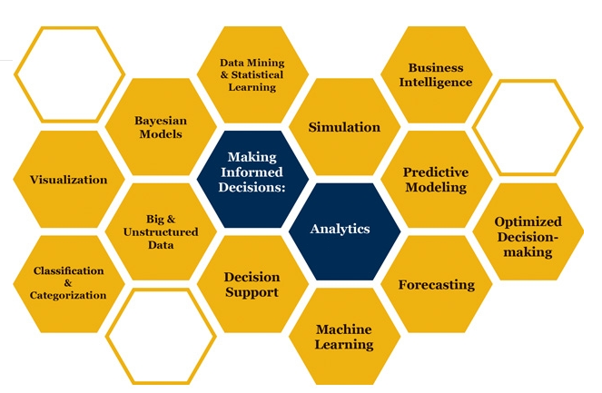

Slide 2

Basic Probability Distributions
How can it be that mathematics, being after all a product of human thought independent of experience, is so admirably adapted to the objects of reality
Albert Einstein
Some parts of these slides were prepared based on
Essentials of Modern Busines Statistics, Anderson et al. 2012, Cengage.
Managing Business Process Flow, Anupindi et al. 2012, Pearson.
Project Management in Practice, Meredith et al. 2014, Wiley

Slide 3
Triangular Probability Distribution

Slide 4
Triangular Probability Distributions
a
m
b
a = smallest value the variable can assume
b = largest value the variable can assume
m = most likely value the variable can assume
Expected Value of x ➔ µ = (a +m+ b)/3
Variance of x ➔ s ² = (a² + m² +b² – ab- am-bm)/18

Slide 5
Generate a Triangular Random Variable
Compute the height of this triangle
H/2= 1/(b-a)
a
m
b
Similarly, the area to the right is
Generate a random number if rand() ≤ (m-a)/(b-a) we are on the left, otherwise on the right

Slide 6
Triangular Probability Distributions
Suppose we are on the left
Then the triangular random variable is something like X
H
h
a
X
m
b
What is the height associated with X?
➔
➔
The area to the left of X is then

Slide 7
Triangular Probability Distributions
H
h
a
X
m
b
The area to the left of X was our rand() which happened to drop on the left

Slide 8
Triangular Probability Distributions
H
h
a
X
m
b
Generate a random number if ≤ (m-a)/(b-a) we are on the left, and implement the above equation to generate the random variable, otherwise we are on the right

Slide 9
Triangular Probability Distributions
We showed that for X on the left
H
h
a
m
X
b
Similarly, we can show that if X is on the right of m, the area to the right of h is
This is the area to the right of X, but the area to the left of X was equal to Rand() ➔ The area to the right of X is equal to 1- Rand()

Slide 10
Triangular Probability Distributions
H
h
a
m
X
b

Slide 11
Triangular Probability Distributions
Generate a random number if ≤ (m-a)/(b-a) we are on the left, otherwise on the right.
If on the left ➔
If on the Right ➔

Slide 12
Triangular Probability Distributions
Suppose a=5, b= 20, m=10
Generate a random number
If Rand()≤0.333333
Otherwise

Slide 13
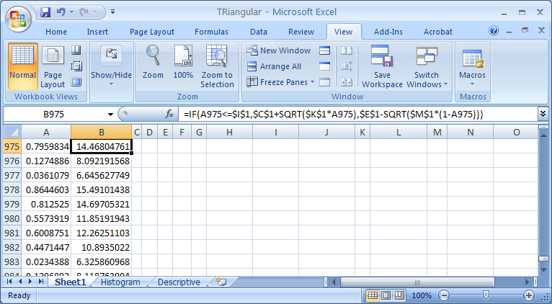
Generate

Slide 14
Histogram

Slide 15
Descriptive Statistics

Slide 16
Practice: Simulate in excel: All Activities Follow Triangular Distribution
3,4,6
6,4,7
A1
A3
E
3,4,5
2,3,5
S
A4
A6
1,3,5
1,2,4
10
11
8
A2
A5
What is the probability of completing the project in 12 days?

Slide 17
Random Variable Generation
Distribution | Mean | Var | Generation
Uniform | (a+b)/2 | (b-a)/12 | x=a+(b-a)Rand()
Normal | μ | σ×σ | x=μ+σNORMSINV(Rand())
Exponential | μ | μ×μ | x=-μLN(Rand())
Triangle | (a +m+ b)/3 | (a² + m² +b² – ab- am-bm)/18 | If Rand()≤(m-a)/(b-a)
 |  |  | Otherwise

