Slide 1

Lecture on Exponential Probability Distribution
https://youtu.be/yfcwjJataV4
Ardavan Asef-Vaziri

Slide 2
Exponential and Poisson Relationship
When average is small: Poisson Looks Like Exponential
As average goes up: Poisson moves looking like Normal
But do not forget: Poisson is a Discrete distribution, Exponential & Normal are Continuous Distributions.

Slide 3
Exponential Probability Distribution
The exponential random variables can be used to describe:
Time between vehicle arrivals at a toll booth.
Distance between major defects in a highway.
Time required to complete a questionnaire.
Time it takes to complete a task.
In waiting line applications, the exponential distribution is often used for interarrival time of orders and processing/service times.
In real-life applications it is a close to reality assumption for interarrival times but not for processing times. However, since exponential distribution has some mathematical futures, it is used for processing times too.
The exponential distribution is skewed to the right. The mean and standard deviation are equal in Exponential distribution. In Poison distribution mean and variance are equal.

Slide 4
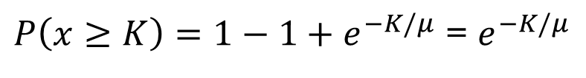
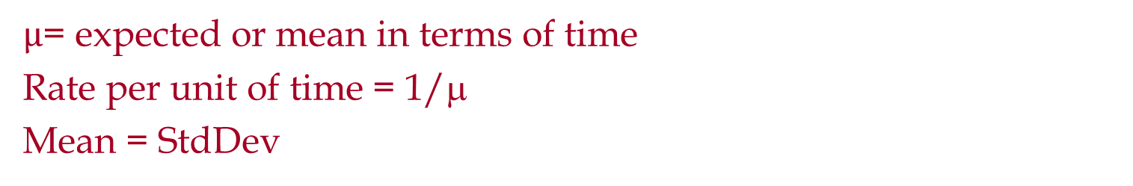
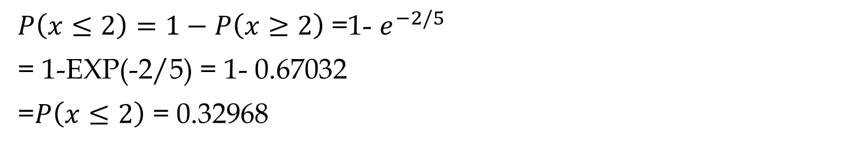

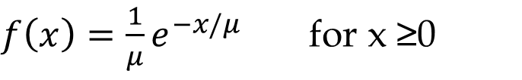

Exponential Probability Distribution
$f\left(x\right)=\frac{1}{μ}e^{−x/μ}$ for x ≥0
$µ$= expected or mean in terms of time
Rate per unit of time = 1/μ
Mean = StdDev
If $µ$= 5 min, compute f(2) = EXPON.DIST(2,1/5,0)
=0.134
$$Compute P\left(x≤2\right)$$
=EXPON.DIST(2,1/5,1)
= 0.32968
$$P\left(x≤K\right)=1−e^{−K/μ}$$
$P\left(x≥K\right)=1−1+e^{−K/μ}$ = $e^{−K/μ}$
$P\left(x≤2\right)=1−P\left(x≥2\right)$ =1- $e^{−2/5}$
= 1-EXP(-2/5) = 1- 0.67032
=$P\left(x≤2\right)$ = 0.32968

Slide 5
Exponential Probability Distribution
The time between arrivals of cars at a gas station follows an exponential probability distribution with a mean time between arrivals of 3 minutes.
What is the probability that the time between two successive arrivals will be 2 minutes or less.
f(x)
P(x < 2) = 1- 0.5134171= 0.4865829
.4
.3
P(x ≥ 2) =e^{-2/3} = EXP(-2/3) = 0.5134171
.2
.1
x
0 1 2 3 4 5 6 7 8 9 10
Time Between Successive Arrivals (mins.)

Slide 6
Exponential Probability Distribution
Average trade time in Ameritrade is one second. Ameritrade has promised its customers if trade time exceeds 5 second it is free (a $10.99 cost saving). The same promises have been exercised by Dominion Pizza (A free regular pizza) and Wells Fargo ($5 if waiting time exceeds 5 minutes). There are 150,000 average daily trade. What is the cost to Ameritrade? Service time follows Exponential distribution.
P(x≥ K) = EXP(-K/µ) = EXP(-5/1) = 0.006738
=1- EXPON.DIST(5,1/1,1) =1- 0.993262 = 0.006738
Probability of not meeting the promise is 0.6738%
0.006738*150,000* = 1011 orders
@10.99 per order = 10.99*1011 = $11111 per day

Slide 7
Exponential Probability Distribution
What was the cost if they had improved their service level by 50% that is to make it free for transactions exceeding 2.5 secs.
EXP(-2.5/1) = 0.082085
8.2085%*150,000*10.99 = $135317 per day
We cut the promised time by half- we may say our service quality doubled.
Our cost increased 12 times- we may say our costs increased by 1100%.

Slide 8
Exponential Probability Distribution
In a single phase single server service process and exponentially distributed interarrival time and service times, the actual total time that a customer spends in the process is also exponentially.
Suppose total time the customers spend in a pharmacy is exponentially distributed with mean of 15 minutes. The pharmacy has promised to fill all prescriptions in 30 minutes. What percentage of the customers cannot be served within this time limit?
P(x≥30) = EXP(-30/15) = 0.1353
13.53% of customers will wait more than 30 minutes.
= P(x ≤ 30) = EXPON.DIST(30,1/15,1)
= P(x ≤ 30) = 0.864665
P(x ≥ 30) = 1- P(x ≤ 30) = 1- 0.864665 = 0.1353

Slide 9
Exponential Probability Distribution
90% of customers are served in less than what time interval?
1-e^{-K/μ} = 0.9
Find K
SOLVER

Slide 10
Exponential Random Number Generator
P(x ≥ X) = e^{(-X/µ)}
P(x ≥ X) = between 0 and 1 = rand()
e^{(-X/µ)} = rand()
-X/µ= ln(rand())
X = -µln(rand())

Slide 11
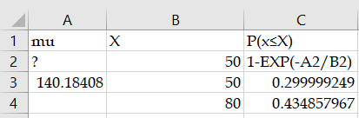
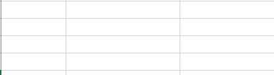
Problem- Exponential- Not Easy
The number of days that elapse between the beginning of a calendar year and the moment a high-risk driver is involved in an accident is exponentially distributed. An insurance company expects that 30% of high-risk drivers will be involved in an accident during the first 50 days of a calendar year.
Compute the average and Standard Deviation of this distribution.
Calculate the portion of high-risk drivers are expected to be involved in an accident during the first 80 days of a calendar year.
(A) 0.15
(B) 0.34
(C) 0.43
(D) 0.57
(E) 0.66

Slide 12
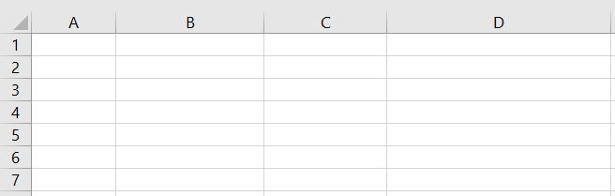
Problem-Exponential-Not easy
The lifetime of a printer costing 200 is exponentially distributed with mean 2 years. The manufacturer agrees to pay a full refund to a buyer if the printer fails during the first year following its purchase, a one-half refund if it fails during the second year, and no refund for failure after the second year.
Calculate the expected total amount of refunds from the sale of 100 printers.
(A) 6,321
(B) 7,358
(C) 7,869
(D) 10,256
(E) 12,642

Slide 13

Poisson Probability Distribution
A Poisson distributed random variable may assume an infinite sequence of values (x = 0, 1, 2, . . . ).Theoretically, there is no upper limit for the number of occurrences.
In reality, f(x) after an initial increase, starts decreasing, such that after some points it is approximately zero.
Two properties of Poisson Distribution
  The probability of an occurrence is the same for any two intervals of equal length.
  The occurrence or nonoccurrence in any interval is independent of the occurrence or nonoccurrence other intervals.
x = the number of occurrences in an interval
f(x) = the probability of x occurrences in an interval
µ = mean number of occurrences in an interval
$$f\left(x\right)=\frac{{μ^{x}e}^{−μ}}{x!}$$
e = 2.71828
x! = x(x – 1)(x – 2) . . . (2)(1)

Slide 14
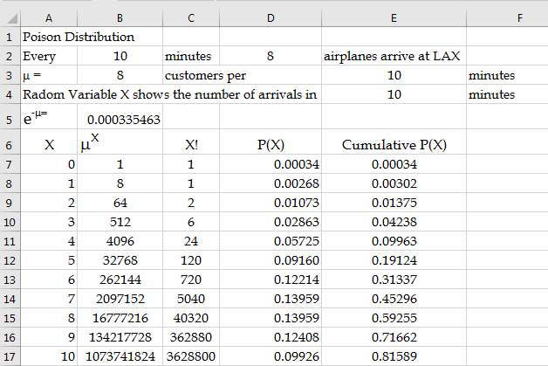
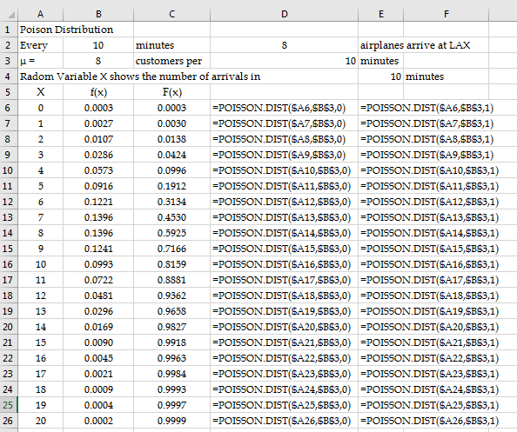
Poisson Probability Distribution Formula
Every 10 minutes 8 airplanes arrive at LAX. μ = 8 arrivals per 10 min. Radom Variable x shows the number of arrivals in 10 mins.
Use Poison formula to compute P(x) = 1, 2, 3, ….10. Also compute P(x) ≤ 1, 2, 3, ….10.

Slide 15
Poisson Probability Distribution
A Poisson random variable is useful in estimating the number of occurrences over a specified interval of time or space.
In practical applications, x will eventually become large enough so that f(x) is approximately zero and the probability of any larger values of x becomes negligible.
Poisson Distribution 1
Poisson Distribution 2

Slide 16
Examples of Poisson Probability Distribution
A retail store aimed to reduce the number of bad checks cashed by its cashiers. The store's goal is to cash no more than eight bad checks per week. The average number of bad checks cashed is three per week.
a) Find the probability that the store's cashiers will not cash any bad checks in a particular week.
P(x=0) = POISSON.DIST(0,3,0) = 0.04979 =
b) Find the probability that the store will not meet its goal in a particular week.
P(x>8) = 1- P(x≤ 8) = 1- POISSON.DIST(8,3,1) = 1- 0.9962 = 0.0038

Slide 17
Examples of Poisson Probability Distribution
c) Find the probability that the store's cashiers will cash no more than 4 bad checks per two-week period.
Mean for 2 weeks = 2(3) = 6
P(x≤ 4) =POISSON.DIST(4,6,1) = 0.28506
d) Find the mean, variance, and standard deviation of the number of bad checks per week?
3, 3, SQRT(3)

Slide 18

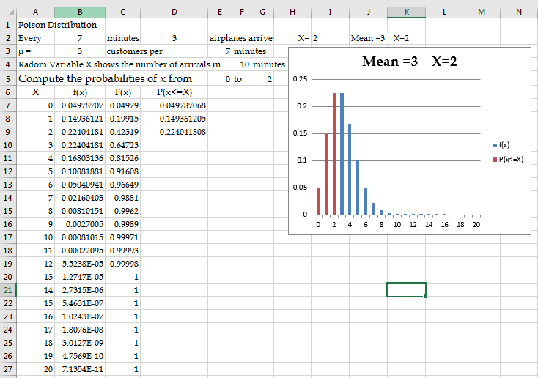
Poisson Excel Sheets

Slide 19
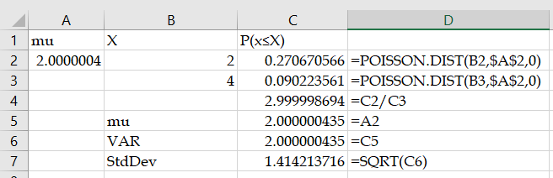
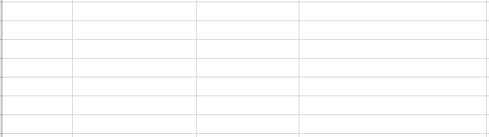
Problem- Poisson- Not Easy
An actuary has discovered that policyholders are three times as likely to file two claims as to file four claims.
The number of claims filed has a Poisson distribution.
Calculate the variance of the number of claims filed.
0.58
1
1.41
2
4

Slide 20
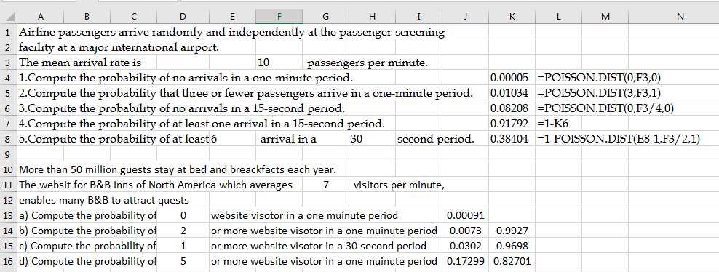
Poisson Distribution

Slide 21
Exponential & Poisson Relationship
The Poisson distribution provides an appropriate
Description of the number of occurrences per interval
The exponential distribution provides an appropriate description of the length of the interval between occurrences
One customer arrives per 15 minutes.
This is Exponential Distribution.
What is the probability of arrival of 3 customers in 30 minutes.
This is Poisson distribution.
The average number of customers arriving in 30 mins is 2.
=POISSON.DIST(3,2,1) =0.857123

Slide 22
Problem- Exponential & Passion Relationship
The interarrival time between two airplanes landing in a busy airport is 1.5 minutes.
a) What is the probability that the time between arrivals of two airplanes is more than one minute?
0.513417119 =EXP(-1/1.5)
0.513417119 =1-EXPON.DIST(1,1/1.5,1)
b) What is the probability that the time between arrivals of two airplanes is less than 150 seconds?
0.811124397 =1-EXP(-150/90)
0.811124397 =EXPON.DIST(150,1/90,1)
0.811124 =EXPON.DIST(2.5,1/1.5,1)

Slide 23
Problem- Exponential & Passion Relationship
c) What is the probability that the time between arrivals of two airplanes is between 100 and 200 seconds?
0.329192988 =EXP(-100/90)
0.108368023 =EXP(-200/90)
0.220824965 =A4-A5
0.670807012 =EXPON.DIST(100,1/90,1)
0.891631977 =EXPON.DIST(200,1/90,1)
0.220824965 =A9-A8

Slide 24
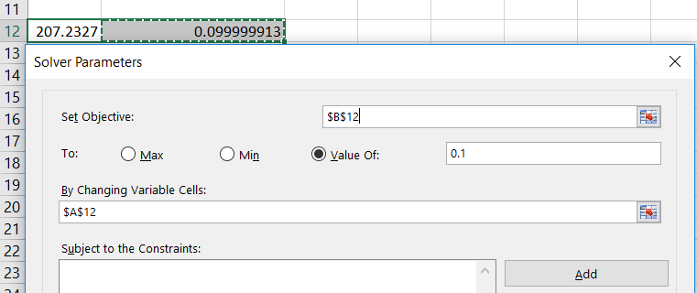
Problem- Exponential & Passion Relationship
d) The top 10% longest interarrival times exceed what time interval?
Set cell A12 as your x. Then in cell B12 type EXP(-A12/1.5). Then in solver the problem to set B12=0.1.
e) On Average how many airplanes arrive in every 15 minutes?
15/1.5= 10 airplanes per 15 minutes
f) What is the probability of arrival of 12 airplanes in 15 minutes?
0.09478033 =POISSON.DIST(12,10,0)

Slide 25
Problem- Exponential & Passion Relationship
g) What is the probability of arrival of at least 15 airplanes in 15 minutes?
0.083458473 =1-POISSON.DIST(14,10,1)
h) What is the probability of arrival of 10 to 20 airplanes in 30 minutes?
0.004995412 =POISSON.DIST(9,20,1)
0.559092584 =POISSON.DIST(20,20,1)
0.554097172 =L23-L22

Slide 26
Problem- Exponential & Passion Relationship
Patients arrive at the emergency room of Mercy Hospital at the average rate of 7 per hour on weekend
Compute the probability of 4 arrivals in 30 minutes on a weekend evening?
Average in 30 mins is 7/2
0.18881229 =POISSON.DIST(4,7/2,0)
b) Compute the probability of 2 or less arrivals in 30 minutes on a weekend evening?
0.3208472 =POISSON.DIST(2,7/2,1)
c) Compute the probability of 3 or more arrivals in 30 minutes on a weekend evening?
1- 0.3208472 = 0.6791528

Slide 27
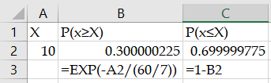
Problem- Exponential & Passion Relationship
d) Compute the probability of 12 or more arrivals in two hours on a weekend evening?
Mu in 2 hours = 7(2)= 14
0.73996008 =1-POISSON.DIST(11,14,1)
e) Compute the probability that the interarrival between two consecutive customers is less than 10 minutes.
0.688596776 =EXPON.DIST(1/6,7,1)
0.688596776 =EXPON.DIST(10,7/60,1)
0.688596776 =1-EXP(-10/(60/7))
f) 70% of patients arrive in less than what time interval after the previous patient.
mu = 60/7 = 8.571428571

Slide 28
Exponential & Poisson Relationship

Slide 29
Poisson and Binomial Relationship
Suppose 60% of a large group of animals is infected with a particular disease. Let Y= the number of non- infected animals in a sample of size 5. The distribution of Y is
  a) binomial with n = 5 and p = 0.6
  b) binomial with n = 5 and p = 0.4
  c) binomial with n = 5 and p = 0.5
  d) Poisson with mu μ= 0.6
  e) Poisson with μ = 3
Compute probability of 2 infected animal in a group of 5.
  a) binomial with n = 5 and p = 0.6 ➔ =BINOM.DIST(2,5,0.6,0)=0.2304
  b) binomial with n = 5 and p = 0.4 ➔ =BINOM.DIST(3,5,0.4,0)=0.2304
  c) binomial with n = 5 and p = 0.5
  d) Poisson with mu μ= 0.6
  e) Poisson with μ = 3 ➔ =POISSON(2,3,0)=0.224041807655388

Slide 30
Poisson and Binomial Relationship
A typical page in a book contains one typo per page. Suppose that every page in the chapter contains exactly 500 words , and there is still an average of one typo per page. What is the probability that there are exactly 8 typos in a given 10-page chapter?
Poisson distribution: Since the expected number of typos on one page is 1, the expected number of typos in 10 pages is 10.
= 10, P(x=8) =?
=POISSON(8,10,0)=0.11259903214902
Binomial distribution: Assume a typo counts as a success. The probability of success is p= 1/500 ; we have n= 5000 trials.
=BINOM.DIST(8,5000,1/500,0)=0.112644065666273

