Slide 1
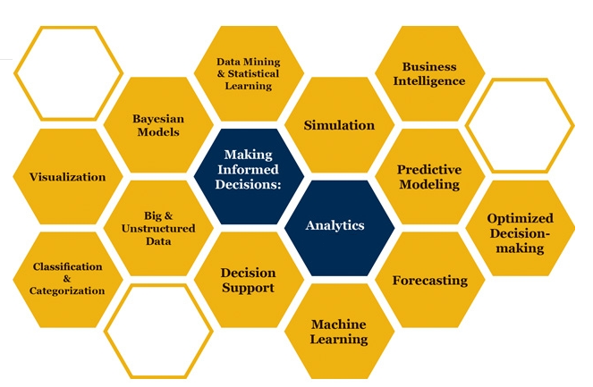

Slide 2
Simulation of Continuous Probability Distributions

Slide 3
Simulation of Break-Even Analysis
Fixed Cost =INT(A$3+(A$4-A$3)*RAND())
Variable Cost=INT(B$3+(B$4-B$3)*RAND())
Sales Price=INT($C$3+$C$4*NORM.S.INV(RAND()))
Sales =-INT($D$3*LN(RAND()))

Slide 4
Simulation of Break-Even Analysis

Slide 5
Simulation
Simulation helps us to overcome our shortcomings in analysis of complex systems using statistics, and also to see the dynamics of the system.
Statistics vs. Simulation: To compute probability of completion time or cost of a network of activities.
  Both must enumerate all the paths to compute the probability
  Statistics assume path interdependence while simulation does not
For Simplicity, Triangular distribution is used to estimate Beta distribution.

