Slide 1
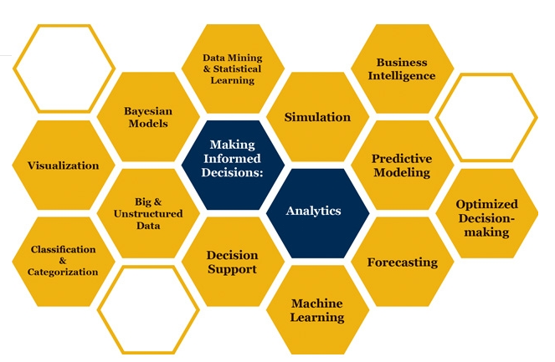
Exponential and Poisson Distributions

Slide 2
Exponential and Poisson Relationship

Slide 3
Exponential Probability Distribution
The exponential random variables can be used to describe:
  Time between vehicle arrivals at a toll booth.
  Distance between major defects in a highway.
  Time required to complete a questionnaire.
  Time it takes to complete a task.
In waiting line applications, the exponential distribution is often used for interarrival times and service times.
In real-life applications it is valid for interarrival times but not for service times. However, since it has some neat mathematical futures, it is used for service times too.
A property of the exponential distribution is that the mean and standard deviation are equal.
The exponential distribution is skewed to the right. Its skewness measure is 2.

Slide 4


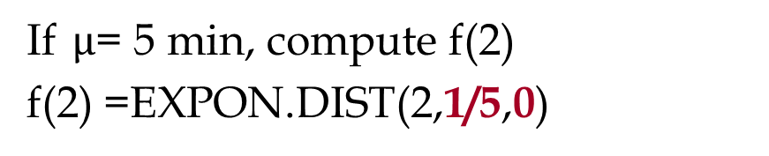
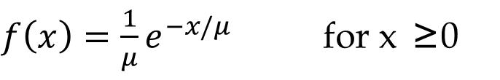
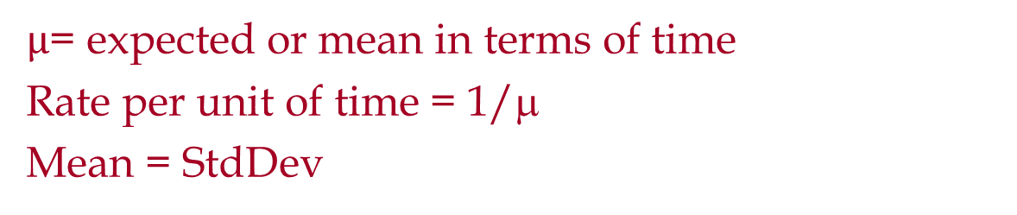
Exponential Probability Distribution
$f\left(x\right)=\frac{1}{μ}e^{−x/μ}$ for x ≥0
$µ$= expected or mean in terms of time
Rate per unit of time = 1/μ
Mean = StdDev
If $µ$= 5 min, compute f(2)
f(2) =EXPON.DIST(2,1/5,0)
=0.134
$$P\left(x≤X1\right)=1−e^{−X1/μ}$$
$$P\left(x≤2\right)=1−e^{−2/5}$$
=EXPON.DIST(2,1/5,1)
=0.32968

Slide 5

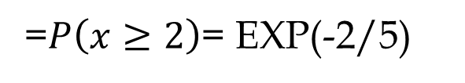

Exponential Probability Distribution
=EXPON.DIST(X1,1/µ,1)
$$P\left(x≥X1\right)=1−\left(x≤X1\right)=1−1+e^{−X1/μ}$$
$$P\left(x≥X1\right)=e^{−X1/μ}=$$
EXP(-X1/µ)
$$P\left(x≤X1\right)=1−\text{EXP}\text{(−}\text{X}\text{1/}µ\text{) }$$
=$P\left(x≥2\right)$= EXP(-2/5)
=0.67032
$P\left(x≤2\right)=1−P\left(x≥2\right)=1−\text{0.67032}$ = 0.32968

Slide 6
Exponential Probability Distribution
The time between arrivals of cars at Al’s gas station follows an exponential probability distribution with a mean time between arrivals of 3 minutes. Al would like to know the probability that the time between two successive arrivals will be 2 minutes or less.
f(x)
P(x < 2) = 1- 0.5134171= 0.4865829
.4
.3
P(x ≥ 2) =e^{-2/3} = EXP(-2/3) = 0.5134171
.2
.1
x
0 1 2 3 4 5 6 7 8 9 10
Time Between Successive Arrivals (mins.)

Slide 7
Exponential Probability Distribution
Average trade time in Ameritrade is one second. Ameritrade has promised its customers if trade time exceeds 5 second it is free (a $10.99 cost saving. The same promises have been practiced by Damion Pizza (A free regular pizza) and Wells Fargo ($5 if waiting time exceeds 5 minutes). There are 150,000 average daily trade. What is the cost to Ameritrade”
P(x≥ X0) = EXP(-X0/µ) = EXP(-5/1) = 0.006738
Probability of not meeting the promise is 0.6738%
0.006738*150,000* = 1011 orders
@10.99 per order = 10.99*1011 = $11111 per day

Slide 8
Exponential Probability Distribution
What was the cost if they had improved their service level by 50% that is to make it free for transactions exceeding 2.5 secs.
EXP(-2.5/1) = 0.082085
8.2085%*150,000*10.99 = $135317 per day
We cut the promised time by half, our cost increased 12 times.

Slide 9
Exponential Probability Distribution
In a single phase single server service process and exponentially distributed interarrival time and service times, the actual total time that a customer spends in the process is also exponentially.
Suppose total time the customers spend in a pharmacy is exponentially distributed with mean of 15 minutes. The pharmacy has promised to fill all prescriptions in 30 minutes. What percentage of the customers cannot be served within this time limit?
P(x≥30) = EXP(-30/15) = 0.1353
13.53% of customers will wait more than 30 minutes.
= P(x≤30) = EXPON.DIST(30,1/15,1)
= P(x≤30) = 0.864665
P(x ≥ 30) = 1- P(x≤30) = 1- 0.864665 = 0.1353

Slide 10
Exponential Probability Distribution
90% of customers are served in less than what time interval?
1-e^{-X0/μ} = 0.9
Find X0
SOLVER

Slide 11
Exponential Probability Distribution
P(x ≤ X0) = 1-e^{(-X0/µ)}
P(x ≤ X0) = rand() = 1-e^{(-X0/µ)}
1-rand() = e^{(-X0/µ)}
1-rand() by itself is a rand()
rand() = e^{(-X0)/µ)}
e^{(-X0/µ)} = rand()
-X0/µ= ln(rand())
x= -µln(rand())

Slide 12
Exponential & Poisson Relationship
The Poisson distribution provides an appropriate
Description of the number of occurrences per interval
The exponential distribution provides an appropriate description of the length of the interval between occurrences
One customer arrives per 15 minutes.
The average number of customers arriving in 30 mins is 2.
This is Poisson distribution.
=POISSON.DIST(3,2,1) =0.857123

Slide 13
Poisson Probability Distribution
The number of knotholes in 14 linear feet of pine board
The number of vehicles arriving at a toll booth in one hour
Bell Labs used the Poisson distribution to model the arrival of phone calls.
A Poisson distributed random variable is often useful in estimating the number of occurrences over a specified interval of time or space.
It is a discrete random variable that may assume an infinite sequence of values (x = 0, 1, 2, . . . ).
The probability of an occurrence is the same for any two intervals of equal length.

Slide 14
Poisson Probability Distribution
The occurrence or nonoccurrence in any interval is independent of the occurrence or nonoccurrence in any other interval.
Since there is no stated upper limit for the number of occurrences, the probability function f(x) is applicable for values x = 0, 1, 2, … without limit.
In practical applications, x will eventually become large enough so that f(x) is approximately zero and the probability of any larger values of x becomes negligible.

Slide 15
Poisson Probability Distribution
x = the number of occurrences in an interval
f(x) = the probability of x occurrences in an interval
μ = mean number of occurrences in an interval
e = 2.71828
x! = x(x – 1)(x – 2) . . . (2)(1)
μ in Poisson is the same as 1/μ in Exponential.
μ =1 customer every 5 mins in Exponential is the same as
μ =1/5 customer per minute in Poisson

Slide 16
Problem
The interarrival time between two airplanes landing in a busy airport is 1.5 minutes.
What is the probability that the time between arrivals of two airplanes is more than one minute?
0.513417119 =EXP(-1/1.5)
0.513417119 =1-EXPON.DIST(1,1/1.5,1)
What is the probability that the time between arrivals of two airplanes is less than 150 seconds?
0.811124397 =1-EXP(-150/90)
0.811124397 =EXPON.DIST(150,1/90,1)
0.811124 =EXPON.DIST(2.5,1/1.5,1)

Slide 17
Problem
What is the probability that the time between arrivals of two airplanes is between 100 and 200 seconds?
0.329192988 =EXP(-100/90)
0.108368023 =EXP(-200/90)
0.220824965 =A4-A5
0.670807012 =EXPON.DIST(100,1/90,1)
0.891631977 =EXPON.DIST(200,1/90,1)
0.220824965 =A9-A8

Slide 18
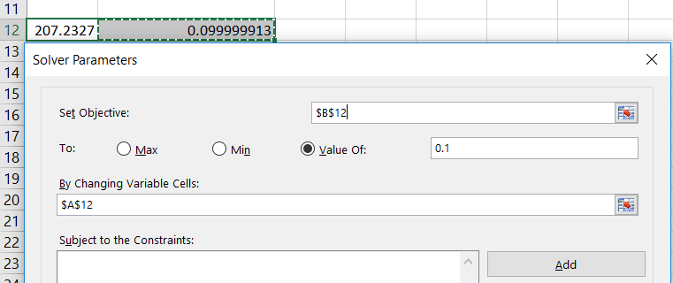
Problem
The top 10% longest interarrival times exceed what time interval?
On Average how many airplanes arrive in every 15 minutes?
15/1.5= 10 airplanes per 15 minutes
What is the probability of arrival of 12 airplanes in 15 minutes?
0.09478033 =POISSON.DIST(12,10,0)

Slide 19
Problem
What is the probability of arrival of at least 15 airplanes in 15 minutes?
0.083458473 =1-POISSON.DIST(14,10,1)
What is the probability of arrival of 10 to 20 airplanes in 30 minutes?
0.004995412 =POISSON.DIST(9,20,1)
0.559092584 =POISSON.DIST(20,20,1)
0.554097172 =L23-L22

Slide 20
Problem

Slide 21
Problem
More than 50 million guests stay at bed and breakfasts each year.
The website for B&B Inns of North America which averages.
7 visitors per minute, enables many B&B to attract quests.
a) Compute the probability of 0 website visitor in a one minute period.
0.000911882 =POISSON.DIST(0,7,0)
0.000911882 =POISSON.DIST(0,7,1)
b) Compute the probability of 2 or more website visitors in a one minute period.
0.992705 =1-POISSON.DIST(1,7,1)
c) Compute the probability of 1 or more website visitors in a 30 second period.
0.969803 =1-POISSON.DIST(0,7/2,1)

Slide 22
Problem
d) Compute the probability of 5 or more website visitors in a one minute period.
0.827008 =1-POISSON.DIST(4,7,1)
e) Compute the probability that the interarrival between two consecutive customers exceed 20 seconds.
This is an exponential distribution associated with a Poison Distribution
7 per minutes, 1/7 in each minute, or average of 8.571429 seconds between two arrivals.
Or Rate of 7/60 per second.
0.096971968 =EXP(-x/mu)= EXP[-20/(60/7)]
0.09697197 =1-EXPON.DIST(20,7/60,1)

Slide 23
Problem
Patients arrive at the emergency room of Mercy Hospital at the average rate of 7 per hour on weekend
Compute the probability of 4 arrivals in 30 minutes on a weekend evening?
Average in 30 mins is 7/2
0.18881229 =POISSON.DIST(4,7/2,0)
b) Compute the probability of 2 or less arrivals in 30 minutes on a weekend evening?
0.3208472 =POISSON.DIST(2,7/2,1)
c) Compute the probability of 3 or more arrivals in 30 minutes on a weekend evening?
1- 0.3208472 = 0.6791528

Slide 24
Problem
d) Compute the probability of 12 or more arrivals in two hours on a weekend evening?
Mu in 2 hours = 7*2
0.73996008 =1-POISSON.DIST(11,7*2,1)
e) Compute the probability that the interarrival between two consecutive customers is less than 10 minutes.
0.688596776 =EXPON.DIST(1/6,7,1)
0.688596776 =EXPON.DIST(10,7/60,1)
0.688596776 =1-EXP(-10/(60/7))
f) 70% of patients arrive in less than what time interval after the previous patient.
mu = 60/7 = 8.571428571

Slide 25
Exponential & Poisson Relationship

Slide 26
Problem
The number of days that elapse between the beginning of a calendar year and the moment a high-risk driver is involved in an accident is exponentially distributed. An insurance company expects that 30% of high-risk drivers will be involved in an accident during the first 50 days of a calendar year.
Calculate the portion of high-risk drivers are expected to be involved in an accident during the first 80 days of a calendar year.
(A) 0.15
(B) 0.34
(C) 0.43
(D) 0.57
(E) 0.66

Slide 27
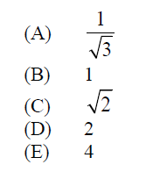
Problem
An actuary has discovered that policyholders are three times as likely to file two claims as to file four claims.
The number of claims filed has a Poisson distribution.
Calculate the variance of the number of claims filed.

Slide 28
Problem
The lifetime of a printer costing 200 is exponentially distributed with mean 2 years. The manufacturer agrees to pay a full refund to a buyer if the printer fails during the first year following its purchase, a one-half refund if it fails during the second year, and no refund for failure after the second year.
Calculate the expected total amount of refunds from the sale of 100 printers.
(A) 6,321
(B) 7,358
(C) 7,869
(D) 10,256
(E) 12,642

