Slide 1
Normal Distribution
Ardavan Asef-Vaziri

Slide 2
Normal Probability Distribution
The Normal probability distribution is the most applied distribution in the real world. Weight of people, test scores, life of a light bulb, number of votes in an election follow Normal Distribution. Normal distribution is symmetric; the right side is the mirror image of the left side..
Mean, median and mode, are equal to each others and are at the highest point. Normal distributions is defined by its mean μ and its standard deviation σ . ➔ X~ N(μ, σ ).
The mean can be any numerical value: negative, zero, or positive.
The standard deviation determines the width of the curve: larger values result in wider, flatter curves.
Coefficient of Variations shows the relative value of σ with respect to μ ⎝ CV =σ /μ

Slide 3

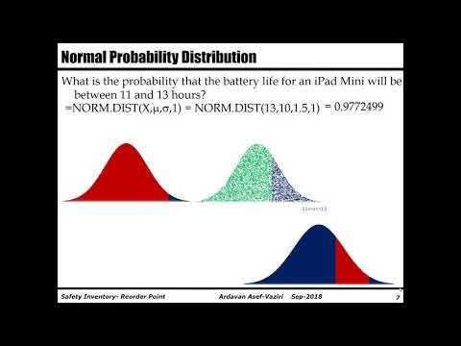
The Full Recorded Lecture
https://youtu.be/DTKp0jGSBTQ

Slide 4
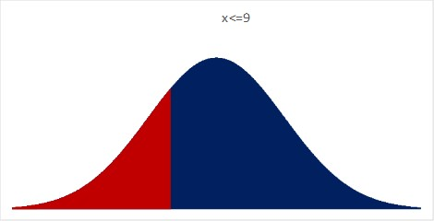
Normal Probability Distribution
Find Probability
Probability = NORM.DIST(X,μ,σ,1)
Given X
Given Probability
X = NORM.INV(Prob., μ, σ )
Find X

Slide 5
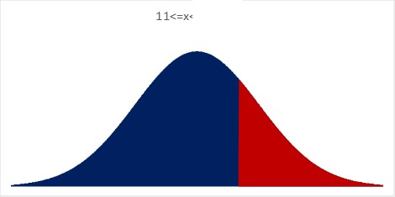
Normal Probability Distribution
Demand for a product follows N~(1000,150).
a) What is the probability that the demand is 900 or less?
=NORM.DIST(X,μ,σ,1)
= NORM.DIST(900,10000,150,1)
=0.25249
b) What is the probability that the demand is at least 1100?
=1-NORM.DIST(X,μ,σ,1) =
0.25249 =1-NORM.DIST(1100,1000,150,1)

Slide 6
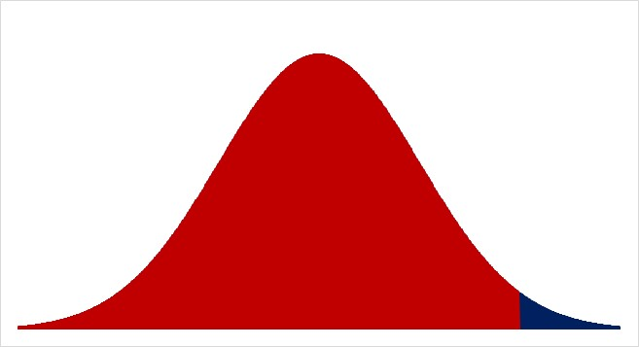
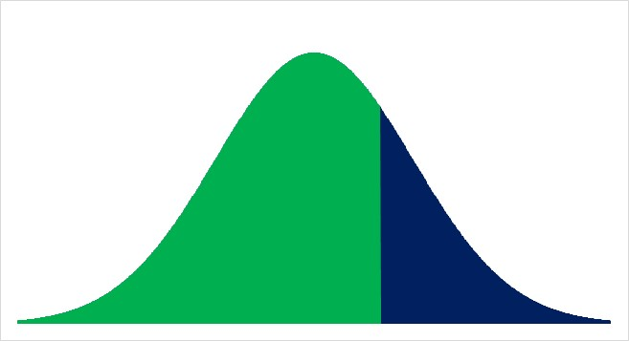
Normal Probability Distribution
c) What is the probability that the demand is between 1100 and 1300?
=NORM.DIST(X,μ,σ,1) = NORM.DIST(1300,1000,150,1)
= 0.9772499
=NORM.DIST(X,μ,σ,1) = NORM.DIST(1100,1000,150,1)
= 0.7475075
0.22974

Slide 7
Normal Probability Distribution
What is the probability that the demand is between 950 and 1150 hours?
=NORM.DIST(X,μ,σ,1))
= NORM.DIST(1150,10,1.5,1)
= 0.8413447
=NORM.DIST(X,μ,σ,1)
= NORM.DIST(950,10,1.5,1)
= 0.3694413
0.4719

Slide 8
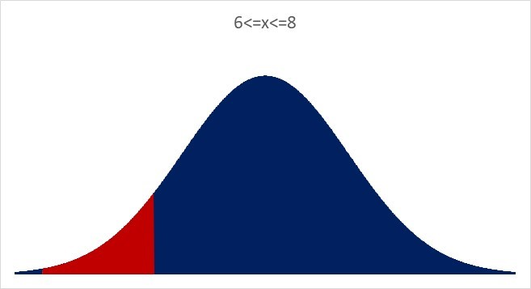
Normal Probability Distribution
What is the probability that demand is between 800 and 600 hours?
=NORM.DIST(X,μ,σ,1) = NORM.DIST(8,10,1.5,1)
= 0.0912112
=NORM.DIST(X,μ,σ,1)
= NORM.DIST(6,10,1.5,1)
= 0.0038304
0.08738

Slide 9
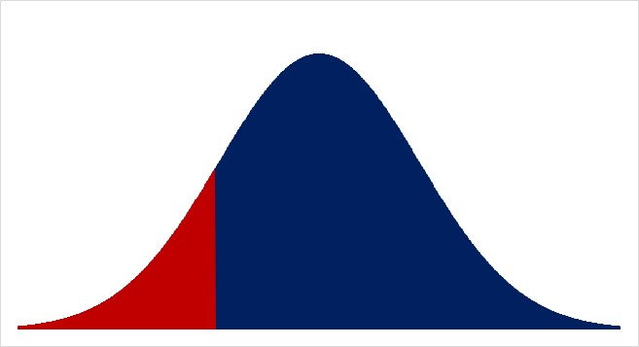
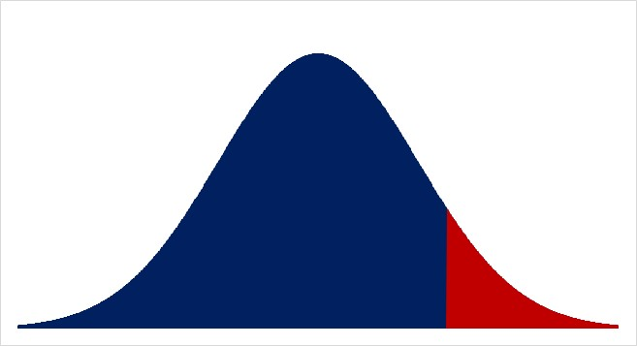
Normal Probability Distribution
The bottom 15% of the batteries last at most for how many hours?
=NORM.INV(0.15,10,1.5) = 8.44535
The top 10% of the batteries live at least for how many hours?
=NORM.INV(1-0.1,10,1.5) = 11.9223

