Slide 1
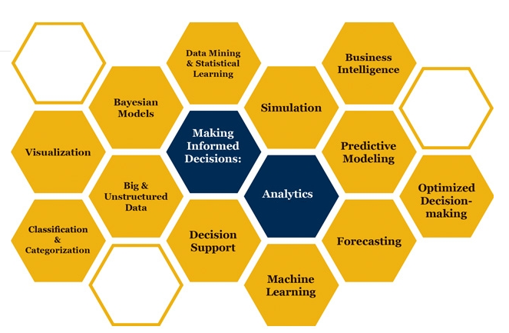

Slide 2

Basic Probability Distributions
How can it be that mathematics, being after all a product of human thought independent of experience, is so admirably adapted to the objects of reality
Albert Einstein
Some parts of these slides were prepared based on
Essentials of Modern Busines Statistics, Anderson et al. 2012, Cengage.
Managing Business Process Flow, Anupindi et al. 2012, Pearson.
Project Management in Practice, Meredith et al. 2014, Wiley

Slide 3
Normal Probability Distribution
Before coming to class, please atch the following repository lectures on youtube
Normal Random Variablew 1
Normal Random Variablew 2
The link to these PowerPoint slides
http://www.csun.edu/~aa2035/CourseBase/Probability/S-5-Normal/PDF-3-Normal.pptx
The link to the excel file
http://www.csun.edu/~aa2035/CourseBase/Probability/S-5-Normal/PDF-3-Normal.xlsx

Slide 4
X: μ, σ, y = 2x➔ μ_{y} = 2μ, σ _{y} = 2σ
A random variable x with mean of μ , and standard deviation of σ is multiplied by 2 generates the random variable y=2x.
x: (μ , σ) ➔ y: (?,?)
Then
Past data on a specific stock shows that the return of this stock has a mean of $0.05 and StdDev of 0.05. Therefore, if we invest $1, the return has an average of 0.05 and standard deviation of 0.05.
If we invest one dollar in this stock, our investment after one year will have probability distribution of of N(0.05, 0.05).
Using simulation in excel show what is the mean and standard deviation of 10,000 and 20,000 investment.

Slide 5
$10,000 or $20,000 in One Stock
Probability is between 0 and 1, rand() is between 0 and 1. A rand() is a random probability.
=NORM.S.INV(rand()) ➔ suppose it is z = 0.441475
X= µ + σz = X = 5%+ 0.441475(5%) ➔ X= 5%+2.21% = 7.21%
=NORM.INV(probability, mu, sigma)
=NORM.INV(probability, 5%, 5%)
=NORM.INV(rand(), 5%, 5%)
= -8.1%

Slide 6
10,000 and 20,000 in One Stock

Slide 7
ROP; Variable R, Fixed L
Demand is fixed and is 50 units per day. From the time that we order until the time we receive the order is referred to as Lead Time. Suppose average lead time is 5 days and standard deviation of lead time is 1 days. At what level of inventory should we place an order such that the service level is 90% (Probability of demand during the lead time exceeding inventory is 10%).
This point is known as Reorder point (ROP).
The difference between ROP and Aveerage demad during lead time is Safety Stock.
What is the average demand during the lead time
What is standard deviation of demand during lead time

Slide 8
μ and σ of the Lead Time and Fided demand per period
x: (μ , σ) ➔ y: (nμ , nσ)

Slide 9
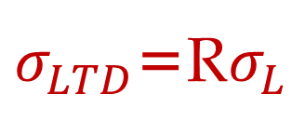
μ and σ of L and Fixed R
If Lead time is variable and Demand is fixed
L: Lead Time
L: Average Lead Time
σ_{L}: Standard deviation of Lead time
R: Demand per period
LTD: Average Demand during lead time
LTD = L × R
σ_{LTD}: Standard deviation of demand during lead time
$σ_{LTD}$=R$σ_{L}$

Slide 10
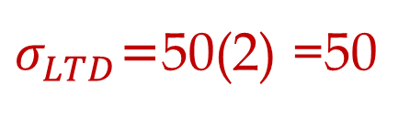
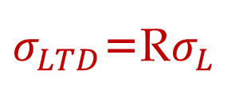
μ and σ of L and Fixed R
If Lead time is variable and Demand is fixed
L: Lead Time
L: Average Lead Time = 5 days
σ_{L}: Standard deviation of Lead time = 1 days
R: Demand per period = 50 per day
LTD: Average Demand During Lead Time
LTD = 5 × 50 = 250
σ_{LTD}: Standard deviation of demand during lead time
$σ_{LTD}$=R$σ_{L}$
$σ_{LTD}$=50(2) =50
=NORM.INV(0.9,250,50) =314.1

Slide 11
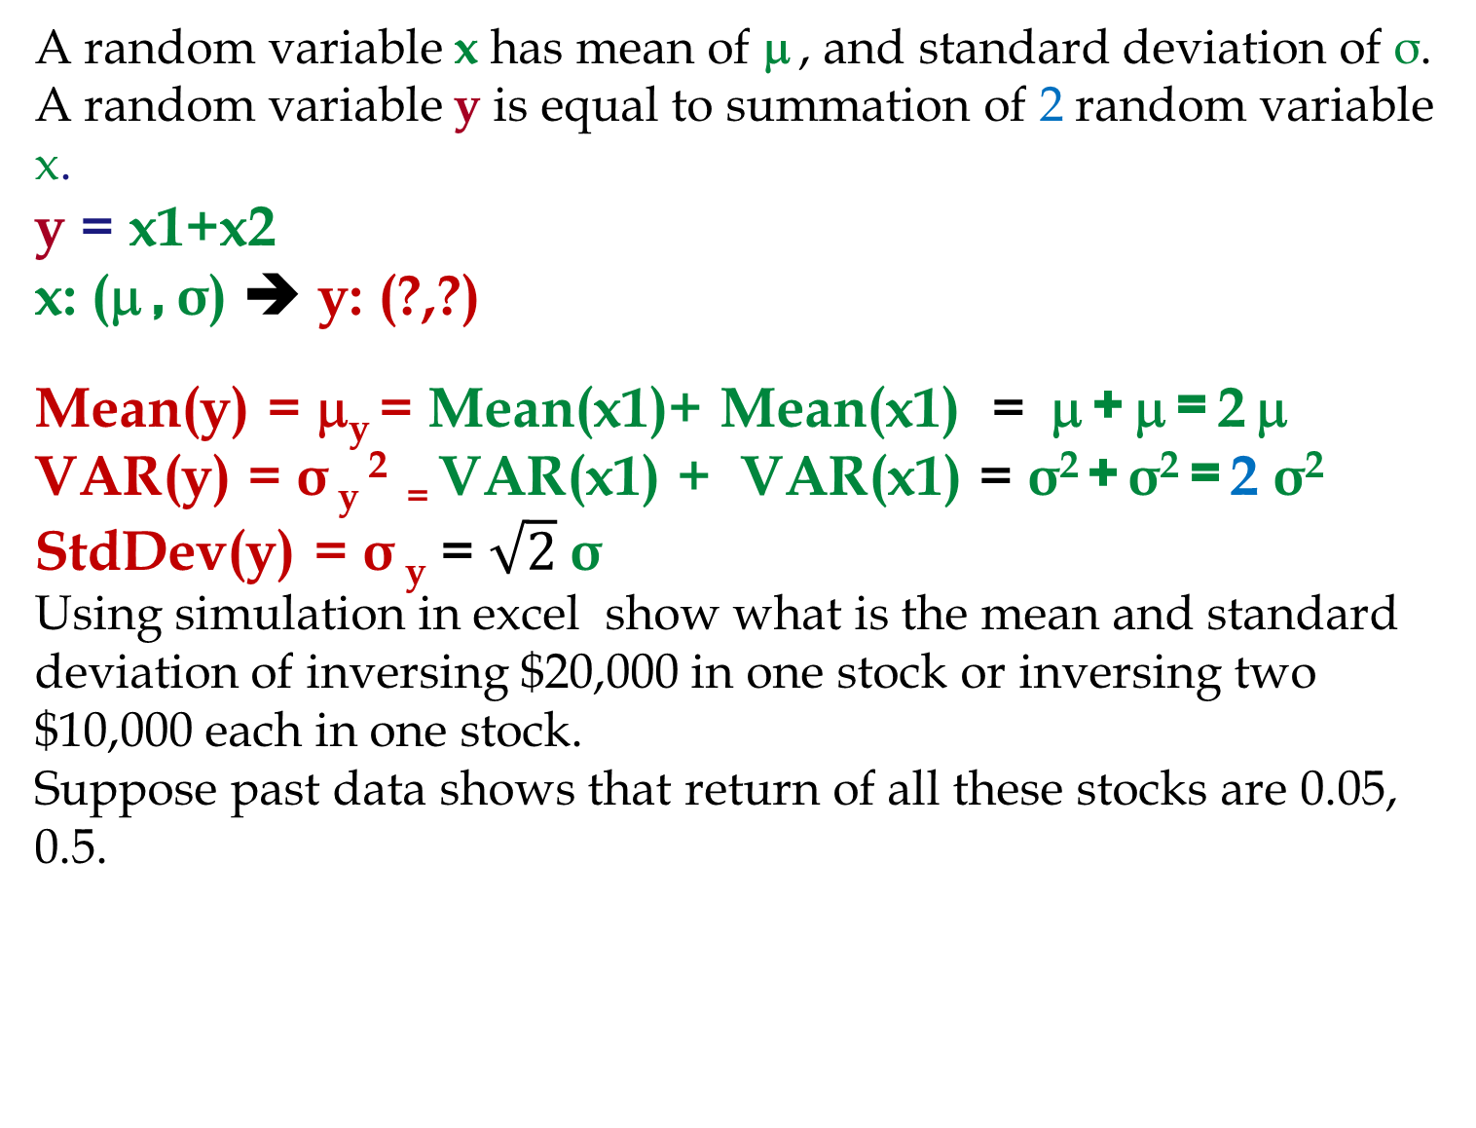
X: μ, σ, y = x1+X2, μ_{y} = 2μ, σ² _{y}= 2σ², σ _{y}= √2σ
A random variable x has mean of μ , and standard deviation of σ. A random variable y is equal to summation of 2 random variable x.
y = x1+x2
x: (μ , σ) ➔ y: (?,?)
Mean(y) = μ_{y} = Mean(x1)+ Mean(x1) = μ + μ = 2 μ
VAR(y) = σ _{y} ² ₌ VAR(x1) + VAR(x1) = σ² + σ² = 2 σ²
StdDev(y) = σ _{y} = $\sqrt{2}$σ
Using simulation in excel show what is the mean and standard deviation of inversing $20,000 in one stock or inversing two $10,000 each in one stock.
Suppose past data shows that return of all these stocks are 0.05, 0.5.

Slide 12
20,000 One Stock or 20,000 in Two Stocks

Slide 13
20,000 One Stock or 20,000 in Two Stocks

Slide 14
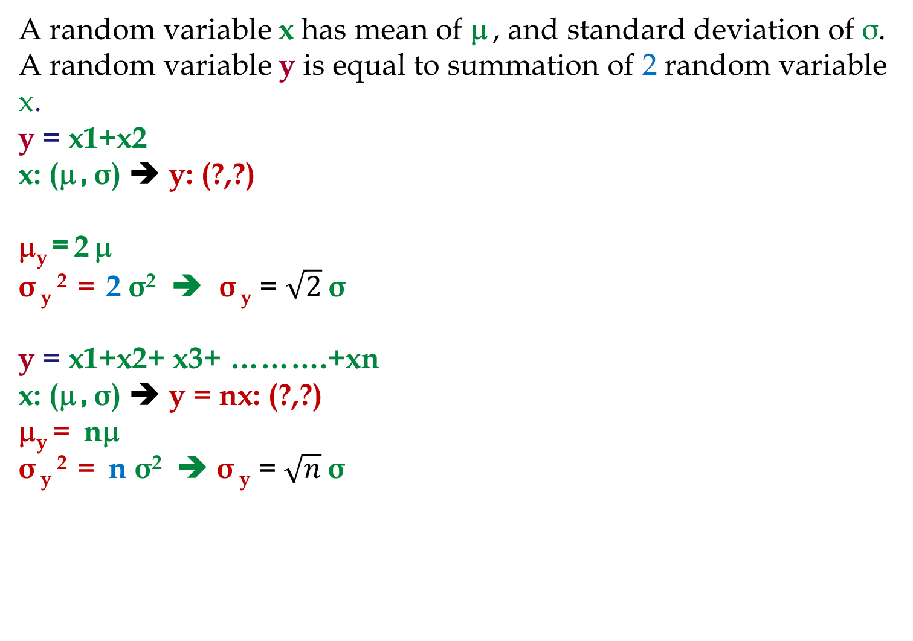
X: μ, σ, y = x1+X2, μ_{y} = 2μ, σ² _{y}= 2σ², σ _{y}= √2σ
A random variable x has mean of μ , and standard deviation of σ. A random variable y is equal to summation of 2 random variable x.
y = x1+x2
x: (μ , σ) ➔ y: (?,?)
μ_{y} = 2 μ
σ _{y} ² = 2 σ² ➔ σ _{y} = $\sqrt{2}$σ
y = x1+x2+ x3+ ……….+xn
x: (μ , σ) ➔ y = nx: (?,?)
μ_{y} = nμ
σ _{y} ² = n σ² ➔ σ _{y} = $\sqrt{n}$σ

Slide 15
100,000 in One Stock or 10,000 in Each of 10 stocks
Suppose there are 10 stocks and with high probability they all have Normal pdf return with mean of 5% and standard deviation of 5%. These stocks are your only options and no more information is available. You have to invest $100,000. What do you do?

Slide 16
100,000 vs. 10(10,000) investment in N(5%, 5%)

Slide 17
Risk Aversion Individual

Slide 18
Problem Game- The News Vendor Problem
Daily demand for your merchandise has mean of 20 and standard deviation of 5. Sales price is $100 per unit of product.
You have decided to close this business line in 60 days. Your supplier has also decided to close this line immediately, but has agreed to provide your last order at a cost of $60 per unit. Any unsold product will be disposed at cost of $10 per unit. How many units do you order
LTD = R ×L =20 ×60 = 1200.
Should we order 1200 units or more or less?
It depends on our service level.
Underage cost = Cu = p – c = 100 – 60 = 40.
Overage cost = Co = 60-0+10 =70
SL = Cu/(Cu+Co) = 40/(40+70) = 0.3636.
Due to high overage cost, SL*< 50%.
Z(0.3636) = ？

Slide 19
ROP; total demand during lead time is variable
If average demand during the lead time (from the time that we order until the time that we receive it) is 200 and standard deviation of demand during lead time is 25. Compute ROP at 90% service level. Compute safety stock.
This Problem: If average demand per day is 50 units and standard deviation of demand per day is 10, and lead time is 5 days. Compute ROP at 90% service level. Compute safety stock.
If we can transform this problem into the previous problem, then we are done, because we already know how to solve the previous problem.

Slide 20
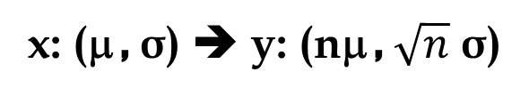
μ and σ of demand per period and fixed L
x: (μ , σ) ➔ y: (nμ , $\sqrt{n}$ σ)

Slide 21
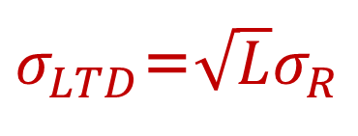
μ and σ of demand per period and fixed L
If Demand is variable and Lead time is fixed
L: Lead Time
R: Demand per period (per day, week, month)
R: Average Demand per period (day, week, month)
σ_{R}: Standard deviation of demand (per period)
LTD: Average Demand During Lead Time
LTD = L × R
σ_{LTD}: Standard deviation of demand during lead time
$σ_{LTD}$=$\sqrt{L}σ_{R}$

Slide 22
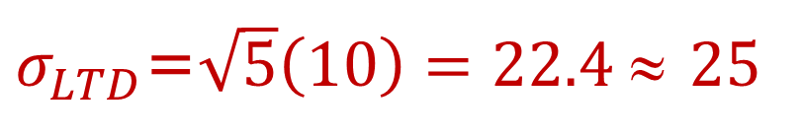
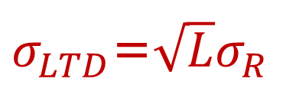
μ and σ of demand per period and fixed L
If demand is variable and Lead time is fixed
L: Lead Time = 5 days
R: Demand per day
R: Average daily demand =50
σ_{R}: Standard deviation of daily demand =10
LTD: Average Demand During Lead Time
LTD = L × R = 5 × 50 = 250
σ_{LTD}: Standard deviation of demand during lead time
$σ_{LTD}$=$\sqrt{L}σ_{R}$
$σ_{LTD}$=$\sqrt{5}\left(10\right)=22.4$≈ 25

Slide 23
Now It is Transformed
The Problem originally was: If average demand per day is 50 units and standard deviation of demand is 10 per day, and lead time is 5 days. Compute ROP at 90% service level. Compute safety stock.
We transformed it to: The average demand during the lead time is 250 and the standard deviation of demand during the lead time is 22.4. Compute ROP at 90% service level. Compute safety stock.
Which is the same as the previous problem: If average demand during the lead time is 200 and standard deviation of demand during lead time is 25. Compute ROP at 90% service level. Compute safety stock.

Slide 24
Now It is Transformed
The Problem originally was: If average demand per day is 50 units and standard deviation of demand is 10 per day, and lead time is 5 days. Compute ROP at 90% service level. Compute safety stock.
We transformed it to: The average demand during the lead time is 250 and the standard deviation of demand during the lead time is 22.4. Compute ROP at 90% service level. Compute safety stock.
=NORM.INV(0.9,250,22.4)
=278.7 ≈ 279

Slide 25
Comparing the two problems

Slide 26
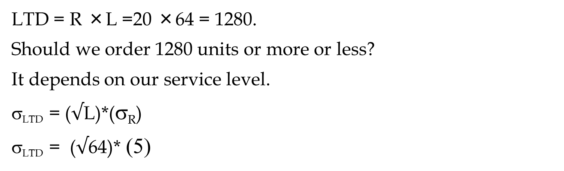
Problem Game- The News Vendor Problem
Daily demand for your merchandise has mean of 20 and standard deviation of 5. Sales price is $100 per unit of product.
You have decided to close this business line in 64 days. Your supplier has also decided to close this line immediately, but has agreed to provide your last order at a cost of $60 per unit. Any unsold product will be disposed at cost of $10 per unit. How many units do you order
LTD = R ×L =20 ×64 = 1280.
Should we order 1280 units or more or less?
It depends on our service level.
σ_{LTD} = ($√$L)*(σ_{R})
σ_{LTD} = ($√$64)* (5)

Slide 27
The News Vendor Problem- Extended
σ_{LTD} = 8* 5 = 40
Underage cost = Cu = = 100 – 60 = 40.
Overage cost = Co = 60 +10 =70
SL = Cu/(Cu+Co) = 40/(40+70) = 0.3636.
Due to high overage cost, SL*< 50%.
Z(0.3636) = ？
The optimal Q = LTD + z σ_{LTD}
=NORM.S.INV(0.3636) = -0.34885
Q = 1280 -0.34885(40)
ROP = 1280-13.9541
ROP = 1266.0459
=NORM.INV(probability, mean, standard_dev)
=NORM.INV(0.3636,1280,40
=1266.0459

Slide 28
X: μ, σ, y = (x1+X2)/2, μ_{y} = μ, σ² _{y}= σ²/2, σ _{y}= σ /√2
A random variable x has mean of μ , and standard deviation of σ. A random variable y is equal to the average of 2 random variables x.
y = (x1+x2)/2
x: (μ , σ) ➔ y: (?,?)
If it was x1+x2 then x1+x2: (2μ , √2σ)
Since it is (x1+x2)/2 or 1/2(x1+x2): 1/2(2μ , √2σ)
That is (μ , (√2/2)σ
y = (x1+x2)/2: μ , σ/√2
y = (x1+x2+x3+……..xn)/n
x: (μ , σ) ➔ y: μ , σ/√n

Slide 29
Present Value Mean and Standard Deviation
STOP HERE
We will have a cash inflow at the end of next year. This cash flow has mean of $1000 and standard deviation of 250. What is the mean and standard deviation of the present value of this cash flow. Our minimum acceptable rate of return in 12%.
We will have two cash inflows at the end of next two years. They both have mean of $1000 and standard deviation of 250. What is the mean and standard deviation of the present value of this cash flow. Our minimum acceptable rate of return in 12%.

Slide 30

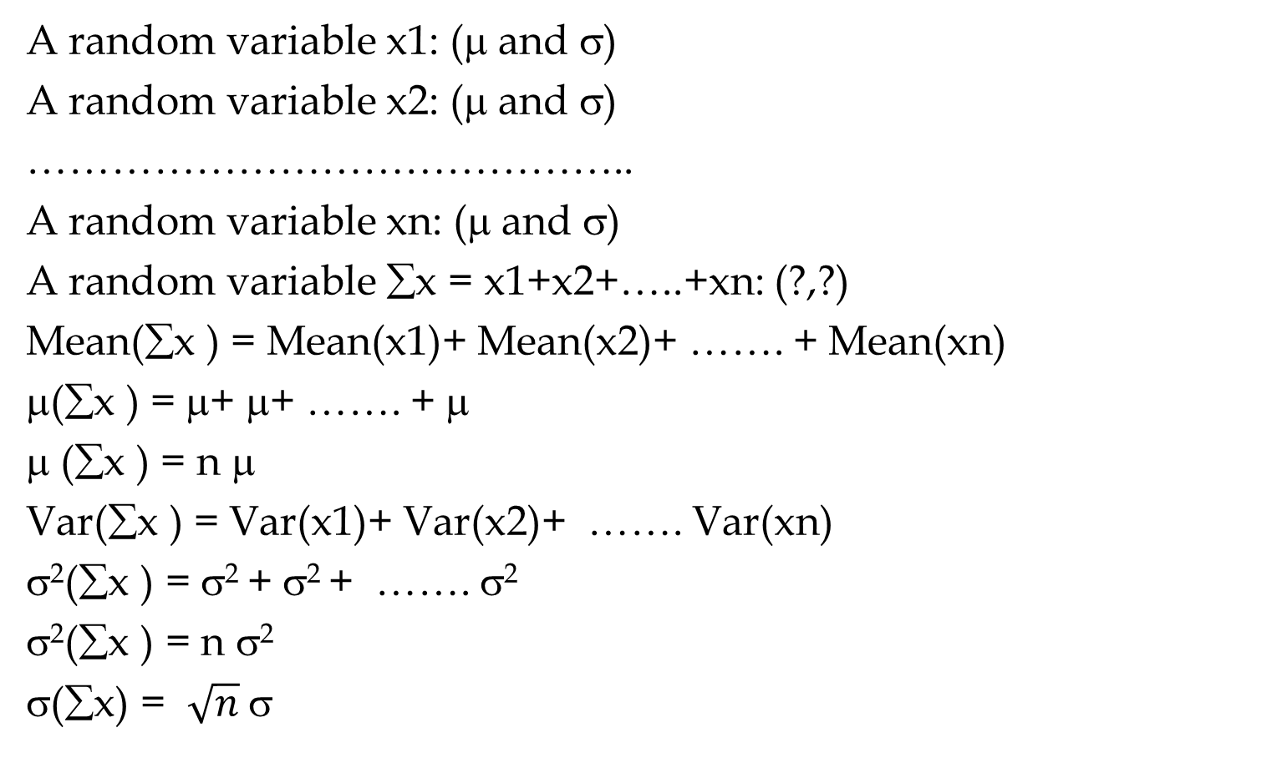
Sampling: Mean and Standard Deviation $\overline{X}$
A random variable x1: (μ and σ)
A random variable x2: (μ and σ)
……………………………………..
A random variable xn: (μ and σ)
A random variable ∑x = x1+x2+…..+xn: (?,?)
Mean(∑x ) = Mean(x1)+ Mean(x2)+ ……. + Mean(xn)
μ(∑x ) = μ+ μ+ ……. + μ
μ (∑x ) = n μ
Var(∑x ) = Var(x1)+ Var(x2)+ ……. Var(xn)
σ²(∑x ) = σ² + σ² + ……. σ²
σ²(∑x ) = n σ²
σ(∑x) = $\sqrt{n}$σ

Slide 31

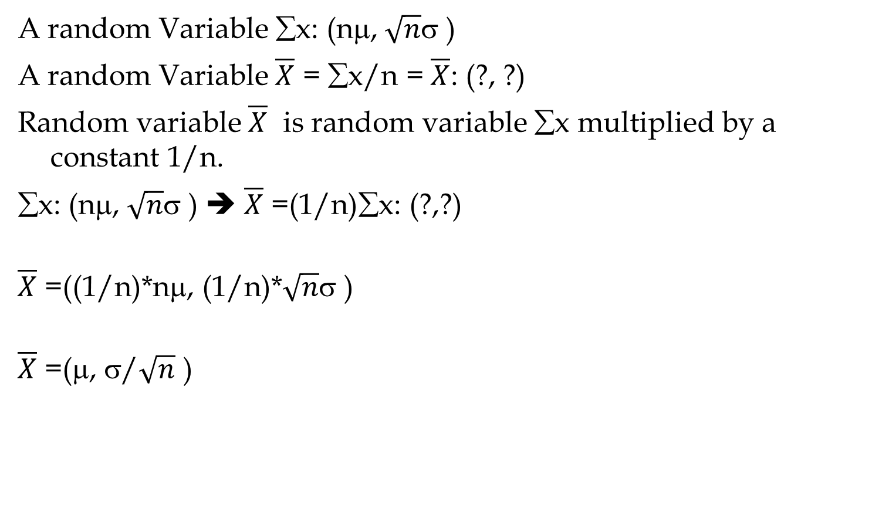
Sampling: Mean and Standard Deviation $\overline{X}$
A random Variable ∑x: (nμ, $\sqrt{n}$σ )
A random Variable $\overline{X}$ = ∑x/n = $\overline{X}$: (?, ?)
Random variable $\overline{X}$ is random variable ∑x multiplied by a constant 1/n.
∑x: (nμ, $\sqrt{n}$σ ) ➔ $\overline{X}$ =(1/n)∑x: (?,?)
$\overline{X}$ =((1/n)*nμ, (1/n)*$\sqrt{n}$σ )
$\overline{X}$ =(μ, σ/$\sqrt{n}$ )

Slide 32
Future Value (FV)
$100, put it in a bank. Interest rate = 10%. How much after 1 year. P = 100. F?
F1 = 100 +0.1(100) = 100(1+0.1)
How much after 2 years?
F2= 100(1+0.1) + 0.1(100(1+0.1)) =
F2= 100(1+0.1) (1+0.1) = 100(1.1)²
How much after 3 years?
F3 = 100(1.1)² + 0.1[100(1.1)²] =
F3 = 100(1.1)² [1+0.1] = 100(1.1)² [1.1] = 100(1.1)³
How much after N years
F = 100(1.1)^{N}

Slide 33
Future Value (FV); Present Value (PV)
P: The initial vale
MARR: Minimum Acceptable Rate of Return
F= P(1+MARR)^{N}
P = F/(1+MARR)^{N}
P = F/(1+r)^{N}
r = the minimum acceptable rate of return
=FV(r, N,PMT,PV,0→ EOY) =
=PV(r, N,PMT,FV,0 →EOY) =

Slide 34
Future Value (FV); Present Value (PV)
=FV(r, N,PMT,PV,0→ EOY) =
=PV(r, N,PMT,FV,0 →EOY) =
=FV(r,N, PMT, PV,0) =
FV(10%,3,0,100,0) =
=PV(r,N, PMT, FV,0) =
PV(10%,3,0,133.1,0) =

Slide 35
Present Value Mean and Standard Deviation
We will have a cash inflow at the end of next year. This cash flow has mean of $1000 and standard deviation of 250. What is the mean and standard deviation of the present value of this cash flow. Our minimum acceptable rate of return in 12%.
P=F/(1+r)
P= [1/(1+r)]F
P= KF
y=Kx
Mean (y) = K*Mean(x)
StdDev(y) = K*StdDev(x)
Mean (x) =1000
StdDev(x) = 300
K= (1/(1+.12) = 1/1.12 =
Mean (P) = 0.893* Mean(F)
Mean (P) = 0.893(1000)
Mean (P) = $893
StdDev(P) = 0.893*StdDev(x)
StdDev(P) = 0.893*250
StdDev(x) = 223
If P has Normal Distribution, Compute
Probability of P ≥ $1000
0.892857

Slide 36
Present Value Mean and Standard Deviation
We will have two cash inflows at the end of next two years. They both have mean of $1000 and standard deviation of 250. What is the mean and standard deviation of the present value of this cash flow. Our minimum acceptable rate of return in 12%.
P1=0.893F/(1+r)
P1= [1/(1+r)]F1
P2= [1/(1+r)²]F2
P1= [1/(1.12)]F1
P2= [1/(1.12)²]F2
P1= 0.893F1
P2= 0.797F2
Mean (P1) = 0.893(1000)
Mean (P2) = 0.797(1000)
P=P1+P2
y=x1+x2
Mean (y) = Mean (x1)+Mean(x2)
Var(y) = Var(x1)+Var(x2)
Mean (P) = Mean(P1)+Mean(P2)
Mean (P) = 893+797 = 1690
StdDev (P1) = 0.893(250) =223
StdDev (P2) = 0.797(250) = 199
Var (P) = Var(P1)+Var(P2)

Slide 37
Present Value Mean and Standard Deviation
Mean (P) = 1690
StdDev (P1) = 0.893(250) =223
StdDev (P2) = 0.797(250) = 199
Var(P1) = (223)² = 49824
Var(P2) = (199)² = 39720
Var (P) = Var(P1)+Var(P2)
Var (P) = 49824 + 39720 = 89544
StdDev (P) = SQRT(Var(P))
StdDev (P) = 299
If P has Normal Distribution, Compute
Probability of P ≥ $2000

Slide 38
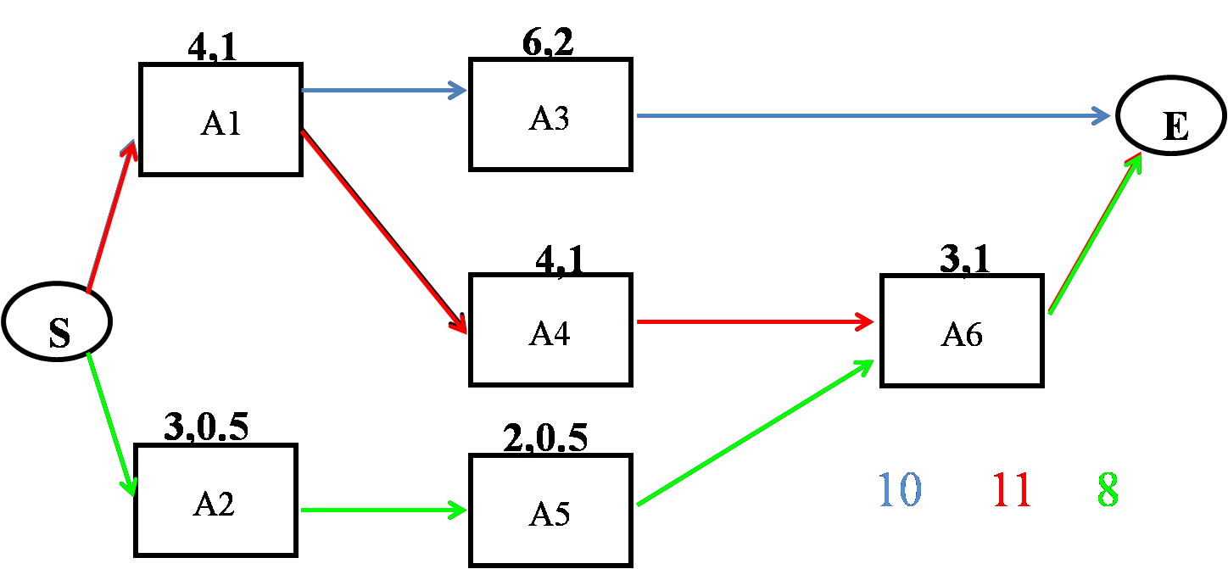
Project Scheduling
Given the following project with three paths, compute the mean and StdDev of each path. The pairs of numbers on each activity represent the mean and StdDev of each activity.

Slide 39
Project Scheduling
m_{CP}= 4+4+3 = 11
σ²_{CP} = 1²+1²+1² = 3
σ_{CP} = 1.73
=NORM.DIST(12,11,1.73,1)
= 0.7184
m_{CP}= 6+4 = 10
σ²_{CP} = 1²+2² = 5
σ_{CP} = 2.24
=NORM.DIST(12,10,2.24,1)
= 0.814
=NORM.DIST(12,8,1.22,1)
= 0.9995
m_{CP}= 3+2+3 = 8
σ²_{CP} = 0.5²+0.5²+1²
σ²_{CP} = 1.5
σ_{CP} = 1.22
The probability of competing the Project in not more than 12 days is 0.72×0.81×1 = 0.58

Slide 40
Project Scheduling
Critical Path
D_{CP} = the desired completion date of the critical path
μ_{CP}= the sum of the T_{E} for the activities on the critical path
σ²_{CP} = the sum of the variances of the activities on the critical path
Using μ_{CP} and σ_{CP} and NORM.DIST(D_{CP}, μ_{CP}, σ_{CP},1) we can find probability of completing the critical path in ≤ D_{CP} .
Project
Find all paths in the network. Compute µ and σ of each path
Compute the probability of completing each path in ≤ the given time
Calculate the probability that the entire project is completed within the specified time by multiplying these probabilities together

Slide 41
Practice
15, 3
5,1
20,4
A
D
G
E
20,2
10,2
10,2
B
S
E
H
10,3
20,5
C
F

