Slide 1

Normal Probability Distribution

Slide 2

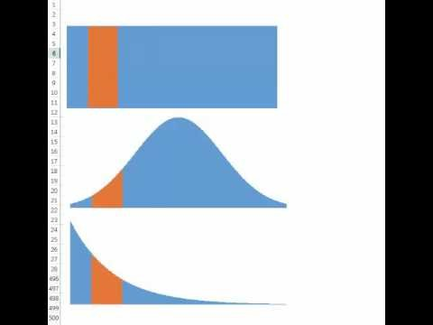
Continuous Probability Distributions
Exponential
Also Available at https://www.youtube.com/watch?v=RoCMGPLU8Ao

Slide 3
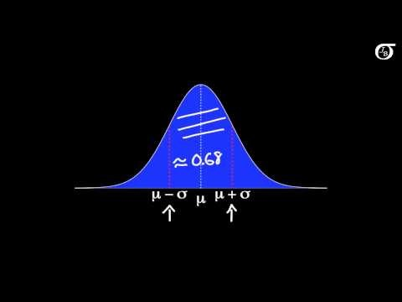
Normal Distribution
https://www.youtube.com/watch?v=iYiOVISWXS4

Slide 4
Normal Probability Distribution
The Normal probability distribution is the most applied distribution in the real world. Weight of people, test scores, life of a light bulb, number of votes in an election follow Normal Distribution. Normal distribution is symmetric; skewness = 0.
Mean, median and mode, are on each others and are at the highest point. Normal distributions is defined by its mean μ and its standard deviation σ . ➔ X~ N(μ, σ ).
The mean can be any numerical value: negative, zero, or positive.
The standard deviation determines the width of the curve: larger values result in wider, flatter curves.

Slide 5
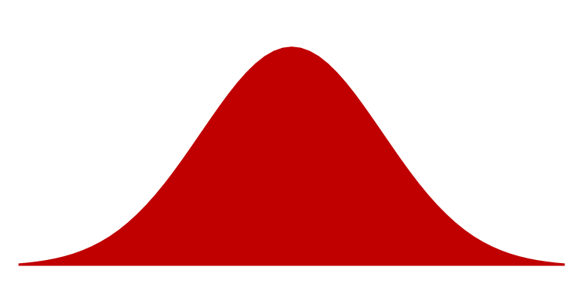

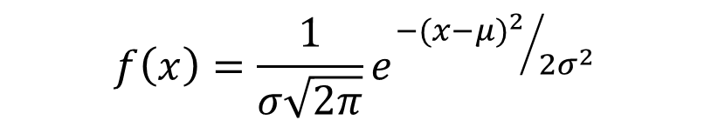
Normal Probability Distribution
Probabilities for the normal random variable are given by areas under the curve. The total area under the curve is 1 (0.5 to the left of the mean and 0.5 to the right).
99.72%
$$f\left(x\right)=\frac{1}{σ\sqrt{2π}}e^{{−{(x−μ)}^{2}}/{2σ^{2}}}$$
95.44%
68.26%
π = 3.14159 = PI()
e = 2.71828 =EXP(1)
$$z=(x−μ)/σ$$
x
μ – 3σ
μ – 1σ
μ
μ + 1σ
μ + 3σ
μ – 2σ
μ + 2σ

Slide 6
Standard Normal Probability Distribution
A random variable is standardized x➔ z first by subtracting µ. x- µ ≥ 0, the random variable is greater than or equal to the mean.
X- µ ≤ 0, the random variable is less than or equal to the mean.
Therefore, half a way to standard normal is to see if the random variable is greater than or less than average.
The secons step is how much greater or less than, but not in absolute term. In terms of the number of standard deviations.
z= (x- µ)/σ
The letter z is used to designate the standard normal random variable.
We can think of z as a measure of the number of standard
deviations x is from μ.
σ = 1
z
0

Slide 7
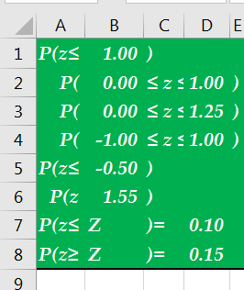
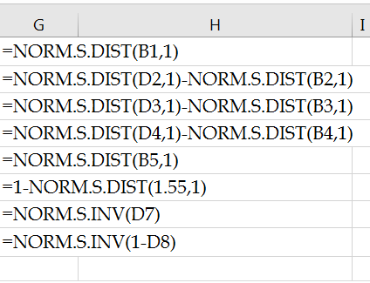
Standard Normal Distribution in Excel
Standard normal probability distribution, z, has a mean of 0 and a standard deviation of 1.
Given z find cumulative probability =NORM.S.DIS(x,1)
Given cumulative probability find z = NORM.S.INV(probability)

Slide 8
Standard Normal Probability Distribution
When the stock of the oil in an oil change station drops to 20 gallons, an order is placed. The demand during lead time (till we receive the order) in gallons is x~N(15, 6). What is the probability that demand during lead-time will exceed 20 gallons (what is probability of stockout)?
P(x ≥ 20) = ?
How far are we from mean? 20-15 = 5
How many standard devotions? (20-15)/6 = 5/6 standard deviations to right.
That is z =5/6
0.7967
0.2023
1 - 0.7977
0.83
z
0

Slide 9
Standard Normal Probability Distribution
If the manager of Pep Zone wants the probability of a stockout during replenishment lead-time to be no more than .05, what should the reorder point be?
=NORM.S.INV(0.95)=
=1.465
1.465 standard deviation
=1.465(6) = 9.87
To right
=15+9.87
=24.87
A reorder point of 25 gallons will place the probability
of a stockout during lead-times at (slightly less than) .05
0.95
0.05
z
0
z_{.05}

Slide 10
Standard Normal Probability Distribution
By raising the reorder point from 20 gallons to 25 gallons on hand, the probability of a stockout decreases from 0.20 to .05.
This is a significant decrease in the chance of being out of stock and unable to meet a customer’s desire to make a purchase.
Instead of NORM.S.XX We can directly use NORM.X function.
=NORM.DIST(20,15,6,1)
=0.797671619
P(x≥20) =1-0.797671619
P(x ≥X1)=0.05
=NORM.INV(0.95,15,6)
= 24.869122

Slide 11
Reorder Point
If average demand during the lead time is 200 and standard deviation of demand during lead time is 25. At what level of inventory we should order such that with 90% confidence we will not have stockout.
=NORM.S.INV(0.9) = 1.2816
We need to go 1.2816 away from average
1.2816(25) ≈ 32
To right
200+32 = 232
We can also use NORM. function directly
=NORM.INV(0.9,200,25) = 232.0388

Slide 12
Service Level
Average lead time demand is 20,000 units. Standard deviation of lead time demand is 5,000 units. The warehouse currently orders a 14-day supply, 28,000 units, each time the inventory level drops to 24,000 units. What is the probability that the demand during the period exceeds inventory?
X= 24000
= 20000
σ = 5000
=NORM.DIST(24000,20000,5000,1)
= 0.788145
In 78.81 % of the order cycles, the warehouse will not have a stockout. Risk = 21.19%.

Slide 13
Apple Ipad-Normal
In October 2012, Apple introduced a much smaller variant of the Apple iPad, known as the iPad Mini. Assume that battery life of the iPad Mini is normally distributed with mean od 10 and standard deviation of 1.5 hours.
What is the probability that the battery life for an iPad Mini will be 9 hours or less?
What is the probability that the battery life for an iPad Mini will be at least 11 hours?
What is the probability that the battery life for an iPad Mini will be between 9.5 and 11.5 hours?
What is the probability that the battery life for an iPad Mini will be between least 11 and 13 hours?
What is the probability that the battery life for an iPad Mini will be between least 6 and 8 hours?
The top 10% of the batteries live at least for how many hours?
The bottom 15% of the batteries live at most for how many hours?

Slide 14
Normal Probability Distribution
The link to the excel file accompanying these slides
http://www.csun.edu/~aa2035/CourseBase/Probability/S-5-Normal/Normal.xlsx
The following slides are recorded lectures
Continuous Probability Distributions
Normal Probability Distribution
Standard Normal Probability Distribution

