Slide 1
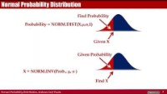
Normal Distribution
Ardavan Asef-Vaziri
https://youtu.be/OeZ2M-NljIw

Slide 2
Normal Probability Distribution
The Normal probability distribution is the most applied distribution in the real world. Weight of people, test scores, life of a light bulb, number of votes in an election, demand for a product, cost of a product follow Normal Distribution.
Normal distribution is symmetric; the right side is the mirror image of the left side.
Mean, median and mode, are equal to each others. Normal distributions is defined by its mean μ and its standard deviation σ . ➔ x~ N(μ, σ ).
The mean can be any numerical value: negative, zero, or positive.
The standard deviation determines the width of the curve: larger values result in wider, flatter curves.
Coefficient of Variations shows the relative value of σ with respect to μ ⎝ CV =σ /μ

Slide 3
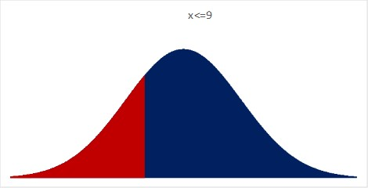
Normal Probability Distribution
Find Probability
Probability = NORM.DIST(X,μ,σ,1)
Given X
Given Probability
X = NORM.INV(Prob., μ, σ )
Find X

Slide 4
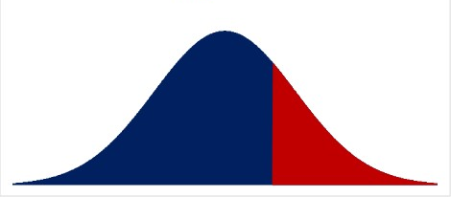
Normal Probability Distribution
Demand for a product follows N~(1000,150).
What is the probability that the demand is 900 or less?
=NORM.DIST(X,μ,σ,1)
= NORM.DIST(900,1000,150,1)
=0.25249
What is the probability that the demand is at least 1100?
=1-NORM.DIST(X,μ,σ,1) =
0.25249 =1-NORM.DIST(1100,1000,150,1)

Slide 5
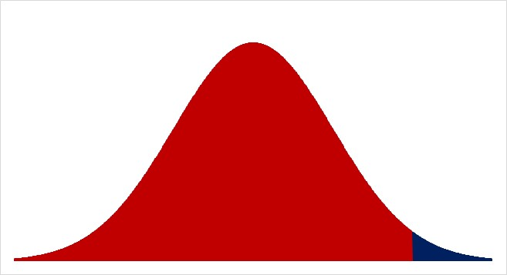
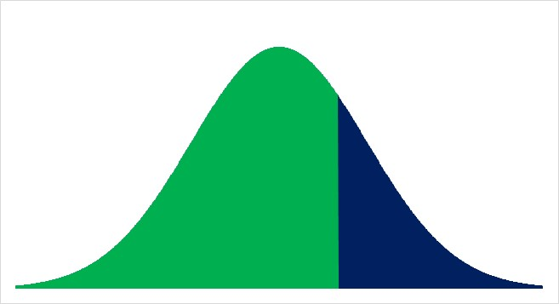
Normal Probability Distribution
Cost of a product follows N~(1000,150). What is the probability that the cost is between 1100 and 1300?
=NORM.DIST(X,μ,σ,1) = NORM.DIST(1300,1000,150,1)
= 0.9772499
=NORM.DIST(X,μ,σ,1) = NORM.DIST(1100,1000,150,1)
= 0.7475075
0.22974

Slide 6
Normal Probability Distribution
Score of students in a test follows N~(800,120). What is the probability that a score is between 760 and 920?
=NORM.DIST(X,μ,σ,1))
= NORM.DIST(920,800,120,1)
= 0.8413447
=NORM.DIST(X,μ,σ,1)
= NORM.DIST(760,800,120,1)
= 0.3694413
0.4719

Slide 7
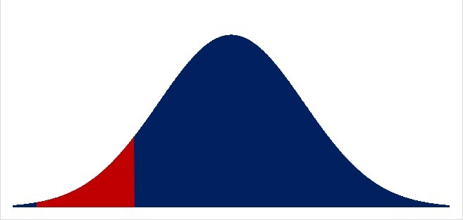
Normal Probability Distribution
Average weight of a red deer follows N~(500,75) lbs. What is the probability that a red deer weight is between 400 and 300 lbs.?
=NORM.DIST(X,μ,σ,1) = NORM.DIST(400,500,75,1)
= 0.0912112
=NORM.DIST(X,μ,σ,1)
= NORM.DIST(300,500,75,1)
= 0.0038304
0.08738

Slide 8
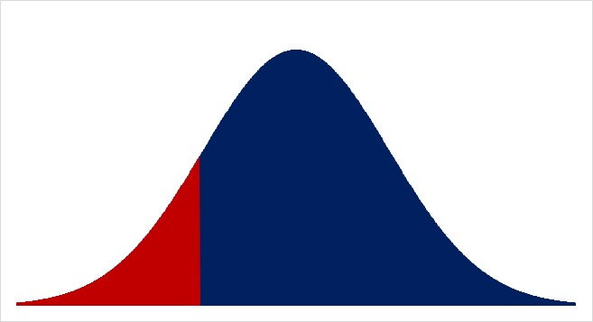
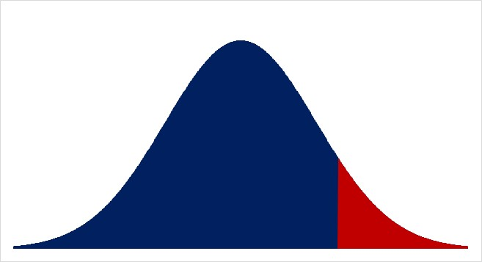
Normal Probability Distribution
Demand for a product follows N~(1000,150). The bottom 15% of the demand is less than what value?
=NORM.INV(0.15,1000,150) = 844.535
How much inventory do we need to make sure the probability of the demand exceeding our inventory does not exceed 10%.
=NORM.INV(1-0.1,1000,150) = 1192.23

