Slide 1
Simulation of Project Management Network
https://youtu.be/wqjGsLsadOo
URV Generation
x= a+(b-a)Rand()
x= 20+(60-40)Rand()

Slide 2
Central Limit Theorem
The distribution of each of the activity was uniform. Summation of them moves towards normal distribution.
Given certain conditions, the arithmetic mean of a sufficiently large number of independent random variables, each with a
well-defined expected value and well-defined
variance, will be approximately normally distributed, regardless of the underlying distribution

Slide 3
Simulation of Project Management Network

Slide 4
Simulation of Project Management Network

Slide 5
Simulation of Project Management Network

Slide 6
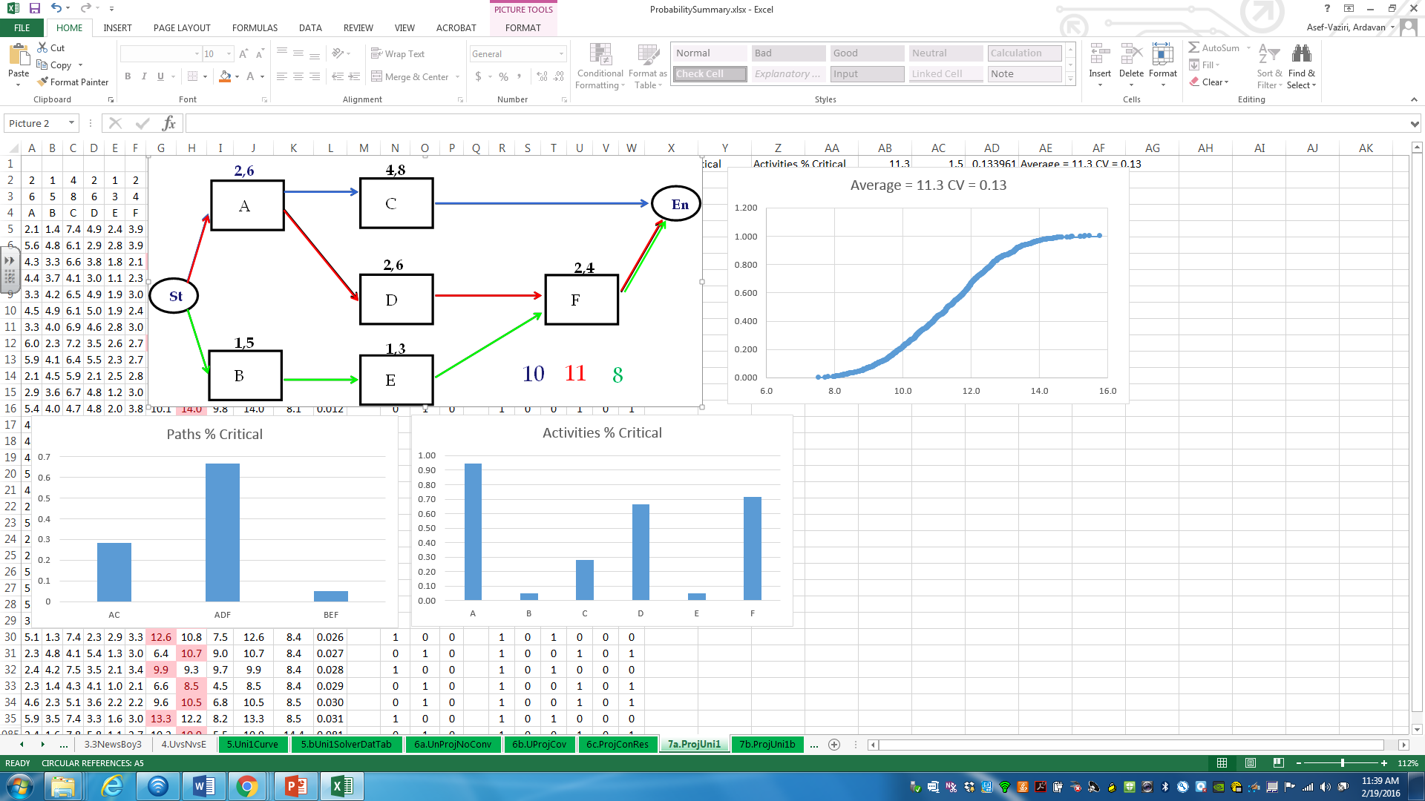
Simulation of Project Management Network

Slide 7
Exponential and Poisson Relationship

