Slide 1
Flow Time
Project/Process Management Usind Uniform Distribution
Sumulatiomn

Slide 2

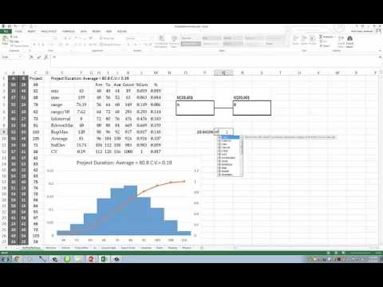
Project Management Simulation,
U-Distribution
https://youtu.be/wqjGsLsadOo

Slide 3
Simulation of Project Management Network
URV Generation
x= a+(b-a)Rand()
x= 20+(60-40)Rand()

Slide 4
Central Limit Theorem
The distribution of each of the activity was uniform. Summation of them moves towards normal distribution.
Given certain conditions, the arithmetic mean of a sufficiently large number of independent random variables, each with a
well-defined expected value and well-defined
variance, will be approximately normally distributed, regardless of the underlying distribution

Slide 5
Simulation of Project Management Network

Slide 6
Simulation of Project Management Network

Slide 7
Simulation of Project Management Network

Slide 8
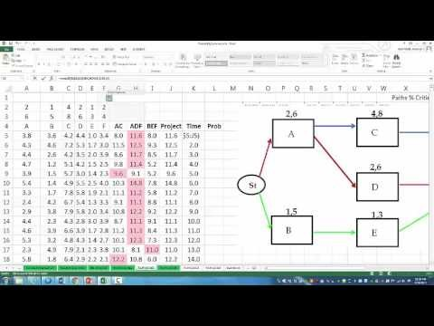
Simulation of Project Management Network
https://www.youtube.com/watch?v=7IEfN5OqtQ0&t=32s

