Slide 1
Descriptive Statistics

Slide 2
Binomial Distribution
Binomial Distribution 1
Binomial Distribution 2
Properties of Binomial Distribution
    The experiment consists of a sequence of n identical trials.
    Each trial can only have two outcomes; success and failure. (success and failure are just two names, they do not carry a value with the name)
    The trials are independent.
    Probability of success is p. It is constant for all trials.
  x is the number of success in n trials
Sample statistics: the measures are computed for data from a sample.
Population statistics: the measures are computed for data from a population.
A sample statistic is the point estimator of the corresponding population parameter.
Statistics
  Measures of Centralization - Measures of Location.
  Measures of Dispersion – Measures of Variability.

Slide 3
Examples of Binomial Distribution
Suppose that 8% of inmates in a large prison are known to be innocent. A non-profit group randomly selects 25 inmates from this prison. Find the probability the group will find at least 3 innocent inmates.
During a severe thunderstorm, any transmission line is damaged with probability 0.04, independently of other transmission lines. A city with 75 transmission lines is hit by a severe thunderstorm. What is the probability that at least 5 of them get damaged?
Henry Ford was concerned about a low retention rate for its employees. To alleviate the problem, he increased the salary of the salary of the daily workers. For any daily worker chosen at random, it was estimated that with a probability of 0.2 that the person will not be with the company next year. What is the probability that chosen 3 workers at random, 1 of them would have left the company in one year.

Slide 4

Binomial Distribution
x = the number of successes
p = the probability of a success on one trial
n = the number of trials
f(x) = the probability of x successes in n trials
n! = n(n – 1)(n – 2) ….. (2)(1)
$$\frac{n!}{x!\left(n−x\right)!}{ × p}^{x}{(1−p)}^{n−x}$$
Number of experimental
outcomes providing exactly
x successes in n trials
Probability of a particular
sequence of trial outcomes
with x successes in n trials

Slide 5
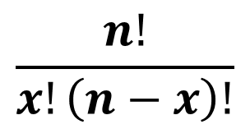
Excel
$$\frac{n!}{x!\left(n−x\right)!}$$

Slide 6
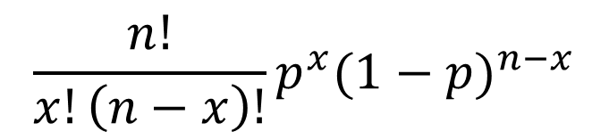
Excel
$$\frac{n!}{x!\left(n−x\right)!}p^{x}{(1−p)}^{n−x}$$

Slide 7
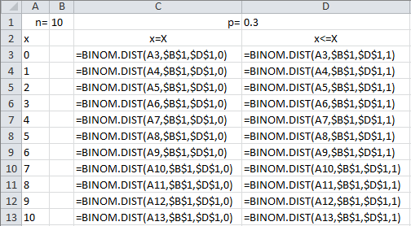
Excel

Slide 9
I am going to have a 10 multiple choice question Quiz (with 4 answers ) tomorrow and have not studied at all. What is the chance of getting at least 60% on the Quiz?

Slide 10
Excel

Slide 11
Excel

Slide 12
Excel

Slide 13
Poisson Probability Distribution
Poisson Distribution 1
Poisson Distribution 2
A Poisson distributed random variable is often
useful in estimating the number of occurrences
over a specified interval of time or space
It is a discrete random variable that may assume
an infinite sequence of values (x = 0, 1, 2, . . . ).

Slide 14
Poisson Probability Distribution
Examples of Poisson distributed random variables:
the number of knotholes in 14 linear feet of
pine board
the number of vehicles arriving at a toll
booth in one hour
Bell Labs used the Poisson distribution to model
the arrival of phone calls.

Slide 15
Poisson Probability Distribution
Two Properties of a Poisson Experiment
  The probability of an occurrence is the same
  for any two intervals of equal length.
  The occurrence or nonoccurrence in any
  interval is independent of the occurrence or
  nonoccurrence in any other interval.

Slide 16
Poisson Probability Distribution
Poisson Probability Function
where:
x = the number of occurrences in an interval
f(x) = the probability of x occurrences in an interval
μ = mean number of occurrences in an interval
e = 2.71828
x! = x(x – 1)(x – 2) . . . (2)(1)

Slide 17
Poisson Probability Distribution
Poisson Probability Function
  Since there is no stated upper limit for the number
  of occurrences, the probability function f(x) is
  applicable for values x = 0, 1, 2, … without limit.
  In practical applications, x will eventually become
  large enough so that f(x) is approximately zero
  and the probability of any larger values of x
  becomes negligible.

Slide 18
Poisson Probability Distribution
Example: Mercy Hospital
Patients arrive at the emergency room of Mercy
Hospital at the average rate of 6 per hour on
weekend evenings.
What is the probability of 4 arrivals in 30 minutes
on a weekend evening?

Slide 19
Poisson Probability Distribution
Using the
probability
function
Example: Mercy Hospital
μ = 6/hour = 3/half-hour, x = 4

Slide 20
Using Excel to Compute
Poisson Probabilities
Excel Formula Worksheet
A
B
1
3
= Mean No. of Occurrences (μ)
2
Number of
3
Arrivals (
x
)
Probability
f
(
x
)
4
0
=POISSON.DIST(A4,$A$1,FALSE)
5
1
=POISSON.DIST(A5,$A$1,FALSE)
6
2
=POISSON.DIST(A6,$A$1,FALSE)
7
3
=POISSON.DIST(A7,$A$1,FALSE)
8
4
=POISSON.DIST(A8,$A$1,FALSE)
9
5
=POISSON.DIST(A9,$A$1,FALSE)
10
6
=POISSON.DIST(A10,$A$1,FALSE)
… and so on … and so on

Slide 21
Using Excel to Compute
Poisson Probabilities
Excel Value Worksheet
A
B
1
3
= Mean No. of Occurrences (μ)
2
Number of
3
Arrivals (
x
)
Probability
f
(
x
)
4
0
0.0498
5
1
0.1494
6
2
0.2240
7
3
0.2240
8
4
0.1680
9
5
0.1008
10
6
0.0504
… and so on … and so on

Slide 22
Poisson Probability Distribution
Example: Mercy Hospital
Poisson Probabilities
0.25
0.20
Actually,
the sequence
continues:
11, 12, 13 …
0.15
Probability
0.10
0.05
0.00
0
1
2
3
4
5
6
7
8
9
10
Number of Arrivals in 30 Minutes

Slide 23
Using Excel to Compute
Cumulative Poisson Probabilities
Excel Formula Worksheet
A
B
1
3
= Mean No. of Occurrences (μ )
2
Number of
3
Arrivals (
x
)
Cumulative Probability
4
0
=POISSON.DIST(A4,$A$1,
TRUE)
5
1
=POISSON.DIST(A5,$A$1,
TRUE)
6
2
=POISSON.DIST(A6,$A$1,
TRUE)
7
3
=POISSON.DIST(A7,$A$1,
TRUE)
8
4
=POISSON.DIST(A8,$A$1,
TRUE)
9
5
=POISSON.DIST(A9,$A$1,
TRUE)
10
6
=POISSON.DIST(A10,$A$1,
TRUE)
… and so on … and so on

Slide 24
Using Excel to Compute
Cumulative Poisson Probabilities
Excel Value Worksheet
A
B
1
3
= Mean No. of Occurrences (μ )
2
Number of
3
Arrivals (
x)
Cumulative Probability
4
0
0.0498
5
1
0.1991
6
2
0.4232
7
3
0.6472
8
4
0.8153
9
5
0.9161
10
6
0.9665
… and so on … and so on

Slide 25
Poisson Probability Distribution
  A property of the Poisson distribution is that
  the mean and variance are equal.
μ = σ ²

Slide 26
Poisson Probability Distribution
Example: Mercy Hospital
Variance for Number of Arrivals
During 30-Minute Periods
μ = σ ² = 3

Slide 27
μ = σ ² = 10 ➔ σ = SQRT(10

Slide 29
End of Chapter 5

