Slide 1

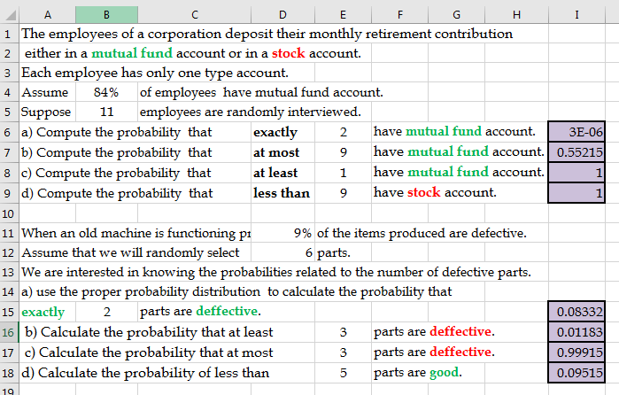
Additional Problems on Binomial Distribution
Binomial Distribution 1
Binomial Distribution 2

Slide 2
Additional Problems on Binomial Distribution

Slide 3
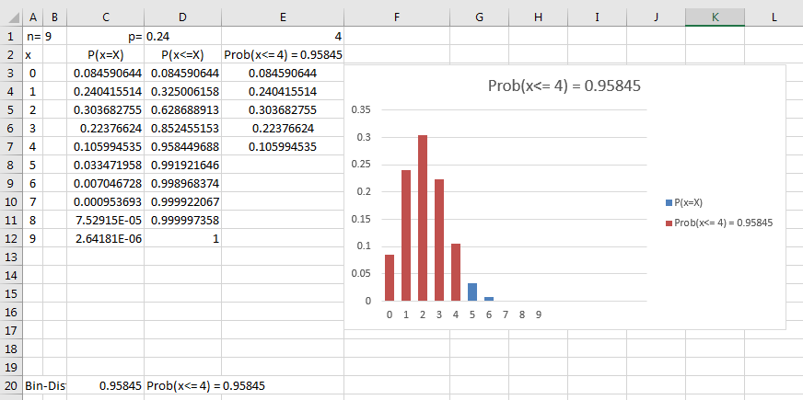
More Visual Representation

Slide 4
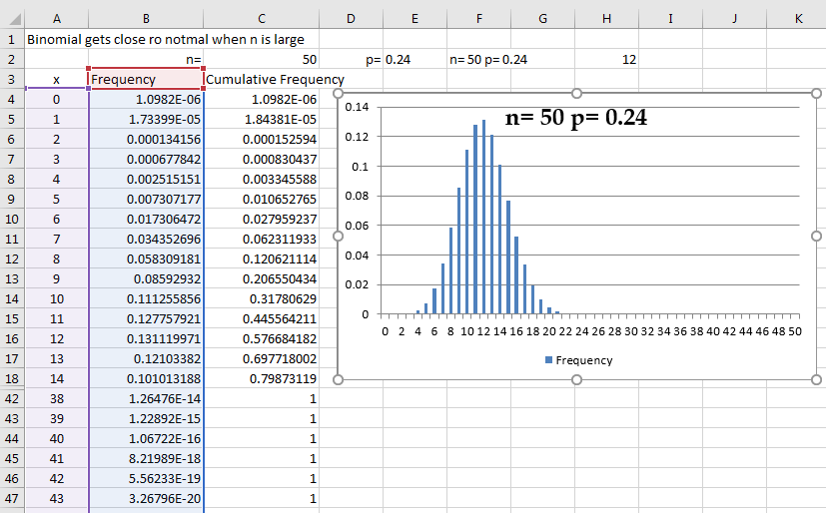
Binomial Distribution Tends to Normal for Large n

Slide 5
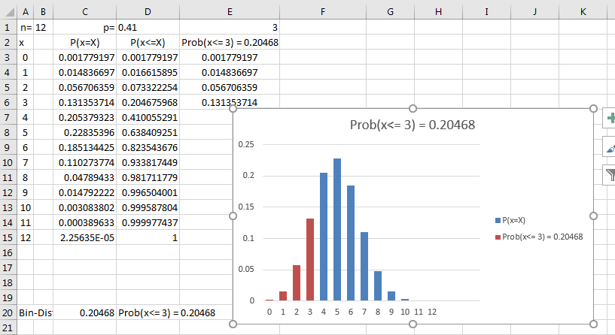
Binomial Distribution Tends to Normal for p Close to 0.5

Slide 6
Binomial to Poisson
During a severe thunderstorm, any transmission line is damaged with probability 0.04, independently of other transmission lines. A city with 75 transmission lines is hit by a severe thunderstorm. What is the probability that at least 5 of them get damaged?
X is Binomial(n = 75, p = 0.04), large n and small p, so X is approximately Poisson.
Large n can also lead to Normal approximation.
Solve in all three ways

Slide 7
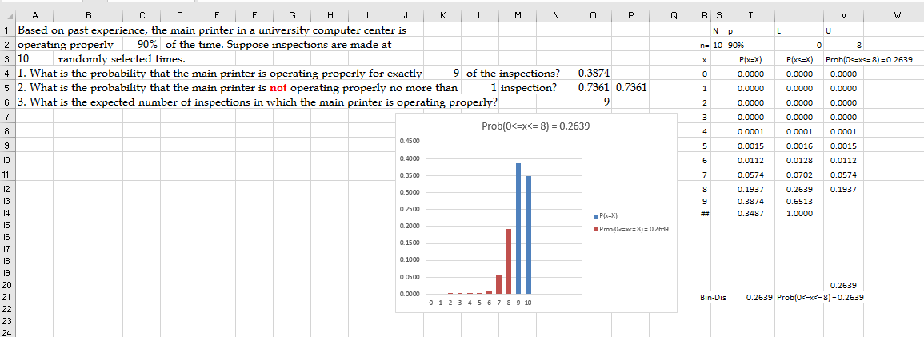
More Example

Slide 8
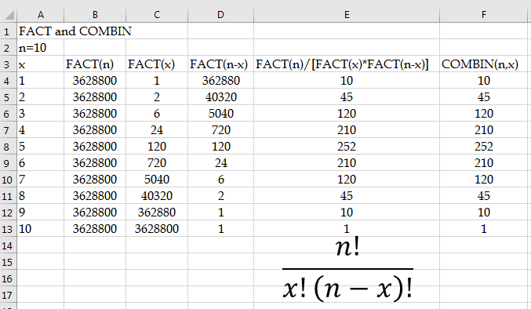
Factorial and Combination

Slide 9
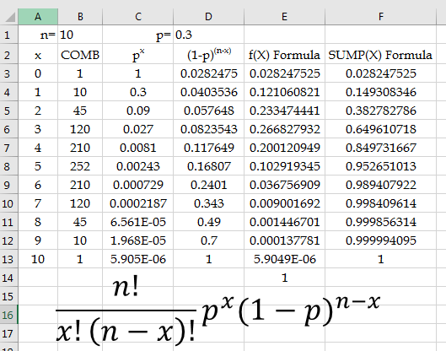
Binomial Distribution Formula and Excel

