Slide 1
Poisson Distribution

Slide 2
Poisson Probability Distribution
The number of defects in one mile of 405 freeway.
The number of vehicles arriving at a gas station on Reseda in 30-minute intervals.
The number of airplanes arriving LAX in one-hour intervals.
The number of emails sent out in DNCBE in one-minute intervals.
The number of knotholes in 14 linear feet of pine board
The number of vehicles arriving at a toll booth in one hour
Bell Labs used the Poisson distribution to model the arrival of phone calls in different time intervals.
A Poisson distributed random variable is often useful in estimating the number of occurrences over a specified interval of time or space.

Slide 3
Examples of Poisson Probability Distribution
The number of customers entering a bank per minute is a Poisson random variable with a mean of 3.5 customers per minute. What is the probability that more than three customers enter the bank in a minute?
P(x≥ 3) = 1- P(x≤ 2)
1- POISSON.DIST(2,3.5,1)
1- 0.32085 = 0.67915
The marketing manager of a company usually receives 10 complaint calls during a week (consisting of five working days). Suppose that the number of calls during a week follows the Poisson distribution. The probability that she gets five such calls in one day is:
P(x= 5) = POISSON.DIST(5,10,0) = 0.03783

Slide 4
Examples of Poisson Probability Distribution
A retail store aimed to reduce the number of bad checks cashed by its cashiers. The store's goal is to cash no more than eight bad checks per week. The average number of bad checks cashed is three per week.
a) Find the probability that the store's cashiers will not cash any bad checks in a particular week.
P(x=0) = POISSON.DIST(0,3,0) = 0.04979 =
b. Find the probability that the store will not meet its goal in a particular week.
P(x>8) = 1- P(x≤ 8) = 1- POISSON.DIST(8,3,1) = 1- 0.9962 = 0.0038
c. Find the probability that the store's cashiers will cash no more than 4 bad checks per two-week period.
Mean for 2 weeks = 2(3) = 6
P(x≤ 4) =POISSON.DIST(4,6,1) = 0.28506
d. Find the mean, variance, and standard deviation of the number of bad checks per week? 3, 3, SQRT(3)

Slide 5
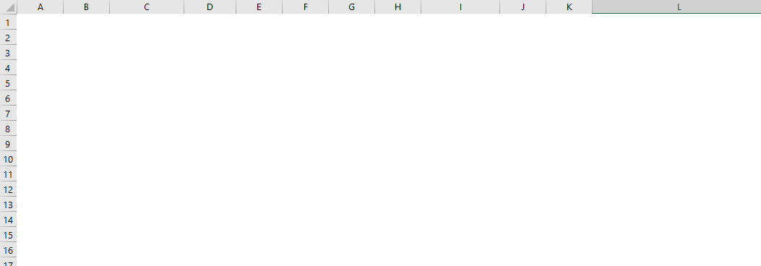
Examples of Poisson Probability Distribution
μ = σ ² = 10 ➔ σ = SQRT(10)

Slide 6
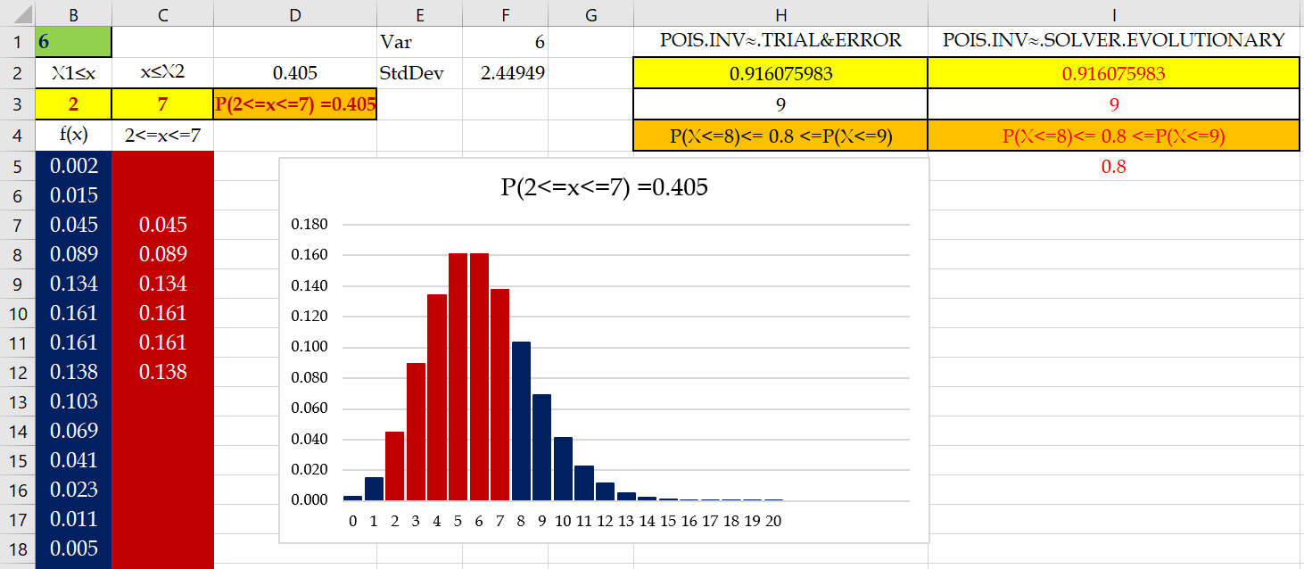
Poisson ToolKit

Slide 7
Poisson and Binomial
Suppose 60% of a large group of animals is infected with a particular disease. Let Y= the number of non- infected animals in a sample of size 5. The distribution of Y is
  a) binomial with n = 5 and p = 0.6
  b) binomial with n = 5 and p = 0.4
  c) binomial with n = 5 and p = 0.5
  d) Poisson with λ =0.6

Slide 8
Poisson and Binomial
A typical page in a book contains one typo per page. What is the probability that there are exactly 8 typos in a given 10-page chapter?
This is a Poisson distribution. Since the expected number of typos on one page is 1, the expected number of typos in 10 pages is 10.
λ = 10, P(x=8) =?
Suppose that every page in the chapter contains exactly 500 words , and there is still an average of one typo per page. What is the probability that there are exactly 8 typos in the 10-page chapter?
This time, we use a binomial distribution, where a typo counts as a success. The probability of success is 1/500 ; we have 5000 trials.

