Slide 1
Binomial Distribution
Ardavan Asef-Vaziri

Slide 2
Binomial Distribution
    A set of identical and independent trials (n trials).
    Each trial can only have two outcomes; success and failure. Success and failure are just names. You can switch the names if you wish. Probity of success is p. Therefore, probability of failure is 1-p.
    The number of success in n trials is our discrete random variable x.
    Suppose that 8% of inmates in a large prison are known to be innocent. A non-profit group randomly selects 25 inmates from this prison. Compute the probability the group will find 3 innocent inmates.
    For any daily worker chosen at random, it was estimated that with a probability of 0.2 that the person will not be with the company next year. What is the probability that chosen 4 workers at random, 1 of them would have left the company in one year.
    Statistics of the past 16 years show that 21% of FTF drop-out by the end of the second year. There are 20 FTF in a class in their first semester at CSUN. n=20, p=0.21
    In a 10 multiple choice questions, each with 5 answers ), what is the probability that a student all-by-guess, gets at least 60%.

Slide 3
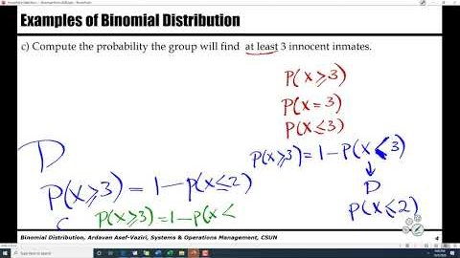
Recorded Lecture
https://youtu.be/acVYNKy4Vh0

Slide 4
Examples of Binomial Distribution
Suppose that 8% of inmates in a large prison are known to be innocent. A non-profit group randomly selects 25 inmates from this prison.
a) Compute the probability the group will find 3 innocent inmates.
P= 0.08, n= 25, P(x=3)=?
=BINOM.DIST(3,25,0.08,0) = 0.188075
b) Compute the probability the group will find at most 3 innocent inmates.
=BINOM.DIST(3,25,0.08,1) = 0.864908
P(x≤ 3)=?
c) Compute the probability the group will find at least 3 innocent inmates.
P(x≥3)=?
=1- P(x≤2) = 1-BINOM.DIST(2,25,0.08,1)
P(x≥3)= 1- 0.676833 = 0.32317
P(x≥3)= P(x=3) + P(x>3)= P(x=3) + 1- P(x≤3) = 0.188075+1- 0.864908
Average of x = µ = np
Variance of x = σ² = np(1-p) ➔ σ = SQRT(np(1-p))

Slide 5
Examples of Binomial Distribution
Henry Ford was concerned about a low retention rate for his employees. To alleviate the problem, he increased the salary of the daily workers. For any daily worker chosen at random, it was estimated that with a probability of 0.2 that the person will not be with the company next year.
What is the probability that chosen 4 workers at random, 1 of them would have left the company in one year.
BINOM.DIST(1,4,0.2,0) = 0.4096
What is the probability that at most 1 of them would have left the company in one year.
BINOM.DIST(1,4,0.2,1) = 0.8192
What is the probability that at least 1 of them would have left the company in one year.
BINOM.DIST(0,4,0.2,1) = 0.4096 or BINOM.DIST(0,4,0.2,0) = 0.4096
1- 0.4096 = 0.5904

Slide 6
Examples of Binomial Distribution
In a 10 multiple choice questions, each with 5 answers ), what is the probability that a student all-by-guess, gets at least 60%. N=10, p=1/5=0.2
P(x≥6)=1-P(x≤5) =1-BINOM.DIST(5,10,0.2,1) = 0.006369382.
During a severe thunderstorm, any transmission line is damaged with probability 0.04, independently of other transmission lines. A city with 75 transmission lines is hit by a severe thunderstorm.
What is the probability that at least 5 of them get damaged?
P= 0.04, n= 75, P(x≥5)=?
P(x≥5)=1- P(x≤ 4)= ?
P(x≤ 4)
=BINOM.DIST(4,75,0.04,1) = 0.818751
P(x≥5)=1- P(x≤ 4)= 1- 0.818751 = 0.181249

Slide 7
First-Time-Freshman (FTF), First-Time-Transfer (FTT)
Head count of DNCBE undergraduate students in 2017 was 6922, 1891 were incoming students, and 729 (729/1891=0.38551) were first-time-freshmen (FTF), and the rest (1-0.38551= 0.61549) were first-time-transfer (FTT). Statistics of the past 16 years show that 21% of FTF drop-out by the end of the second year. There are 20 FTF in a class in their first semester at CSUN. n=20, p=0.21
a) What is the probability that 5 of them are not at CSUN at the start of the third year.
P(x=5) =BINOM.DIST(5,20,0.21,0) = 0.184479
b) What is the probability that at most 5 of them are not at CSUN at the start of the third year.
P(x≤ 5) =BINOM.DIST(5,20,0.21,1) = 0.770302
c) What is the probability that at least 5 of them are not at CSUN at the start of the third year.
P(x ≥ 5) =1- P(x<5) = 1-P(x≤ 4) = 1- BINOM.DIST(4,20,0.21,1) = 1- 0.585823 = 0.414177

Slide 8
First-Time-Freshman (FTF), First-Time-Transfer (FTT)
d) What is the probability that 13 of them are at CSUN at the start of the third year.
P(y=13) = BINOM.DIST(13,20,0.79,0) = 0.0651780
P(y=13) = P(x=7) = BINOM.DIST(7,20,0.21,0) = 0.0651780
e) What is the probability that at most 13 of them are at CSUN at the start of the third year.
P(y≤ 13) =BINOM.DIST(13,20,0.79,1) = 0.1071011473
P(y≤ 13) = P(x ≥ 7)= 1-P(x<7)=1-P(x ≤ 6) = 1- 0.892899 = 0.1071011473
f) What is the probability that at least 13 of them are at CSUN at the start of the third year.
P(y ≥ 13) =1- P(y<13) = 1-P(y≤ 12) = 1- BINOM.DIST(12,20,0.79,1) = 1- 0.04192315 = 0.95807685
P(y ≥ 13) =P(x≤ 7) = BINOM.DIST(7,20,0.21,1) = 0.95807685

Slide 9
First-Time-Freshman (FTF), First-Time-Transfer (FTT)
g) Compute average and standard deviation of number of the 2017 FTF students at CSUN in Fall 2020.
Average = np = 20(0.21) = 4.2
Variance = np(1-p) = 20(0.21)(1-0.21) = 3.318, Standard Deviation = SQRT(3.318) = 1.82
h) What is the probability that 13 of them are at CSUN at the start of the third year.
Now we define a new p for those who are still at CSUN; that is 1-0.21 = 0.79
P(y=13) =BINOM.DIST(13,20,0.79,0) = 0.0651780
i) What is the probability that at most 13 of them are at CSUN at the start of the third year.
P(y≤ 13) =BINOM.DIST(13,20,0.79,1) = 0.1071011473
j) What is the probability that at least 13 of them are at CSUN at the start of the third year.
P(y ≥ 13) =1- P(x<13) = 1-P(x≤ 12) = 1- BINOM.DIST(12,20,0.79,1) = 1- 0.04192315 = 0.95807685

Slide 10
From ECON to STAT- From Linear Demand Curve to Uniform Distribution
Represent the demand curve P=175-2.5Q as a uniform distribution. Compute average and standard deviation.
MaxP =u= 175, MinP = l= 0
µ= (0+175)/2 = 87.5
σ² = (175-0)²/12= 2552.1
σ = SQRT(2552.1) = 50.52
f(x) =1/175
Compute the probability of sale if P=125
Probability of Sale = (175-P)/(175-0)= 1-P/175
= 1-125/175= 0.714
Probability of success (probability of sale) = p= 0.714
How many visitors visit this site?
What if we set price = 0
70 people n=70
0
P
175

Slide 11
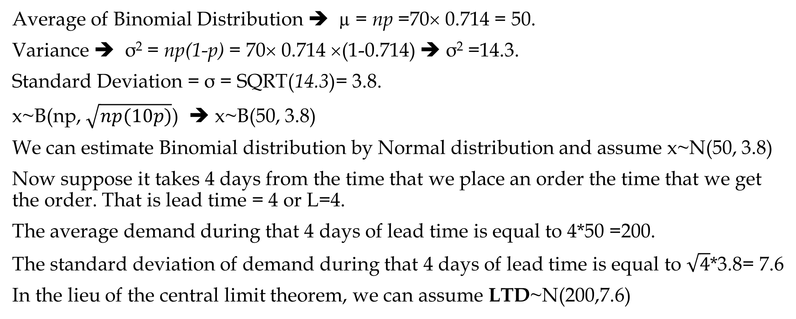
Binomial Distribution- Mean & Standard Deviation
Costumers look at the website that you have made for a product. The probability for a visitor to buy your product is 0.714. Your web site has a traffic of 70 visitors per day. What is the average and standard deviation of this distribution?
Average of Binomial Distribution ➔ µ = np =70× 0.714 = 50.
Variance ➔ σ² = np(1-p) = 70× 0.714 ×(1-0.714) ➔ σ² =14.3.
Standard Deviation = σ = SQRT(14.3)= 3.8.
x~B(np, $\sqrt{np(10p)}$) ➔ x~B(50, 3.8)
We can estimate Binomial distribution by Normal distribution and assume x~N(50, 3.8)
Now suppose it takes 4 days from the time that we place an order the time that we get the order. That is lead time = 4 or L=4.
The average demand during that 4 days of lead time is equal to 4*50 =200.
The standard deviation of demand during that 4 days of lead time is equal to $\sqrt{4}$*3.8= 7.6
In the lieu of the central limit theorem, we can assume LTD~N(200,7.6)

Slide 12
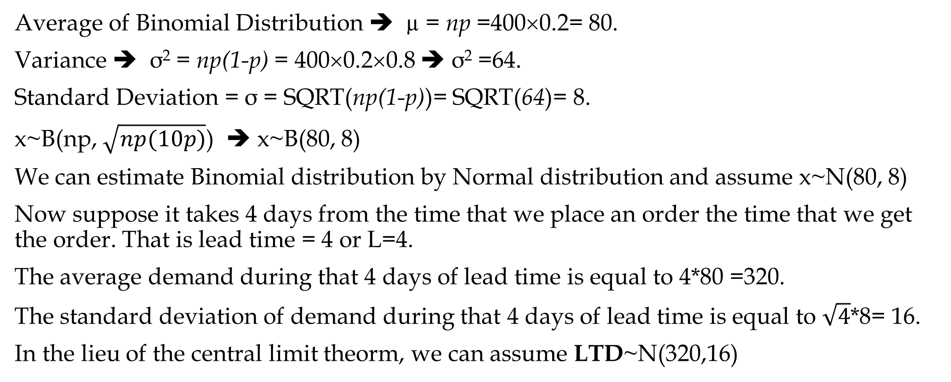
Binomial Distribution- Mean & Standard Deviation
Costumers look at the website that you have made for a product. The probability for a visitor to buy your product is 20%. Your web site has a traffic of 400 visitors per day. What is the average and standard deviation of this distribution?
Average of Binomial Distribution ➔ µ = np =400×0.2= 80.
Variance ➔ σ² = np(1-p) = 400×0.2×0.8 ➔ σ² =64.
Standard Deviation = σ = SQRT(np(1-p))= SQRT(64)= 8.
x~B(np, $\sqrt{np(10p)}$) ➔ x~B(80, 8)
We can estimate Binomial distribution by Normal distribution and assume x~N(80, 8)
Now suppose it takes 4 days from the time that we place an order the time that we get the order. That is lead time = 4 or L=4.
The average demand during that 4 days of lead time is equal to 4*80 =320.
The standard deviation of demand during that 4 days of lead time is equal to $\sqrt{4}$*8= 16.
In the lieu of the central limit theorm, we can assume LTD~N(320,16)

Slide 13
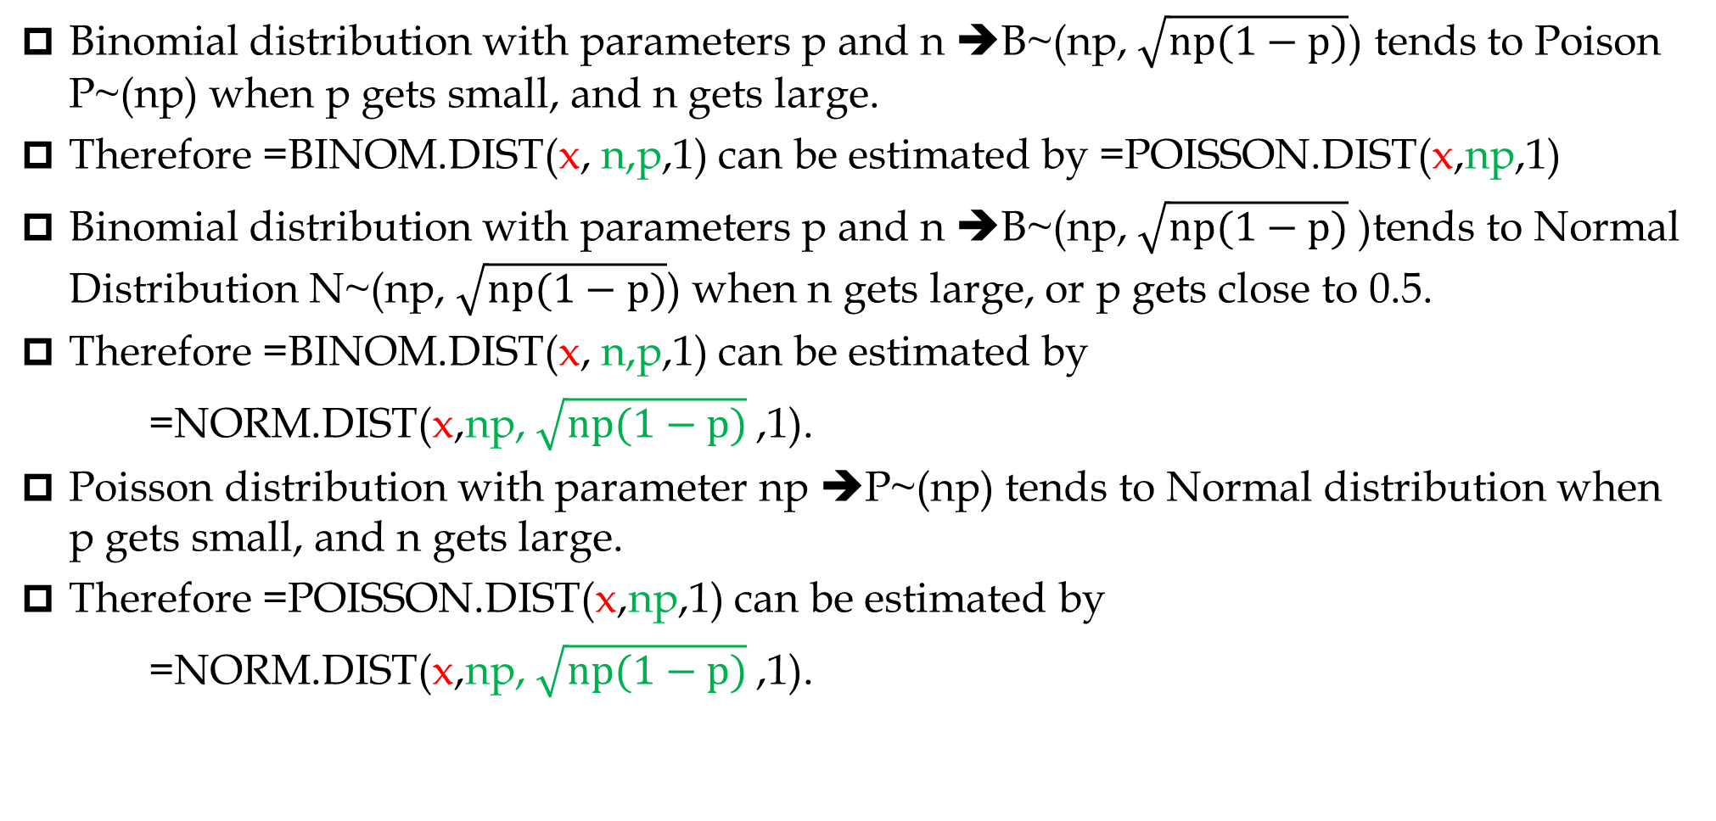
Binomial, Poison, Normal
Binomial distribution with parameters p and n ➔B~(np, $\sqrt{np(1−p)}$) tends to Poison P~(np) when p gets small, and n gets large.
Therefore =BINOM.DIST(x, n,p,1) can be estimated by =POISSON.DIST(x,np,1)
Binomial distribution with parameters p and n ➔B~(np, $\sqrt{np(1−p)}$)tends to Normal Distribution N~(np, $\sqrt{np(1−p)}$) when n gets large, or p gets close to 0.5.
Therefore =BINOM.DIST(x, n,p,1) can be estimated by
=NORM.DIST(x,np, $\sqrt{np(1−p)}$,1).
Poisson distribution with parameter np ➔P~(np) tends to Normal distribution when p gets small, and n gets large.
Therefore =POISSON.DIST(x,np,1) can be estimated by
=NORM.DIST(x,np, $\sqrt{np(1−p)}$,1).

Slide 14
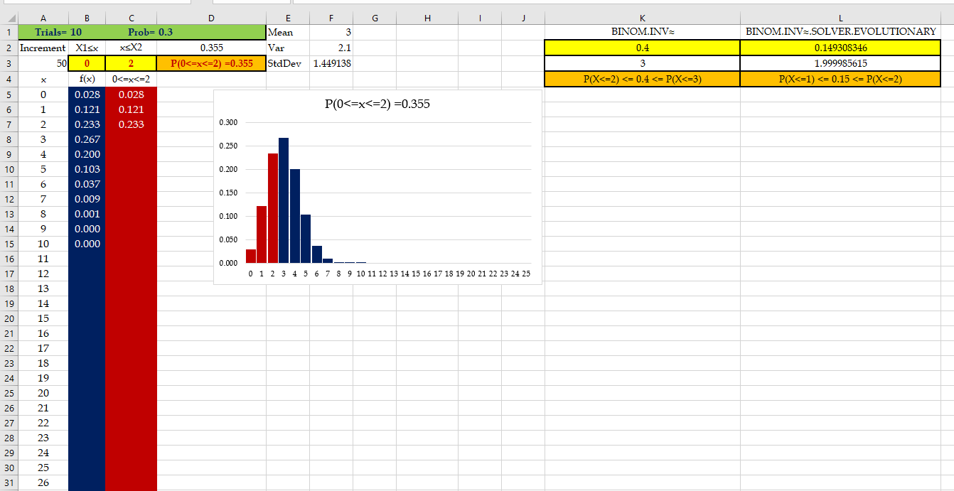
Binomial ToolKit

Slide 15
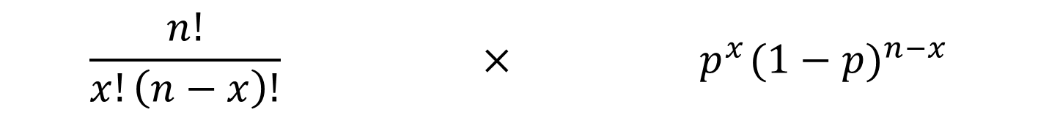
Binomial Distribution Formulas
x = the number of successes
p = the probability of a success on one trial
n = the number of trials
f(x) = the probability of x successes in n trials
n! = n(n – 1)(n – 2) ….. (2)(1)
$$\frac{n!}{x!\left(n−x\right)!}{ × p}^{x}{(1−p)}^{n−x}$$
Number of experimental
outcomes providing exactly
x successes in n trials
Probability of a particular
sequence of trial outcomes
with x successes in n trials

