Slide 1
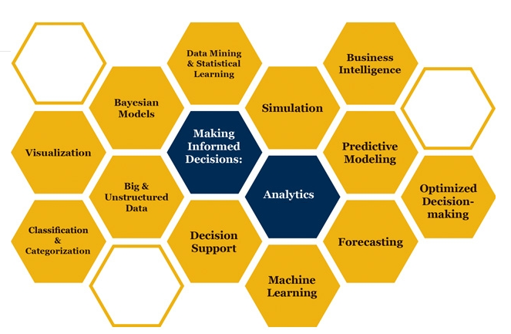

Slide 2
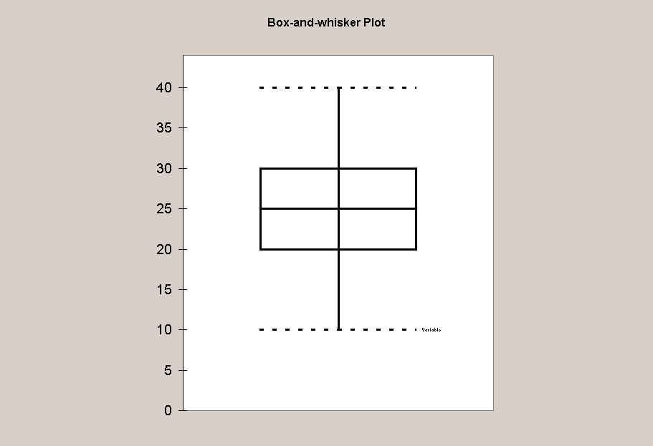
Sample Mean. Reclaimed phospate land in Polk County, Florida, has been found to emit a higher mean radiation level than other nonmining land in the county. Suppose that the radiation level for the reclaimed land has a distribution with mean 5.0 working levels (WL) and a standard deviation of 0.5 WL. Suppose further that 20 houses built on reclaimed land are randomly selected and the radiation level is measured in each.
  What is the probability that the sample mean for the 20 houses exceeds 4.7 WL?
  What is the probability that the sample mean is less than 4.8 WL?
Sample Mean and CLT. The length of time of long-distance telephone calls has mean of 18 minutes and standard deviation of 4 minutes. Suppose a sample of 50 telephone calls is used to reflect on the population of all long-distance calls.
  What is the chance that the average of the 50 calls is between 16 and 17 minutes?
  What theorem do we need in order to solve (a.)?

Slide 3
  Binomial. Based on past experience, the main printer in a university computer center is operating properly 90% of the time. Suppose inspections are made at 10 randomly selected times.
  What is the probability that the main printer is operating properly for exactly 9 of the inspections?
  What is the probability that the main printer is not operating properly no more than 1 inspection?
  What is the expected number of inspections in which the main printer is operating properly?
The time required to complete a final examination in a particular college course is normally distributed, with mean of 80 minutes and a standard deviation of 10 minutes. Answer the following questions.
  What is the probability of completing the exam in one hour or less?
  What is the probability a student will complete the exam in a time between 60 and 75 minutes?
  What is the interquartile range for completion times?
[Go to answer]
Assume that the dividends of electric utility stocks as of a given date have a symmetric distribution with mean of 8.5 percent and standard deviation of 2.5 percent. Find the probability that the average dividend of 25 such stocks will exceed 10 percent.
[Go to answer]
The probability that a patient fails to recover from a particular operation is 0.1. Suppose that eight patients having this operation are selected at random. Answer the following questions.
  What is the probability that at most one patient will not recover?
  What is the probability that at least 2 but no more than 3 patients will not recover?
  What is the probability that all patients will not recover?
  What is the expected number of patients that will not recover?
[Go to answer]
of 50 small businesses that have been in business for one year.

Slide 4
The length of time of long-distance telephone calls has mean of 18 minutes and standard deviation of 4 minutes. Suppose a sample of 50 telephone calls is used to reflect on the population of all long-distance calls.
  What is the chance that the average of the 50 calls is between 16 and 17 minutes?
  What theorem do we need in order to solve (a.)?
The time required to complete a final examination in a particular college course is normally distributed, with mean of 80 minutes and a standard deviation of 10 minutes. Answer the following questions.
  What is the probability of completing the exam in one hour or less?
  What is the probability a student will complete the exam in a time between 60 and 75 minutes?
  What is the interquartile range for completion times?
Assume that the dividends of electric utility stocks as of a given date have a symmetric distribution with mean of 8.5 percent and standard deviation of 2.5 percent. Find the probability that the average dividend of 25 such stocks will exceed 10 percent.
The probability that a patient fails to recover from a particular operation is 0.1. Suppose that eight patients having this operation are selected at random. Answer the following questions.
  What is the probability that at most one patient will not recover?
  What is the probability that at least 2 but no more than 3 patients will not recover?
  What is the probability that all patients will not recover?
  What is the expected number of patients that will not recover?
[Go to answer]

Slide 5
The probability that a patient fails to recover from a particular operation is 0.1. Suppose that eight patients having this operation are selected at random. Answer the following questions.
  What is the probability that at most one patient will not recover?
  What is the probability that at least 2 but no more than 3 patients will not recover?
  What is the probability that all patients will not recover?
  What is the expected number of patients that will not recover?
An insurance company states that 10% of all fire insurance claims are fraudulent. Suppose the company is correct, and that it receives 125 claims.
  What's the probability that at least 15 claims are fraudulent?
  What's the probability that less than 10 claims are fraudulent?
What type of data would be collected by the following survey questions?
  "How many pairs of shoes do you own?"
  "What color are your eyes?"
  "Which brand of soft drink do you prefer?"
  "What is the circumference of that tree?"
  "What is your GPA?"
  "Are you planning to vote this year?"
A random sample of 33 price-earnings ratios for a set of stocks whose prices are quoted by NASDAQ is displayed in the following stem-and-leaf plot. Stem-and-Leaf Display Stem unit: 10 0 4 1 0 5 6 8 8 9 2 0 1 1 1 2 3 4 5 5 6 7 8 8 9 9 3 0 1 2 3 4 4 5 7 4 1 7 5 6 2
  What is the shape of this data?
  What is the mode of this dataset?

Slide 6
The probability that a patient fails to recover from a particular operation is 0.1. Suppose that eight patients having this operation are selected at random. Answer the following questions.
  What is the probability that at most one patient will not recover?
  What is the probability that at least 2 but no more than 3 patients will not recover?
  What is the probability that all patients will not recover?
  What is the expected number of patients that will not recover?
An insurance company states that 10% of all fire insurance claims are fraudulent. Suppose the company is correct, and that it receives 125 claims.
  What's the probability that at least 15 claims are fraudulent?
  What's the probability that less than 10 claims are fraudulent?
What type of data would be collected by the following survey questions?
  "How many pairs of shoes do you own?"
  "What color are your eyes?"
  "Which brand of soft drink do you prefer?"
  "What is the circumference of that tree?"
  "What is your GPA?"
  "Are you planning to vote this year?"
A random sample of 33 price-earnings ratios for a set of stocks whose prices are quoted by NASDAQ is displayed in the following stem-and-leaf plot. Stem-and-Leaf Display Stem unit: 10 0 4 1 0 5 6 8 8 9 2 0 1 1 1 2 3 4 5 5 6 7 8 8 9 9 3 0 1 2 3 4 4 5 7 4 1 7 5 6 2
  What is the shape of this data?
  What is the mode of this dataset?
Seventy percent of small businesses experience cash flow problems during their first year of operation. A consultant takes a random sample of 50 small businesses that have been in business for one year.
  What is the probability that more than 80% of the sample have experienced cash flow problems?
  What is the probability that more than half of the sample has had cash flow problems?
Consider the following sample of data. Obtain the "1-Var Stats" from the TI-83 in order to answer the following questions. 7, -5, -8, 7, 9, 12, 0, 3, 11, 8, 6, -2, 4
  What are the mean and median for this dataset?
  What are the standard deviation and variance?
  What are the range and interquartile range?
  What are the midhinge and midrange?
[Go to answer]
Consider the following boxplot. Suppose 95% of the data falls between 15 and 35. Based on the empirical rule, what is the standard deviation of this sample of data?
[Go to answer]
A company estimates that there is an 80% chance of an order arriving on time from a supplier. Suppose 5 orders are placed this week.
  What is the probability that at least 4 orders arrive on time?
  What is the probability that none of the orders arrive on time?
  How many orders would you expect to arrive on time?
[Go to answer]
The reaction time to a certain psychological experiment is considered to be normally distributed with a mean of 20 seconds and a standard deviation of 4 seconds.
  What proportion of subjects take between 15 and 30 seconds to react?
  What proportion of subjects take longer than 30 seconds to react?
  What is the reaction time such that only 10% of subjects are faster?
[Go to answer]
A natural gas exploration company averages four strikes (that is, natural gas is found) per 100 holes drilled.
  If 20 holes are to be drilled, what is the probability that no strikes will be made?
  What is the probability that at least one strike will be made?
[Go to answer]
Suppose you are in charge of student ticket sales for a college football team. From past experience, you know that the number of tickets purchased by a student standing in line at the ticket window has a distribution with mean 2.4 and standard deviation 2.0. For today's game, there are 100 students standing in line to purchase tickets. If only 250 tickets remain, what is the probability that all 100 students will be able to purchase the tickets they desire? (Hint: 250 tickets for 100 students would be how many on average for each student?)
[Go to answer]
Wages for workers in a particular industry average $11.90 per hour with a standard deviation of 40 cents. The wages are considered to be normally distributed.
  Suppose you are employed in this industry. What would your wage have to be if 75% of all workers earn more than you?
  What proportion of workers receive wages less than $11 per hour?
  What proportion of workers make between $12 and $13 per hour?
[Go to answer]
Researchers have developed sophisticated intrusion-detection algorithms to protect the security of computer-based systems. These algorithms use principles of statistics to identify unusual or unexpected data, i.e., "intruders". One popular intrusion-detection system assumes the data being monitored are normally distributed. Consider the following data on input-output (I/O) units utilized by a sample of 44 users of a system. 15 5 2 17 4 3 1 1 0 0 0 0 0 0 0 20 9 0 0 0 1 6 1 3 1 0 6 0 0 0 0 1 14 0 7 0 2 9 4 0 0 0 9 10 Use your TI-83 to decide whether or not the data appear to be approximately normal:
  Obtain a boxplot and histogram of this data. Based on the shape, does it look like this sample comes from a normally distributed population?
  Obtain a normal probability plot. What is your conclusion?
[Go to answer]

Slide 7
Seventy percent of small businesses experience cash flow problems during their first year of operation. A consultant takes a random sample of 50 small businesses that have been in business for one year.
  What is the probability that more than 80% of the sample have experienced cash flow problems?
  What is the probability that more than half of the sample has had cash flow problems?
Consider the following sample of data. Obtain the "1-Var Stats" from the TI-83 in order to answer the following questions. 7, -5, -8, 7, 9, 12, 0, 3, 11, 8, 6, -2, 4
  What are the mean and median for this dataset?
  What are the standard deviation and variance?
  What are the range and interquartile range?
  What are the midhinge and midrange?
[Go to answer]
Consider the following boxplot. Suppose 95% of the data falls between 15 and 35. Based on the empirical rule, what is the standard deviation of this sample of data?
[Go to answer]
A company estimates that there is an 80% chance of an order arriving on time from a supplier. Suppose 5 orders are placed this week.
  What is the probability that at least 4 orders arrive on time?
  What is the probability that none of the orders arrive on time?
  How many orders would you expect to arrive on time?
[Go to answer]
The reaction time to a certain psychological experiment is considered to be normally distributed with a mean of 20 seconds and a standard deviation of 4 seconds.
  What proportion of subjects take between 15 and 30 seconds to react?
  What proportion of subjects take longer than 30 seconds to react?
  What is the reaction time such that only 10% of subjects are faster?
[Go to answer]
A natural gas exploration company averages four strikes (that is, natural gas is found) per 100 holes drilled.
  If 20 holes are to be drilled, what is the probability that no strikes will be made?
  What is the probability that at least one strike will be made?
[Go to answer]
Suppose you are in charge of student ticket sales for a college football team. From past experience, you know that the number of tickets purchased by a student standing in line at the ticket window has a distribution with mean 2.4 and standard deviation 2.0. For today's game, there are 100 students standing in line to purchase tickets. If only 250 tickets remain, what is the probability that all 100 students will be able to purchase the tickets they desire? (Hint: 250 tickets for 100 students would be how many on average for each student?)
[Go to answer]
Wages for workers in a particular industry average $11.90 per hour with a standard deviation of 40 cents. The wages are considered to be normally distributed.
  Suppose you are employed in this industry. What would your wage have to be if 75% of all workers earn more than you?
  What proportion of workers receive wages less than $11 per hour?
  What proportion of workers make between $12 and $13 per hour?
[Go to answer]
Researchers have developed sophisticated intrusion-detection algorithms to protect the security of computer-based systems. These algorithms use principles of statistics to identify unusual or unexpected data, i.e., "intruders". One popular intrusion-detection system assumes the data being monitored are normally distributed. Consider the following data on input-output (I/O) units utilized by a sample of 44 users of a system. 15 5 2 17 4 3 1 1 0 0 0 0 0 0 0 20 9 0 0 0 1 6 1 3 1 0 6 0 0 0 0 1 14 0 7 0 2 9 4 0 0 0 9 10 Use your TI-83 to decide whether or not the data appear to be approximately normal:
  Obtain a boxplot and histogram of this data. Based on the shape, does it look like this sample comes from a normally distributed population?
  Obtain a normal probability plot. What is your conclusion?
[Go to answer]

Slide 8
The reaction time to a certain psychological experiment is considered to be normally distributed with a mean of 20 seconds and a standard deviation of 4 seconds.
  What proportion of subjects take between 15 and 30 seconds to react?
  What proportion of subjects take longer than 30 seconds to react?
  What is the reaction time such that only 10% of subjects are faster?
[Go to answer]
A natural gas exploration company averages four strikes (that is, natural gas is found) per 100 holes drilled.
  If 20 holes are to be drilled, what is the probability that no strikes will be made?
  What is the probability that at least one strike will be made?
[Go to answer]
Suppose you are in charge of student ticket sales for a college football team. From past experience, you know that the number of tickets purchased by a student standing in line at the ticket window has a distribution with mean 2.4 and standard deviation 2.0. For today's game, there are 100 students standing in line to purchase tickets. If only 250 tickets remain, what is the probability that all 100 students will be able to purchase the tickets they desire? (Hint: 250 tickets for 100 students would be how many on average for each student?)
[Go to answer]
Wages for workers in a particular industry average $11.90 per hour with a standard deviation of 40 cents. The wages are considered to be normally distributed.
  Suppose you are employed in this industry. What would your wage have to be if 75% of all workers earn more than you?
  What proportion of workers receive wages less than $11 per hour?
  What proportion of workers make between $12 and $13 per hour?
[Go to answer]
Researchers have developed sophisticated intrusion-detection algorithms to protect the security of computer-based systems. These algorithms use principles of statistics to identify unusual or unexpected data, i.e., "intruders". One popular intrusion-detection system assumes the data being monitored are normally distributed. Consider the following data on input-output (I/O) units utilized by a sample of 44 users of a system. 15 5 2 17 4 3 1 1 0 0 0 0 0 0 0 20 9 0 0 0 1 6 1 3 1 0 6 0 0 0 0 1 14 0 7 0 2 9 4 0 0 0 9 10 Use your TI-83 to decide whether or not the data appear to be approximately normal:
  Obtain a boxplot and histogram of this data. Based on the shape, does it look like this sample comes from a normally distributed population?
  Obtain a normal probability plot. What is your conclusion?
[Go to answer]

Slide 9

Basic Probability Distributions
How can it be that mathematics, being after all a product of human thought independent of experience, is so admirably adapted to the objects of reality
Albert Einstein
Some parts of these slides were prepared based on
Essentials of Modern Busines Statistics, Anderson et al. 2012, Cengage.
Managing Business Process Flow, Anupindi et al. 2012, Pearson.
Project Management in Practice, Meredith et al. 2014, Wiley

Slide 10
Normal Probability Distribution
Before coming to class, please atch the following repository lectures on youtube
Normal Random Variablew 1
Normal Random Variablew 2
The link to these PowerPoint slides
http://www.csun.edu/~aa2035/CourseBase/Probability/S-5-Normal/PDF-3-Normal.pptx
The link to the excel file
http://www.csun.edu/~aa2035/CourseBase/Probability/S-5-Normal/PDF-3-Normal.xlsx

Slide 11
X: μ, σ, y = 2x➔ μ_{y} = 2μ, σ _{y} = 2σ
A random variable x with mean of μ , and standard deviation of σ is multiplied by 2 generates the random variable y=2x.
x: (μ , σ) ➔ y: (?,?)
Then
Past data on a specific stock shows that the return of this stock has a mean of $0.05 and StdDev of 0.05. Therefore, if we invest $1, the return has an average of 0.05 and standard deviation of 0.05.
If we invest one dollar in this stock, our investment after one year will have probability distribution of of N(0.05, 0.05).
Using simulation in excel show what is the mean and standard deviation of 10,000 and 20,000 investment.

Slide 12
$10,000 or $20,000 in One Stock
Probability is between 0 and 1, rand() is between 0 and 1. A rand() is a random probability.
=NORM.S.INV(rand()) ➔ suppose it is z = 0.441475
X= µ + σz = X = 5%+ 0.441475(5%) ➔ X= 5%+2.21% = 7.21%
=NORM.INV(probability, mu, sigma)
=NORM.INV(probability, 5%, 5%)
=NORM.INV(rand(), 5%, 5%)
= -8.1%

Slide 13
10,000 and 20,000 in One Stock

Slide 14
ROP; Variable R, Fixed L
Demand is fixed and is 50 units per day. From the time that we order until the time we receive the order is referred to as Lead Time. Suppose average lead time is 5 days and standard deviation of lead time is 1 days. At what level of inventory should we place an order such that the service level is 90% (Probability of demand during the lead time exceeding inventory is 10%).
This point is known as Reorder point (ROP).
The difference between ROP and Aveerage demad during lead time is Safety Stock.
What is the average demand during the lead time
What is standard deviation of demand during lead time

Slide 15
μ and σ of the Lead Time and Fided demand per period
x: (μ , σ) ➔ y: (nμ , nσ)

Slide 16
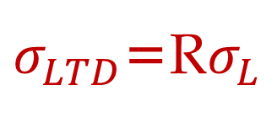
μ and σ of L and Fixed R
If Lead time is variable and Demand is fixed
L: Lead Time
L: Average Lead Time
σ_{L}: Standard deviation of Lead time
R: Demand per period
LTD: Average Demand during lead time
LTD = L × R
σ_{LTD}: Standard deviation of demand during lead time
$σ_{LTD}$=R$σ_{L}$

Slide 17
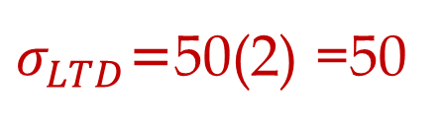
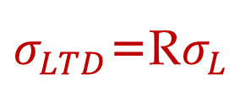
μ and σ of L and Fixed R
If Lead time is variable and Demand is fixed
L: Lead Time
L: Average Lead Time = 5 days
σ_{L}: Standard deviation of Lead time = 1 days
R: Demand per period = 50 per day
LTD: Average Demand During Lead Time
LTD = 5 × 50 = 250
σ_{LTD}: Standard deviation of demand during lead time
$σ_{LTD}$=R$σ_{L}$
$σ_{LTD}$=50(2) =50
=NORM.INV(0.9,250,50) =314.1

Slide 18
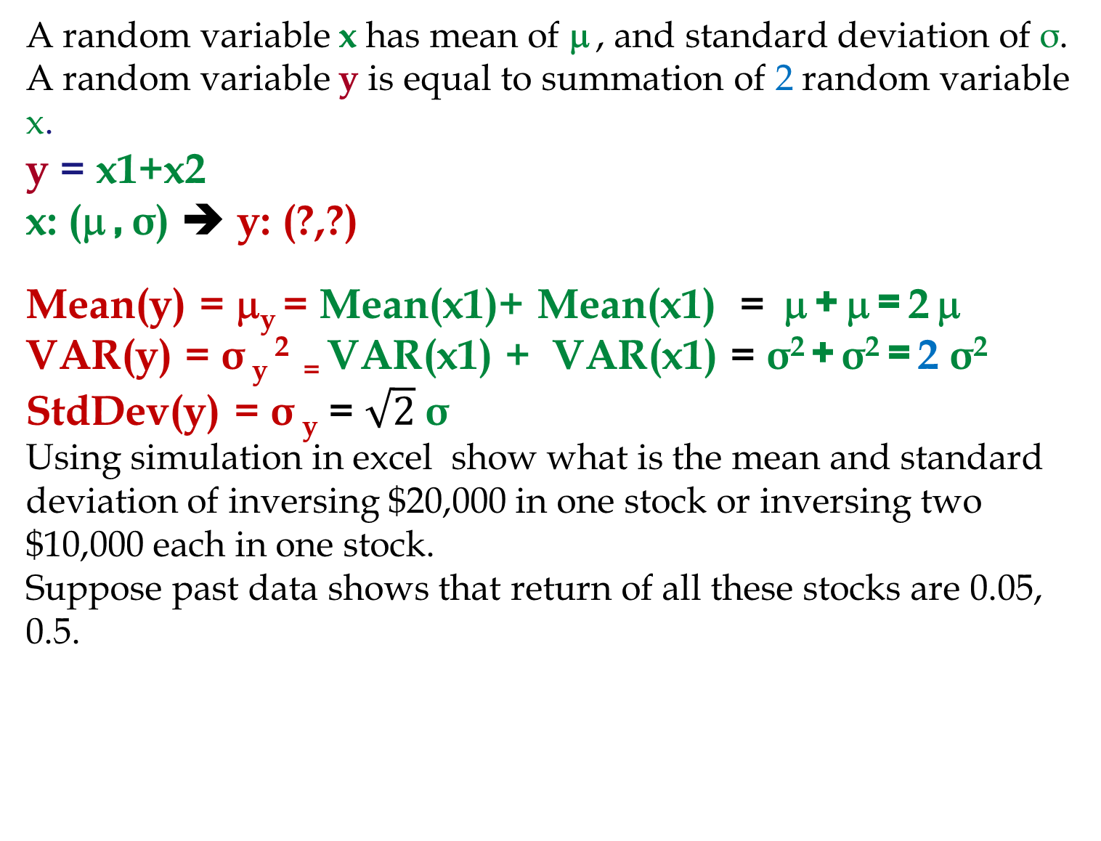
X: μ, σ, y = x1+X2, μ_{y} = 2μ, σ² _{y}= 2σ², σ _{y}= √2σ
A random variable x has mean of μ , and standard deviation of σ. A random variable y is equal to summation of 2 random variable x.
y = x1+x2
x: (μ , σ) ➔ y: (?,?)
Mean(y) = μ_{y} = Mean(x1)+ Mean(x1) = μ + μ = 2 μ
VAR(y) = σ _{y} ² ₌ VAR(x1) + VAR(x1) = σ² + σ² = 2 σ²
StdDev(y) = σ _{y} = $\sqrt{2}$σ
Using simulation in excel show what is the mean and standard deviation of inversing $20,000 in one stock or inversing two $10,000 each in one stock.
Suppose past data shows that return of all these stocks are 0.05, 0.5.

Slide 19
20,000 One Stock or 20,000 in Two Stocks

Slide 20
20,000 One Stock or 20,000 in Two Stocks

Slide 21
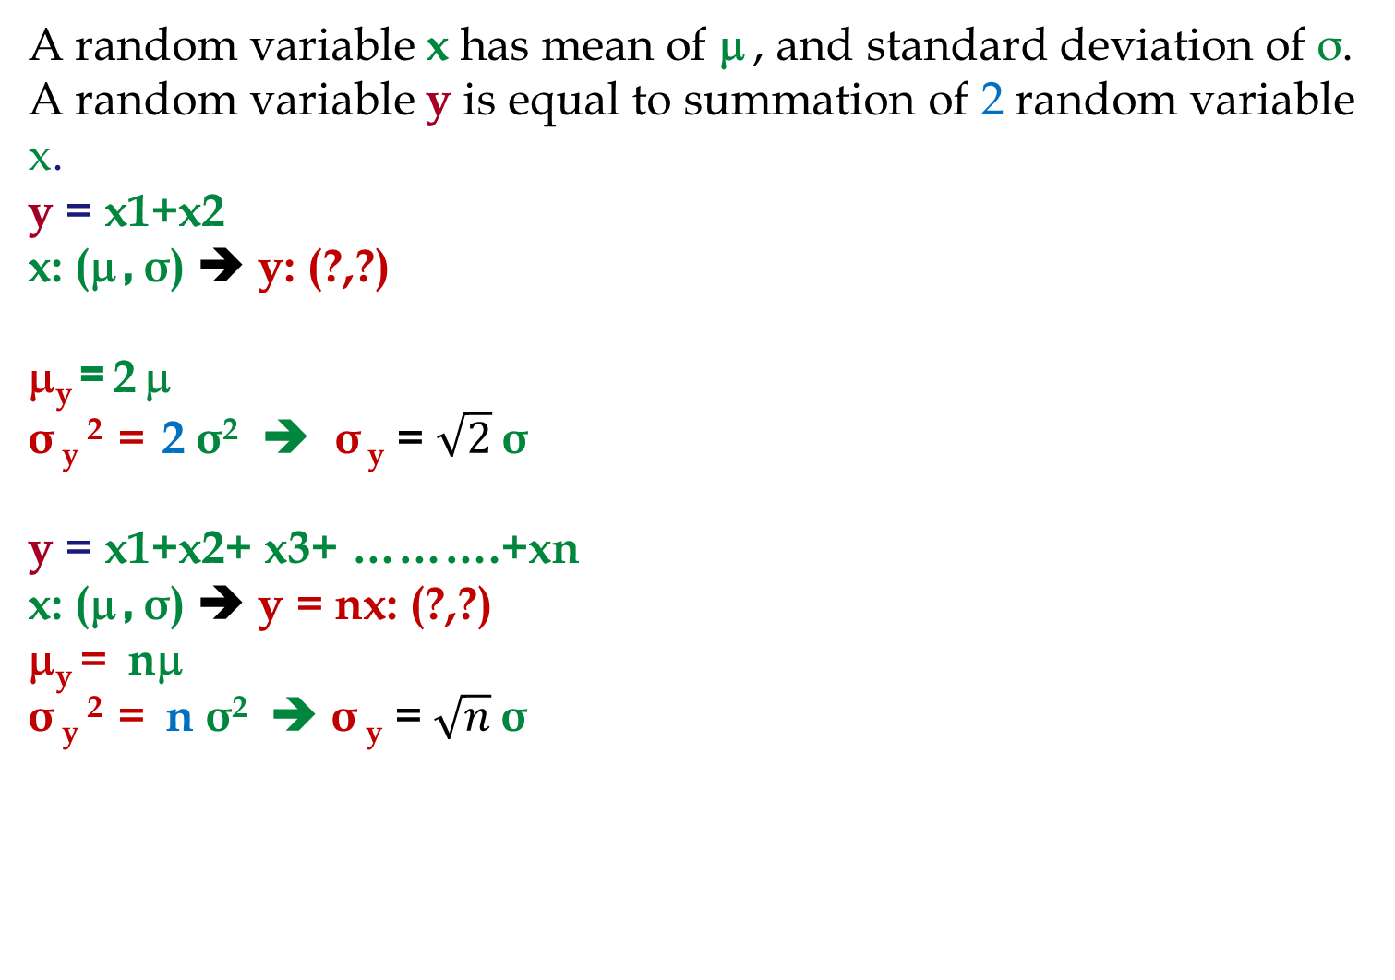
X: μ, σ, y = x1+X2, μ_{y} = 2μ, σ² _{y}= 2σ², σ _{y}= √2σ
A random variable x has mean of μ , and standard deviation of σ. A random variable y is equal to summation of 2 random variable x.
y = x1+x2
x: (μ , σ) ➔ y: (?,?)
μ_{y} = 2 μ
σ _{y} ² = 2 σ² ➔ σ _{y} = $\sqrt{2}$σ
y = x1+x2+ x3+ ……….+xn
x: (μ , σ) ➔ y = nx: (?,?)
μ_{y} = nμ
σ _{y} ² = n σ² ➔ σ _{y} = $\sqrt{n}$σ

Slide 22
100,000 in One Stock or 10,000 in Each of 10 stocks
Suppose there are 10 stocks and with high probability they all have Normal pdf return with mean of 5% and standard deviation of 5%. These stocks are your only options and no more information is available. You have to invest $100,000. What do you do?

Slide 23
100,000 vs. 10(10,000) investment in N(5%, 5%)

Slide 24
Risk Aversion Individual

Slide 25
Problem Game- The News Vendor Problem
Daily demand for your merchandise has mean of 20 and standard deviation of 5. Sales price is $100 per unit of product.
You have decided to close this business line in 60 days. Your supplier has also decided to close this line immediately, but has agreed to provide your last order at a cost of $60 per unit. Any unsold product will be disposed at cost of $10 per unit. How many units do you order
LTD = R ×L =20 ×60 = 1200.
Should we order 1200 units or more or less?
It depends on our service level.
Underage cost = Cu = p – c = 100 – 60 = 40.
Overage cost = Co = 60-0+10 =70
SL = Cu/(Cu+Co) = 40/(40+70) = 0.3636.
Due to high overage cost, SL*< 50%.
Z(0.3636) = ？

Slide 26
ROP; total demand during lead time is variable
If average demand during the lead time (from the time that we order until the time that we receive it) is 200 and standard deviation of demand during lead time is 25. Compute ROP at 90% service level. Compute safety stock.
This Problem: If average demand per day is 50 units and standard deviation of demand per day is 10, and lead time is 5 days. Compute ROP at 90% service level. Compute safety stock.
If we can transform this problem into the previous problem, then we are done, because we already know how to solve the previous problem.

Slide 27
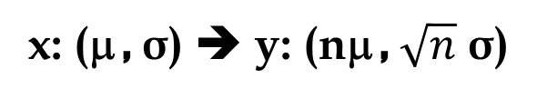
μ and σ of demand per period and fixed L
x: (μ , σ) ➔ y: (nμ , $\sqrt{n}$ σ)

Slide 28
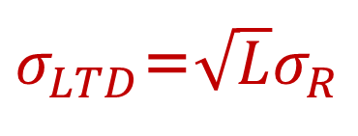
μ and σ of demand per period and fixed L
If Demand is variable and Lead time is fixed
L: Lead Time
R: Demand per period (per day, week, month)
R: Average Demand per period (day, week, month)
σ_{R}: Standard deviation of demand (per period)
LTD: Average Demand During Lead Time
LTD = L × R
σ_{LTD}: Standard deviation of demand during lead time
$σ_{LTD}$=$\sqrt{L}σ_{R}$

Slide 29
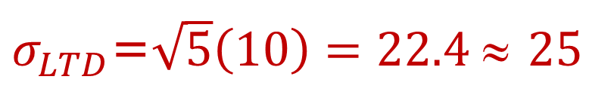
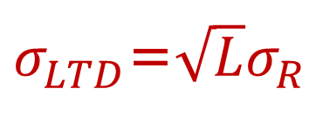
μ and σ of demand per period and fixed L
If demand is variable and Lead time is fixed
L: Lead Time = 5 days
R: Demand per day
R: Average daily demand =50
σ_{R}: Standard deviation of daily demand =10
LTD: Average Demand During Lead Time
LTD = L × R = 5 × 50 = 250
σ_{LTD}: Standard deviation of demand during lead time
$σ_{LTD}$=$\sqrt{L}σ_{R}$
$σ_{LTD}$=$\sqrt{5}\left(10\right)=22.4$≈ 25

Slide 30
Now It is Transformed
The Problem originally was: If average demand per day is 50 units and standard deviation of demand is 10 per day, and lead time is 5 days. Compute ROP at 90% service level. Compute safety stock.
We transformed it to: The average demand during the lead time is 250 and the standard deviation of demand during the lead time is 22.4. Compute ROP at 90% service level. Compute safety stock.
Which is the same as the previous problem: If average demand during the lead time is 200 and standard deviation of demand during lead time is 25. Compute ROP at 90% service level. Compute safety stock.

Slide 31
Now It is Transformed
The Problem originally was: If average demand per day is 50 units and standard deviation of demand is 10 per day, and lead time is 5 days. Compute ROP at 90% service level. Compute safety stock.
We transformed it to: The average demand during the lead time is 250 and the standard deviation of demand during the lead time is 22.4. Compute ROP at 90% service level. Compute safety stock.
=NORM.INV(0.9,250,22.4)
=278.7 ≈ 279

Slide 32
Comparing the two problems

Slide 33
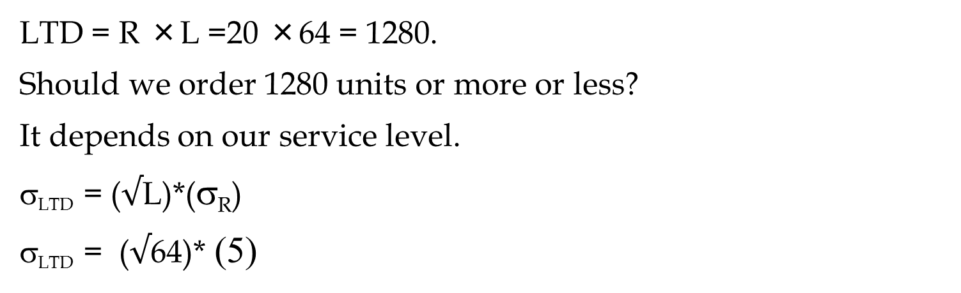
Problem Game- The News Vendor Problem
Daily demand for your merchandise has mean of 20 and standard deviation of 5. Sales price is $100 per unit of product.
You have decided to close this business line in 64 days. Your supplier has also decided to close this line immediately, but has agreed to provide your last order at a cost of $60 per unit. Any unsold product will be disposed at cost of $10 per unit. How many units do you order
LTD = R ×L =20 ×64 = 1280.
Should we order 1280 units or more or less?
It depends on our service level.
σ_{LTD} = ($√$L)*(σ_{R})
σ_{LTD} = ($√$64)* (5)

Slide 34
The News Vendor Problem- Extended
σ_{LTD} = 8* 5 = 40
Underage cost = Cu = = 100 – 60 = 40.
Overage cost = Co = 60 +10 =70
SL = Cu/(Cu+Co) = 40/(40+70) = 0.3636.
Due to high overage cost, SL*< 50%.
Z(0.3636) = ？
The optimal Q = LTD + z σ_{LTD}
=NORM.S.INV(0.3636) = -0.34885
Q = 1280 -0.34885(40)
ROP = 1280-13.9541
ROP = 1266.0459
=NORM.INV(probability, mean, standard_dev)
=NORM.INV(0.3636,1280,40
=1266.0459

Slide 35
X: μ, σ, y = (x1+X2)/2, μ_{y} = μ, σ² _{y}= σ²/2, σ _{y}= σ /√2
A random variable x has mean of μ , and standard deviation of σ. A random variable y is equal to the average of 2 random variables x.
y = (x1+x2)/2
x: (μ , σ) ➔ y: (?,?)
If it was x1+x2 then x1+x2: (2μ , √2σ)
Since it is (x1+x2)/2 or 1/2(x1+x2): 1/2(2μ , √2σ)
That is (μ , (√2/2)σ
y = (x1+x2)/2: μ , σ/√2
y = (x1+x2+x3+……..xn)/n
x: (μ , σ) ➔ y: μ , σ/√n

Slide 36
Present Value Mean and Standard Deviation
STOP HERE
We will have a cash inflow at the end of next year. This cash flow has mean of $1000 and standard deviation of 250. What is the mean and standard deviation of the present value of this cash flow. Our minimum acceptable rate of return in 12%.
We will have two cash inflows at the end of next two years. They both have mean of $1000 and standard deviation of 250. What is the mean and standard deviation of the present value of this cash flow. Our minimum acceptable rate of return in 12%.

Slide 37

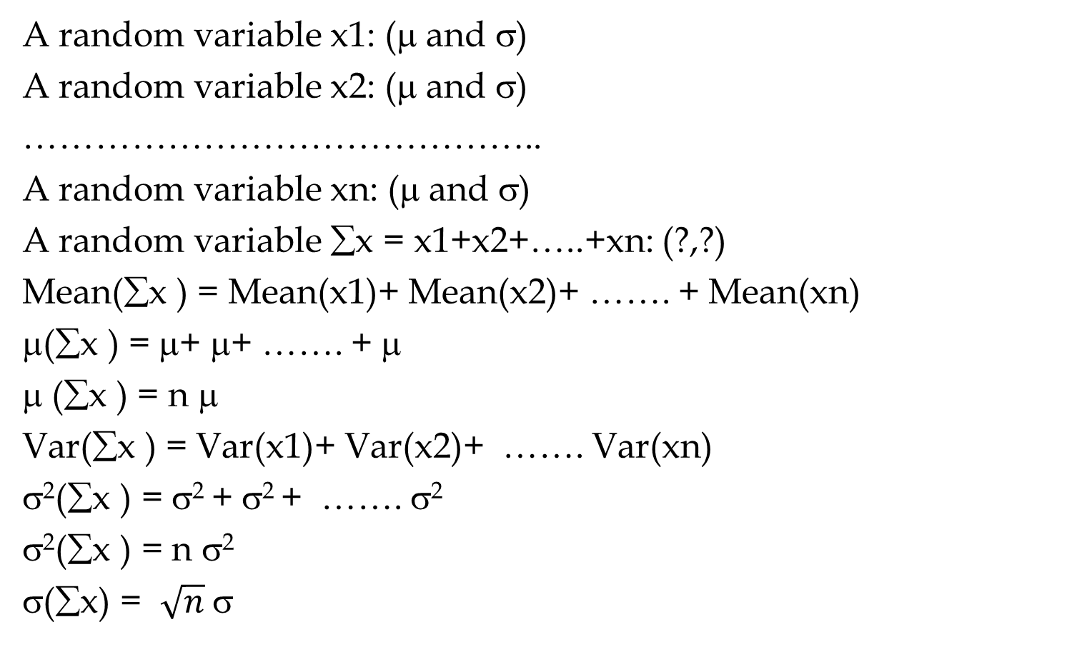
Sampling: Mean and Standard Deviation $\overline{X}$
A random variable x1: (μ and σ)
A random variable x2: (μ and σ)
……………………………………..
A random variable xn: (μ and σ)
A random variable ∑x = x1+x2+…..+xn: (?,?)
Mean(∑x ) = Mean(x1)+ Mean(x2)+ ……. + Mean(xn)
μ(∑x ) = μ+ μ+ ……. + μ
μ (∑x ) = n μ
Var(∑x ) = Var(x1)+ Var(x2)+ ……. Var(xn)
σ²(∑x ) = σ² + σ² + ……. σ²
σ²(∑x ) = n σ²
σ(∑x) = $\sqrt{n}$σ

Slide 38

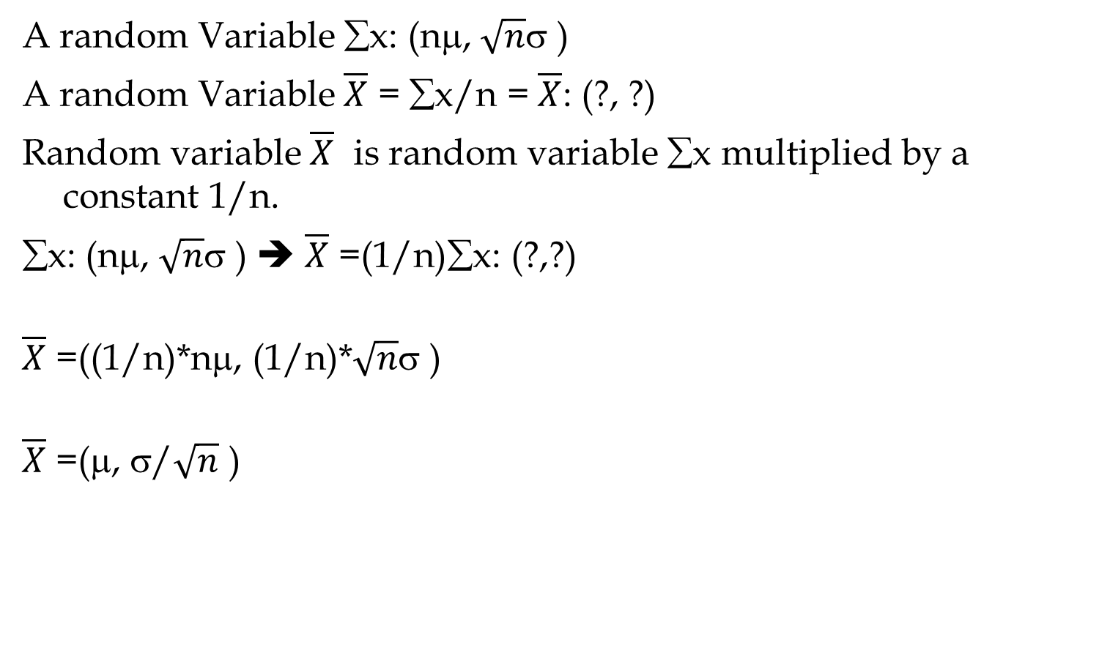
Sampling: Mean and Standard Deviation $\overline{X}$
A random Variable ∑x: (nμ, $\sqrt{n}$σ )
A random Variable $\overline{X}$ = ∑x/n = $\overline{X}$: (?, ?)
Random variable $\overline{X}$ is random variable ∑x multiplied by a constant 1/n.
∑x: (nμ, $\sqrt{n}$σ ) ➔ $\overline{X}$ =(1/n)∑x: (?,?)
$\overline{X}$ =((1/n)*nμ, (1/n)*$\sqrt{n}$σ )
$\overline{X}$ =(μ, σ/$\sqrt{n}$ )

Slide 39
Future Value (FV)
$100, put it in a bank. Interest rate = 10%. How much after 1 year. P = 100. F?
F1 = 100 +0.1(100) = 100(1+0.1)
How much after 2 years?
F2= 100(1+0.1) + 0.1(100(1+0.1)) =
F2= 100(1+0.1) (1+0.1) = 100(1.1)²
How much after 3 years?
F3 = 100(1.1)² + 0.1[100(1.1)²] =
F3 = 100(1.1)² [1+0.1] = 100(1.1)² [1.1] = 100(1.1)³
How much after N years
F = 100(1.1)^{N}

Slide 40
Future Value (FV); Present Value (PV)
P: The initial vale
MARR: Minimum Acceptable Rate of Return
F= P(1+MARR)^{N}
P = F/(1+MARR)^{N}
P = F/(1+r)^{N}
r = the minimum acceptable rate of return
=FV(r, N,PMT,PV,0→ EOY) =
=PV(r, N,PMT,FV,0 →EOY) =

Slide 41
Future Value (FV); Present Value (PV)
=FV(r, N,PMT,PV,0→ EOY) =
=PV(r, N,PMT,FV,0 →EOY) =
=FV(r,N, PMT, PV,0) =
FV(10%,3,0,100,0) =
=PV(r,N, PMT, FV,0) =
PV(10%,3,0,133.1,0) =

Slide 42
Present Value Mean and Standard Deviation
We will have a cash inflow at the end of next year. This cash flow has mean of $1000 and standard deviation of 250. What is the mean and standard deviation of the present value of this cash flow. Our minimum acceptable rate of return in 12%.
P=F/(1+r)
P= [1/(1+r)]F
P= KF
y=Kx
Mean (y) = K*Mean(x)
StdDev(y) = K*StdDev(x)
Mean (x) =1000
StdDev(x) = 300
K= (1/(1+.12) = 1/1.12 =
Mean (P) = 0.893* Mean(F)
Mean (P) = 0.893(1000)
Mean (P) = $893
StdDev(P) = 0.893*StdDev(x)
StdDev(P) = 0.893*250
StdDev(x) = 223
If P has Normal Distribution, Compute
Probability of P ≥ $1000
0.892857

Slide 43
Present Value Mean and Standard Deviation
We will have two cash inflows at the end of next two years. They both have mean of $1000 and standard deviation of 250. What is the mean and standard deviation of the present value of this cash flow. Our minimum acceptable rate of return in 12%.
P1=0.893F/(1+r)
P1= [1/(1+r)]F1
P2= [1/(1+r)²]F2
P1= [1/(1.12)]F1
P2= [1/(1.12)²]F2
P1= 0.893F1
P2= 0.797F2
Mean (P1) = 0.893(1000)
Mean (P2) = 0.797(1000)
P=P1+P2
y=x1+x2
Mean (y) = Mean (x1)+Mean(x2)
Var(y) = Var(x1)+Var(x2)
Mean (P) = Mean(P1)+Mean(P2)
Mean (P) = 893+797 = 1690
StdDev (P1) = 0.893(250) =223
StdDev (P2) = 0.797(250) = 199
Var (P) = Var(P1)+Var(P2)

Slide 44
Present Value Mean and Standard Deviation
Mean (P) = 1690
StdDev (P1) = 0.893(250) =223
StdDev (P2) = 0.797(250) = 199
Var(P1) = (223)² = 49824
Var(P2) = (199)² = 39720
Var (P) = Var(P1)+Var(P2)
Var (P) = 49824 + 39720 = 89544
StdDev (P) = SQRT(Var(P))
StdDev (P) = 299
If P has Normal Distribution, Compute
Probability of P ≥ $2000

Slide 45
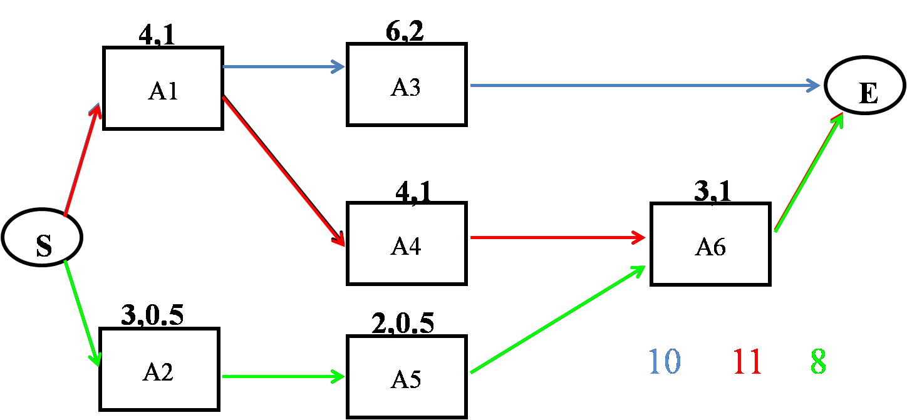
Project Scheduling
Given the following project with three paths, compute the mean and StdDev of each path. The pairs of numbers on each activity represent the mean and StdDev of each activity.

Slide 46
Project Scheduling
m_{CP}= 4+4+3 = 11
σ²_{CP} = 1²+1²+1² = 3
σ_{CP} = 1.73
=NORM.DIST(12,11,1.73,1)
= 0.7184
m_{CP}= 6+4 = 10
σ²_{CP} = 1²+2² = 5
σ_{CP} = 2.24
=NORM.DIST(12,10,2.24,1)
= 0.814
=NORM.DIST(12,8,1.22,1)
= 0.9995
m_{CP}= 3+2+3 = 8
σ²_{CP} = 0.5²+0.5²+1²
σ²_{CP} = 1.5
σ_{CP} = 1.22
The probability of competing the Project in not more than 12 days is 0.72×0.81×1 = 0.58

Slide 47
Project Scheduling
Critical Path
D_{CP} = the desired completion date of the critical path
μ_{CP}= the sum of the T_{E} for the activities on the critical path
σ²_{CP} = the sum of the variances of the activities on the critical path
Using μ_{CP} and σ_{CP} and NORM.DIST(D_{CP}, μ_{CP}, σ_{CP},1) we can find probability of completing the critical path in ≤ D_{CP} .
Project
Find all paths in the network. Compute µ and σ of each path
Compute the probability of completing each path in ≤ the given time
Calculate the probability that the entire project is completed within the specified time by multiplying these probabilities together

Slide 48
Practice
15, 3
5,1
20,4
A
D
G
E
20,2
10,2
10,2
B
S
E
H
10,3
20,5
C
F

