Slide 1

Sampling and Confidence Interval
How can it be that mathematics, being after all a product of human thought independent of experience, is so admirably adapted to the objects of reality
Albert Einstein
Some parts of these slides were prepared based on
Managing Business Process Flow, Anupindi et al. 2012. Pearson.
Essentials of Modern Busines Statistics, Anderson et al. 2012. Cengage.

Slide 2
Sampling
An element is the entity on which data are collected.
A population is a collection of all the elements of interest.
Sample is a subset of the population. It contains only a portion of the population.
Frame is a list of objects
The sample results provide estimates of the values of the population characteristics
With proper sampling methods, the sample results can provide “good” estimates of the population characteristics.

Slide 3
Sampling from a Finite Population
St. Andrew’s College received 900 applications for admission in the upcoming year from prospective students. The applicants were numbered, from 1 to 900, as their applications arrived. The Director of Admissions would like to select a simple random sample of 30 applicants.
Generate rand() in column next to the names. Then sort the rand column. Select the top 30 names.
Sometimes we want to select a sample, but find it is not possible to obtain a list of all elements in the population.
As a result, we cannot construct a frame for the population. We cannot use the random number selection procedure.
Most often this situation occurs in infinite population
cases.

Slide 4
Sampling from an Infinite Population
Populations are often generated by an ongoing process where there is no upper limit on the number of units that can be generated. Examples of on-going processes, with infinite populations, are:
parts being manufactured on a production line
transactions occurring at a bank
telephone calls arriving at a technical help desk
customers entering a store
These are objects.
A random sample from an infinite population is a sample selected such that the following conditions are satisfied.
Each element selected comes from the population of interest.
Each element is selected independently.

Slide 5
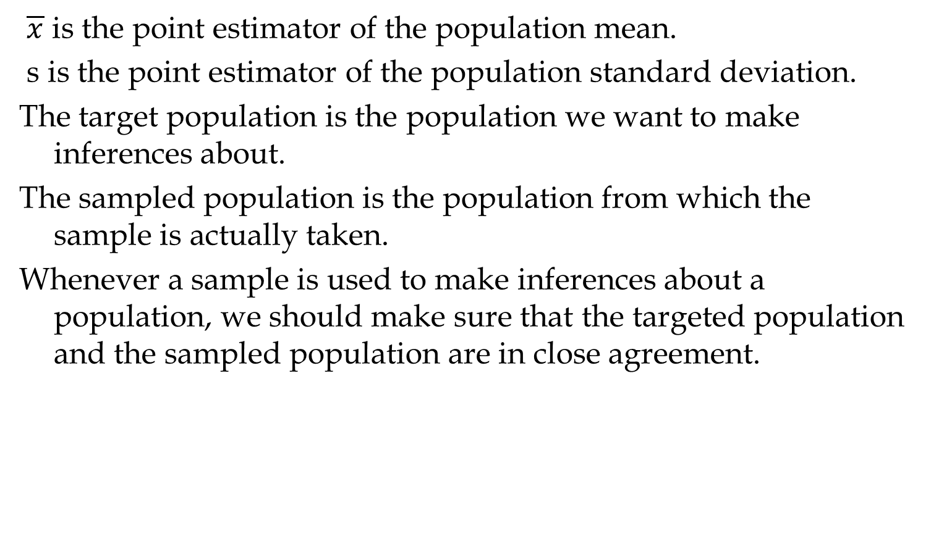
Sampling from an Infinite Population
$\overline{x}$ is the point estimator of the population mean.
s is the point estimator of the population standard deviation.
The target population is the population we want to make inferences about.
The sampled population is the population from which the sample is actually taken.
Whenever a sample is used to make inferences about a population, we should make sure that the targeted population and the sampled population are in close agreement.

Slide 6
10 Samples of size 25

Slide 7
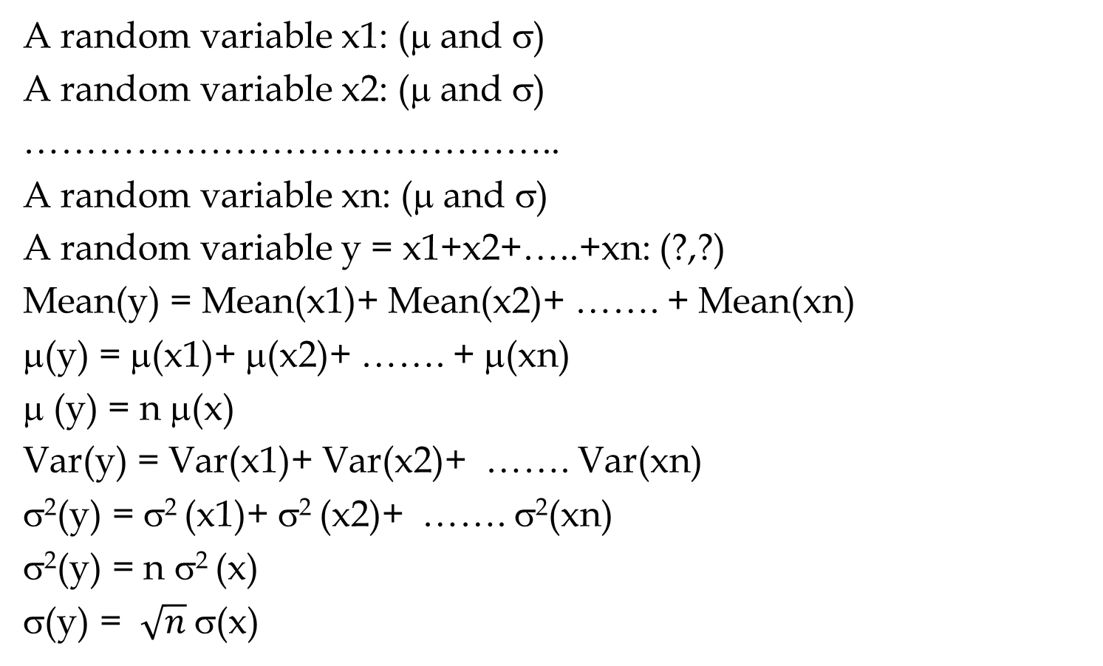
Sampling from an Infinite Population
A random variable x1: (μ and σ)
A random variable x2: (μ and σ)
……………………………………..
A random variable xn: (μ and σ)
A random variable y = x1+x2+…..+xn: (?,?)
Mean(y) = Mean(x1)+ Mean(x2)+ ……. + Mean(xn)
μ(y) = μ(x1)+ μ(x2)+ ……. + μ(xn)
μ (y) = n μ(x)
Var(y) = Var(x1)+ Var(x2)+ ……. Var(xn)
σ²(y) = σ² (x1)+ σ² (x2)+ ……. σ²(xn)
σ²(y) = n σ² (x)
σ(y) = $\sqrt{n}$σ(x)

Slide 8
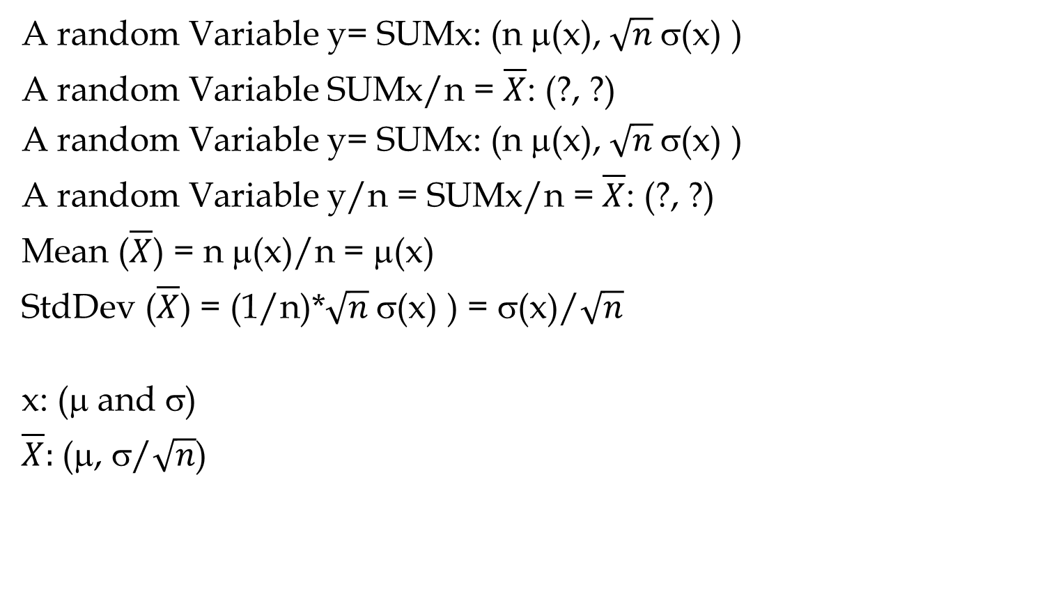
Sampling from an Infinite Population
A random Variable y= SUMx: (n μ(x), $\sqrt{n}$σ(x) )
A random Variable SUMx/n = $\overline{X}$: (?, ?)
A random Variable y= SUMx: (n μ(x), $\sqrt{n}$σ(x) )
A random Variable y/n = SUMx/n = $\overline{X}$: (?, ?)
Mean ($\overline{X}$) = n μ(x)/n = μ(x)
StdDev ($\overline{X}$) = (1/n)*$\sqrt{n}$σ(x) ) = σ(x)/$\sqrt{n}$
x: (μ and σ)
$\overline{X}:$(μ, σ/$\sqrt{n}$)

Slide 9

Standard Deviation of $\overline{X}$ for N=25 and N=50

Slide 10
Standard Deviation of $\overline{X}$ for N=25 and N=50

Slide 11
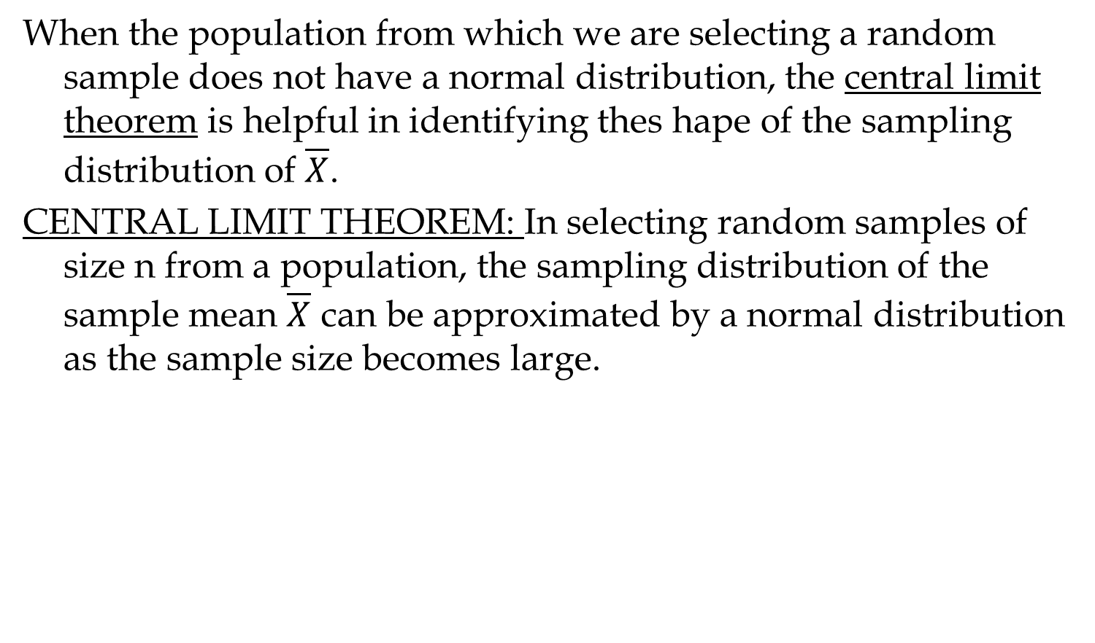
Sampling from an Infinite Population
When the population from which we are selecting a random sample does not have a normal distribution, the central limit theorem is helpful in identifying thes hape of the sampling distribution of $\overline{X}$.
CENTRAL LIMIT THEOREM: In selecting random samples of size n from a population, the sampling distribution of the sample mean $\overline{X}$ can be approximated by a normal distribution as the sample size becomes large.

Slide 12
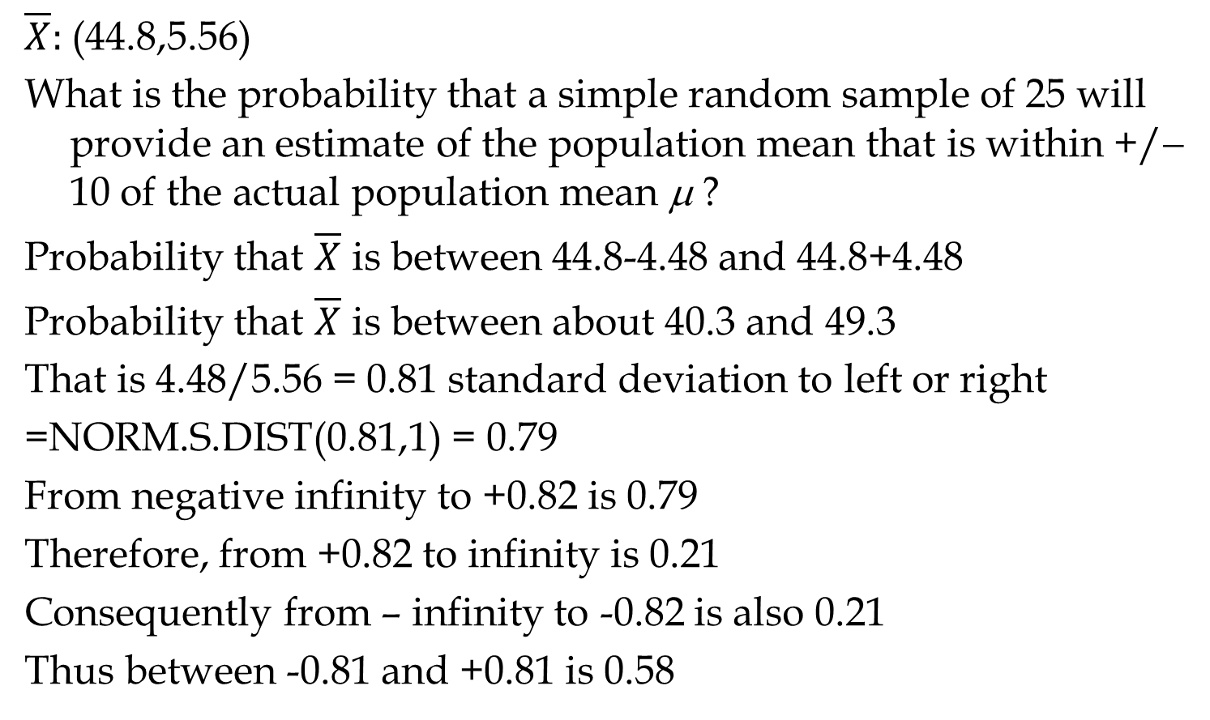
Sampling from an Infinite Population
$\overline{X}:$(44.8,5.56)
What is the probability that a simple random sample of 25 will provide an estimate of the population mean that is within +/−10 of the actual population mean μ ?
Probability that $\overline{X}$ is between 44.8-4.48 and 44.8+4.48
Probability that $\overline{X}$ is between about 40.3 and 49.3
That is 4.48/5.56 = 0.81 standard deviation to left or right
=NORM.S.DIST(0.81,1) = 0.79
From negative infinity to +0.82 is 0.79
Therefore, from +0.82 to infinity is 0.21
Consequently from – infinity to -0.82 is also 0.21
Thus between -0.81 and +0.81 is 0.58

Slide 13
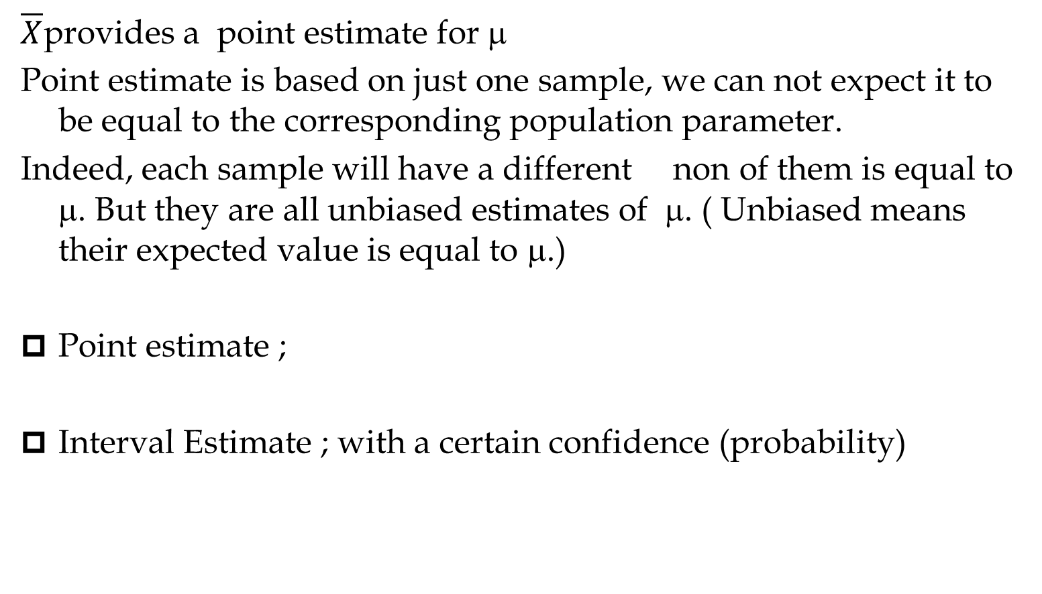
Interval Estimation vs Point Estimation
$\overline{X}$provides a point estimate for μ
Point estimate is based on just one sample, we can not expect it to be equal to the corresponding population parameter.
Indeed, each sample will have a different non of them is equal to μ. But they are all unbiased estimates of μ. ( Unbiased means their expected value is equal to μ.)
Point estimate ;
Interval Estimate ; with a certain confidence (probability)

Slide 14
Relationship between μ and x
.95
1-α

Slide 15
Relationship between μ and x

Slide 16
Relationship between μ and x

Slide 17
Interval Estimation of a Population Mean: σ is known

Slide 18
3-Ways to Compute CI in Excel: σ is known

Slide 19
3-Ways to Compute CI in Excel: σ is known

Slide 20
Sampling Error
For the case of a sample mean estimating a population mean, the sampling error is
There is .95 probability that estimates μ with
precision
Sampling
distribution
of
0.95 of all
values
.025
0.975
μ

Slide 21
Example: National Discount, Inc.
National Discount has 260 retail outlets throughout the United States. National evaluates each potential location for a new retail outlet in part on the mean annual income of the individuals in the marketing area of the new location.
The purpose of this example is to show how sampling can be used to develop an interval estimate of the mean annual income for individuals in a potential marketing area for National Discount.
Based on similar annual income surveys, the standard deviation of annual incomes in the entire population is considered known with σ = $5,000.
  We will use a sample size of n = 64.

Slide 22
Example: National Discount, Inc.
Precision Statement
There is a 0.95 probability that the value of a sample mean for National Discount will provide a sampling error of $????? or less.
Z0.975 = 1.959964
StdDev = 5000
StdDevXbar = 5000/SQRT(64)
StdDevXbar = 5000/8 =626
(Z0.975)(StdDevXbar) = 1.96(625) = 1225
Precision Statement
There is a .95 probability that the value of a sample mean for National Discount will provide a sampling error of $1,225 or less.

Slide 23
Sample Size for an Interval Estimate of a Population Mean
Suppose that National’s management team wants an estimate of the population mean such that there is a 0.95 probability that the sampling error is $500 or less.
How large a sample size is needed to meet the required precision? Recall that σ = 5,000

Slide 24
Interval Estimation of a Population Mean: σ is unknown
Instead of population standard deviation σ, we have sample standard deviation of s
Instead of normal distribution, we have t distribution
The t distribution is a family of similar probability distributions.
A specific t distribution depends on a parameter known as the degrees of freedom.
As the number of degrees of freedom increases, the difference between the t distribution and the standard normal probability distribution becomes smaller and smaller.
A t distribution with more degrees of freedom has less dispersion.
The mean of the t distribution is zero

Slide 25
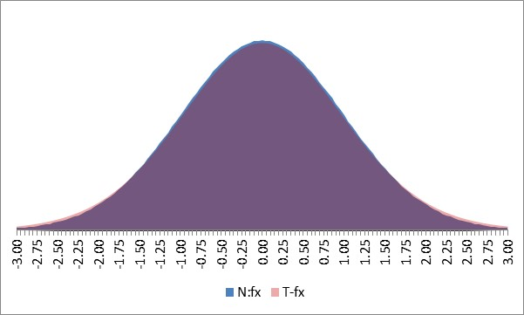
z and t: n=2, 10, 20

Slide 26
Interval Estimation of a Population Mean: σ Unknown
The interval estimate is given by:
where 1 -α is the confidence coefficient
t_{α/2} is the t value providing an area of α/2 in the upper tail of a t distribution with n - 1 degrees of freedom
s is the sample standard deviation

Slide 27
Example: Apartment Rents

