Slide 1
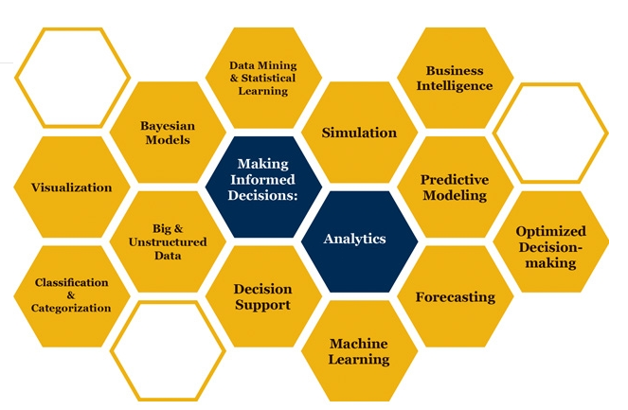

Slide 2

Basic Probability Distributions
How can it be that mathematics, being after all a product of human thought independent of experience, is so admirably adapted to the objects of reality
Albert Einstein
Some parts of these slides were prepared based on
Essentials of Modern Busines Statistics, Anderson et al. 2012, Cengage.
Managing Business Process Flow, Anupindi et al. 2012, Pearson.
Project Management in Practice, Meredith et al. 2014, Wiley

Slide 3
Continuous Probability Distributions

Slide 4
Continuous Probability Distributions
Uniform
Normal
Exponential

Slide 5
Exponential and Poisson Relationship

Slide 6
Exponential and Poisson Distributions
https://www.youtube.com/watch?v=ejIOt1uZovg
https://www.youtube.com/watch?v=JR-1ftUj__Y

Slide 7
Exponential Probability Distribution
The exponential random variables can be used to describe:
  Time between vehicle arrivals at a toll booth
  Distance between major defects in a highway
  Time required to complete a questionnaire
  Time it takes to complete a task.
In waiting line applications, the exponential distribution is often used for interarrival time and service times.
A property of the exponential distribution is that the mean and standard deviation are equal.
The exponential distribution is skewed to the right. Its skewness measure is 2.

Slide 8
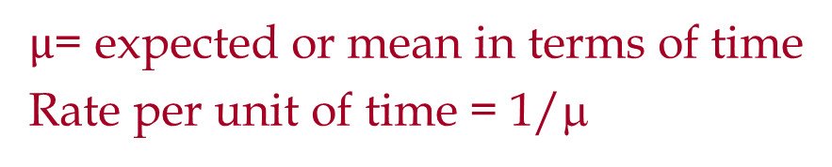


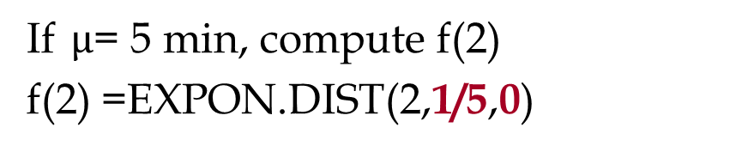
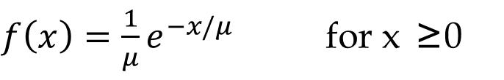
Exponential Probability Distribution
$f\left(x\right)=\frac{1}{μ}e^{−x/μ}$ for x ≥0
$µ$= expected or mean in terms of time
Rate per unit of time = 1/μ
If $µ$= 5 min, compute f(2)
f(2) =EXPON.DIST(2,1/5,0)
=0.134064
$$P\left(x≤X1\right)=1−e^{−x/μ}$$
$$P\left(x≤2\right)=1−e^{−2/5}$$
=EXPON.DIST(2,1/5,1)
=0.32968

Slide 9
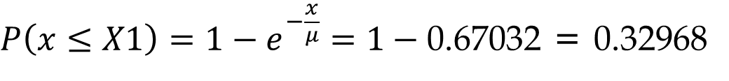

Exponential Probability Distribution
=EXPON.DIST(2,1/5,1) =0.32968
$$P\left(x≥X1\right)=1−\left(x≤X1\right)=1−1+e^{−x/μ}$$
$$P\left(x≥X1\right)=e^{−x/μ}$$
=EXP(-2/5)
=0.67032
$P\left(x≤X1\right)=1−e^{−\frac{x}{μ}}=1−\text{0.67032}$ = 0.32968

Slide 10
Exponential Probability Distribution
The time between arrivals of cars at Al’s gas station follows an exponential probability distribution with a mean time between arrivals of 3 minutes. Al would like to know the probability that the time between two successive arrivals will be 2 minutes or less.
f(x)
P(x < 2) = 1- e^{-2/3}
=EXPON.DIST(2,1/3,1) | 0.4865829
=EXP(-2/3) | 0.5134171
.4
.3
P(x ≥ 2) =1- P(x < 2) = 1-1+ e^{-2/3} = e^{-2/3}
.2
.1
x
0 1 2 3 4 5 6 7 8 9 10
Time Between Successive Arrivals (mins.)

Slide 11
Exponential Probability Distribution
Average trade time in Ameritrade is one second. Ameritrade has promised its customers if trade time exceeds 5 second it is free (a $10.99 cost saving. The same promises have been practiced by Damion Pizza (A free regular pizza) and Wells Fargo ($5 if waiting time exceeds 5 minutes). There are 150,000 average daily trade. What is the cost to Ameritrade”
P(x≥ X0) = e^{-X0/μ}= e^{-5/1} = 0.006738
Probability of not meeting the promise is 0.6738%
0.006738*150,000* = 1011 orders
@10.99 per order = 10.99*1011 = $11111 per day

Slide 12
Exponential Probability Distribution
What was the cost if they had improved their service level by 50% that is to make it free for transactions exceeding 2.5 secs.
e^{-2.5/1} = 0.082085
8.2085%*150,000*10.99 = $135317 per day
We cut the promised time by half, our cost increased 12 times.

Slide 13
Exponential Probability Distribution
In a single phase single server service process and exponentially distributed interarrival time and service times, the actual total time that a customer spends in the process is also exponentially.
Suppose total time the customers spend in a pharmacy is exponentially distributed with mean of 15 minutes. The pharmacy has promised to fill all prescriptions in 30 minutes. What percentage of the customers cannot be served within this time limit?
P(x≥30) = EXP(-30/15) = 0.1353
13.53% of customers will wait more than 30 minutes.
= P(x≤30) = EXPON.DIST(30,1/15,1)
= P(x≤30) = 0.864665
P(x ≥ 30) = 1- P(x≤30) = 1- 0.864665 = 0.1353

Slide 14
Exponential Probability Distribution
90% of customers are served in less than what time limit?
1-e^{-X0/μ} = 0.9
Find X0
SOLVER

Slide 15
Exponential Random Variable
P(x ≤ X0) = 1-e^{(-X0/µ)}
P(x ≤ X0) = rand() = 1-e^{(-X0/µ)}
1-rand() = e^{(-X0/µ)}
1-rand() by itself is a rand()
rand() = e^{(-X0)/µ)}
e^{(-X0/µ)} = rand()
X0= -µrand()
x= -µrand()

Slide 16
Exponential & Poisson
The Poisson distribution provides an appropriate
Description of the number of occurrences per interval
The exponential distribution provides an appropriate description of the length of the interval between occurrences
One customer arrives per 15 minutes.
The average number of customers arriving in 30 mins is 2.
This is Poisson distribution.
=POISSON.DIST(3,2,1) =0.857123

Slide 17
Poisson Probability Distribution
The number of knotholes in 14 linear feet of pine board
The number of vehicles arriving at a toll booth in one hour
Bell Labs used the Poisson distribution to model the arrival of phone calls.
A Poisson distributed random variable is often useful in estimating the number of occurrences over a specified interval of time or space.
It is a discrete random variable that may assume an infinite sequence of values (x = 0, 1, 2, . . . ).
The probability of an occurrence is the same for any two intervals of equal length.

Slide 18
Poisson Probability Distribution
The occurrence or nonoccurrence in any interval is independent of the occurrence or nonoccurrence in any other interval.
Since there is no stated upper limit for the number of occurrences, the probability function f(x) is applicable for values x = 0, 1, 2, … without limit.
In practical applications, x will eventually become large enough so that f(x) is approximately zero and the probability of any larger values of x becomes negligible.

Slide 19
Poisson Probability Distribution
x = the number of occurrences in an interval
f(x) = the probability of x occurrences in an interval
μ = mean number of occurrences in an interval
e = 2.71828
x! = x(x – 1)(x – 2) . . . (2)(1)

Slide 20
Poisson Probability Distribution

Slide 21
Simulation of Break-Even Analysis
Fixed Cost =INT(A$3+(A$4-A$3)*RAND())
Variable Cost=INT(B$3+(B$4-B$3)*RAND())
Sales Price=INT($C$3+$C$4*NORM.S.INV(RAND()))
Sales =-INT($D$3*LN(RAND()))

Slide 22
Simulation of Break-Even Analysis

Slide 23
Simulation
Simulation helps us to overcome our shortcomings in analysis of complex systems using statistics, and also to see the dynamics of the system.
Statistics vs. Simulation: To compute probability of completion time or cost of a network of activities.
  Both must enumerate all the paths to compute the probability
  Statistics assume path interdependence while simulation does not
For Simplicity, Triangular distribution is used to estimate Beta distribution.

