Slide 1
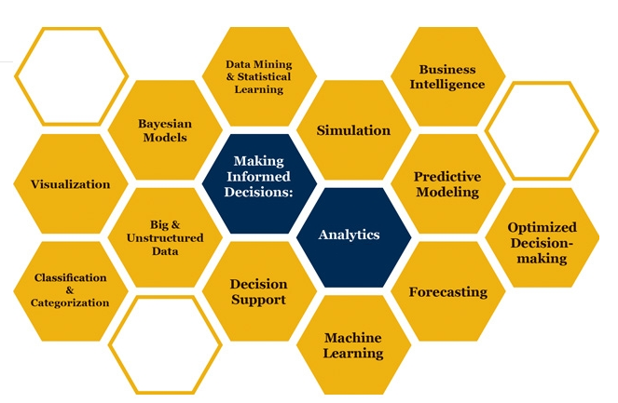

Slide 2

Basic Probability Distributions
How can it be that mathematics, being after all a product of human thought independent of experience, is so admirably adapted to the objects of reality
Albert Einstein
Some parts of these slides were prepared based on
Essentials of Modern Busines Statistics, Anderson et al. 2012, Cengage.
Managing Business Process Flow, Anupindi et al. 2012, Pearson.
Project Management in Practice, Meredith et al. 2014, Wiley

Slide 3
Normal Probability Distribution
https://www.youtube.com/watch?v=iYiOVISWXS4
https://www.youtube.com/watch?v=4R8xm19DmPM

Slide 4
Normal Probability Distribution
The Normal probability distribution is the most applied distribution for describing a continuous random variable.
It has been used in a wide variety of applications such as weight of people, test scores, life of a light bulb, number of votes in an election.
Normal distribution is symmetric; its skewness measure is zero.
The highest point on the normal curve is at the mean, which is
also the median and mode.
Standard Deviation σ
x
Mean μ

Slide 5
Normal Probability Distribution
The entire family of normal probability distributions is defined
by its mean μ and its standard deviation σ .
The mean can be any numerical
value: negative, zero, or
positive.
The standard deviation
determines the width of the
curve: larger values result in
wider, flatter curves.

Slide 6
Normal Probability Distribution
Probabilities for the normal random variable are given by areas under the curve. The total area under the curve is 1 (.5 to the left of the mean and .5 to the right).
99.72%
95.44%
68.26%
π = 3.14159 = PI()
e = 2.71828 =EXP(1)
x
μ
μ – 3σ
μ – 1σ
μ + 1σ
μ + 3σ
μ – 2σ
μ + 2σ

Slide 7
Standard Normal Probability Distribution
A random variable having a normal distribution with a mean of 0 and a standard deviation of 1 is said to have a standard normal probability distribution.
The letter z is used to designate the standard normal random variable.
We can think of z as a measure of the number of standard
deviations x is from .
σ = 1
z
0

Slide 8
Standard Normal Distribution in Excel
=NORM.S.DIS(x,cumulative)
= NORM.S.INV(probability)
A
B
1
Probabilities: Standard Normal Distribution
2
3
P
(
z
<
1.00)
=NORM.S.DIST(1,1)
0.8413
4
=NORM.S.DIST(1,1)-NORM.S.DIST(0,1)
P
(0.00
<
z
<
1.00)
0.3413
5
=NORM.S.DIST(1.25)-NORM.S.DIST(0,1)
P
(0.00
<
z
<
1.25)
0.3944
6
=NORM.S.DIST(1,1)-NORM.S.DIST(-1,1)
P
(-1.00
<
z
<
1.00)
0.6827
7
=1-NORM.S.DIST(1.58,1)
0.0571
P
(
z
>
1.58)
8
=NORM.S.DIST(-0.5,1)
0.3085
P
(
z
<
-0.50)
9

Slide 9
Standard Normal Distribution in Excel
)
=NORM.S.INV(0.025)
A
B
1
Finding
z
Values, Given Probabilities
2
3
z
value with .10 in upper tail
=NORM.S.INV(0.9)
1.28
4
z
value with .025 in upper tail
=NORM.S.INV(0.975)
1.96
5
z
value with .025 in lower tail
=NORM.S.INV(0.025)
-1.96
6

Slide 10
Standard Normal Probability Distribution
Pep Zone sells auto parts and supplies including a popular multi-grade motor oil. When the stock of this oil drops to 20 gallons, a replenishment order is placed. The store manager is concerned that sales are being lost due to stockouts while waiting for a replenishment order.
It has been determined that demand during replenishment lead-time is normally distributed with a mean of 15 gallons and a standard deviation of 6 gallons. The manager would like to know the probability of a stockout during replenishment lead-time. In other words, what is the probability that demand during lead-time will exceed 20 gallons?
P(x ≥ 20) = ?

Slide 11
Standard Normal Probability Distribution
Haw far are we from mean?
20-15 = 5
How many standard devotions
(20-15)/6 = 5/6 standard deviations to right
That is z
NORM.S.DIST(0.83333,1)
0.7977
P(z ≤20) = 0.7977
P(z ≥20) = 1-0.7977
P(z ≥20) = 0.2023

Slide 12
Standard Normal Probability Distribution
Area = 1 - .7977
= .2023
Area = .7967
z
0
.83

Slide 13
Standard Normal Probability Distribution
If the manager of Pep Zone wants the probability of a stockout during replenishment lead-time to be no more than .05, what should the reorder point be?
Area = .9500
=NORM.S.INV(0.95)
1.465
1.465 standard deviation
=1.465(6) = 9.87
To right
=15+9.87
=24.87
A reorder point of 25 gallons will place the probability
of a stockout during lead-times at (slightly less than) .05
Area = .0500
z
0
z_{.05}

Slide 14
Standard Normal Probability Distribution
Probability of no
stockout during
replenishment
lead-time = .95
Probability of a
stockout during
replenishment
lead-time = .05
x
15
24.87

Slide 15
Standard Normal Probability Distribution
By raising the reorder point from 20 gallons to 25 gallons on hand, the probability of a stockout decreases from 0.20 to .05.
This is a significant decrease in the chance of being out of stock and unable to meet a customer’s desire to make a purchase.
=NORM.DIST(20,15,6,1)
=0.797671619
P(x≥20) =1-0.797671619
P(x ≥X1)=0.05
=NORM.INV(0.95,15,6)
= 24.869122

Slide 16
Using Excel to Compute Normal Probabilities
A
B
1
Probabilities: Normal Distribution
2
P
(
3
x
>
20)
=1-NORM.DIST(20,15,6,1)
4
=0.2023
5
Finding
x
Values, Given Probabilities
6
7
x
value with .05 in upper tail
=NORM.INV(0.95,15,6)
8
=24.87
Note: P(x > 20) = .2023 here using Excel, while our
previous manual approach using the z table yielded
.2033 due to our rounding of the z value.

Slide 17
Reorder Point
If average demand during the lead time is 200 and standard deviation of demand during lead time is 25. At what level of inventory we should order such that with 90% confidence we will not have stockout.
=NORM.S.INV(0.9) = 1.2816
We need to go 1.2816 away from average
1.2816(25) ≈ 32
To right
200+32 = 232
=NORM.INV(0.9,200,25)
232.0388

Slide 18
Service Level
Average lead time demand is 20,000 units. Standard deviation of lead time demand is 5,000 units. The warehouse currently orders a 14-day supply, 28,000 units, each time the inventory level drops to 24,000 units. What is the probability that the demand during the period exceeds inventory?
X= 24000
= 20000
σ = 5000
=NORM.DIST(24000,20000,5000,1)
= 0.788145
In 78.81 % of the order cycles, the warehouse will not have a stockout. Risk = 21.19%.

Slide 19
Optimal Service Level: The News Vendor Problem
An electronics superstore is carrying a 60” LEDTV for the upcoming Christmas holiday sales. Each TV can be sold at $2,500. The store can purchase each unit for $1,800. Any unsold TVs can be salvaged, through end of year sales, for $1,700. The retailer estimates that the demand for this TV will be Normally distributed with mean of 150 and standard deviation of 15. How many units should they order?
Note: If they order 150, they will be out of stock 50% of the time.
Which service level is optimal? 80%, 90%, 95%, 99%??
Cost =1800, Sales Price = 2500, Salvage Value = 1700
Underage Cost = Marginal Benefit = p-c = 2500-1800 = 700
Overage Cost = Marginal Cost = c-v = 1800-1700 = 100
Optimal Service Level = SL* = P(LTD ≤ ROP) = Cu/(Cu+Co)
Or in NVP Terminology SL* = P(R ≤ Q*) = Cu/(Cu+Co)

Slide 20
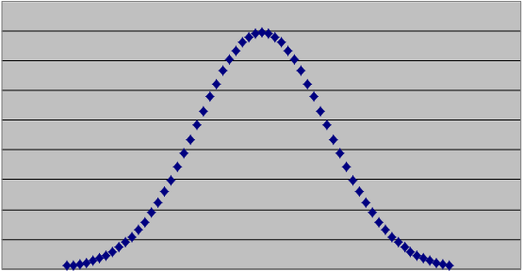
Optimal Service Level: The Newsvendor Problem
Underage cost = Marginal Benefit =Cu = 2500-1800 = 700
Overage Cost = Marginal Cost = Co = 1800-1700 = 100
SL* = Cu/(Cu+Co)
SL* = 700/800 = 0.875
LTD =N(150,15)
ROP = LTD + Isafety
= LTD + zσ_{LTD}
= 150+1.15(15)
Isafety = 17.25 = 18
ROP = 168
Risk = 12.5%
Probability of
excess inventory
Probability of
shortage
1.15
0.875
0.125

Slide 21
The News Vendor Problem
The expected number of participants in a conference is normally distributed with mean of 500 and standard deviation of 150. The participants spend one night in the hotel and the cost is paid by the conference. The hotel has offered a rate of $200 per room if a block of rooms is reserved (non-refundable) in advance. The rate in the conference day is $300. All rooms will be single occupied. How many rooms should we reserve in the non-refundable block to minimize our expected total cost.
Service level (Probability of demand not exceeding what we have ordered) SL* = Cu/(Cu+Co)
Co = 200, Cu = 300-200 = 100
SL* = Cu/(Cu+Co) = 100/(100+200) = 1/3
=NORM.INV(1/3,500,150)
=436

Slide 22
100,000 in One Stock
Suppose there is a stock with its return following Nomal distribution with mean of 4% and standard deviation of 4%. Therefore if we invest one dollar in this stock, our investment after one year will have pdf of N(1.04, 0.04).
What will be mean and standard deviation of our investment if we invest 100,000.
=NORM.INV(probability, mu, sigma)
=NORM.INV(probability, 5%, 5%)
=NORM.INV(rand(), 5%, 5%)

Slide 23
y = Kx➔ μ(y) = k μ(x), σ(y) = Kσ(x)
A random variable x with mean of μ , and standard deviation of σ is multiplied by a constant K and generates the random variable y=Kx.
Then
Mean (y) = K*Mean(x)
StdDev (y) = |K|*StdDev(x)
If $1 after one year has mean of $1.04 and StdDev of 0.04
Then
100,000 after one year has mean of $(100,000)1.04 and StdDev of 100,000(0.04)

Slide 24
90000 in One Stock or 10000 in Each of 10 stocks
Suppose there are 9 stocks and with high probability they all have Normal pdf return with mean of 5% and standard deviation of 5%. These stocks are your only options and no more information is available. You have to invest $100,000. What do you do?
=NORM.S.INV(rand())
=z = 0.441475
X= µ + sz = X = 5%+ 0.441475(5%)
X= 5%+2.21% = 7.21%
=NORM.INV(probability, mu, sigma)
=NORM.INV(probability, 5%, 5%)
=NORM.INV(rand(), 5%, 5%)
= -8.1%

Slide 25
100,000 vs. 10(10,000) investment in N(5%, 5%)

Slide 26
Risk Aversion Individual

Slide 27
y = x1+x2+…+xk➔ μ(y) = k μ(x), VAR(y) = KVAR(y)
A random y is equal to summation of K random variable x each with mean of μ and standard deviation of σ.
y = x1+x2+….xK
Mean (y) = K*Mean(x)
VAR (y) = K*VAR(x)

Slide 28
ROP; total demand during lead time is variable
If average demand during the lead time is 200 and standard deviation of demand during lead time is 25. Compute ROP at 90% service level. Compute safety stock.
This Problem: If average demand per day is 20 units and standard deviation of demand per day is 5, and lead time is 16 days. Compute ROP at 90% service level. Compute safety stock.
If we can transform this problem into the previous problem, then we are done, because we already know how to solve the previous problem.

Slide 29
μ and σ of demand per period and fixed L
If Demand is variable and Lead time is fixed
L: Lead Time
R: Demand per period (per day, week, month)
R: Average Demand per period (day, week, month)
σ_{R}: Standard deviation of demand (per period)
LTD: Average Demand During Lead Time
LTD = L × R
σ_{LTD}: Standard deviation of demand during lead time
$σ_{LTD}$=$\sqrt{L}σ_{R}$

Slide 30
μ and σ of demand per period and fixed L
If demand is variable and Lead time is fixed
L: Lead Time = 16 days
R: Demand per day
R: Average daily demand =20
σ_{R}: Standard deviation of daily demand =5
LTD: Average Demand During Lead Time
LTD = L × R = 16 × 20 = 320
σ_{LTD}: Standard deviation of demand during lead time
$σ_{LTD}$=$\sqrt{L}σ_{R}$
$σ_{LTD}$=$\sqrt{16}\left(5\right)=20$

Slide 31
μ and σ of demand per period and fixed LT
R: demand rate per period (a random variable)
R: Average demand rate per period
σ_{R}: Standard deviation of the demand rate per period
L: Lead time (a constant number of periods)
LTD: demand during the lead time (a random variable)
LTD: Average demand during the lead time
σ_{LTD}: Standard deviation of the demand during lead time

Slide 32
μ and σ of demand per period and fixed LT
A random variable R: N(R, σ_{R}) repeats itself L times during the lead time. The summation of these L random variables R, is a random variable LTD
If we have a random variable LTD which is equal to summation of L random variables R
LTD = R₁+R₂+R₃+…….+R_{L}
Then there is a relationship between mean and standard deviation of the two random variables

Slide 33
Now It is Transformed
The Problem originally was: If average demand per day is 20 units and standard deviation of demand is 5 per day, and lead time is 16 days. Compute ROP at 90% service level. Compute safety stock.
We transformed it to: The average demand during the lead time is 320 and the standard deviation of demand during the lead time is 20. Compute ROP at 90% service level. Compute safety stock.
Which is the same as the previous problem: If average demand during the lead time is 200 and standard deviation of demand during lead time is 25. Compute ROP at 90% service level. Compute safety stock.

Slide 34
ROP; Variable R, Fixed L
e) If demand per day is 20 units and lead time is 16 days and standard deviation of lead time is 4 days. Compute ROP at 90% service level. Compute Isafety.
What is the average demand during the lead time
What is standard deviation of demand during lead time

Slide 35
μ and σ of L and Fixed R
If Lead time is variable and Demand is fixed
L: Lead Time
L: Average Lead Time
σ_{L}: Standard deviation of Lead time
R: Demand per period
LTD: Average Demand during lead time
LTD = L × R
σ_{LTD}: Standard deviation of demand during lead time
$σ_{LTD}$=R$σ_{L}$

Slide 36
μ and σ of L and Fixed R
If Lead time is variable and Demand is fixed
L: Lead Time
L: Average Lead Time = 16 days
σ_{L}: Standard deviation of Lead time = 4 days
R: Demand per period = 20 per day
LTD: Average Demand During Lead Time
LTD = 16 × 20 = 320
σ_{LTD}: Standard deviation of demand during lead time
$σ_{LTD}$=R$σ_{L}$
$σ_{LTD}$=20(4) =80

Slide 37
μ and σ of lead time and fixed Demand per period
L: lead time (a random variable)
L: Average lead time
σ_{L}: Standard deviation of the lead time
RL
R: Demand per period (a constant value)
LTD: demand during the lead time (a random variable)
LTD: Average demand during the lead time
σ_{LTD}: Standard deviation of the demand during lead time
R
L

Slide 38
μ and σ of demand per period and fixed LT
A random variable L: N(L, σ_{L}) is multiplied by a constant R and generates the random variable LTD.
If we have a random variable LTD which is equal to a constant R times a random variables L
LTD = RL
Then there is a relationship between mean and standard deviation of the two random variables
RL
R
L

Slide 39
Variable R fixed L………….Variable L fixed R
R
+
R
+
R
+
R
+
R
RL
R
R
R
R
R
R
L
L

Slide 40
μ and σ of L and Fixed R
LDT = 320
σ_{LTD} = 80
SL = 90%
z =1.28
ROP = LTD +zσ_{LTD}
ROP = 320 +1.28(80)
ROP = 320 + 102.4
Isafety = 102.4

Slide 41
Comparing the two problems
Average demand per day is 10 units and standard deviation of demand per day is 3 units. The lead time is 5 days
Demand per day is 10 units. The average lead time is 3 days and standard deviation of lead time is 1 days.

Slide 42
Service Level, Fill Rate
Within 100 time intervals, stockouts occur in 20.
Service Level = 80/100 = 80%.
Probability of stock-out = 20%.
Risk = # of stockout intervals/ Total # of intervals
Service Level = 1- (# of stockout intervals/ Total # of intervals)
Suppose that in each time interval in which a stockout occurred, the number of units by which we were short.
Suppose that cumulative demand during the 100 time intervals was 15,000 units and the total number of units short in the 20 intervals with stockouts was 1,500 units.
Fill rate = (15,000-1,500)/15,000 = 13,500/15,000 = 90%.
Fill Rate = Expected Sales / Expected Demand
Fill Rate = (1- Expected Stockout )/ Expected Demand

Slide 43
Demand During the Lead Time

Slide 44
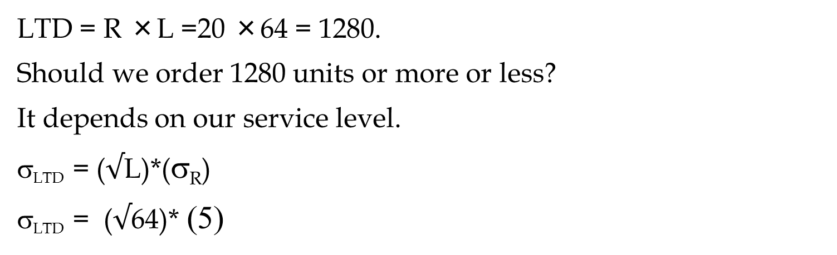
Problem Game- The News Vendor Problem
Daily demand for your merchandise has mean of 20 and standard deviation of 5. Sales price is $100 per unit of product.
You have decided to close this business line in 64 days. Your supplier has also decided to close this line immediately, but has agreed to provide your last order at a cost of $60 per unit. Any unsold product will be disposed at cost of $10 per unit. How many units do you order
LTD = R ×L =20 ×64 = 1280.
Should we order 1280 units or more or less?
It depends on our service level.
σ_{LTD} = ($√$L)*(σ_{R})
σ_{LTD} = ($√$64)* (5)

Slide 45
Problem Game- The News Vendor Problem
σ_{LTD} = 8* 5 = 40
Underage cost = Cu = = 100 – 60 = 40.
Overage cost = Co = 60 +10 =70
SL = Cu/(Cu+Co) = 40/(40+70) = 0.3636.
Due to high overage cost, SL*< 50%.
Z(0.3636) = ？
The optimal Q = LTD + z σ_{LTD}
=NORM.S.INV(0.3636) = -0.34885
Q = 1280 -0.34885(40)
ROP = 1280-13.9541
ROP = 1266.0459
=NORM.INV(probability, mean, standard_dev)
=NORM.INV(0.3636,1280,40
=1266.0459

Slide 46
Present Value Mean and Standard Deviation
We will have a cash inflow at the end of next year. This cash flow has mean of $1000 and standard deviation of 250. What is the mean and standard deviation of the present value of this cash flow. Our minimum acceptable rate of return in 12%.
We will have two cash inflows at the end of next two years. They both have mean of $1000 and standard deviation of 250. What is the mean and standard deviation of the present value of this cash flow. Our minimum acceptable rate of return in 12%.

Slide 47
Future Value (FV)
$100, put it in a bank. Interest rate = 10%. How much after 1 year. P = 100. F?
F1 = 100 +0.1(100) = 100(1+0.1)
How much after 2 years?
F2= 100(1+0.1) + 0.1(100(1+0.1)) =
F2= 100(1+0.1) (1+0.1) = 100(1.1)²
How much after 3 years?
F3 = 100(1.1)² + 0.1[100(1.1)²] =
F3 = 100(1.1)² [1+0.1] = 100(1.1)² [1.1] = 100(1.1)³
How much after N years
F = 100(1.1)^{N}

Slide 48
Future Value (FV); Present Value (PV)
P: The initial vale
MARR: Minimum Acceptable Rate of Return
F= P(1+MARR)^{N}
P = F/(1+MARR)^{N}
P = F/(1+r)^{N}
r = the minimum acceptable rate of return
=FV(r, N,PMT,PV,0→ EOY) =
=PV(r, N,PMT,FV,0 →EOY) =

Slide 49
Future Value (FV); Present Value (PV)
=FV(r, N,PMT,PV,0→ EOY) =
=PV(r, N,PMT,FV,0 →EOY) =
=FV(r,N, PMT, PV,0) =
FV(10%,3,0,100,0) =
=PV(r,N, PMT, FV,0) =
PV(10%,3,0,133.1,0) =

Slide 50
Present Value Mean and Standard Deviation
We will have a cash inflow at the end of next year. This cash flow has mean of $1000 and standard deviation of 250. What is the mean and standard deviation of the present value of this cash flow. Our minimum acceptable rate of return in 12%.
P=F/(1+r)
P= [1/(1+r)]F
P= KF
y=Kx
Mean (y) = K*Mean(x)
StdDev(y) = K*StdDev(x)
Mean (x) =1000
StdDev(x) = 300
K= (1/(1+.12) = 1/1.12 =
Mean (P) = 0.893* Mean(F)
Mean (P) = 0.893(1000)
Mean (P) = $893
StdDev(P) = 0.893*StdDev(x)
StdDev(P) = 0.893*250
StdDev(x) = 223
If P has Normal Distribution, Compute
Probability of P ≥ $1000
0.892857

Slide 51
Present Value Mean and Standard Deviation
We will have two cash inflows at the end of next two years. They both have mean of $1000 and standard deviation of 250. What is the mean and standard deviation of the present value of this cash flow. Our minimum acceptable rate of return in 12%.
P1=0.893F/(1+r)
P1= [1/(1+r)]F1
P2= [1/(1+r)²]F2
P1= [1/(1.12)]F1
P2= [1/(1.12)²]F2
P1= 0.893F1
P2= 0.797F2
Mean (P1) = 0.893(1000)
Mean (P2) = 0.797(1000)
P=P1+P2
y=x1+x2
Mean (y) = Mean (x1)+Mean(x2)
Var(y) = Var(x1)+Var(x2)
Mean (P) = Mean(P1)+Mean(P2)
Mean (P) = 893+797 = 1690
StdDev (P1) = 0.893(250) =223
StdDev (P2) = 0.797(250) = 199
Var (P) = Var(P1)+Var(P2)

Slide 52
Present Value Mean and Standard Deviation
Mean (P) = 1690
StdDev (P1) = 0.893(250) =223
StdDev (P2) = 0.797(250) = 199
Var(P1) = (223)² = 49824
Var(P2) = (199)² = 39720
Var (P) = Var(P1)+Var(P2)
Var (P) = 49824 + 39720 = 89544
StdDev (P) = SQRT(Var(P))
StdDev (P) = 299
If P has Normal Distribution, Compute
Probability of P ≥ $2000

Slide 53
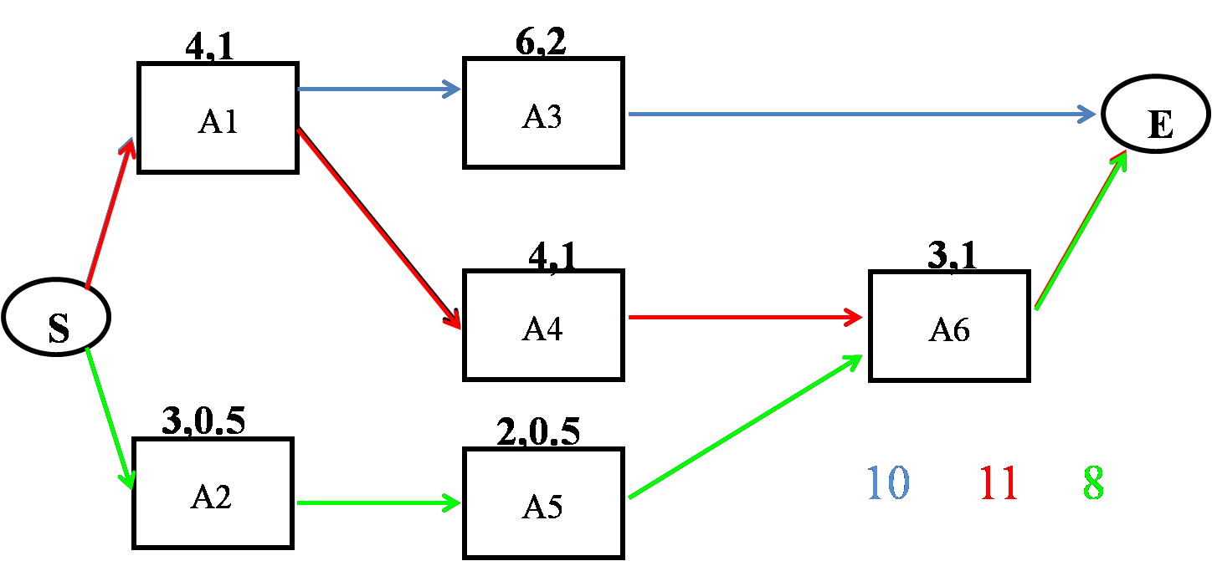
Project Scheduling
Given the following project with three paths, compute the mean and StdDev of each path. The pairs of numbers on each activity represent the mean and StdDev of each activity.

Slide 54
Project Scheduling
m_{CP}= 4+4+3 = 11
σ²_{CP} = 1²+1²+1² = 3
σ_{CP} = 1.73
=NORM.DIST(12,11,1.73,1)
= 0.7184
m_{CP}= 6+4 = 10
σ²_{CP} = 1²+2² = 5
σ_{CP} = 2.24
=NORM.DIST(12,10,2.24,1)
= 0.814
=NORM.DIST(12,8,1.22,1)
= 0.9995
m_{CP}= 3+2+3 = 8
σ²_{CP} = 0.5²+0.5²+1²
σ²_{CP} = 1.5
σ_{CP} = 1.22
The probability of competing the Project in not more than 12 days is 0.72×0.81×1 = 0.58

Slide 55
Project Scheduling
Critical Path
D_{CP} = the desired completion date of the critical path
μ_{CP}= the sum of the T_{E} for the activities on the critical path
σ²_{CP} = the sum of the variances of the activities on the critical path
Using μ_{CP} and σ_{CP} and NORM.DIST(D_{CP}, μ_{CP}, σ_{CP},1) we can find probability of completing the critical path in ≤ D_{CP} .
Project
Find all paths in the network. Compute µ and σ of each path
Compute the probability of completing each path in ≤ the given time
Calculate the probability that the entire project is completed within the specified time by multiplying these probabilities together

Slide 56
Practice
15, 3
5,1
20,4
A
D
G
E
20,2
10,2
10,2
B
S
E
H
10,3
20,5
C
F

