Slide 1
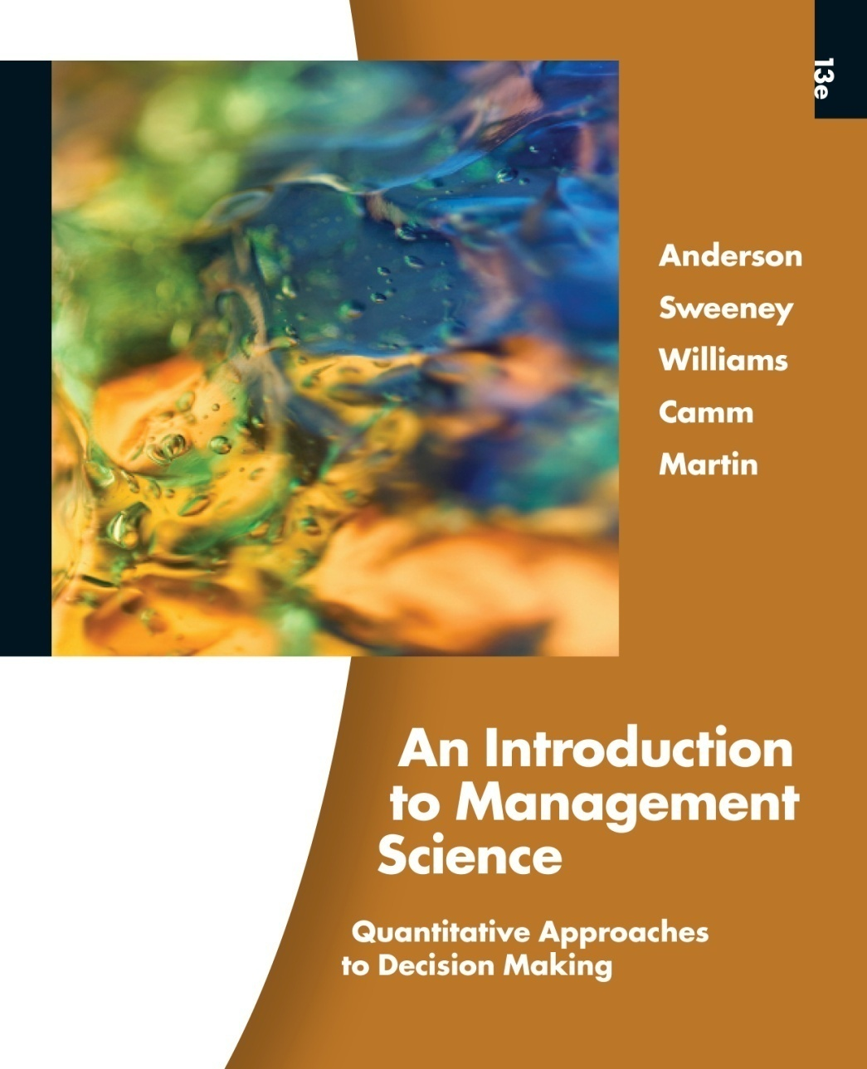
Slides by
John
Loucks
St. Edward’s
University
Modifications by
A. Asef-Vaziri

Slide 2
Chapter 6, Part B
Distribution and Network Models
Shortest-Route Problem
Maximal Flow Problem
A Production and Inventory Application

Slide 3
Shortest-Route Problem
The shortest-route problem is concerned with finding the shortest path in a network from one node (or set of nodes) to another node (or set of nodes).
If all arcs in the network have nonnegative values then a labeling algorithm can be used to find the shortest paths from a particular node to all other nodes in the network.
The criterion to be minimized in the shortest-route problem is not limited to distance even though the term "shortest" is used in describing the procedure. Other criteria include time and cost. (Neither time nor cost are necessarily linearly related to distance.)

Slide 4
Shortest-Route Problem
Linear Programming Formulation
Using the notation:
x_{ij} = 1 if the arc from node i to node j
is on the shortest route
0 otherwise
c_{ij} = distance, time, or cost associated
with the arc from node i to node j
continued

Slide 5
Shortest-Route Problem
Linear Programming Formulation (continued)

Slide 6
Example: Shortest Route
Susan Winslow has an important business meeting
in Paducah this evening. She has a number of alternate
routes by which she can travel from the company headquarters in Lewisburg to Paducah. The network of alternate routes and their respective travel time,
ticket cost, and transport mode appear on the next two slides.
If Susan earns a wage of $15 per hour, what route
should she take to minimize the total travel cost?

Slide 7
Example: Shortest Route
Network Representation
2
F
5
K
L
A
B
G
C
3
J
6
1
D
H
I
Paducah
Lewisburg
E
M
4

Slide 8
Example: Shortest Route
Transport Time Ticket
Route Mode (hours) Cost
A Train 4 $ 20
B Plane 1 $115
C Bus 2 $ 10
D Taxi 6 $ 90
E Train 3 1/3 $ 30
F Bus 3 $ 15
G Bus 4 2/3 $ 20
H Taxi 1 $ 15
I Train 2 1/3 $ 15
J Bus 6 1/3 $ 25
K Taxi 3 1/3 $ 50
L Train 1 1/3 $ 10
M Bus 4 2/3 $ 20

Slide 9
Example: Shortest Route
Transport Time Time Ticket Total
Route Mode (hours) Cost Cost Cost
A Train 4 $60 $ 20 $ 80
B Plane 1 $15 $115 $130
C Bus 2 $30 $ 10 $ 40
D Taxi 6 $90 $ 90 $180
E Train 3 1/3 $50 $ 30 $ 80
F Bus 3 $45 $ 15 $ 60
G Bus 4 2/3 $70 $ 20 $ 90
H Taxi 1 $15 $ 15 $ 30
I Train 2 1/3 $35 $ 15 $ 50
J Bus 6 1/3 $95 $ 25 $120
K Taxi 3 1/3 $50 $ 50 $100
L Train 1 1/3 $20 $ 10 $ 30
M Bus 4 2/3 $70 $ 20 $ 90

Slide 10
Example: Shortest Route
LP Formulation
  Objective Function
Min 80x₁₂ + 40x₁₃ + 80x₁₄ + 130x₁₅ + 180x₁₆ + 60x₂₅
+ 100x₂₆ + 30x₃₄ + 90x₃₅ + 120x₃₆ + 30x₄₃ + 50x₄₅
+ 90x₄₆ + 60x₅₂ + 90x₅₃ + 50x₅₄ + 30x₅₆
  Node Flow-Conservation Constraints
  x₁₂ + x₁₃ + x₁₄ + x₁₅ + x₁₆ = 1 (origin)
  – x₁₂ + x₂₅ + x₂₆ – x₅₂ = 0 (node 2)
  – x₁₃ + x₃₄ + x₃₅ + x₃₆ – x₄₃ – x₅₃ = 0 (node 3)
  – x₁₄ – x₃₄ + x₄₃ + x₄₅ + x₄₆ – x₅₄ = 0 (node 4)
  – x₁₅ – x₂₅ – x₃₅ – x₄₅ + x₅₂ + x₅₃ + x₅₄ + x₅₆ = 0 (node 5)
  x₁₆ + x₂₆ + x₃₆ + x₄₆ + x₅₆ = 1 (destination)

Slide 11
Excel Solution

Slide 12
Maximal Flow Problem
The maximal flow problem is concerned with determining the maximal volume of flow from one node (called the source) to another node (called the sink).
In the maximal flow problem, each arc has a maximum arc flow capacity which limits the flow through the arc.

Slide 13
Example: Maximal Flow
A capacitated transshipment model can be developed for the maximal flow problem.
We will add an arc from the sink node back to the source node to represent the total flow through the network.
There is no capacity on the newly added sink-to-source arc.
We want to maximize the flow over the sink-to-source arc.

Slide 14
Maximal Flow Problem
LP Formulation
(as Capacitated Transshipment Problem)
  There is a variable for every arc.
  There is a constraint for every node; the flow out must equal the flow in.
  There is a constraint for every arc (except the added sink-to-source arc); arc capacity cannot be exceeded.
  The objective is to maximize the flow over the added, sink-to-source arc.

Slide 15
Maximal Flow Problem
LP Formulation
(as Capacitated Transshipment Problem)
Max x_{k1} (k is sink node, 1 is source node)
s.t. Σx_{ij} - Σx_{ji} = 0 (conservation of flow) i j
x_{ij} < c_{ij} (c_{ij} is capacity of ij arc)
x_{ij} > 0, for all i and j (non-negativity)
(x_{ij} represents the flow from node i to node j)

Slide 16
Example: Maximal Flow
National Express operates a fleet of cargo planes and
is in the package delivery business. NatEx is interested
in knowing what is the maximum it could transport in
one day indirectly from San Diego to Tampa (via Denver, St. Louis, Dallas, Houston and/or Atlanta) if its direct flight was out of service.
NatEx's indirect routes from San Diego to Tampa, along with their respective estimated excess shipping capacities (measured in hundreds of cubic feet per day), are shown on the next slide.
Is there sufficient excess capacity to indirectly ship 5000 cubic feet of packages in one day?

Slide 17
Example: Maximal Flow
Network Representation
3
Denver
2
5
St. Louis
3
4
2
3
2
3
4
San
Diego
1
4
4
3
7
Tampa
3
1
3
5
1
5
Dallas
Houston
3
6
Atlanta
6

Slide 18
Example: Maximal Flow
Modified Network Representation
3
2
5
3
4
2
3
2
Source
3
4
Sink
1
4
4
3
7
3
1
3
Added
arc
5
1
5
3
6
6

Slide 19
Example: Maximal Flow
LP Formulation
  18 variables (for 17 original arcs and 1 added arc)
  24 constraints
    7 node flow-conservation constraints
    17 arc capacity constraints (for original arcs)

Slide 20
Example: Maximal Flow
LP Formulation
  Objective Function
Max x₇₁
  Node Flow-Conservation Constraints
  x₁₂ + x₁₃ + x₁₄ – x₇₁ = 0 (node 1)
  – x₁₂ + x₂₄ + x₂₅ – x₄₂ – x₅₂ = 0 (node 2)
  – x₁₃ + x₃₄ + x₃₆ – x₄₃ = 0 (and so on)
  – x₁₄ – x₂₄ – x₃₄ + x₄₂ + x₄₃ + x₄₅ + x₄₆ + x₄₇ – x₅₄ – x₆₄ = 0
  – x₂₅ – x₄₅ + x₅₂ + x₅₄ + x₅₇ = 0
  – x₃₆ – x₄₆ + x₆₄ + x₆₇ = 0
  – x₄₇ – x₅₇ – x₆₇ + x₇₁ = 0

Slide 21
Example: Maximal Flow
LP Formulation (continued)
  Arc Capacity Constraints
x₁₂ < 4 x₁₃ < 3 x₁₄ < 4
x₂₄ < 2 x₂₅ < 3
x₃₄ < 3 x₃₆ < 6
x₄₂ < 3 x₄₃ < 5 x₄₅ < 3 x₄₆ < 1 x₄₇ < 3
x₅₂ < 3 x₅₄ < 4 x₅₇ < 2
x₆₄ < 1 x₆₇ < 5

Slide 22
Example: Maximal Flow
Alternative Optimal Solution #1
Objective Function Value = 10.000
Variable Value
x₁₂ 3.000
x₁₃ 3.000
x₁₄ 4.000
x₂₄ 1.000
x₂₅ 2.000
x₃₄ 0.000
x₃₆ 5.000
x₄₂ 0.000
x₄₃ 2.000
Variable Value
x₄₅ 0.000
x₄₆ 0.000
x₄₇ 3.000
x₅₂ 0.000
x₅₄ 0.000
x₅₇ 2.000
x₆₄ 0.000
x₆₇ 5.000
x₇₁ 10.000

Slide 23
Example: Maximal Flow
Alternative Optimal Solution #1
2
2
5
3
1
2
Source
Sink
1
4
4
3
7
3
2
5
10
3
6
5

Slide 24
Example: Maximal Flow
Alternative Optimal Solution #2
Objective Function Value = 10.000
Variable Value
x₁₂ 3.000
x₁₃ 3.000
x₁₄ 4.000
x₂₄ 1.000
x₂₅ 2.000
x₃₄ 0.000
x₃₆ 4.000
x₄₂ 0.000
x₄₃ 1.000
Variable Value
x₄₅ 0.000
x₄₆ 1.000
x₄₇ 3.000
x₅₂ 0.000
x₅₄ 0.000
x₅₇ 2.000
x₆₄ 0.000
x₆₇ 5.000
x₇₁ 10.000

Slide 25
Example: Maximal Flow
Alternative Optimal Solution #2
2
2
5
3
1
2
Source
Sink
1
4
4
3
7
1
3
1
5
10
3
6
4

Slide 26
A Production and Inventory Application
Transportation and transshipment models can be developed for applications that have nothing to do with the physical movement of goods from origins to destinations.
For example, a transshipment model can be used to solve a production and inventory problem.

Slide 27
Example: Production & Inventory Application
Fodak must schedule its production of camera film for the first four months of the year. Film demand (in 000s of rolls) in January, February, March and April is expected to be 300, 500, 650 and 400, respectively. Fodak's production capacity is 500 thousand rolls of film per month.
The film business is highly competitive, so Fodak cannot afford to lose sales or keep its customers waiting. Meeting month i's demand with month i+1's production is unacceptable.

Slide 28
Example: Production & Inventory Application
Film produced in month i can be used to meet demand in month i or can be held in inventory to meet demand in month i+1 or month i+2 (but not later due to the film's limited shelf life). There is no film in inventory at the start of January.
The film's production and delivery cost per thousand rolls will be $500 in January and February. This cost will increase to $600 in March and April due to a new labor contract. Any film put in inventory requires additional transport costing $100 per thousand rolls. It costs $50 per thousand rolls to hold film in inventory from one month to the next.

Slide 29
Example: Production & Inventory Application
Network Representation

Slide 30
Example: Production & Inventory Application
Linear Programming Formulation
Define the decision variables:
x_{ij} = amount of film “moving” between node i and node j
Define objective:
Minimize total production, transportation, and inventory holding cost.
MIN 600x₁₅ + 500x₁₈ + 600x₂₆ + 500x₂₉ + 700x₃₇ + 600x₃₁₀ + 600x₄₁₁ + 50x₅₉ + 100x₅₁₀ + 50x₆₁₀ + 100x₆₁₁ + 50x₇₁₁

Slide 31
Example: Production & Inventory Application
Linear Programming Formulation (continued)
Define the constraints:
Amount (1000s of rolls) of film produced in January: x₁₅ + x₁₈ < 500
Amount (1000s of rolls) of film produced in February: x₂₆ + x₂₉ < 500
Amount (1000s of rolls) of film produced in March: x₃₇ + x₃₁₀ < 500
Amount (1000s of rolls) of film produced in April: x₄₁₁ < 500

Slide 32
Example: Production & Inventory Application
Linear Programming Formulation (continued)
Define the constraints:
Amount (1000s of rolls) of film in/out of January inventory: x₁₅ - x₅₉ - x₅₁₀ = 0
Amount (1000s of rolls) of film in/out of February inventory: x₂₆ - x₆₁₀ - x₆₁₁ = 0
Amount (1000s of rolls) of film in/out of March inventory: x₃₇ - x₇₁₁ = 0

Slide 33
Example: Production & Inventory Application
Linear Programming Formulation (continued)
Define the constraints:
Amount (1000s of rolls) of film satisfying January demand: x₁₈ = 300
Amount (1000s of rolls) of film satisfying February demand x₂₉ + x₅₉ = 500
Amount (1000s of rolls) of film satisfying March demand: x₃₁₀ + x₅₁₀ + x₆₁₀ = 650
Amount (1000s of rolls) of film satisfying April demand: x₄₁₁ + x₆₁₁ + x₇₁₁ = 400
Non-negativity of variables: x_{ij} > 0, for all i and j.

Slide 34
Example: Production & Inventory Application
Computer Output
OBJECTIVE FUNCTION VALUE = 1045000.000
Variable Value Reduced Cost
x₁₅ 150.000 0.000
x₁₈ 300.000 0.000
x₂₆ 0.000 100.000
x₂₉ 500.000 0.000
x₃₇ 0.000 250.000
x₃₁₀ 500.000 0.000
x₄₁₁ 400.000 0.000
x₅₉ 0.000 0.000
x₅₁₀ 150.000 0.000
x₆₁₀ 0.000 0.000
x₆₁₁ 0.000 150.000
x₇₁₁ 0.000 0.000

Slide 35
Example: Production & Inventory Application
Optimal Solution
From To Amount
January Production January Demand 300
January Production January Inventory 150
February Production February Demand 500
March Production March Demand 500
January Inventory March Demand 150
April Production April Demand 400

Slide 36
End of Chapter 6, Part B

