Slide 1
Network Flows

Slide 2
Table of Contents
Chapter 6 (Network Optimization Problems)
Minimum-Cost Flow Problems (Section 6.1) 6.2–6.12
A Case Study: The BMZ Maximum Flow Problem (Section 6.2) 6.13–6.16
Maximum Flow Problems (Section 6.3) 6.17–6.21
Shortest Path Problems: Littletown Fire Department (Section 6.4) 6.22–6.25
Shortest Path Problems: General Characteristics (Section 6.4) 6.26–6.27
Shortest Path Problems: Minimizing Sarah’s Total Cost (Section 6.4) 6.28–6.31
Shortest Path Problems: Minimizing Quick’s Total Time (Section 6.4) 6.32–6.36

Slide 3
Distribution Unlimited Co. Problem
The Distribution Unlimited Co. has two factories producing a product that needs to be shipped to two warehouses
  Factory 1 produces 80 units.
  Factory 2 produces 70 units.
  Warehouse 1 needs 60 units.
  Warehouse 2 needs 90 units.
There are rail links directly from Factory 1 to Warehouse 1 and Factory 2 to Warehouse 2.
Independent truckers are available to ship up to 50 units from each factory to the distribution center, and then 50 units from the distribution center to each warehouse.
Question: How many units (truckloads) should be shipped along each shipping lane?

Slide 4
Minimum Cost Flow Problem: Narrative representation
There are 2 plants, 2 demand centers and 1 transshipment point.
Production of Plants 1 and 2 are 80 and 70 units respectively.
Demand of Demand centers 1 and 2 ( we call them points 4 and 5) are 60 and 90 units respectively.
Transshipment point ( point 3) is does not have any supply or demand.
Given the information on the next page, formulate this problem as an LP to satisfy supply and demand with minimal transportation costs.

Slide 5
Minimum Cost Flow Problem: Narrative representation
Transportation costs for each unit of product and max capacity of each road is given below
From To cost/ unit Max capacity
1 4 700 No limit
1 3 300 50
2 3 400 50
2 5 900 No limit
3 4 200 50
3 5 400 50
There is no other link between any pair of points

Slide 6
Minimum Cost Problem: Pictorial Representation
x₁₄
30
80
1
4
60
x₁₃
50
x₃₄
30
50
50
3
30
50
50
x₂₃
50
x₂₅
x₃₅
70
2
40
5
90

Slide 7
Conventions
Minimum Cost Flow is the same as Transportation and Transshipment problem.
We reformulate the same problem in the context of Minimum Cost flow just as an introduction to the domain of the Network Optimization Problems.
For each node i , we define the net flow as the difference between total outflow minus total inflow.
f_{i} : Net flow of node i
If i is a supply point then f_{i} = + supply of node i
If i is a demand point then f_{i} = - demand of node i
If i is a transshipment point then f_{i} = 0

Slide 8
Notations and Formulation
Notation
t_{ij} : Outflow from node i to node j with i ---------> j
t_{ji} : Inflow from node j to node i with i <---------- j
T_{ij :} Maximum capacity of arc ij
t_{ij} ≤ T_{ij} ∀ ij ∈ A ( A is the set of directed arcs)
f_{i} : Net flow of node i
∑ t_{ij} - ∑ t_{ji} = f_{i} ∀ i ∈ N ( N is the set of nodes)
c_{ij} : Cost of moving one unit on arc ij

Slide 9
Minimum Cost Flow Problem: decision variables
x₁₄ = Volume of product sent from point 1 to 4
x₁₃ = Volume of product sent from point 1 to 3
x₂₃ = Volume of product sent from point 2 to 3
x₂₅ = Volume of product sent from point 2 to 5
x₃₄ = Volume of product sent from point 3 to 4
x₃₅ = Volume of product sent from point 3 to 5
We want to minimize
Z = 700 x₁₄ +300 x₁₃ + 400 x₂₃ + 900 x₂₅ +200 x₃₄ + 400 x₃₅

Slide 10
Minimum Cost Flow Problem: constraints
Supply
x₁₄ + x₁₃ = 80
x₂₃ + x₂₅ = 70
Demand
x₁₄ + x₃₄ = 60
x₂₅ + x₃₅ = 90
Transshipment
x₁₃ + x₂₃ = x₃₄ + x₃₅ (Move all variables to LHS)
x₁₃ + x₂₃ - x₃₄ - x₃₅ =0

Slide 11
Minimum Cost Flow Problem: constraints
Capacity
x_{13 ≤ 50}
x_{23 ≤ 50}
x_{34 ≤ 50}
x₃₅ _{≤ 50}
Nonnegativity
x₁₄, x₁₃ , x₂₃ , x₂₅ , x₃₄ , x₃₅ ≥ 0

Slide 12
Example
700
80
1
4
-60
300
200
50
50
3
400
400
50
50
70
2
900
5
-90
Node 1 : t₁₃ + t₁₄ = 80 ( the same for node 2)
Node 4 : -t₁₄ - t₃₄ = -60 (the same for node 5)
Node 3 : t₃₄ + t₃₅ - t₁₃ - t₂₃ = 0
Capacity Constraints on arc 13 : t₁₃ ≤ 50 ( the same for arcs 2-3, 3-4, and 3-5)
Min Z = + 300 t₁₃ + 700 t₁₄ + 400 t₂₃ + 900 t₂₅ + 200 t₃₄ + 400 t₃₅

Slide 13
Excel

Slide 14
Excel

Slide 15
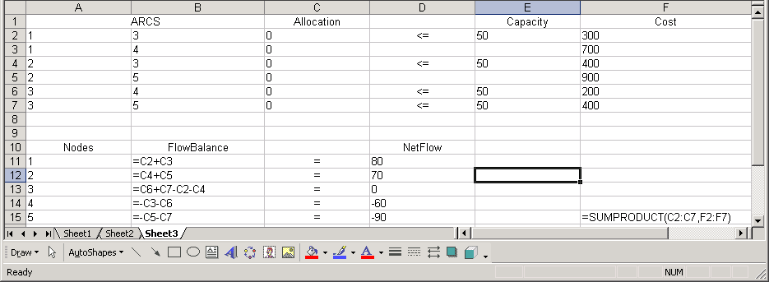
Excel
700
80
1
4
-60
300
200
50
50
3
400
400
50
50
70
2
900
5
-90

Slide 16
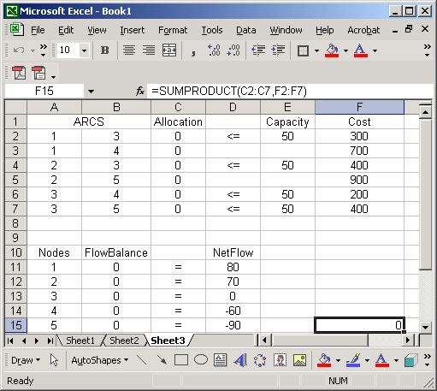
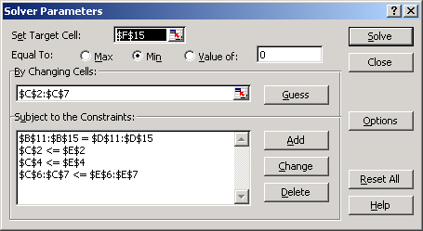
Solver

Slide 17
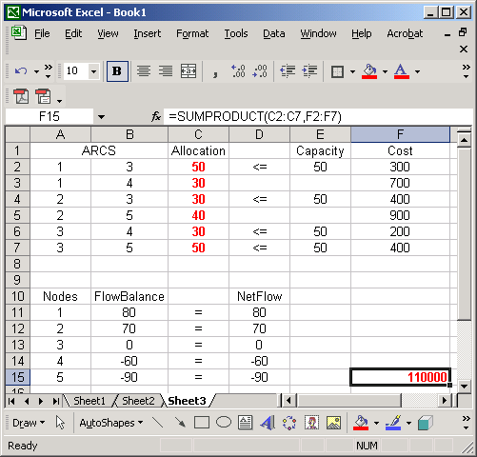
Solution

Slide 18
Minimum Cost Flow Problem: constraints

Slide 19
Minimum Cost Problem: Pictorial Representation
30
80
1
4
60
50
30
50
50
3
30
50
50
50
70
2
40
5
90

Slide 20
Transportation problem II : Formulation

Slide 21
Transportation problem II : Solution

Slide 22
Transportation problem II : Solution

Slide 23
Transportation problem III : Pictorial representation
x₁₄
900
+50
1
4
-30
x₁₃
400
x₁₂
200
300
50
3
200
x₃₅
x₅₄
x₄₅
300
80
x₂₃
100
2
5
+40
-60

Slide 24
Transportation problem III : Formulation
Material Flow Balance. At each node we have
Supply + Inflow = Demand + Outflow
50 = x₁₂+ x₁₃ + x₁₄
40+x₁₂ = x₂₃
x₁₃+ x₂₃ = x₃₅
x₁₄+ x₅₄ = 30 + x₄₅
x₃₅+ x₄₅ = 60 + x₅₄
Capacity
x₁₂ ≤ 50
x₃₅ ≤ 80
Min Z = 200x₁₂+ 400x₁₃ + 900x₁₄ + 300x₂₃ + 100x₃₅ + 300x₄₅ + 200x₅₄

Slide 25
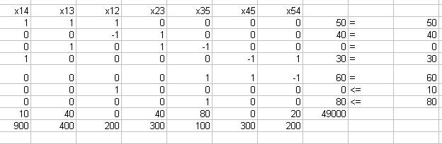
Transportation problem III : Excel Solution

Slide 26
The Maximum Flow Problem
There is no inflow associated
with origin
There is no outflow
associated
with destination
We want to
Maximize
total outflow of the origin
or
total inflow of the destination
2
60
5
80
50
40
D
70
3
O
70
50
6
40
30
4

Slide 27
Notations and Formulation
t_{ij} : Outflow from node i to node j with i ---------> j
t_{ji} : Inflow from node j to node i with i <---------- j
T_{ij :} Maximum capacity of arc ij
t_{ij} ≤ T_{ij} ∀ ij ∈ A
f_{i} : is zero for all nodes except Origin(s) and Destination(s)
∑ t_{ij} - ∑ t_{ji} = 0 ∀ i ∈ N \ O and D

Slide 28
Example
t₂₅ - t_{O2} = 0
t₃₅ + t₃₆ - t_{O3} = 0
t₄₆ - t_{O4} = 0
t_{5D} - t₂₅ - t₃₅ = 0
t_{6D} - t₃₆ - t₄₆ = 0
60
2
80
5
50
40
D
3
70
O
70
50
6
40
30
t_{O2} ≤ 50
t_{O3} ≤ 70
t_{O4} ≤ 40
t₂₅ ≤ 60
t₃₅ ≤ 40
t₃₆ ≤ 50
and so on
t_{6D} ≤ 70
4
Max Z = t_{O2} + t_{O3} + t_{O4}

Slide 29
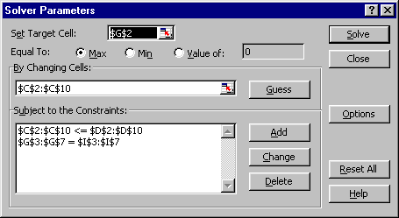
Excel and Solver
60
2
80
5
50
40
D
3
70
O
70
50
6
40
30
4

Slide 30
Solution
60(50)
2
5
80
50
40 (30)
D
70
3
O
70
50(40)
6
40 (30)
30
4

Slide 31
More Than One Origin
40
7
8
60
20
30
10
20
D2
2
O2
40
60
80
5
50
40
D1
3
70
O1
70
50
6
40
30
4
∑ t_{ij} - ∑ t_{ji} = 0 ∀ i ∈ N \ Os and Ds
t_{ij} ≤ T_{ij} ∀ ij ∈ A

Slide 32
Example
∑ t_{ij} - ∑ t_{ji} = 0 ∀ i ∈ N \ Os and Ds
Example: Node 7
+ t₇₈ + t₇₅ - t_{O27} = 0
Example: Node 5
+ t_{5D1} + t_{5D2} - t₂₅ - t₃₅ - t₇₅ = 0
t_{ij} ≤ T_{ij} ∀ ij ∈ A
Example: Arc 46
t₄₆ ≤ 30
Example: Arc O12
t_{O12} ≤ 50
Objective Function
Max Z = + t_{O12} + t_{O13} + t_{O14} + t_{O22} + t_{O27}
40
7
8
60
20
30
10
20
D2
2
O2
40
60
80
5
50
40
D
3
70
O1
70
50
6
40
30
4

Slide 33
The Shortest Route Problem
The shortest route between two points
l _{ij} : The length of the directed arc ij. l _{ij} is a parameter, not a decision variable. It could be the length in term of distance or in terms of time or cost ( the same as c _{ij} )
For those nodes which we are sure that we go from i to j we only have one directed arc from i to j.
For those node which we are not sure that we go from i to j or from j to i, we have two directed arcs, one from i to j, the other from j to i.
We may have symmetric or asymmetric network.
In a symmetric network l_{ij} = l_{ji} ∀ ij
In a asymmetric network this condition does not hold

Slide 34
Example
2
6
6
5
2
2
4
2
7
6
4
1
2
8
2
5
2
7
3

Slide 35
Decision Variables and Formulation
x_{ij} : The decision variable for the directed arc from node i to nod j.
x_{ij} = 1 if arc ij is on the shortest route
x_{ij} = 0 if arc ij is not on the shortest route
∑ x_{ij} - ∑ x_{ji} = 0 ∀ i ∈ N \ O and D
∑ x_{oj} =1
∑ x_{iD} = 1
Min Z = ∑ l_{ij} x_{ij}

Slide 36
Example
2
6
6
5
2
2
4
2
7
6
4
1
2
8
2
5
2
7
3

Slide 37
Example
+ x₁₃ + x₁₄+ x₁₂= 1
- x₅₇ - x₆₇ = -1
+ x₃₄ + x₃₅ - x₄₃ - x₁₃ = 0
+ x₄₂ + x₄₃ + x₄₅ + x₄₆ - x₁₄ - x₂₄ - x₃₄ = 0
….
…..
Min Z = + 5x₁₂ + 4x₁₃ + 3x₁₄ + 2x₂₄ + 6x₂₆ + 2x₃₄ + 3x₃₅
+ 2x₄₃ + 2x₄₂ + 5x₄₅ + 4x₄₆ + 3x₅₆ + 2x₅₇ + 3x₆₅ + 2x₆₇
2
6
2
6
2
5
4
2
6
7
4
1
2
8
5
2
2
7
3

Slide 38
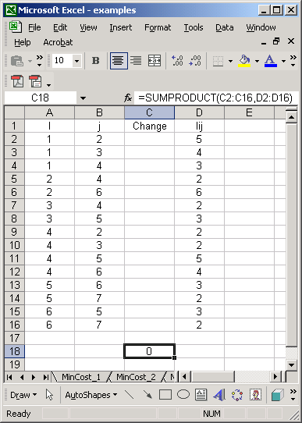
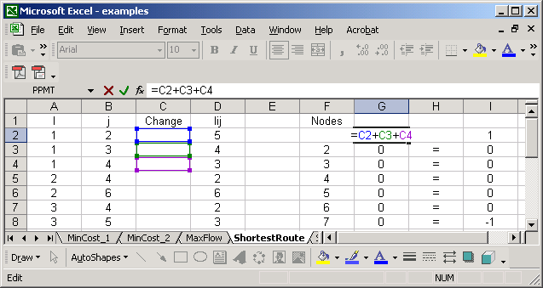
Excel
6
2
2
6
2
5
4
2
6
7
4
1
2
8
5
2
2
7
3

Slide 39
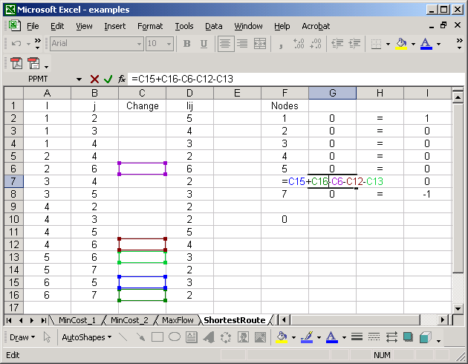
Excel
6
2
2
6
2
5
4
2
6
7
4
1
2
8
5
2
2
7
3

Slide 40
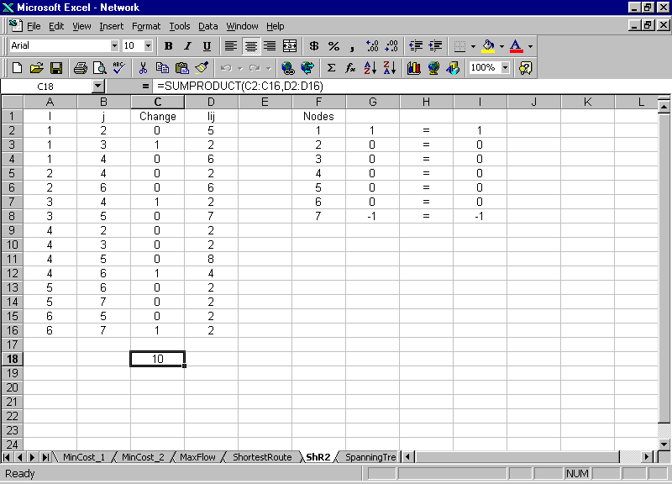
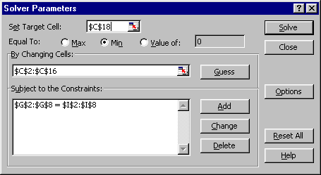
Solver Solution
6
2
2
6
2
5
4
2
6
7
4
1
2
8
5
2
2
7
3

Slide 41
After class practice; Find the shortest route
4
6
9
3
6
4
3
6
2
2
11
5
2
2
6
6
8
6
D
2
2
5
O
3
4
3
5
10
4
3
1
2
5
7
2
4
3
3

Slide 42
Two important observations in the LP-relaxation
2
6
1
4
2
3
4
1
3
Formulate on the problem on the black board
Did I say x_{ij} <= 1 ?
Why all the variables came out less than 1
Did I say x_{ij} 0 or 1
Why all variables came out 0 or 1

Slide 43
The Minimum Spanning Tree
Find a tree such that we can access each and every node at the minimum cost. The total length ( or cost) of the tree is minimized.
In other words, we want to minimize the construction cost of the tree.
Edges on the MST are bi-directional
l _{ij} : The length or cost of the bi-directional edge ij.
We usually use the term “EDGE” as nondirected, and term “ARC” as directed.
All distances in MSE network are symmetric.

Slide 44
The Minimum Spanning Tree
2
7
2
2
1
5
4
6
4
5
4
1
3
1
7
7
3
4
5

Slide 45
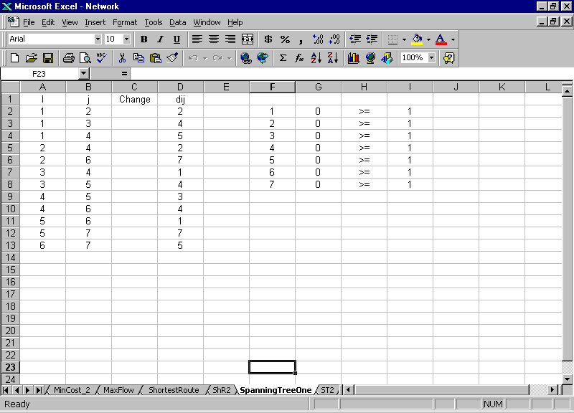
Minimum Spanning Tree
2
2
2
7
1
5
4
4
6
5
4
3
1
7
4
7
3
5

Slide 46
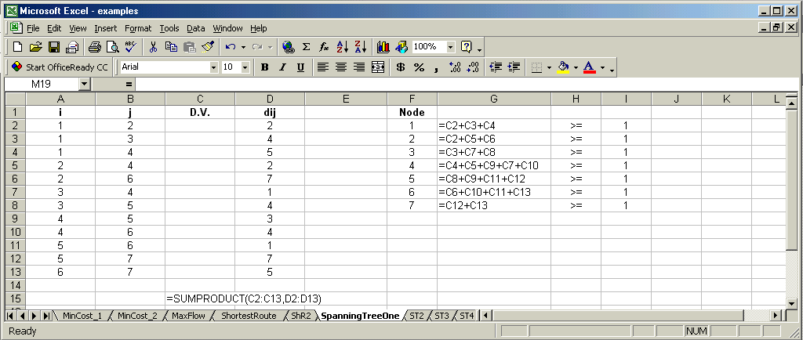
Minimum Spanning Tree
2
2
2
7
1
5
4
4
6
5
4
3
1
7
4
7
3
5

Slide 47
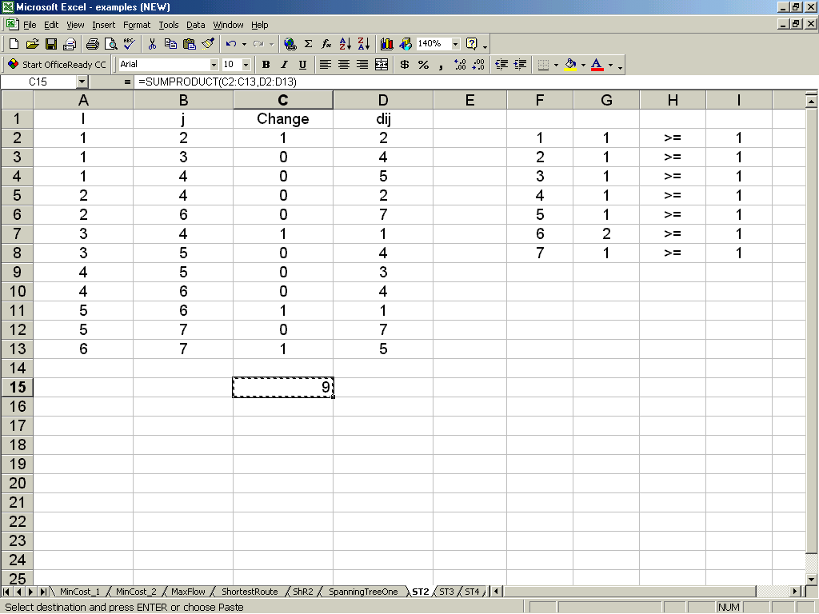
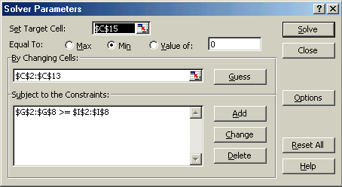
Minimum Spanning Tree : Connectivity

Slide 48
Minimum Spanning Tree : Connectivity
2
2
2
7
1
5
4
4
6
5
4
3
1
7
4
7
3
5

Slide 49
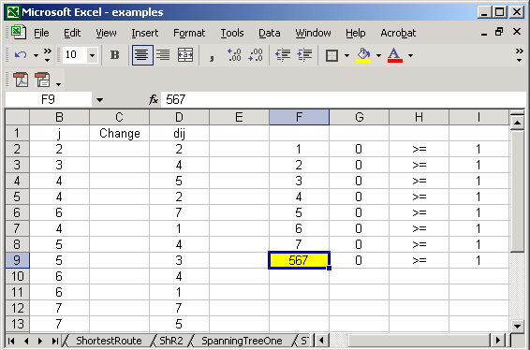
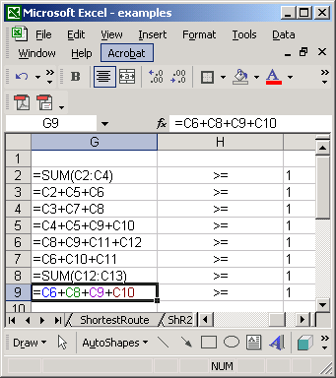
Minimum Spanning Tree : Connectivity
2
2
2
7
1
5
4
4
6
5
4
3
1
7
4
7
3
5

Slide 50
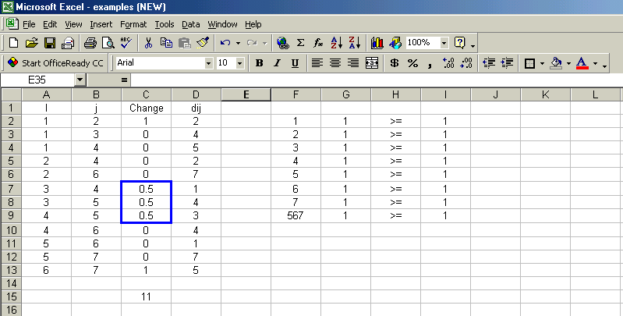
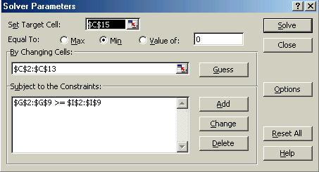
Minimum Spanning Tree : Integrality
2
2
2
7
1
5
4
4
6
5
4
3
1
7
4
7
3
5

Slide 51
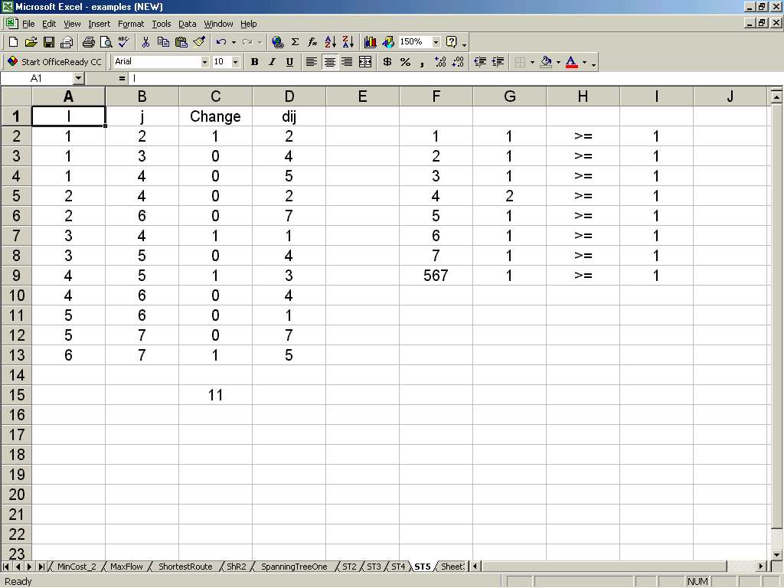

Minimum Spanning Tree : Connectivity
2
2
2
7
1
5
4
4
6
5
4
3
1
7
4
7
3
5

Slide 52
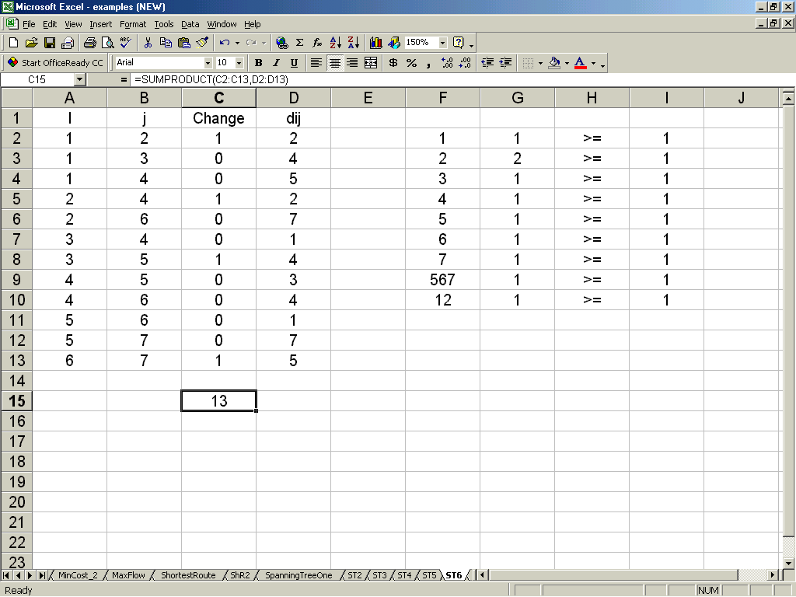
Minimum Spanning Tree : Connectivity
2
2
2
7
1
5
4
4
6
5
4
3
1
7
4
7
3
5

Slide 53

Minimum Spanning Tree : Connectivity
2
2
2
7
1
5
4
4
6
5
4
3
1
7
4
7
3
5

Slide 54
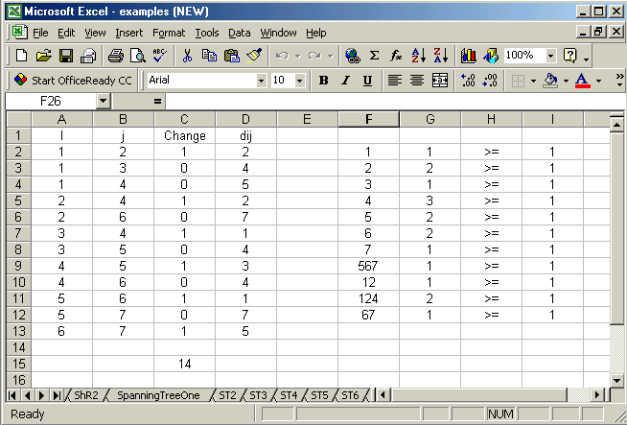
Minimum Spanning Tree : Optimal Solution

Slide 55
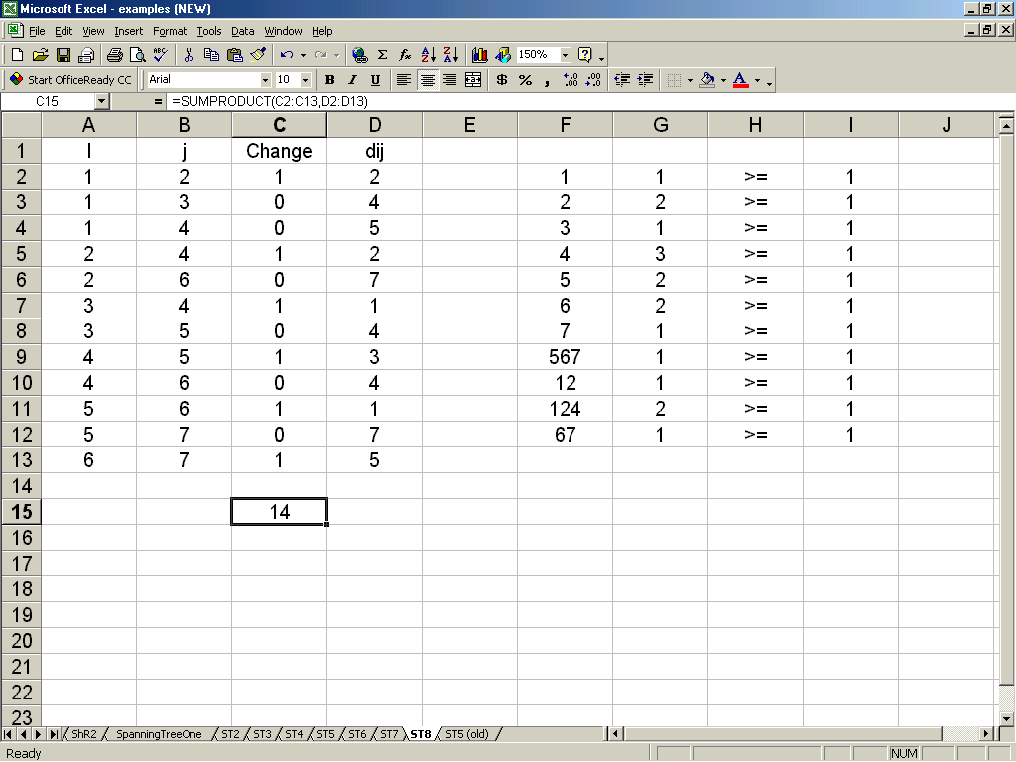
Minimum Spanning Tree : Optimal Solution
2
2
2
7
1
5
4
4
6
5
4
3
1
7
4
7
3
5

