Slide 1
Demand and Cost Data
160
2200
140
2000
120
100
1800
80
1600
60
1400
40
20
1200
0
1000
0
10
20
30
40
50
60
70
0
10
20
30
40
50
60
70
Quantity
Quantity

Slide 2
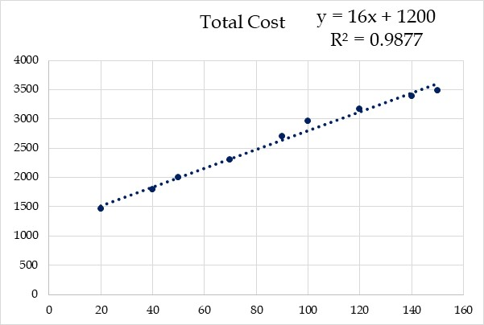
Easiest – Scatter Graph – Add Trend Line – Show Equation & R²

Slide 3
Worse- Data Analysis- Regression- Occupies Space- Rigid

Slide 4
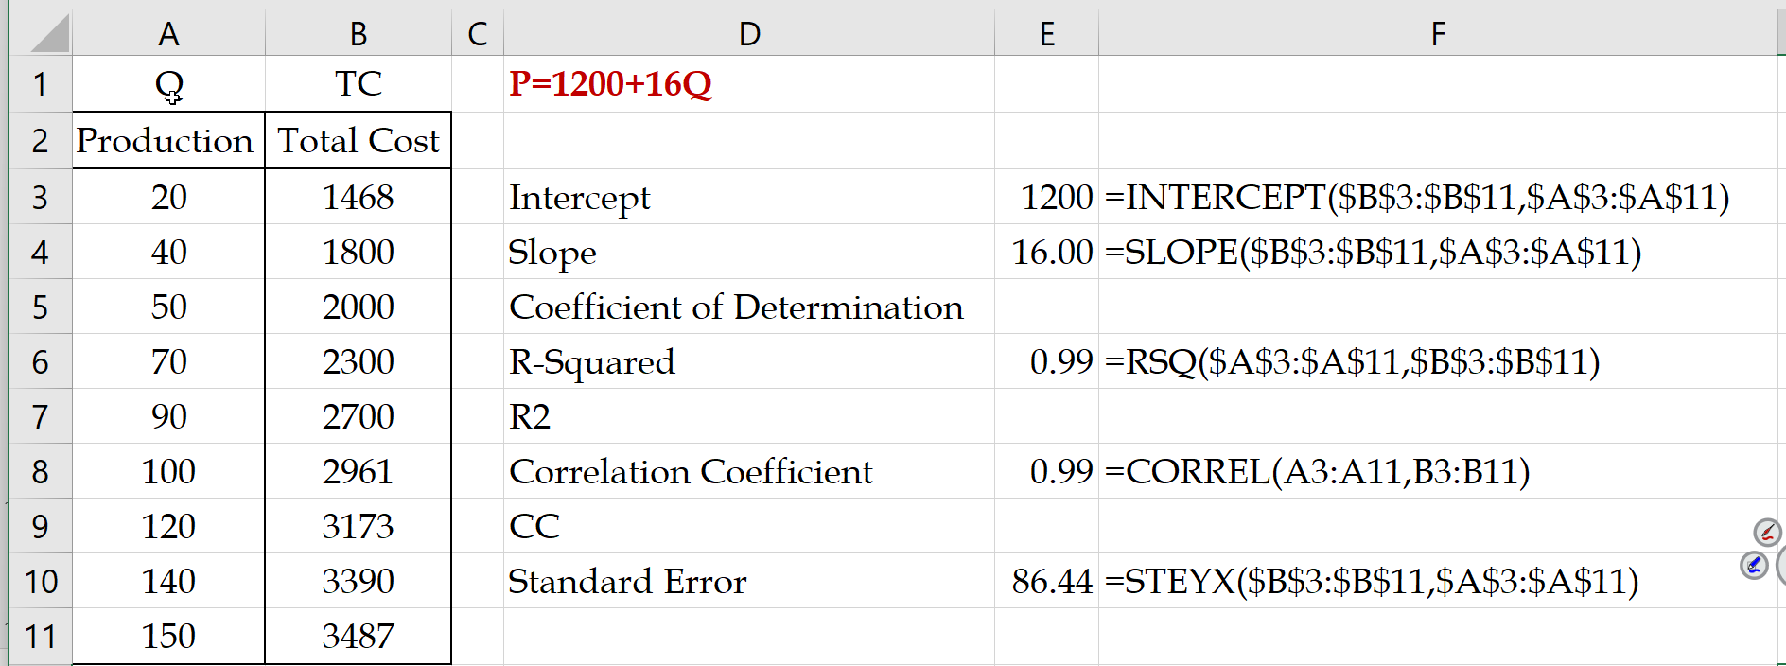
Best - INTERCEPT- SLOPE - RSQ - STEYX - Flexible - Updates as Data Changes

Slide 5
The Foundations of Min LSQ, and Excel’s Dynamic Arrays

Slide 6
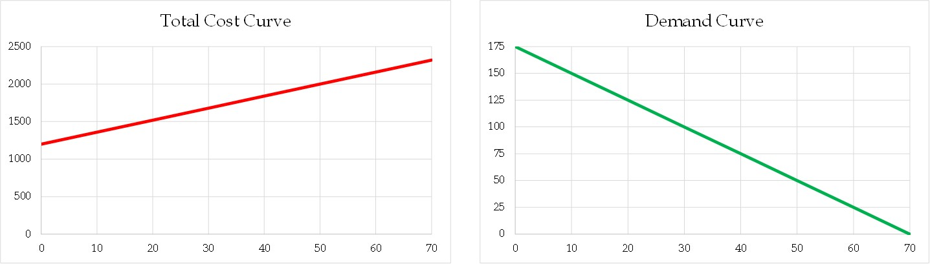
Cost and Demand Curve Estimates
Pmax
F
V
Qmax

Slide 7
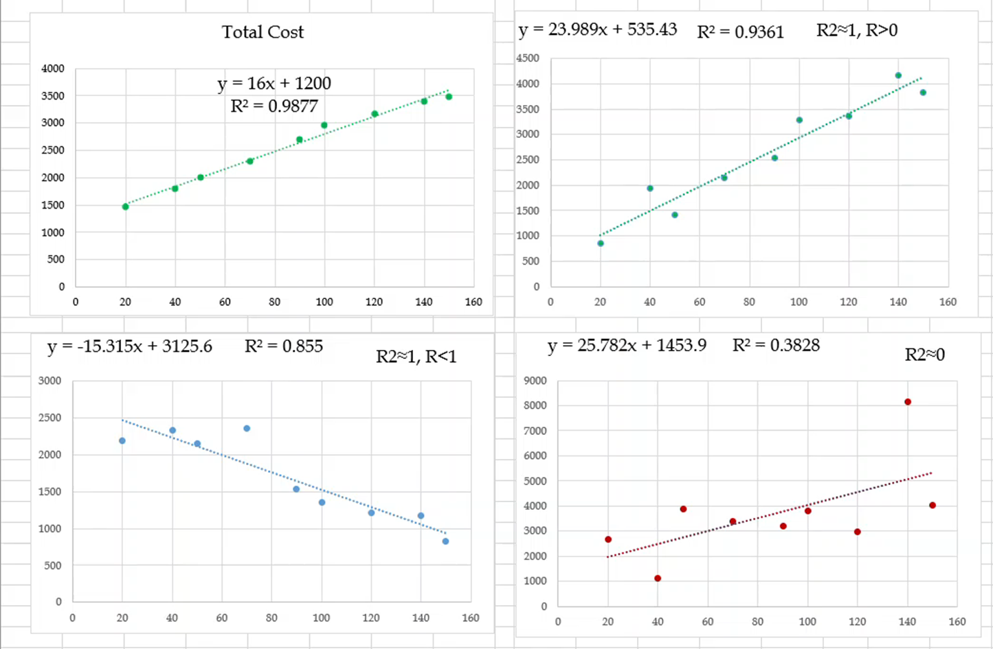
General R² Values

Slide 8
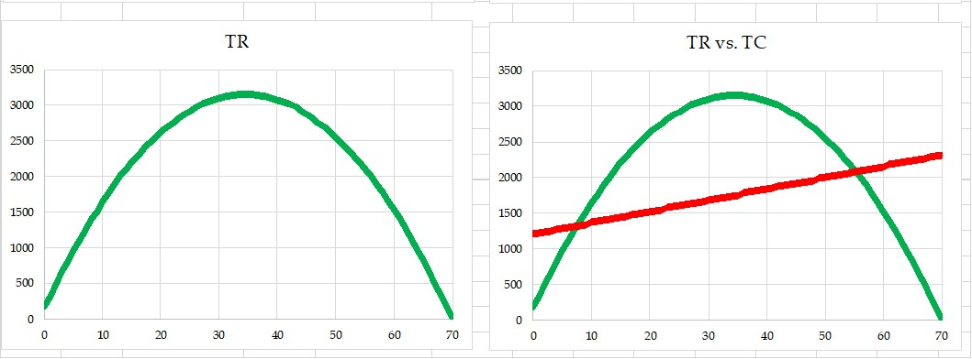
Line Graphs, Scatter Graph, Visualization

Slide 9
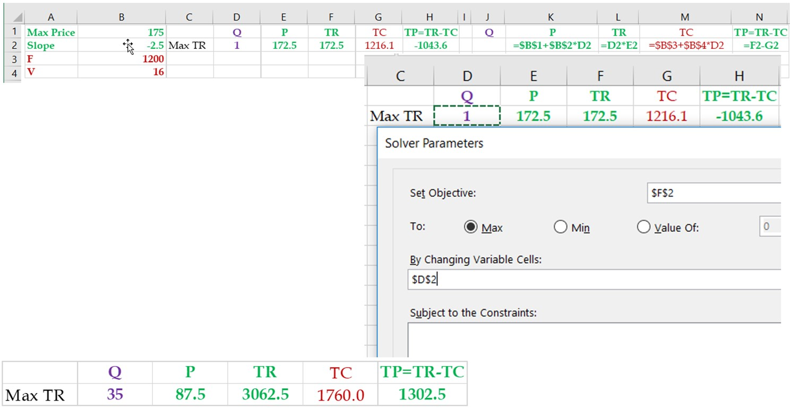
No Derivatives, Graphs, XLOOKUP, DataTable, Solver ➔ Max Revenue

Slide 10
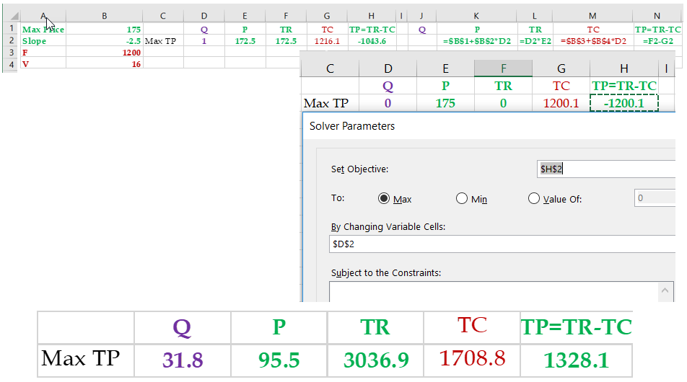
Max TP Vs Max TR

Slide 11
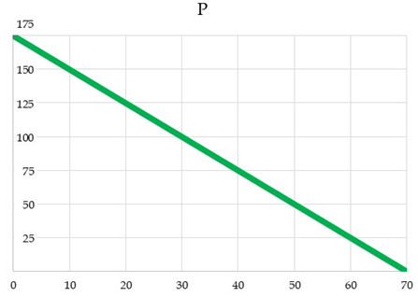
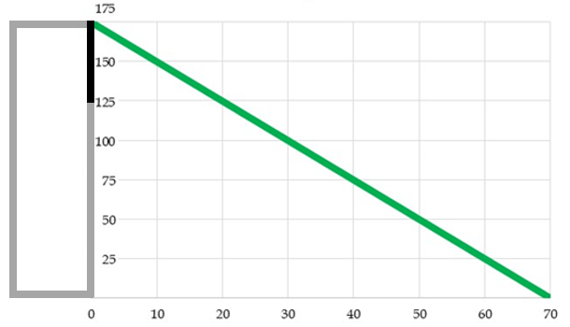
From Linear Demand Curve to Uniform Distribution
P = P
Q = (Pmax-P)/|Slope|
TR = P(Pmax-P)/|Slope|

Slide 12
From Linear Demand Curve to Uniform Distribution
Qmax= Pmax/|Slope|
P = P
Prob(Sales for P) = (Pmax-P)/Pmax
Q=(Pmax-P)/|Slope|
TR=P(Pmax-P)/|Slope|

Slide 13

From Linear Uniform Distribution To Binomial
n
P(95.5 ≤ x ≤ 175) = 0.45
P=0.45
1-P=0.55
0
175

Slide 14
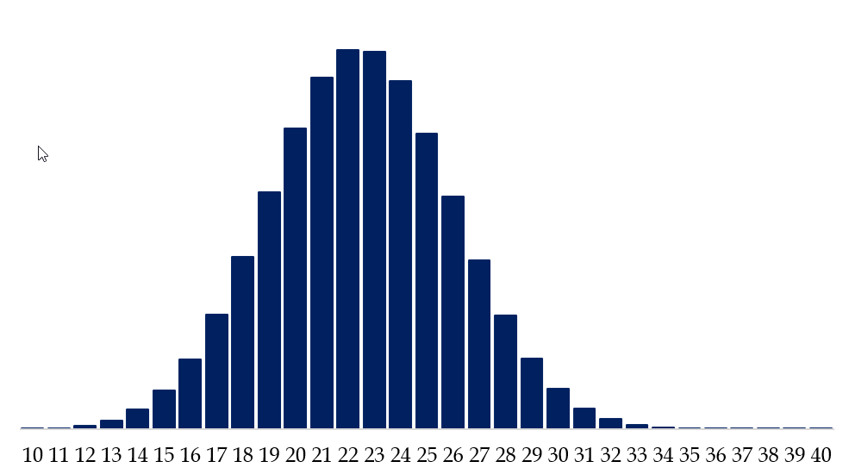
From Linear Uniform Distribution To Binomial
μ = np ➔ μ = 22.5
σ = SQRT((np*(1-np)) ➔ σ = 3.5

Slide 15
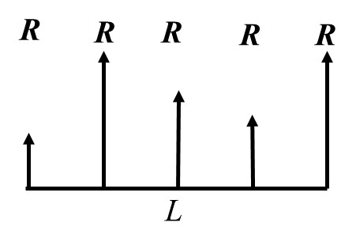
R
+
R
+
R
+
R
+
R

Slide 16

Summation of Variables & Central Limit Theorem

Slide 17

Safety Stock But Under What Service Level
LTD
ROP= +
Isafety
L

Slide 18
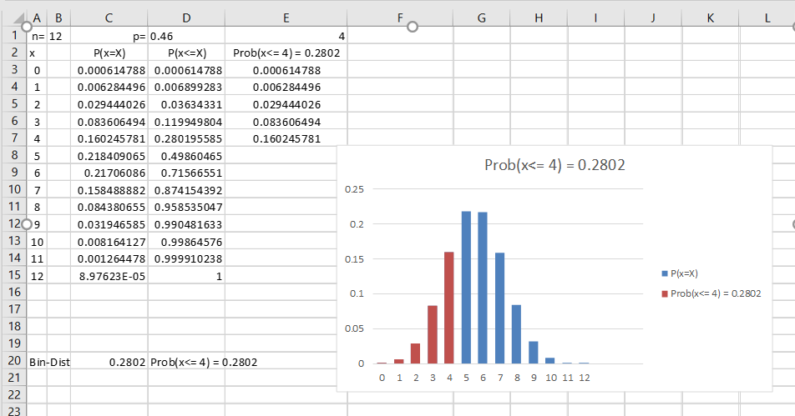
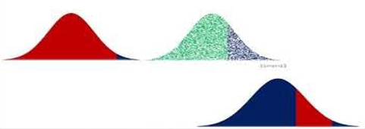
Non Linear TR, Linear TC, U, B, and N Distributions

Slide 19


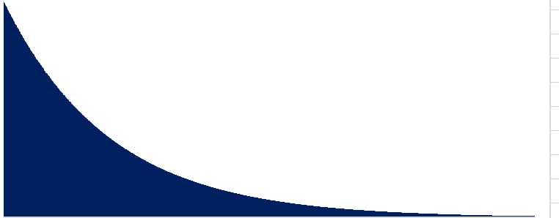
Three Well-Known Probability Distributions
U ~ (a,b)
μ = (a+b)/2
σ = (b-a)/SQRT(12)
N ~ (Mean, StdDev)
N ~ (μ, σ)
E ~ (μ)
σ= μ

Slide 20



Uniform Distribution Random Number Generation
(X-a)/(b-a) = 0≤area≤1 = Rand()
(X-a)= (b-a)*Rand()
X= a+(b-a)*Rand()
X= -μln(RAND())
0≤prob≤1
0≤area≤1
0≤RAND()≤1
X = NORM.INV(Rand(),μ, σ)

Slide 21
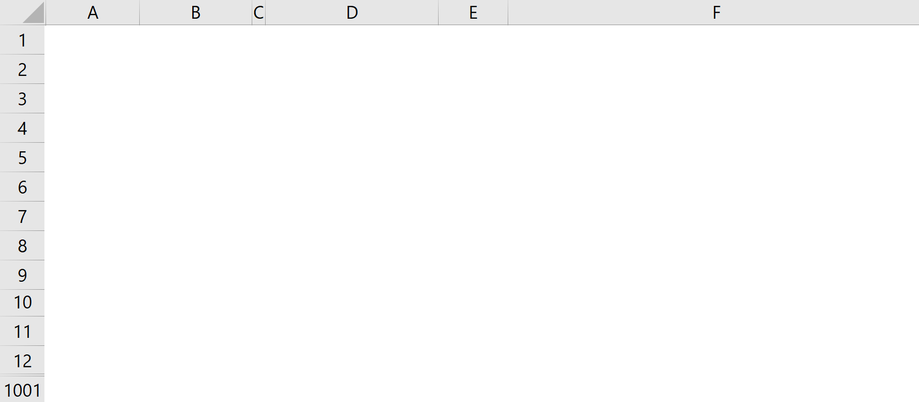
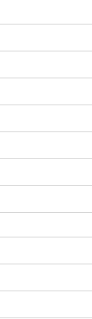
Under Stock, Average Sales, Over Stock, Fill Rate, Service Level
=MAX(0,A2-$E$12)
=IF(A2>$E$12, A2-$E$12,0)

Slide 22
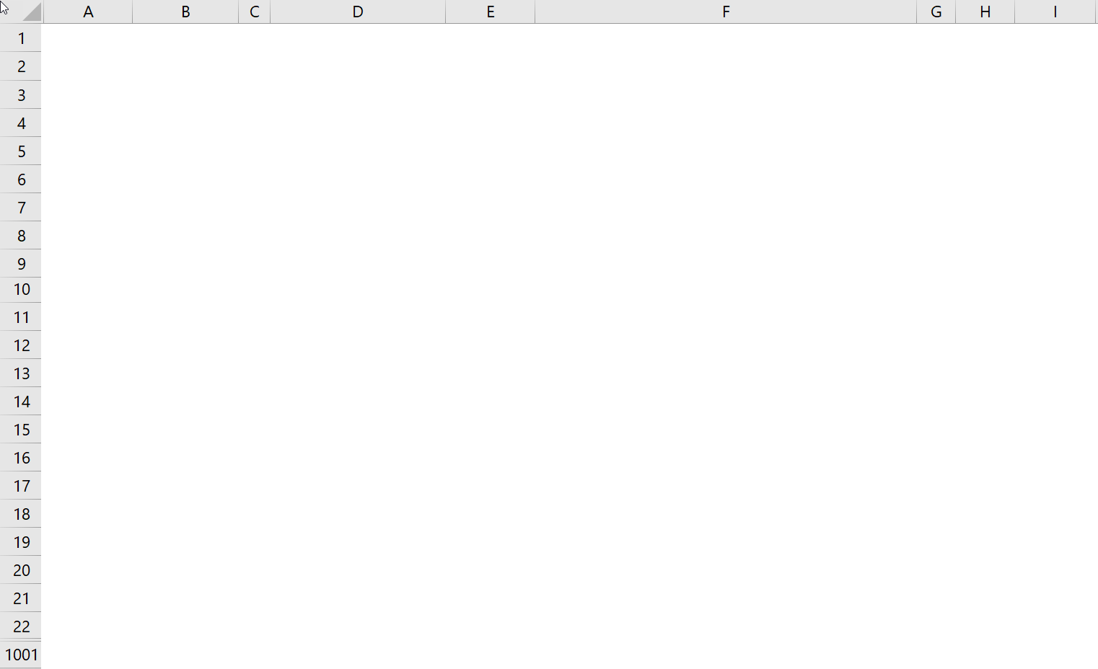
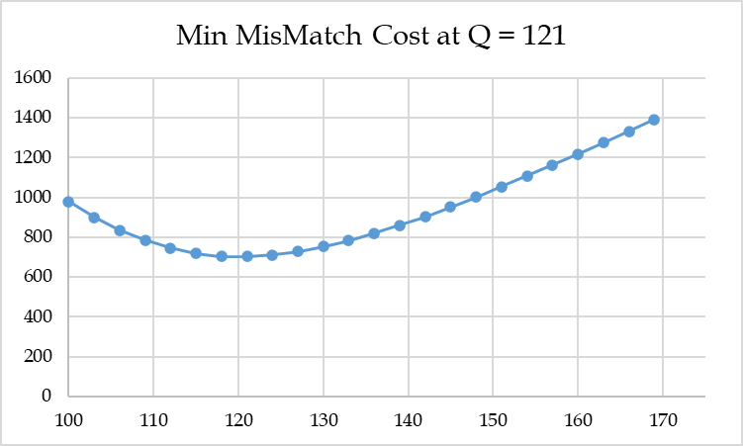
What Q to Order To Minimize Overage+Underage Cost; Mismatch Cost
DataTable
Over+Under Costs vs Quantity Ordered

Slide 23
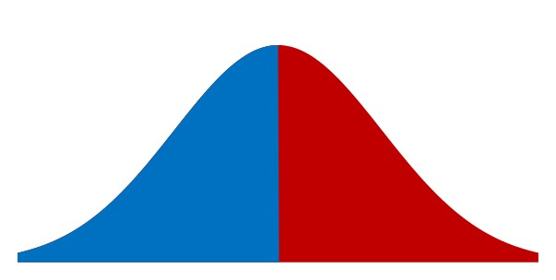
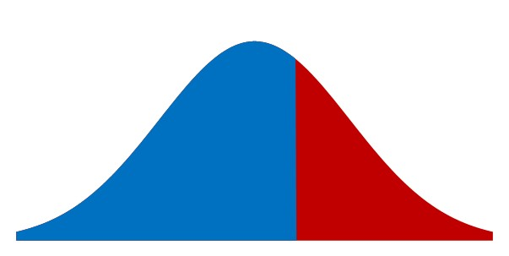
Cu vs Co Balance of Power
p =$120, c=$70, v=$20
Cu = 120-70 = 50
Co =70-20= 50
0.50
SL* = Cu/(Cu+Co)
SL*=50/(50+50)=0.5
50
50
SL* = Cu/(Cu+Co)
SL*=80/(80+20)=0.8
0.80
p =$120, c=$40, v=$20
Cu = 120-40 = 80
Co =40-20= 20
20
80
NORM.INV(0.8,100,25)

Slide 24
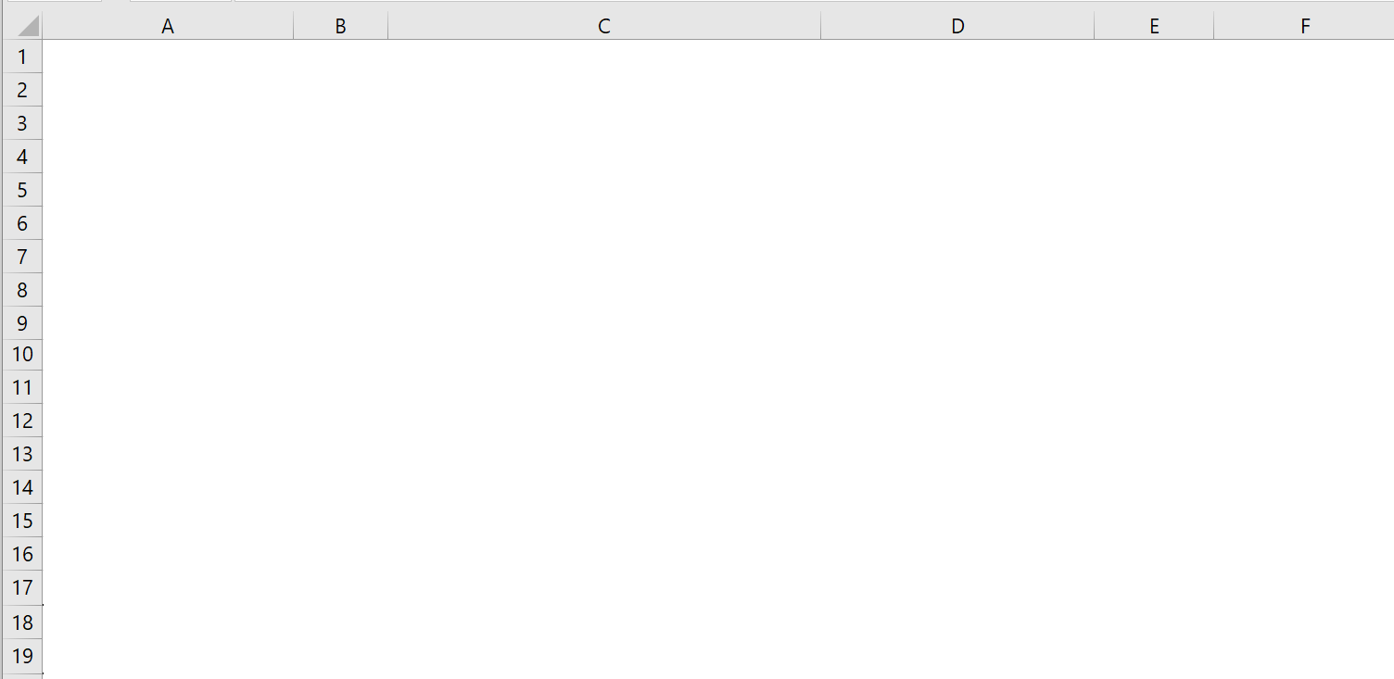
Value of Information- Maximum to Spend on Forecasting Improvement

Slide 25
Value of Collaboration- Maximum Expected Value of Supply Chain Profit

