Slide 1

The Newsvendor Problem and Collaboration Between Supplier and Retailer
Ardavan Asef-Vaziri

Slide 2
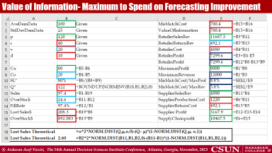
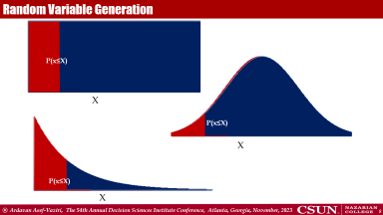
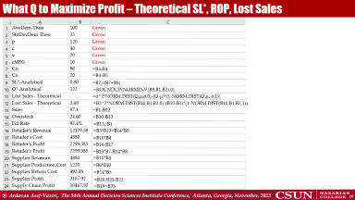
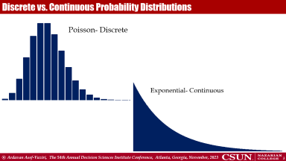
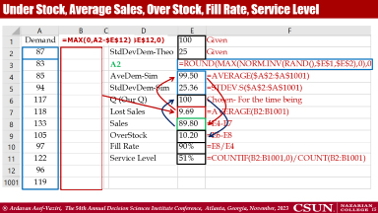
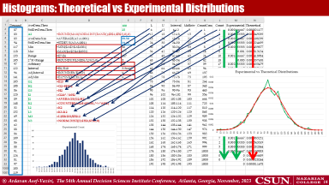
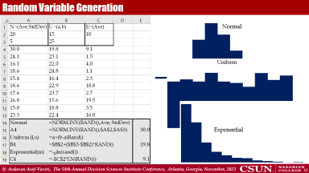
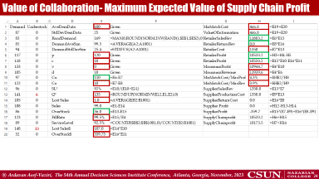

Slide 3
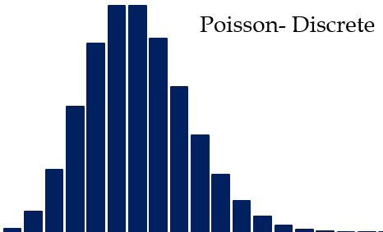
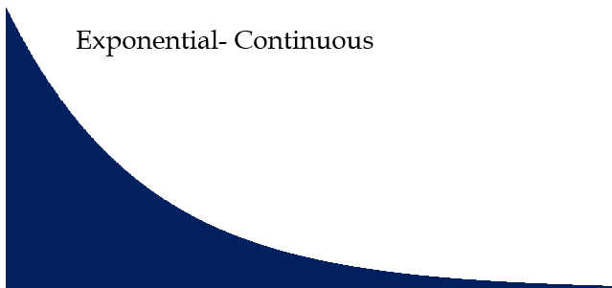
Discrete vs. Continuous Probability Distributions

Slide 4

Continuous Probability Distributions P(x=K)=0
1
1/∞ = 0
P(x=X)=0
In continuous pdf
pdf?
pdf?
NOT portable document format
BUT probability distribution function

Slide 5



Continuous Probability Distributions P(x≤K), P(x≥K), P(L≤x≤K)

Slide 6


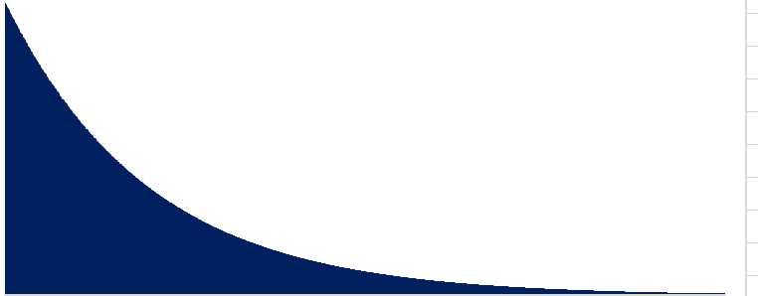
Three Well-Known Probability Distributions
U ~ (a,b)
μ = (a+b)/2
σ = (b-a)/SQRT(12)
N ~ (Mean, StdDev)
N ~ (μ, σ)
E ~ (μ)
σ= μ

Slide 7
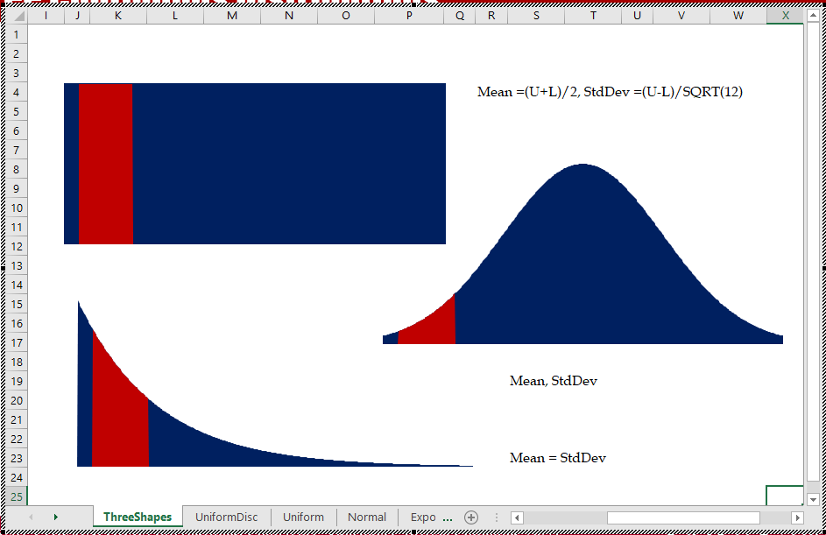
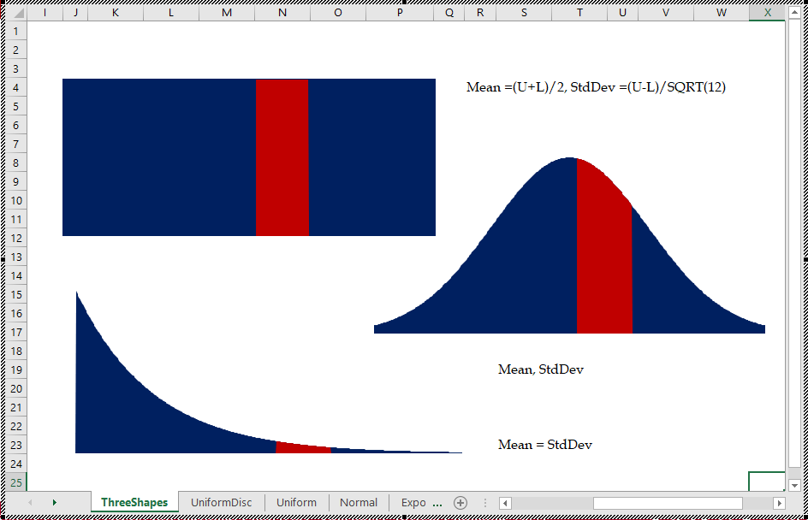
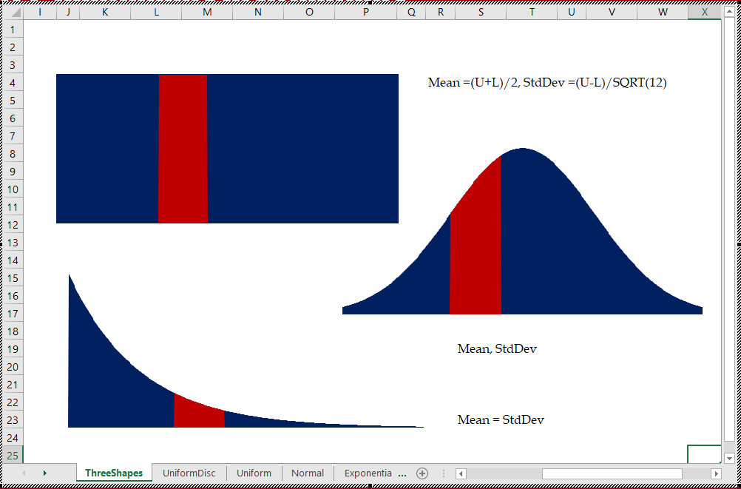
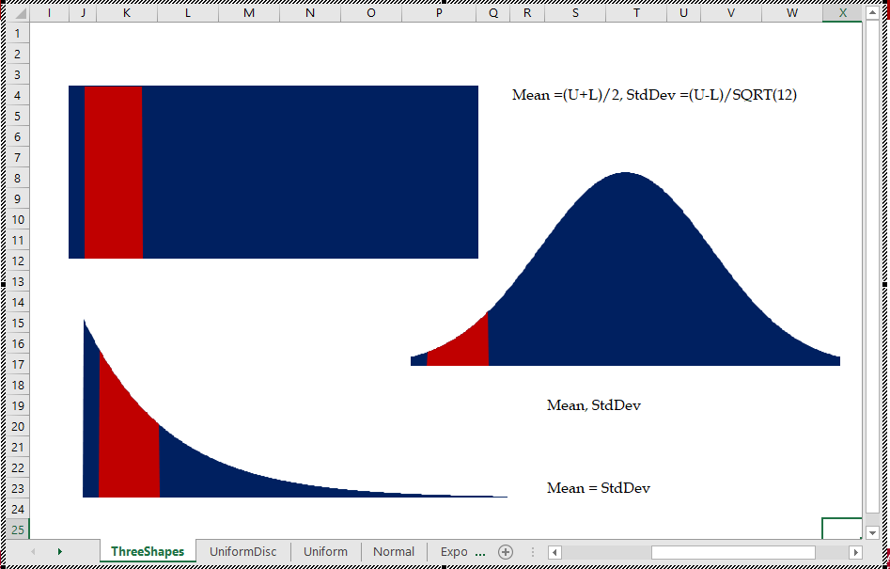
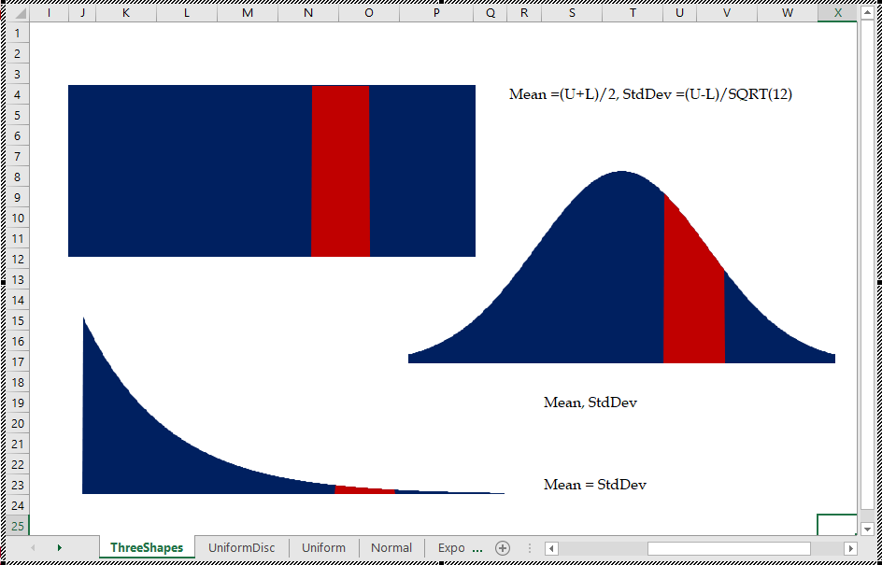
Three Well-Known Probability Distributions

Slide 8





Random Variable Generation
P(x≤X)
X
P(x≤X)
X
P(x≤X)
X

Slide 9



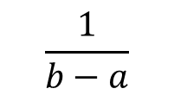
Uniform Distribution Random Number Generation
1
(X-a)*(1/(b-a))
0≤area≤1
$$\frac{1}{b−a}$$
a
b
a
X
b
(X-a)/(b-a)
0≤area≤1
0≤RAND()≤1
(X-a)/(b-a) = 0≤area≤1 = Rand()
(X-a)= (b-a)*Rand()
X= a+(b-a)*Rand()
a
X
b
a
X
b

Slide 10

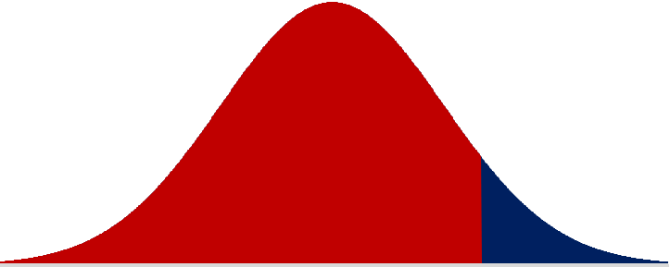


Normal Distribution Random Number Generation
N ~ (μ, σ)
NORM.DIST(X,μ, σ,1)
0≤prob≤1
N ~ (μ, σ)
X
0≤prob≤1
0≤area≤1
0≤RAND()≤1
X = NORM.INV(Rand(),μ, σ)
0≤prob≤1
0≤area≤1
NORM.INV(prob,μ, σ)
X
X

Slide 11



Exponential Distribution Random Number Generation
0≤prob≤1
1-e^{(-X/μ)}
1-EXP(-X/μ)
E ~ (μ)
EXP(-X/μ)
X
e^{(-X/μ)} = 0≤prob≤1 = RAND()
e^{(-X/μ)} = RAND()
lne^{(-X/μ)} = lnRAND()
-(X/μ)ln(e) = ln(RAND())
ln(e) = 1
-X/μ = ln(RAND())
X= -μln(RAND())
X= -μln(RAND())
X

Slide 12
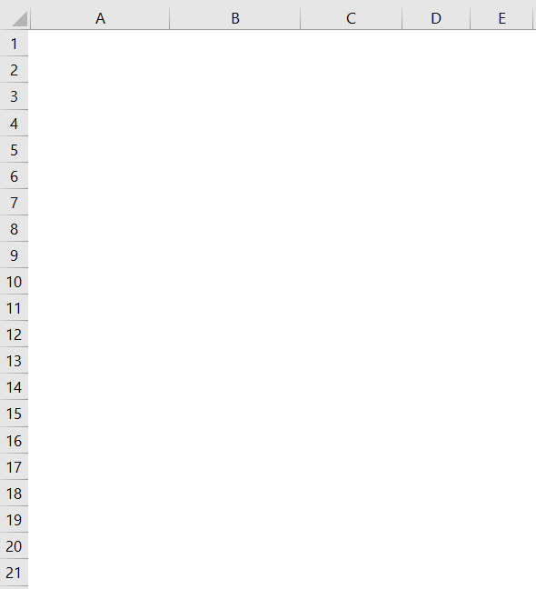
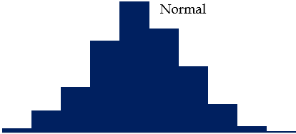
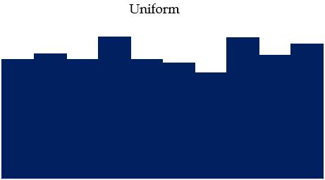
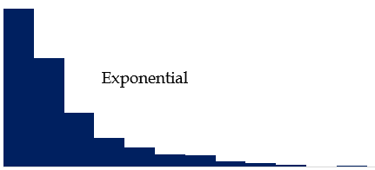
Random Variable Generation

Slide 13
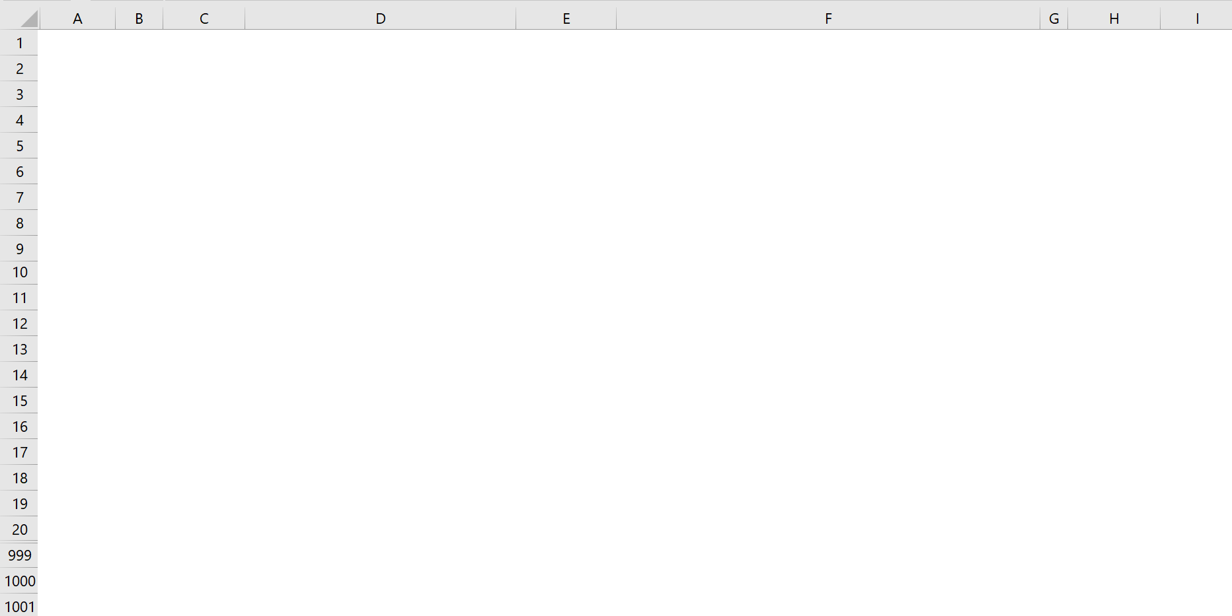
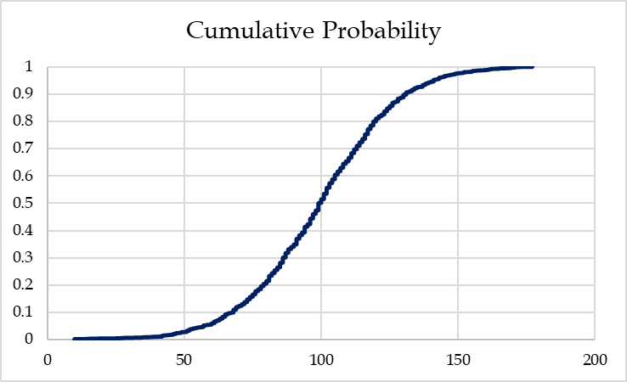
Normal Random Number Generation

Slide 14

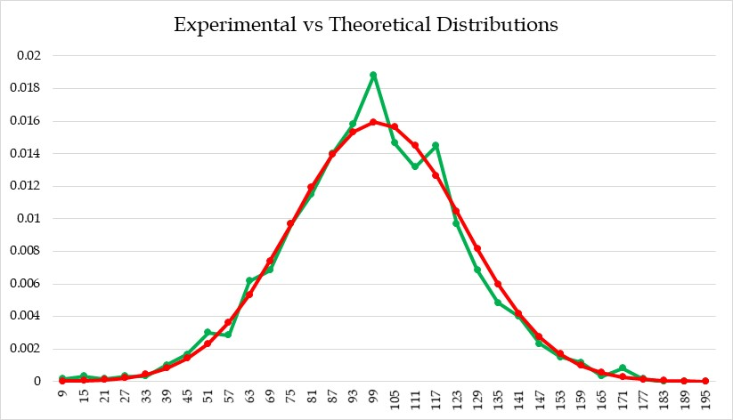
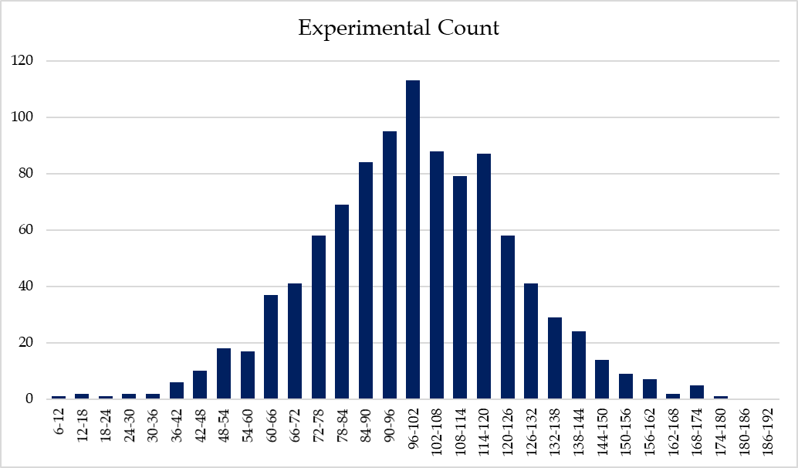
Histograms: Theoretical vs Experimental Distributions

Slide 15
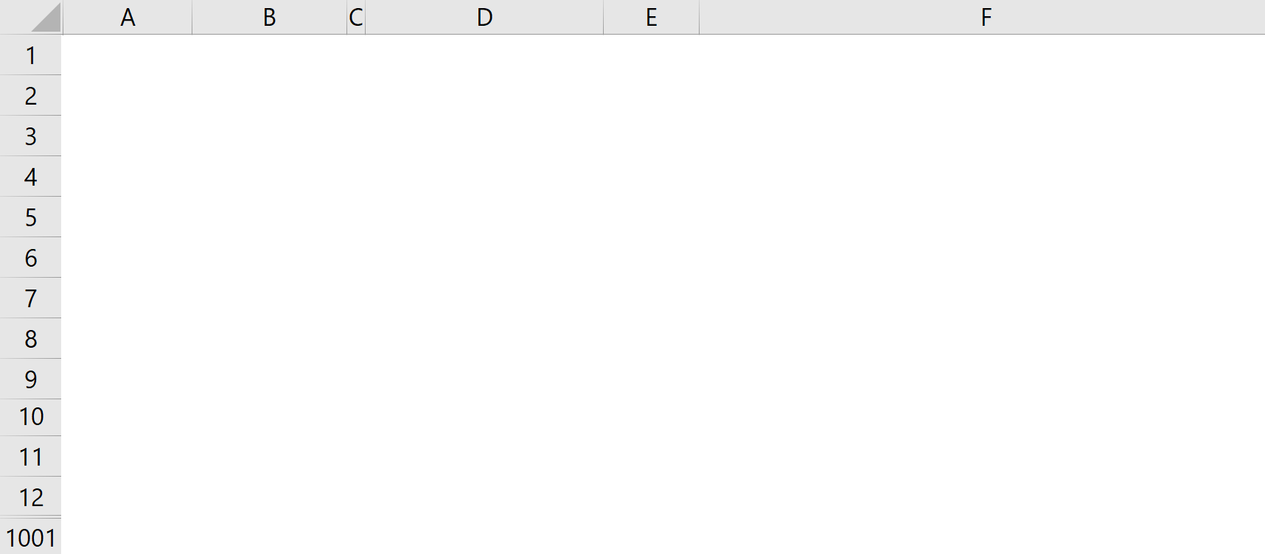
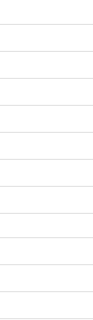
Under Stock, Average Sales, Over Stock, Fill Rate, Service Level
=MAX(0,A2-$E$12)
=IF(A2>$E$12, A2-$E$12,0)

Slide 16
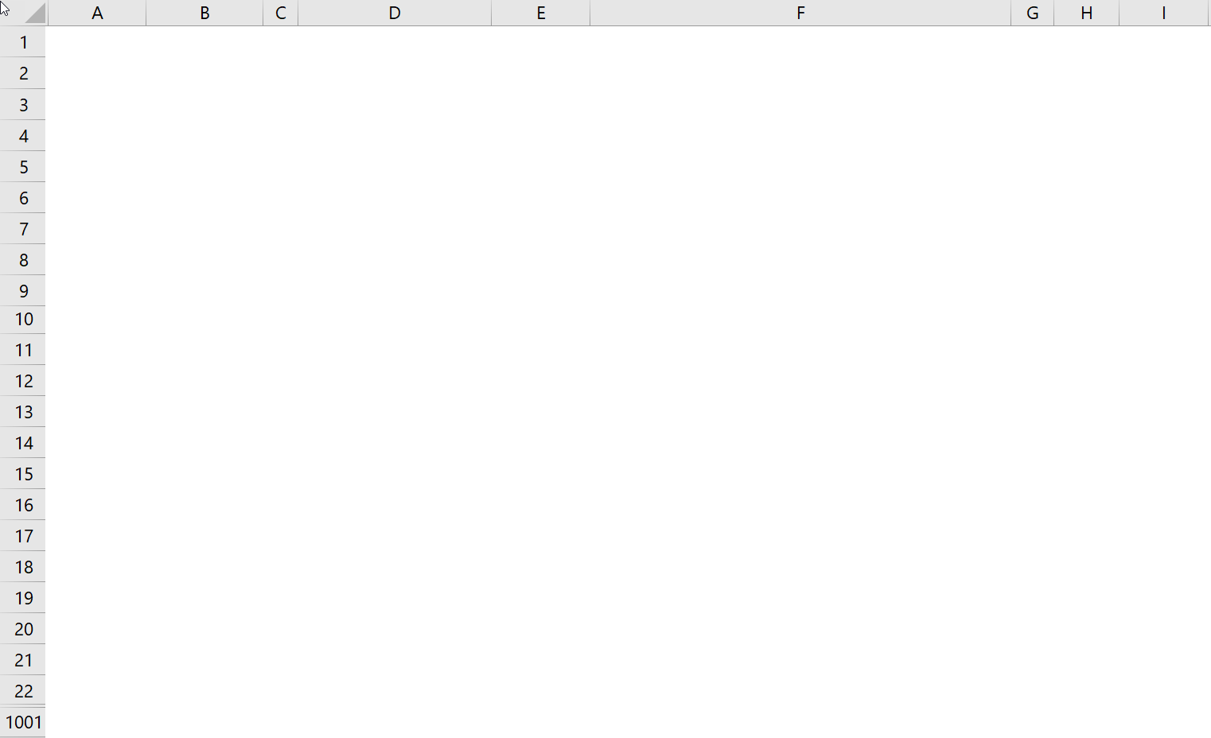
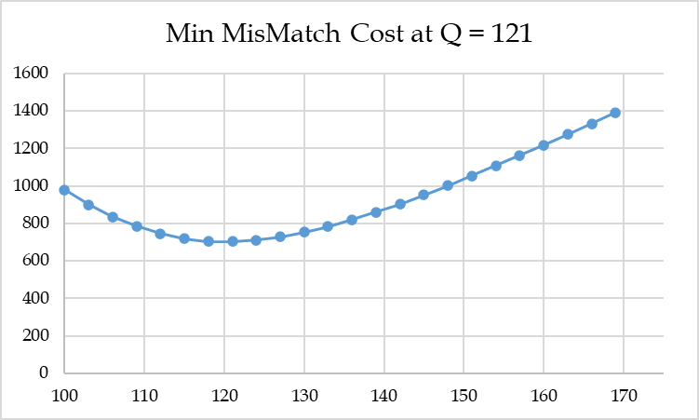
What Q to Order To Minimize Overage+Underage Cost; Mismatch Cost
DataTable
Over+Under Costs vs Quantity Ordered

Slide 17
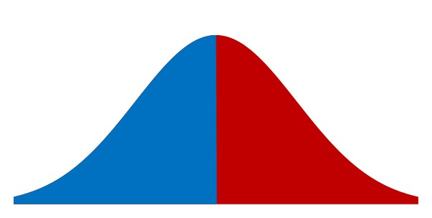
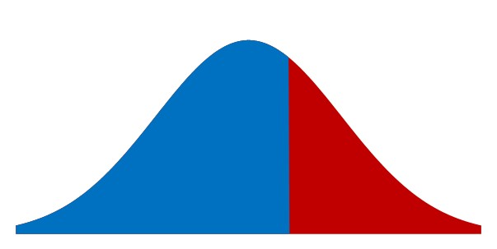
Cu vs Co Balance of Power
p =$120, c=$70, v=$20
Cu = 120-70 = 50
Co =70-20= 50
0.50
SL* = Cu/(Cu+Co)
SL*=50/(50+50)=0.5
50
50
SL* = Cu/(Cu+Co)
SL*=80/(80+20)=0.8
0.80
p =$120, c=$40, v=$20
Cu = 120-40 = 80
Co =40-20= 20
20
80
NORM.INV(0.8,100,25)

Slide 18
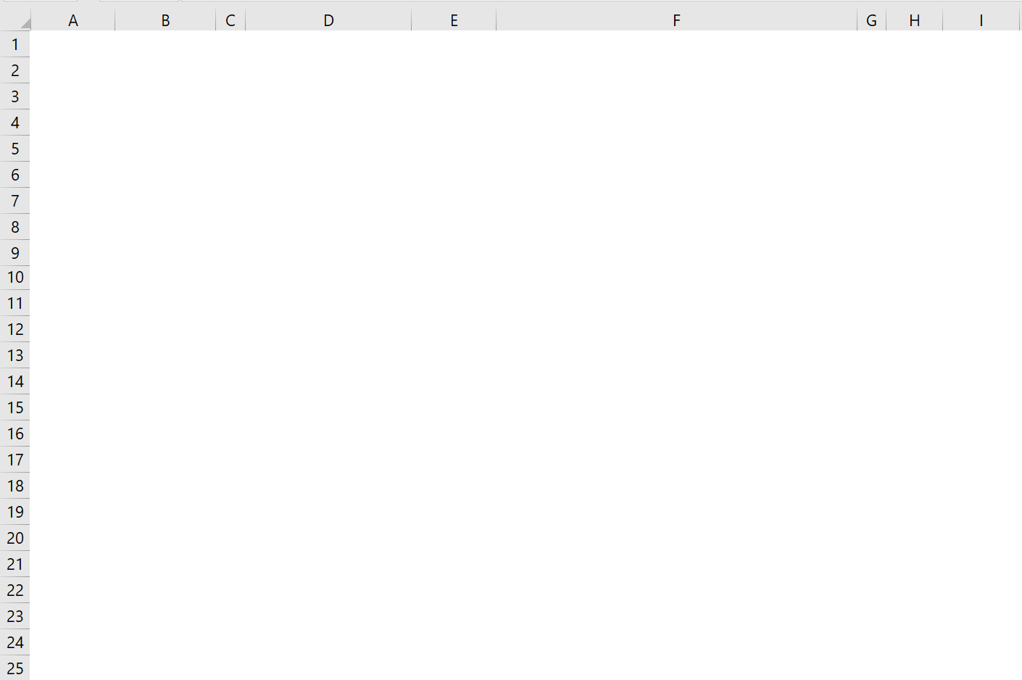
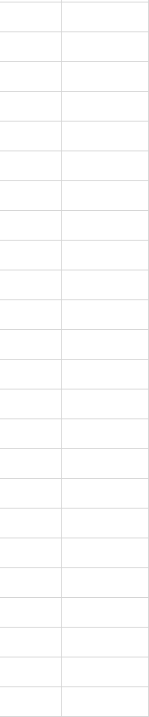
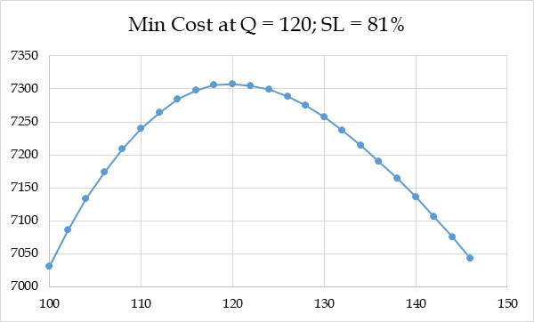
SL*=ROUND(NORM.INV(80/(80+20),100,25),0)=121

Slide 19
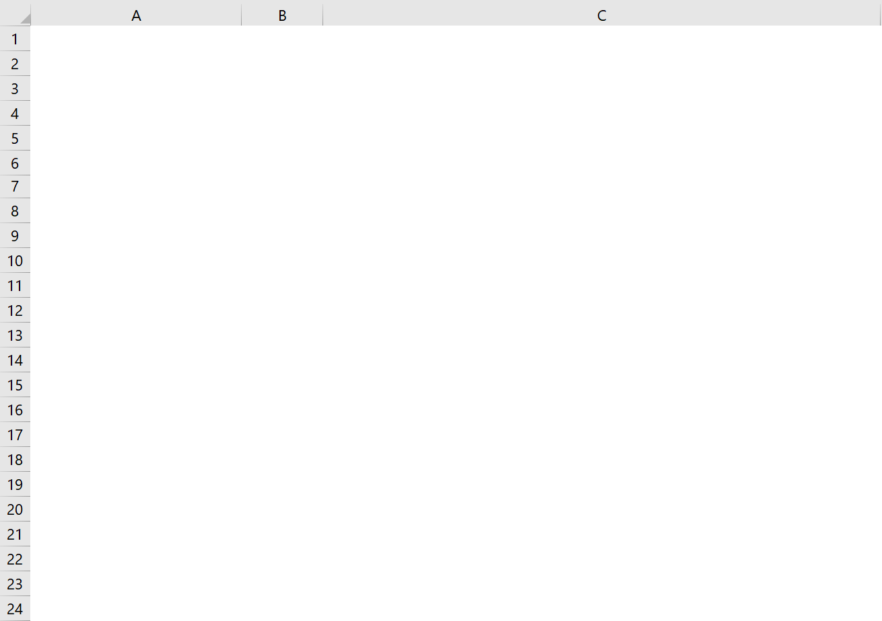
What Q to Maximize Profit – Theoretical SL*, ROP, Lost Sales
AveDem-Theo
100
Given
StdDevDem-Theo
25
Given
p
120
Given
c
40
Given
v
20
Given
cMFG
10
Given
Cu
80
=B3-B4
Co
20
=B4-B5
SL*-Analytical
0.80
=B7/(B7+B8)
Q*-Analytical
122
=ROUNDUP(NORMINV(B9,B1,B2),0)
Lost Sales - Theoretical
=σ^2*NORM.DIST(Q,μ,σ,0)-(Q-μ)*(1-NORM.DIST(Q,μ, σ,1))
Lost Sales - Theoretical
2.60
=B2^2*NORM.DIST(B10,B1,B2,0)-(B10-B1)*(1-NORM.DIST(B10,B1,B2,1))
Sales
97.4
=B1-B12
Overstock
24.60
=B10-B13
Fill Rate
97.4%
=B13/B1
Retailer's Revenue
12179.59
=B3*B13+B14*B5
Retailer's Cost
4880
=B10*B4
Retailer's Profit
7299.585
=B16-B17
Retailer's Profit
7299.585
=B13*B7-B14*B8
Supplier Revenue
4880
=B10*B4
Supplier Production Cost
1220
=B6*B10
Supplier Return Cost
492.08
=B14*B5
Supplier Profit
3167.92
=B20-B21-B22
Supply Chain Profit
10467.50
=B19+B23

Slide 20
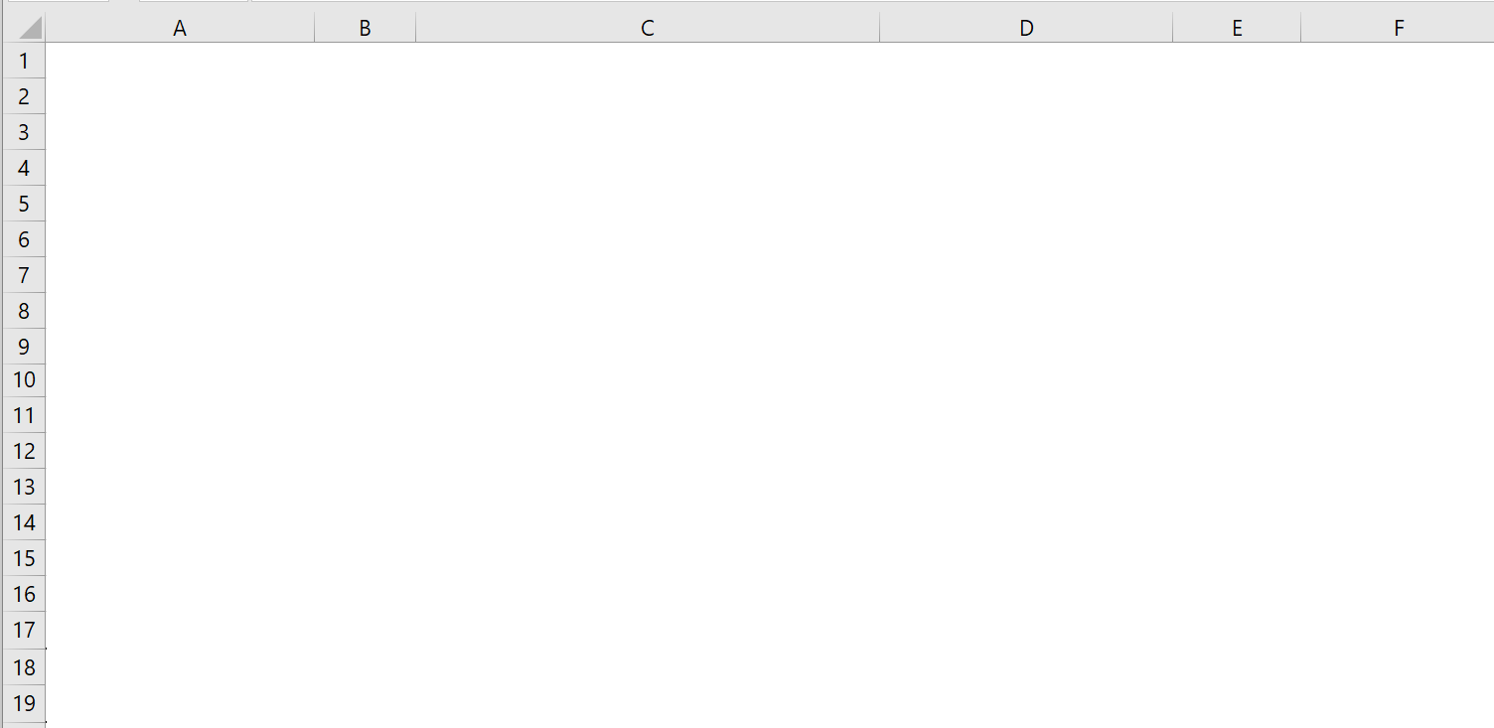
Value of Information- Maximum to Spend on Forecasting Improvement

Slide 21
Value of Collaboration- Maximum Expected Value of Supply Chain Profit

Slide 22
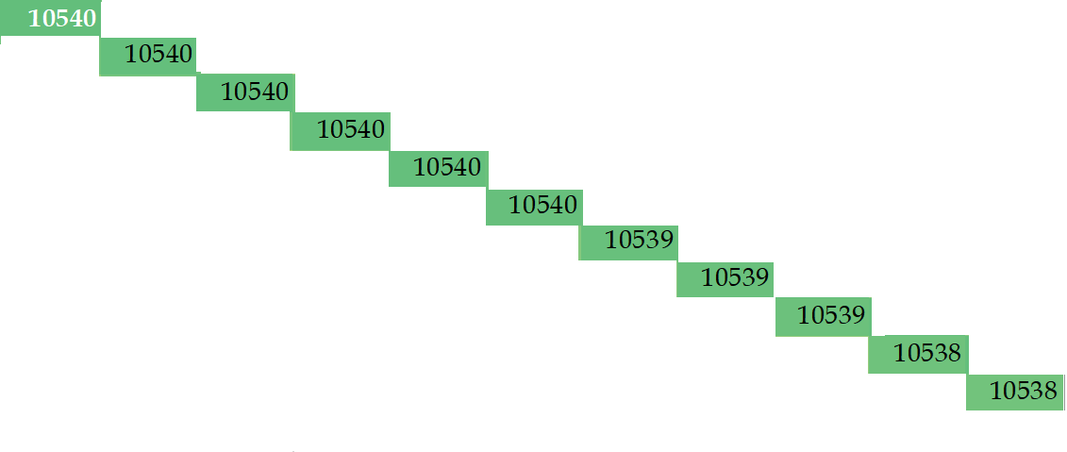
Sensitivity Analysist
v
c

Slide 24
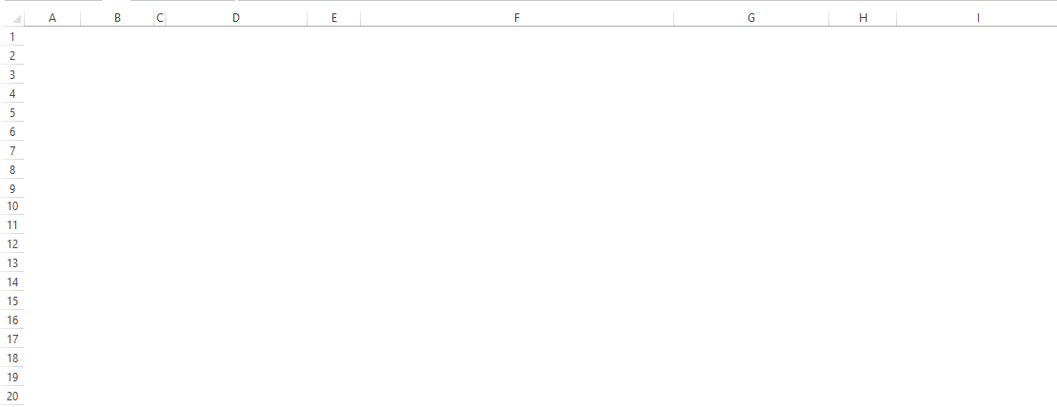
Value of Collaboration- Maximum Expected Value of Supply Chain Profit

Slide 25
Value of Collaboration- Maximum Expected Value of Supply Chain Profit

Slide 26
Analytical Solution Got Easy
Demand Distrinutions N~(100,25)
p=120, c=40, v = 20 ➔ Cu=120-40=80, Co= 40-20 =20
SL*=Cu/Cu+Co= 80/(80+20)=0.8
Q* = ROUNDUP(NORM.INV(0.8,100,25),0) = 122
Lost Sales = σ^2*NORM.DIST(Q,μ,σ,0)-(Q- μ)*(1-NORM.DIST(Q,μ, σ,1))
Lost Sales = 25^2*NORM.DIST(122,100,25,0)-(122- 100)*(1-NORM.DIST(122,100, 25,1))
Lost Sales = 625*0.010834558872 -22*(1- 0.810570345 ) = 6.77-4.17 = 2.6
Sales = 100-2.6= 97.4
Over Stock = 122-97.4 = 24.6
Retailer Revenue = 97.4*120+24.6*20 = 12180
Retailer Cost = 122(40) =4880
Retailer Profit = 12180- 4880 =7300
Retailer Profit =97.4(80)-24.6(20) =7300
-

Slide 27
Value of Collaboration
Supplier Profit = 122(40-10)-24.6 (20)=3168
Supply Chain Profit = 3168+ 7300 = 10468
Compute Supply Chain Profit if c=10 and v=0
Cu=120-10=110, Co= 10-0 =10
SL*=110/(110+10) =0.916667
Q* = NORM.INV(0.916667 ,100,25)= 135.57=136
Lost Sales = 25²NORM.DIST(136,100,25,0)-(136- 100)*(1-NORM.DIST(136,100, 25,1))
Lost Sales = 625*0.005658 -36*(1-0.925066)
Lost Sales = 3.54-2.7 = 0.84
Sales = 100-0.84= 99.16
Over Stock = 136-99.16 = 36.84
Retailer Profit = 99.16(120-10)-36.84(10) =10539
Supplier Profit = 0 ➔ Supply Chain Profit = 10539+0 = 10539 – 10468 = 61
-

Slide 28
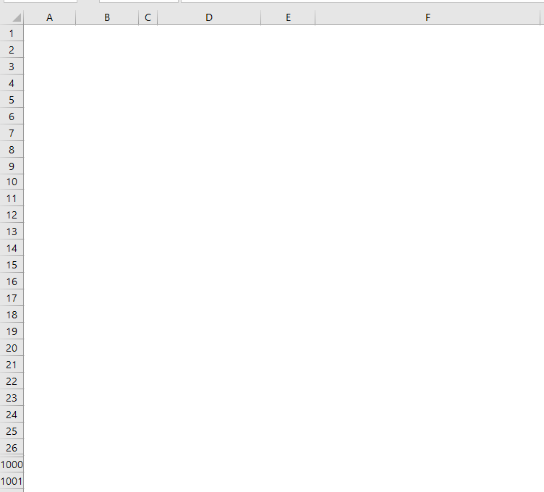
Supply Chain Profit

Slide 29
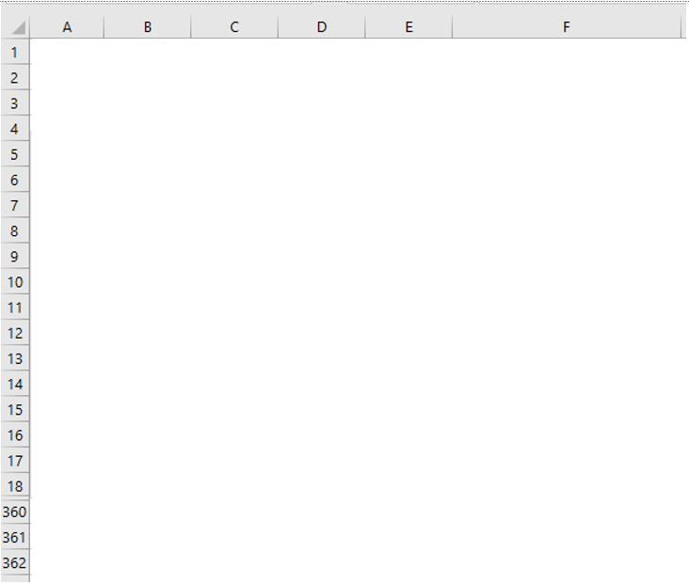
Theoretical Normal Graphs and Impact of Standard Deviation
NORM.DIST(x,μ,σ,1) = NORM.DIST((x-μ)/σ,0,1,1)
NORM.DIST(x,μ,σ,1) = NORM.S.DIST((x-μ)/σ, 1)
NORM.DIST(x,μ,σ,0) ≠ NORM.DIST((x-μ)/σ,0,1,0)
NORM.DIST(x,μ,σ,0) ≠ NORM.S.DIST((x-μ)/σ, 0)

Slide 30
How Much Inventory to Maximize Profit

Slide 31
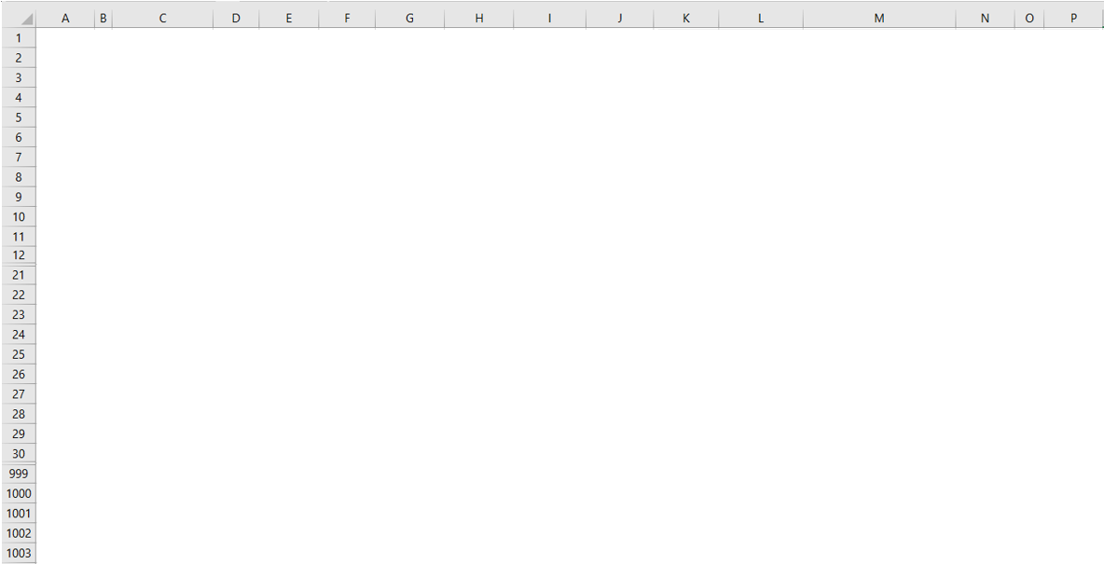
Simulation Based Distribution Function (Empirical pdf)
Blank after F(x) =1

Slide 32
Demand of N~(100,25), How Much Inventory Is Needed to Sell 100 Units
=qNORM.S.DIS((q-μ)/σ,1)+Q(1-NORM. S.DIS((Q-μ)/σ,1))
+μ(NORM.S.DIS((Q-μ/σ),1)-NORM.S.DIS((q-μ)/σ,1))
-σ(NORM.S.DIS ((Q-μ)/σ,0)-NORM.S.DIS ((q-μ)/σ,0))
=q*NORM.DIS(q,μ,σ,1)+Q*(1-NORM.DIS(Q,μ,σ,1))
+μ(NORM.DIS(Q,μ,σ,1)-NORM.DIS(q,μ,σ,1))
-(σ^2)(NORM.DIS (Q,μ,σ,0)-NORM.DIS (q,μ,σ,0))
NORM.S.DIST((x-μ)/σ,0)
NORM.DIST(x,μ,σ,0)

Slide 33
If, Overlap, NA(), White Font, Conditional Formatting to Black
White fonts
NA() when exceed
Conditional formatting turn white to black for non-NA()

Slide 34
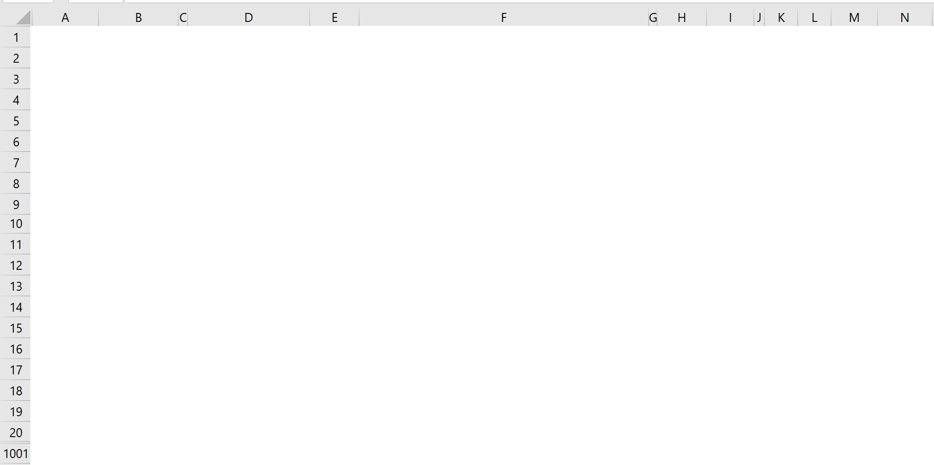
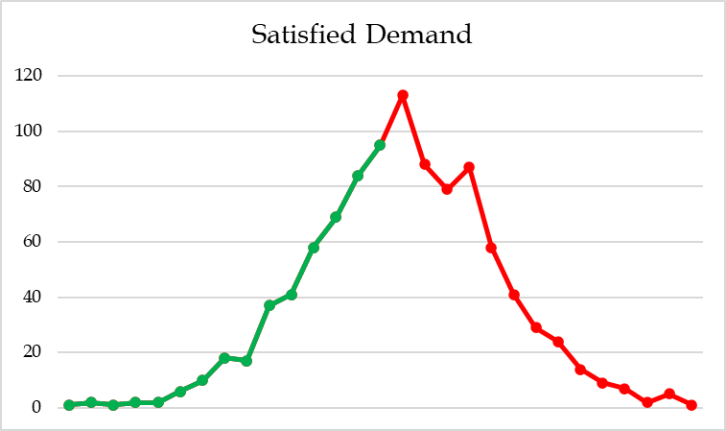
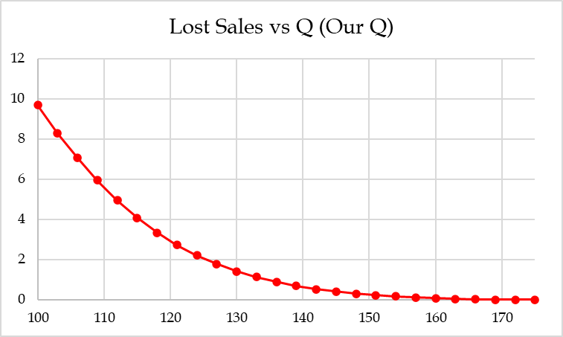
Visual Representation, Data Table Graph, and Histogram
DataTable
Lost Sales vs Quantity Ordered

