Slide 1

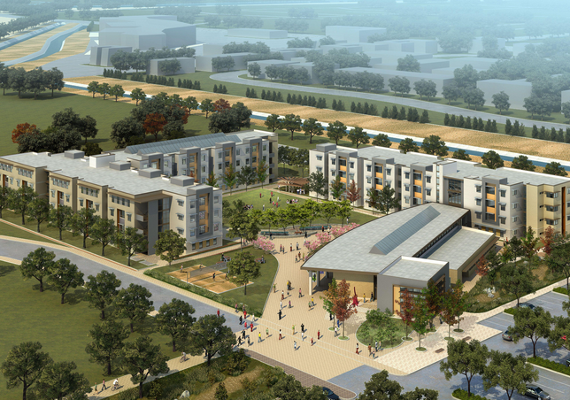
Teaching OM-SCM Analytical Formulas by Structuring a Basic Simulation Model in a Class of Business Analytics Foundations
CSUPOM 2023
Ardavan Asef-Vaziri
Systems and Operations Management, California State University, Northridge

Slide 2
AACSB Accredited Business (and Accounting-Business) Schools
42%

Slide 3
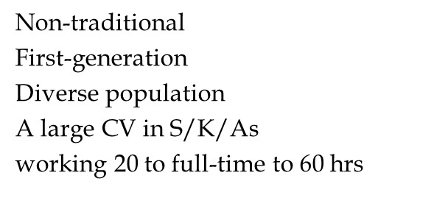
Flow of Students in an Undergraduate Program in a SFTFBS*

Slide 4
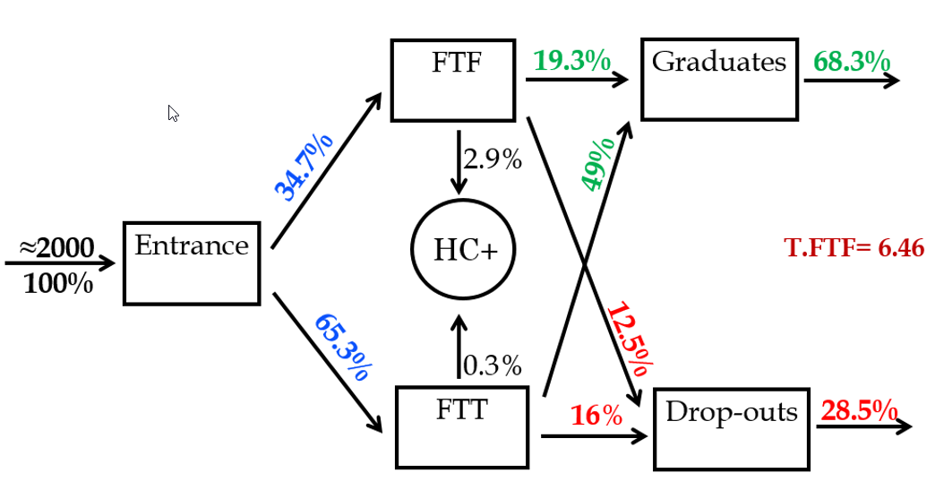
Flow of Students in an Undergraduate Program in a SFTFBS*

Slide 5
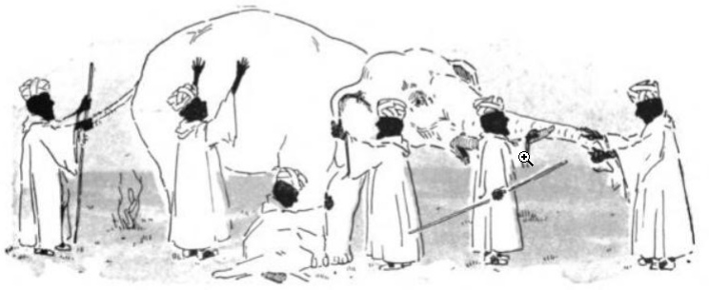
Systems Approach
Performance of subsystems to be linked to the performance of the total system

Slide 6
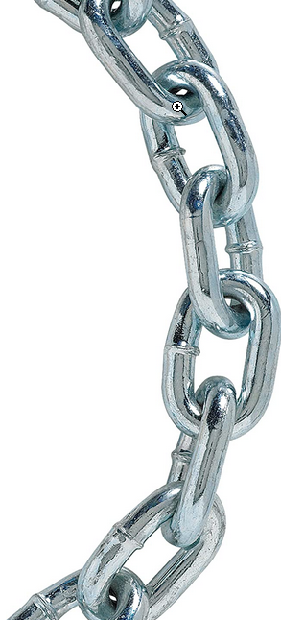
Theory of Constraints (TOC)
A Chain is As Strong As Its Weakest Link
Text Books
Course Material
Course Delivery System
Professors
Exploit the System’s Binding Constraint
Subordinate Everything Else to the Binding Constraint
Elevate the System’s Constraints

Slide 7
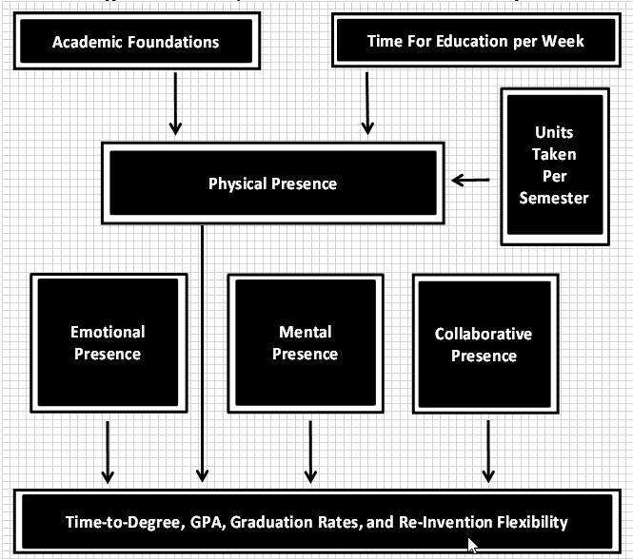
For Dimensions of Student Presence

Slide 8
A Premise
Skills learned in this course will be of great use no matter what path you choose to follow. The objective of the course is to enable the students to provide quantitative pictures of verbal or written explanations by differentiating relevant and non-relevant parts, ignoring the non-relevant parts, explaining the quantitative relationship between the relevant parts, developing appropriate models, and providing results to facilitate the decision-making process.
Tabular and schematic representations, spreadsheet functions, formulas, and models are the basic components of a quantitative picture.
Excel is fully embedded in this course. Excel - and only Excel- No R, No Python, No Visual Basic, etc.
The skills you will develop in learning Excel functions and formulas and the knowledge you will gain in developing spreadsheet modeling will improve your analytical capabilities and position you in a better place in the job market.

Slide 9
A Premise
(i) Excel, (ii) Project Management, and (iii) Communications skills are the top three skills that employees are looking for in Business School graduates.
While this course will not play a role in improving your (ii) communication skills - if know it only as writing and speaking- you will learn higher layers of communication, including Tabular representation, Schematic Representation, and Quantitative Representation. These three types of representations could profoundly enhance students’ communication skills.
We will benefit from Excel Visualization tools such as Excel Charts and Maps and 3D maps. We also do a little on (iii) Project management in this course.
I hope the material I have put together motivates you to have Physical Presence, Mental Presence, and Collaborative Presence in this course throughout the semester.

Slide 10
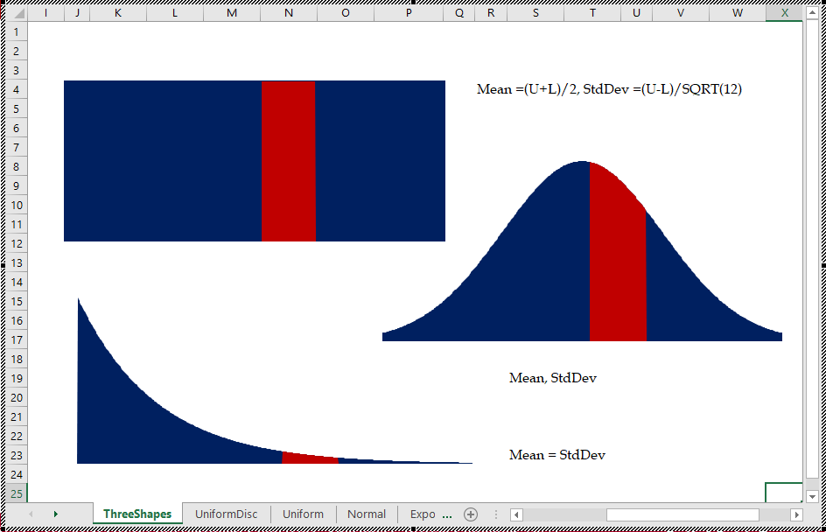
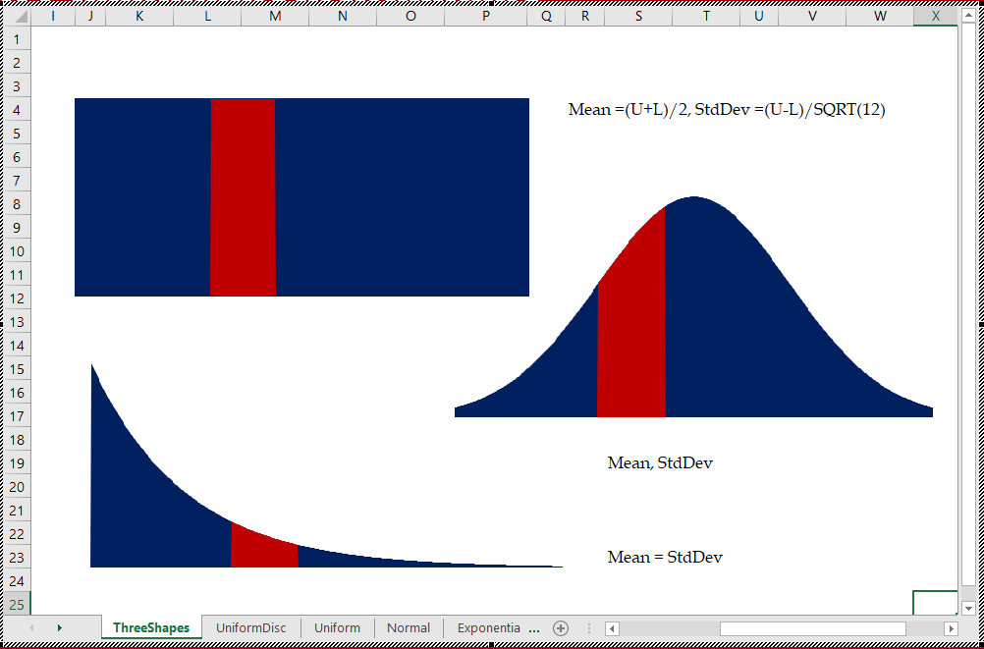
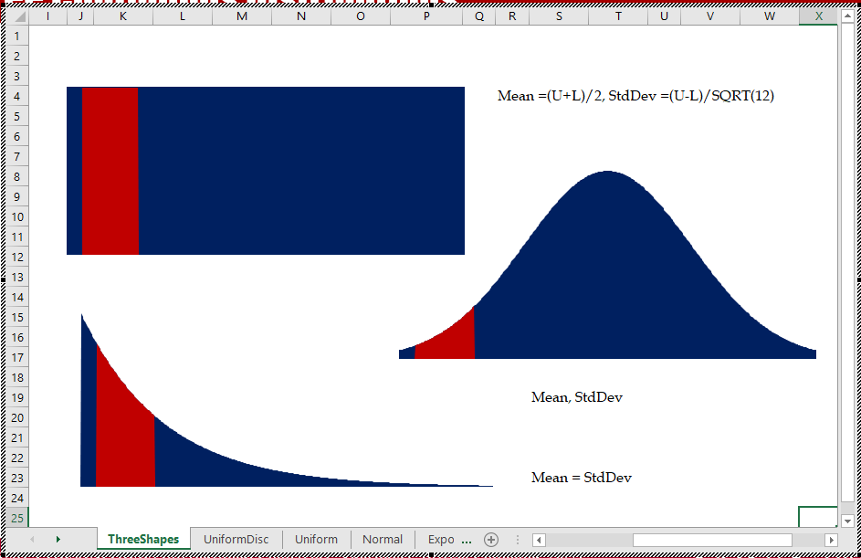
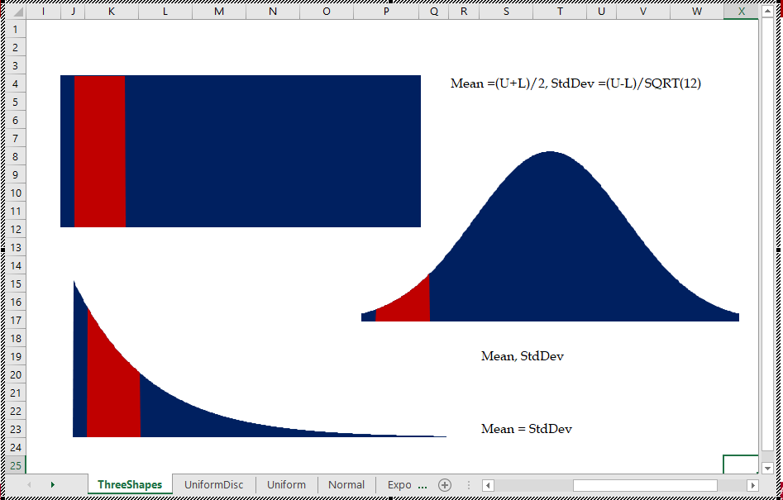
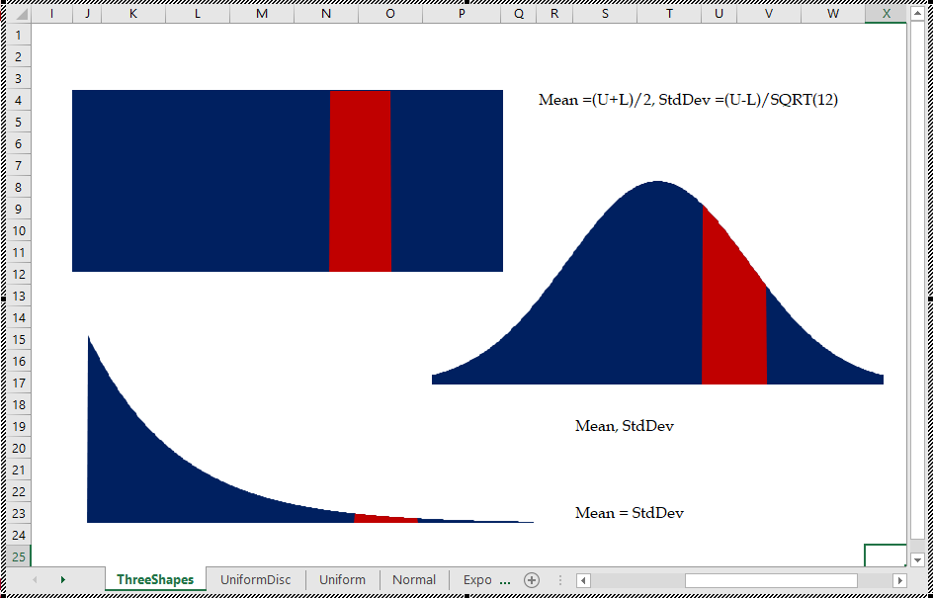
Three Well-Known Probability Distributions
U ~ (l,u)
Mean=(l+u)/2, StdDev=(u-l)/SQRT(12)
N ~ (Mean, StdDev)
E ~ (Mean)

Slide 11
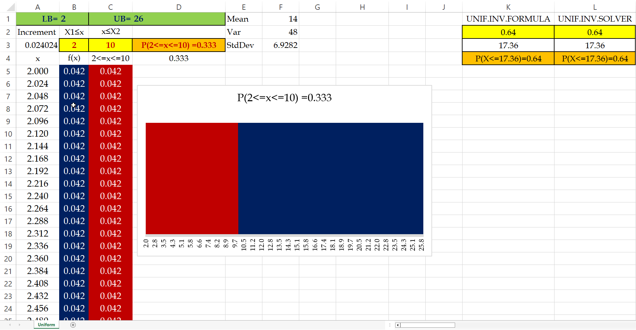
Uniform Distribution

Slide 12
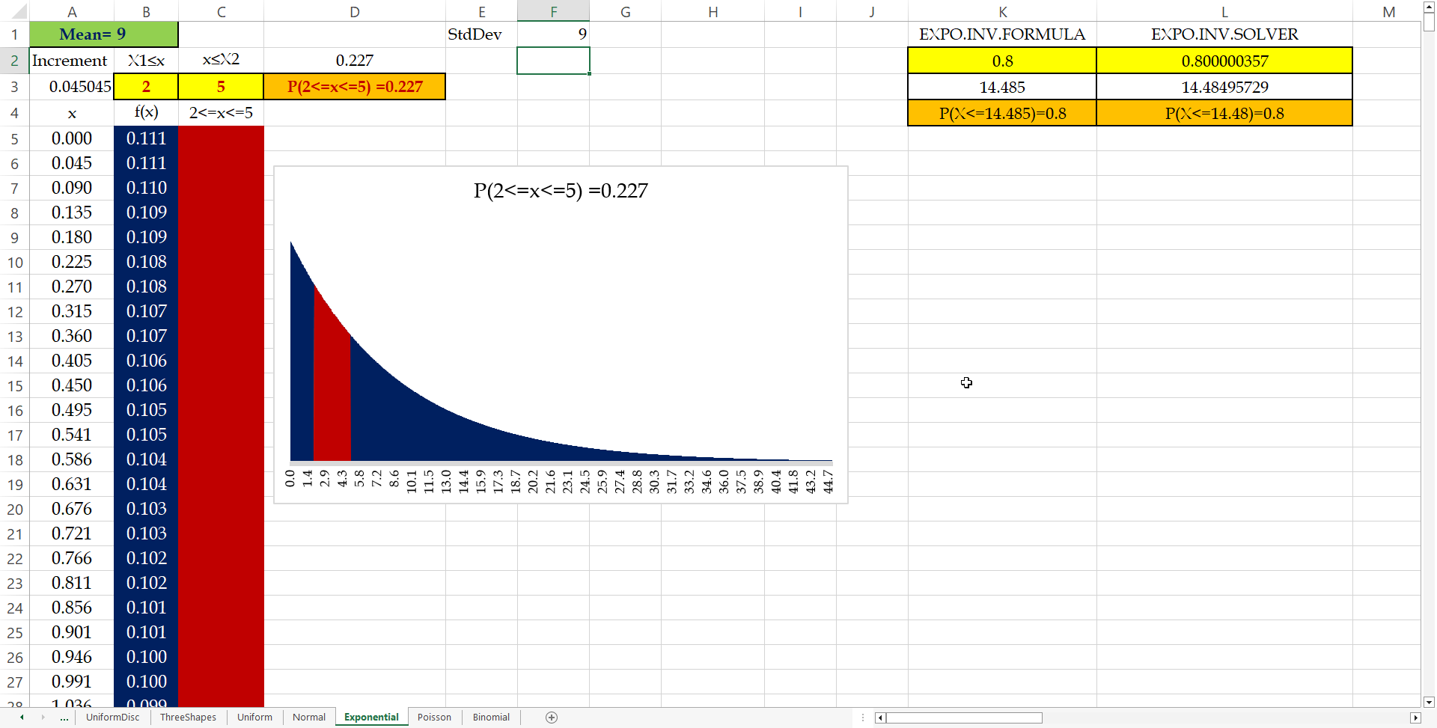
Exponential Distribution

Slide 13
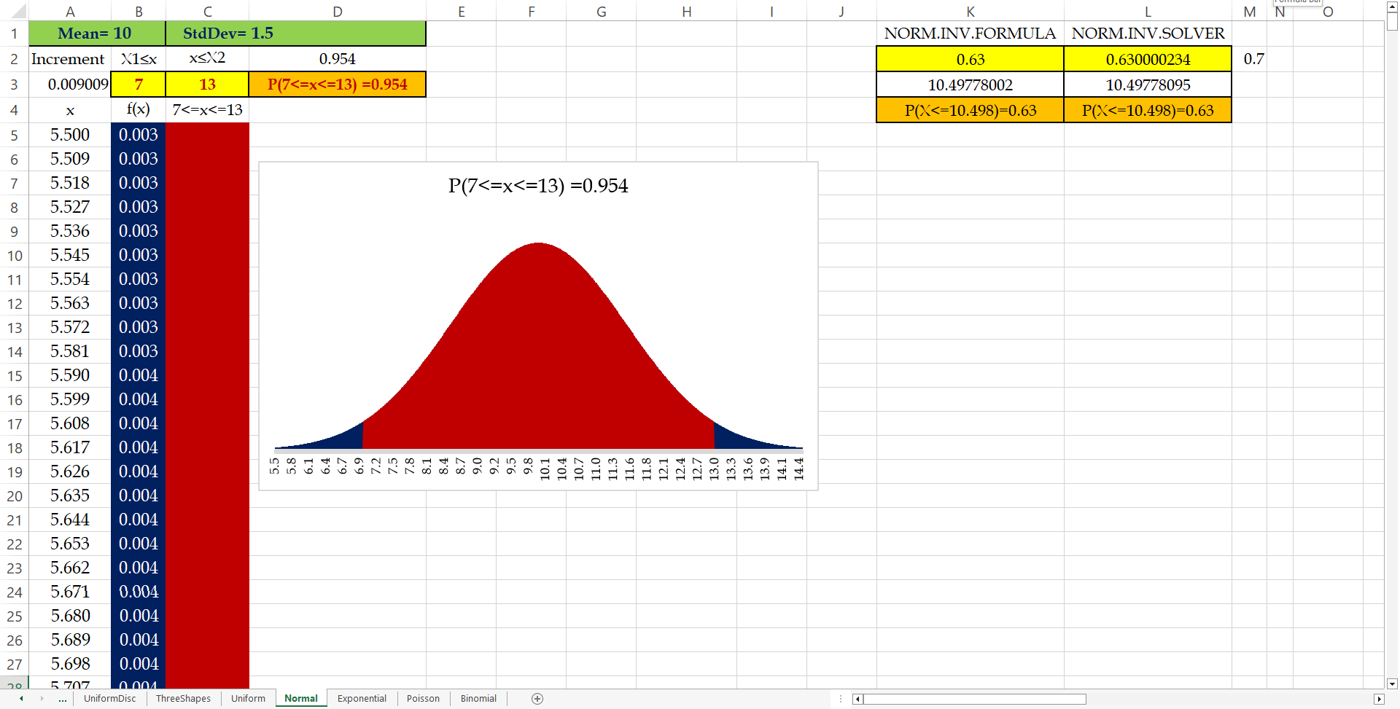
Normal Distribution

Slide 14
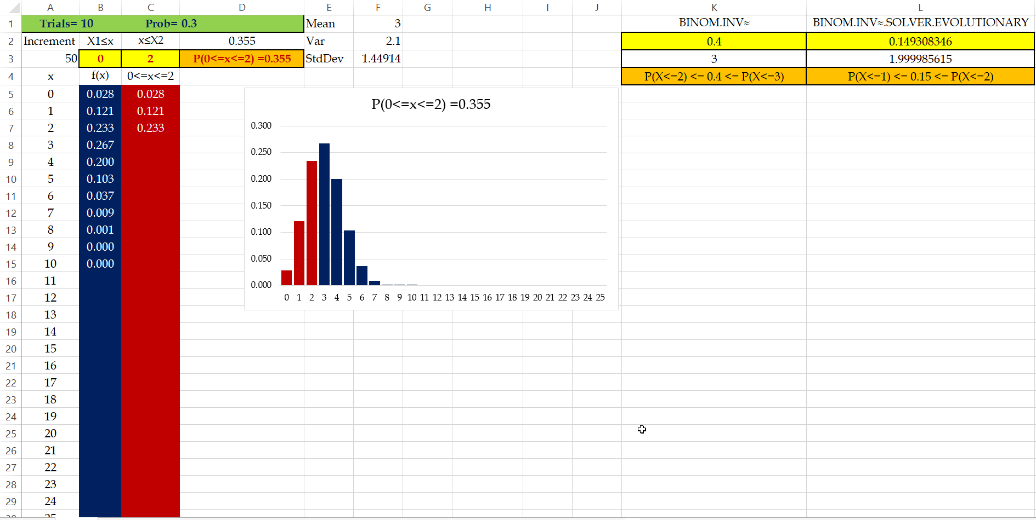
Binomial Distribution

Slide 15
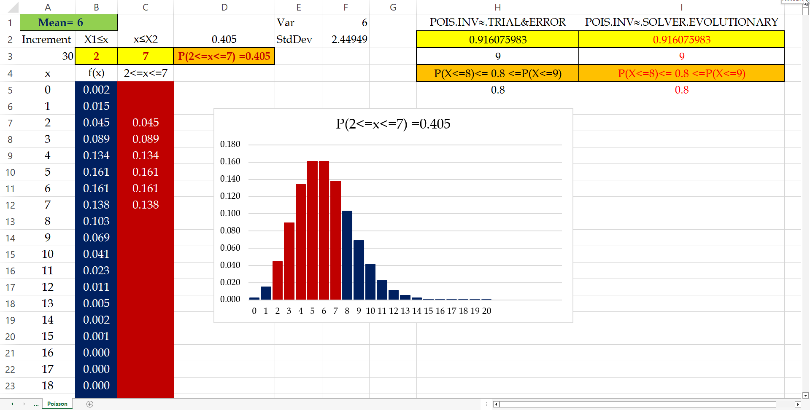
Poisson Distribution

Slide 16
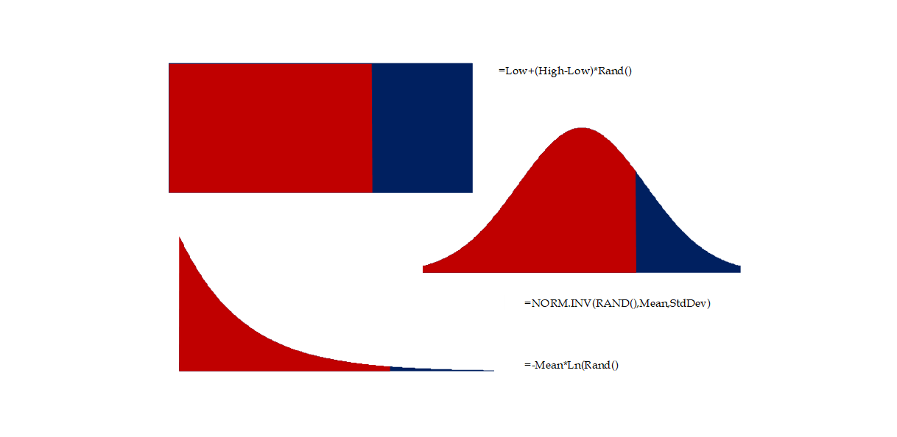
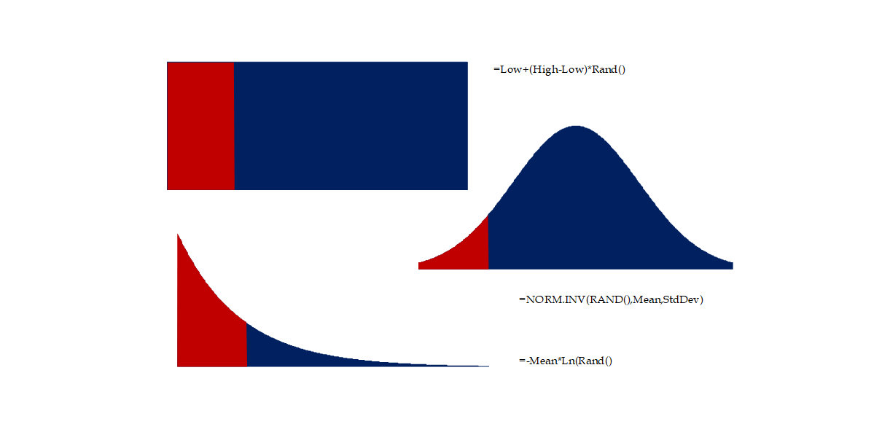

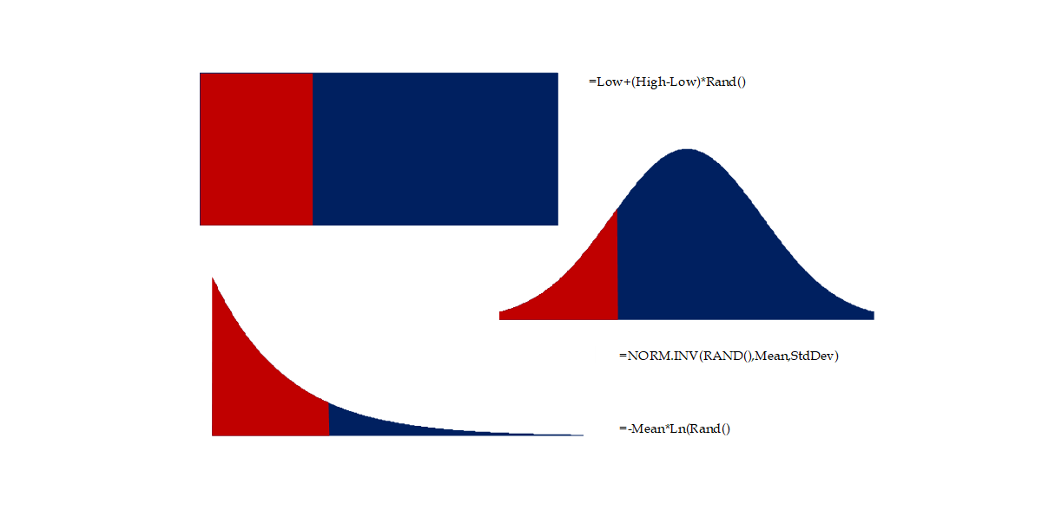
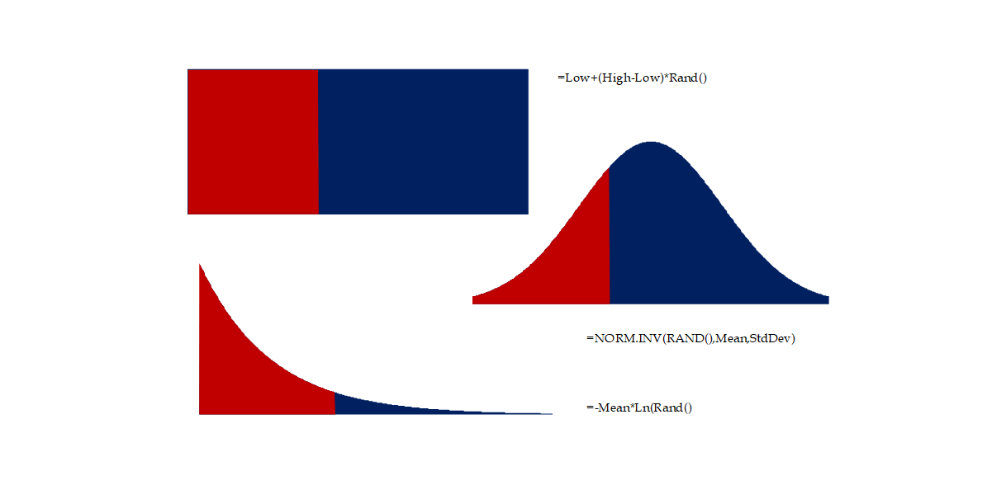
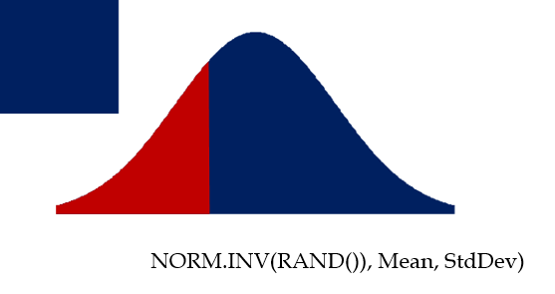
Random Number Generation
U=l+(u-l)*Rand()
NORM.INV(RAND()), Mean, StdDev)
-Mean*Ln(Rand())

Slide 17
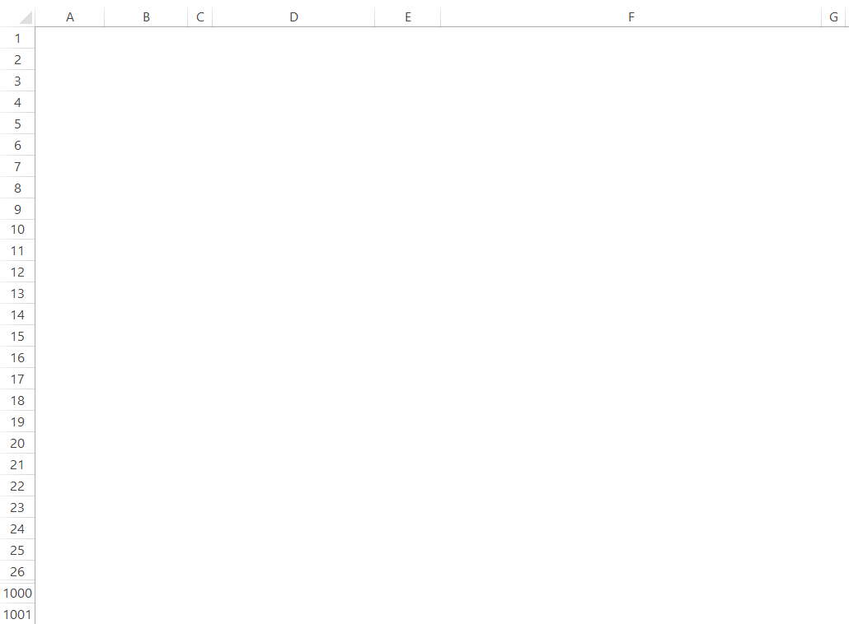
Random Number Generation

Slide 18
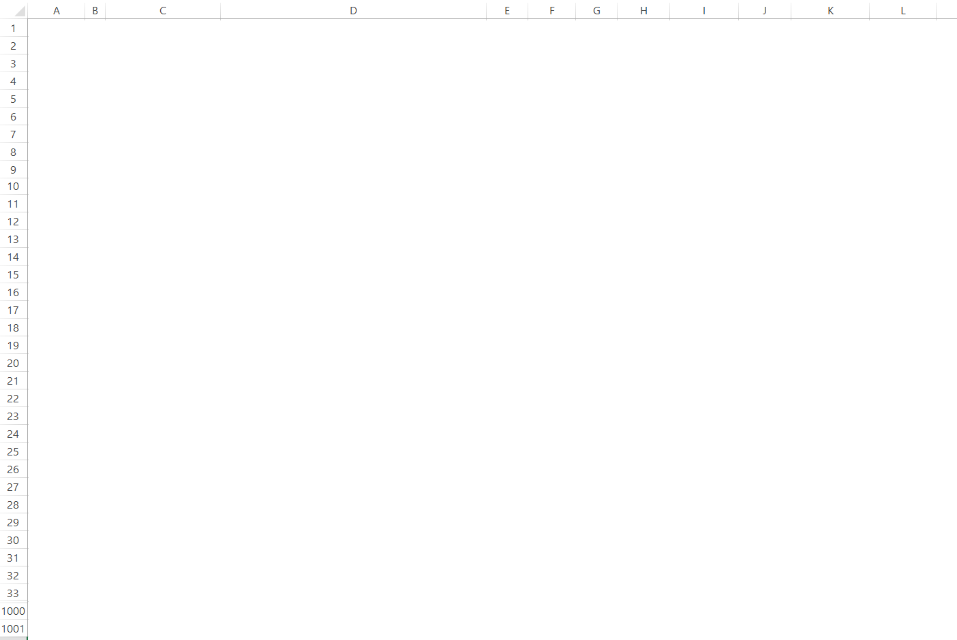
Theoretical vs Experimental Distributions

Slide 19
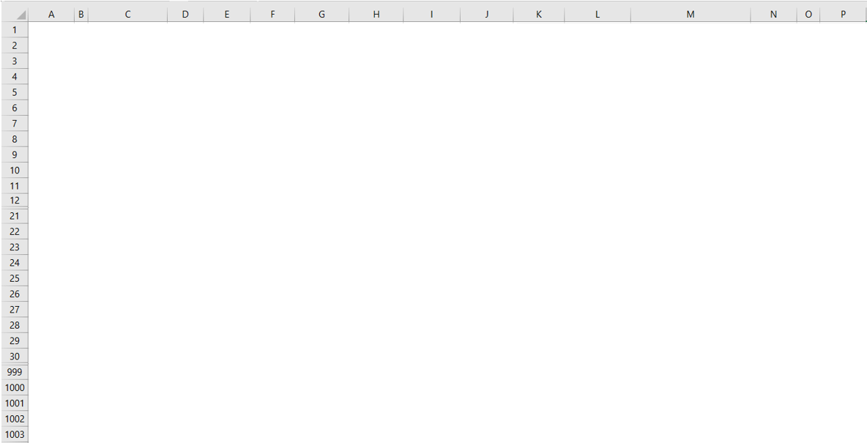
Simulation Based Distribution Function (Empirical pdf)
Blank after F(x) =1

Slide 20
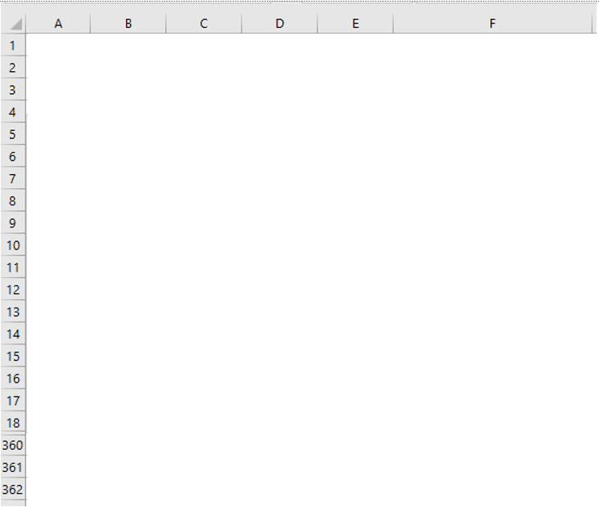
Theoretical Normal Graphs and Impact of Standard Deviation
NORM.DIST(x,μ,σ,1) = NORM.DIST((x-μ)/σ,0,1,1)
NORM.DIST(x,μ,σ,1) = NORM.S.DIST((x-μ)/σ, 1)
NORM.DIST(x,μ,σ,0) ≠ NORM.DIST((x-μ)/σ,0,1,0)
NORM.DIST(x,μ,σ,0) ≠ NORM.S.DIST((x-μ)/σ, 0)

Slide 21
Demand of N~(100,25), How Much Inventory Is Needed to Sell 100 Units
=qNORM.S.DIS((q-μ)/σ,1)+Q(1-NORM. S.DIS((Q-μ)/σ,1))
+μ(NORM.S.DIS((Q-μ/σ),1)-NORM.S.DIS((q-μ)/σ,1))
-σ(NORM.S.DIS ((Q-μ)/σ,0)-NORM.S.DIS ((q-μ)/σ,0))
=q*NORM.DIS(q,μ,σ,1)+Q*(1-NORM.DIS(Q,μ,σ,1))
+μ(NORM.DIS(Q,μ,σ,1)-NORM.DIS(q,μ,σ,1))
-(σ^2)(NORM.DIS (Q,μ,σ,0)-NORM.DIS (q,μ,σ,0))
NORM.S.DIST((x-μ)/σ,0)
NORM.DIST(x,μ,σ,0)

Slide 22
How Much Inventory to Sell The Average Demand
=MAX(0,A2-$E$13)
=IF(A2>$E$13, A2-$E$13,0)
DataTable
Lost Sales vs Quantity Ordered

Slide 23
If, Overlap, NA(), White Font, Conditional Formatting to Black
White fonts
NA() when exceed
Conditional formatting turn white to black for non-NA()

Slide 24

Demand, Lost Sales, Sales, Service Level, Fill Rate, Over Stock

Slide 25
Lost Sales, Underage Cost, Overstock, Overage Cost

Slide 26
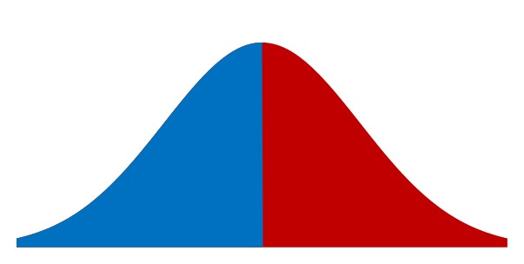
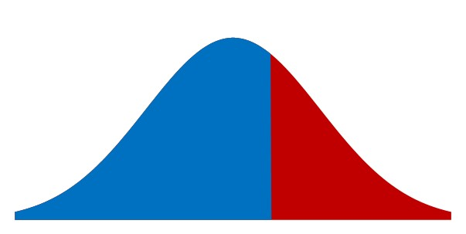
Cu vs Co Balance of Power
p =$100, c=$40, v=$0
Cu = 80-40 = 40
Co =40-0= 40
SL* = Cu/(Cu+Co)
SL*=40/(40+40)=0.5
40
40
SL* = Cu/(Cu+Co)
SL*=40/(40+20)=0.667
p =$80, c=$40, v=$20
p =$80, c=$40, v=$0
Cu = 80-40 = 40
Co =40-20= 20
20
40

Slide 27
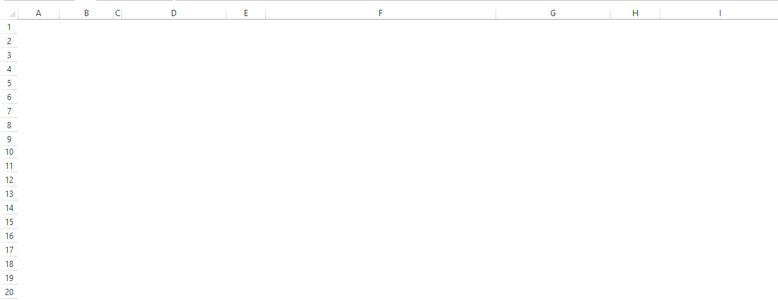
Value of Information- Maximum to Spend on Forecasting Improvement

Slide 28
Value of Collaboration- Maximum Expected Value of Supply Chain Profit

Slide 29
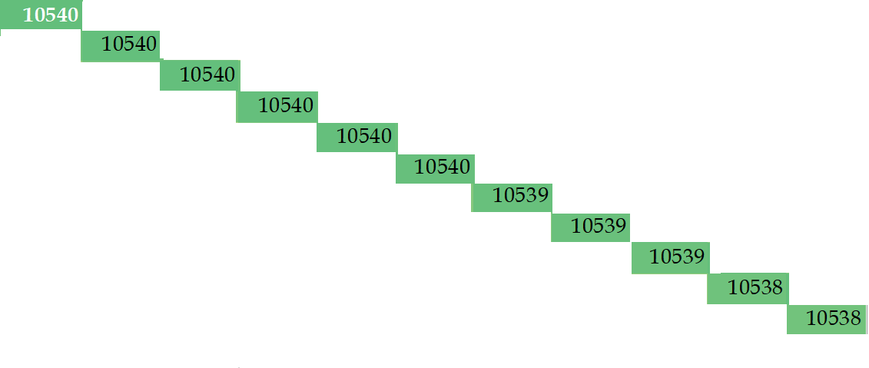
Data Table – Trade at Manufacturer’s Cost to Max SC Profit
v
c

Slide 30
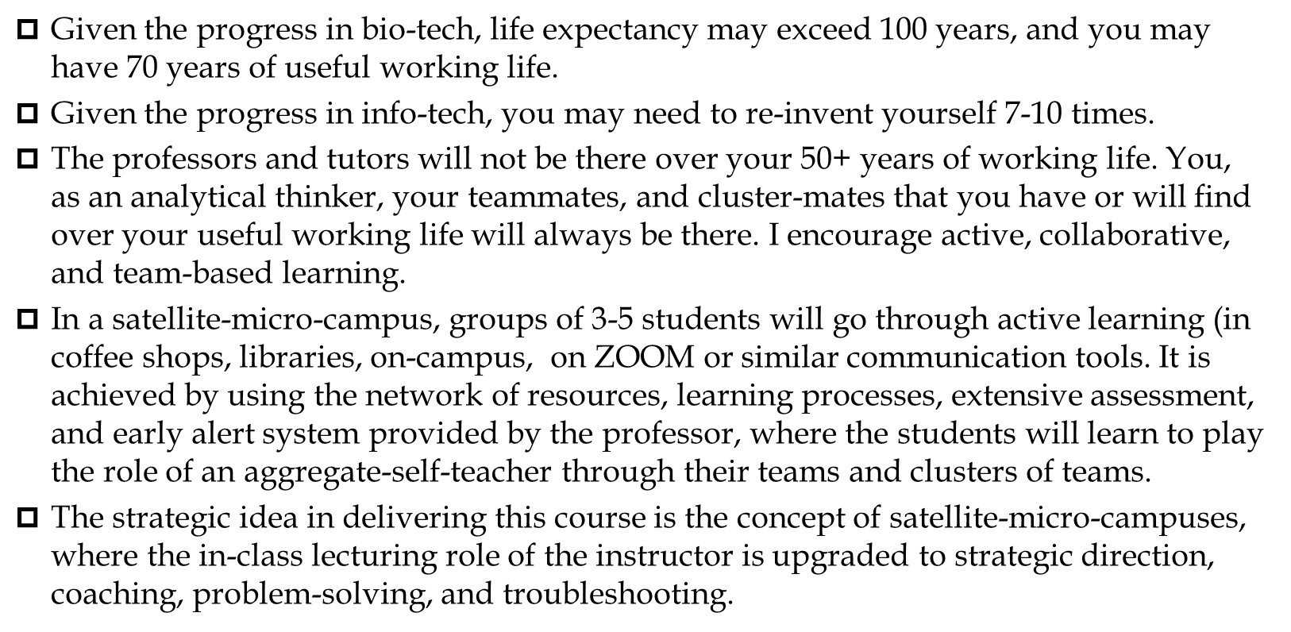
A Premise
Given the progress in bio-tech, life expectancy may exceed 100 years, and you may have 70 years of useful working life.
Given the progress in info-tech, you may need to re-invent yourself 7-10 times.
The professors and tutors will not be there over your 50+ years of working life. You, as an analytical thinker, your teammates, and cluster-mates that you have or will find over your useful working life will always be there. I encourage active, collaborative, and team-based learning.
In a satellite-micro-campus, groups of 3-5 students will go through active learning (in coffee shops, libraries, on-campus, on ZOOM or similar communication tools. It is achieved by using the network of resources, learning processes, extensive assessment, and early alert system provided by the professor, where the students will learn to play the role of an aggregate-self-teacher through their teams and clusters of teams.
The strategic idea in delivering this course is the concept of satellite-micro-campuses, where the in-class lecturing role of the instructor is upgraded to strategic direction, coaching, problem-solving, and troubleshooting.

Slide 31
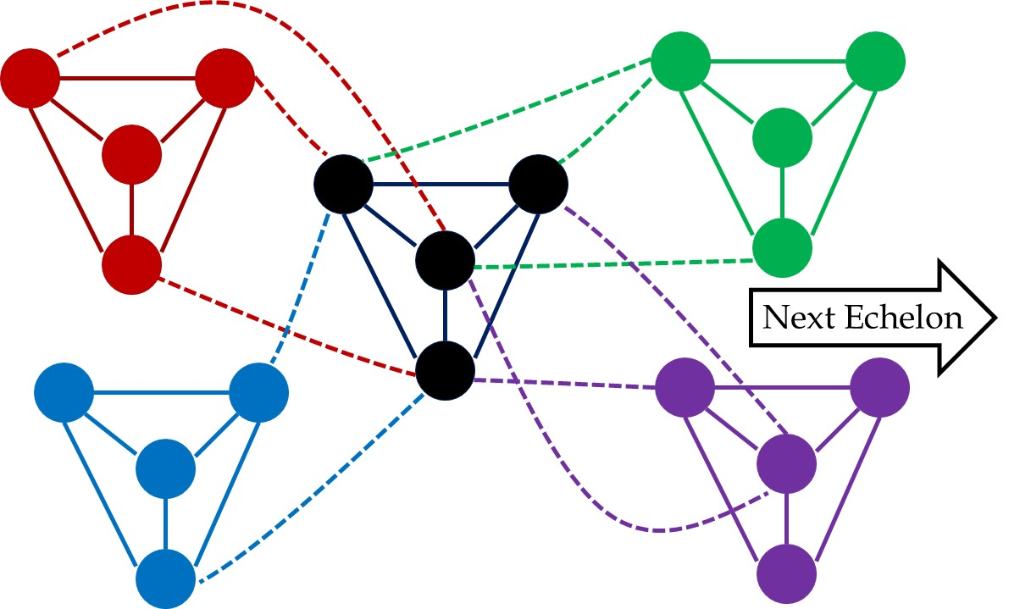
Teams and Clusters- In this Course and …

Slide 32
Teams and Clusters- In this Course and …

Slide 33
A Premise
Given the progress in bio-tech, life expectancy may exceed 100 years, and you may have 70 years of useful working life. Given the progress in info-tech, you may need to re-invent yourself 7-10 times.
I hope the material I have put together motivates you to have Physical Presence, Mental Presence, and Collaborative Presence in this course throughout the semester.
The professors and tutors will not be there over your 50+ years of working life. You, as an analytical thinker, your teammates, and cluster-mates that you have or will find over your useful working life will always be there. I encourage active, collaborative, and team-based learning.
In a satellite-micro-campus, groups of 3-5 students will go through active learning (in coffee shops, libraries, on-campus, on ZOOM or similar communication tools. It is achieved by using the network of resources, learning processes, extensive assessment, and early alert system provided by the professor, where the students will learn to play the role of an aggregate-self-teacher through their teams and clusters of teams.

