Slide 1




Excel Simulation for the Newsvendor Problem and Collaboration Between Supplier and Retailer
Ardavan Asef-Vaziri
Systems and Operations Management, California State University, Northridge

Slide 2
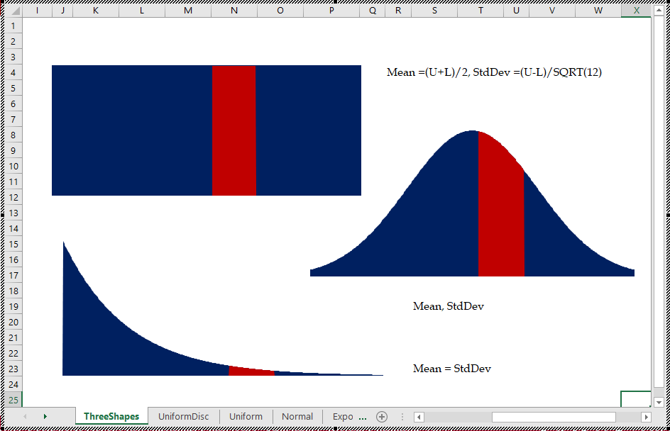
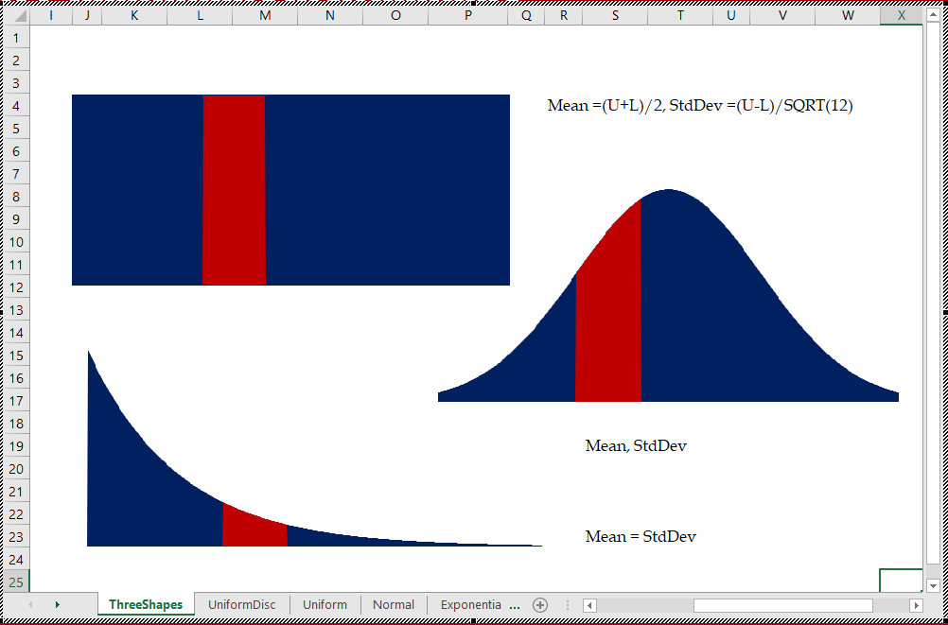
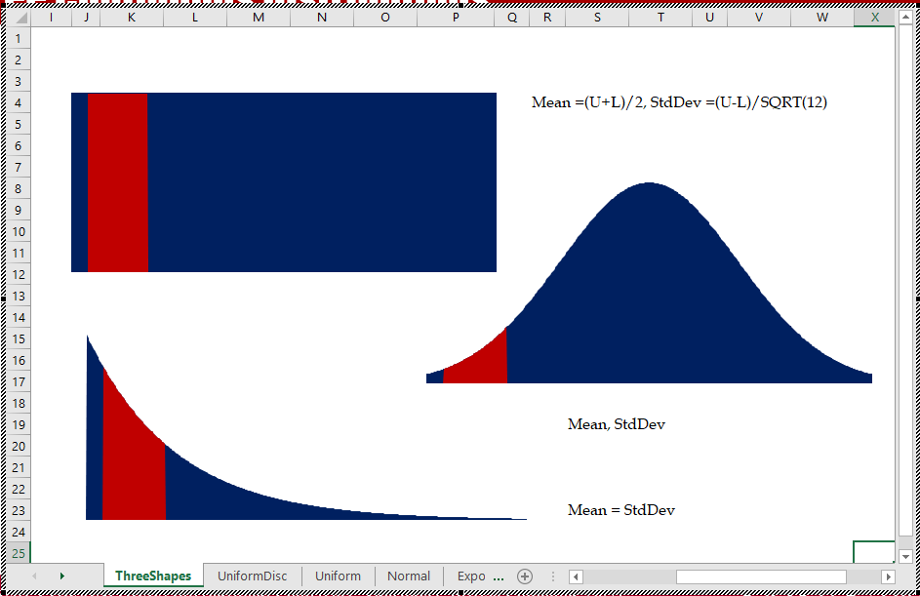
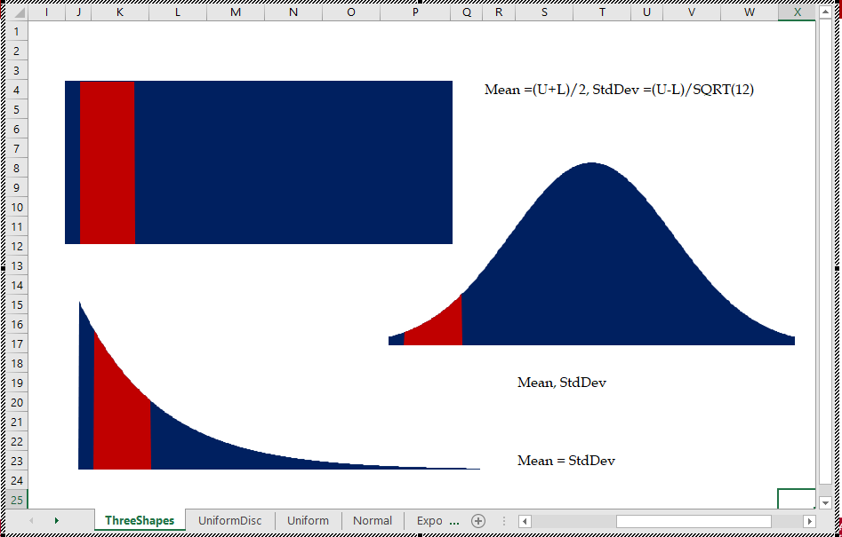
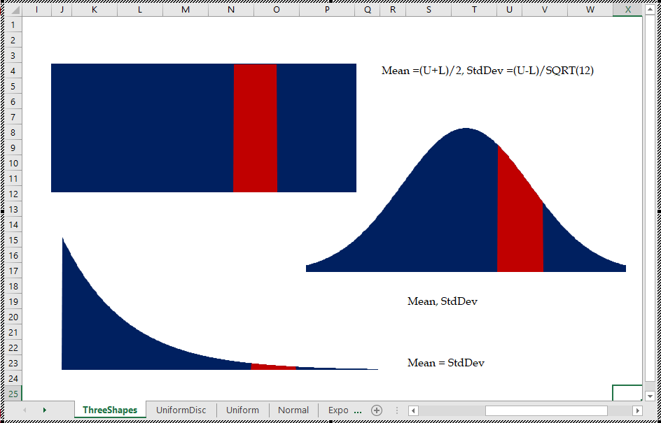
Three Well-Known Probability Distributions
U ~ (l,u)
Mean=(l+u)/2, StdDev=(u-l)/SQRT(12)
N ~ (Mean, StdDev)
E ~ (Mean)

Slide 3





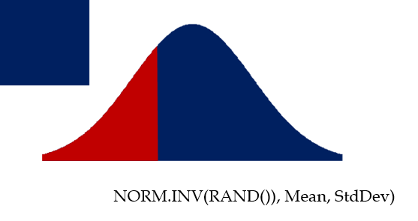
Random Number Generation
U=l+(u-l)*Rand()
NORM.INV(RAND()), Mean, StdDev)
-Mean*Ln(Rand())

Slide 4
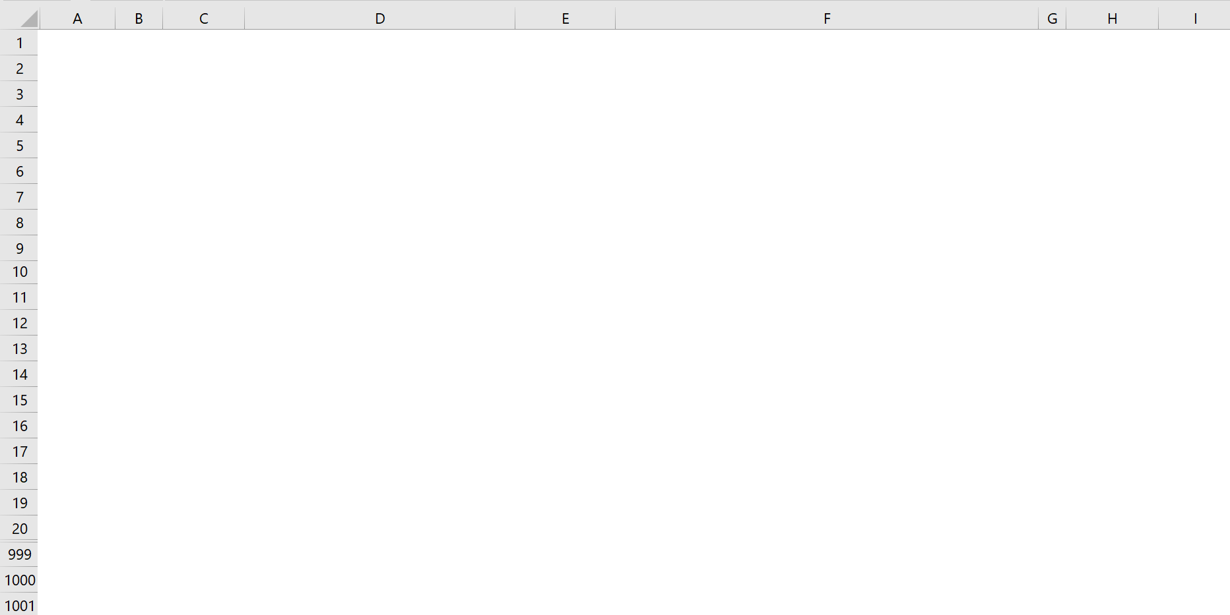
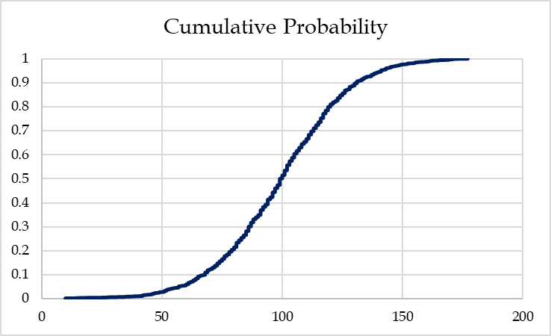
Random Number Generation

Slide 5

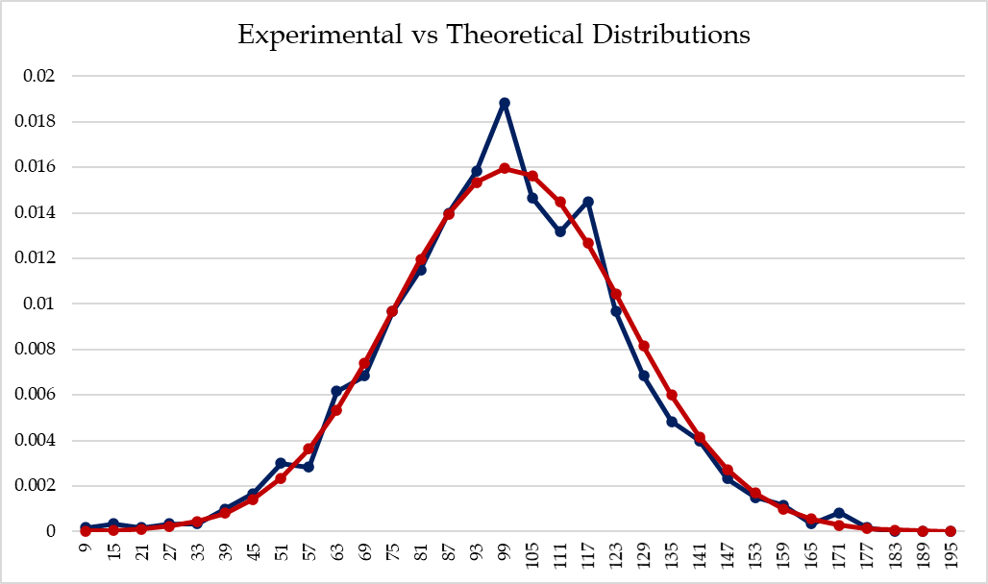
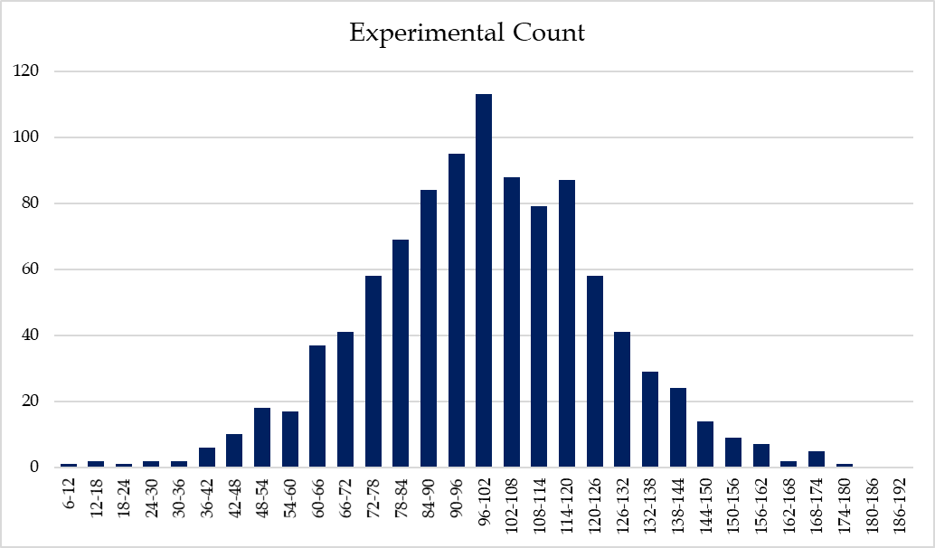
Theoretical vs Experimental Distributions
Blank after F(x) =1

Slide 6
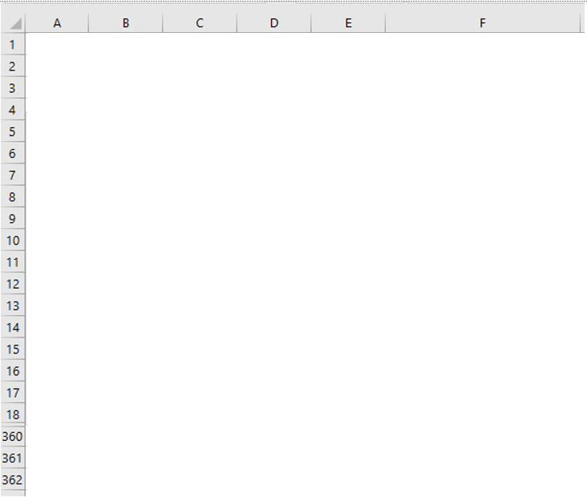
Theoretical Normal Graphs and Impact of Standard Deviation
NORM.DIST(x,μ,σ,1) = NORM.DIST((x-μ)/σ,0,1,1)
NORM.DIST(x,μ,σ,1) = NORM.S.DIST((x-μ)/σ, 1)
NORM.DIST(x,μ,σ,0) ≠ NORM.DIST((x-μ)/σ,0,1,0)
NORM.DIST(x,μ,σ,0) ≠ NORM.S.DIST((x-μ)/σ, 0)

Slide 7
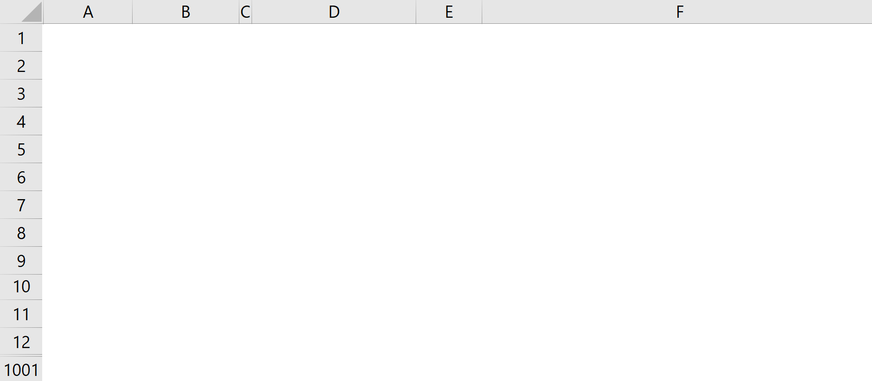

Under Stock, Average Sales, Over Stock, Fill Rate, Service Level
=MAX(0,A2-$E$12)
=IF(A2>$E$12, A2-$E$12,0)

Slide 8
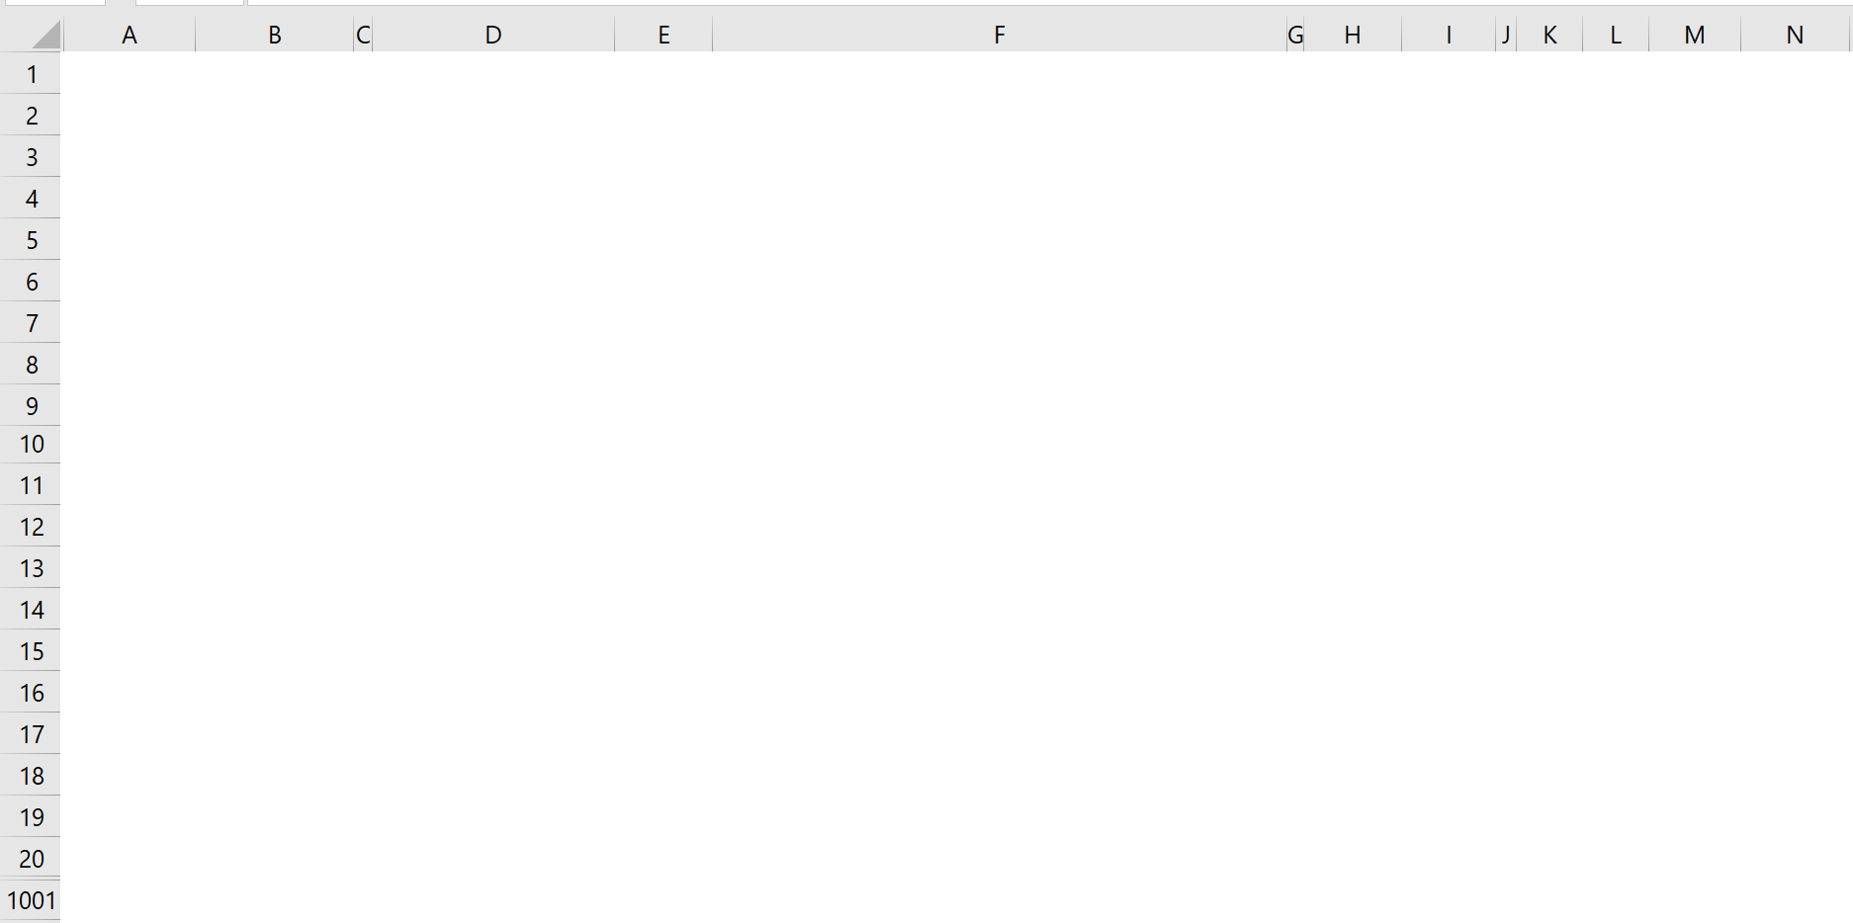
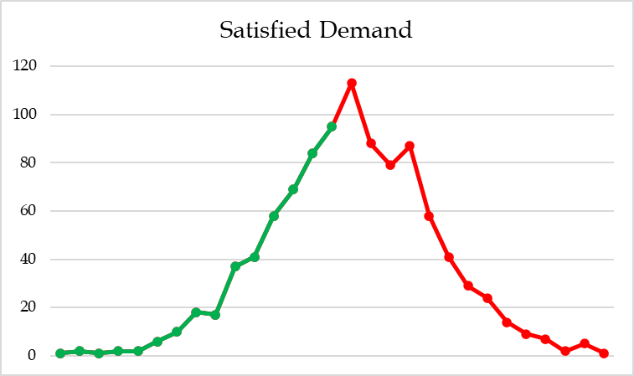
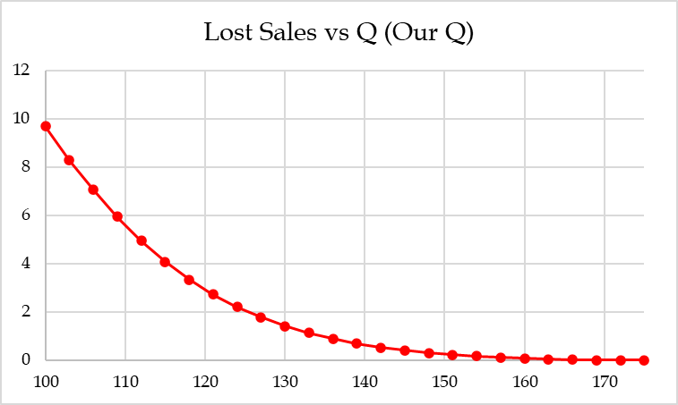
Visual Representation, Data Table Graph, and Histogram
DataTable
Lost Sales vs Quantity Ordered

Slide 9
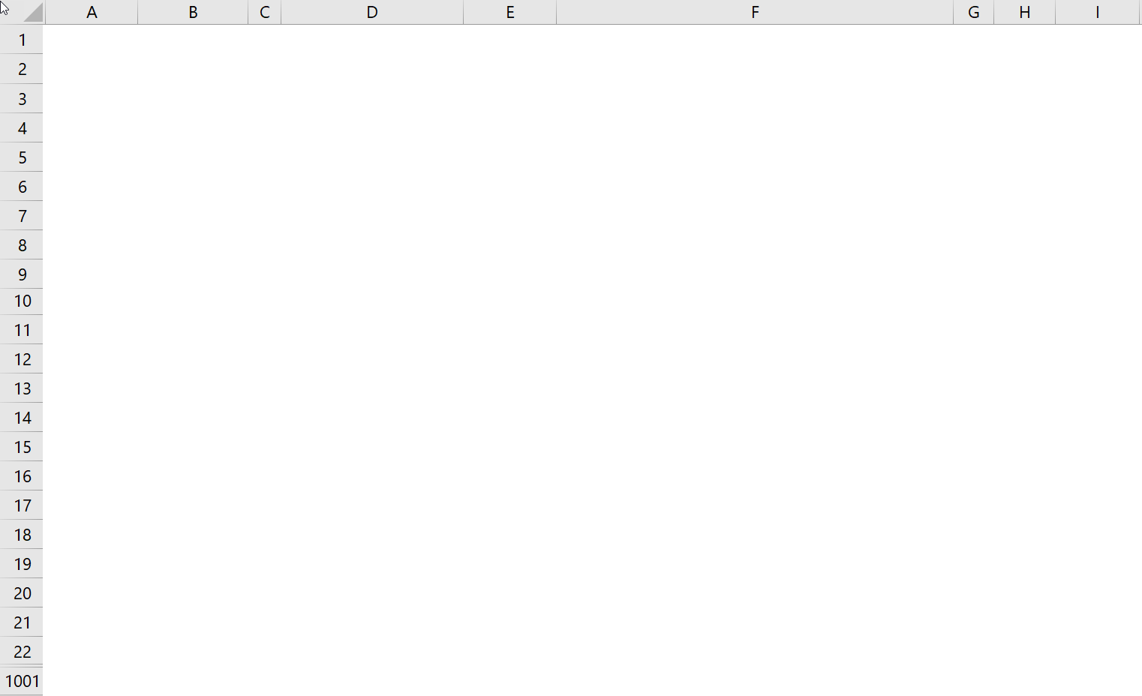
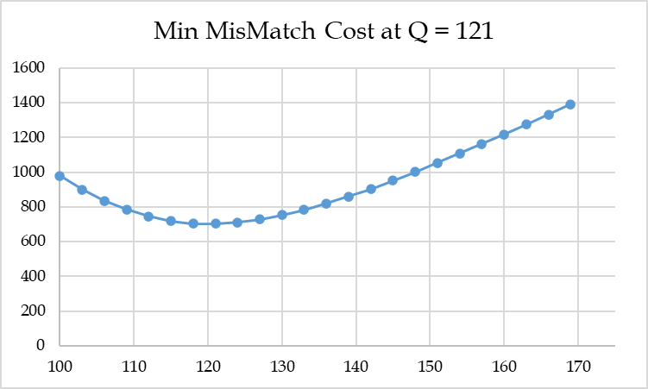
What Q to Order To Minimize Overage+Underage Cost; Mismatch Cost
DataTable
Over+Under Costs vs Quantity Ordered

Slide 10
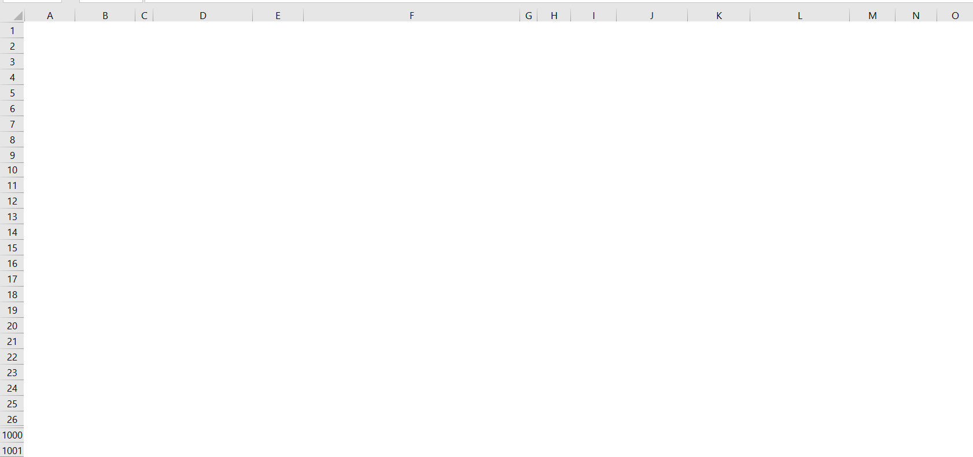
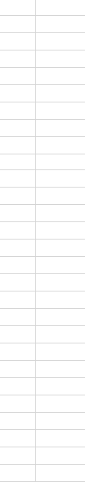
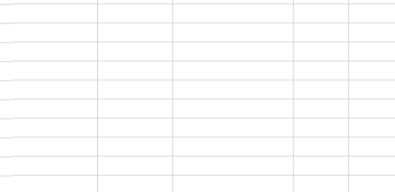
What Q to Maximize Profit
DataTable: Retailer Profit vs Quantity Ordered

Slide 11
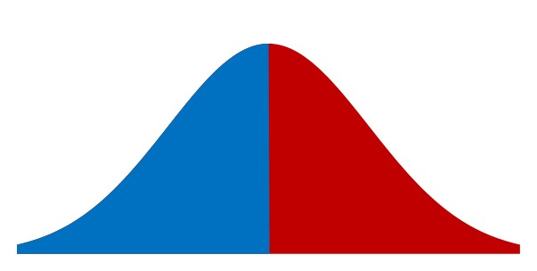
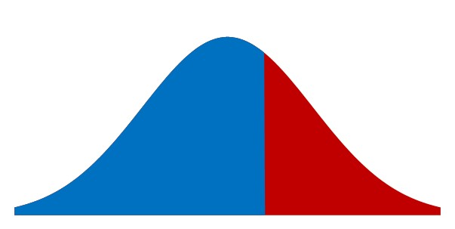
Cu vs Co Balance of Power
p =$100, c=$40, v=$0
Cu = 80-40 = 40
Co =40-0= 40
SL* = Cu/(Cu+Co)
SL*=40/(40+40)=0.5
40
40
SL* = Cu/(Cu+Co)
SL*=40/(40+20)=0.667
p =$80, c=$40, v=$20
p =$80, c=$40, v=$0
Cu = 80-40 = 40
Co =40-20= 20
20
40

Slide 12

What Q to Maximize Profit – Theoretical SL*, ROP, Lost Sales
AveDem-Theo
100
Given
StdDevDem-Theo
25
Given
p
120
Given
c
40
Given
v
20
Given
cMFG
10
Given
Cu
80
=B3-B4
Co
20
=B4-B5
SL*-Analytical
0.80
=B7/(B7+B8)
Q*-Analytical
122
=ROUNDUP(NORMINV(B9,B1,B2),0)
Lost Sales - Theoretical
=σ^2*NORM.DIST(Q,μ,σ,0)-(Q-μ)*(1-NORM.DIST(Q,μ, σ,1))
Lost Sales - Theoretical
2.60
=B2^2*NORM.DIST(B10,B1,B2,0)-(B10-B1)*(1-NORM.DIST(B10,B1,B2,1))
Sales
97.4
=B1-B12
Overstock
24.60
=B10-B13
Fill Rate
97.4%
=B13/B1
Retailer's Revenue
12179.59
=B3*B13+B14*B5
Retailer's Cost
4880
=B10*B4
Retailer's Profit
7299.585
=B16-B17
Retailer's Profit
7299.585
=B13*B7-B14*B8
Supplier Revenue
4880
=B10*B4
Supplier Production Cost
1220
=B6*B10
Supplier Return Cost
492.08
=B14*B5
Supplier Profit
3167.92
=B20-B21-B22
Supply Chain Profit
10467.50
=B19+B23

Slide 13
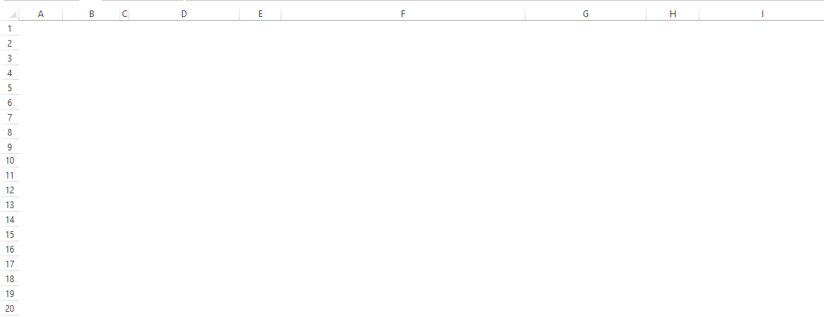
Value of Information- Maximum to Spend on Forecasting Improvement

Slide 14
Value of Collaboration- Maximum Expected Value of Supply Chain Profit

Slide 15
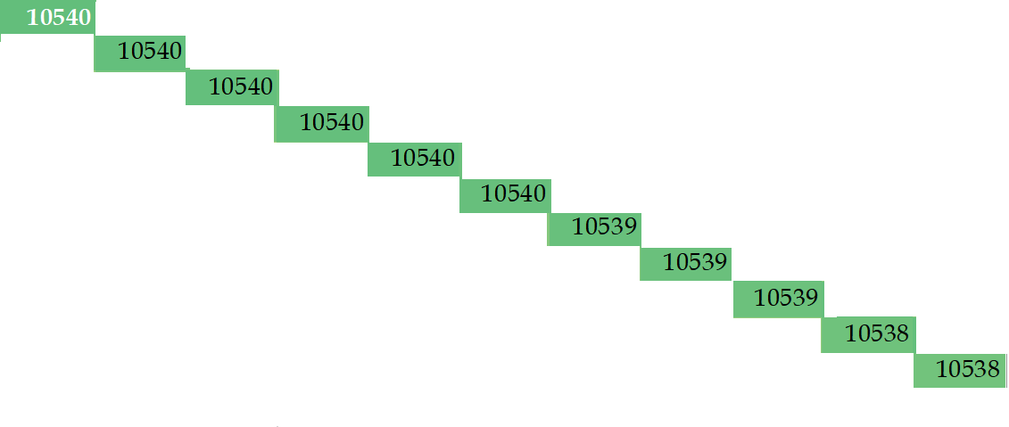
Data Table – Trade at Manufacturer’s Cost to Max SC Profit
v
c

Slide 16
Analytical Solution Got Easy
Demand Distrinutions N~(100,25)
p=120, c=40, v = 20 ➔ Cu=120-40=80, Co= 40-20 =20
SL*=Cu/Cu+Co= 80/(80+20)=0.8
Q* = NORM.INV(0.8,100,25)= 121.04=122
Lost Sales = σ^2*NORM.DIST(Q,μ,σ,0)-(Q- μ)*(1-NORM.DIST(Q,μ, σ,1))
Lost Sales = 25^2*NORM.DIST(122,100,25,0)-(122- 100)*(1-NORM.DIST(122,100, 25,1))
Lost Sales = 625*0.010834558872 -22*(1- 0.810570345 ) = 6.77-4.17 = 2.6
Sales = 100-2.6= 97.4
Over Stock = 122-97.4 = 24.6
Retailer Revenue = 97.4*120+24.6*20 = 12180
Retailer Cost = 122(40) =4880
Retailer Profit = 12180- 4880 =7300
Retailer Profit =97.4(80)-24.6(20) =7300
-

Slide 17
Value of Collaboration
Supplier Profit = 122(40-10)-24.6 (20)=3168
Supply Chain Profit = 3168+ 7300 = 10468
Compute Supply Chain Profit if c=10 and v=0
Cu=120-10=110, Co= 10-0 =10
SL*=110/(110+10) =0.916667
Q* = NORM.INV(0.916667 ,100,25)= 135.57=136
Lost Sales = 25²NORM.DIST(136,100,25,0)-(136- 100)*(1-NORM.DIST(136,100, 25,1))
Lost Sales = 625*0.005658 -36*(1-0.925066)
Lost Sales = 3.54-2.7 = 0.84
Sales = 100-0.84= 99.16
Over Stock = 136-99.16 = 36.84
Retailer Profit = 99.16(120-10)-36.84(10) =10539
Supplier Profit = 0 ➔ Supply Chain Profit = 10539+0 = 10539 – 10468 = 61
-

Slide 18
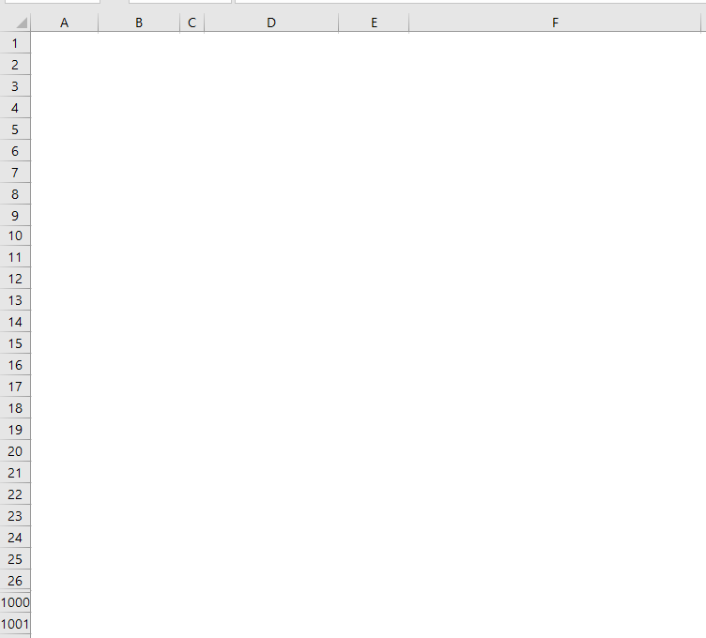
Supply Chain Profit

Slide 19
How Much Inventory to Maximize Profit

Slide 20

Simulation Based Distribution Function (Empirical pdf)
Blank after F(x) =1

Slide 21
Demand of N~(100,25), How Much Inventory Is Needed to Sell 100 Units
=qNORM.S.DIS((q-μ)/σ,1)+Q(1-NORM. S.DIS((Q-μ)/σ,1))
+μ(NORM.S.DIS((Q-μ/σ),1)-NORM.S.DIS((q-μ)/σ,1))
-σ(NORM.S.DIS ((Q-μ)/σ,0)-NORM.S.DIS ((q-μ)/σ,0))
=q*NORM.DIS(q,μ,σ,1)+Q*(1-NORM.DIS(Q,μ,σ,1))
+μ(NORM.DIS(Q,μ,σ,1)-NORM.DIS(q,μ,σ,1))
-(σ^2)(NORM.DIS (Q,μ,σ,0)-NORM.DIS (q,μ,σ,0))
NORM.S.DIST((x-μ)/σ,0)
NORM.DIST(x,μ,σ,0)

Slide 22
If, Overlap, NA(), White Font, Conditional Formatting to Black
White fonts
NA() when exceed
Conditional formatting turn white to black for non-NA()

