Slide 1
The Magnitude of Shortages (Out of Stock)

Slide 2
What are the Reasons?

Slide 3
Consumer Reaction

Slide 4
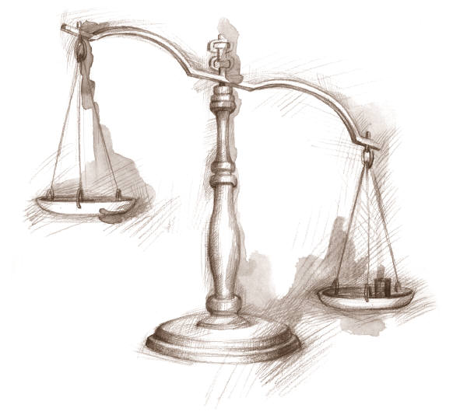
Optimal Service Level: The Newsvendor Problem
How do we choose what level of service a firm should offer?
Cost of ordering too much: holding cost, salvage
Cost of ordering too little: lost of sale, low service level
The decision maker balances the expected costs of ordering too much with the expected costs of ordering too little to determine the optimal order quantity.

Slide 5
News Vendor Model; Assimptions
  Demand is random
  Distribution of demand is known
  No initial inventory
  Set-up cost is zero
  Single period
  Zero lead time
  Linear costs
  Purchasing (production)
  Salvage value
  Revenue
  Goodwill

Slide 6
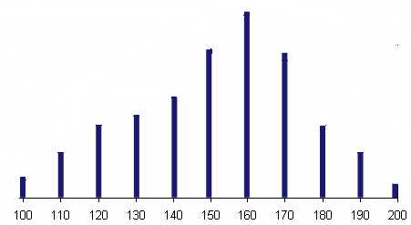
Optimal Service Level: The Newsvendor Problem
Cost =1800, Sales Price = 2500, Salvage Price = 1700
Underage Cost = 2500-1800 = 700, Overage Cost = 1800-1700 = 100
0.09
What is probability of demand to be equal to 130?
What is probability of demand to be less than or equal to 140?
What is probability of demand to be greater than or equal to 140?
What is probability of demand to be equal to 133?
0.35
0.02+0.05+0.08+0.09+0.11=
1-0.35+0.11=
0.76
0
P(R ≥ Q ) = 1-P(R ≤ Q)+P(R = Q)
R is quantity of demand
Q is the quantity ordered

Slide 7
Optimal Service Level: The Newsvendor Problem
0.005
What is probability of demand to be equal to 116?
What is probability of demand to be less than or equal to 116?
What is probability of demand to be greater than or equal to 116?
What is probability of demand to be equal to 113.3?
0.02+0.035 =
0.055
1-0.055+0.005 =
0.95
0

Slide 8
Optimal Service Level: The Newsvendor Problem
What is probability of demand to be equal to 130?
0
What is probability of demand to be less than or equal to 145?
0.02+0.05+0.08+0.09+0.11 =
0.35
What is probability of demand to be greater than or equal to 145?
1-0.35 =
0.65
P(R ≥ Q) = 1-P(R ≤ Q)

Slide 9
Compute the Average Demand
Average Demand =
+100×0.02 +110×0.05+120×0.08 +130×0.09+140×0.11 +150×0.16
+160×0.20 +170×0.15 +180×0.08 +190×0.05+200×0.01
Average Demand = 151.6
How many units should I have to sell 151.6 units (on average)?
How many units do I sell (on average) if I have 100 units?

Slide 10
Suppose I have ordered 140 Unities.
On average, how many of them are sold? In other words, what is the expected value of the number of sold units?
When I can sell all 140 units?
I can sell all 140 units if ➔ R ≥ 140
Prob(R ≥ 140) = 0.76
The expected number of units sold –for this part- is
(0.76)(140) = 106.4
Also, there is 0.02 probability that I sell 100 units➔ 2 units
Also, there is 0.05 probability that I sell 110 units➔5.5
Also, there is 0.08 probability that I sell 120 units➔ 9.6
Also, there is 0.09 probability that I sell 130 units➔ 11.7
106.4 + 2 + 5.5 + 9.6 + 11.7 = 135.2

Slide 11
Suppose I have ordered 140 Unities.
On average, how many of them are salvaged? In other words, what is the expected value of the number of salvaged units?
0.02 probability that I sell 100 units.
In that case 40 units are salvaged ➔ 0.02(40) = .8
0.05 probability to sell 110 ➔ 30 salvaged ➔ 0.05(30)= 1.5
0.08 probability to sell 120 ➔ 20 salvaged ➔ 0.08(20) = 1.6
0.09 probability to sell 130 ➔ 10 salvaged ➔ 0.09(10) =0.9
0.8 + 1.5 + 1.6 + 0.9 = 4.8
Total number Sold 135.2 @ 700 = 94640
Total number Salvaged 4.8 @ -100 = -480
Expected Profit = 94640 – 480 = 94,160

Slide 12
Cumulative Probabilities

Slide 13
Number of Units Sold, Salvages
Sold@700
Salvaged@-100

Slide 14
Total Revenue for Different Ordering Policies

Slide 15
Denim Wholesaler; Marginal Analysis
The demand for denim is:
  1000 with probability 0.10
  2000 with probability 0.15
  3000 with probability 0.15
  4000 with probability 0.20
  5000 with probability 0.15
  6000 with probability 0.15
  7000 with probability 0.10
Unit Revenue (p ) = 30
Unit purchase cost (c )= 10
Salvage value (v )= 5
Goodwill cost (g )= 0
How much should we order?

Slide 16
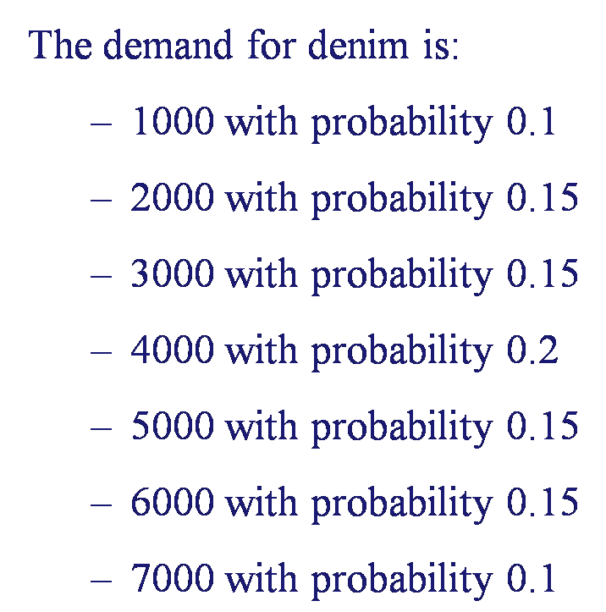
Marginal Analysis
Marginal analysis: What is the value of an additional unit ordered?
Suppose the wholesaler purchases 1000 units
What is the value of having the 1001st unit?
Marginal Cost: The retailer must salvage the additional unit and losses $5 (10 – 5).
P(R ≤ 1000) = 0.1
Expected Marginal Cost = 0.1(5) = 0.5

Slide 17
Marginal Analysis
Marginal Profit: The retailer makes and extra profit of $20 (30 – 10)
P(R > 1000) = 0.9
Expected Marginal Profit= 0.9(20) = 18
MP ≥ MC
Expected Value = 18-0.5 = 17.5
  By purchasing an additional unit, the expected profit increases by $17.5
The retailer should purchase at least 1,001 units.

Slide 18
Marginal Analysis
Should he purchase 1,002 units?
Marginal Cost: $5 salvage ➔ P(R ≤ 1001) = 0.1
Expected Marginal Cost = 0.5
Marginal Profit: $20 profit ➔ P(R >1002) = 0.9 ➔ 18
Expected Marginal Profit = 18
Expected Value = 18-0.5 = 17.5
Assuming that the initial purchasing quantity is between 1000 and 2000, then by purchasing an additional unit exactly the same savings will be achieved.
Conclusion:
Wholesaler should purchase at least 2000 units.

Slide 19
Marginal Analysis
Marginal analysis: What is the value of an additional unit ordered?
Suppose the retailer purchases 2000 units
What is the value of having the 2001st unit?
Marginal Cost: The retailer must salvage the additional unit and losses $5 (10 – 5).
P(R ≤ 2000) = 0.25
Expected Marginal Cost = 0.25(5) = 1.25

Slide 20
Marginal Analysis
Marginal Profit: The retailer makes and extra profit of $20 (30 – 10)
P(R > 2000) = 0.75
Expected Marginal Profit= 0.75(20) = 15
MP ≥ MC
Expected Value = 15-1.25 = 13.75
  By purchasing an additional unit, the expected profit increases by $13.75
The retailer should purchase at least 2,001 units.

Slide 21
Marginal Analysis
Should he purchase 2,002 units?
Marginal Cost: $5 salvage ➔ P(R ≤ 2001) = 0.25
Expected Marginal Cost = 1.25
Marginal Profit: $20 profit ➔ P(R >2002) = 0.75
Expected Marginal Profit = 15
Expected Value = 18-0.5 = 13.75
Assuming that the initial purchasing quantity is between 2000 and 3000, then by purchasing an additional unit exactly the same savings will be achieved.
Conclusion:
Wholesaler should purchase at least 3000 units.

Slide 22
Marginal Analysis
Why does the marginal value of an additional unit decrease, as the purchasing quantity increases?
  Expected cost of an additional unit increases
  Expected savings of an additional unit decreases

Slide 23
Marginal Analysis
What is the optimal purchasing quantity?
  Answer: Choose the quantity that makes marginal value: zero
Marginal value
17.5
13.75
10
5
1.3
Quantity
-2.5
1000
2000
3000
4000
5000
6000
7000
8000
-5

Slide 24
Analytical Solution for the Optimal Service Level
Marginal Profit:
Marginal Cost:
MP = p – c
MC = c - v
MP = 30 - 10 = 20
MC = 10-5 = 5
Suppose I have ordered Q units.
What is the expected cost of ordering one more units?
What is the expected benefit of ordering one more units?
If I have ordered one unit more than Q units, the probability of not selling that extra unit is the probability demand to be less than or equal to Q.
Since we have P( R ≤ Q).
The expected marginal cost =MC× P( R ≤ Q)

Slide 25
Analytical Solution for the Optimal Service Level
If I have ordered one unit more than Q units, the probability of selling that extra unit is the probability of demand to be greater than Q.
We know that P(R > Q) = 1- P(R ≤ Q).
The expected marginal benefit = MB× [1-Prob.( r ≤ Q)]
As long as expected marginal cost is less than expected marginal profit we buy the next unit.
We stop as soon as: Expected marginal cost ≥ Expected marginal profit.

Slide 26

Analytical Solution for the Optimal Service Level
MC×Prob(R ≤ Q*) ≥ MP× [1 – Prob( R ≤ Q*)]
Prob(R ≤ Q*) ≥
MP = p – c = Underage Cost = C_{u}
MC = c – v = Overage Cost = C_{o}

Slide 27
Marginal Value: The General Formula
P(R ≤ Q*) ≥ C_{u} / (C_{o}+C_{u})
C_{u} / (C_{o}+C_{u}) = (30-10)/[(10-5)+(30-10)] = 20/25 = 0.8
Order until P(R ≤ Q*) ≥ 0.8
P(R ≤ 5000) ≥ = 0.75 not > 0.8 still order
P(R ≤ 6000) ≥ = 0.9 > 0.8 Stop
In Continuous Model where demand for example has Uniform or Normal distribution

Slide 28
Type-1 Service Level
What is the meaning of the number 0.80?
80% of the time all the demand is satisfied.
  Probability {demand is smaller than Q} =
  Probability {No shortage} =
  Probability {All the demand is satisfied from stock} = 0.80

Slide 29
Marginal Value: Uniform distribution
Suppose instead of a discreet demand of
We have a continuous demand uniformly distributed between 1000 and 7000
1000
7000
Pr{r ≤ Q*} = 0.80
How do you find Q?

Slide 30
Marginal Value: Uniform distribution
Q-l = Q-1000
?
0.80
1/6000
l=1000
u=7000
u-l=6000
(Q-1000)/6000=0.80
Q = 5800

Slide 31
Marginal Value: Normal Distribution
Suppose the demand is normally distributed with a mean of 4000 and a standard deviation of 1000.
What is the optimal order quantity?
Notice: F(Q) = 0.80 is correct for all distributions.
We only need to find the right value of Q assuming the normal distribution.
P(z ≤ Z) = 0.8 ➔ Z= 0.842
Q = mean + z Standard Deviation ➔ 4000+841 = 4841

Slide 32
Marginal Value: Normal Distribution
Probability of
excess inventory
Probability of
shortage
4841
0.80
0.20
Given a service level, how do we calculate z?
From our normal table or
From Excel Normsinv(service level)

Slide 33
Additional Example
Your store is selling calendars, which cost you $6.00 and sell for $12.00 Data from previous years suggest that demand is well described by a normal distribution with mean value 60 and standard deviation 10. Calendars which remain unsold after January are returned to the publisher for a $2.00 "salvage" credit. There is only one opportunity to order the calendars. What is the right number of calendars to order?
MC= Overage Cost = C_{o} = Unit Cost – Salvage = 6 – 2 = 4
MB= Underage Cost = C_{u} = Selling Price – Unit Cost = 12 – 6 = 6

Slide 34
Additional Example - Solution
Look for P(x ≤ Z) = 0.6 in Standard Normal table or
for NORMSINV(0.6) in excel ➔ 0.2533
By convention, for the continuous demand distributions, the results are rounded to the closest integer.
Suppose the supplier would like to decrease the unit cost in order to have you increase your order quantity by 20%. What is the minimum decrease (in $) that the supplier has to offer.

Slide 35
Additional Example - Solution
Q^{new} = 1.2 * 63 = 75.6 ~ 76 units
Look for P(Z ≤ 1.6) = 0.6 in Standard Normal table
or for NORMSDIST(1.6) in excel ➔ 0.9452

Slide 36
Additional Example
On consecutive Sundays, Mac, the owner of your local newsstand, purchases a number of copies of “The Computer Journal”. He pays 25 cents for each copy and sells each for 75 cents. Copies he has not sold during the week can be returned to his supplier for 10 cents each. The supplier is able to salvage the paper for printing future issues. Mac has kept careful records of the demand each week for the journal. The observed demand during the past weeks has the following distribution:

Slide 37
Additional Example
a) How many units are sold if we have ordered 7 units
There is 0.18 + 0.20 + 0.10 + 0.10 + 0.08 + 0.04 + 0.04 = 0.74
There is 0.74 probability that demand is greater than or equal to 7.
There is 0.16 probability that demand is equal to 6.
There is 0.06 probability that demand is equal to 5.
There is 0.04 probability that demand is equal to 4.
The expected number of units sold is
0.74(7) + 0.16 (6) + 0.06 (5) + 0.04 (4) = 6.6

Slide 38
Additional Example
b) How many units are salvaged?
7-6.6 = 0.4. Alternatively, we can compute it directly
There is 0.74 probability that we salvage 7 – 7 = 0 units
There is 0.16 probability that we salvage 7- 6 = 1 units
There is 0.06 probability that we salvage 7- 5 = 2 units
There is 0.04 probability that we salvage 7-4 = 3 units
The expected number of units salvaged is
0.74(0) + 0.16 (1) + 0.06 (2) + 0.04 (3) = 0.4 and 7-0.4 = 6.6 sold

Slide 39
Additional Example
c) Compute the total profit if we order 7 units.
Out of 7 units, 6.6 sold, 0.4 salvaged.
P = 75, c= 25, v=10.
Profit per unit sold = 75-25 = 50
Cost per unit salvaged = 25-10 = 15
Total Profit = 6.6(50) + 0.4(15) = 333 - 9 = 324

Slide 40
Additional Example
d) Compute the expected Marginal profit of ordering the 8th unit.
MP = 75-25 = 50
P(R ≥ 8) = 0.2 + 0.1 + 0.1 + 0.08 + 0.04 + 0.04 = 0.56
Expected Marginal profit = 0.56(50) = 28
d) Compute the expected Marginal cost of ordering the 8th unit.
MC = 25 – 10 = 15
P(R ≤ 7) = 1-0.56 = 0.44
Expected Marginal cost = 0.44(15) = 6.6

Slide 41
Additional Example - Solution
e) What is the optimum order quantity for Mac to minimize his cost?
Overage Cost = C_{o} = Unit Cost – Salvage = 0.25 – 0.1 = 0.15
Underage Cost = C_{u} = Selling Price – Unit Cost = 0.75 – 0.25 = 0.50
Q* = 10

