Slide 1
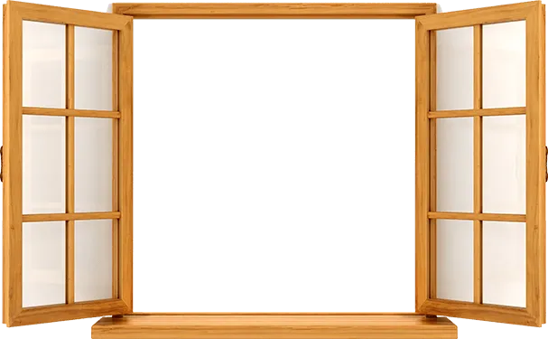

Building the Course of Operations Management Around Web-Based Simulation Games
Ardavan Asef-Vaziri
Systems and Operations Management, California State University, Northridge

Slide 2
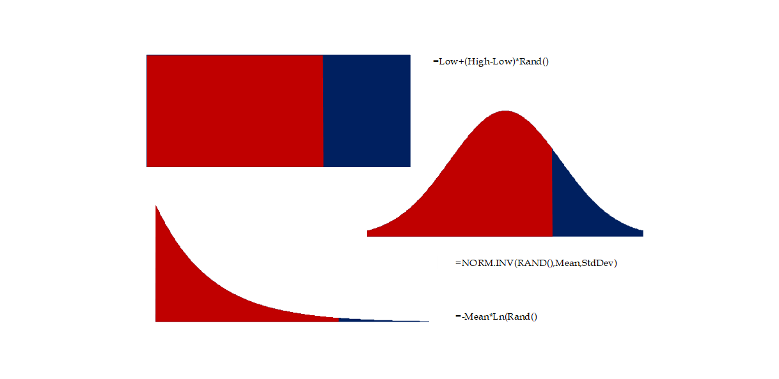
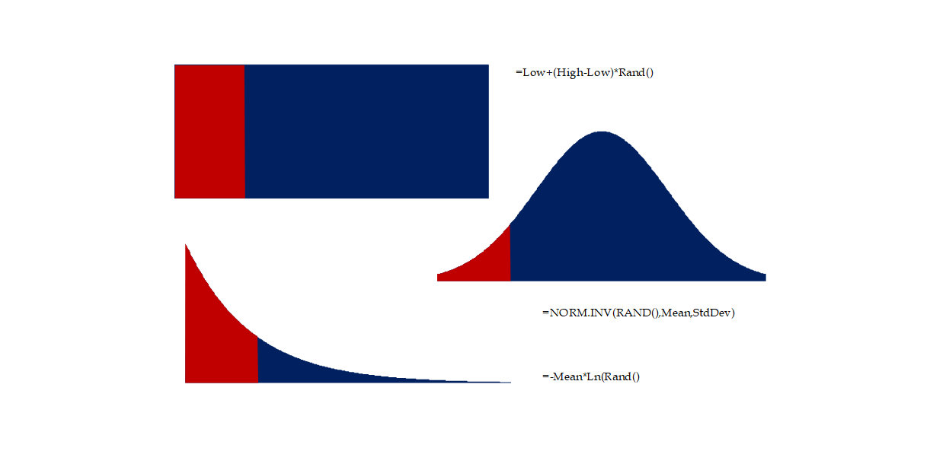

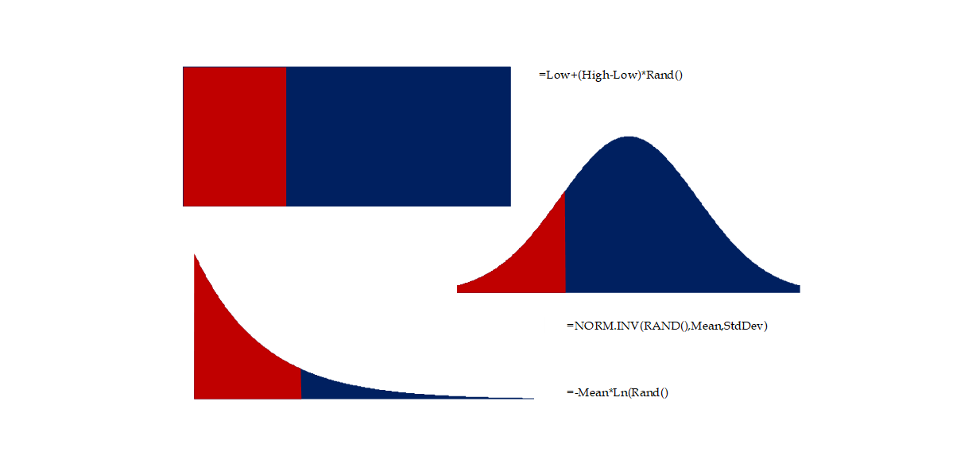
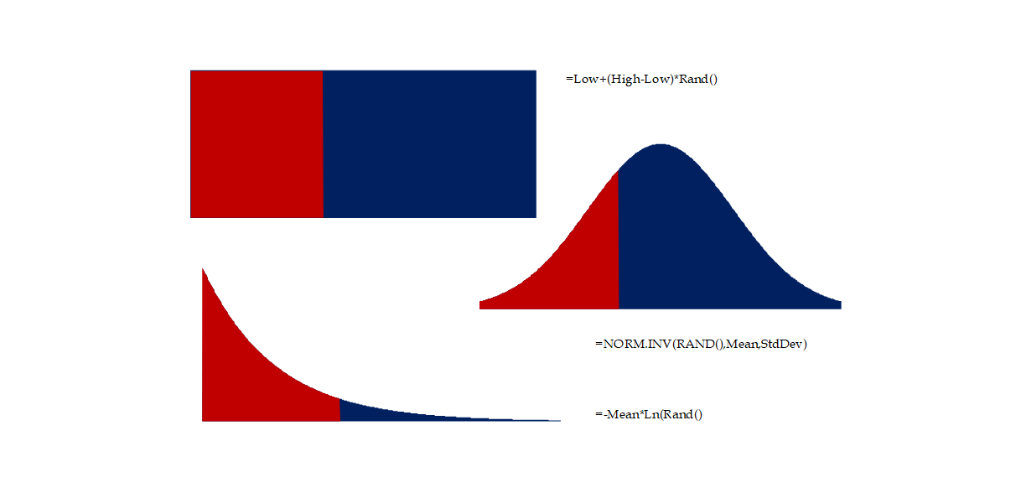
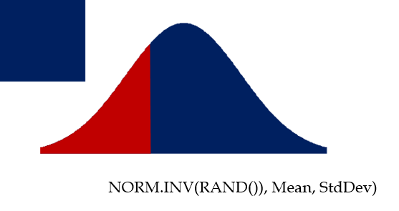
Random Number Generation
U=l+(u-l)*Rand()
NORM.INV(RAND()), Mean, StdDev)
-Mean*Ln(Rand())

Slide 3
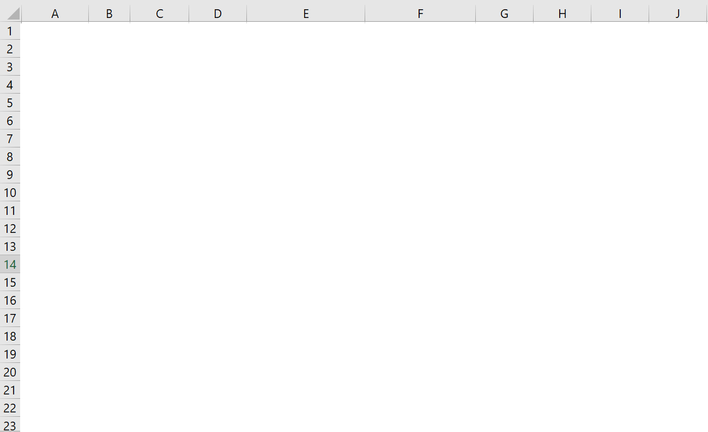
Drawing the Curves

Slide 4
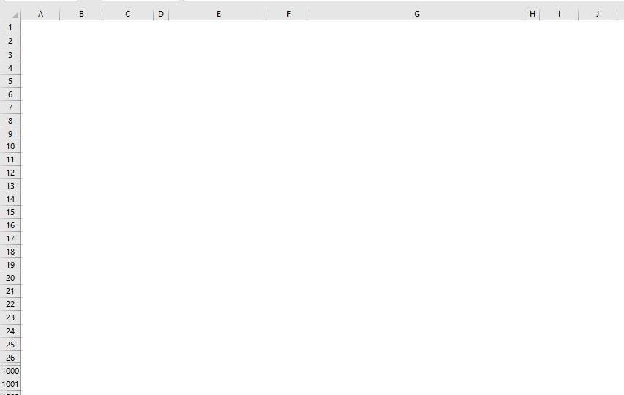
Starting Data

Slide 5
Demand, Supply, Sortage, and Sles
=MAX(0,A2-$F$13)

Slide 6
Lost Sales (Shortage) vs Over Stock (Leftover) & Fill Rate vs Service Level

Slide 7
Underage Cost vs Overage Cost

Slide 8
Total underage vs Total Overage Cost; Simulation-Based Service Level

Slide 9
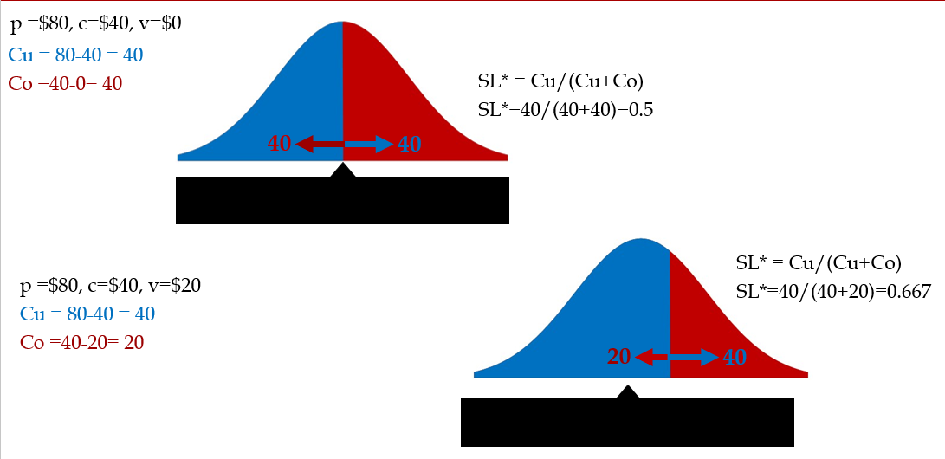
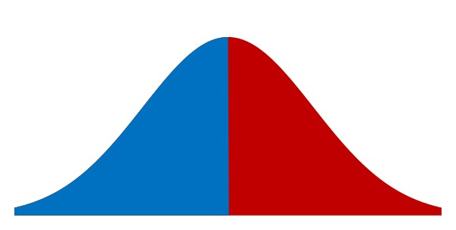
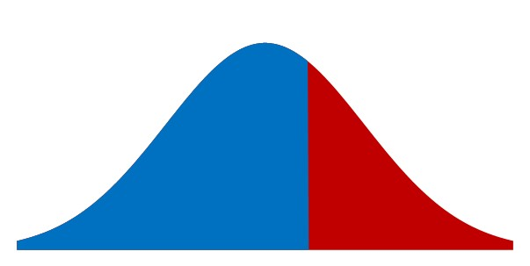
Cu vs Co Balance of Power ➔The Optimal Analytical Service Level
p =$80, c=$40, v=$0
Cu = 80-40 = 40
Co =40-0= 40
SL* = Cu/(Cu+Co)
SL*=40/(40+40)=0.5
40
40
SL* = Cu/(Cu+Co)
SL*=40/(40+20)=0.667
p =$80, c=$40, v=$20
Cu = 80-40 = 40
Co =40-20= 20
20
40

Slide 10
Total Underage Costs vs Total overage Costs

Slide 11
Retailer profit vs Supplier Profit
Random
Demand
Understock
AveDemData
100
Given
92
94
0
StdDevDemData
25
Given
85
102
2
RandDemand
116
=ROUND(NORM.INV(RAND(),$F$1,$F$2),0)
80
124
24
DemandAveSim
100.59
=AVERAGE(B2:B1001)
103
85
0
DemandStdDevSim
25.42
=STDEV.S(B2:B1001)
49
104
4
p
120
Given
83
128
28
c
40
Given
133
86
0
v
20
Given
82
78
0
Cu
80
Given
93
116
16
Co
20
=F7-F8
71
92
0
SL*
80%
=F9/(F9+F10)
90
32
0
RoundUpQ*
122
=ROUNDUP(NORMINV(F11,F1,F2),0)
94
109
9
OurQ
100
Chosen
130
97
0
Lost SalesAve
10.4
=AVERAGE(C2:C1001)
54
97
0
SalesAve
90.2
=F4-F14
111
80
0
OverStockAve
9.82
=F13-F15
159
80
0
$Lost SalesAve
832.64
=F14*F9
105
102
2
$OverStockAve
196.32
=F16*F10
102
95
0
$TotalOverUnderStock
1028.96
=F17+F18
90
132
32
Service Level
80.0%
=F9/(F9+F10)
141
77
0
FillRate
0.89653
=F15/F4
88
130
30
ServiceLevel
0.487
=COUNTIF($C$2:$C$1001,0)/COUNT(C2:C1001)
118
83
0
Retailes Expected Profit
7018.4
=F9*F15-F10*F16
103
115
15
Retailes Expected Profit
7018.4
=F15*F6+F16*F8-F13*F7
96
122
22
cM
10
Given
71
122
22
Manufacturer Profit
2803.68
=F13*(F7-F25)-F16*(F8-F25)
112
83
0
Supply Chain Profit
9228.08
=F23+F26
70
101
1

Slide 12
Optimal Service Level

Slide 13
Random Number Generation

Slide 14
Additional Practices

Slide 15
How Much Inventory to Sell The Average Demand
=MAX(0,A2-$E$13)

Slide 16
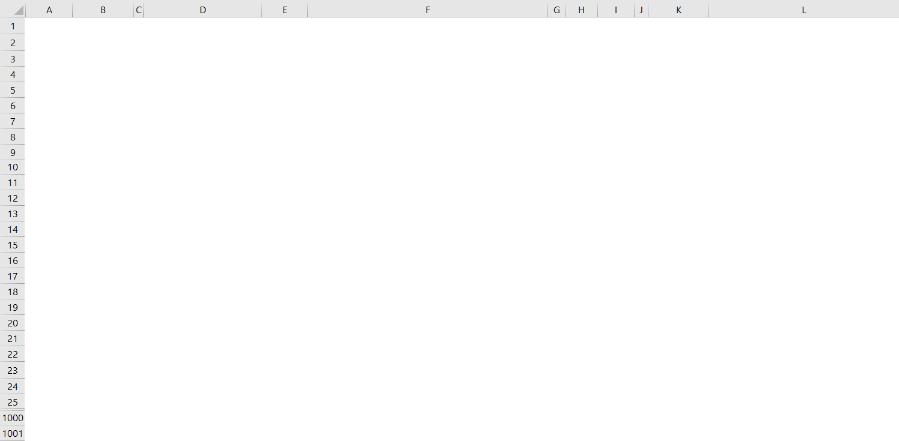
`

Slide 19
Random Number Generation

