Slide 1
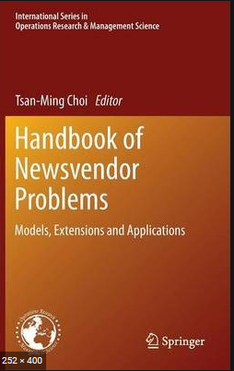

The Newsvendor Problem
The most important questions of life are, for the most part, really only problems of probability.
Pierre-Simon Laplace
Ardavan Asef-Vaziri
Systems and Operations Management
David Nazarian College of Business and Economics
California State University, Northridge
March 2020

Slide 2

Teams and Clusters- In this Course and In Future
This Semester
Next Semester
https://youtu.be/_4WLZ8jUxIc

Slide 3
Operations Management Objectives
Create a Smooth Flow
Understand Trade-Off
Removes Variability
Align Process Competencies with Product Attributes
Optimally locate
  Product buffer- Inventory- Product Waits
  Capacity buffer- Safety Capacity - Capacity Waits
  Time Buffer – Customer Waits
Provide examples in LFT-Game-2

Slide 4
ROP-Multiple Choice-P1-P2
1. Most inventory models attempt to minimize
  A) the number of items ordered and the safety stock
  B) total inventory costs and likelihood of a stockout
  C) the number of orders placed and the average inventory
  D) All of the above
  E) None of the above
2. Usage of the material is normally distributed with a mean of 20 pounds per day and a standard deviation of 4 pounds per day. Lead time is 4 days. What is the reorder point if the acceptable risk of a stockout is 1%?
  90
  86
  20
  99
  102

Slide 5
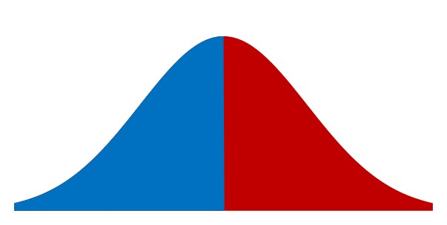
Overage Cost vs. Underage Cost
Swell Productions is sponsoring an outdoor conclave for owners of collectible and classic Fords. The concession stand in the T-Bird area will sell clothing such as official Thunderbird racing jerseys. Suppose the probability of jerseys sales quantities is Normally distributed with mean of 100 and standard deviation of 25. Suppose sales price is $80 per jersey, purchase cost is $40, and unsold jerseys are returned to the manufacturer for $20 per unit. How many Jerseys Swell Production orders?
Cu: Underage Cost
Cu = 80-40 = 40
Co: Overage Cost
If Co was also 40
Blue Arrow (Blue Arrow + Red Arrow)
= Cu/(Cu+Co)
SL*= 40/(40+40)
SL*= 0.5
40
40

Slide 6
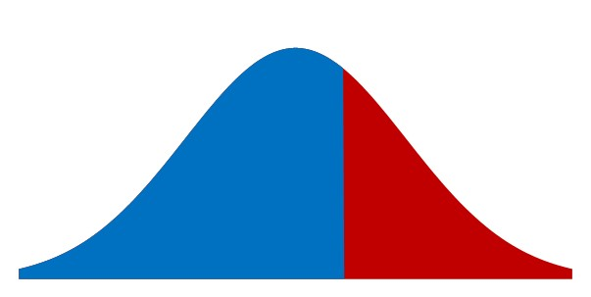
Optimal Service Level
Cu: Underage Cost
Cu = 80-40 = 40
Co: Overage Cost
Co = 40-20 = 20
Given a 66.67% SL
66.67% Probability
Blue Arrow (Blue Arrow + Red Arrow)
SL* = Cu/(Cu+Co) = P(LTD ≤ ROP)
SL* = 40/(40+20)
SL* = 2/3 = 0.67
20
40
Compute x
ROP= NORMINV(2/3,100,25) = 110.7682 ≈111
New SL = NORM.DIST(111,100,25,1) = 0.670031446

Slide 7
Problem 2. The News Vendor Problem
An electronics superstore is carrying a 60” LEDTV for the upcoming Christmas holiday sales. Each TV can be sold at $2,500. The store can purchase each unit for $1,800. Any unsold TVs can be salvaged, through end of year sales, for $1,700. The retailer estimates that the demand for this TV will be Normally distributed with mean of 150 and standard deviation of 15. How many units should they order?
Note: If they order 150, they will be out of stock 50% of the time.
Which service level is optimal? 80%, 90%, 95%, 99%??
Cost =1800, Sales Price = 2500, Salvage Value = 1700
Underage Cost = Marginal Benefit = p-c = 2500-1800 = 700
Overage Cost = Marginal Cost = c-v = 1800-1700 = 100
Optimal Service Level = SL* = P(LTD ≤ ROP) = Cu/(Cu+Co)
Or in NVP Terminology SL* = P(R ≤ Q*) = Cu/(Cu+Co)

Slide 8
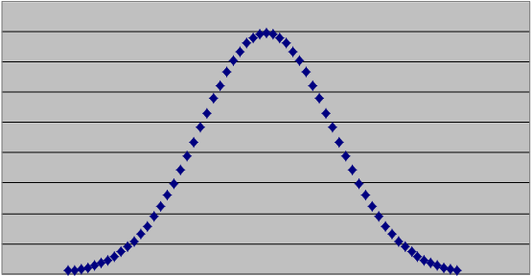
Optimal Service Level
Underage cost = Marginal Benefit =Cu = 2500-1800 = 700
Overage Cost = Marginal Cost = Co = 1800-1700 = 100
SL* = Cu/(Cu+Co)
SL* = 700/800 = 0.875
ROP =NORM.INV(0.875,150,15) = = 167.2552407 ≈168
We place an order for 168 units ➔ Is = 168-150 = 18
New SL*= =NORM.DIST(168,150,15,1) = 0.88493033
Probability of
excess inventory
Probability of
shortage
0.875
0.125

Slide 9
Problem 3. Salvage Value
Demand for a product in the upcoming period is normally distributed with mean of 4000 and standard deviation of 1000.
Where is the optimal service level? How much do you order?
Sales Price = $30. Purchase cost = $10.
Salvage value (return or sell the product for this price) = $6. Goodwill cost (dammage to reputation per unit of product) = $1.
LTD ~ N(4000,1000)
Overage Cost = Marginal Cost = Co = 10-6 = 4
Underage Cost = Marginal Benefit = 30-10 +1 = 21
SL*= Cu/(Cu+Co) = SL*= 21/25 = 0.84
ROP = Q = NORMINV(0.84,4000,1000) 4994.457883≈ 4995
New SL = NORM.DIST(4995,4000,1000,1) 0.840131868
Risk = 15.99%

Slide 10
Problem 4. The Game
Daily demand for your product R~N(R,σ_{R} ) = N(20, 5). Sales price is $100 per unit of product. You have decided to close this business line in 60 days. Your supplier has also decided to close the line immediately but has agreed to provide your last order at a cost of $60 per unit. Any unsold product will be disposed at cost of $10 per unit due to EPA regulations. How many units do you order
LTD = R ×L =20 ×60 = 1200.
Should we order 1200 units or more or less? If we order 1200, the chance of shortage/overstock is 50/50.
Cu = 100 – 60 = 40
Co = 60-0+10 =70
SL = Cu/(Cu+Co) = 40/(40+70) = 0.3636.

Slide 11
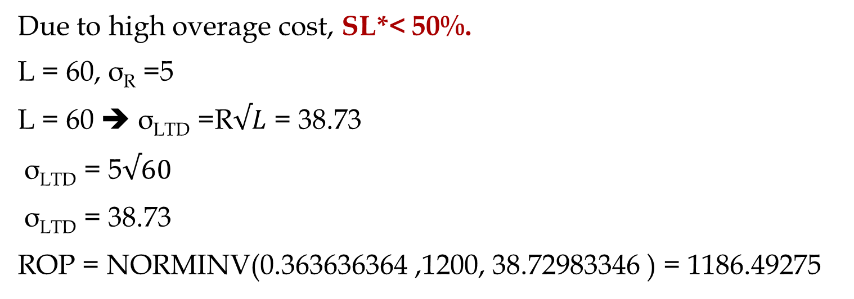
Less Than 50% Service Level
Due to high overage cost, SL*< 50%.
L = 60, σ_{R} =5
L = 60 ➔ σ_{LTD} =R$√L$ = 38.73
σ_{LTD} = 5$√60$
σ_{LTD} = 38.73
ROP = NORMINV(0.363636364 ,1200, 38.72983346 ) = 1186.49275

Slide 12
The Newsvendor Problem Terminology
In the NVP terminology, the following notations is used
R: demand during the single period of study
R =N(R, σ_{R})
Q* : What we order (only once)
P(R ≤ Q*) = Cu/(Cu+Co)

Slide 13

Extra - Problem 7.4
Johnson Electronics sells electrical and electronic components through catalogs. Catalogs are printed once every two years. Each printing run incurs a variable production cost of $5 per catalog. Annual demand for catalogs has normal distribution; mean of 16,000 and standard deviation of 4,000. On average, each customer ordering a catalog generates a $35 sales revenue. Assuming that Johnson wants only one printing run in each two-year cycle (and leftovers of the previous cycle are worthless), how many catalogs should be printed in each run?
Is this an EOQ problem?
We do a run every two years. That would mean, in a deterministic EOQ setting, that Q must equal two years of average demand; 32000 units. This is indeed a periodic inventory system, and the period is 2 years.

Slide 14
Extra - Problem 7.4
The question is whether 32000 is the best quantity we can print every two years? Or we should print more. If we produce 32,000 the probability of stockout is 50%. So this is an ROP problem when we want to have Isafety for 2 years.
What the appropriate safety stock (or service level) should be.
Every catalog fetches sales of 35 and costs 5 to produce.
Cu = 35 - 5= 30.
What is my overage cost? Each catalog costs $5, if not used, salvages at the end of two year period.
Co = 5-0 =5

Slide 15


Extra - Problem 7.4
The optimal service level (or critical fractile):
SL* = Cu/(Cu+Co) = 30/(30+5) = 0.857.
L = 2 ➔ σ_{LTD}=4000$√2$ = 5657
LTD = 2(16000)= 32000
=NORM.INV(30/35,2*16000,SQRT(2)*4000) = 38039.09085
If we order 38,039, there is 85.7% probability that we are not out of stock in the next two years. The Risk is 14.3%. The inventory cost is minimized.
How many catalogs should be distributed to break-even the fixed cost of 25,000
Marginal profit = 30,
Q = 25000/30 = 833.3 =834

