Slide 1
Network Flows
Based on the book: Introduction to Management Science. Hillier & Hillier. McGraw-Hill

Slide 2
The Shortest Route Problem
The shortest route between two points
l _{ij} : The length of the directed arc ij. l _{ij} is a parameter, not a decision variable. It could be the length in term of distance or in terms of time or cost ( the same as c _{ij} )
For those nodes which we are sure that we go from i to j we only have one directed arc from i to j.
For those node which we are not sure that we go from i to j or from j to i, we have two directed arcs, one from i to j, the other from j to i.
We may have symmetric or asymmetric network.
In a symmetric network l_{ij} = l_{ji} for all ij
In a asymmetric network this condition does not hold

Slide 3
Example
2
6
6
5
2
2
4
2
7
6
4
1
2
8
2
5
2
7
3

Slide 4
Decision Variables and Formulation
x_{ij} : The decision variable for the directed arc from node i to nod j.
x_{ij} = 1 if arc ij is on the shortest route
x_{ij} = 0 if arc ij is not on the shortest route
∑ x_{ij} - ∑ x_{ji} = 0 for all nodes except the origin and destination
∑ x_{oj} =1
∑ x_{iD} = 1
Min Z = ∑ l_{ij} x_{ij}

Slide 5
Example
2
6
6
5
2
2
4
2
7
6
4
1
2
8
2
5
2
7
3

Slide 6
Example
+ x₁₃ + x₁₄+ x₁₂= 1
- x₅₇ - x₆₇ = -1
+ x₃₄ + x₃₅ - x₄₃ - x₁₃ = 0
+ x₄₂ + x₄₃ + x₄₅ + x₄₆ - x₁₄ - x₂₄ - x₃₄ = 0
….
…..
Min Z = + 5x₁₂ + 4x₁₃ + 3x₁₄ + 2x₂₄ + 6x₂₆ + 2x₃₄ + 3x₃₅
+ 2x₄₃ + 2x₄₂ + 5x₄₅ + 4x₄₆ + 3x₅₆ + 2x₅₇ + 3x₆₅ + 2x₆₇
6
2
2
6
2
5
4
2
6
7
4
1
2
8
5
2
2
7
3

Slide 7
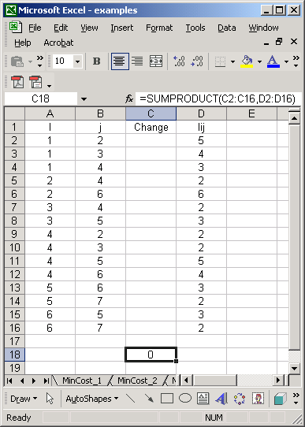
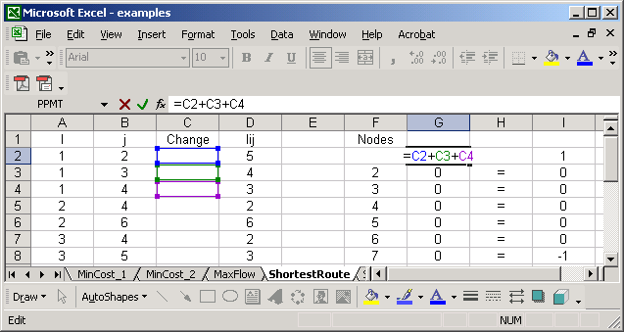
Excel
6
2
2
6
2
5
4
2
6
7
4
1
2
8
5
2
2
7
3

Slide 8
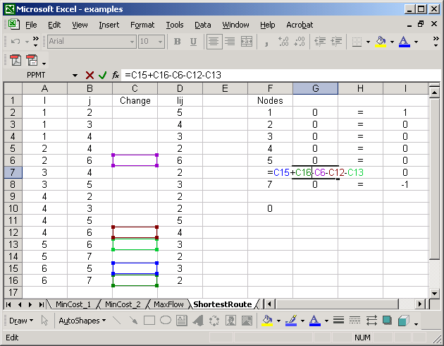
Excel
6
2
2
6
2
5
4
2
6
7
4
1
2
8
5
2
2
7
3

Slide 9
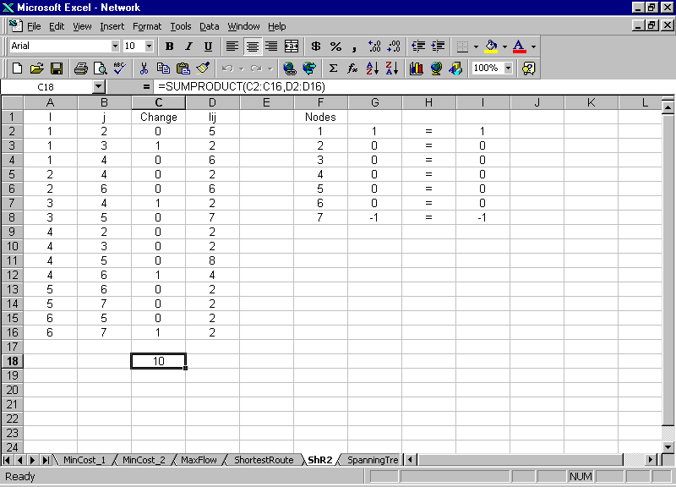
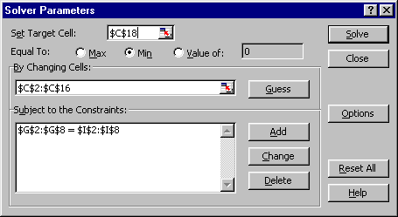
Solver Solution
6
2
2
6
2
5
4
2
6
7
4
1
2
8
5
2
2
7
3

Slide 10
After class practice; Find the shortest route
4
6
9
3
6
4
3
6
2
2
11
5
2
2
6
6
8
6
D
2
2
5
O
3
4
3
5
10
4
3
1
2
5
7
2
4
3
3

Slide 11
Important observations in the LP-relaxation
2
6
1
4
2
3
4
1
3
Formulate on the problem on the black board
Did I say x_{ij} <= 1 ?
Why all the variables came out less than 1
Did I say x_{ij} 0 or 1
Why all variables came out 0 or 1

