Slide 1
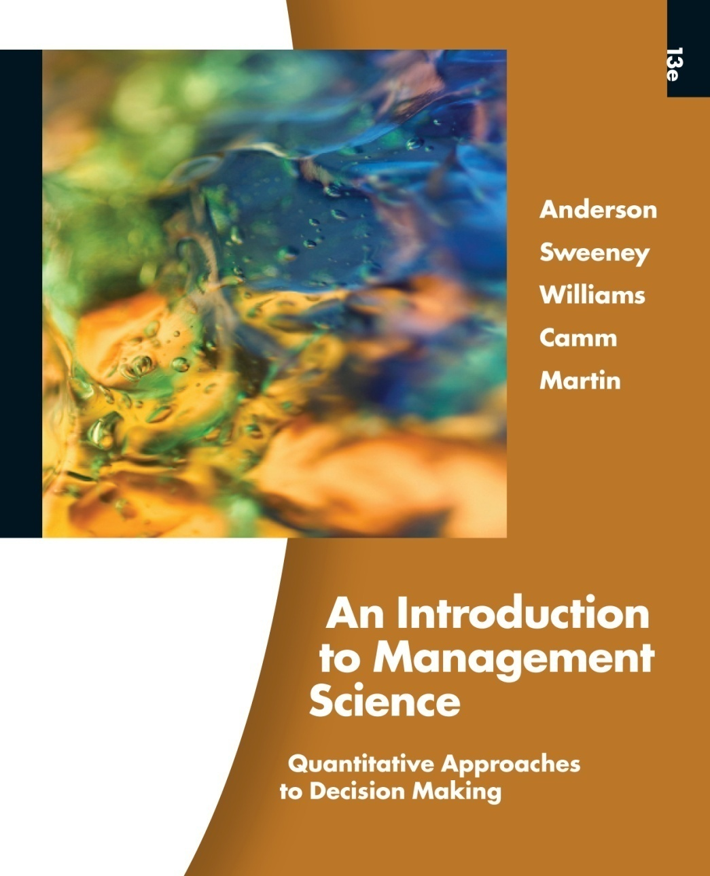
Slides by
John
Loucks
St. Edward’s
University
Modifications by
A. Asef-Vaziri

Slide 2
Shortest-Route Problem
The shortest-route problem is concerned with finding the shortest path in a network from one node (or set of nodes) to another node (or set of nodes).
If all arcs in the network have nonnegative values then a labeling algorithm can be used to find the shortest paths from a particular node to all other nodes in the network.
The criterion to be minimized in the shortest-route problem is not limited to distance even though the term "shortest" is used in describing the procedure. Other criteria include time and cost. (Neither time nor cost are necessarily linearly related to distance.)

Slide 3
Shortest-Route Problem
Linear Programming Formulation
Using the notation:
x_{ij} = 1 if the arc from node i to node j
is on the shortest route
0 otherwise
c_{ij} = distance, time, or cost associated
with the arc from node i to node j
continued

Slide 4
Shortest-Route Problem
Linear Programming Formulation (continued)

Slide 5
Example: Shortest Route
Susan Winslow has an important business meeting
in Paducah this evening. She has a number of alternate
routes by which she can travel from the company headquarters in Lewisburg to Paducah. The network of alternate routes and their respective travel time,
ticket cost, and transport mode appear on the next two slides.
If Susan earns a wage of $15 per hour, what route
should she take to minimize the total travel cost?

Slide 6
Example: Shortest Route
Network Representation
2
F
5
K
L
A
B
G
C
3
J
6
1
D
H
I
Paducah
Lewisburg
E
M
4

Slide 7
Example: Shortest Route
Transport Time Time Ticket Total
Route Mode (hours) Cost Cost Cost
1-2 Train 4 $60 $ 20 $ 80
1-3 Bus 2 $30 $ 10 $ 40
1-4 Train 3 1/3 $50 $ 30 $ 80
1-5 Plane 1 $15 $115 $130
1-6 Taxi 6 $90 $ 90 $180
2-5 Bus 3 $45 $ 15 $ 60
2-6 Taxi 3 1/3 $50 $ 50 $100
3-4 Taxi 1 $15 $ 15 $ 30
3-5 Bus 4 2/3 $70 $ 20 $ 90
3-6 Bus 6 1/3 $95 $ 25 $120
4-5 Train 2 1/3 $35 $ 15 $ 50
4-6 Bus 4 2/3 $70 $ 20 $ 90
5-6 Train 1 1/3 $20 $ 10 $ 30

Slide 8
Example: Shortest Route
LP Formulation
  Objective Function
Min 80x₁₂ + 40x₁₃ + 80x₁₄ + 130x₁₅ + 180x₁₆ + 60x₂₅
+ 100x₂₆ + 30x₃₄ + 90x₃₅ + 120x₃₆ + 30x₄₃ + 50x₄₅
+ 90x₄₆ + 60x₅₂ + 90x₅₃ + 50x₅₄ + 30x₅₆
  Node Flow-Conservation Constraints
  x₁₂ + x₁₃ + x₁₄ + x₁₅ + x₁₆ = 1 (origin)
  – x₁₂ + x₂₅ + x₂₆ – x₅₂ = 0 (node 2)
  – x₁₃ + x₃₄ + x₃₅ + x₃₆ – x₄₃ – x₅₃ = 0 (node 3)
  – x₁₄ – x₃₄ + x₄₃ + x₄₅ + x₄₆ – x₅₄ = 0 (node 4)
  – x₁₅ – x₂₅ – x₃₅ – x₄₅ + x₅₂ + x₅₃ + x₅₄ + x₅₆ = 0 (node 5)
  x₁₆ + x₂₆ + x₃₆ + x₄₆ + x₅₆ = 1 (destination)

Slide 9
Excel Solution

