Slide 1
Network Flows
Based on the book: Introduction to Management Science. Hillier & Hillier. McGraw-Hill

Slide 2
Minimum Cost Flow
Distribution Unlimited Co. Problem
The Distribution Unlimited Co. has two factories producing a product that needs to be shipped to two warehouses
  Factory 1 produces 80 units.
  Factory 2 produces 70 units.
  Warehouse 1 needs 60 units.
  Warehouse 2 needs 90 units.
There are rail links directly from Factory 1 to Warehouse 1 and Factory 2 to Warehouse 2.
Independent truckers are available to ship up to 50 units from each factory to the distribution center, and then 50 units from the distribution center to each warehouse.
Question: How many units (truckloads) should be shipped along each shipping lane?

Slide 3
The Distribution Network
Notes:
Figure 6.1 The distribution network for the Distribution Unlimited Co. problem, where each feasible shipping lane is represented by an arrow.

Slide 4
Data for Distribution Network
700
80
1
4
60
300
200
50
50
3
400
400
50
50
70
2
900
5
90

Slide 5
Minimum Cost Flow Problem: Narrative representation
Transportation costs for each unit of product and max capacity of each road is given below
From To cost/ unit Max capacity
1 4 700 No limit
1 3 300 50
2 3 400 50
2 5 900 No limit
3 4 200 50
3 5 400 50
There is no other link between any pair of points

Slide 6
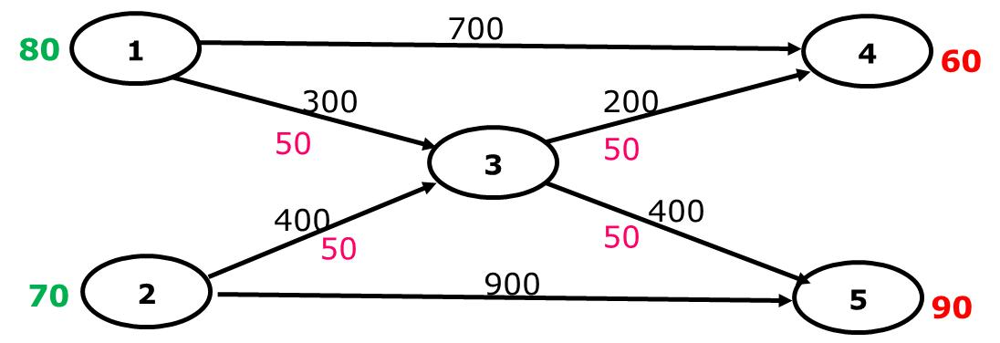
Minimum Cost Flow Problem: decision variables
x₁₄ = Volume of product sent from point 1 to 4
x₁₃ = Volume of product sent from point 1 to 3
x₂₃ = Volume of product sent from point 2 to 3
x₂₅ = Volume of product sent from point 2 to 5
x₃₄ = Volume of product sent from point 3 to 4
x₃₅ = Volume of product sent from point 3 to 5
We want to minimize
Z = 700 x₁₄ +300 x₁₃ + 400 x₂₃ + 900 x₂₅ +200 x₃₄ + 400 x₃₅

Slide 7
Minimum Cost Flow Problem: constraints
Supply
x₁₄ + x₁₃ = 80
x₂₃ + x₂₅ = 70
Demand
x₁₄ + x₃₄ = 60
x₂₅ + x₃₅ = 90
Transshipment
x₁₃ + x₂₃ = x₃₄ + x₃₅ (Move all variables to LHS)
x₁₃ + x₂₃ - x₃₄ - x₃₅ =0
Supply
x₁₄ + x₁₃ ≤ 80
x₂₃ + x₂₅ ≤ 70
Demand
x₁₄ + x₃₄ ≥ 60
x₂₅ + x₃₅ ≥ 90

Slide 8
Minimum Cost Flow Problem: constraints
Capacity
x_{13 ≤ 50}
x_{23 ≤ 50}
x_{34 ≤ 50}
x₃₅ _{≤ 50}
Nonnegativity
x₁₄, x₁₃ , x₂₃ , x₂₅ , x₃₄ , x₃₅ ≥ 0

Slide 9
The SUMIF Function
The SUMIF formula can be used to simplify the node flow constraints. =SUMIF(Range A, x, Range B)
For each quantity in (Range A) that equals x, SUMIF sums the corresponding entries in (Range B).
The net outflow (flow out – flow in) from node x is then
=SUMIF(“From labels”, x, “Flow”) – SUMIF(“To labels”, x, “Flow”)

Slide 10
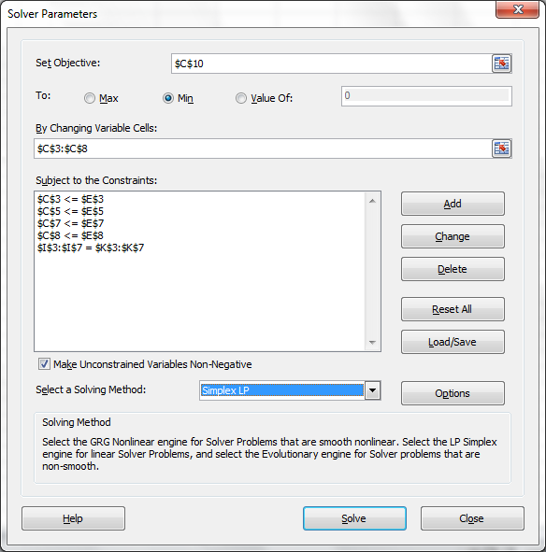
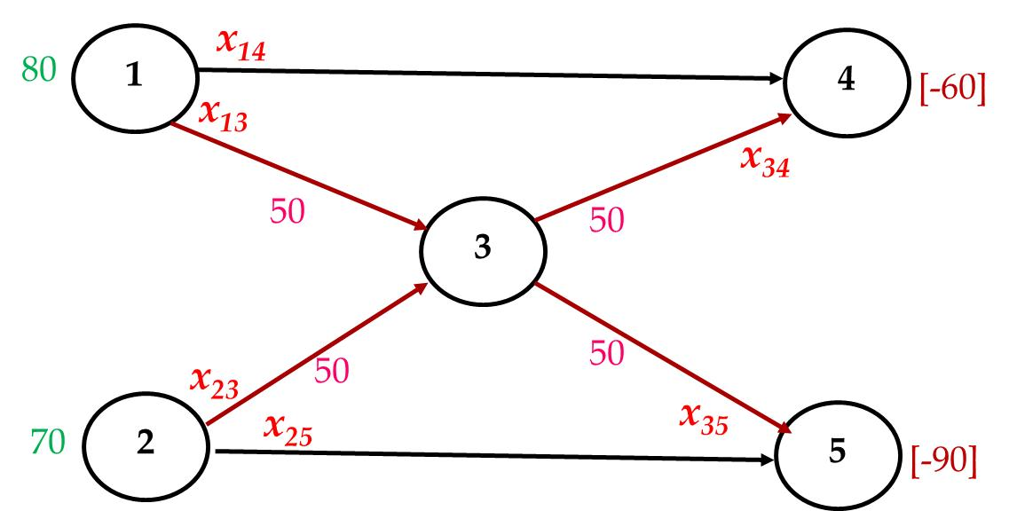
Excel Implementation

Slide 11
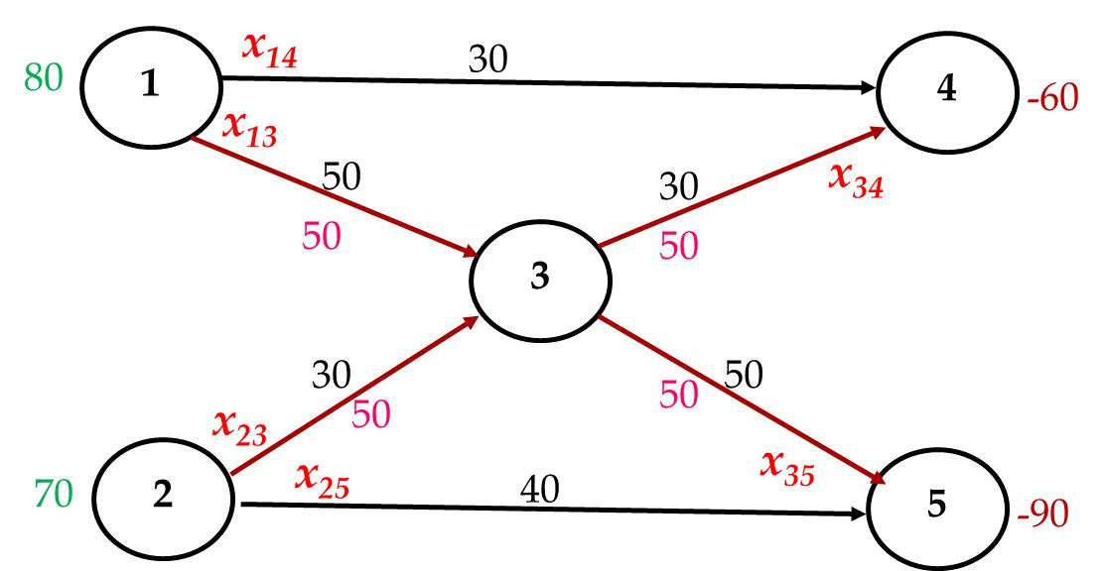
Excel Implementation

Slide 12
Terminology for Minimum-Cost Flow Problems
The model for any minimum-cost flow problem is represented by a network with flow passing through it.
The circles in the network are called nodes.
Each node where the net amount of flow generated (outflow minus inflow) is a fixed positive number is a supply node.
Each node where the net amount of flow generated is a fixed negative number is a demand node.
Any node where the net amount of flow generated is fixed at zero is a transshipment node. Having the amount of flow out of the node equal the amount of flow into the node is referred to as conservation of flow.
The arrows in the network are called arcs.
The maximum amount of flow allowed through an arc is referred to as the capacity of that arc.

Slide 13
Assumptions of a Minimum-Cost Flow Problem
At least one of the nodes is a supply node.
At least one of the other nodes is a demand node.
All the remaining nodes are transshipment nodes.
Flow through an arc is only allowed in the direction indicated by the arrowhead, where the maximum amount of flow is given by the capacity of that arc. (If flow can occur in both directions, this would be represented by a pair of arcs pointing in opposite directions.)
The network has enough arcs with sufficient capacity to enable all the flow generated at the supply nodes to reach all the demand nodes.
The cost of the flow through each arc is proportional to the amount of that flow, where the cost per unit flow is known.
The objective is to minimize the total cost of sending the available supply through the network to satisfy the given demand. (An alternative objective is to maximize the total profit from doing this.)

Slide 14
Typical Applications of Minimum-Cost Flow Problems
Kind of Application | Supply Nodes | Transshipment Nodes | Demand Nodes
Operation of a distribution network | Sources of goods | Intermediate storage facilities | Customers
Solid waste management | Sources of solid waste | Processing facilities | Landfill locations
Operation of a supply network | Vendors | Intermediate warehouses | Processing facilities
Coordinating product mixes at plants | Plants | Production of a specific product | Market for a specific product
Cash flow management | Sources of cash at a specific time | Short-term investment options | Needs for cash at a specific time
Notes:
Table 6.1 Typical kinds of applications of minimum-cost flow problems.

Slide 15
Data for Distribution Network
700
80
1
4
60
300
200
50
50
3
400
400
50
50
70
2
900
5
90

Slide 16
Transportation problem II : Formulation

Slide 17
Transportation problem II : Solution

Slide 18
Transportation problem II : Solution

