Slide 1
MRP: Material Requirement Planning
Product Tree

Slide 2
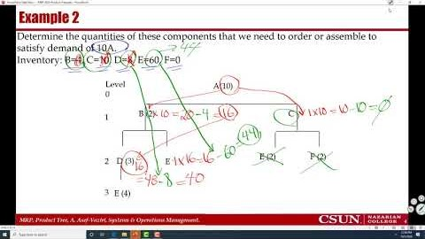
Recorded Lecture- Product Tree
https://youtu.be/ytyTDHVE2tA

Slide 3
Example 1. Product Structure Tree- Quantities
Determine the quantities of B, C, D, E, and F to produce one unit of A
Level
0
A
1
B (2)
C
E
E (2)
F (2)
2
D (3)
E
E
3
E (4)
E

Slide 4
Example 1.
Determine the quantities of B, C, D, E, and F to produce one unit of A
Level
0
A
1
B (2)
C
E (2*1=2)
F (2*1=2)
2
D (3*2=6)
E(1*2=2)
3
E (4
*6=24)
A(1), B(2), C, D(6), E(28), and F (2)

Slide 5
Example 2
Determine the quantities of these components that we need to order or assemble to satisfy demand of 10A.
Inventory: B=4, C=10, D=8, E=60, F=0
Level
0
A(10)
1
B (2)
C
E (2)
F (2)
2
D (3)
E
3
E (4)

Slide 6
Example 2
10A. Inventory: B=4, C=10, D=8, E=60, F=0
10A. Inventory: B=0, C=0, D=8, E=60, F=0
Level
0
A(10)
1
B (10×2-4=16)
C(10×1-10=0)
E (2)
F (2)
2
D (3)
E
3
E (4)

Slide 7
Example 2
10A. Inventory: B=0, C=0, D=8, E=60, F=0
10A. Inventory: B=0, C=0, D=0, E=44, F=0
Level
0
A(10)
1
B (16)
C(0)
E (0)
F (0)
2
D (16×3-8=40)
E (16×1-60=-44?)
3
E (16?× 4-?)

Slide 8
Example 2
10A. Inventory: B=0, C=0, D=0, E=44, F=0
Level
0
A(10)
1
B (16)
C(0)
E (0)
F (0)
2
D (40)
E (0)
3
E (40× 4-44)=116

Slide 9
Example 2
Level
0
A(10)
1
B (16)
C(0)
E (0)
F (0)
2
D (40)
E (0)
3
E (116)

Slide 10
Example 3.
Item A B C D E F G H
Inventory On Hand 0 10 10 25 12 30 5 0
For 20 units of the end item, how many additional units of each item is required
Level
0
A(20)
1
B (2)
C
D(3)
2
E (2)
F(3)
G (2)
E (2)
H (4)
E (2)

Slide 11
Example 3
Item A B C D E F G H
InvOnHand 0 10 10 25 12 30 5 0
InvOnHand 0 0 0 0 12 30 5 0
Level
0
A
1
B (20*2-10 = 30)
C(20*1-10=10)
D(20*3-25=35)
2
E (2)
F(3)
G (2)
E (2)
H (4)
E (2)

Slide 12
Example 3
Item A B C D E F G H
InvOnHand 0 0 0 0 12 30 5 0
InvOnHand 0 0 0 0 0 0 0 0
Level
0
A
1
B (30)
C(10)
D(35)
2
E (30*2-12) =48
F(30*3-30=60)
G (10*2-5=15)
E (10*2=20)
H (35*4=140)
E (35*2=70)
Item End B C D E F G H
Needed 20 30 10 35 138 60 15 140

Slide 13
Example 4
15 units of A is needed. Inventory is as follows
A=2, B=60, C=11, D=19
How many of each part do we need
A
B(4)
C(2)
D(2)
E
D(3)
B(2)
D(2)
E

Slide 14
Example 4
Inventory Beginning
A=2
B=60
C=11
D=19
A(15
-2= 13)
B(4
×13
-60=-8)
C(2
×13
-11=15)
D(2
×0 = 0)
E(1
×0 = 0)
D(3
×15
-19=26)
B(2
×15
-8=22)
D(2
×22
=44)
E(1
×22
=22)

