Slide 1
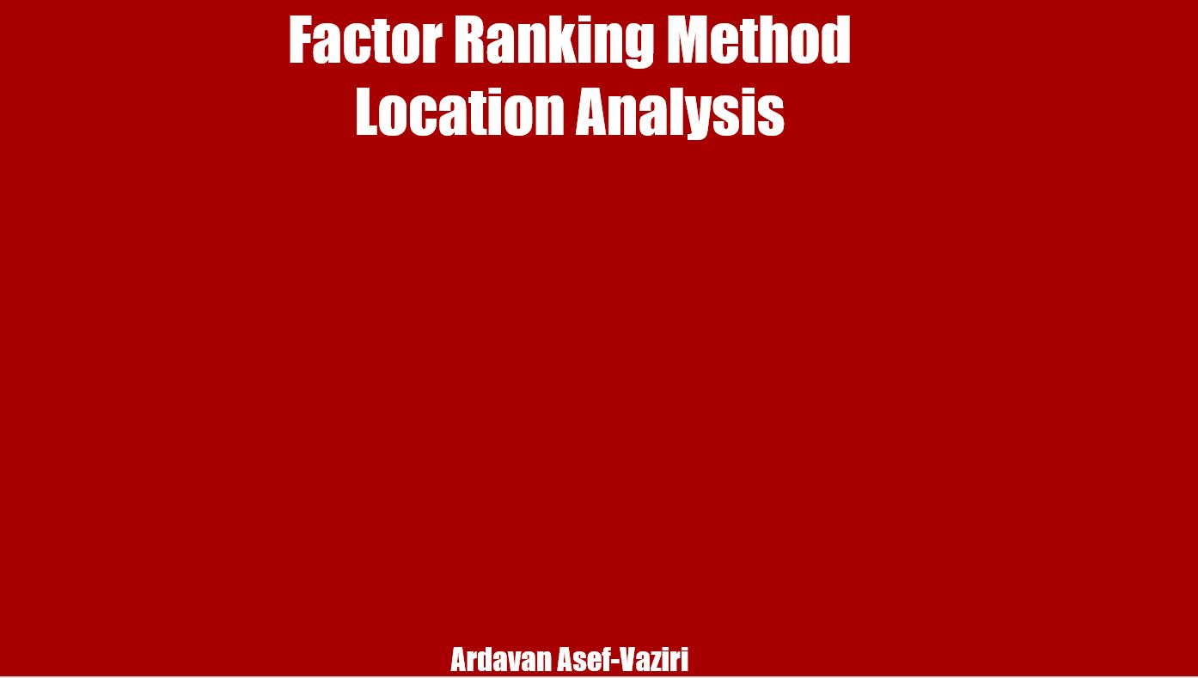
Factor Ranking Method
Location Analysis
Ardavan Asef-Vaziri
https://youtu.be/6fbvLZwcrlo

Slide 2
Location Decisions
Location of Markets
Location of Raw Material
Transportation Infrastructure, Modes (Truck, Rail, Water) and Costs
Energy Availability & Costs
Availability of Skilled Labor & Labor Costs
Land, Building, and Construction Costs
Cultural Considerations
Weather, Living Conditions Standards
Regulations, Taxes, and Tariffs
Notes:
HP: computer, printer

Slide 3
Questions
While selecting a factory location in a foreign country, consideration should be given to
  Culture
  Legal system
  Monetary policies
  Transportation infrastructure
  All answers are correct
2. Multinational organizations can shop from country to country and cut costs through
  Lower wage scales
  Lower indirect labor costs
  Less stringent regulations
  Lower taxes and tariffs
  All answers are correct

Slide 4
Factor Rating Method for Location Decisions
Popular because a wide variety of factors can be included in the analysis
Five steps in the method
  Develop a list of relevant factors
  Assign a weight to each factor
  Normalize the weights to SUM=1
  Score each location for each factor based on a consistent scale
  Calculate the weighted average of total score for each location
Make a recommendation based on the highest score
Notes:
HP: computer, printer

Slide 5
Factor Rating Method For Location & Site Evaluation
11. A company wants to build a major warehouse in Europe. Four locations are being considered. The following table shows the important factors to bring into account along with the importance level (weight) of each factor. The attractiveness of each location relative to each factor is indicated on a 0-100 point scale. Find the best location.
Germany: 0.3(70)+0.3(60)+0.3(70)+0.1(80) = 21+18+21+8 = 68
France: 0.3(90)+0.3(70)+0.3(30)+0.1(50) = 27+21+9+5 = 62
Belgium: 0.3(50)+0.3(60)+0.3(70)+0.1(60) = 15+18+21+6 =60
Netherland: 0.3(50)+0.3(70)+0.3(70)+0.1(50) = 15+21+21+5 = 62

Slide 6
Factor Rating Method For Location & Site Evaluation
12. In this example summation of the weight is NOT one (100%). We first need to normalize it to 100%.
Scores were given in the range of 50 to 100.

Slide 7
Transportation and Production Costs
13. A manufacturer of men’s shirts can produce shirts in its Houston plant for $5 per shirt. Chicago is a major market for 100,000 shirts per year. Transportation and storage charges from Houston and Chicago amount to $5 per 100 pounds. Each packaged shirt weighs 1 pound. As an alternative, the company can have the shirts produced in China for $4 per shirt. The raw materials would be shipped from Houston to China at a cost of $10 per 100 pounds. When the shirts are completed, they are to be shipped directly to Chicago at a transportation and storage cost of $16 per 100 pounds. An import duty of $0.5 per shirt is assessed. Where should the shirts be produced and at what costs..
Houston; $805,000
China; $458,000
Houston; $605,000
China; $476,000
We need to think more- We really need
Houston: 5+0.05 = 5.05 (100,000) = 505000
China: 4+0.1+0.16+0.5 = 4.76(100,000) = 476000

