Slide 1
Managing Flow Variability
Process Control

Slide 2
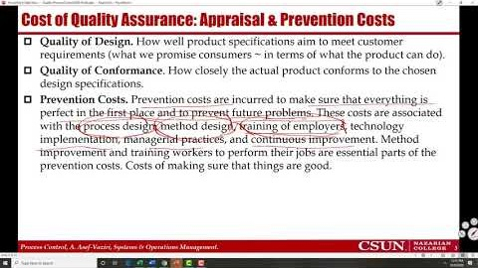

Recorded Lecture- Part 1/3 Introduction https://youtu.be/n_-LajBg_NQ

Slide 3
The Garage Door Manufacturer
In a manufacturing or service
  Product or service quality may be lower than expectations
  Price may be higher than expectations
  Products and services may not be delivered on-time
  After sales service may be at a low level
We can not rely of subjective statements and opinions
  We need to collect data on performance measures that drive customer satisfaction
  Quality, Cost, Time, Variety
Processes with greater variability are judged less satisfactory than those with consistent, predictable performance.
All internal and external performance measures display vary from time to time.
  External Measurements - customer satisfaction, product rankings, customer complaints.
  Internal Measurements - flow unit cost, quality, time, and variety.

Slide 4
Performance Variability
We cannot avoid random variations, but (i) we can differentiate them from systematic vitiations, and (ii) we can make changes in the system (better methods, better equipment and technology, appropriate and continual training, and better management to reduce them.
Sources of Variability
  Internal: imprecise equipment, lack of adequate training for workers, and lack of well-designed standard methods of operations.
  External: unreliable suppliers, inconsistency in raw materials and components, change in customer preferences, change in the business ecosystem.
A discrepancy between the actual and the expected performance often leads to cost↑, flow time↑, quality↓, variety ↓ ➔ and is finally translated into dissatisfied customers.
In general, a product is classified as defective if its cost, quality, availability or flow time differ significantly from their expected values. Again, these are finally translated into dissatisfied customers.

Slide 5
Cost of Quality Assurance: Appraisal & Prevention Costs
Quality of Design. How well product specifications aim to meet customer requirements (what we promise consumers ~ in terms of what the product can do).
Quality of Conformance. How closely the actual product conforms to the chosen design specifications.
Prevention Costs. Prevention costs are incurred to make sure that everything is perfect in the first place and to prevent future problems. These costs are associated with the process design, method design, training of employers, technology implementation, managerial practices, and continuous improvement. Method improvement and training workers to perform their jobs are essential parts of the prevention costs. Costs of making sure that things are good.
Appraisal Costs. Costs that are incurred to ensure that the processes are performed as expected. Prevention costs are to make sure that the processes are good. Appraisal costs are to make sure that the processes remain good. Evaluation incoming material, processes, products and services against expectations. Costs of making sure that good things remain good.

Slide 6
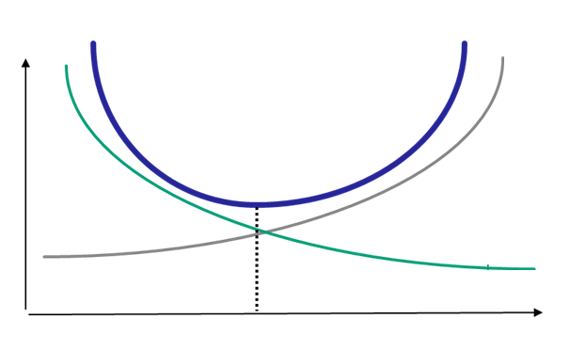
Cost of Quality Non-Conformance: Internal & External Failure Costs
Internal failure costs. Costs to remedy defects discovered before the product or service is delivered to the customer. They are mostly include (i) rework cost to correct defective material, parts, products, and services, and (ii) scrap costs to either dispose or sell at substantially low price.
External failure costs. Costs to remedy defects not detected until after transfer to the customer. They include replace, repairs, and servicing of failed products.
Cost
Cost of Assurance
(Appraisal & Prevention)
Cost of Non-Conformance
(Internal & External)
Quality Conformance
Optimal Trade-Off

Slide 7
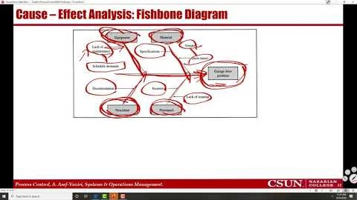
Recorded Lecture- Part 2/3 Tools for Analysis of Process Variability
https://youtu.be/bkHWLPA0M84

Slide 8
Tools for Analysis of Process Variability - A Garage Door Manufacturer
According to the sales manager of a high-tech manufacturer of garage doors, while the company has 15% of market share, customers are not satisfied
  Low Quality in terms of safety, durability, and ease of use
  High Price compared competitors’ process
  Delays in order delivery
  Poor after sales Service
We can not rely of subjective statements and opinions
  Collect and analyze concrete data –facts- on performance measures that drive customer satisfaction
  Identify, correct, and prevent sources of future problems

Slide 9
Performance Charts. Tools for Analysis of Process Variability
Check Sheet. A Table showing the types and frequency of problems.
Pareto Chart. A bar chart of of Check Sheet in non-increasing order.
The 80-20 Pareto Principle. 20% of problem types account for 80% of all occurrences.
Histogram. A bar plot that displays the frequency distribution. Ex. 20% of the freshman students get UDF in lower division quantitative courses, or the median of grades is C+.
Pareto Chart
Histogram
Check Sheet

Slide 10
Tools for Analysis of Process Variability
Run chart. A plot of a measure of process performance over time
Multi-Vari chart. A run-chart showing Min-Average-Max values of process performance over time
Run Chart
Multi-Vari Chart

Slide 11
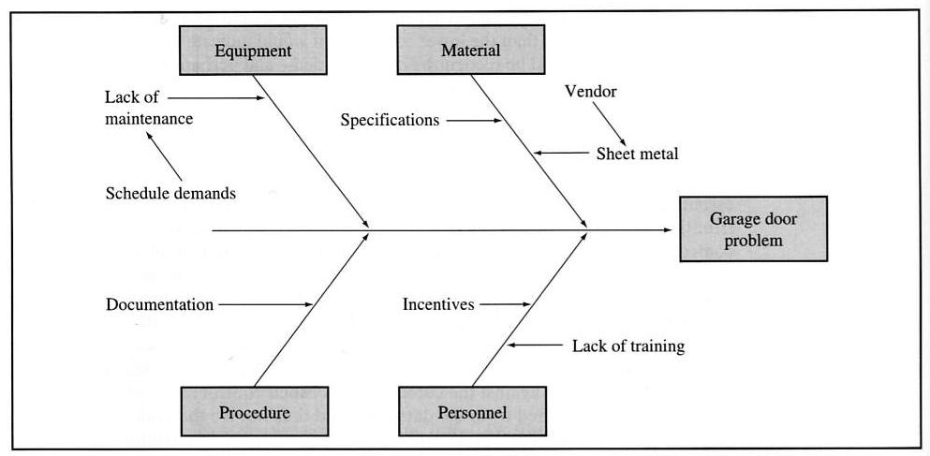
Cause – Effect Analysis: Fishbone Diagram
Why are these doors so heavy? | Because the Sheet Metal was too thick.
Why was the sheet metal too thick? | Because the rollers at the steel mill were set incorrectly.
Why were the rollers set incorrectly? | Because the supplier is not able to meet our specifications.
Why did we select this supplier? | Because our Project Supervisor was too busy getting the product out – didn’t have time to research other vendors.
Why did he get himself in this situation? | Because he gets paid by meeting the production quotas.

Slide 12
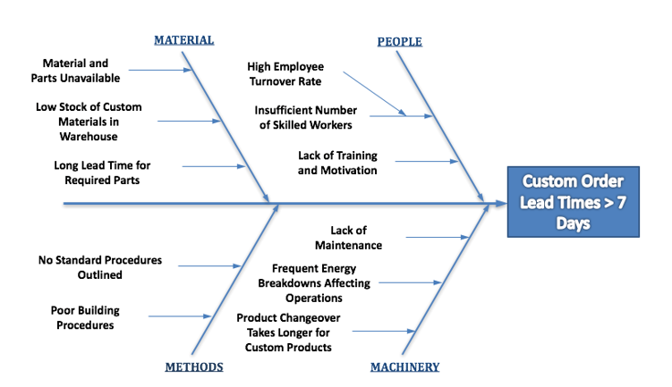
Cause – Effect Analysis: Fishbone Diagram
https://fishbonediagram.org/example-2-delays-in-custom-order-shipments/

Slide 13
Cause – Effect (Fishbone) Diagram. Why Low Grade in SOM306
Unit Load
Emotional Availability
Mental Availability
Academic Availability
Study Hours
Working Hours
Average
TTD
≥ 6 Years
Reading Writing Habits
MATH Foundations
Not Knowing the System
Poor Advisement
Relevance to Career

Slide 14
Cause – Effect (Fishbone) Diagram. Why Less DUF in Spring 2020
Academic Ethics Violation
Tough Job Market
Open Book Exams
Students Studied Harder
Grades in Spring 2020 have significantly
Increased
System Changed
Faculty Taught Better
Easier Grading
Easier Exams

Slide 15
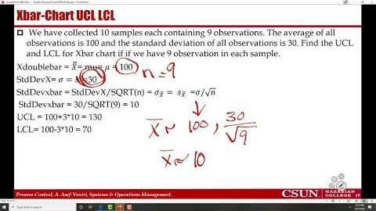
Recorded Lecture- Part 3/3 Process Performance Control Charts
https://youtu.be/9Eshaht8IaI

Slide 16
Control Charts
Process control charts – for any process - define acceptable variations - around the mean (average).
Upper Control Limit and Lower Control Limit (UCL & LCL) define a range within which any variation in performance is interpreted as normal and random
How do we know if the variations are normal and the process is in control- Similar to Tracking Signal- Recall-
  Numbers are within the UCL and LCL
  No systematic pattern is observed
In Tracking Signal we did not have clear UCL & LCL, and I explained that +3.75MAD is incorrect.
The UCL & LCL are clearly defined for process performance control chats.
Applications of Process Control Charts
  Controlling quality, inventory, throughput, flow and time.
  Stock trading - purchase when the price drops below LCL, and sell when exceeds UCL.

Slide 17
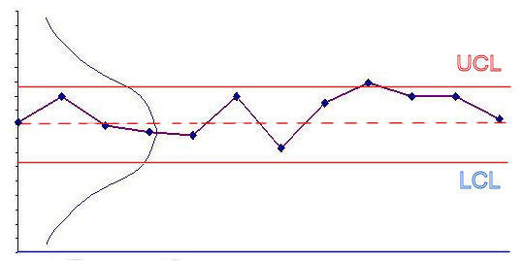
Statistical Process Control
If the observed values are within the range and do not show a systematic pattern
  Accept the variations as normal
  Don’t make any adjustments to the process
If the observed values are
  Outside of UCL or LCL
  Show a pattern- trend or cycles
The process is out of control
  Need to investigate what’s causing the problems – the assignable cause
Optimal Degree of Control depends on 2 things:
  How much variability in the performance measure we consider acceptable
  How frequently we monitor the process performance.

Slide 18
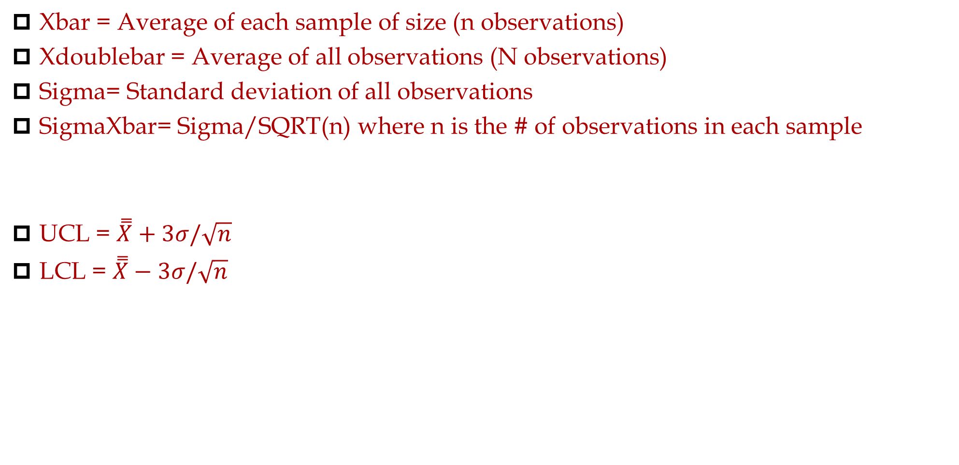
Control Charts
Xbar = Average of each sample of size (n observations)
Xdoublebar = Average of all observations (N observations)
Sigma= Standard deviation of all observations
SigmaXbar= Sigma/SQRT(n) where n is the # of observations in each sample
UCL = $\overset{̿}{X}+3σ/\sqrt{n}$
LCL = $\overset{̿}{X}−3σ/\sqrt{n}$

Slide 19
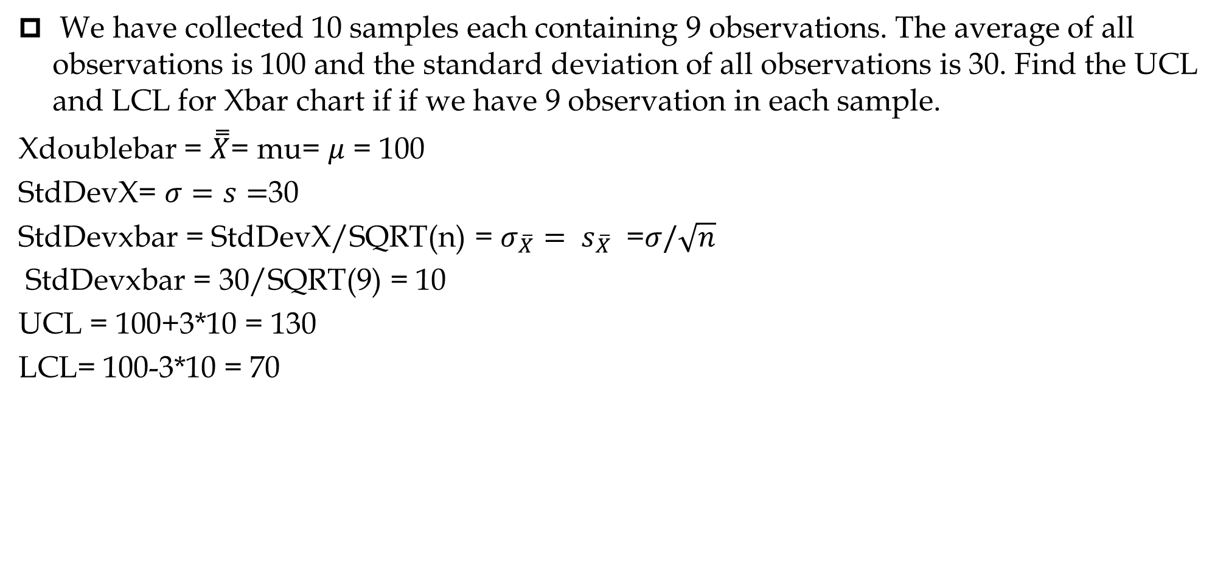
Xbar-Chart UCL LCL
We have collected 10 samples each containing 9 observations. The average of all observations is 100 and the standard deviation of all observations is 30. Find the UCL and LCL for Xbar chart if if we have 9 observation in each sample.
Xdoublebar = $\overset{̿}{X}$= mu= $μ$ = 100
StdDevX= $σ=s=$30
StdDevxbar = StdDevX/SQRT(n) = $σ_{\overline{X}}= s_{\overline{X}}$ =$σ/\sqrt{n}$
StdDevxbar = 30/SQRT(9) = 10
UCL = 100+3*10 = 130
LCL= 100-3*10 = 70

Slide 20
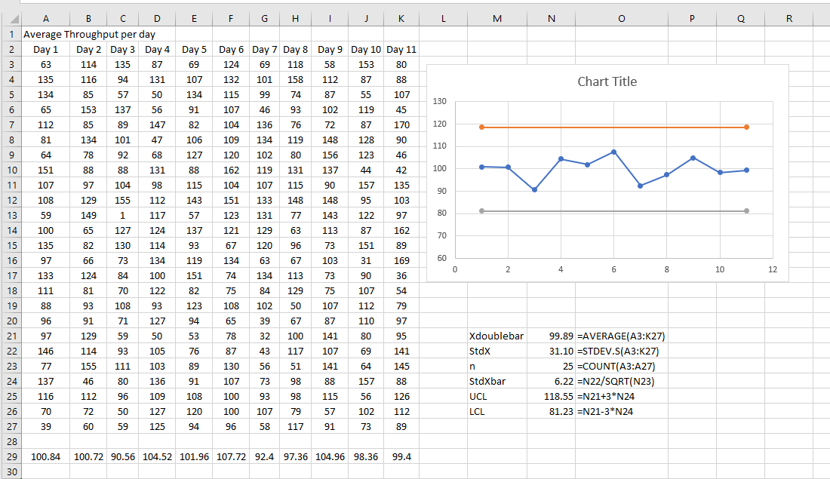
Xbar-Chart – Sales of 25 Stores in 11 Weeks (n=25)

Slide 21
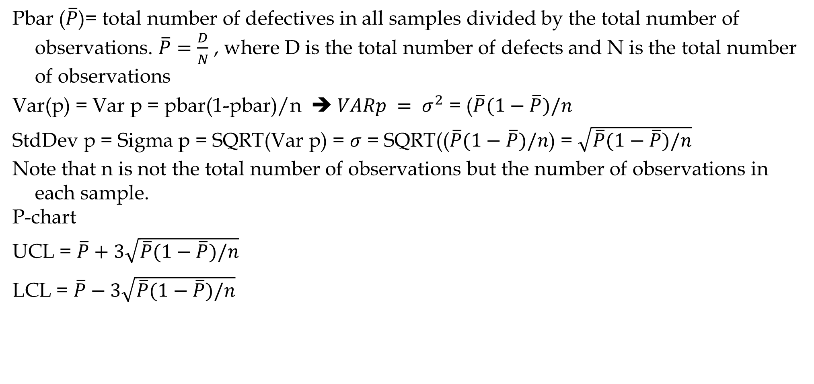
p-Chart
Pbar ($\overline{P}$)= total number of defectives in all samples divided by the total number of observations. $\overline{P}=\frac{D}{N}$ , where D is the total number of defects and N is the total number of observations
Var(p) = Var p = pbar(1-pbar)/n ➔ $VARp = σ^{2}$ = ($\overline{P}(1−\overline{P})/n$
StdDev p = Sigma p = SQRT(Var p) = $σ$ = SQRT(($\overline{P}(1−\overline{P})/n$) = $\sqrt{\overline{P}(1−\overline{P})/n}$
Note that n is not the total number of observations but the number of observations in each sample.
P-chart
UCL = $\overline{P}+3\sqrt{\overline{P}(1−\overline{P})/n}$
LCL = $\overline{P}−3\sqrt{\overline{P}(1−\overline{P})/n}$

Slide 22
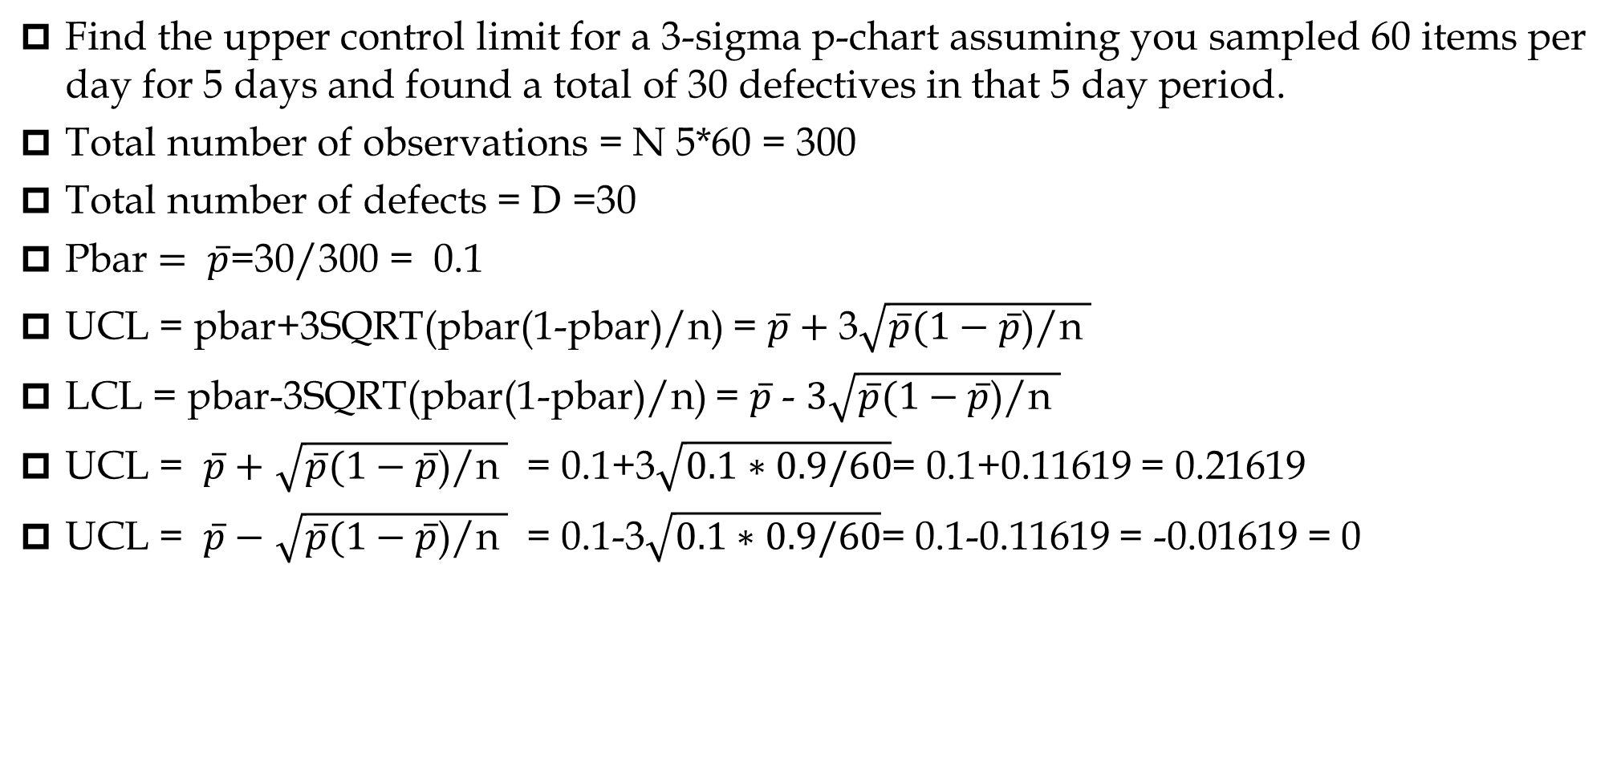
P-Chart UCL LCL
Find the upper control limit for a 3-sigma p-chart assuming you sampled 60 items per day for 5 days and found a total of 30 defectives in that 5 day period.
Total number of observations = N 5*60 = 300
Total number of defects = D =30
Pbar $= \overline{p}$=30/300 = 0.1
UCL = pbar+3SQRT(pbar(1-pbar)/n) = $\overline{p}+$ 3$\sqrt{\overline{p}(1−\overline{p}\text{)/}\text{n} }$
LCL = pbar-3SQRT(pbar(1-pbar)/n) = $\overline{p}$ - $3\sqrt{\overline{p}(1−\overline{p}\text{)/}\text{n} }$
UCL = $\overline{p}+$ $\sqrt{\overline{p}(1−\overline{p}\text{)/}\text{n} }$ = 0.1+3$\sqrt{0.1∗0.9/60}$= 0.1+0.11619 = 0.21619
UCL = $\overline{p}−$ $\sqrt{\overline{p}(1−\overline{p}\text{)/}\text{n} }$ = 0.1-3$\sqrt{0.1∗0.9/60}$= 0.1-0.11619 = -0.01619 = 0

Slide 23


p-Chart
Based on 20 samples of 5 doors each, the number of defective doors in each sample is 1, 0, 0, 2, 1, 1, 0, 1, 2, 1, 2, 1, 1, 2, 1, 0, 3, 0, 1, 0.
We have had 20*5 = 100 observations. We have found 20 defects in total
=20/100 = 0.2
U$CL=0.2+3\sqrt{0.2(0.8)/5}=0.07366$
$$LCL=0.2−3\sqrt{0.2(0.8)/5}=−0.1366=0$$
If the observed fraction defective is less than 0.07366, we conclude the process is in control, as is the case above.

Slide 24
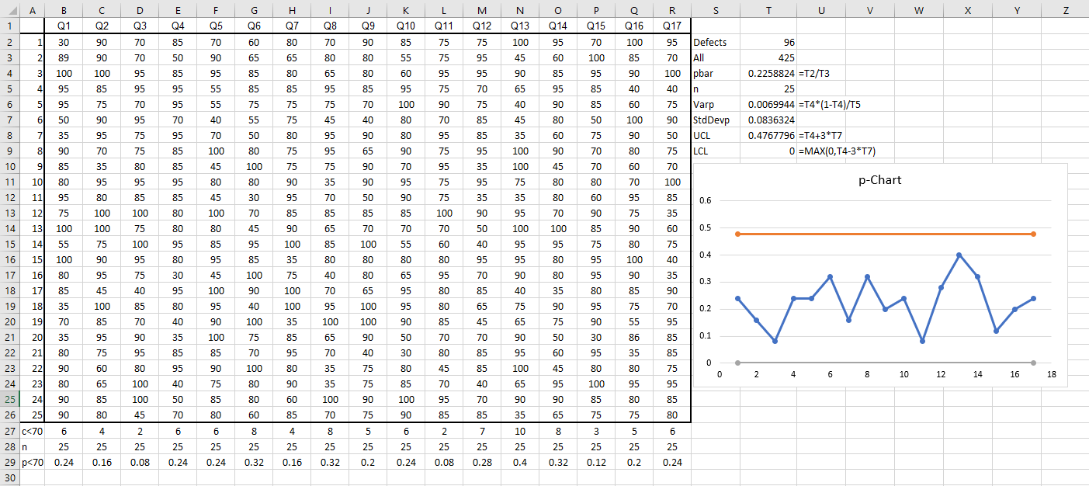
Samples of 25 Students in D&F Range in 17 Quizzes

Slide 25
Performance Variation
Stable
Unstable
Trend
Cyclical
Shift
UCL
❍
LCL
Out of Control In Control Improved

Slide 26
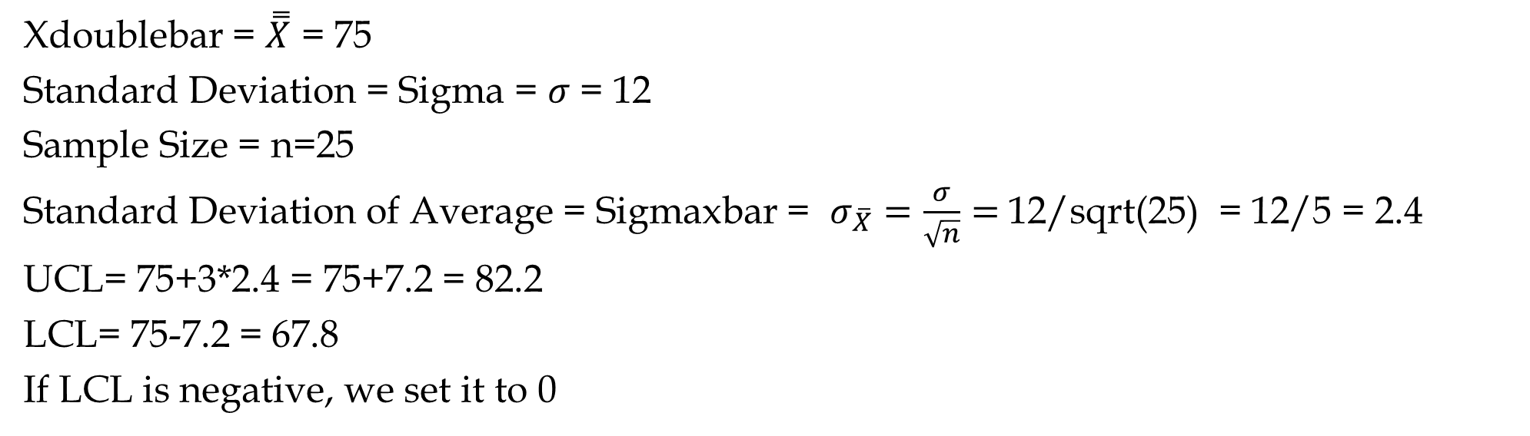
Practice
Assuming you sampled final grades of samples of 25 students per course in 8 core courses. Suppose the average and standard deviation of all the data are 75 and 12 respectively. Suppose there are 44 students with D/F grades.
Find the UCL and LCL for average grades of samples of 25 students in core courses (Xbar-Chart).
Xdoublebar = $\overset{̿}{X}$ = 75
Standard Deviation = Sigma = $σ$ = 12
Sample Size = n=25
Standard Deviation of Average = Sigmaxbar = $σ_{\overline{X}}=\frac{σ}{\sqrt{n}}=$12/sqrt(25) = 12/5 = 2.4
UCL= 75+3*2.4 = 75+7.2 = 82.2
LCL= 75-7.2 = 67.8
If LCL is negative, we set it to 0

Slide 27
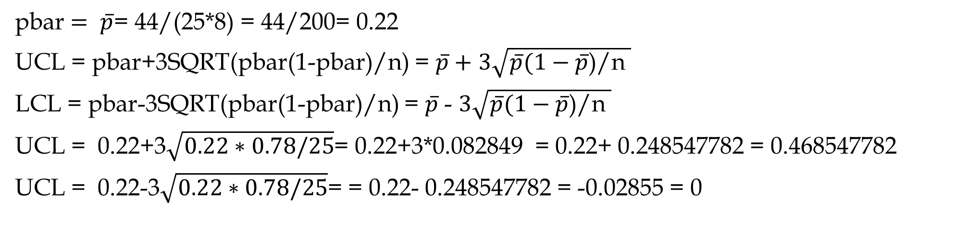
Practice
Assuming you sampled final grades of samples of 25 students per course in 8 core courses. Suppose there are 44 students with D/F grades.
Find the UCL and LCL for proportion of students with D/F samples of 25 students in core courses (p-Chart).
pbar $= \overline{p}$= 44/(25*8) = 44/200= 0.22
UCL = pbar+3SQRT(pbar(1-pbar)/n) = $\overline{p}+$ $3\sqrt{\overline{p}(1−\overline{p}\text{)/}\text{n} }$
LCL = pbar-3SQRT(pbar(1-pbar)/n) = $\overline{p}$ - $3\sqrt{\overline{p}(1−\overline{p}\text{)/}\text{n} }$
UCL = 0.22+3$\sqrt{0.22∗0.78/25}$= 0.22+3*0.082849 = 0.22+ 0.248547782 = 0.468547782
UCL = 0.22-3$\sqrt{0.22∗0.78/25}$= = 0.22- 0.248547782 = -0.02855 = 0

Slide 28
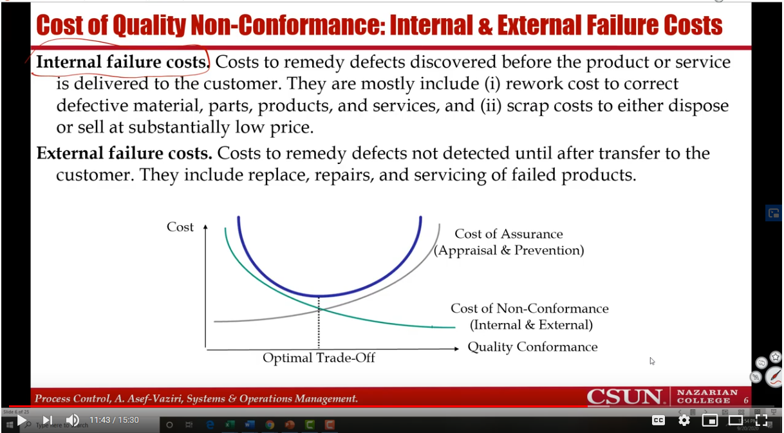



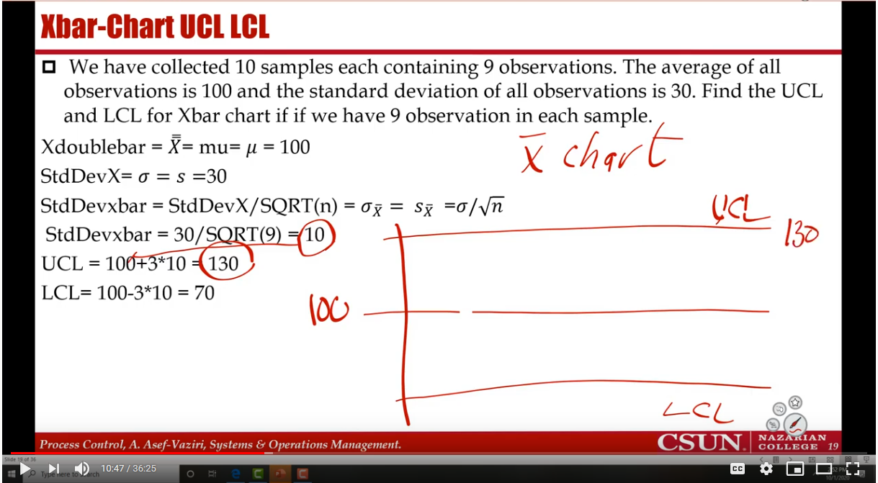
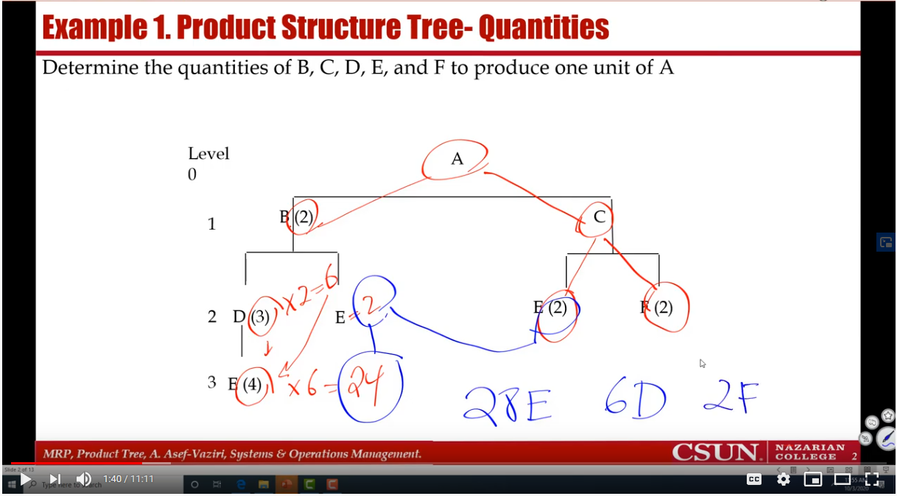



Slide 29
3-Sigma & 6-Sigma Capability
Mean output +/- 3 standard deviations falls within the design specification
It means that 0.26% of output falls outside the design specification and is unacceptable.
The result: a 3-sigma capable process produces 2600 defects for every million units produced
Six sigma capability assumes the process is capable of producing output where the mean +/- 6 standard deviations fall within the design specifications
The result: only 3.4 defects for every million produced
Six sigma capability means smaller variation and therefore higher quality
A higher value of the average indicates a that all doors produced are consistently heavier. An increase in the value of the standard deviation means a wider spread of the distribution around the mean, implying that many doors are much heavier or lighter than the overall average weight.

