Slide 1
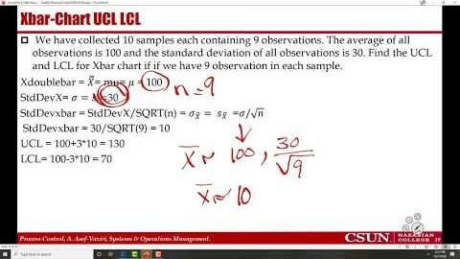
Recorded Lecture- Part 3/3 Process Performance Control Charts
https://youtu.be/9Eshaht8IaI

Slide 2
Control Charts
Process control charts – for any process - define acceptable variations - around the mean (average).
Upper Control Limit and Lower Control Limit (UCL & LCL) define a range within which any variation in performance is interpreted as normal and random
How do we know if the variations are normal and the process is in control- Similar to Tracking Signal- Recall-
  Numbers are within the UCL and LCL
  No systematic pattern is observed
In Tracking Signal we did not have clear UCL & LCL, and I explained that +3.75MAD is incorrect.
The UCL & LCL are clearly defined for process performance control chats.
Applications of Process Control Charts
  Controlling quality, inventory, throughput, flow and time.
  Stock trading - purchase when the price drops below LCL, and sell when exceeds UCL.

Slide 3
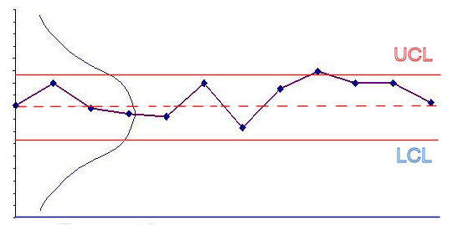
Statistical Process Control
If the observed values are within the range and do not show a systematic pattern
  Accept the variations as normal
  Don’t make any adjustments to the process
If the observed values are
  Outside of UCL or LCL
  Show a pattern- trend or cycles
The process is out of control
  Need to investigate what’s causing the problems – the assignable cause
Optimal Degree of Control depends on 2 things:
  How much variability in the performance measure we consider acceptable
  How frequently we monitor the process performance.

Slide 4
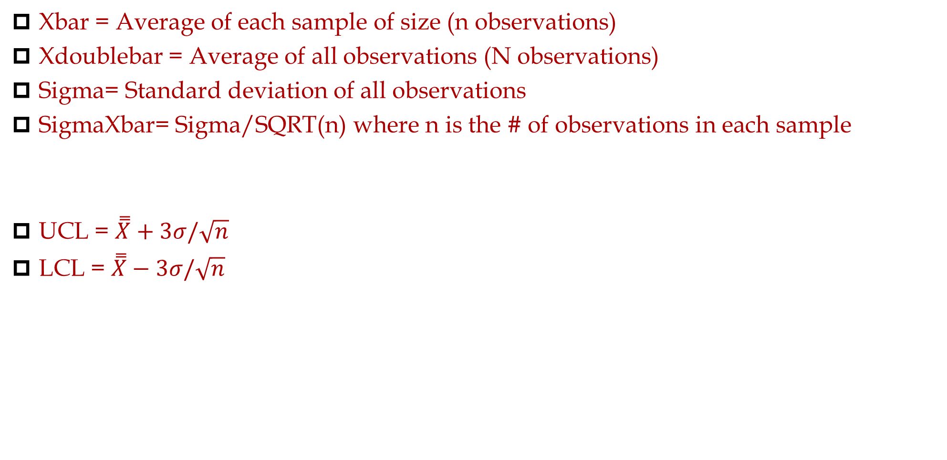
Control Charts
Xbar = Average of each sample of size (n observations)
Xdoublebar = Average of all observations (N observations)
Sigma= Standard deviation of all observations
SigmaXbar= Sigma/SQRT(n) where n is the # of observations in each sample
UCL = $\overset{̿}{X}+3σ/\sqrt{n}$
LCL = $\overset{̿}{X}−3σ/\sqrt{n}$

Slide 5
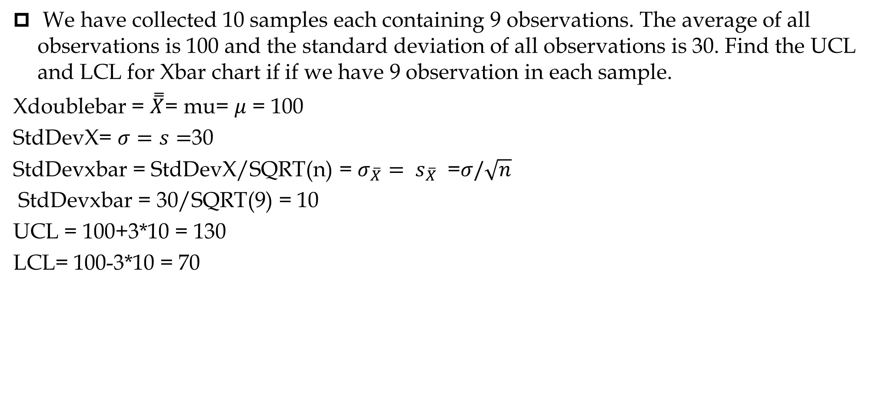
Xbar-Chart UCL LCL
We have collected 10 samples each containing 9 observations. The average of all observations is 100 and the standard deviation of all observations is 30. Find the UCL and LCL for Xbar chart if if we have 9 observation in each sample.
Xdoublebar = $\overset{̿}{X}$= mu= $μ$ = 100
StdDevX= $σ=s=$30
StdDevxbar = StdDevX/SQRT(n) = $σ_{\overline{X}}= s_{\overline{X}}$ =$σ/\sqrt{n}$
StdDevxbar = 30/SQRT(9) = 10
UCL = 100+3*10 = 130
LCL= 100-3*10 = 70

Slide 6
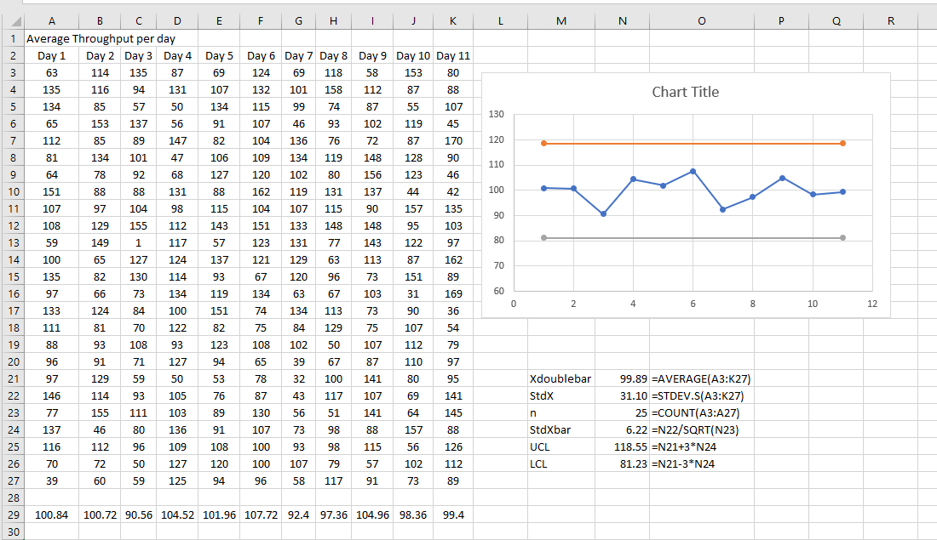
Xbar-Chart – Sales of 25 Stores in 11 Weeks (n=25)

Slide 7
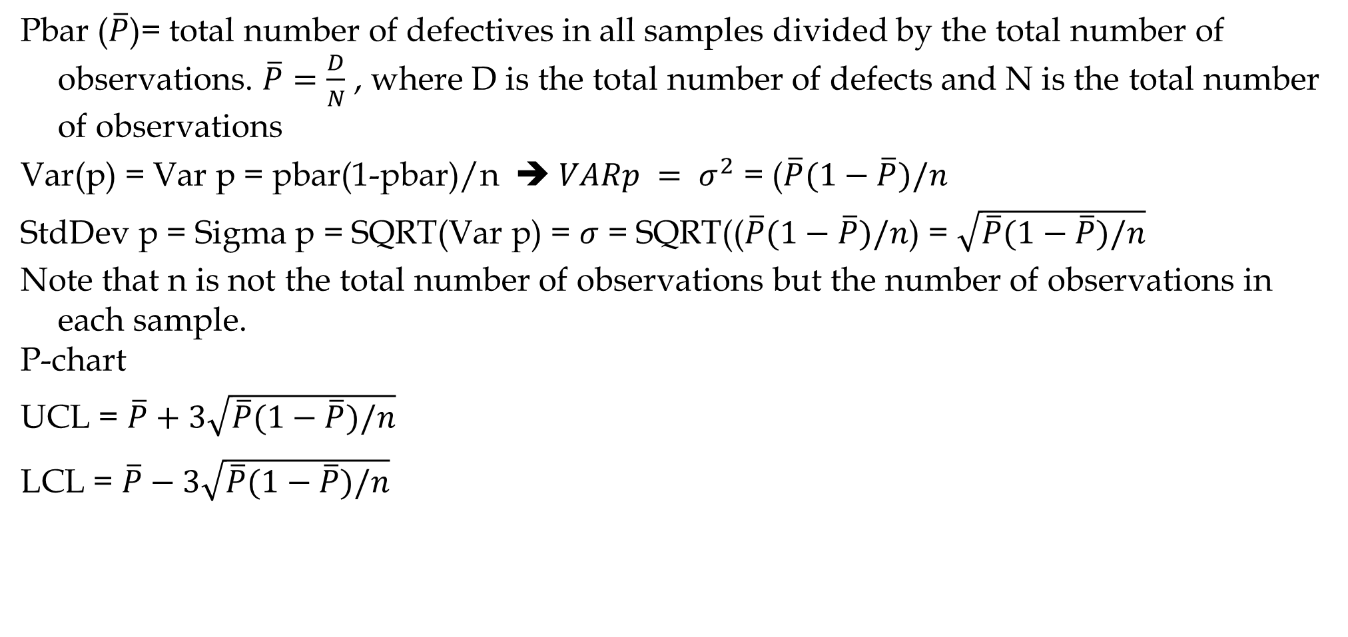
p-Chart
Pbar ($\overline{P}$)= total number of defectives in all samples divided by the total number of observations. $\overline{P}=\frac{D}{N}$ , where D is the total number of defects and N is the total number of observations
Var(p) = Var p = pbar(1-pbar)/n ➔ $VARp = σ^{2}$ = ($\overline{P}(1−\overline{P})/n$
StdDev p = Sigma p = SQRT(Var p) = $σ$ = SQRT(($\overline{P}(1−\overline{P})/n$) = $\sqrt{\overline{P}(1−\overline{P})/n}$
Note that n is not the total number of observations but the number of observations in each sample.
P-chart
UCL = $\overline{P}+3\sqrt{\overline{P}(1−\overline{P})/n}$
LCL = $\overline{P}−3\sqrt{\overline{P}(1−\overline{P})/n}$

Slide 8
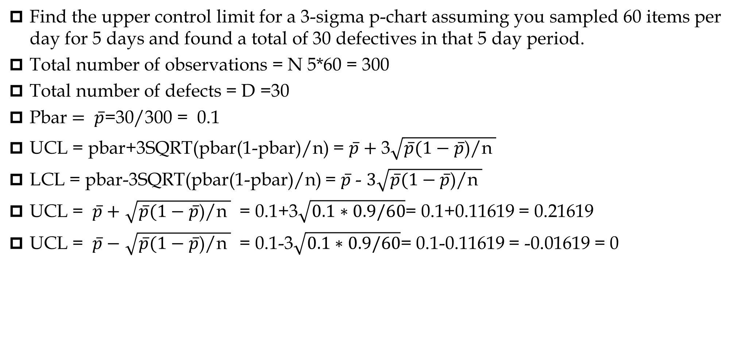
P-Chart UCL LCL
Find the upper control limit for a 3-sigma p-chart assuming you sampled 60 items per day for 5 days and found a total of 30 defectives in that 5 day period.
Total number of observations = N 5*60 = 300
Total number of defects = D =30
Pbar $= \overline{p}$=30/300 = 0.1
UCL = pbar+3SQRT(pbar(1-pbar)/n) = $\overline{p}+$ 3$\sqrt{\overline{p}(1−\overline{p}\text{)/}\text{n} }$
LCL = pbar-3SQRT(pbar(1-pbar)/n) = $\overline{p}$ - $3\sqrt{\overline{p}(1−\overline{p}\text{)/}\text{n} }$
UCL = $\overline{p}+$ $\sqrt{\overline{p}(1−\overline{p}\text{)/}\text{n} }$ = 0.1+3$\sqrt{0.1∗0.9/60}$= 0.1+0.11619 = 0.21619
UCL = $\overline{p}−$ $\sqrt{\overline{p}(1−\overline{p}\text{)/}\text{n} }$ = 0.1-3$\sqrt{0.1∗0.9/60}$= 0.1-0.11619 = -0.01619 = 0

Slide 9


p-Chart
Based on 20 samples of 5 doors each, the number of defective doors in each sample is 1, 0, 0, 2, 1, 1, 0, 1, 2, 1, 2, 1, 1, 2, 1, 0, 3, 0, 1, 0.
We have had 20*5 = 100 observations. We have found 20 defects in total
=20/100 = 0.2
U$CL=0.2+3\sqrt{0.2(0.8)/5}=0.07366$
$$LCL=0.2−3\sqrt{0.2(0.8)/5}=−0.1366=0$$
If the observed fraction defective is less than 0.07366, we conclude the process is in control, as is the case above.

Slide 10
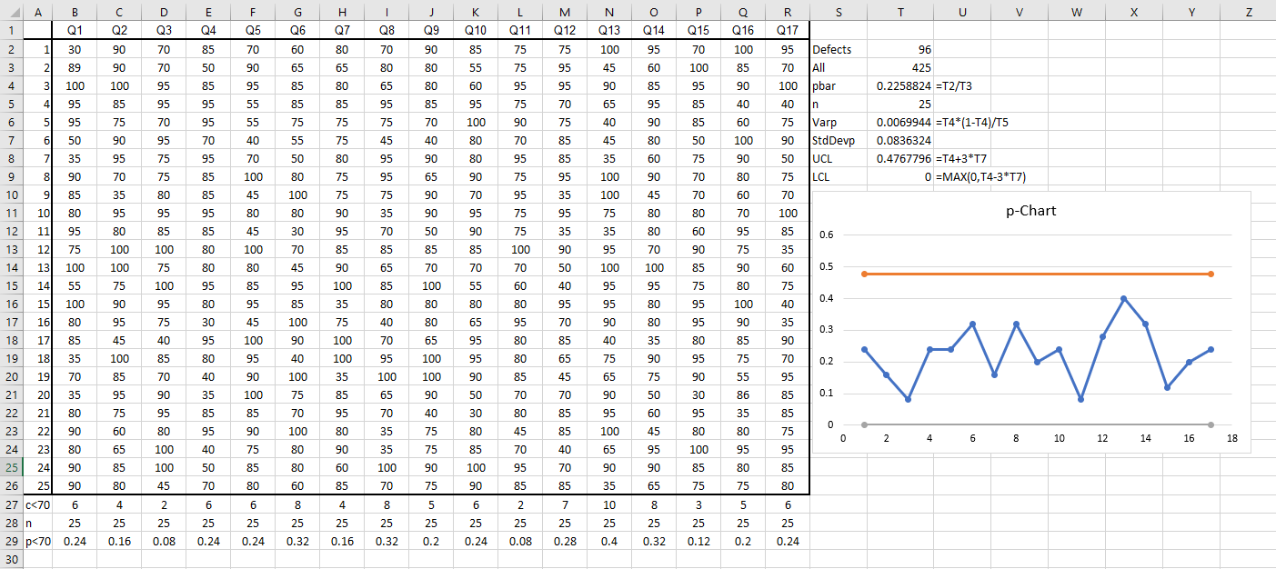
Samples of 25 Students in D&F Range in 17 Quizzes

Slide 11
Performance Variation
Stable
Unstable
Trend
Cyclical
Shift
UCL
❍
LCL
Out of Control In Control Improved

Slide 12
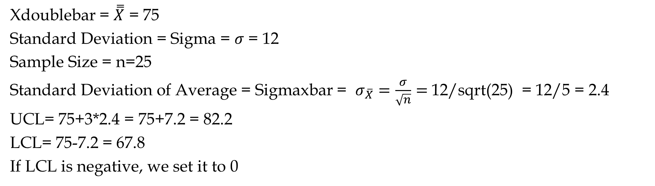
Practice
Assuming you sampled final grades of samples of 25 students per course in 8 core courses. Suppose the average and standard deviation of all the data are 75 and 12 respectively.
Find the UCL and LCL for average grades of samples of 25 students in core courses (Xbar-Chart).
Xdoublebar = $\overset{̿}{X}$ = 75
Standard Deviation = Sigma = $σ$ = 12
Sample Size = n=25
Standard Deviation of Average = Sigmaxbar = $σ_{\overline{X}}=\frac{σ}{\sqrt{n}}=$12/sqrt(25) = 12/5 = 2.4
UCL= 75+3*2.4 = 75+7.2 = 82.2
LCL= 75-7.2 = 67.8
If LCL is negative, we set it to 0

Slide 13
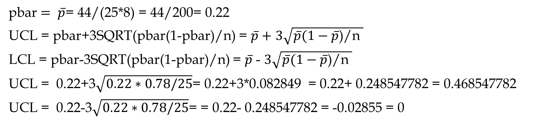
Practice
Assuming you sampled final grades of samples of 25 students per course in 8 core courses. Suppose there are 44 students with D/F grades.
Find the UCL and LCL for proportion of students with D/F samples of 25 students in core courses (p-Chart).
pbar $= \overline{p}$= 44/(25*8) = 44/200= 0.22
UCL = pbar+3SQRT(pbar(1-pbar)/n) = $\overline{p}+$ $3\sqrt{\overline{p}(1−\overline{p}\text{)/}\text{n} }$
LCL = pbar-3SQRT(pbar(1-pbar)/n) = $\overline{p}$ - $3\sqrt{\overline{p}(1−\overline{p}\text{)/}\text{n} }$
UCL = 0.22+3$\sqrt{0.22∗0.78/25}$= 0.22+3*0.082849 = 0.22+ 0.248547782 = 0.468547782
UCL = 0.22-3$\sqrt{0.22∗0.78/25}$= = 0.22- 0.248547782 = -0.02855 = 0

Slide 14
3-Sigma & 6-Sigma Capability
Mean output +/- 3 standard deviations falls within the design specification
It means that 0.26% of output falls outside the design specification and is unacceptable.
The result: a 3-sigma capable process produces 2600 defects for every million units produced
Six sigma capability assumes the process is capable of producing output where the mean +/- 6 standard deviations fall within the design specifications
The result: only 3.4 defects for every million produced
Six sigma capability means smaller variation and therefore higher quality
A higher value of the average indicates a that all doors produced are consistently heavier. An increase in the value of the standard deviation means a wider spread of the distribution around the mean, implying that many doors are much heavier or lighter than the overall average weight.

