Slide 1
Managing Flow Variability
Process Control

Slide 2
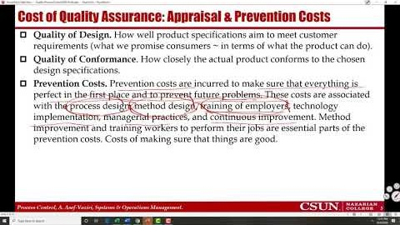

Recorded Lecture- Part 1/3 Introduction https://youtu.be/n_-LajBg_NQ

Slide 3
The Garage Door Manufacturer
In a manufacturing or service
  Product or service quality may be lower than expectations
  Price may be higher than expectations
  Products and services may not be delivered on-time
  After sales service may be at a low level
We can not rely of subjective statements and opinions
  We need to collect data on performance measures that drive customer satisfaction
  Quality, Cost, Time, Variety
Processes with greater variability are judged less satisfactory than those with consistent, predictable performance.
All internal and external performance measures display vary from time to time.
  External Measurements - customer satisfaction, product rankings, customer complaints.
  Internal Measurements - flow unit cost, quality, time, and variety.

Slide 4
Performance Variability
We cannot avoid random variations, but (i) we can differentiate them from systematic vitiations, and (ii) we can make changes in the system (better methods, better equipment and technology, appropriate and continual training, and better management to reduce them.
Sources of Variability
  Internal: imprecise equipment, lack of adequate training for workers, and lack of well-designed standard methods of operations.
  External: unreliable suppliers, inconsistency in raw materials and components, change in customer preferences, change in the business ecosystem.
A discrepancy between the actual and the expected performance often leads to cost↑, flow time↑, quality↓, variety ↓ ➔ and is finally translated into dissatisfied customers.
In general, a product is classified as defective if its cost, quality, availability or flow time differ significantly from their expected values. Again, these are finally translated into dissatisfied customers.

Slide 5
Cost of Quality Assurance: Appraisal & Prevention Costs
Quality of Design. How well product specifications aim to meet customer requirements (what we promise consumers ~ in terms of what the product can do).
Quality of Conformance. How closely the actual product conforms to the chosen design specifications.
Prevention Costs. Prevention costs are incurred to make sure that everything is perfect in the first place and to prevent future problems. These costs are associated with the process design, method design, training of employers, technology implementation, managerial practices, and continuous improvement. Method improvement and training workers to perform their jobs are essential parts of the prevention costs. Costs of making sure that things are good.
Appraisal Costs. Costs that are incurred to ensure that the processes are performed as expected. Prevention costs are to make sure that the processes are good. Appraisal costs are to make sure that the processes remain good. Evaluation incoming material, processes, products and services against expectations. Costs of making sure that good things remain good.

Slide 6
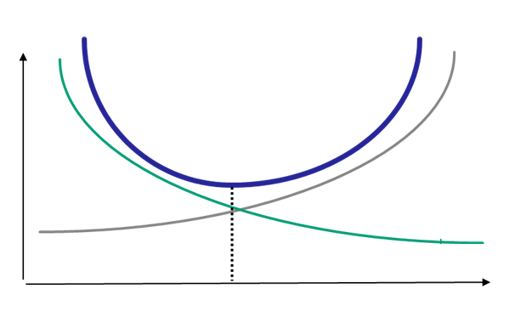
Cost of Quality Non-Conformance: Internal & External Failure Costs
Internal failure costs. Costs to remedy defects discovered before the product or service is delivered to the customer. They are mostly include (i) rework cost to correct defective material, parts, products, and services, and (ii) scrap costs to either dispose or sell at substantially low price.
External failure costs. Costs to remedy defects not detected until after transfer to the customer. They include replace, repairs, and servicing of failed products.
Cost
Cost of Assurance
(Appraisal & Prevention)
Cost of Non-Conformance
(Internal & External)
Quality Conformance
Optimal Trade-Off

Slide 7
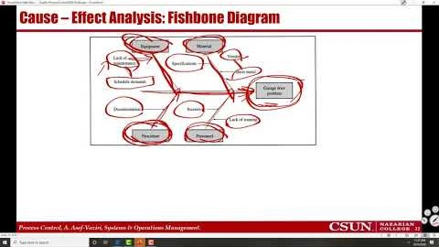
Recorded Lecture- Part 2/3 Tools for Analysis of Process Variability
https://youtu.be/bkHWLPA0M84

Slide 8
Tools for Analysis of Process Variability - A Garage Door Manufacturer
According to the sales manager of a high-tech manufacturer of garage doors, while the company has 15% of market share, customers are not satisfied
  Low Quality in terms of safety, durability, and ease of use
  High Price compared competitors’ process
  Delays in order delivery
  Poor after sales Service
We can not rely of subjective statements and opinions
  Collect and analyze concrete data –facts- on performance measures that drive customer satisfaction
  Identify, correct, and prevent sources of future problems

Slide 9
Performance Charts. Tools for Analysis of Process Variability
Check Sheet. A Table showing the types and frequency of problems.
Pareto Chart. A bar chart of Check Sheet in non-increasing order.
The 80-20 Pareto Principle. 20% of problem types account for 80% of all occurrences.
Histogram. A bar plot that displays the frequency distribution. Ex. 20% of the freshman students get UDF in lower division quantitative courses, or the median of grades is C+.
Pareto Chart
Histogram
Check Sheet

Slide 10
Tools for Analysis of Process Variability
Run chart. A plot of a measure of process performance over time
Multi-Vari chart. A run-chart showing Min-Average-Max values of process performance over time
Run Chart
Multi-Vari Chart

Slide 11
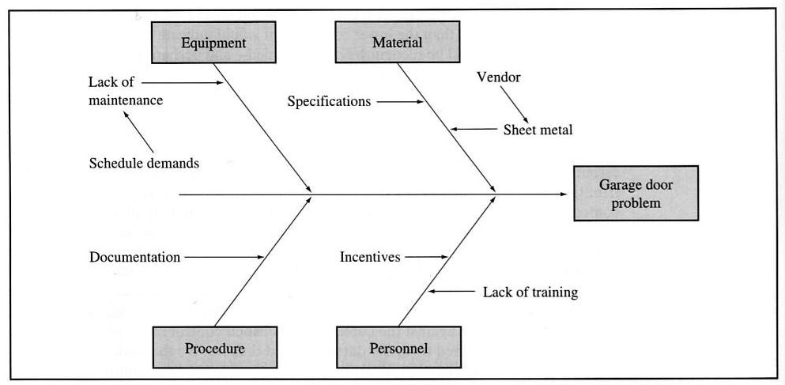
Cause – Effect Analysis: Fishbone Diagram
Why are these doors so heavy? | Because the Sheet Metal was too thick.
Why was the sheet metal too thick? | Because the rollers at the steel mill were set incorrectly.
Why were the rollers set incorrectly? | Because the supplier is not able to meet our specifications.
Why did we select this supplier? | Because our Project Supervisor was too busy getting the product out – didn’t have time to research other vendors.
Why did he get himself in this situation? | Because he gets paid by meeting the production quotas.

Slide 12
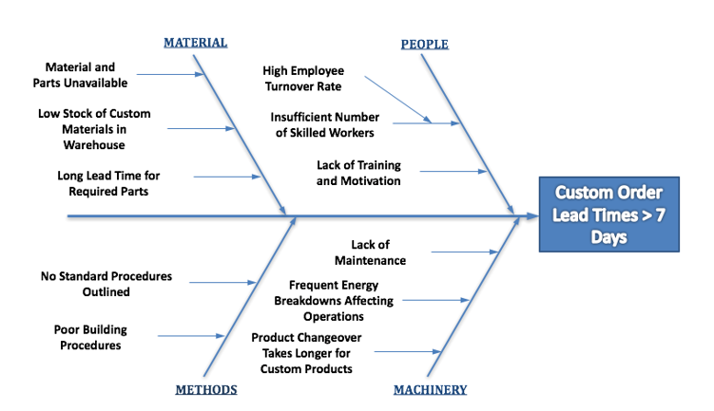
Cause – Effect Analysis: Fishbone Diagram
https://fishbonediagram.org/example-2-delays-in-custom-order-shipments/

Slide 13
Cause – Effect (Fishbone) Diagram. Why Low Grade in SOM306
Relevance of the Course Material to Real Life Applications
Level of Focus and Concentration
Available Time
Number of Courses Taken per Semester
Study Hours
Working Hours
Average
Time to Degree of Undergraduate students
Exceeds 6 Years
Reading Writing Habits
Not Knowing Good Practices
Relevance to Career
MATH Foundations
Poor Advisement

Slide 14
Cause – Effect (Fishbone) Diagram. Why Less DUF in Spring 2020
Academic Ethics Violation
Tough Job Market
Open Book Exams
Students Studied Harder
Grades in Spring 2020 have significantly
Increased
System Changed
Faculty Taught Better
Easier Grading
Easier Exams

