Slide 1
Building Lean Systems
5S, VA/NVA
Ardavan Asef-Vaziri

Slide 2
Cellular Layout
Standard Work
Operator
Tasks
1
2
3
1
7
8
2
6
3
4
5
1
8
7
Flow-through racks
for materials
2
6
3
4
5

Slide 3
Cellular Layout
A mixture of job shop and flow shop for producing a family of product with somehow similar set of required operations.
Reduces movement and facilitates 1 piece flow
Improves visibility, operators can see each others
Motivates team work.
Creates cross-functional work force.
Flexible as takt time changes, allows add/subtract work force, allows combing duties.
U shape most common, also T, Z, L shape, and loop.

Slide 4
Standard Work
Clear specification of how tasks should be performed.
The best sequence using the best combination of resources.
Fully documented, and all operators must follow. The operators should be involved in defining standard work. That way, they will improvement efforts in the future.
Consistency
  Fair output rates are established. Everyone is judged by the same standards.
  Improves safety. Also useful when training new employees.
  Leads to continuous improvement dues to collaboration of the work force.
Not against creativity; but every operator follow the best practices. The best practice may be a moving target; work force may come up with a better standard work.
Standard work is a set of tasks allocated to an operator, so standard work will also change when the takt time or the model mix changes.
The goals are to give each operator an amount of work less than or equal to the takt time while creating a compact footprint for each operator.

Slide 5
Pull Replenishment
Contain inventory usually using kanban (signal).
Transferred production responsibility to operators instead of a centralized scheduler to push in advance.
Downstream operator signal (kanban) upstream when parts are needed.
Requirements
  Repetitive demand and short lead times.
  Availability of components to produce when the visual signal is generated.
First step: how much inventory to buffer the downstream operator from the upstream operator.

Slide 6
In-process Kanban
Two types: In-process kanbans and Material kanbans.
In-process kanbans when the operations are close to each others. The upstream is triggered by a visual signal. A physical location will specify the maximum inventory that the upstream operator can place.
Stop production if the in-process kanban is full.
Paint a rectangle on the floor between the two operations where the parts should be placed.
If there are multiple part types, each might have a different color code. Each location or container has a number indicating the WIP inventory limit.

Slide 7
Material Kanbans
A production facility may use them to signal a replenishment of material from a supermarket or warehouse (a withdrawal kanban), another production facility (a production kanban), or a supplier (a supplier kanban). A production kanban is used in place of an in-process kanban if the upstream and downstream processes are far apart with no visibility.
The replenishment signals are usually transmitted either through a card or an electronic signal. Each card requests that a specific number of items be replenished.

Slide 8
How Kanbans Work: An Example
Inbound Buffer
Outbound Buffer
Inbound Buffer
Outbound Buffer
WS1
WS2
Supplier Kanban
Production Kanban
Withdrawal Kanban

Slide 9
Kanban Calculations
Number of kanbans =
# of cards required for system to work
Number of Kanbans =
D x (1 + SF) x KCT
+1
Kanban Size
D = Average Demand
SF = Safety Factor
KCT = Kanban Cycle Time (in terms of demand period)
(time for material to be replenished once a signal has been received)

Slide 10
Kanban Calculations: An Example
Parts per product
Model # of Parts of Z
A 1
B 3
C 2
Daily demand per product
Model Demand
A 21
B 16
C 32
KCT = Replenishment Time = 0.25 day
SF = Safety Factor = 0.10
K = Kanban Size = 15

Slide 11
The Formula
The formula assumes that the signal to replenish a container of parts is triggered when the container becomes empty.
Two unknown values: (1) the number of kanban cards (2) the kanban size.
kanban size is determined in consultation with the supplier, or the upstream facility or the supermarket based on a variety of factors, such as standard container sizes or ergonomic issues.
The formula is used to determine the number of cards in circulation.
Some enterprises use a two-bin system of replenishment: they start with two kanban cards and use the formula to determine kanban size. If the number is unsatisfactory, the number of cards is increased by one and the computation is repeated until a satisfactory kanban size is determined.
There needs to be a minimum of two cards because there should always be one container at the workstation for the operator to pull parts from.
Withdrawal kanban signals are typically generated from a production facility that keeps materials at point of use.

Slide 12
Pull System
Create a pull for products across the value stream.
Pull scheduling
  Build only to demand
    Build to Takt Time
  Concept of Kanbans: A Cap on WIP
    Stop working if your output buffer is full.

Slide 13
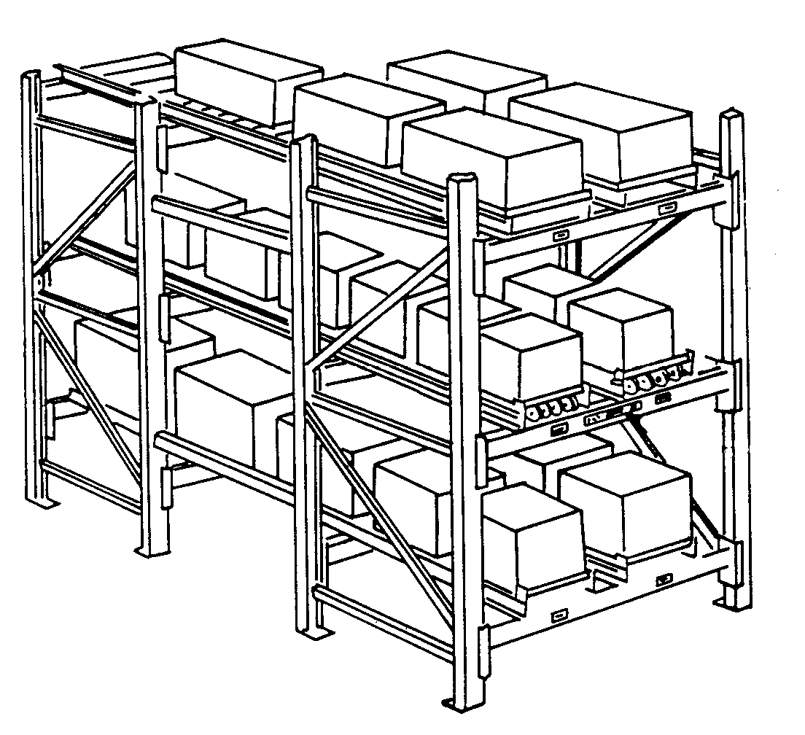
Point-Of-Use Material Storage
The upstream process or external supplier, based on a kanban signal, delivers the material direct to the point of use, than to a central warehouse.
The materials are often stored on flow-through racks just outside the cell.
Flow-through racks, like wending machines, are storage locations with shelves that can be replenished from the back and consumed from the front. FIFO usage and replenishment from outside the cell.
For material that cannot be stored at point of use, supermarkets (nearby storage locations) are often used in place of centralized storage.
Parts used by several cells are delivered to a supermarket once a day, and are pulled out in hourly quantities depending on which cell is active.
Notes:
Like the soda refrigerators in gas stations

Slide 14
Total Productive Maintenance (TPS)
Systematic execution of maintenance by all employees.
Total productive maintenance (TPM) is an equipment management strategy. Originally developed in 1970 to support TPS and it evolved from the TQM (Deming and Juran).
The original TQM concepts were modified to fit or work well in the maintenance environment,.
The goal: increase capacity, decrease variation, increase employee morale and job satisfaction.
TPM resembles TQM in a number of ways, and the similarities are not coincidental.
Notes:
Toyota…

Slide 15
Maintenance Classifications
Traditionally, maintenance can be classified as
  Corrective waits until a failure occurs, then remedies it as quickly as possible; a sensor failing in an automobile.
  Preventive aims at maintaining equipment at regular intervals to keep an otherwise troublesome failure mode at bay; changing the oil for an automobile.
  Predictive examines vital signs displayed by equipment, to determine the health of the equipment; analyze car engine wear using instruments like vibration analyzers.
  Proactive analyzes why defects occur in an equipment, and then designs the problem out of the machine.
Notes:
Toyota…

Slide 16
TPM
TPM emphasizes the importance of people and joint effort by production and maintenance staff.
It is continuous improvement philosophy.
It is a vital part of any lean implementation. Because there is a natural tendency for people to follow the "if it ain't broke don't fix it" philosophy.

Slide 17
Mistake Proofing and Method Sheets
Mistake proofing (poka yoke). Combined with other lean tools, tries to build 100% quality built into both process and product. The three-prong electrical plug: There is only one way you can plug it in.
Techniques to prevent defects from being passed on to the next process.
Quality checks are built into operations and equipment, using sensors to detect errors and stop the process as needed. Autonomation; Automation with human touch).
Method sheets are visual instructions (drawings and pictures) located at a workstation that show how a job must be done, the quality checks necessary, and the tools to be used. They are understandable by even new operators
Notes:
Fast food restaurants

Slide 18
Continuous Improvement and the Pursuit of Perfection
Complacency is the toughest challenge in any lean transformation. Lean is not a one-time effort; is an ongoing journey that requires a sustained effort at continuous improvement.
Transformation to lean is not accomplished by simply applying a few techniques; it is a whole new way of looking at the operations of the enterprise.
Continuously reexamine processes to take out waste and non-value-added activities if enterprises are to see significant improvement in financial performance.
It is necessary that enterprises constantly initiate kaizen events that promote continuous improvements.
At the same time, there is a need to promote kaikaku, the radical redesign of processes and methods geared for achieving breakthroughs in performance and growth.
Once a kaikaku step is applied, kaizen becomes a powerful follow up drive to perfect the processes and methods and to continue to adapt to stay relevant.

Slide 19
Continuous Improvement and the Pursuit of Perfection
The sequential application of a kaikaku step followed by a series of kaizen events results in performance improvements that effectively match the S-curve model for enterprise grow containing jumps and gradual progresses.
Applying lean thinking and implementing tools to create flow result in a fundamental change in the way the enterprise thinks about its operations. Employees soon realize there is no end to the pursuit of perfection-to reducing effort, time, space, cost, and mistakes in the process of producing and delivering a product.
When products flow faster through the enterprise, they expose hidden waste in the value stream. The harder the pull, the more obstacles are revealed and the more easily they can be removed.
While lean implementations must have commitment and support from top management, shop floor personnel are also critical to their success. Many enterprises have initiated their lean efforts from the bottom up.

Slide 20
Continuous Improvement and the Pursuit of Perfection
Continuous improvement (kaizen) events play a vital role in getting employees engaged in the lean journey, and that pays dividends. Managers at all levels became lean thinkers and change agents.
A truly lean enterprise makes it much easier for everyone-shop floor employees, supervisors, lean champions, subcontractors, and first-tier suppliers-to discover better ways to create value.
Because feedback loops are significantly shortened, there is faster feedback to employees, providing a more conducive environment for them to pursue perfection
Whenever an individual or a business decides that success has been attained, progress stops.
Lean is a journey-a continuous journey that requires sustained effort to maintain momentum.

Slide 21
Summary
Once there is a sharpened awareness among employees of the waste present in the system, there will be a concerted effort to maintain the momentum to reduce it if the right incentives are provided.
All types of manufacturing, distribution, software development, or financial services.
Important points that enterprises should keep in mind when embarking on a lean journey are these:
While the goal of lean has often been identified as the removal of waste, removing muda is just a means to an end. The real goal of lean is to reduce lead time. Lean is all about lead-time reduction and creating flow.
Some of the more important steps that enterprises can take to create flow are takt time, standard work, pull replenishment, and 5S. All of them readily apply in a service setting as well.
Enterprises that embark on the lean journey typically start by identifying a product family they can apply lean principles to.

Slide 22
Summary
Steps like 5S and takt time are often misunderstood or misused. For instance, the fifth step in the 5S program, Sustain, is vital for maintaining momentum. Once a 5S program is put in place, some enterprises neglect this step. Again, lean is a journey-one that really never ends.
Lean thinking must be applied to all the processes in the enterprise that work on the selected product family. The idea is not to simply lean out some of the process steps and create a few islands of excellence.
While some waste may be removed in creating such islands, the products flowing out of them will end up waiting elsewhere in the enterprise, usually queuing up in front of the constraint resources.
Finally, the lean supply chain is the ultimate goal. It is the responsibility of the lean enterprise to collaborate with upstream and downstream supply chain members to success­fully streamline the supply chain.

Slide 23
Summary

