Slide 1
Building Lean Systems
5S, VA/NVA
Ardavan Asef-Vaziri

Slide 2
The Read Cost of Inventory
Has cost
  Physical carrying costs – we need storage and human resources.
  Financial costs (Opportunity Cost) – We could have invested our capital elsewhere and benefit from it. In the LFT Game financial cost is 10% of the cost of goods.
Has risk of obsolescence
  Due to change in customer preferences, and due to technological changes.
Hides problems
  Even if we produce low quality product, there is enough inventory downstream.
  Untrustworthy suppliers, machine breakdowns, long changeover times, too much scrap do not show up.
  Long flow time, Feedback loop is long. not-uniform operations.

Slide 3
Enable Flow: River Analogy
A "river and rocks" analogy likens the water level to the inventory level in a facility. A higher water level hides potential blemishes in the process. As the water level is lowered, these problems surface, forcing management to correct. The key is to resist to reduce the inventory level too quickly. Lower the water level a little, break apart the exposed rocks (obstacles), and then lower the water level once again.
Scrap
Capacity Imbalances
Large Setup Times
Unreliable Suppliers

Slide 4
The Lean System
As attempts are made to reduce inventory levels, other major elements that should be in place are
  Reliable processes
  Preventive maintenance systems
  Cross-trained workers
  Setup reduction programs
  Reliable suppliers.
  Partnership with supplies, schedule visibility
If these are not already present in a factory, putting them in place takes time-it cannot happen overnight.
The Japanese spent bout 20 years perfecting the system before the US automakers observed TPS.

Slide 5
The Lean System
For the boat to move faster, all the oars should be in the water at the same time.
  Balance the flow across the supply chain
  Have all processes working at the same rate
Having some resources working faster than others will pile up inventory. Making sure all resources respond to pull signals ensures a smooth flow of products across the enterprise, or the supply chain.

Slide 6
The important lean thinking tools to promote flow
5S
Flow Chart the Process
Value- and non-value added activities
Takt Time
Average Labor Content, and minimum manpower
Mixed Model Scheduling
One Piece Flow
Cellular Layout
Standard Work
Pull Replenishment: Placing a cap on WIP
Point-Of-Use Material Storage
Mistake Proofing and Method sheets
Continuous Improvement and the Pursuit of Perfection

Slide 7
The Toyota Production System (TPS) & JIT
TPS & JIT
  Kanban
  Layout of The Plant – U-Shape Cells, a person serves more than one machine, better communications of workers
  Kaizen
  Moving Assembly Line
  Supermarket Operations
  Waste Reduction
The Outcome
  JIT ➔ Every step should work in harmony

Slide 8
How to Implement
The goal of lean is to transform inputs into outputs faster; a leter that reaches its destination more quickly. No waiting, no delay.
Question
  Implement lean on all processes and activities or first focus on a subset?
  Implement lean on all products or first on a subset?
Answer: Choose one product family at a time and implement lean on all the processes and activities that apply to that product family before moving on to the next product family.

Slide 9
5S: A systematic process for organizing the workplace
Japanese | Definition | English | Example
Seiri | Tidiness. Throw Away Rubbish. | Sorting | Items are classified as Necessary, Unnecessary (disposed of immediately), Red tag (auctioned for anyone to claim as necessary). No claim → discarded
Seiton | Organization. Retrieve in 30-seconds | Storing | Arrange items in order so that they can be picked up easily. Visual information about what & how much should be stored in a spot. Tools are hung on boards, with a silhouette (shadow box) of the tool painted. Drawers have Styrofoam cutouts of the items to be stored.
Seiso | Cleanliness. keeping the area clean, and organized. | Sanitizing | Individual Responsibility. Not just sweeping the floor and cleaning up leaks and spills. Checks for malfunctioning machinery or loose parts on machines. If machines are kept clean, oil leaks will be discovered before a equipment failure. If aisles are clean, accidents are minimized, etc.
Seiketsu | Neatness. | Standardizing | Standards by which personnel must measure and maintain personal and environmental "cleanliness." What the normal condition should be. How an abnormal condition should be corrected. Visual management; by color-coding and standardization of colors for easier identification of problems. Personnel are trained to detect such problems using one or more of their five senses and to correct them immediately.
Shitsuke | Discipline | Sustaining | Do 5S Activities Daily and continually

Slide 10

Identify Value & Non-Value Added Activities
Value added; An activity that adds value to the product in the eyes of the customer. Non-Value added: any thing else.
Identifying and reducing NVA activities is key to streamlining a process.
The Value added ratio. Total VA time divided by the total process time. While the it depends on the industry, a ratio of 10% is suggested. It is 1.8% in the next flow chart. It indicates the amount of waste and opportunities for lean efforts to remove waste.
Process flow chart ➔ captures the logical sequence of activities ➔ to eliminate NVA activities.
Spaghetti diagram ➔ depicts the physical movement of products ➔ the extent of travel, and back-tracking. To come out with a better layout.
The process flow chart should be drawn after 5S. If before, lack of attention to simple housekeeping activities may obfuscate some of the NVA activities. For instance, the operators could be taking more time to change tooling simply because they cannot find the tools, and that may be reflected in the time standards set for tool changeover.

Slide 11
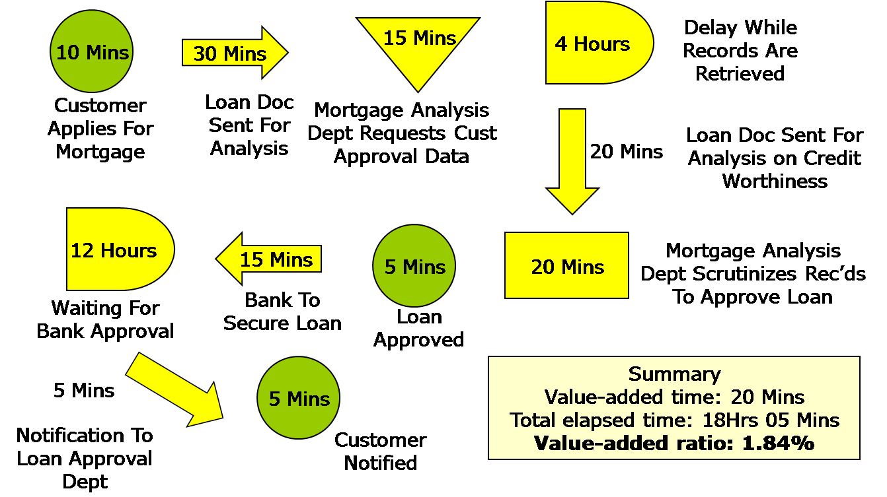
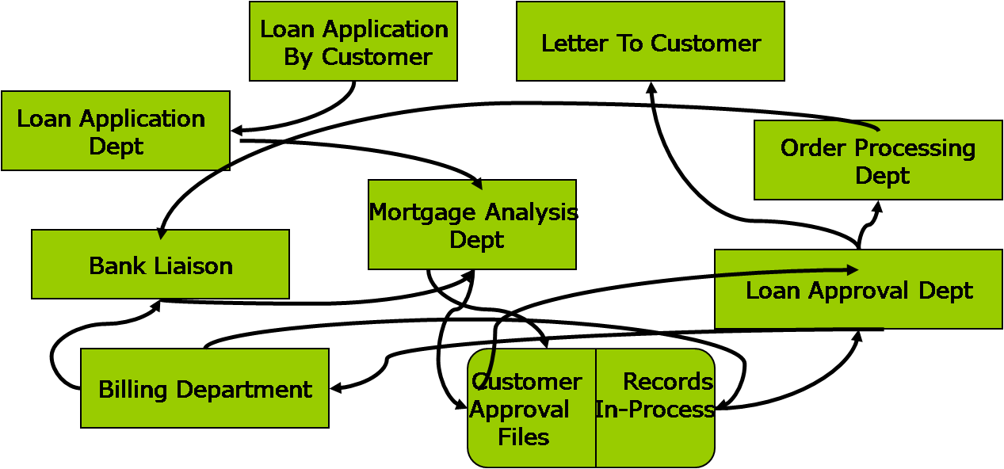
Process Flow Chart and Spaghetti Diagram

